Slide 1
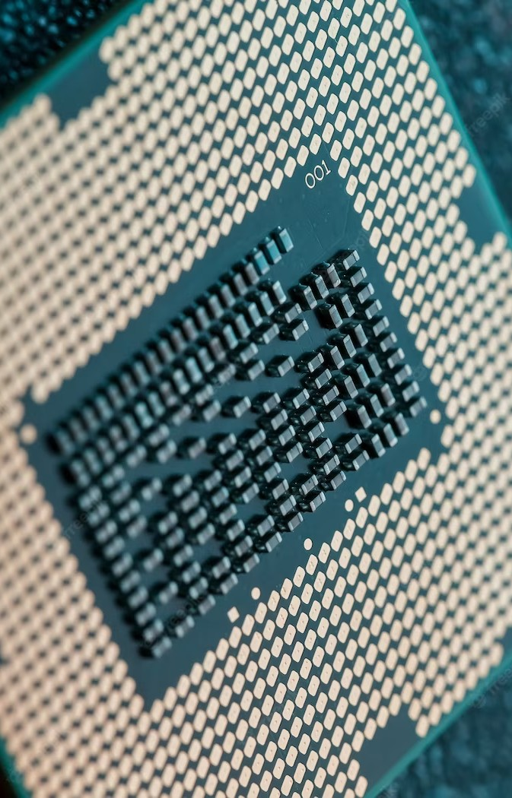
Field- Programmable Gate Arrays (FPGAs) as a microprocessor

Slide 2
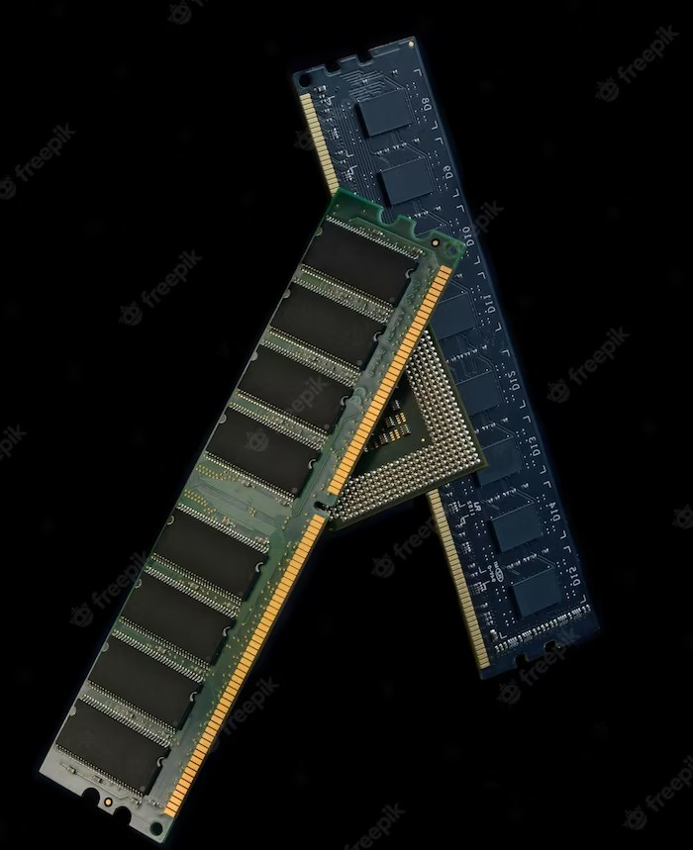
Introduction
Problems facing digital design field.
FPGAs overview.

Slide 3
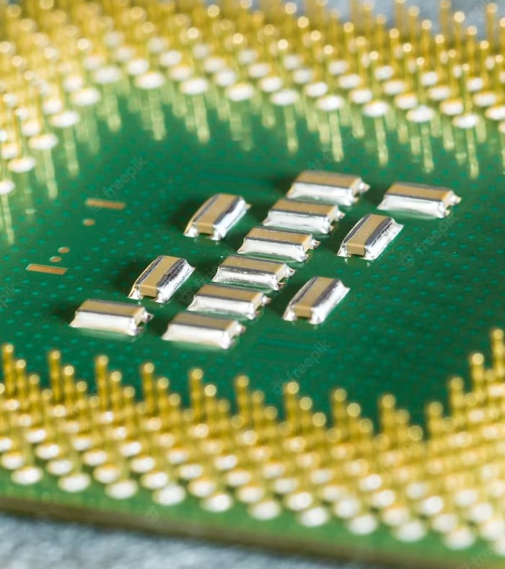
What are FPGAs?
FPGAs definition.
FPGAs uses.

Slide 4
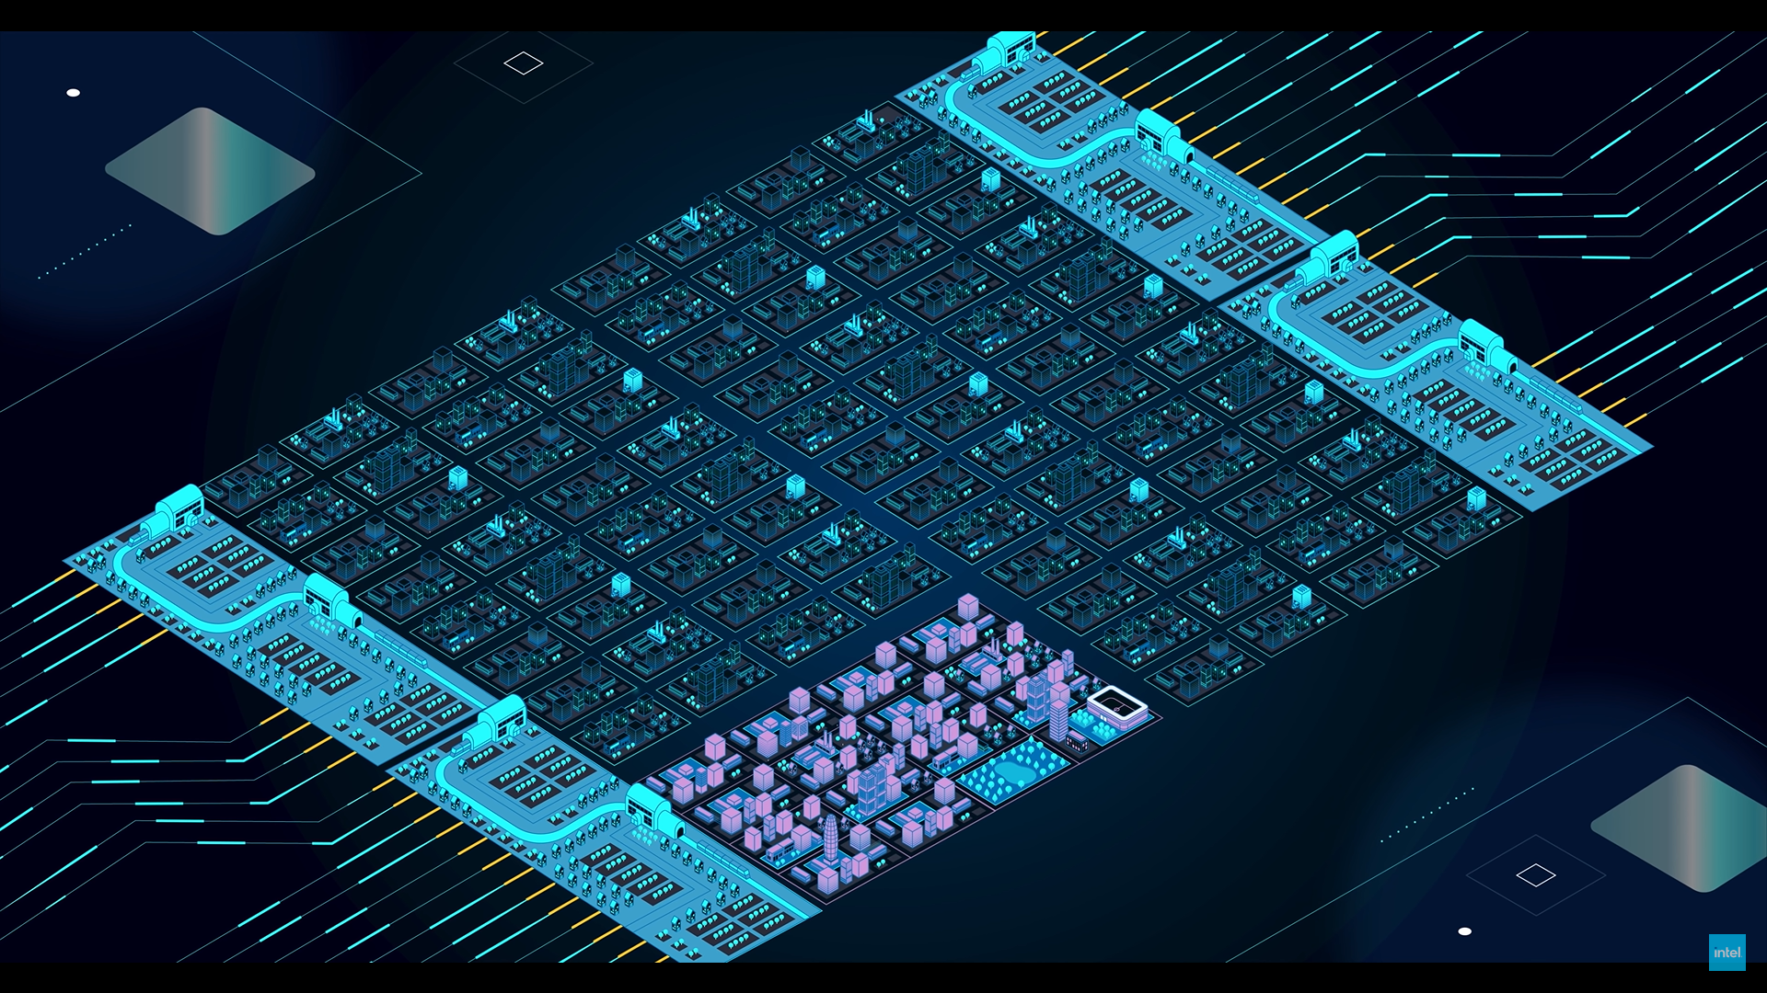
FPGA as MPU
City?!!

Slide 5

Designing ALU with FPGAs
What is ALU?
How we implemented it.
Testing our design.

Slide 6
Conclusion & Future work
FPGAs are revolutionizing the ﬁeld of digital design.
Integrating more complex designs with FPGAs.

Slide 7
Thanks!

