Slide 1




What is IEEE?

Slide 2

what is IEEE ?
IEEE Stands for institute of electrical and electronics engineers. Founded: 1963
Headquarters: New York, USA
Organization that merged:
IEEE resulted from the merger of two majors:
AIEE ( 1884) : Focused on power systems, electricity and generators.
IRE(1912) : Focused on radio, communication and modern electronics.

Slide 3
Why Was IEEE Created?

Slide 4
Why Was IEEE Created?
IEEE was formed due to the rapid growth in fields of such as:
Electrical engineering, Electronics Telecommunication, Computer science
Main fields of interests:
IEEE covers more than 40 technical areas including:
AI
Robotics
Computer engineering
Telecommunication

Slide 5
Major Contributions
IEEE plays a role in technological development by :
Publishing millions of scientific papers Organizing hundreds of global conferences Creating over 1300 technical standards
IEEE Student Branch:
Located inside universities, it helps students by providing:
Technical workshop
Soft skills training
Hackathon and competition
Networking opportunity

Slide 6
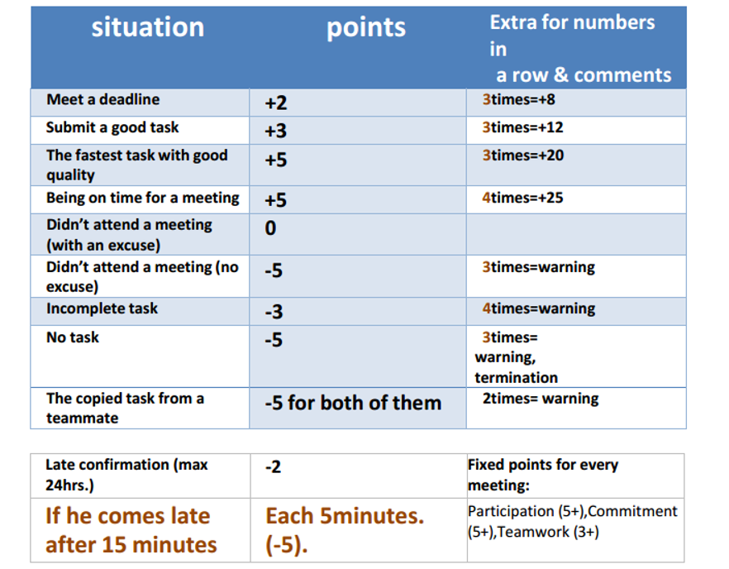

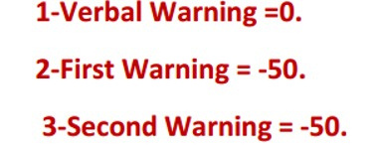
Points System

Slide 7

Points System
Termination
If you didn’t attend the meetings 3 times without excuse mail before the meeting within 24 hours.
If you didn’t reply repeatedly without an excuse through a communication channel.
According to the action you made.

Slide 8
Formal Mails
Excuse
Task
Warning
from committee member to HR member
Embedded.HR.IEEE@gmail.com

Slide 9
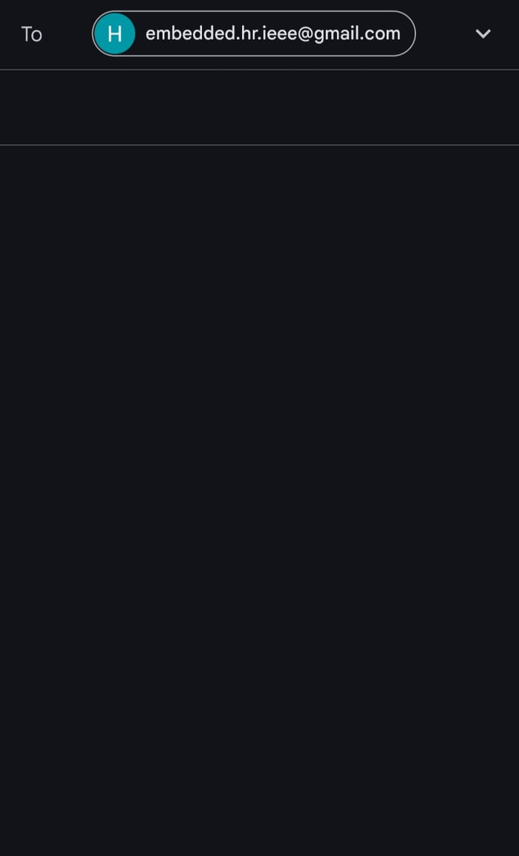
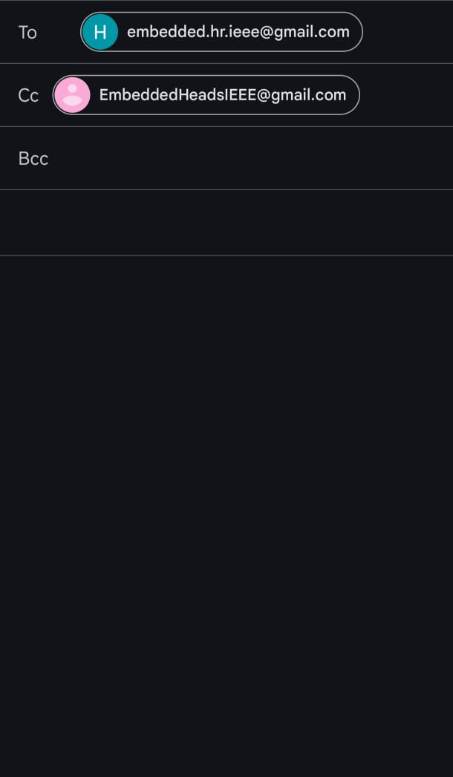
Excuse Mail
Absence Today - [Your Name]
Dear HR,
Please accept this email as notification that I am unable to attend today’s meeting, [Date], due to [matter].
Thank you for your understanding.
Best regards,
[Your Name]
Absence Today - [Your Name]
Dear HR,
Please accept this email as notification that I am unable to attend today’s meeting, [Date], due to [matter].
Thank you for your understanding.
Best regards,
[Your Name]

Slide 10
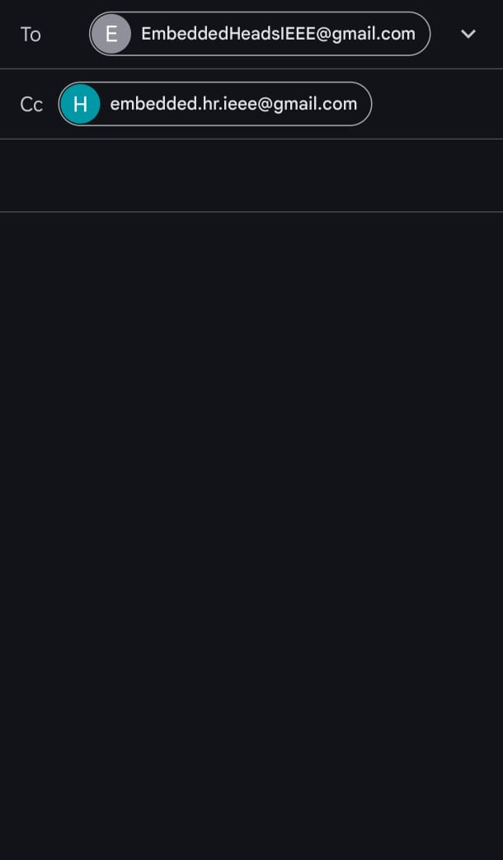
Task - [Your Name]
To Whom It May Concern,
I hope this email finds you well.
Please find attached file for the task as required.
Waiting for your feedback.
Best regards,
[Your Name]
Task Mails

Slide 11
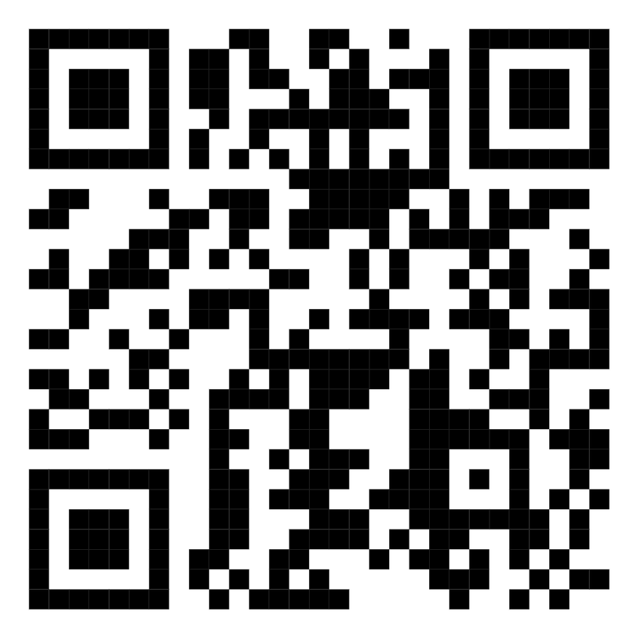
Attendance
Scan QR to sign attendance

Slide 12


