Slide 1


Embedded Systems Workshop
Session
4

Slide 2



Hello!
Instructor: Mariam Ahmed.
Cairo University, EECE Department.

Slide 3


Slide 4


Content
MCAL vs HAL vs APP
GPIO Registers
Input vs Output
Pull-up vs Pull-down

Slide 5

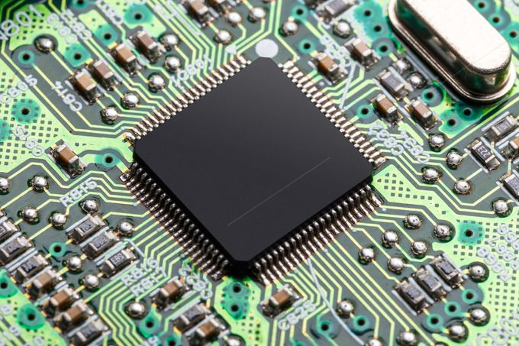
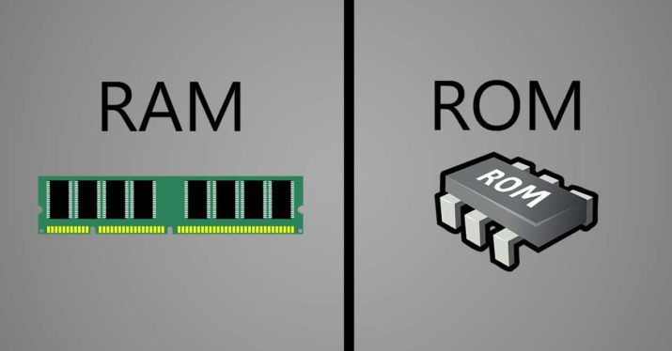
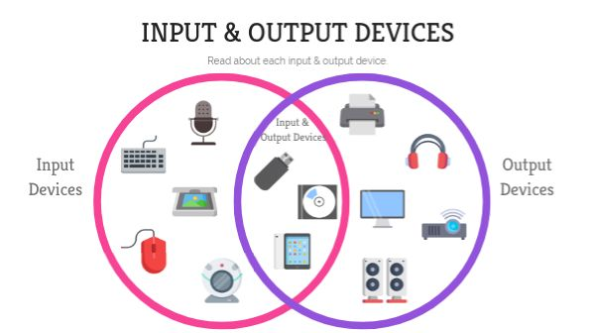

REMEMBER
Any computing system contains:
CPU
Memory
I/O Peripherals
Notes:
Know why the difference in shape between the ram and the rom (just in case someone asked)
Know how to zoom in so that ur able to show the I/O peripherals clearly

Slide 6
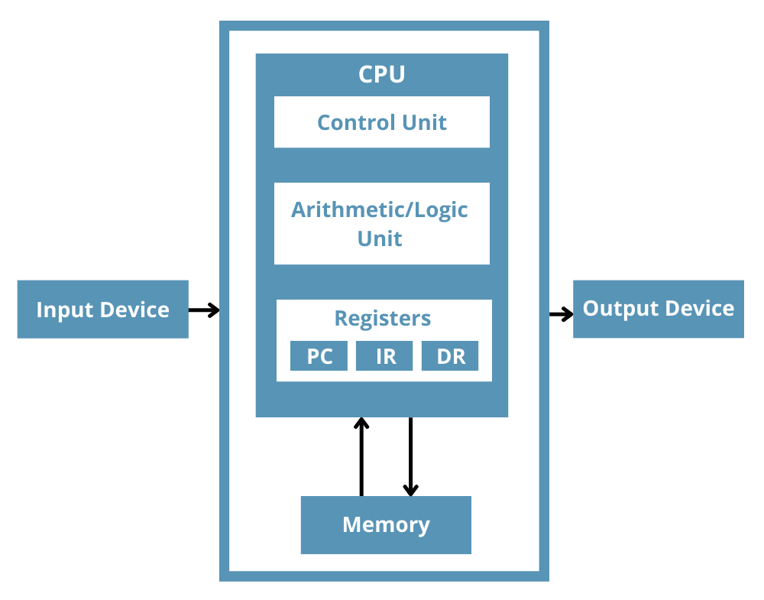
REMEMBER
Registers:
Registers are small, fast storage locations inside the CPU.
Used to store (Temporary data, Control information, Results of operations).

Slide 7
Peripherals
There are two types of registers:
On-chip peripherals
Off-chip peripherals
Timers
Motors
ADC
GPIO
LCD
Communication interfaces
Sensors
Camera

Slide 8

Peripherals
On-chip
Off-chip
GPIO → buttons & LEDs
Timers → motor control
Communication → camera
Motors
Camera
Sensors
Drone Behaviour
Take-off / landing
Stabilization
Camera control
Notes:
Ask:
Where do we write the code?
What happens if hardware changes?
What if we reuse the project?

Slide 9
Why Layered Architecture?

Slide 10
Layered Architecture
What is Layered Architecture?
APP
Layered architecture is a software design approach that organizes an embedded system into multiple layers.
Each layer has a specific responsibility and interacts only with specific layers.
HAL
MCAL

Slide 11
Layered Architecture
Why Layered Architecture?
APP
Separation and abstraction.
Easier debugging and testing.
Code reusability
Hardware independence
HAL
MCAL

Slide 12
MCAL vs HAL vs APP

Slide 13
MCAL vs HAL vs APP
APP
Application Layer
HAL
Hardware Abstraction Layer
MCAL
Microcontroller Abstraction Layer

Slide 14
MCAL vs HAL vs APP
APP
Defines the overall system behaviour and application.
HAL
Provides drivers and modules for interfacing with off-chip peripherals.
MCAL
Provides drivers and modules for interfacing with on-chip microcontroller peripherals.

Slide 15
MCAL
HAL
GPIO
Timers
Motors
Camera
Communication
Sensors
APP
Take-off/Landing
Stabilization
Camera Control

Slide 16
LIB Layer
LIB: Library layer
LIB
APP
Provides common utility functions and definitions that can be used by all software layers.
It includes Common macros and definitions:
Bit manipulation utilities.
Standard data types.
Bit manipulation → BIT_MATH.h
Standard data types → STD_TYPES.h
HAL
MCAL

Slide 17
GPIO Registers

Slide 18
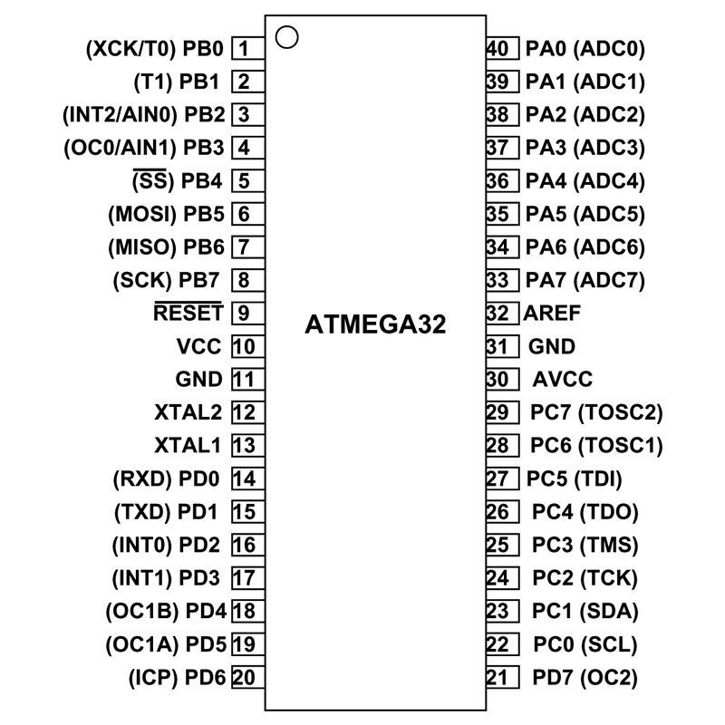
ATmega32 Pin overview
There are two types of pins:
Specific purpose pins
VCC
GND (2 Pins)
AVCC
AREF
XTAL1
XTAL2

Slide 19
ATmega32 Pin overview
There are two types of pins:
Specific purpose pins
General purpose pins (GPIO/DIO)
VCC
GND (2 Pins)
AVCC
AREF
XTAL1
XTAL2
PORT A
PORT B
PORT C
PORT D

Slide 20
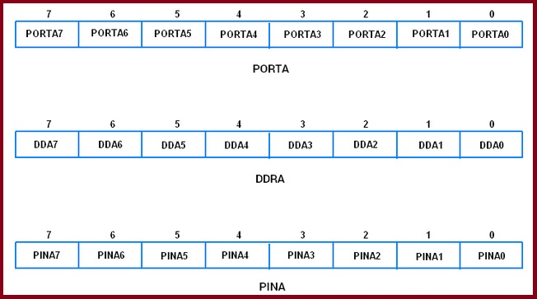
GPIO Registers
Each PORT has 3 registers:
DDR: data direction register
PORT: output data register.
PIN: input data register.
So, for each port these 3 registers for example:
Port A: A0→A7, DDRA, PORTA, PINA

Slide 21
How Do Layers Appear In Code?

Slide 22
Code Organization Based on Layered Architecture
APP
main.c
HAL
led.c / button.c
MCAL
GPIO.c
LIB
bitmath.h / standard_types.h

Slide 23
LIB Layer

Slide 24
LIB Layer in Code
Compiler x
Compiler y
Memory explosion
int x;
// int → 2 bytes
int x;
// int → 4 bytes
Data loss

Slide 25

LIB Layer in Code
To solve this problem, use specific data types like:
Signed long int
Unsigned short int
Not practical
To make it more practical and easier to deal with:
Signed char → s8
Unsigned short int → u16
Unsigned long int → u32
How to achieve so in C?
Using typedef

Slide 26
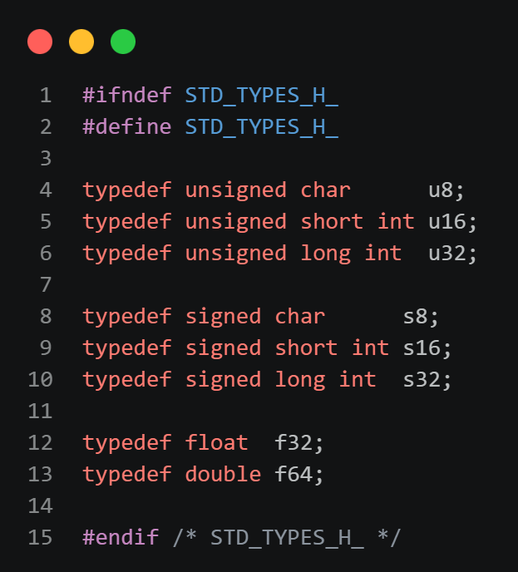
LIB Layer in Code
STD_TYPES.h file:
STD_TYPES.h is a library file that defines fixed-size, compiler-independent data types to ensure consistent memory usage across different compilers
STD_TYPES.h is located in the LIB layer.
typedef data_type new_data_name

Slide 27
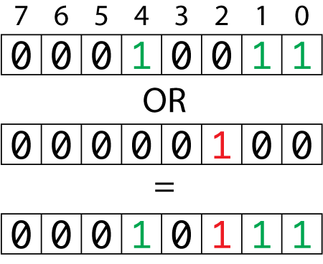
LIB Layer in Code
Bit Manipulation:
Set bit
Clear bit
Toggle bit
Get bit
Rotate bit left/right
Set bit number 2
Why?
Registers are controlled using bits
Bit operations are used in all layers
Rewriting bit logic reduces readability and safety

Slide 28
LIB Layer in Code
Bit Manipulation using bitwise operators:
Set bit:
REG |= (1<<BIT)
Clear bit:
REG &= (~(1<<BIT))
Toggle bit:
REG ^= (1<<BIT)
Get bit:
(REG & (1<<BIT)) >> BIT
Rotate left bit:
REG = (REG<<num) | (REG>>(8-num))

Slide 29
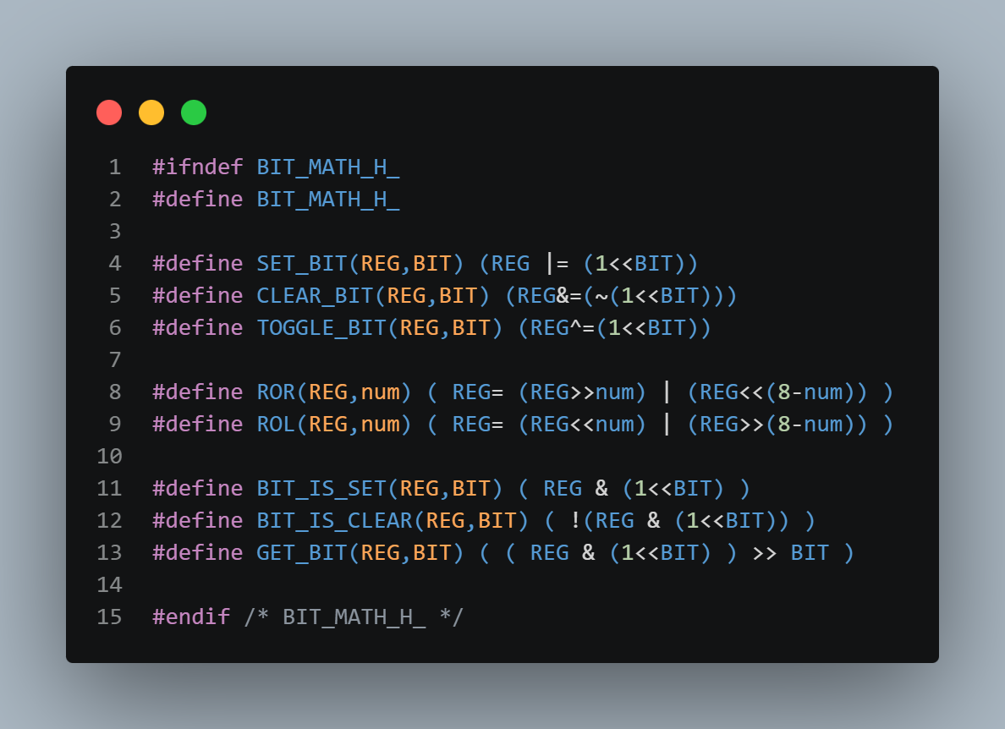
LIB Layer in Code
BIT_MATH.h file:
BIT_MATH.h is a library file that provides reusable macro functions for performing bit-level operations on registers in embedded systems.
BIT_MATH.h is located in the LIB layer.

Slide 30
MCAL Layer

Slide 31
MCAL Layer in Code
To access any peripheral, we deal with its registers.
So, to access the GPIO we deal with the registers: DDR, PORT, PIN.
Register accessing using pointers:
To access registers, we access their addresses by using pointers:
u8 *DDRA = (u8*) 0x3A;
u8 *PORTA = (u8*) 0x3B;
Not practical

Slide 32
MCAL Layer in Code
Why not practical?
Memory consumable.
* DDRA is used to access the register instead of DDRA directly.
To solve this, use #define:
#define DDRA (*(volatile u8*)(0x39))
Why volatile?
volatile prevents the compiler from caching a variable, ensuring each access reads the current value from the hardware.

Slide 33
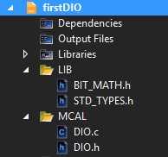
MCAL Layer in Code
GPIO Driver consists of two files:
GPIO.h file is a header file that contains function prototypes, macros, and configuration options for the GPIO driver.
GPIO.c file is a source file that contains the implementation of the functions declared in GPIO.h file.

Slide 34
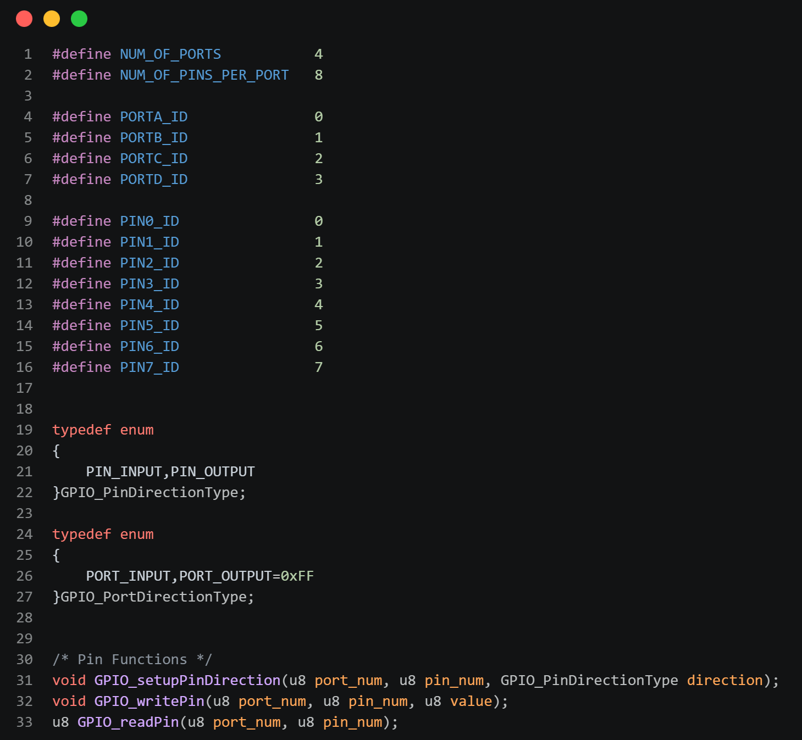
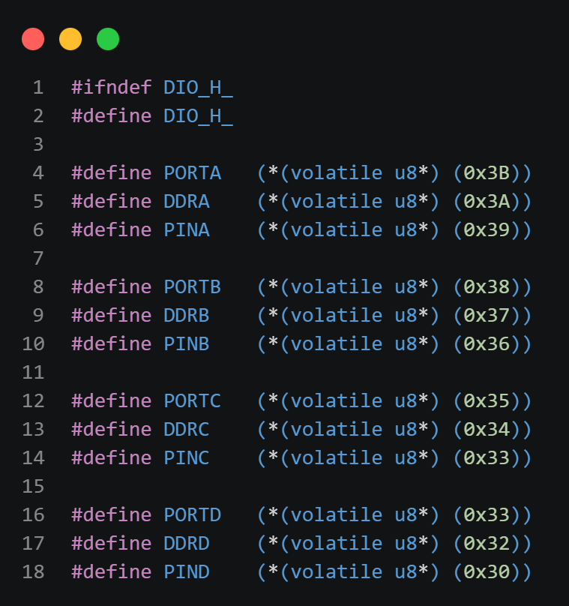
MCAL Layer in Code

Slide 35
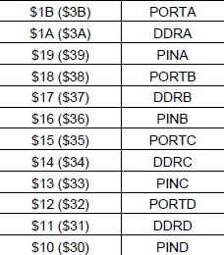


MCAL Layer in Code
For register addresses refer to Atmega 32 Datasheet, inserted table in page 327

Slide 36
GPIO Driver

Slide 37
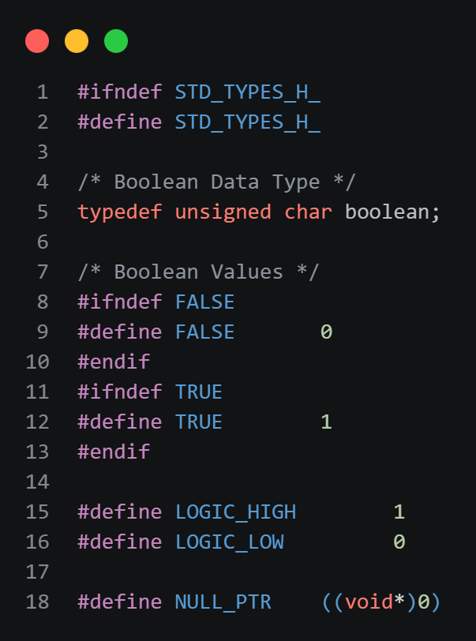
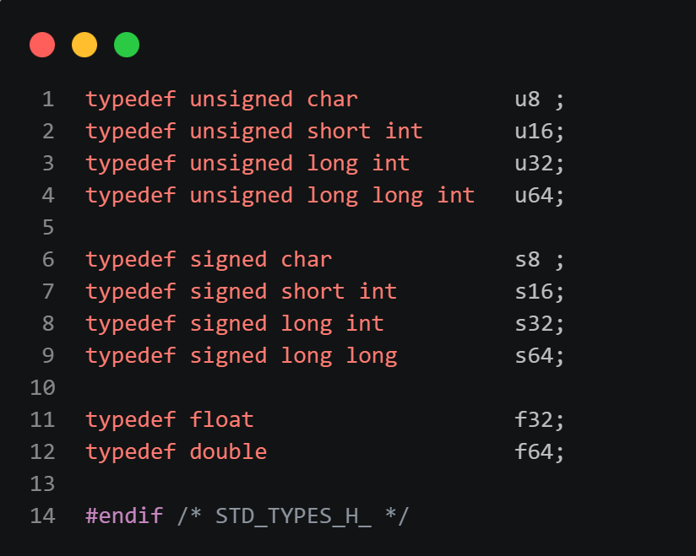
STD_TYPES.h

Slide 38
BIT_MATH.h

Slide 39
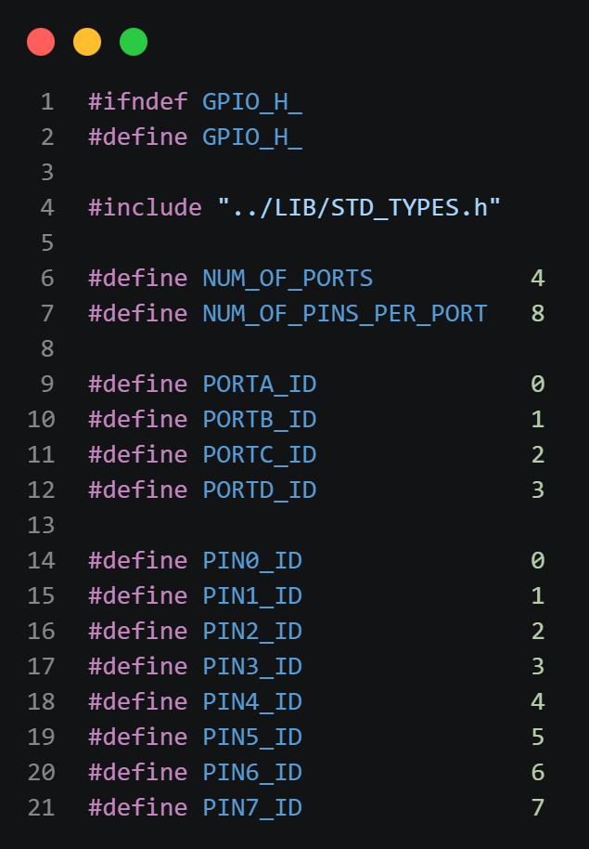
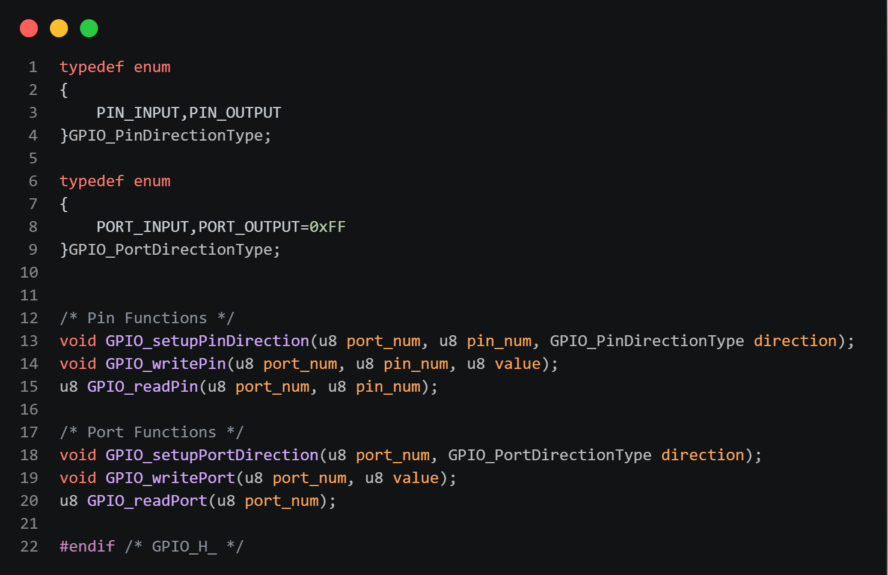
GPIO.h

Slide 40
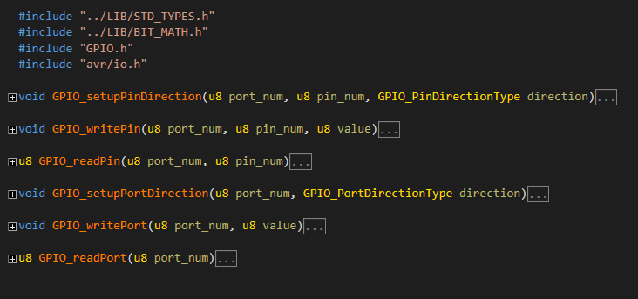
GPIO.c

Slide 41
Break

Slide 42


Hello!
Instructor: Mohamed Magdy
Cairo University, Electrical Engineering ( EPE ) Department.
Contact me: mohamed.naem04@eng-st.cu.edu.eg
LinkedIn: https://shorturl.at/hgsIP
@ 2026 Mohamed Magdy

Slide 43

@ 2026 Mohamed Magdy

Slide 44
AGENDA :
Input VS Output
Pull Up VS Pull down
@ 2026 Mohamed Magdy

Slide 45


Input VS Output
@ 2026 Mohamed Magdy
@ 2026 Mohamed Magdy

Slide 46
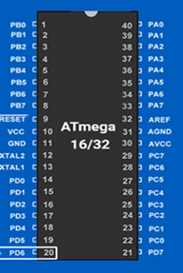
In our course we will use Microcontroller AVR Atmega32.
It has 32 DIO pins grouped as following:
1- PORTA has 8 DIO Pins from A0 to A7
2- PORTB has 8 DIO Pins from B0 to B8
3- PORTC has 8 DIO Pins from C0 to C8
4- PORTD has 8 DIO Pins from D0 to D8
PORT B
PORT A
PORT C
PORT D
@ 2026 Mohamed Magdy
@ 2026 Mohamed Magdy

Slide 47
Each port has 8 pins the pins of these four ports can be used as general purpose input/output (-GPIO-)
PORT B
PORT A
Each I/O Could be input or output (multiplexed direction).This could be controlled through the I/O port direction register
PORT C
PORT D
@ 2026 Mohamed Magdy
@ 2026 Mohamed Magdy

Slide 48
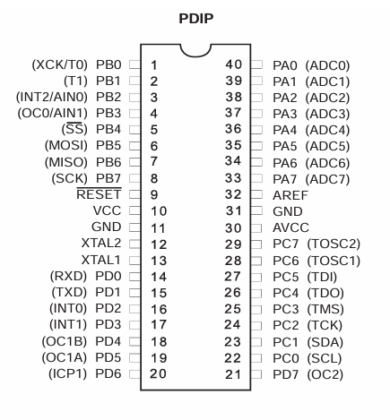
Each MC pin could be assigned to different I/O functions. Pin Could be
configured for digital I/O, analog input, Timer I/O, Serial I/O, For example PD0
could be digital I/O or UART serial input ( Multiplexed Functionality )
@ 2026 Mohamed Magdy
@ 2026 Mohamed Magdy

Slide 49
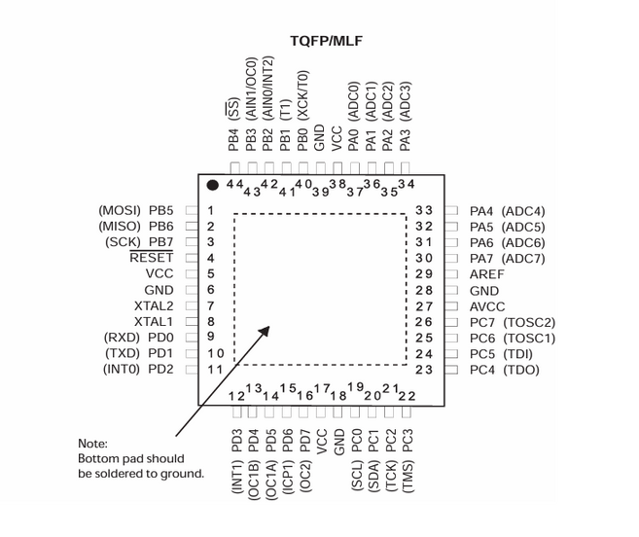
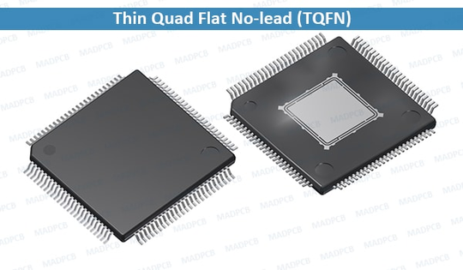
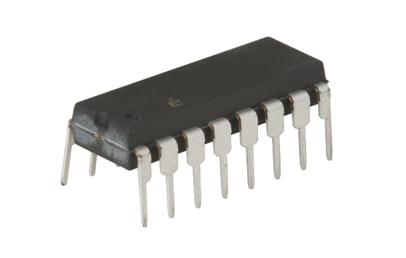
Packaging
PDIP PLASTIC DUAL IN LINE PACAKGE
@ 2026 Mohamed Magdy
@ 2026 Mohamed Magdy

Slide 50


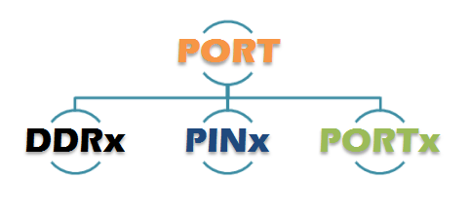
Each Port is controlled by 3 registers
DDRx( Data Direction Register)
This register used to decide the direction of the pins , i.e Whether the pins will act as input pins or as output pins
PORTx( Output Register )
This register is used to set the logic on the output pins HIGH OR LOW
PINx ( Input Register )
This register is used to read the logic level on the port input pins
Note : x could be A,B,C, OR D depending on which port registers are being addressed
@ 2026 Mohamed Magdy

Slide 51
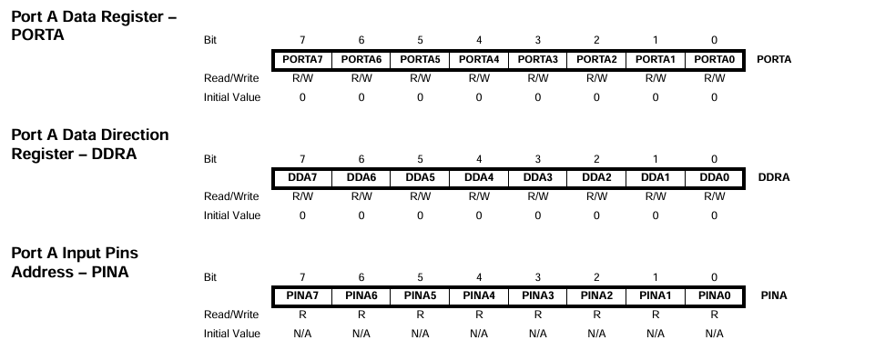
Each Port is controlled by 3 registers
@ 2026 Mohamed Magdy

Slide 52
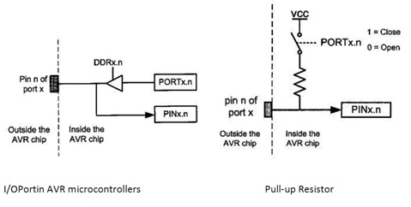
I/O Pin Programming Steps In AVR MC
1-Decide which pin is input and which pin is output
2-Configure the port direction use register DDRx
1 for Output.
0 for Input.
3- In Read (input case) Use register PINx
4-In write ( Output case ) Use register PORTx
@ 2026 Mohamed Magdy

Slide 53
I/O Pin Programming Steps In AVR MC
For each output pin we can perform read/write operation on this pin .We can write on it using PORTx register and read it through PINx or PORTx register .
For each Input pin we can perform read operation only through the PINx register
@ 2026 Mohamed Magdy

Slide 54
Pull Up VS Pull Down
@ 2026 Mohamed Magdy
@ 2026 Mohamed Magdy

Slide 55
Pull Up VS Pull Down
What is Pull-up resistor ?
What is Pull-down resistor ?
Why we need it ?
Why we need it ?
How to use this feature ?
How to use this feature ?
@ 2026 Mohamed Magdy
@ 2026 Mohamed Magdy

Slide 56
Internal Pull Up resistor
In case you set any PIN as input you can activate the internal pull up resistor by setting the corresponding bit in Portx register.
For each Input pin we can perform read operation only through the PINx register.
This feature is supported by all pins in the Atmega16/32 MC.
There is no internal Pull-down resistor in Atmega16/32 MC pins but it could be supported in other MC
@ 2026 Mohamed Magdy

Slide 57
Internal Pull Up resistor
Example :
Setup pin 2 in PORTB as input and activate the internal pull up resistor
DDRB&=~(1<<2);
PORTB|=(1<<2);
@ 2026 Mohamed Magdy

Slide 58
Internal Pull Up resistor
Lets Summarize our cases :
A PORT can have four different states depending upon the state of the bits corresponding to this pin in the data direction register (DDRx) and a data register (PORTx) of that specific port.
@ 2026 Mohamed Magdy

Slide 59
4 Cases
DDxn
PORTxn
I/O
PULL-UP
Comment
O
NO
TRI-STATE
( HIGH-Z )
0
I
Pxn will source current if pulled low externally
0
1
I
YES
output
low ( sink )
1
0
O
NO
output
high ( source )
1
1
O
NO
@ 2026 Mohamed Magdy
@ 2026 Mohamed Magdy

Slide 60

Internal Pull Up resistor
This is internal PULL-UP resistor to all the pins can be disabled by writing one to the PUD BIT IN THE SFIOR register When this is done the pins are in tri state( high impedance states ) if DDRxn =0 and PORTXN=1
Bit-2 ( PUD ) : Pull up disable
when this bit is written to one , the pull-ups in the I/O ports are disabled even if the DDxn and PORTxn Registers are configured to enable the PUll-ups
@ 2026 Mohamed Magdy

Slide 61
Basics
@ 2026 Mohamed Magdy
@ 2026 Mohamed Magdy

Slide 62
How to set values in registers ?
Set all pins of Port A AS OUTPUT
DDRA = 255;
DDRA= 0xFF;
DDRA=0b11111111;
@ 2026 Mohamed Magdy

Slide 63
How to set values in registers ?
set all Pins in PORTA
PORTA=255;
PORTA= 0xFF;
PORTA=0b11111111;
@ 2026 Mohamed Magdy

Slide 64
How to set values in registers ?
Clear all pins in PORTA
PORTA=0;
PORTA= 0x00;
PORTA=0b00000000;
@ 2026 Mohamed Magdy

Slide 65

How to deal with a specific pin and conserving other pins ?
Set Specified bit in register
Make OR operation on the old register value with one shift left by the pin number For example if we want to set pin number 5 in PORTA
PORTA|= (1<<5);
Clear( reset ) specified bit in register
Make AND operation on the old register value with the 1 ‘s complement value of one shift left bt the pin number For example if we want to clear pin number 3 in PORTB
PORTB&=~ (1<<3);
@ 2026 Mohamed Magdy
@ 2026 Mohamed Magdy

Slide 66
How to deal with a specific pin and conserving other pins ?
Toggle or Flip specified bit in register
Make XOR operation on the register old value with one shift left by the pin number for example if we want to toggle pin number 2 in PORTC
PORTC^=(1<<2);
@ 2026 Mohamed Magdy
@ 2026 Mohamed Magdy

Slide 67
How to deal with a specific pin and conserving other pins ?
Check if a specified bit is set ( one )
Make AND operation on the register value with one shift left by the pin number For examlpe check if pin 2 in PORTD Is set
if( PIND&(1<<2) ) {
/*CODE*/
}
@ 2026 Mohamed Magdy
@ 2026 Mohamed Magdy

Slide 68
How to deal with a specific pin and conserving other pins ?
Check if a specified bit is cleared ( reset or zero )
Just revert the previous condition For example check if pin 2 IN PORTD is cleared
if( ! ( PIND &(1<<2) ) ) {
/*CODE*/
}
@ 2026 Mohamed Magdy
@ 2026 Mohamed Magdy

Slide 69
Know More about your MC
( DATA SHEET )
Sink current vs Source current
Sink current :
PIN LOW
the sink value is the amount of current that can flow into the pin ( and therefore into the MC) safely.
Source current :
PIN HIGH
The SOURCE current is the amount of the current that can be pulled out of the pin safely.
It is very important that you try to limit the amount of current flowing into and out of your pin ( typically using series resistance )
@ 2026 Mohamed Magdy
@ 2026 Mohamed Magdy

Slide 70
Applications
@ 2026 Mohamed Magdy
@ 2026 Mohamed Magdy

Slide 71
Output pins
Input pins
LED AND 7-Segemnt
Switches ( Push button ,keypad and etc.. )
LCD display
analog/digital sensors
Motors
Signal from another MC
Buzzer
input from PC through PC Serial Port
Signal to other MC
Output to PC through PC Serial Port
@ 2026 Mohamed Magdy

Slide 72
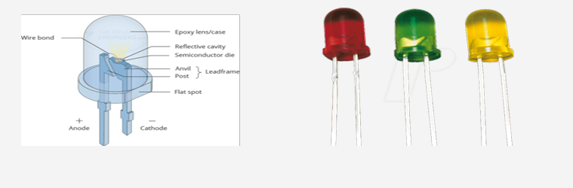
Interfacing
LED :
Light Emitting Diode is an electrical element that emits light
by supplying a voltage difference between its terminals
@ 2026 Mohamed Magdy

Slide 73
Interfacing
LED :
Negative Logic
Positive Logic
R= 220 : 350
@ 2026 Mohamed Magdy

Slide 74
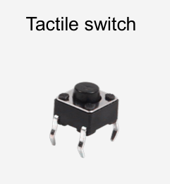
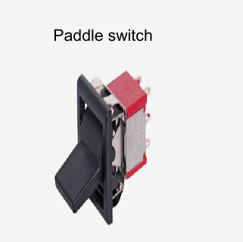
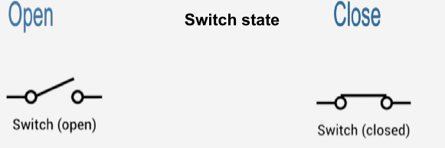
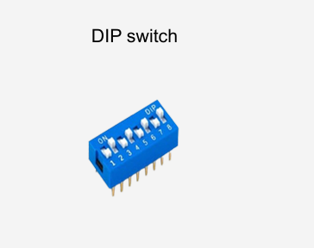
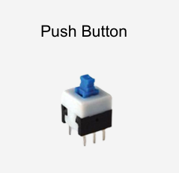
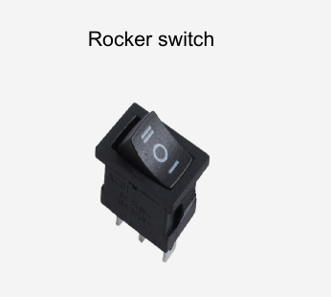
Interfacing
Mechanical Switch :
Mechanical Switch is an electrical component that can connect or break an electrical circuit.
@ 2026 Mohamed Magdy

Slide 75
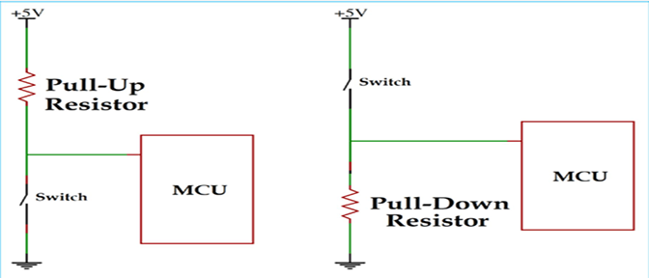
Interfacing
Mechanical Switch :
Switch shall be connected by pull up or pull down resistor to avoid short circuits.
@ 2026 Mohamed Magdy

Slide 76
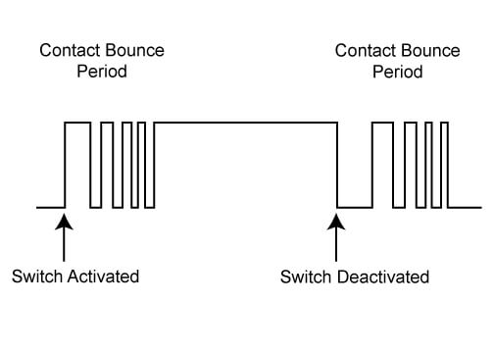
Interfacing
De-bonce Issue
When the Push Button is pressed the switch does not provide a clean edge The input value is bouncing for 10-30 ms
If this signal was used as an input to a digital counter for example you would get multiple counts rather than the expected single count
Sol:
1-Software
2-hardawre
@ 2026 Mohamed Magdy

Slide 77
infinite Loop
Any C project in Embedded Systems application shall have an infinite loop called Super loop . This loop is a must even if you will leave it empty!!
Super loop used as here we have an embedded application used for a certain purpose
This loop prevents the program counter ( PC ) from continues incrementing over the flash memory and execute a garbage code.
while(1) {
/*code*/
}
for(;;){
/*code*/
}
loop:
/*code*/
gotoloop;
Most Common
Better performance
Not Good !
@ 2026 Mohamed Magdy

Slide 78
Busy loop Delay
Software Technique to make the processor halt it’s activity for a certain time using loop.
Delay Library “util/delay.h” In AVR provides Two basic functions:
_delay_ms (value in ms);
_delay_us (value in us);
Before Using the delay library we have to define our system frequency through the F_CPU macro used by the delay library:
#define F_CPU 8000000UL 8MHZ
If not defined it will use its default frequency value which is 1Mhz
@ 2026 Mohamed Magdy

Slide 79
TASK
• Build: Button → LED system Using layered architecture
@ 2026 Mohamed Magdy
@ 2026 Mohamed Magdy

