Slide 1


Embedded Workshop
Session
9

Slide 2



Hello!
Instructor: Fatma Foley.
Cairo University, EECE Department.

Slide 3

Embedded Systems Workshop
1
My LinkedIn Profile

Slide 4


Content
Introduction to Communication
Baud Rate
UART

Slide 5

Introduction to Communication

Slide 6

Definitions
Bit time: The time taken to transmit a bit.
Bit rate: The number of bits transmitted per second (Bit rate = 1 / Bit time).
Baud Rate: The number of symbols signaled in a second (Symbol = number of bits).
Baud rate = Bit rate / number of bits per symbol.
Example: When using a device has a set of 8 different symbols. Each symbol represents 3 bits of useful data. If it transmits 300 bits per second,
it gathers each 3 bits in 1 symbol. So it transmits 100 symbol per second.
Bit rate = 300 bit/sec.
Baud rate = 100 symbol/sec.

Slide 7
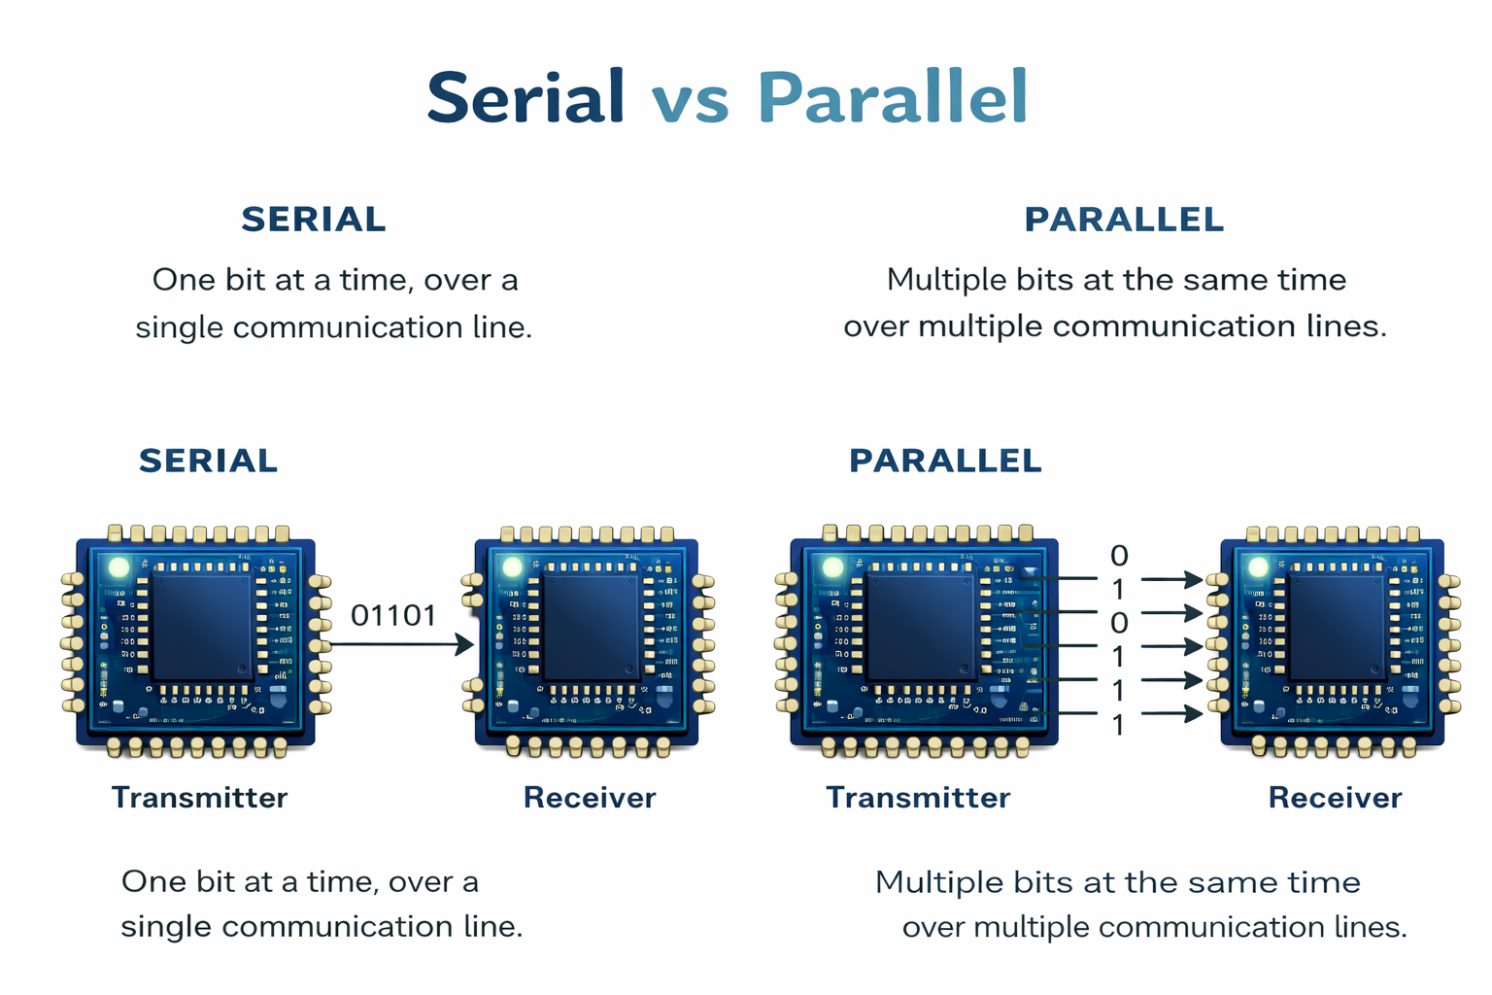
Serial vs Parallel
0
1
1
0
1
01101

Slide 8
Serial vs Parallel
Feature | Serial | Parallel
Data transfer | Bits sent one after another | Multiple bits sent at the same time
Speed | Slower | Faster
Frequency | Low frequency operation | High frequency operation
Cables | Fewer wires | Multiple wires
Distance | Suitable for long distance | Suitable for short distance
Cost | Low | High

Slide 9
Serial Communications
We will focus on serial communication because it is the most common in embedded systems.
Serial communications is a method to transfer data between two distant devices.
For serial communications to be accomplished there must be a transmitter (TX), and a receiver (RX).
Data transfer is accomplished by means of signaling bits in a limited number of wires (ideally 2 or 3 wires).
Serial communication is also used to transfer data between two MCUs and between the MCU and peripherals connected to it.

Slide 10
Serial Communications In Embedded Systems
We use serial communication (USART-SPI-I2C) to interface microcontroller with different devices such as :
Other Micro-controller.
PC.
External devices like: LCD, Bluetooth, GSM and GPS Modems, External EEPROM and Flash EEPROM, External ADC and External Watch-Dog Timer.
Also, There are serial communication protocols used in automotive embedded systems networks such as: Controller Area Networks (CAN) and Local Interconnect Networks (LIN).

Slide 11
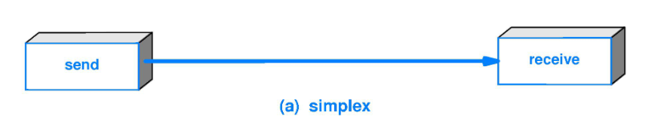
Serial Communications Types
Simplex Communication
One way communication, Sender can send the data but it can’t receive the data from other device. It is a unidirectional communication.
Example: TV and Radio.

Slide 12
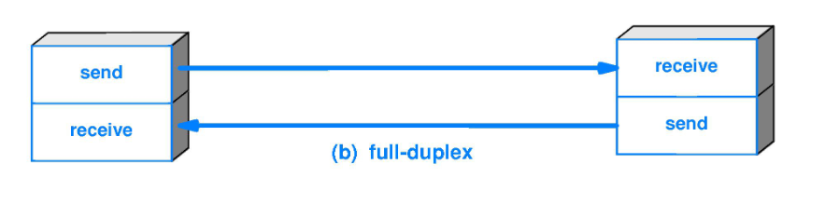
Serial Communications Types
Half Duplex Communication
Sender can send the data and also can receive the data but one at a time.
It is two-way directional communication but only one direction at a time.
Example: walkie-talkie.

Slide 13
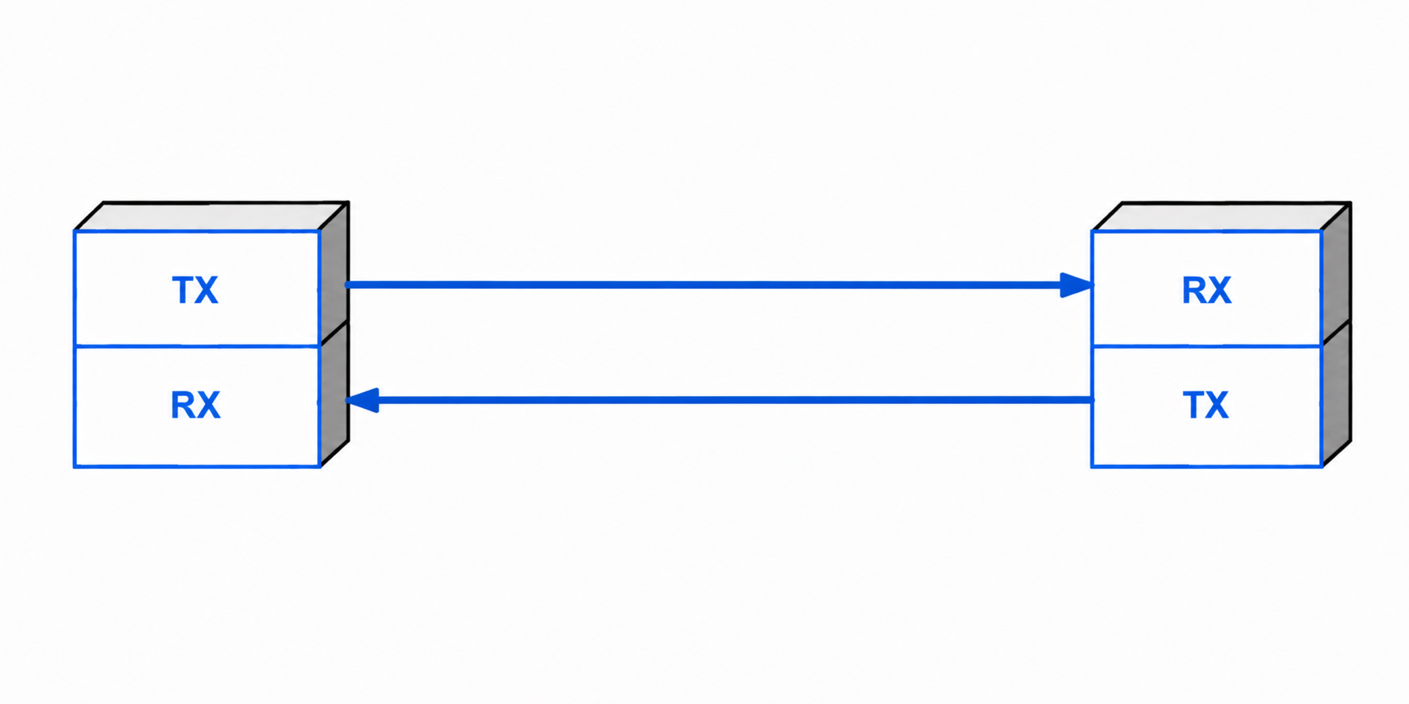
Serial Communications Types
Full Duplex Communication
Sender can send the data and also can receive the data simultaneously.
It is two-way directional communication simultaneously.
Example: Telephone.

Slide 14
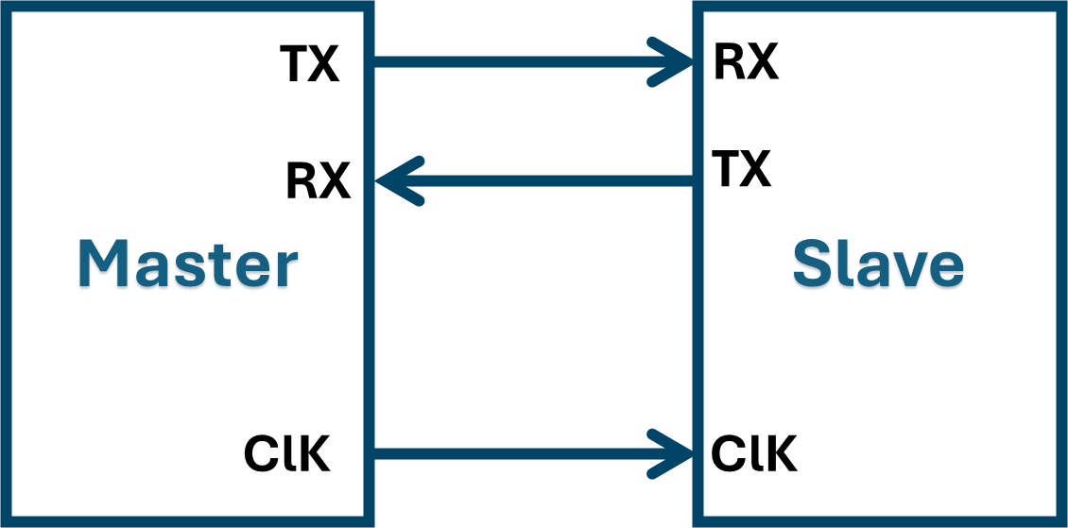
Serial Communications Modes
Synchronous Transmission
A clock line from one terminal (master) to the other terminal (slave) makes the synchronization.
Another line is used for data transmission between master and slave(s).
If the master communicates with many slave devices using the same data and clock lines, a (slave select) line is used to determine which slave to communicate
with like Serial peripheral Interface (SPI) protocol. It will be discussed later.

Slide 15
Synchronous Transmission
Since data is sampled depending upon clock pulses, and since the clock sources are very reliable, so there is much less error in Synchronous as compared to Asynchronous.
Preferred for short-distance transmission. Not used for long-distance transmission as sending the clock signal with the data signal is not an appropriate solution for the additional costs and clock skew.
Synchronous communication is usually more efficient because only data bits are transmitted between sender and receiver (no overhead) which leads to a higher bit rate.
Synchronous communication can be more costly if extra wiring and circuits are required to share a clock signal between the sender and receiver.

Slide 16
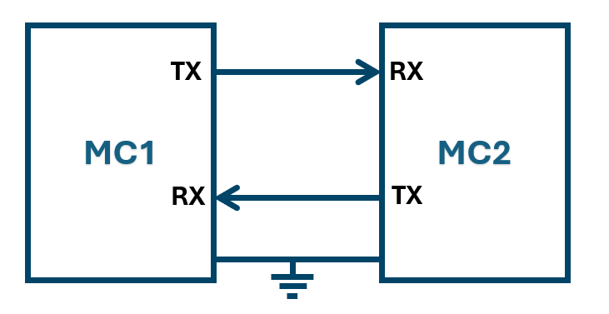
Serial Communications Modes
Asynchronous Transmission
GND
GND

Slide 17
Asynchronous Transmission
Data Transfer is called Asynchronous when data bits are not “synchronized” with a clock line. there is no clock line at all!
For asynchronous data transfer, There is no common clock signal between the sender and receivers. Therefore, the sender and the receiver first need to agree on a data transfer speed and both devices must use the same data rate. This speed usually does not change after the data transfer starts.
Synchronization bits are added at the front, middle or end of the data to synchronize the sending and receiving units.
Due to these extra bits used to synchronize between the sender and receiver, There is an overhead in asynchronous transmission and that’s why the asynchronous serial transmission has slower data transfer rate compared with synchronous. Extra synchronization bits may account for up to 50% data transfer!

Slide 18
Baud Rate

Slide 19
What is Baud Rate?
Baud Rate is the speed of data transmission in UART communication.
It represents how many symbols are sent or received per second.
Example: If the baud rate is: 9600 baud
This means the UART transmits: 9600 symbols every second
(Each symbol may correspond to one or more bits)

Slide 20
Why is Baud Rate Important?
Both devices in UART communication must use the same baud rate. Otherwise, the received data will be incorrect or unreadable.
Common Baud Rate Values:
9600
19200
38400
57600
115200
In UART, each symbol represents one bit, so: Baud Rate ≈ Bit Rate

Slide 21
UART

Slide 22
UART Protocol
USART stands for Universal Synchronous Asynchronous Receiver Transmitter. It is also called SCI (Serial Communication Interface).
Serial Full Duplex communication (Both transmission and reception can occur at the same time).
The UART uses two I/O pins to transmit and receive serial data and another clock line in synchronous mode only.
Some microcontrollers have USART device and others have UART device.

Slide 23
Connections
Asynchronous Mode:
MC1
MC2
TX
RX
RX
TX
GND
GND

Slide 24
Synchronous Mode:
Master
Slave
TX
RX
RX
TX
ClK
ClK

Slide 25
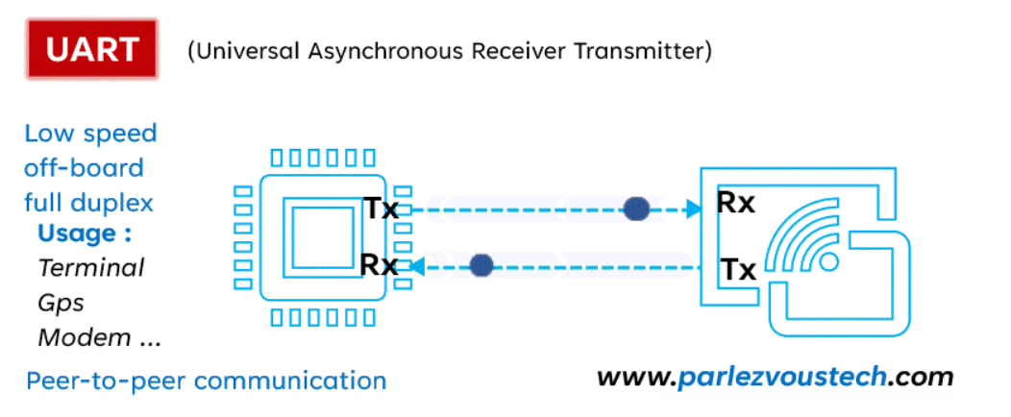

Slide 26
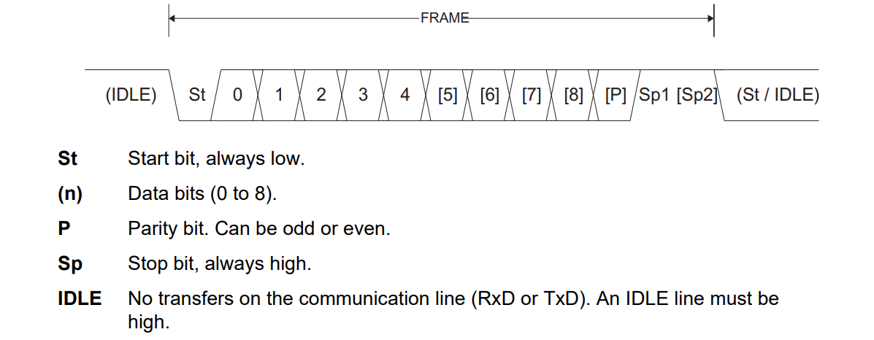
UART Frame
The UART frame is usually as follows:
Start Bit: This bit indicates the start of frame transmission on the serial line, always low ‘0’.
Data Bits: 4, 5, 6, 7, 8 or 9 bits of useful data bits (Usually 8-bits are used).
Parity Bit: To check for transmission errors and it is optional part in the frame.
Stop Bit: 1 or 2 stop bits to declare the end of frame, always high ‘1’.

Slide 27
Parity Bit
Parity bit is the simplest method of error detection. If the parity bit is enabled in the UART frame, the sender device will calculate the parity bit and send it as part from the frame. The receiver device will also calculate the parity bit after receiving the complete frame from the transmitter.
If the calculated parity bit at the receiver side matches the one sent by the transmitter, then the received frame is correct, and if not the receiver device will raise an error

Slide 28
Parity Bit Types
Even Parity:
0: when the number of ‘1’ symbols inside a frame be even.
1: when the number of ‘1’ symbols inside a frame be odd.
Odd Parity:
0: when the number of ‘1’ symbols inside a frame be odd.
1: when the number of ‘1’ symbols inside a frame be even.

Slide 29
Advantages of UART
Easy to use.
Full duplex transmission of data can be achieved with only two wires.
Clock or timing signals are not required (less number of pins).
Integrated error checking is ensured using parity bits.

Slide 30
Disadvantages of UART
The data frame is limited by size. Maximum one byte per frame.
Data transfer speed is low in comparison with synchronous serial communication.
Appropriate rules must be agreed upon by both devices in communication, like start and stop bits and this will make overhead on the transmission rate.
It doesn't support communication with several devices.

Slide 31
Break

Slide 32
Hello!
Instructor: Basma.
Cairo University, EECE Department.

Slide 33
Embedded Systems Workshop
1
My LinkedIn Profile

Slide 34
Practical Part

Slide 35
Thank You!
Any questions?

