Slide 1
Hive Master
A Honey Harvesting Initiative

Slide 2
ABSTRACT
HiveMaster: A Honey Harvesting Initiative explores modern apiary operations through an integrated beekeeping data programme. This project models the full lifecycle of commercial and hobby apiaries, mapped for commercial purposes. HiveMaster enables granular analysis of productivity, hive health, treatment costs, and seasonal performance across diverse apiary environments.
Total 8124.10 kgs of honey harvested
from July 22, 2020 to December 31, 2024
Average 25.38 kgs of honey harvested per harvest

Slide 3
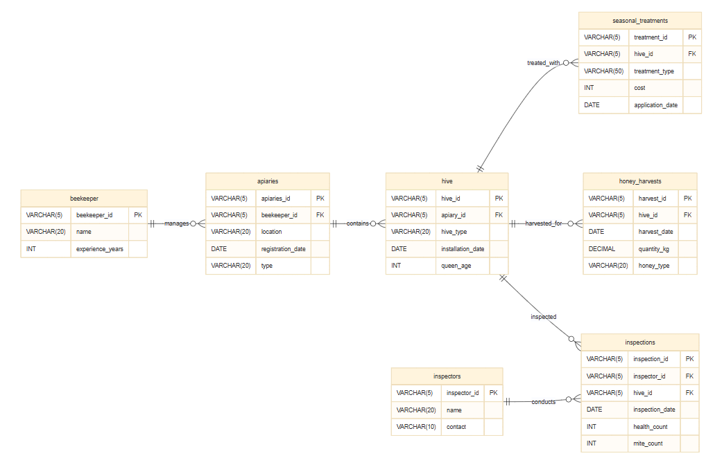
ER DIAGRAM .

Slide 4
01
STRUCTURE OF TABLES
Syntax: DESC tablename;

Slide 5

DESC BEEKEEPER;
Stores the beekeeper’s unique ID, their names and their experience years.

Slide 6
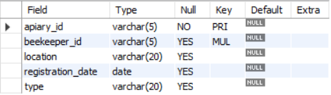
DESC APIARIES;
Stores the apiaries’ unique ID, their location and their registration dates, the particular type and the ID of beekeeper responsible to maintain it.

Slide 7
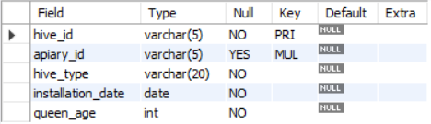
DESC HIVE;
Stores the hive’s unique ID, the apiary ID that the hive belongs to, the type of hive, installation date of the hive, and the age of the queen of the particular hive.

Slide 8

DESC INSPECTORS;
Stores a uniquely identifying ID of each inspector, their name and their contact

Slide 9
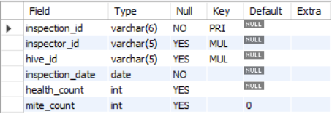
DESC INSPECTIONS;
Stores a unique Inspection ID, the ID of the inspector that’s conducting the inspection, the ID of the hive that’s being inspected, the date of the inspection, total health count out of 100, and mite count.

Slide 10
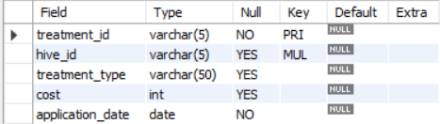
DESC SEASONAL_TREATMENTS;
Stores a unique treatment ID, the ID of the hive that is treated, the type of treatment, cost of the treatment and the application date.

Slide 11
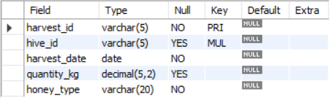
DESC HONEY_HARVESTS;
Stores a unique harvest ID, the ID of the hive being harvested, date of harvest, how much honey is harvested in kgs and the type of honey that is harvested.

Slide 12
02
CONTENTS OF TABLES
Syntax: SELECT * FROM tablename;

Slide 13
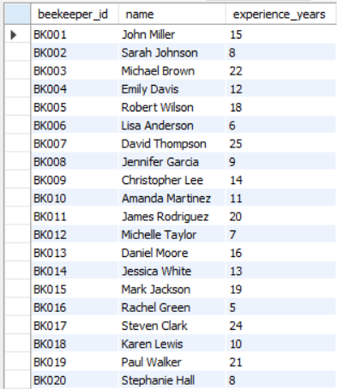
SELECT * FROM BEEKEEPER;
35 rows

Slide 14
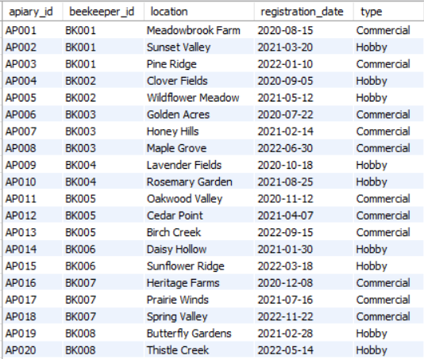
SELECT * FROM APIARIES;
72 rows

Slide 15
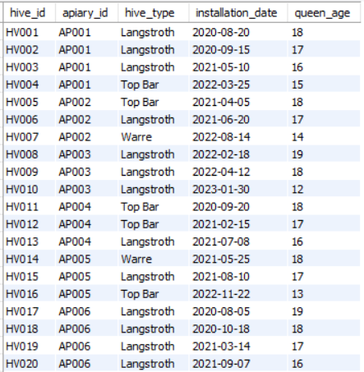
SELECT * FROM HIVE;
198 rows

Slide 16
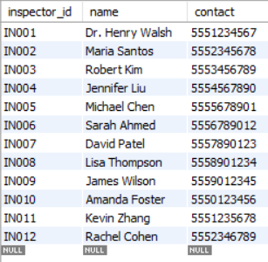
SELECT * FROM INSPECTORS;
12 rows

Slide 17
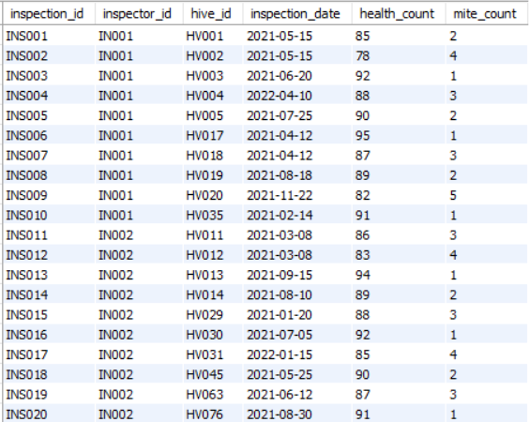
SELECT * FROM INSPECTIONS;
274 rows

Slide 18
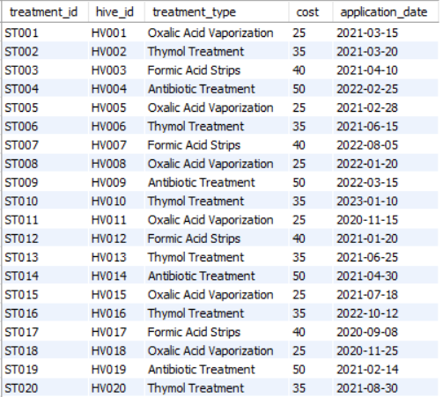
SELECT * FROM SEASONAL_TREATMENTS;
300 rows

Slide 19
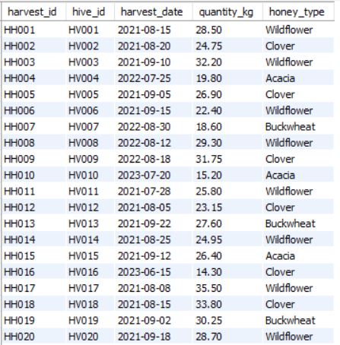
SELECT * FROM HONEY_HARVESTS;
320 rows

Slide 20
03
SUBQUERIES

Slide 21
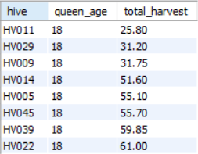
Which top 5 hives have queens in their prime age 18 months but are underperforming compared to other hives with similar queen ages?
select hive_id as hive, queen_age, (select sum(quantity_kg) from honey_harvests where hive_id = h.hive_id) as total_harvest
from hive h
where queen_age = 18
AND
(select sum(quantity_kg) from honey_harvests where h.hive_id = hive_id) <
(SELECT AVG(harvest_total)
FROM (SELECT SUM(quantity_kg) as harvest_total
FROM honey_harvests hh2
INNER JOIN hive h2 ON hh2.hive_id = h2.hive_id
WHERE h2.queen_age = 18
GROUP BY h2.hive_id) as prime_age_harvests)
ORDER BY total_harvest ASC;
8 rows

Slide 22
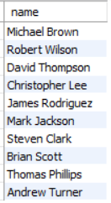
2. Which beekeepers have hives that harvested more than 35 kg of honey in a single harvest?
select distinct name from beekeeper
where beekeeper_id in
(select beekeeper_id from apiaries where apiary_id in
(select apiary_id from hive where hive_id in
(select hive_id from honey_harvests where quantity_kg > 35)));
10 rows

Slide 23
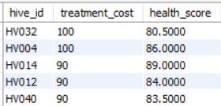
3. Which top 5 hives have received more expensive treatments than the average cost for hives in their health score range?
SELECT hive_id,(SELECT SUM(cost) FROM seasonal_treatments WHERE hive_id = h.hive_id) as treatment_cost,
(SELECT AVG(health_count) FROM inspections WHERE hive_id = h.hive_id) as health_score
FROM hive h
WHERE (SELECT SUM(cost) FROM seasonal_treatments WHERE hive_id = h.hive_id) >
(SELECT AVG(cost) FROM seasonal_treatments)
AND
(SELECT COUNT(*) FROM inspections WHERE hive_id = h.hive_id) > 1
ORDER BY treatment_cost DESC
LIMIT 5;
5 rows

Slide 24
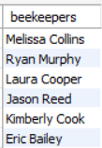
4. Which beekeepers have an apiary where all hives' latest inspections show mite_count below 3?
SELECT DISTINCT b.name as beekeepers
FROM beekeeper b
INNER JOIN apiaries a ON b.beekeeper_id = a.beekeeper_id
WHERE a.apiary_id NOT IN (
SELECT a2.apiary_id
FROM apiaries a2
INNER JOIN hive h ON a2.apiary_id = h.apiary_id
WHERE h.hive_id IN (
SELECT hive_id
FROM inspections
WHERE mite_count >= 3 )
);
6 rows

Slide 25
04
JOINS

Slide 26
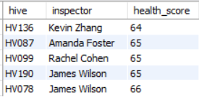
Which 5 hives had the lowest health scores between July 2023-2024, and which inspectors identified these issues?
select h.hive_id as hive, inrs.name as inspector, ins.health_count as health_score
from hive h
inner join inspections ins on h.hive_id = ins.hive_id
inner join inspectors inrs on ins.inspector_id = inrs.inspector_id
where ins.inspection_date between '2023-07-01' and '2024-07-31'
order by ins.health_count, h.hive_id limit 5;
5 rows

Slide 27
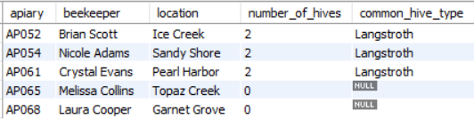
2. Show apiaries created in 2024, with their beekeeper, location, number of hives, and most common hive type.
select distinct(a.apiary_id) as apiary, b.name as beekeeper, a.location, count(h.hive_id) as number_of_hives,
(select h.hive_type from hive h where h.apiary_id = a.apiary_id
group by hive_type
order by count(*) desc limit 1) as common_hive_type
from apiaries a
inner join beekeeper b on a.beekeeper_id = b.beekeeper_id
left join hive h on a.apiary_id = h.apiary_id
where registration_date between '2024-01-01' and '2024-12-31'
group by a.apiary_id;
5 rows

Slide 28
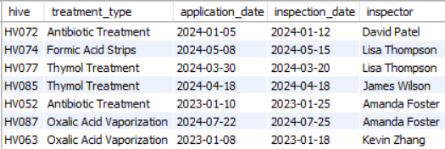
3. Which hives received a treatment and inspection in the same month? Show the treatment, treatment date, inspection date, and inspector.
select h.hive_id as hive, s.treatment_type, s.application_date, ins.inspection_date, inrs.name as inspector from hive h
inner join seasonal_treatments s on h.hive_id = s.hive_id
inner join inspections ins on h.hive_id = ins.hive_id
inner join inspectors inrs on ins.inspector_id = inrs.inspector_id
where year(ins.inspection_date) = year(s.application_date)
and month(ins.inspection_date) = month(s.application_date);
7 rows

Slide 29

4. Which hives were installed in the same apiary within 60 days (approx. 2 months) of each other?
SELECT
h1.hive_id as first_hive, h2.hive_id as second_hive, h1.installation_date as first_install_date, h2.installation_date as second_install_date,
ABS(DATEDIFF(h1.installation_date, h2.installation_date)) as days_apart, h1.apiary_id
FROM hive h1
INNER JOIN hive h2 ON h1.apiary_id = h2.apiary_id
AND h1.hive_id != h2.hive_id
AND h1.hive_id < h2.hive_id
WHERE ABS(DATEDIFF(h1.installation_date, h2.installation_date)) <= 60
ORDER BY h1.apiary_id, days_apart;
3 rows

Slide 30
Thank you!
Prepared by
Mrunmayee Ovhal
T343

