Slide 1
Project: Charge of electric vehicles in a company
Hyun Gyu Shin
Vincent meng

Slide 2

Presentation
Nowadays people try to find some
solutions for:
Reduce the energy cost
Reduce the consumption of petrol
Protect the environment
Thus utilisation of electric vehicles should be increase in the future.
Problem: Currently the infrastructures and organizations are not ready for that.

Slide 3
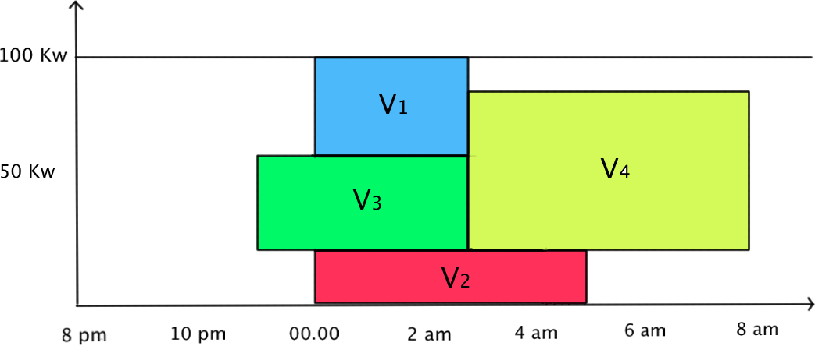
Presentation
How organize the electricity recharge for vehicles in a company and minimize the cost?
Example:
-4 vehicles
-Cheapest cost 00.00- 5 am

Slide 4
Mathematical model
Parameter to consider:
Battery capacity of each vehicles Cai
Total charge time for each vehicles Chi
Capacity of the building for deliver the electricity (100Kw)
Cost/intervalle/Kw Ct
Bij = Cai * Chi Demand in electricity for each vehicles
Example

Slide 5
Mathematical model

Slide 6
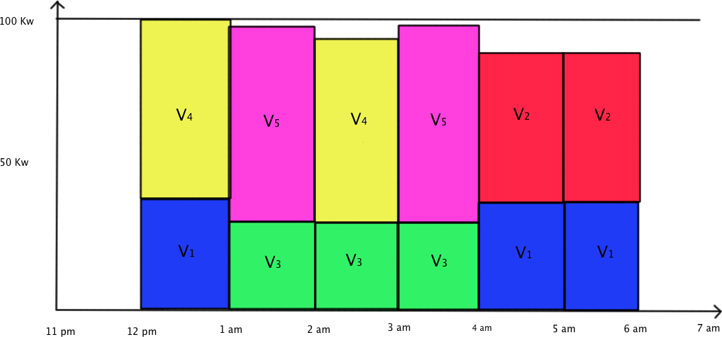
Mathematical model

Slide 7
Evolution of the problem
Consider the need of each vehicle (maybe the vehicles don’t need to be recharge completely)
Use a planning for know the displacement of each vehicle during several days
Consider the possibility to recharge during the day if the vehicle isn’t available during the night
Capacity of the building change (function of the time, or season)

Slide 8
NP-Complemteness
Our problem is NP-Complete
NP
Consider the decision problem. Given jop assignment, we can determine whether this assignment have a cost lower than Budget or not in polynomial time. Therefore, our problem is NP
V2
V5
V6
V7
V3
V1
V4
c1
c2
c3
c4
c5

Slide 9
NP-Complemteness
Our problem is NP-Complete
NP-Hard
We can successfully reduce 1D bin packing problem into our problem. In other words, we can solve 1D bin packing problem by reducing it into our problem, and solve it. Because 1D bin packing problem is NP-Complete, our problem is NP-Hard.
1D bin packing prob.
Our problem
reduce

Slide 10
NP-Complemteness
Our problem is NP-Complete
NOT Easy Problem
There is no polynomial time algorithm
We need approximation technique such as SA, GA, etc.
Dynamic Programming can be used to solve this problem for small number of jobs and bins ( But we didn’t implement it. It is just one way to approach )

Slide 11
Solving Technique
Approximation Algorithm
Simulated Annealing
Sequence Modeling
Parameters
Genetic Algorithm
Genetic Information Encoding
Crossover
Mutation
Heuristic
Best-Fit Decreasing

Slide 12
Simulated Annealing
Sequence Modeling
In the TSP, we need sequence to perform simulated annealing
1
3
2
5
4
6
7
S0
1
3
4
5
2
6
7
S1

Slide 13
Simulated Annealing
Sequence Modeling
Like this, we need to make sequence for our problem
1
3
2
5
4
6
7
S0
V1
V2
V3
V7
V6
V4
V5
c1
c2
c3
c4
c5

Slide 14
Simulated Annealing
Sequence Modeling
Like this, we need to make sequence for our problem
1
3
2
5
4
6
7
S0
V2
V3
V7
V6
V1
V4
V5
c1
c2
c3
c4
c5

Slide 15
Simulated Annealing
Sequence Modeling
Like this, we need to make sequence for our problem
1
3
2
5
4
6
7
S0
V2
V7
V3
V6
V1
V4
V5
c1
c2
c3
c4
c5

Slide 16
Simulated Annealing
Sequence Modeling
Like this, we need to make sequence for our problem
1
3
2
5
4
6
7
S0
V2
V7
V3
V6
V1
V4
V5
c1
c2
c3
c4
c5

Slide 17
Simulated Annealing
Sequence Modeling
Like this, we need to make sequence for our problem
1
3
2
5
4
6
7
S0
V2
V5
V7
V3
V6
V1
V4
c1
c2
c3
c4
c5

Slide 18
Simulated Annealing
Sequence Modeling
Like this, we need to make sequence for our problem
1
3
2
5
4
6
7
S0
V2
V5
V7
V3
V6
V1
V4
c1
c2
c3
c4
c5

Slide 19
Simulated Annealing
Sequence Modeling
Like this, we need to make sequence for our problem
1
3
2
5
4
6
7
S0
V2
V5
V6
V7
V3
V1
V4
c1
c2
c3
c4
c5

Slide 20
Simulated Annealing
Sequence Modeling
Like this, we need to make sequence for our problem
1
3
2
5
4
6
7
S0
V2
V5
V6
V7
V3
V1
V4
c1
c2
c3
c4
c5

Slide 21
Simulated Annealing
Sequence Modeling
Like this, we need to make sequence for our problem
1
3
2
5
4
6
7
S0
V2
V5
V6
V7
V3
V1
V4
Sort the cost in increasing order.
Then assigning the job into left interval is always better than do it into right interval
c1
<
c2
<
c3
<
c4
c5
<

Slide 22

Simulated Annealing
Sequence Modeling
Like this, we need to make sequence for our problem
Let Cost(Si) be the cost of seqeunce Si. Then we can perform simulated annealing !
Set initial solution S0 be random sequence
Generate new solution S1 by swapping two numbers.
Compare the Cost(S0) and Cost(S1). If new solution is better, than take it. Otherwise, take a new solution with some probability.
$$e^{−(after −before)/T}$$

Slide 23

Simulated Annealing
Sequence Modeling
Like this, we need to make sequence for our problem
Let Cost(Si) be the cost of seqeunce Si. Then we can perform simulated annealing !
Set initial solution S0 be random sequence
Generate new solution Si+1 by swapping two numbers.
Compare the Cost(Si) and Cost(Si+1). If new solution is better, than take it. Otherwise, take a new solution with some probability.
Parameter
L = 500, T0 = L / $\sqrt{n}$, Ti+1 = 0.95Ti

Slide 24
Genetic Algorithm
Genetic Information Encoding
1
2
3
5
3
4
4
3
2
3
5
2
5
5
1
1
4
1
2
4

Slide 25
Genetic Algorithm
Crossover
1
2
3
5
3
1
3
4
4
3
4
3
2
3
5
2
5
2
5
5
1
1
1
5
4
1
2
4
2
4

Slide 26
Genetic Algorithm
Crossover
1
2
3
5
3
1
3
3
4
4
3
4
3
4
2
3
5
2
5
2
1
5
5
1
1
1
5
2
4
1
2
4
2
4
5

Slide 27
Genetic Algorithm
Crossover
1
2
3
5
3
1
3
1
3
4
4
3
4
3
4
3
2
3
5
2
5
2
1
4
5
5
1
1
1
5
2
5
4
1
2
4
2
4
5
2

Slide 28
Genetic Algorithm
Crossover
1
2
3
5
3
1
3
1
3
4
4
3
4
3
4
3
2
3
5
2
5
2
1
4
5
5
1
1
1
5
2
5
4
1
2
4
2
4
5
2

Slide 29
Genetic Algorithm
Crossover
1
2
3
5
3
1
2
3
3
4
4
3
4
3
4
4
2
3
5
2
1
4
3
3
5
5
1
1
2
5
5
5
4
1
2
4
5
2
1
1
Gi
Gi+1

Slide 30
Genetic Algorithm
Mutation
1
2
3
5
3
1
2
3
3
4
4
3
4
3
4
4
2
3
5
2
1
4
3
3
5
5
1
1
2
5
5
5
4
1
2
4
5
2
1
1
Gi
Gi+1

Slide 31
Genetic Algorithm
Mutation
1
2
3
5
3
1
2
3
3
4
4
3
4
3
4
4
2
3
5
2
1
4
3
3
5
5
1
1
2
5
5
5
4
1
2
4
5
2
1
1
Gi
Gi+1

Slide 32
Genetic Algorithm
Mutation
1
2
3
5
2
1
2
3
3
4
4
3
4
3
4
4
2
3
5
2
1
4
3
3
5
5
1
1
3
5
5
5
4
1
2
4
5
2
1
1
Gi
Gi+1

Slide 33
Genetic Algorithm
Mutation
1
2
3
5
2
1
2
3
3
4
4
3
4
3
4
4
2
3
5
2
1
4
3
3
5
5
1
1
3
5
5
5
4
1
2
4
5
2
1
1
Gi
Gi+1

Slide 34
Heuristic
Similar to Best-Fit Decreasing algorithm
Sort the job sequence as decreasing order
V1
V2
V3
V7
V6
V4
V5
c1
c2
c3
c4
c5

Slide 35
Heuristic
Similar to Best-Fit Decreasing algorithm
Sort the job sequence as decreasing order
Perform best-fit algorithm
V7
V3
V6
V2
V1
V4
V5
c1
c2
c3
c4
c5

Slide 36
Heuristic
Similar to Best-Fit Decreasing algorithm
Sort the job sequence as decreasing order
Perform best-fit algorithm
V7
V3
V6
V2
V1
V4
V5
c1
c2
c3
c4
c5

Slide 37
Heuristic
Similar to Best-Fit Decreasing algorithm
Sort the job sequence as decreasing order
Perform best-fit algorithm
V7
V3
V6
V2
V1
V4
V5
c1
c2
c3
c4
c5

Slide 38
Heuristic
Similar to Best-Fit Decreasing algorithm
Sort the job sequence as decreasing order
Perform best-fit algorithm
V7
V3
V6
V2
V1
V4
V5
c1
c2
c3
c4
c5

Slide 39
Heuristic
Similar to Best-Fit Decreasing algorithm
Sort the job sequence as decreasing order
Perform best-fit algorithm
V2
V7
V3
V6
V1
V4
V5
c1
c2
c3
c4
c5

Slide 40
Heuristic
Similar to Best-Fit Decreasing algorithm
Sort the job sequence as decreasing order
Perform best-fit algorithm
V2
V7
V3
V6
V1
V4
V5
c1
c2
c3
c4
c5

Slide 41
Heuristic
Similar to Best-Fit Decreasing algorithm
Sort the job sequence as decreasing order
Perform best-fit algorithm
V4
V2
V7
V3
V6
V1
V5
c1
c2
c3
c4
c5

Slide 42
Heuristic
Similar to Best-Fit Decreasing algorithm
Sort the job sequence as decreasing order
Perform best-fit algorithm
V5
V4
V2
V7
V3
V6
V1
c1
c2
c3
c4
c5

Slide 43
Heuristic
Similar to Best-Fit Decreasing algorithm
Sort the job sequence as decreasing order
Perform best-fit algorithm
Sort the result as decreasing order
V5
V4
V2
V7
V3
V6
V1
c1
c2
c3
c4
c5

Slide 44
Heuristic
Similar to Best-Fit Decreasing algorithm
Sort the job sequence as decreasing order
Perform best-fit algorithm
Sort the result as decreasing order
V4
V5
V2
V7
V3
V6
V1
c1
c2
c3
c4
c5

Slide 45
Heuristic
Similar to Best-Fit Decreasing algorithm
Calculate the cost
Cost sequence has to be sorted as increasing order
V4
V5
V2
V7
V3
V6
V1
c1
<
c2
<
c3
<
c4
c5
<

Slide 46

Heuristic
Performance
It takes O(n log n + mn). n = # of jobs, m = # of bins
We don’t need to implement it efficiently because we don’t have not that many jobs and bins in realistic.
(Our Cost) $≤$ 20/9 * (Optimal Cost)
Pretty good result
Proof is not that difficult, but not so easy

Slide 47
Result
Simulated Annealing is pretty better than other methods
SA < GA < Heuristic
However, Heuristic method is much more faster than SA and GA.
 | SA | GA | Heuristic
N = 5 | 44.96 | 44.96 | 44.96
N = 80 | 369.60 | 369.86 | 370.52
N = 320 | 872.64 | 888.16 | 892.80

Slide 48
Conclusion & Discussion
We can use approximation method to solve NP-Complete problem
Simulated Annealing is better.
Heuristic method is also efficient in terms of speed
Still, we have several issue to improve
Sequence model is NOT that good.
The bound of our heuristic method is NOT tight. We need more analysis.
Another heuristic can be used.
There are so many constraints to relize this problem.

Slide 49


Questions ?
$$P=NP$$

