Slide 1
ML
Focuses on algorithms which help computer to learn from data without explicit programming
Subset of AI that tries to solve a specific problem and make predictions using data

Slide 2
AI
Area of computer science where the goal is to enable computers and machines to perform human like tasks and simulate human behavior

Slide 3
DS
Is a field that attempts to find patterns and draw insights from data

Slide 4
All field overlaps

Slide 5
Types of ML
Supervised learning
Uses labeled inputs(implies that input has a corresponding output labels) to train models and learn outputs

Slide 6
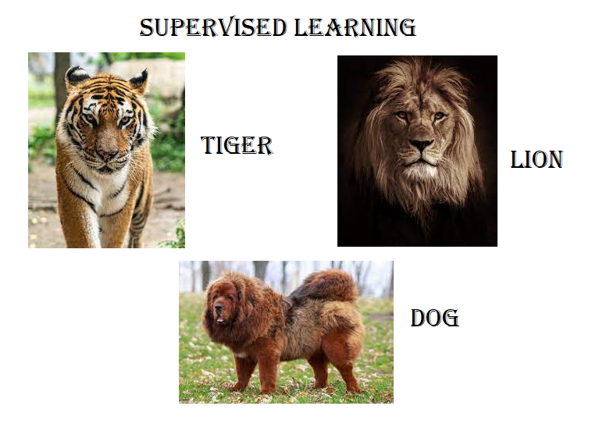
Supervised learning

Slide 7
Unsupervised learning
Uses unlabeled data to learn about patterns in data

Slide 8
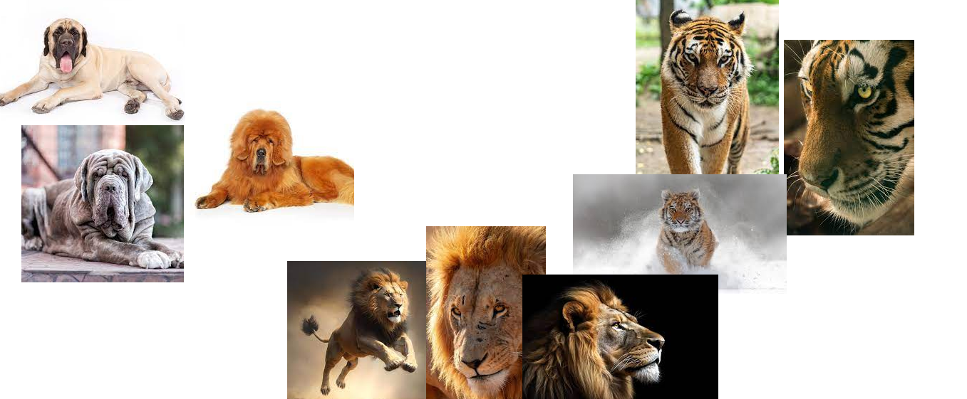
Unsupervised learning

Slide 9
Reinforcement learning
Agent learning in interactive environment based on rewards and penalties
Feedback is taken into consideration

Slide 10
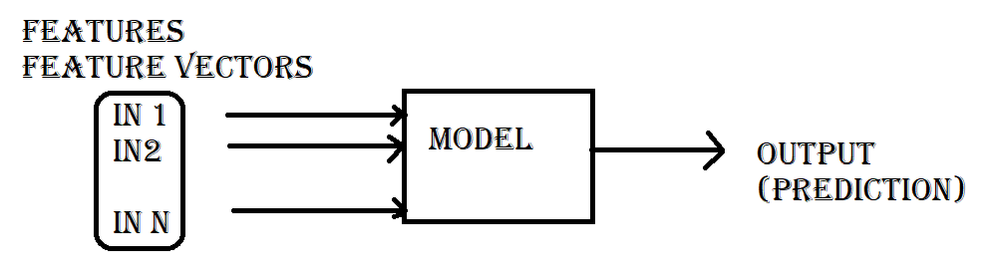
Supervised learning

Slide 11
Features
Qualitative
categorical data
male female
football teams in meeting
esma team1 ko number1 arko ko 2 etc hudaina
these are Nominal data
i.e. no inherent order
quantitative

Slide 12
Features
Nominal data ma handle garna
one-hot encoding use huncha
[MMC, NRT, JYC,APF]
1 if the category is matched
[mmc] [1,0,0,0]
[nrt] [0,1,0,0]
[jyc] [0,0,1,0]
[apf] [0,0,0,1]

Slide 13
Features
Ordinal data
Inherent order huncha
For eg:
Group ma various age group ko manche chan
School padne,college jane, retired etc
School padne ra college jane are comparatively closer

Slide 14
Quantitative data
Numerical valued data
Continuous and discrete huncha

Slide 15
Supervised learning
Esma herda ke ke predict garne vanne huncha
1 classification- predict discrete classes
Multiclass classification
sun,moon,Jupiter
tiger,lion,dog
fishes

Slide 16
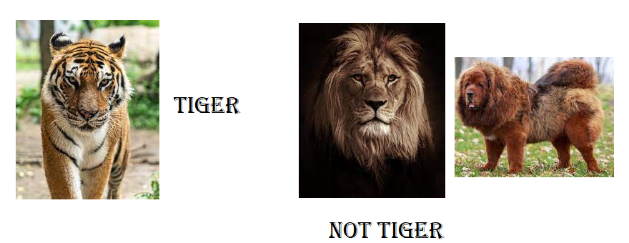
Binary Classification
Positive negative
Spam not spam
Tiger/ lion

Slide 17
Regression
Predict continuous values
Value haru predict garcha
Like:
Price of house
Salary of employee

Slide 18
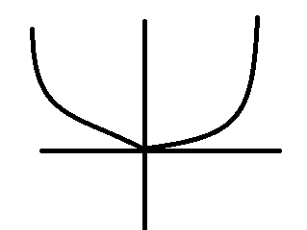
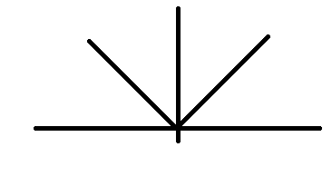
Metrics of performance
Loss function
L1 loss
L2 loss
Real and predicted ko difference herne ani loss check garne
Kati milyo kati milena herne
Accuracy
4 wota ma 3 milyo vane 75% milyo accuracy ¾ 75%

