Slide 1
Back Propagation
By Sam Wang

Slide 2
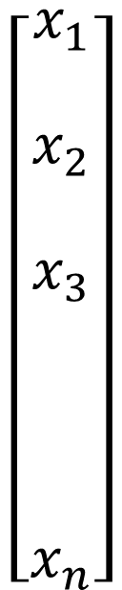

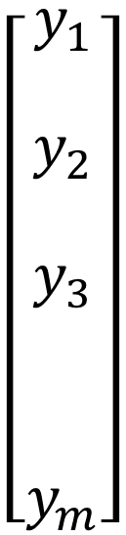
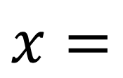
1-Layer
$$W$$
$$\left[\begin{matrix}\begin{aligned}x_{1} \\ \end{aligned} \\ \begin{aligned}x_{2} \\ \end{aligned} \\ \begin{aligned}x_{3} \\ \\ \\ \\ x_{n}\end{aligned}\end{matrix}\right]$$
$$\left[\begin{matrix}\begin{aligned}y_{1} \\ \end{aligned} \\ \begin{aligned}y_{2} \\ \end{aligned} \\ \begin{aligned}y_{3} \\ \\ \\ y_{m}\end{aligned}\end{matrix}\right]$$
$$x=$$
·
·
·
·
·
·

Slide 3




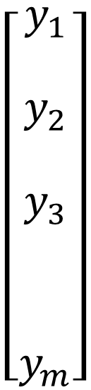

Weight Matrix
$$W_{ij}=from x_{i} to y_{j}$$
$$W_{11}$$
$$\left[\begin{matrix}\begin{aligned}x_{1} \\ \end{aligned} \\ \begin{aligned}x_{2} \\ \end{aligned} \\ \begin{aligned}x_{3} \\ \\ \\ \\ x_{n}\end{aligned}\end{matrix}\right]$$
$$\left[\begin{matrix}\begin{aligned}y_{1} \\ \end{aligned} \\ \begin{aligned}y_{2} \\ \end{aligned} \\ \begin{aligned}y_{3} \\ \\ \\ y_{m}\end{aligned}\end{matrix}\right]$$
$$W_{21}$$
$$W_{31}$$
$$x=$$
·
·
·
·
·
·
$$W_{n1}$$

Slide 4




Weight Matrix
$$W_{ij}=from x_{i} to y_{j}$$
$$\left[\begin{matrix}\begin{aligned}x_{1} \\ \end{aligned} \\ \begin{aligned}x_{2} \\ \end{aligned} \\ \begin{aligned}x_{3} \\ \\ \\ \\ x_{n}\end{aligned}\end{matrix}\right]$$
$$W_{12}$$
$$\left[\begin{matrix}\begin{aligned}y_{1} \\ \end{aligned} \\ \begin{aligned}y_{2} \\ \end{aligned} \\ \begin{aligned}y_{3} \\ \\ \\ y_{m}\end{aligned}\end{matrix}\right]$$
$$W_{22}$$
$$x=$$
$$W_{32}$$
·
·
·
·
·
·
$$W_{n2}$$

Slide 5




Weight Matrix
$$W_{ij}=from x_{i} to y_{j}$$
$$\left[\begin{matrix}\begin{aligned}x_{1} \\ \end{aligned} \\ \begin{aligned}x_{2} \\ \end{aligned} \\ \begin{aligned}x_{3} \\ \\ \\ \\ x_{n}\end{aligned}\end{matrix}\right]$$
$$W_{13}$$
$$\left[\begin{matrix}\begin{aligned}y_{1} \\ \end{aligned} \\ \begin{aligned}y_{2} \\ \end{aligned} \\ \begin{aligned}y_{3} \\ \\ \\ y_{m}\end{aligned}\end{matrix}\right]$$
$$W_{23}$$
$$x=$$
$$W_{33}$$
·
·
·
·
·
·
$$W_{n3}$$

Slide 6




Weight Matrix
$$W_{ij}=from x_{i} to y_{j}$$
$$\left[\begin{matrix}\begin{aligned}x_{1} \\ \end{aligned} \\ \begin{aligned}x_{2} \\ \end{aligned} \\ \begin{aligned}x_{3} \\ \\ \\ \\ x_{n}\end{aligned}\end{matrix}\right]$$
$$W_{1m}$$
$$\left[\begin{matrix}\begin{aligned}y_{1} \\ \end{aligned} \\ \begin{aligned}y_{2} \\ \end{aligned} \\ \begin{aligned}y_{3} \\ \\ \\ y_{m}\end{aligned}\end{matrix}\right]$$
$$W_{2m}$$
$$x=$$
$$W_{3m}$$
·
·
·
·
·
·
$$W_{nm}$$

Slide 7
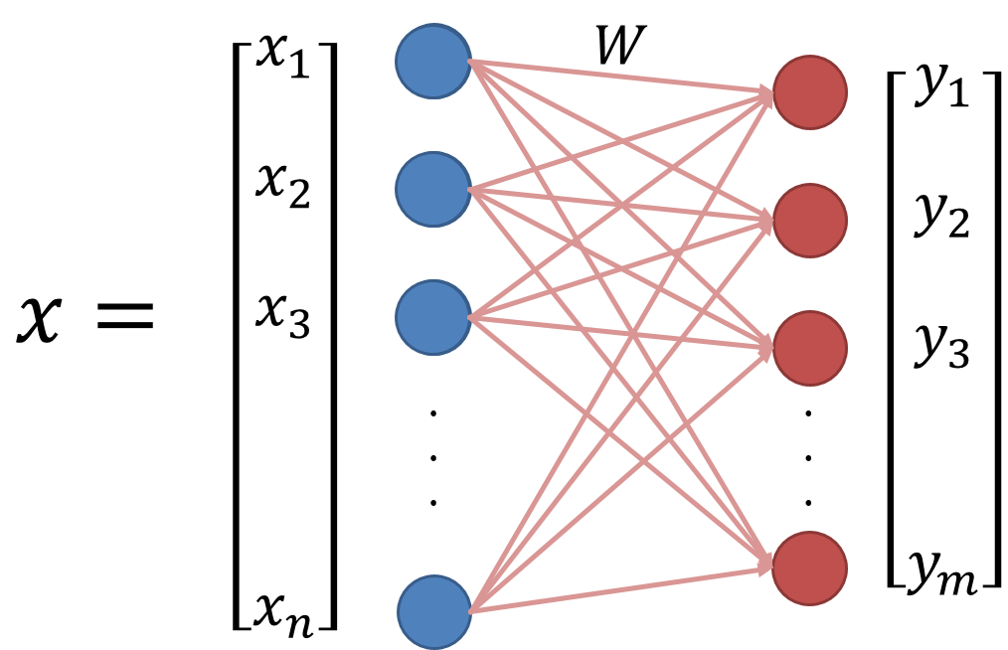
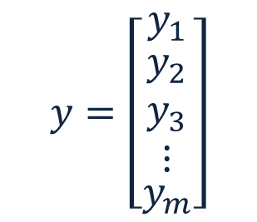
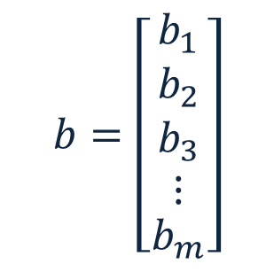
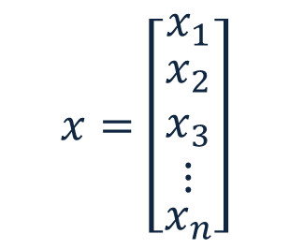

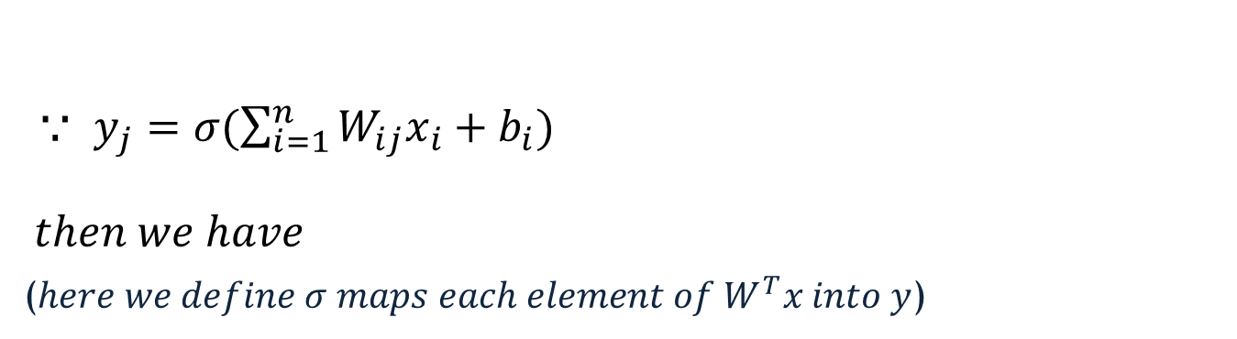
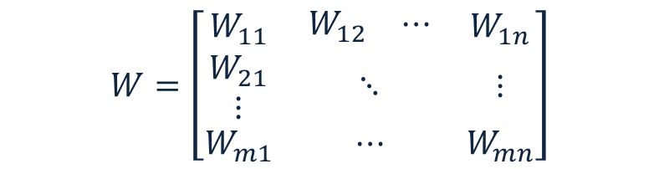
1-Layer (Vectorization)
$$x=\left[\begin{matrix}x_{1} \\ \begin{aligned}x_{2} \\ x_{3} \\ ⋮\end{aligned} \\ x_{n}\end{matrix}\right]$$
$$y=\left[\begin{matrix}y_{1} \\ \begin{aligned}y_{2} \\ y_{3} \\ ⋮\end{aligned} \\ y_{m}\end{matrix}\right]$$
$$b=\left[\begin{matrix}b_{1} \\ \begin{aligned}b_{2} \\ b_{3} \\ ⋮\end{aligned} \\ b_{m}\end{matrix}\right]$$
$$W=\left[\begin{matrix}W_{11} & \begin{matrix}W_{12} & ⋯\end{matrix} & W_{1n} \\ \begin{aligned}W_{21} \\ ⋮\end{aligned} & ⋱ & ⋮ \\ W_{m1} & ⋯ & W_{mn}\end{matrix}\right]$$
$⸪ y_{j}=σ(\sum_{i=1}^{n}{W_{ij}x_{i}+b_{i})}$
$$then we have$$
($here we define σ maps each element of W^{T}x into y$)
$y=σ\left(W^{T}x+b\right)$

Slide 8



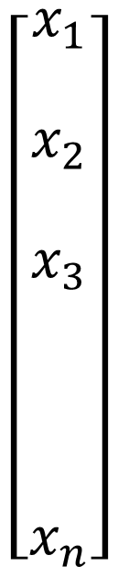












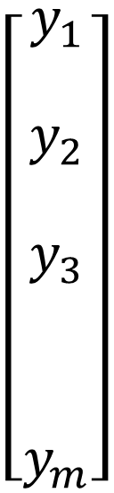



Deep Neuron Networks
$$hidden layer$$
$$input layer$$
$$output layer$$
$$W^{1}$$
$$W^{2}$$
$$\left[\begin{matrix}\begin{aligned}x_{1} \\ \end{aligned} \\ \begin{aligned}x_{2} \\ \end{aligned} \\ \begin{aligned}x_{3} \\ \\ \\ \\ x_{n}\end{aligned}\end{matrix}\right]$$
$${ h}_{1}^{2}$$
$${ h}_{1}^{1}$$
$$y_{1}$$
$$\left[\begin{matrix}\begin{aligned}y_{1} \\ \end{aligned} \\ \begin{aligned}y_{2} \\ \end{aligned} \\ \begin{aligned}y_{3} \\ \\ \\ y_{m}\end{aligned}\end{matrix}\right]$$
$$W^{l}$$
$${ h}_{2}^{2}$$
$${ h}_{2}^{1}$$
$${ y}_{2}$$
· · ·
$${ h}_{3}^{2}$$
$${ h}_{3}^{1}$$
$${ y}_{3}$$
·
·
·
·
·
·
·
·
·
·
·
·
$${ h}_{N_{1}}^{1}$$
· · ·
$$y_{m}$$
$${ h}_{N_{2}}^{2}$$

Slide 9
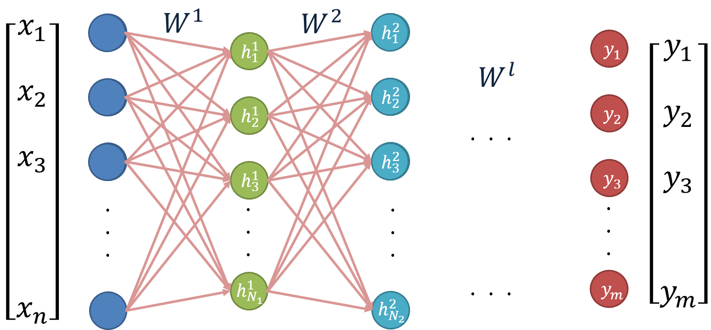
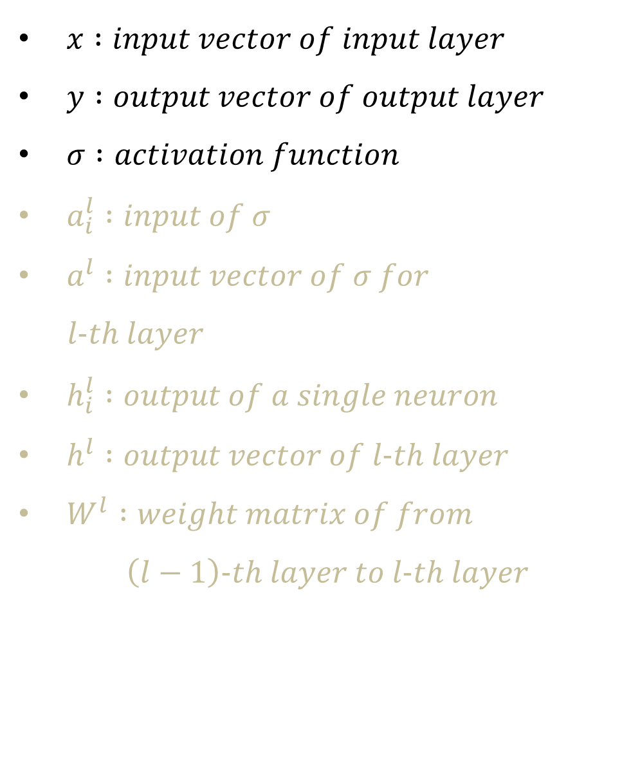
Define our notation
$x :input vector of input layer$
$y :output vector of output layer$
$σ :activation function$
$a_{i}^{l} :input of σ$
$a^{l} :input vector of σ for$
$l−th layer$
$h_{i}^{l} :output of a single neuron$
$h^{l} :output vector of l−th layer$
$W^{l} :weight matrix of from$
$$\left(l−1\right)−th layer to l−th layer$$

Slide 10






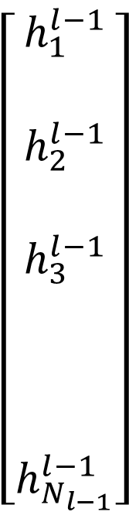







From (l-1)-th layer to l-th layer
$$bias$$
$$(l−1)−th layer$$
$$weight$$
$$b_{j}^{l}$$
$$\left[\begin{matrix}\begin{aligned}h_{1}^{l−1} \\ \end{aligned} \\ \begin{aligned}h_{2}^{l−1} \\ \end{aligned} \\ \begin{aligned}h_{3}^{l−1} \\ \\ \\ \\ h_{N_{l−1}}^{l−1}\end{aligned}\end{matrix}\right]$$
$$×w_{1j}^{l}$$
$$×w_{2j}^{l}$$
$$activation$$
$$function$$
$$×w_{3j}^{l}$$
$$σ( ∙ )$$
$$a_{j}^{l}$$
$$h_{j}^{l}$$
·
·
·
$$l−th layer$$
$$×w_{N_{l−1}j}^{l}$$

Slide 11
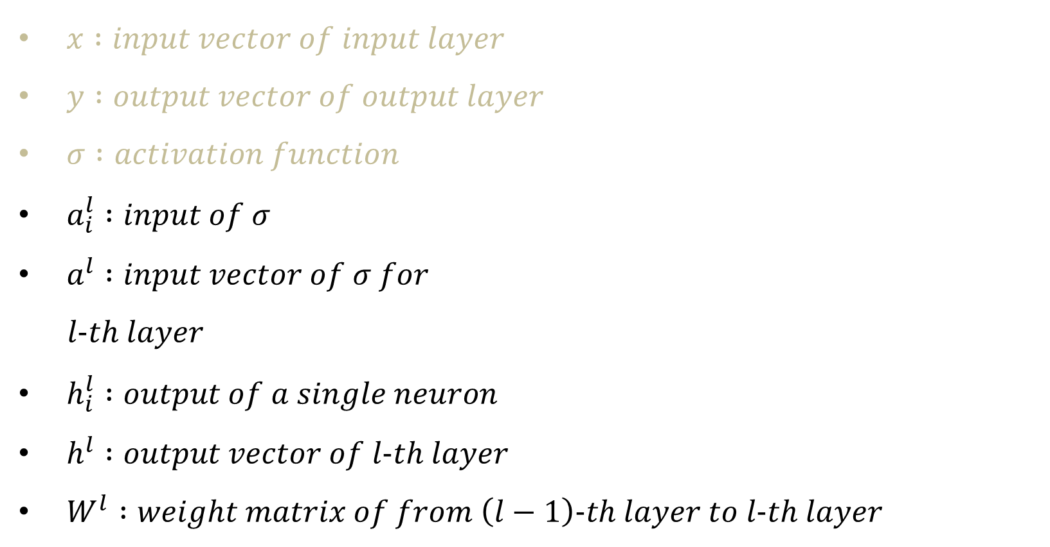
Define our notation
$x :input vector of input layer$
$y :output vector of output layer$
$σ :activation function$
$a_{i}^{l} :input of σ$
$a^{l} :input vector of σ for$
$l−th layer$
$h_{i}^{l} :output of a single neuron$
$h^{l} :output vector of l−th layer$
$W^{l} :weight matrix of from \left(l−1\right)−th layer to l−th layer$

Slide 12
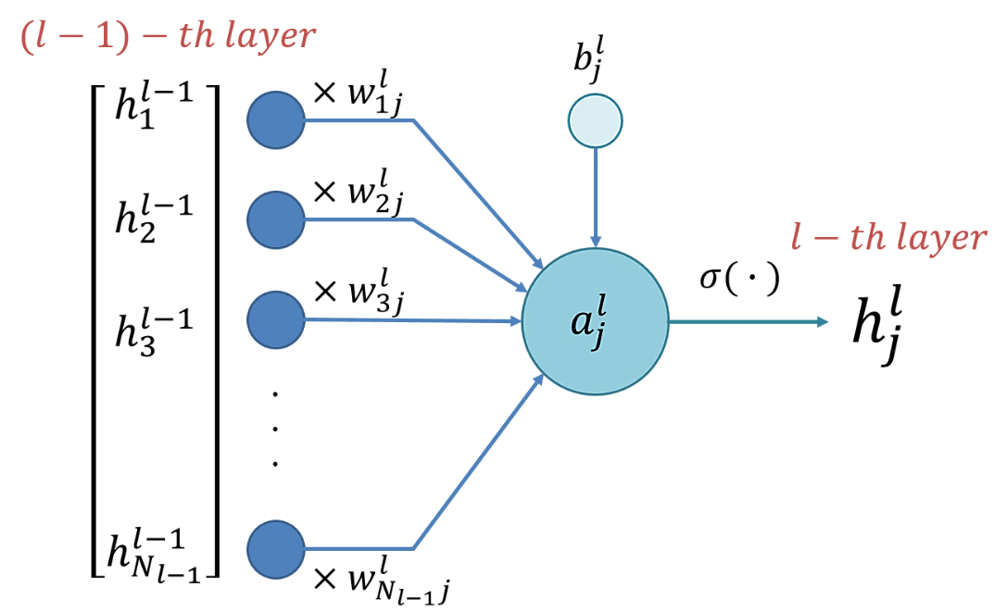

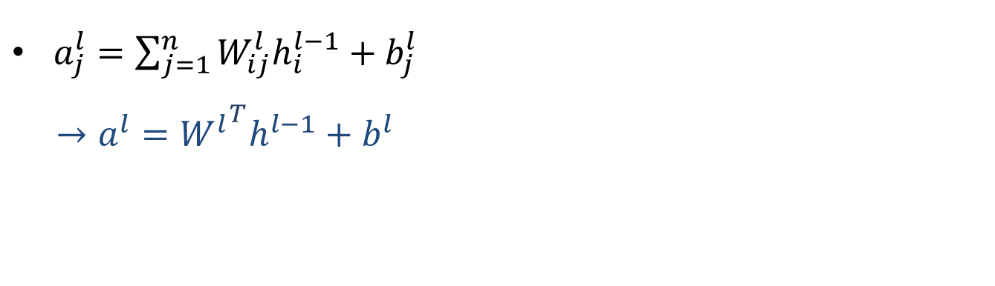
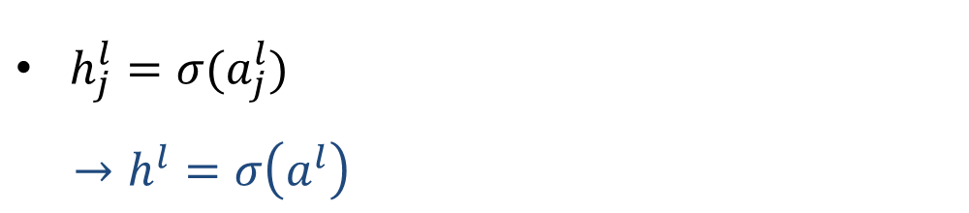

Vectorization
$a_{j}^{l}=\sum_{j=1}^{n}{W_{ij}^{l}h_{i}^{l−1}+b_{j}^{l}}$
$→a^{l}={W^{l}}^{T}h^{l−1}+b^{l}$
$h_{j}^{l}=σ(a_{j}^{l})$
$→h^{l}=σ\left(a^{l}\right)$
$h^{l}=σ\left(a^{l}\right)=σ\left({W^{l}}^{T}h^{l−1}+b^{l}\right)$
$then we have$

Slide 13
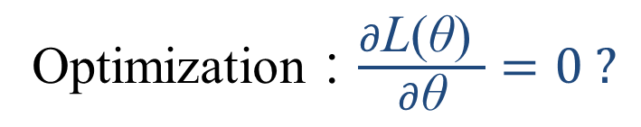
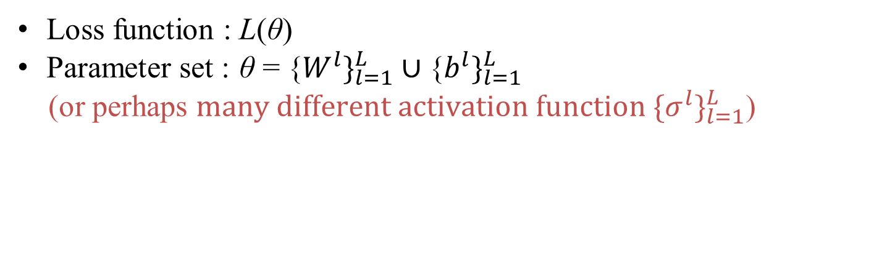

Our task
Loss function : $\text{L}\text{(}\text{θ}\text{)}$
Parameter set : $\text{θ}\text{ = \{}W^{l}\}_{l=1}^{L}∪\text{\{}b^{l}\}_{l=1}^{L}$
(or perhaps $\text{many} \text{different} \text{activation} \text{function}\text{ \{}σ^{l}\}_{l=1}^{L}$)
We need to find a great $\text{θ}$ that minimizes $\text{L}\text{(}\text{θ}\text{)}$
Optimization：$\frac{∂\text{L}\text{(}\text{θ}\text{) }}{∂\text{θ}}=0 ?$

Slide 14
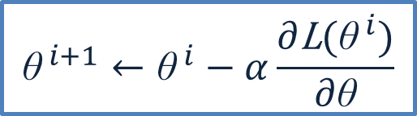
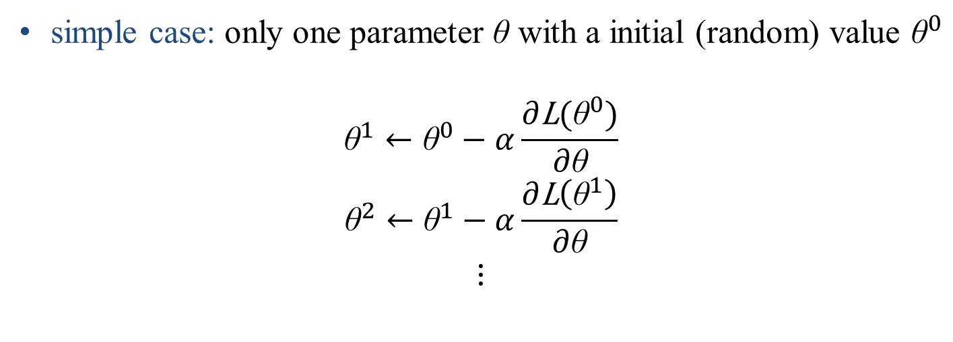
Gradient descent
simple case: only one parameter $\text{θ} \text{with}$ a initial (random) value ${\text{θ}}^{0}$
$${\text{θ}}^{1}←{\text{θ}}^{0}−α\frac{∂\text{L}({\text{θ}}^{0})}{∂\text{θ}}$$
$${\text{θ}}^{2}←{\text{θ}}^{1}−α\frac{∂\text{L}\left({\text{θ}}^{1}\right)}{∂\text{θ}}$$
$$⋮$$
$${\text{θ}}^{ i+1}←{\text{θ}}^{ i}−α\frac{∂\text{L}({\text{θ}}^{ i})}{∂\text{θ}}$$

Slide 15
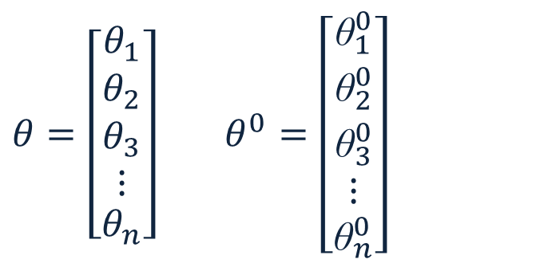
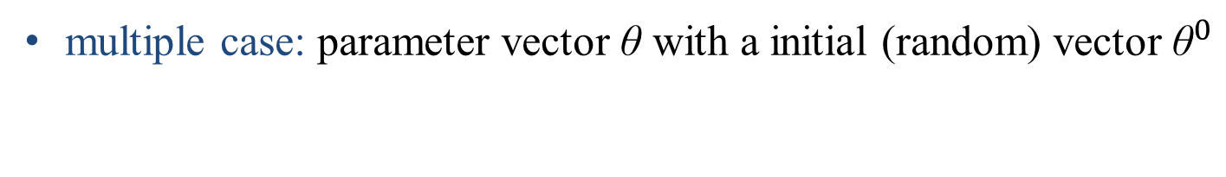
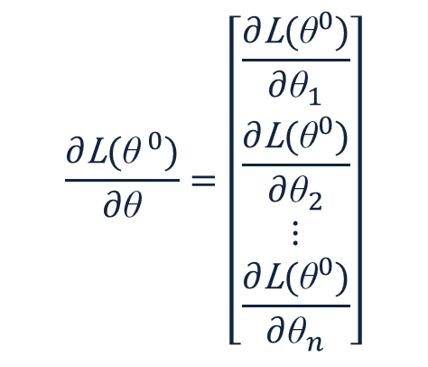

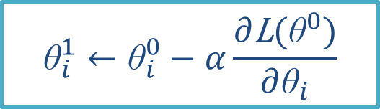
Gradient descent
multiple case: parameter vector $\text{θ} \text{with}$ a initial (random) vector ${\text{θ}}^{0}$
$$θ=\left[\begin{matrix}θ_{1} \\ \begin{aligned}θ_{2} \\ θ_{3} \\ ⋮\end{aligned} \\ θ_{n}\end{matrix}\right] θ^{0}=\left[\begin{matrix}{\text{θ}}_{1}^{0} \\ \begin{aligned}{\text{θ}}_{2}^{0} \\ {\text{θ}}_{3}^{0} \\ ⋮\end{aligned} \\ {\text{θ}}_{n}^{0}\end{matrix}\right]$$
$$\frac{∂\text{L}({\text{θ}}^{ 0})}{∂\text{θ}}=\left[\begin{matrix}\frac{∂\text{L}({\text{θ}}^{0})}{∂{\text{θ}}_{1}} \\ \begin{aligned}\frac{∂\text{L}({\text{θ}}^{0})}{∂{\text{θ}}_{2}} \\ ⋮\end{aligned} \\ \frac{∂\text{L}({\text{θ}}^{0})}{∂{\text{θ}}_{n}}\end{matrix}\right]$$
$${\text{θ}}_{i}^{1}←{\text{θ}}_{i}^{0}−α\frac{∂\text{L}({\text{θ}}^{0})}{∂{\text{θ}}_{i}}$$
$${\text{θ}}^{ i+1}←{\text{θ}}^{ i}−α\frac{∂\text{L}({\text{θ}}^{ i})}{∂\text{θ}}$$

Slide 16


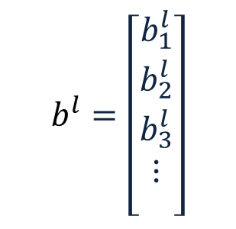
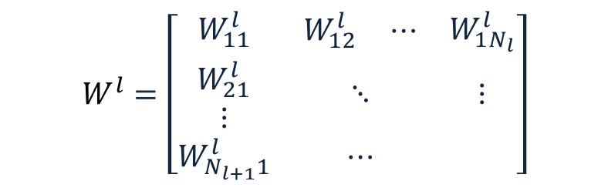
Gradient descent
Neuron networks: $\text{θ}\text{ = }\text{\{}W^{1},W^{2},…,W^{L},b^{1},b^{2},…,b^{L}\text{\}}$
$$b^{l}=\left[\begin{matrix}b_{1}^{l} \\ \begin{aligned}b_{2}^{l} \\ b_{3}^{l} \\ ⋮\end{aligned} \\ \end{matrix}\right]$$
$$W^{l}=\left[\begin{matrix}W_{11}^{l} & \begin{matrix}W_{12}^{l} & ⋯\end{matrix} & W_{1N_{l}}^{l} \\ \begin{aligned}W_{21}^{l} \\ ⋮\end{aligned} & ⋱ & ⋮ \\ W_{N_{l+1}1}^{l} & ⋯ & \end{matrix}\right]$$
${\text{θ}}^{ i+1}←{\text{θ}}^{ i}−α\frac{∂\text{L}({\text{θ}}^{ i})}{∂\text{θ}}$ ，then …

Slide 17
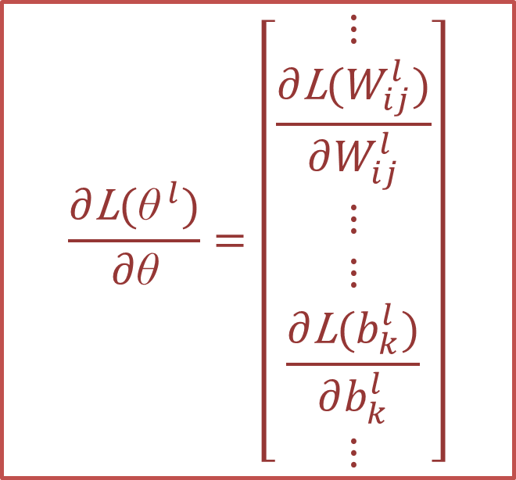

Gradient descent
${\text{θ}}^{ i+1}←{\text{θ}}^{ i}−α\frac{∂\text{L}({\text{θ}}^{ i})}{∂\text{θ}}$ ，then …
It is not easy to calculate, and it might cost so much time.
$$\frac{∂\text{L}({\text{θ}}^{ l})}{∂\text{θ}}=\left[\begin{matrix}⋮ \\ \begin{aligned}\frac{∂\text{L}(W_{ij}^{l})}{∂W_{ij}^{l}} \\ ⋮ \\ ⋮\end{aligned} \\ \begin{aligned}\frac{∂\text{L}(b_{k}^{l})}{∂b_{k}^{l}} \\ ⋮\end{aligned}\end{matrix}\right]$$
Fortunately, there is a great method to calculate all of the values in a efficient way.
Back Propagation

Slide 18
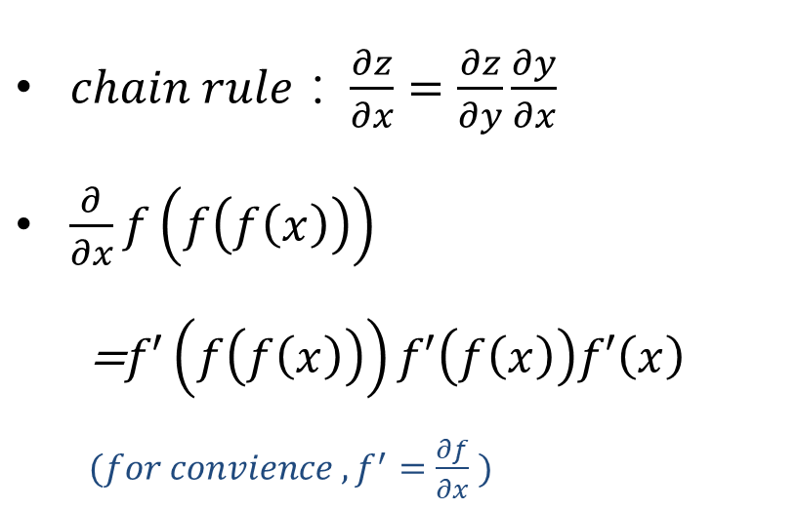


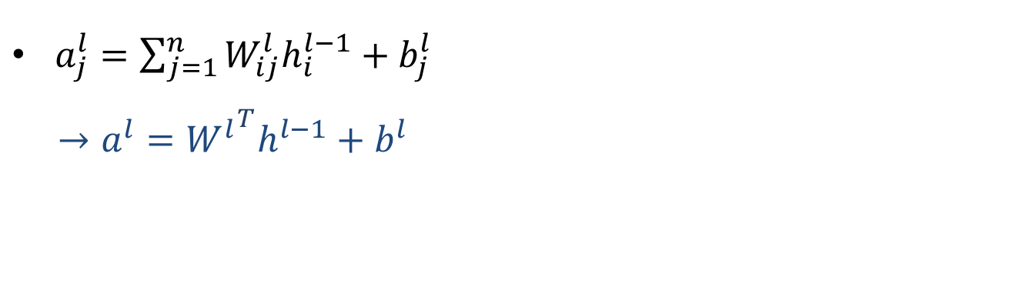
Recall some relations
$chain rule：\frac{∂z}{∂x}=\frac{∂z}{∂y}\frac{∂y}{∂x}$
$\frac{∂}{∂x}f\left(f\left(f\left(x\right)\right)\right)$
=$f′\left(f\left(f\left(x\right)\right)\right)f′\left(f\left(x\right)\right)f′\left(x\right)$
$(for convience ,f^{′}=\frac{∂f}{∂x} )$
$a_{j}^{l}=\sum_{j=1}^{n}{W_{ij}^{l}h_{i}^{l−1}+b_{j}^{l}}$
$→a^{l}={W^{l}}^{T}h^{l−1}+b^{l}$
$h_{j}^{l}=σ(a_{j}^{l})$
$→h^{l}=σ\left(a^{l}\right)$
Compute $\frac{∂\text{L}(θ)}{∂W_{ij}^{l}}，\frac{∂\text{L}(θ)}{∂b_{i}^{l}}$

Slide 19
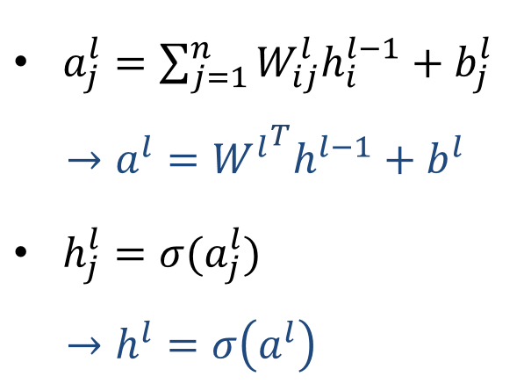
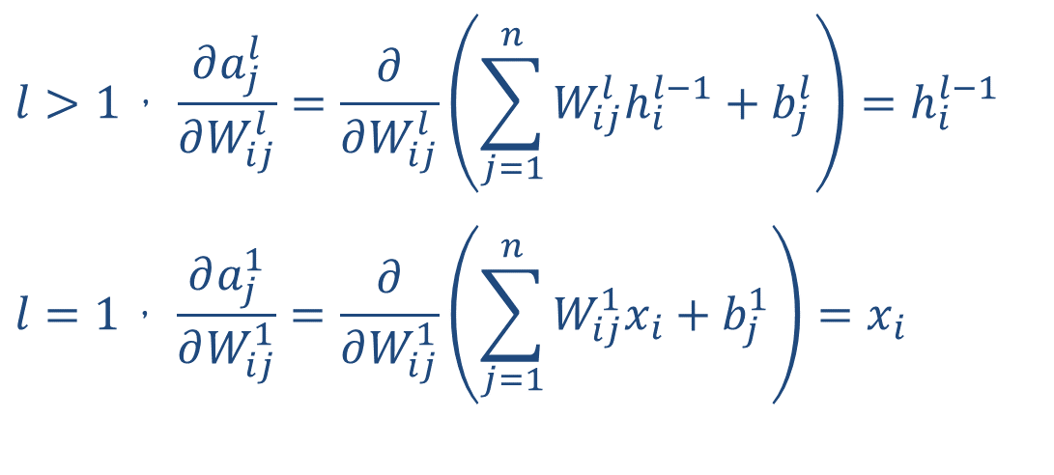
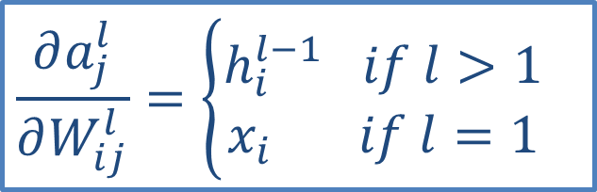
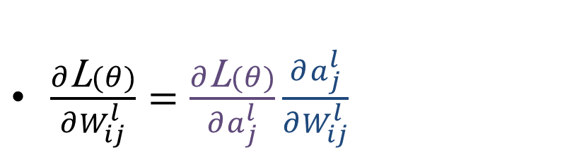
$$∂\text{L}\left(θ\right)/∂W_{ij}^{l}$$
$\frac{∂\text{L}(θ)}{∂W_{ij}^{l}}=\frac{∂\text{L}(θ)}{∂a_{j}^{l}}\frac{∂a_{j}^{l}}{∂W_{ij}^{l}}$
$$l>1，\frac{∂a_{j}^{l}}{∂W_{ij}^{l}}=\frac{∂}{∂W_{ij}^{l}}\left(\sum_{j=1}^{n}{W_{ij}^{l}h_{i}^{l−1}+b_{j}^{l}}\right)=h_{i}^{l−1}$$
$$l=1，\frac{∂a_{j}^{1}}{∂W_{ij}^{1}}=\frac{∂}{∂W_{ij}^{1}}\left(\sum_{j=1}^{n}{W_{ij}^{1}x_{i}+b_{j}^{1}}\right)=x_{i}$$
$$\frac{∂a_{j}^{l}}{∂W_{ij}^{l}}=\left\{\begin{aligned}h_{i}^{l−1} if l>1 \\ x_{i} if l=1\end{aligned}\right.$$

Slide 20
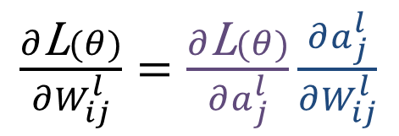


How about $∂\text{L}\left(θ\right)/∂a_{j}^{l}$ ?
$$α_{j}^{l}=\frac{∂\text{L}(θ)}{∂a_{j}^{l}}$$
Define
There is a way to
compute $α_{j}^{l}$ by $α_{j}^{l+1}$

Slide 21
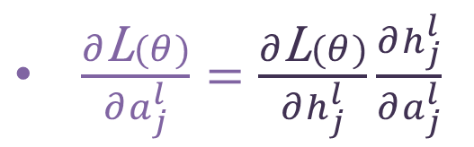

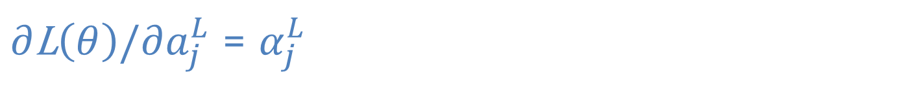

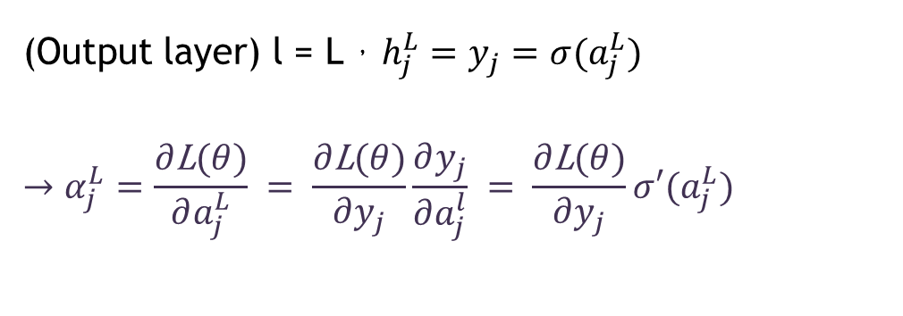
$∂\text{L}\left(θ\right)/∂a_{j}^{L}$ = $α_{j}^{L}$
$\frac{∂\text{L}(θ)}{∂a_{j}^{l}}=\frac{∂\text{L}(θ)}{∂h_{j}^{l}}\frac{∂h_{j}^{l}}{∂a_{j}^{l}}$
(Output layer) l = L，$h_{j}^{L}=y_{j}=σ(a_{j}^{L})$
$$→α_{j}^{L}=\frac{∂\text{L}(θ)}{∂a_{j}^{L}} = \frac{∂\text{L}(θ)}{∂y_{j}}\frac{∂y_{j}}{∂a_{j}^{l}} = \frac{∂\text{L}(θ)}{∂y_{j}}σ′(a_{j}^{L})$$
$$then{ α}^{L}=\frac{∂\text{L}(θ)}{∂a^{L}}=\frac{∂\text{L}(θ)}{∂y} ⨀σ′(a^{L})$$
$⨀$ : element-wise multiplication

Slide 22
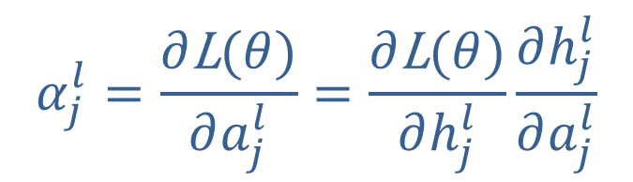

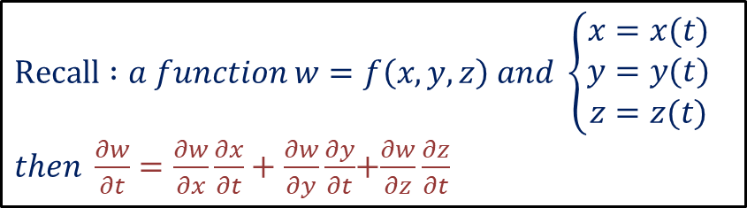
$$compute α_{j}^{l} by{ α}_{j}^{l+1}$$
What is the relation between $\frac{∂\text{L}(θ)}{∂a_{j}^{l}}、\frac{∂\text{L}(θ)}{∂a_{k}^{l+1}}？$
$$Recall :a function w=f\left(x,y,z\right) and \left\{\begin{aligned}x=x(t) \\ y=y(t) \\ z=z(t)\end{aligned}\right.$$
$then \frac{∂w}{∂t}=\frac{∂w}{∂x}\frac{∂x}{∂t}+\frac{∂w}{∂y}\frac{∂y}{∂t}$+$\frac{∂w}{∂z}\frac{∂z}{∂t}$

Slide 23
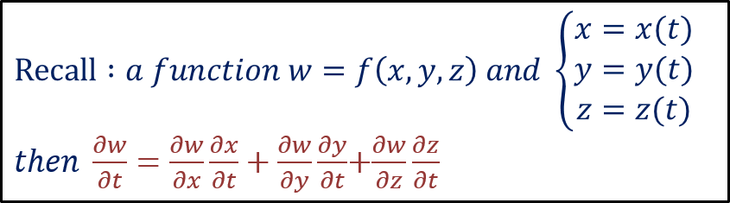
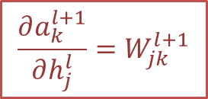
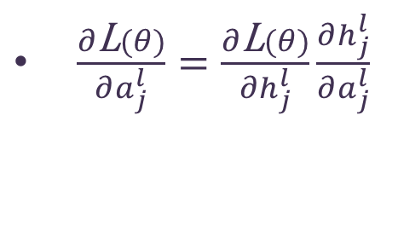
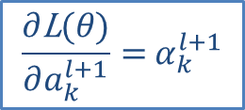
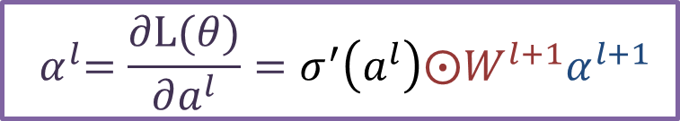



$$compute α_{j}^{l} by{ α}_{j}^{l+1}$$
$\frac{∂\text{L}(θ)}{∂a_{j}^{l}}=\frac{∂\text{L}(θ)}{∂h_{j}^{l}}\frac{∂h_{j}^{l}}{∂a_{j}^{l}}$
$$=\frac{∂h_{j}^{l}}{∂a_{j}^{l}} \sum_{k=1}^{N_{l+1}}{\frac{∂\text{L}(θ)}{∂a_{k}^{l+1}}\frac{∂a_{k}^{l+1}}{∂h_{j}^{l}}}$$
$$\frac{∂h_{j}^{l}}{∂a_{j}^{l}}=σ^{′}\left(a_{j}^{l}\right)$$
$$=σ^{′}\left(a_{j}^{l}\right)\sum_{k=1}^{N_{l+1}}{{ α}_{k}^{l+1}W_{jk}^{l+1}}$$
$$\frac{∂\text{L}(θ)}{∂a_{k}^{l+1}}={ α}_{k}^{l+1}$$
$${ α}^{l}=\frac{∂L(θ)}{∂a^{l}}=σ^{′}\left(a^{l}\right)⨀W^{l+1}α^{l+1}$$
$$\frac{∂a_{k}^{l+1}}{∂h_{j}^{l}}=W_{jk}^{l+1}$$

Slide 24



Summary $∂\text{L}\left(θ\right)/∂W_{ij}^{l}$
$$\frac{∂\text{L}(θ)}{∂W_{ij}^{l}}=\frac{∂\text{L}(θ)}{∂a_{j}^{l}} \frac{∂a_{j}^{l}}{∂W_{ij}^{l}}$$
Algorithm :
$${ α}^{L}=\frac{∂\text{L}(θ)}{∂y} ⨀σ′(a^{L})$$
$${ →α}^{L−1}=σ^{′}\left(a^{L−1}\right)⨀{{(W}_{}^{L})}^{T}α^{L}$$
$$⋮$$
$${ →α}^{l}=σ^{′}\left(a^{l}\right)⨀{{(W}_{}^{l+1})}^{T}α^{l+1}$$
$$⋮$$
$$\frac{∂a_{j}^{l}}{∂W_{ij}^{l}}=\left\{\begin{aligned}h_{i}^{l−1} if l>1 \\ x_{i} if l=1\end{aligned}\right.$$
it is pre-computed

Slide 25









Back propagation
We calculate all of the values in a efficient way！
$${ α}^{1}$$
$$←$$
$${ α}^{2}$$
$$⋯$$
$$←$$
$${ α}^{L−1}$$
$$←$$
$${ α}^{L}$$

Slide 26

Summary BP
$$\frac{∂\text{L}(θ)}{∂W_{ij}^{l}}=\frac{∂\text{L}(θ)}{∂a_{j}^{l}} \frac{∂a_{j}^{l}}{∂W_{ij}^{l}}$$
Backward propagation
forward propagation
$$\frac{∂a_{j}^{l}}{∂W_{ij}^{l}}=\left\{\begin{aligned}h_{i}^{l−1} if l>1 \\ x_{i} if l=1\end{aligned}\right.$$

