Slide 1
The Difficulty of Training Neural Networks
By Sam Wang

Slide 2
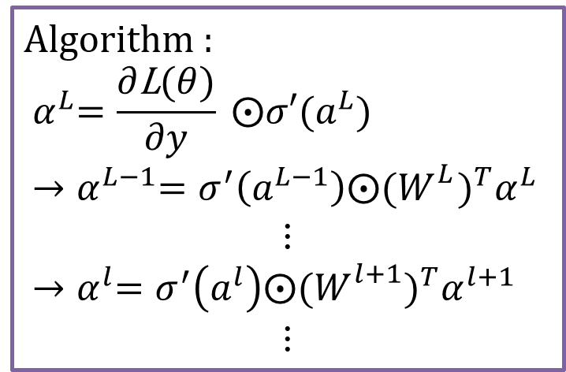
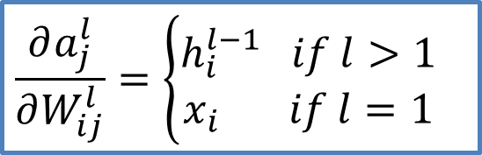
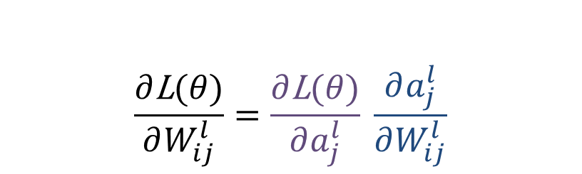
Recall Back Propagation
$$\frac{∂\text{L}(θ)}{∂W_{ij}^{l}}=\frac{∂\text{L}(θ)}{∂a_{j}^{l}} \frac{∂a_{j}^{l}}{∂W_{ij}^{l}}$$
Backward propagation
forward propagation
$$\frac{∂a_{j}^{l}}{∂W_{ij}^{l}}=\left\{\begin{aligned}h_{i}^{l−1} if l>1 \\ x_{i} if l=1\end{aligned}\right.$$

Slide 3
Necessary Conditions for NNs
神經網絡的訓練需要大量的數據
當數據量很小時，難以體現其強大的擬合能力
神經網絡需要深
好比Fouerier Transform理論中，任意可積函數都可以用三角級數來逼近，但是面對震盪大、形狀醜的函數時，我們需要大量的三角函數來進行擬合

Slide 4
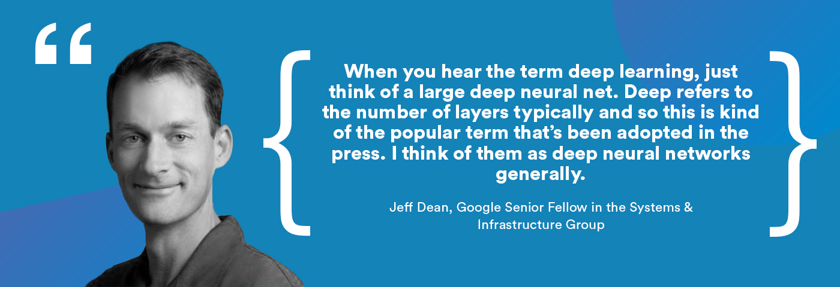
DEEP!DEEP!DEEP!
Can we construct a neural network as deep as we want?

Slide 5

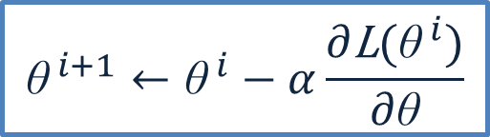

The Problems We Are Faced with
Training Problem
Gradient vanishing
Gradient exploding
$${\text{θ}}^{ i+1}←{\text{θ}}^{ i}−α\frac{∂\text{L}({\text{θ}}^{ i})}{∂\text{θ}}$$
※Gradient descent

Slide 6
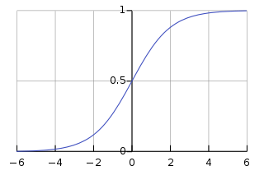

Gradient Vanishing - Activation Function
$$Sigmoid function is defined by σ\left(x\right)=\frac{1}{1+e^{−x}}$$
$$→σ′\left(x\right)=σ\left(x\right)(1−σ\left(x\right))$$
$$As \left|x\right| increases, { σ}^{′}\left(x\right) tends to zero$$
$$saturation region$$
$$→Leads to Gradient vanshing$$

Slide 7
Some solutions
Weight Clipping & Gradient Penalty
Optimization Algorithm
Initial Scheme
Batch Normalization
Residual Connection (e.g. ResNet, DenseNet )

Slide 8
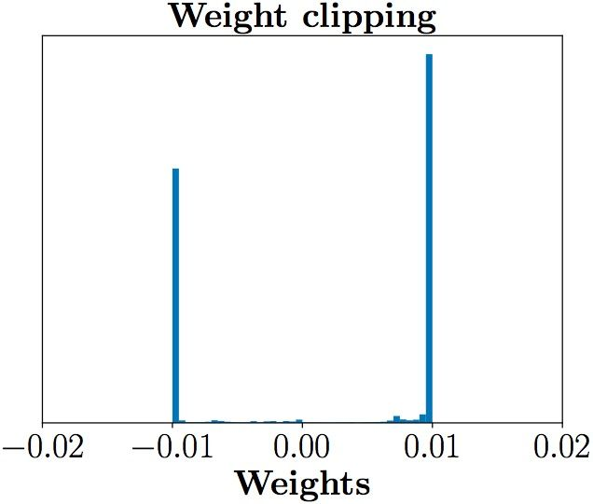
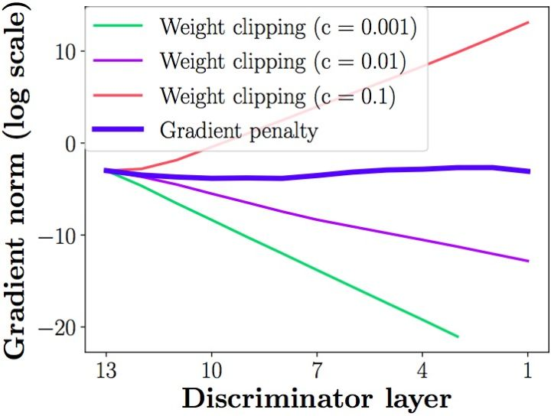
Weight clipping & Gradient penalty
Weight Clipping: 直接限制weight的大小
Gradient penalty: 用loss的方式限制gradient的大小

Slide 9
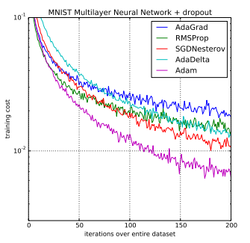
Optimization

Slide 10
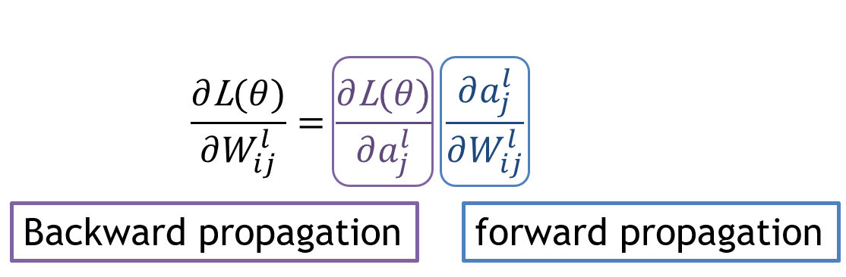
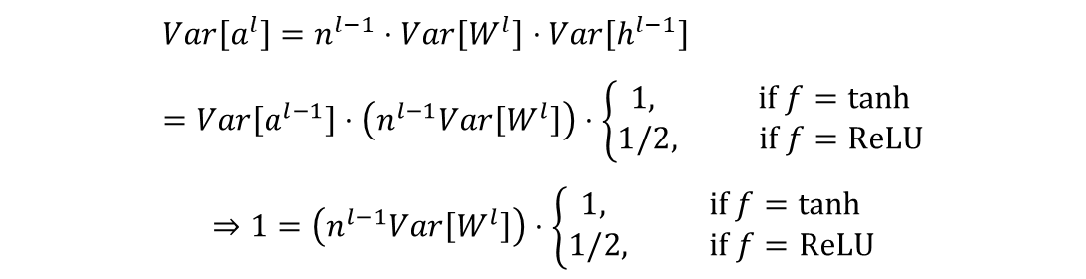
Initial Scheme
Main idea: stability of propagation
Xavier normal
He normal
(Delta) orthogonal weight → 10000-layer CNN!
$$Var\left[a^{l}\right]=n^{l−1}⋅Var\left[W^{l}\right]⋅Var\left[h^{l−1}\right] \\ =Var\left[a^{l−1}\right]⋅\left(n^{l−1}Var\left[W^{l}\right]\right)⋅\left\{\begin{aligned}1, if f=tanh \\ 1/2, if f=ReLU\end{aligned}\right.$$
$$⇒1=\left(n^{l−1}Var\left[W^{l}\right]\right)⋅\left\{\begin{aligned}1, if f=tanh \\ 1/2, if f=ReLU\end{aligned}\right.$$

Slide 11
Batch Normalization
Internal covariate shift
Normalization for hidden layers

Slide 12
To be continued…

