Slide 1
Yolov5-EasyOCR
Number Plate Recognition system

Slide 2
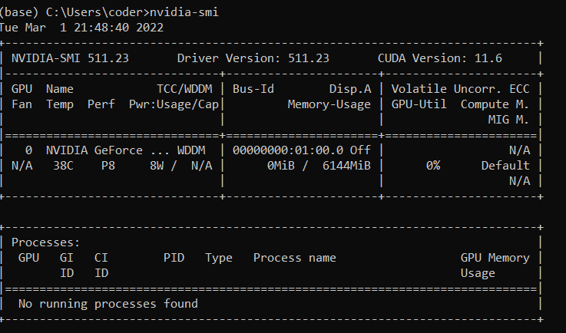
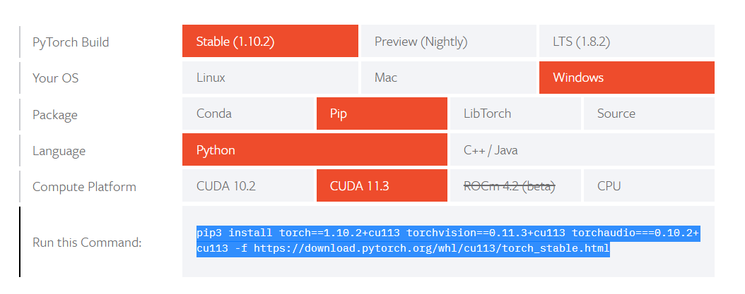
Install pytorch: (YOUR SYSTEM MUST HAVE CUDA AND NVIDIA DRIVER)
Open command prompt(anaconda) : cd C:\Users\coder\Downloads\youtube_zero\yolov5_deploy
Create a new conda env for pytorch: conda create -n pytorch-gpu python==3.8
Activate the env: conda activate pytorch-gpu
Check cuda installed on your system: nvidia-smi
Install pytorch : https://pytorch.org/get-started/locally/
To install all requirements: pip3 install -r requirements.txt

Slide 3
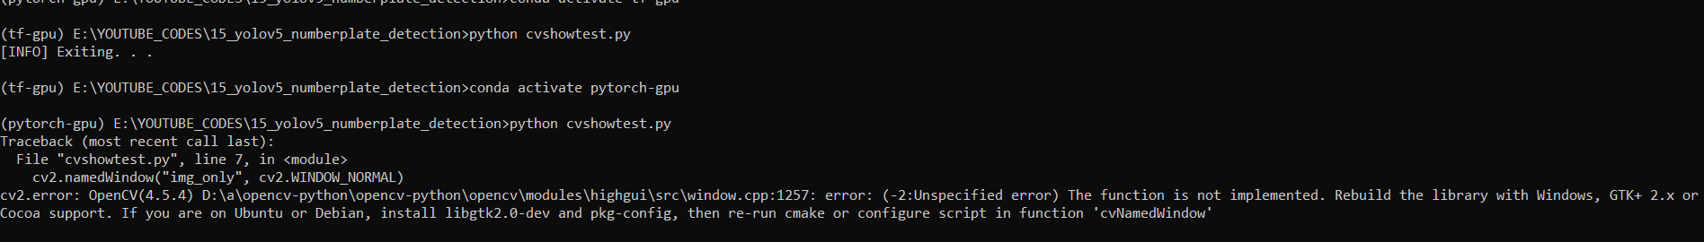
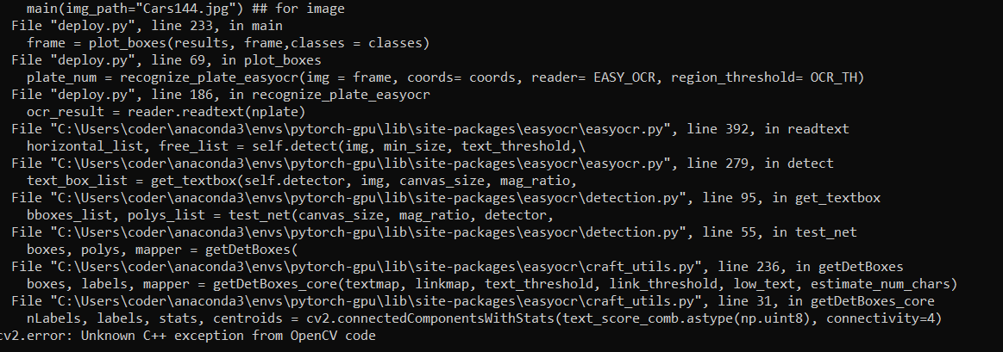
install easyOCR -> pip install easyocr
There may be some issue with cv2.imshow and c++ distribution fter installing easyOCR.
SOLUTIONS:
pip uninstall opencv-python-headless –y
pip install opencv-python==4.3.0.38

Slide 4
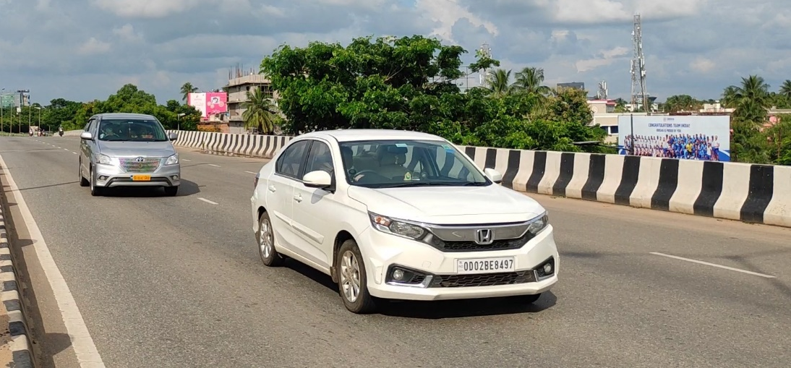


Idea:
YOLOV5
How to train custom yolov5: https://youtu.be/12UoOlsRwh8
DATASET: 1) https://www.kaggle.com/datasets/deepakat002/indian-vehicle-number-plate-yolo-annotation
2) https://www.kaggle.com/datasets/elysian01/car-number-plate-detection
easyOCR

Slide 5
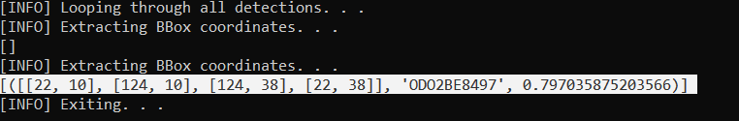
BBox coordinates of localized Text
Text result
Probability

