Slide 1

INF 551
PROJECT PROPOSAL
YOUHYON KIM
PHUONG NGO

Slide 2
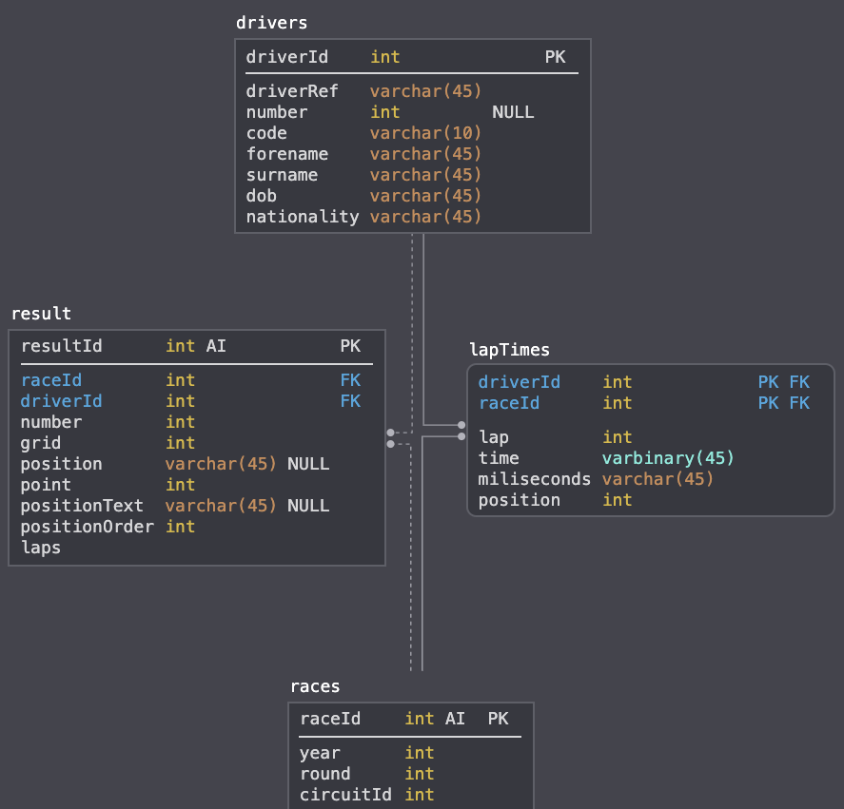
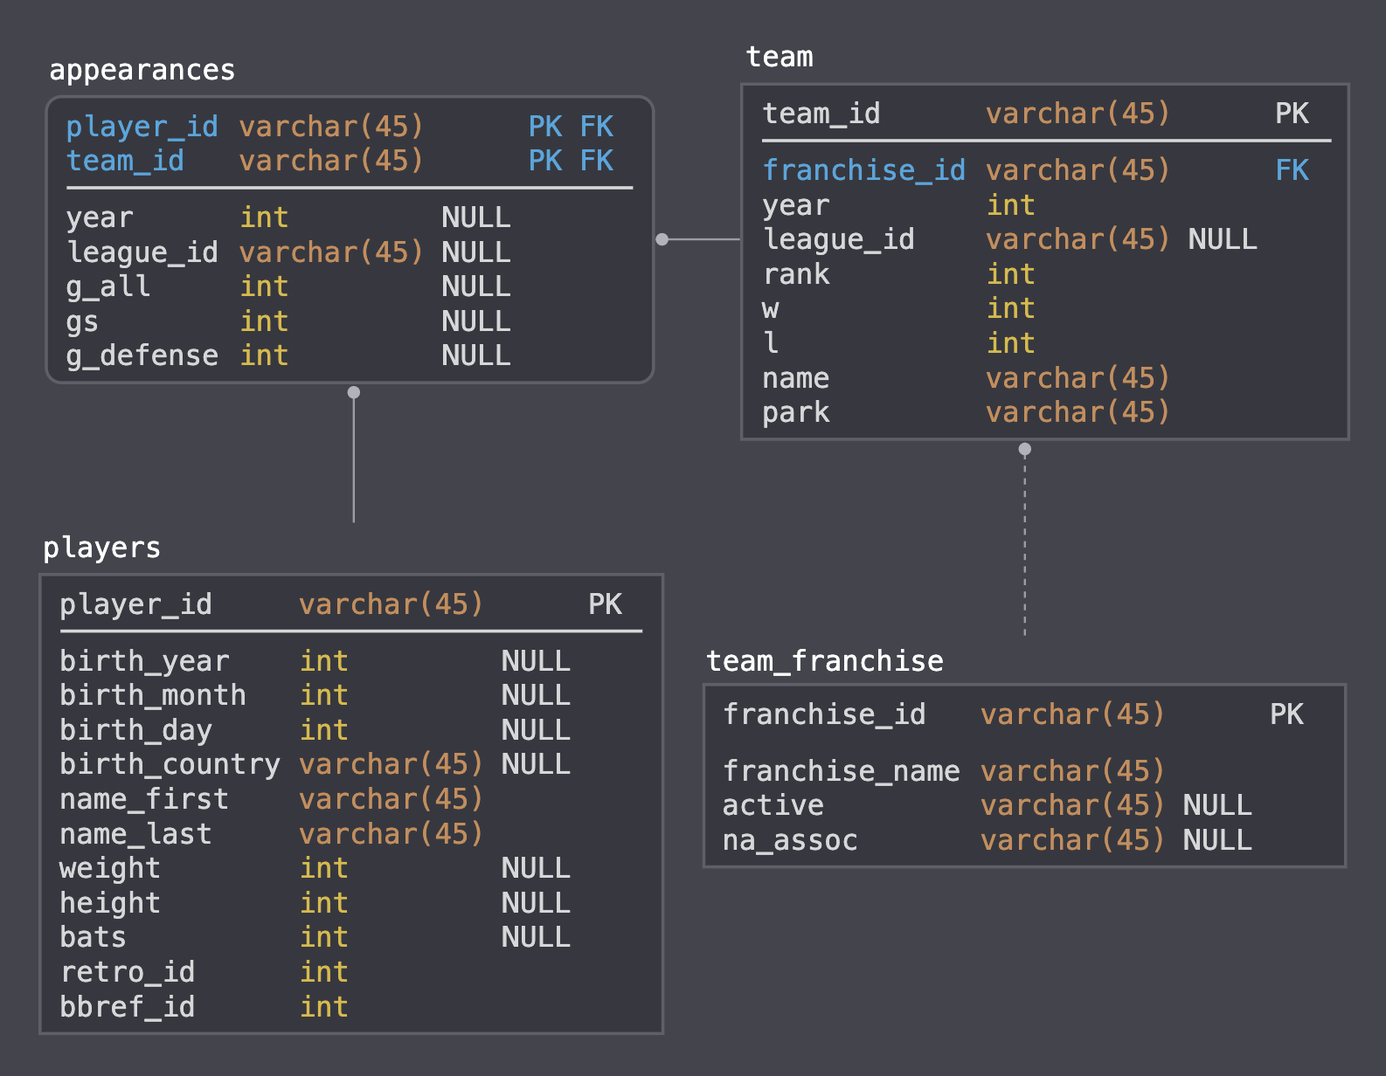
DATABASE
Database 1: Formula 1
Database 2: Baseball History

Slide 3



UI
FINDATA
Use keywords to look up instances from the selected database
Formula 1
Select a database
Search…
Italian
Baseball History
Showing instances including “Italian” Found 9304 results across 2 tables
Search Time: 0.3 seconds
Drivers
Results from table
Formula 1
See all…
driverId | driverRef | number | code | forename | surname | dob | Nationality | url
15 | trulli | null | TRU | Jarno | Trulli | 13/07/1974 | Italian | http://en.wik...
21 | Fishicella | null | FIS | Giancarlo | Fisichella | 14/01/1973 | Italian | http://en.wik...
24 | Liuzzi | null | LIU | Vitantonio | Liuzzi | 6/8/80 | Italian | http://en.wik...
45 | Pantano | null | null | Giorgio | Pantano | 4/2/79 | Italian | http://en.wik...
World
Results from table
Races
See all…
raceId | year | round | circuitId | name | date | time | url
13 | 2009 | 13 |  | Italian Grand Prix | 9/13/09 | 12:00:00 | http://en.wik...
48 | 2007 | 13 | 14 | Italian Grand Prix | 9/9/07 | 12:00:00 | http://en.wik...
67 | 2006 | 15 | 14 | Italian Grand Prix | 9/10/06 | 14:00:00 | http://en.wik...
85 | 2005 | 15 | 14 | Italian Grand Prix | 9/4/05 | 14:00:00 | http://en.wik...
14
Notes:
Displays data

Slide 4
UI
FINDATA
Use keywords to look up instances from the selected database
Formula 1
Italian
Showing instances including “circuitId : 14” Found 4 results across 2 tables
Search Time: 0.2 seconds
Results from table
Races
raceId | year | round | circuitId | name | date | time | url
13 | 2009 | 13 | 14 | Italian Grand Prix | 9/13/09 | 12:00:00 | http://en.wik...
48 | 2007 | 13 | 14 | Italian Grand Prix | 9/9/07 | 12:00:00 | http://en.wik...
67 | 2006 | 15 | 14 | Italian Grand Prix | 9/10/06 | 14:00:00 | http://en.wik...
Results from table
Circuits
curcuitId | curcuitRef | name | location | country | lat | lng | alt | url
14 | monza | Autodromo Nazi… | Monza | Italy | 45.6156 | 9.28111 | null | http://en.wik...

