Slide 1


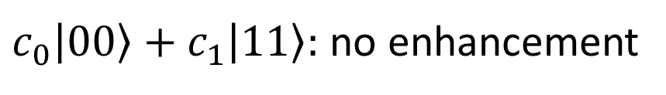
$$ω_{0}$$
$c_{0}\left|00\right\rangle +c_{1}\left|11\right\rangle :$ no enhancement
$$ω_{0}$$

Slide 2

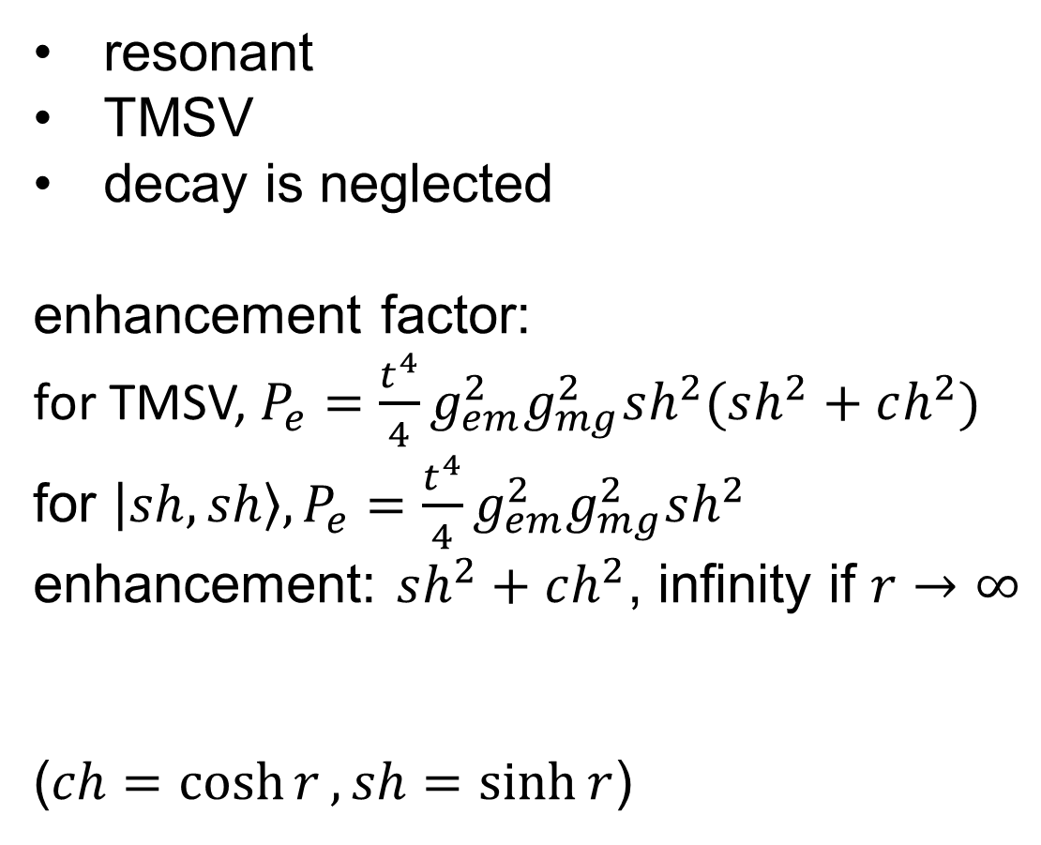
resonant
TMSV
decay is neglected
enhancement factor:
for TMSV, $P_{e}=\frac{t^{4}}{4}g_{em}^{2}g_{mg}^{2}sh^{2}(sh^{2}+ch^{2})$
for $\left|sh,sh\right\rangle , P_{e}=\frac{t^{4}}{4}g_{em}^{2}g_{mg}^{2}sh^{2}$
enhancement: $sh^{2}+ch^{2}$, infinity if $r→∞$
($ch=\cosh{r}, sh=\sinh{r}$)
$$ω_{0}$$
$$ω_{0}$$

Slide 3

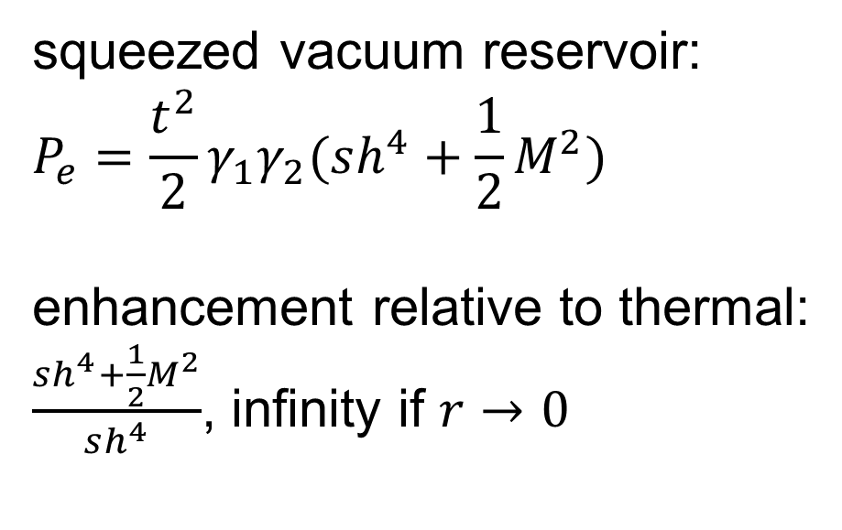
squeezed vacuum reservoir:
$$P_{e}=\frac{t^{2}}{2}γ_{1}γ_{2}(sh^{4}+\frac{1}{2}M^{2})$$
enhancement relative to thermal:
$\frac{sh^{4}+\frac{1}{2}M^{2}}{sh^{4}}$, infinity if $r→0$
$$ω_{0}$$
$$ω_{0}$$

Slide 4
$$ω_{0}$$
TMSV:
$$ω_{0}$$
motivation?

