Slide 1
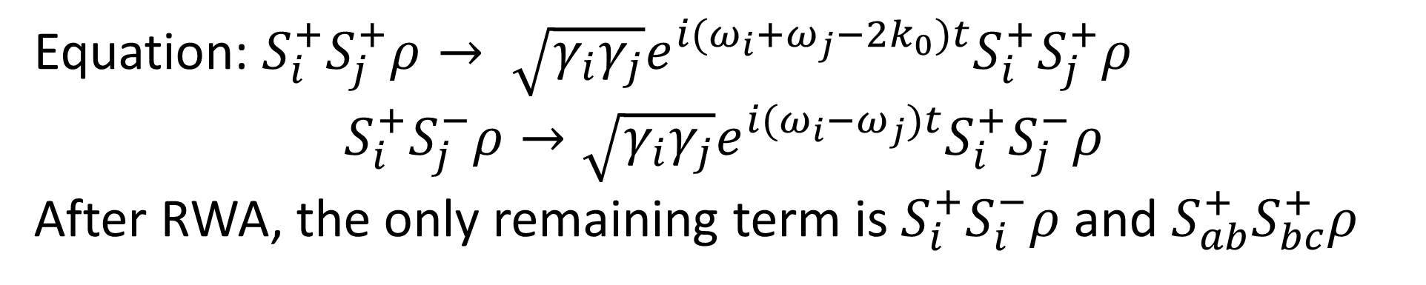

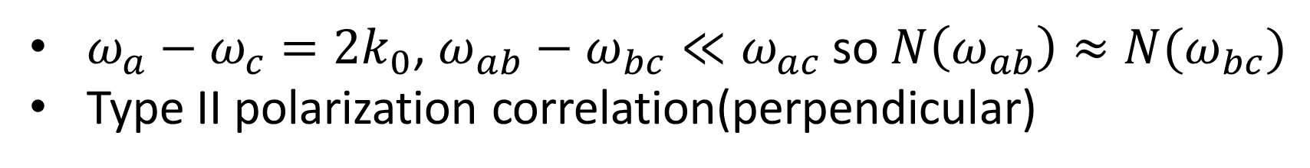




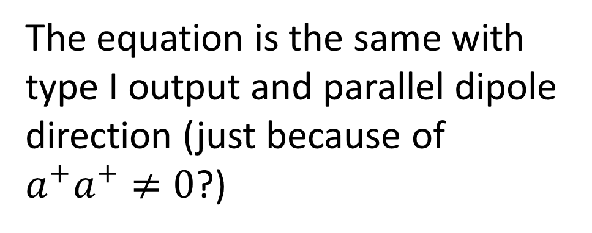
$$ω_{a}$$
$$σ^{+}$$
The equation is the same with type I output and parallel dipole direction (just because of $a^{+}a^{+}≠0$?)
$$ω_{b}$$
$$σ^{−}$$
$$ω_{c}$$
$ω_{a}−ω_{c}=2k_{0}$, $ω_{ab}−ω_{bc}≪ω_{ac}$ so $N\left(ω_{ab}\right)≈N(ω_{bc})$
Type II polarization correlation(perpendicular)
Equation: $S_{i}^{+}S_{j}^{+}ρ→ \sqrt{γ_{i}γ_{j}}e^{i(ω_{i}+ω_{j}−2k_{0})t}S_{i}^{+}S_{j}^{+}ρ$
$$S_{i}^{+}S_{j}^{−}ρ→\sqrt{γ_{i}γ_{j}}e^{i(ω_{i}−ω_{j})t}S_{i}^{+}S_{j}^{−}ρ$$
After RWA, the only remaining term is $S_{i}^{+}S_{i}^{−}ρ$ and $S_{ab}^{+}S_{bc}^{+}ρ$

Slide 2
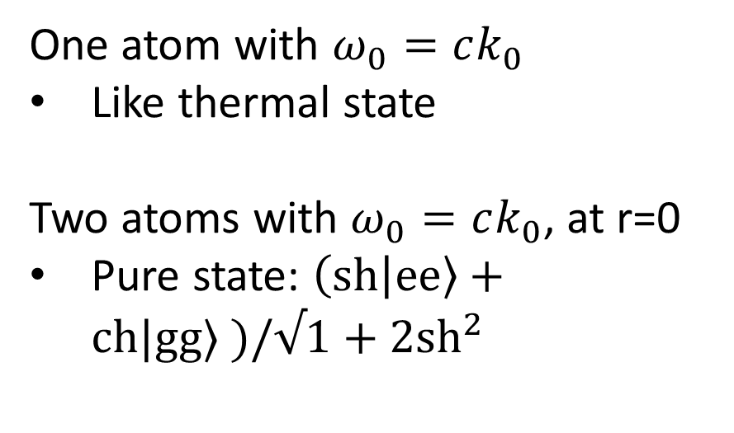
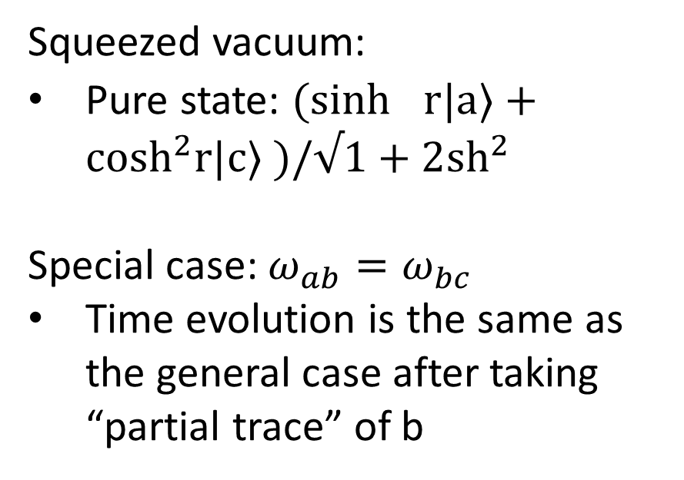
Final state
Thermal:
Boltzmann distribution
Mixed state
Squeezed vacuum:
Pure state: $(\sinh^{}r|a⟩+\cosh^{2}r|c⟩ )/√1+2{sh}^{2}$
Special case: $ω_{ab}=ω_{bc}$
Time evolution is the same as the general case after taking “partial trace” of b
One atom with $ω_{0}=ck_{0}$
Like thermal state
Two atoms with $ω_{0}=ck_{0}$, at r=0
Pure state: $\left(sh | ee\right\rangle +ch|gg⟩ )/√1+2{sh}^{2}$

Slide 3
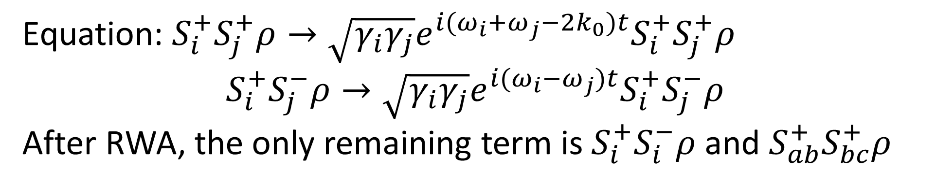
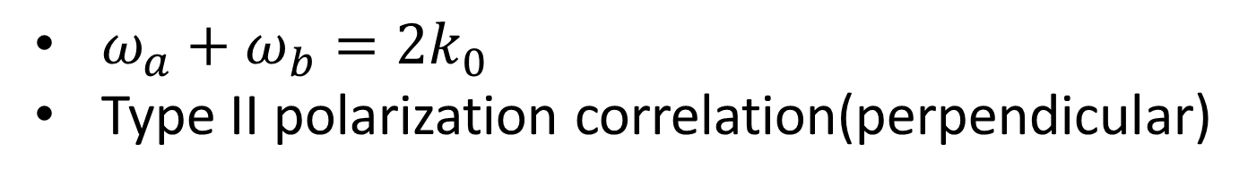


$$ω_{a}$$
$$σ^{+}$$
The equation is the same with type I output and parallel dipole direction (just because of $a^{+}a^{+}≠0$?)
$$ω_{b}$$
$$σ^{−}$$
$$ω_{c}$$
$ω_{a}+ω_{b}=2k_{0}$
Type II polarization correlation(perpendicular)
Equation: $S_{i}^{+}S_{j}^{+}ρ→\sqrt{γ_{i}γ_{j}}e^{i(ω_{i}+ω_{j}−2k_{0})t}S_{i}^{+}S_{j}^{+}ρ$
$$S_{i}^{+}S_{j}^{−}ρ→\sqrt{γ_{i}γ_{j}}e^{i(ω_{i}−ω_{j})t}S_{i}^{+}S_{j}^{−}ρ$$
After RWA, the only remaining term is $S_{i}^{+}S_{i}^{−}ρ$ and $S_{ab}^{+}S_{bc}^{+}ρ$

Slide 4
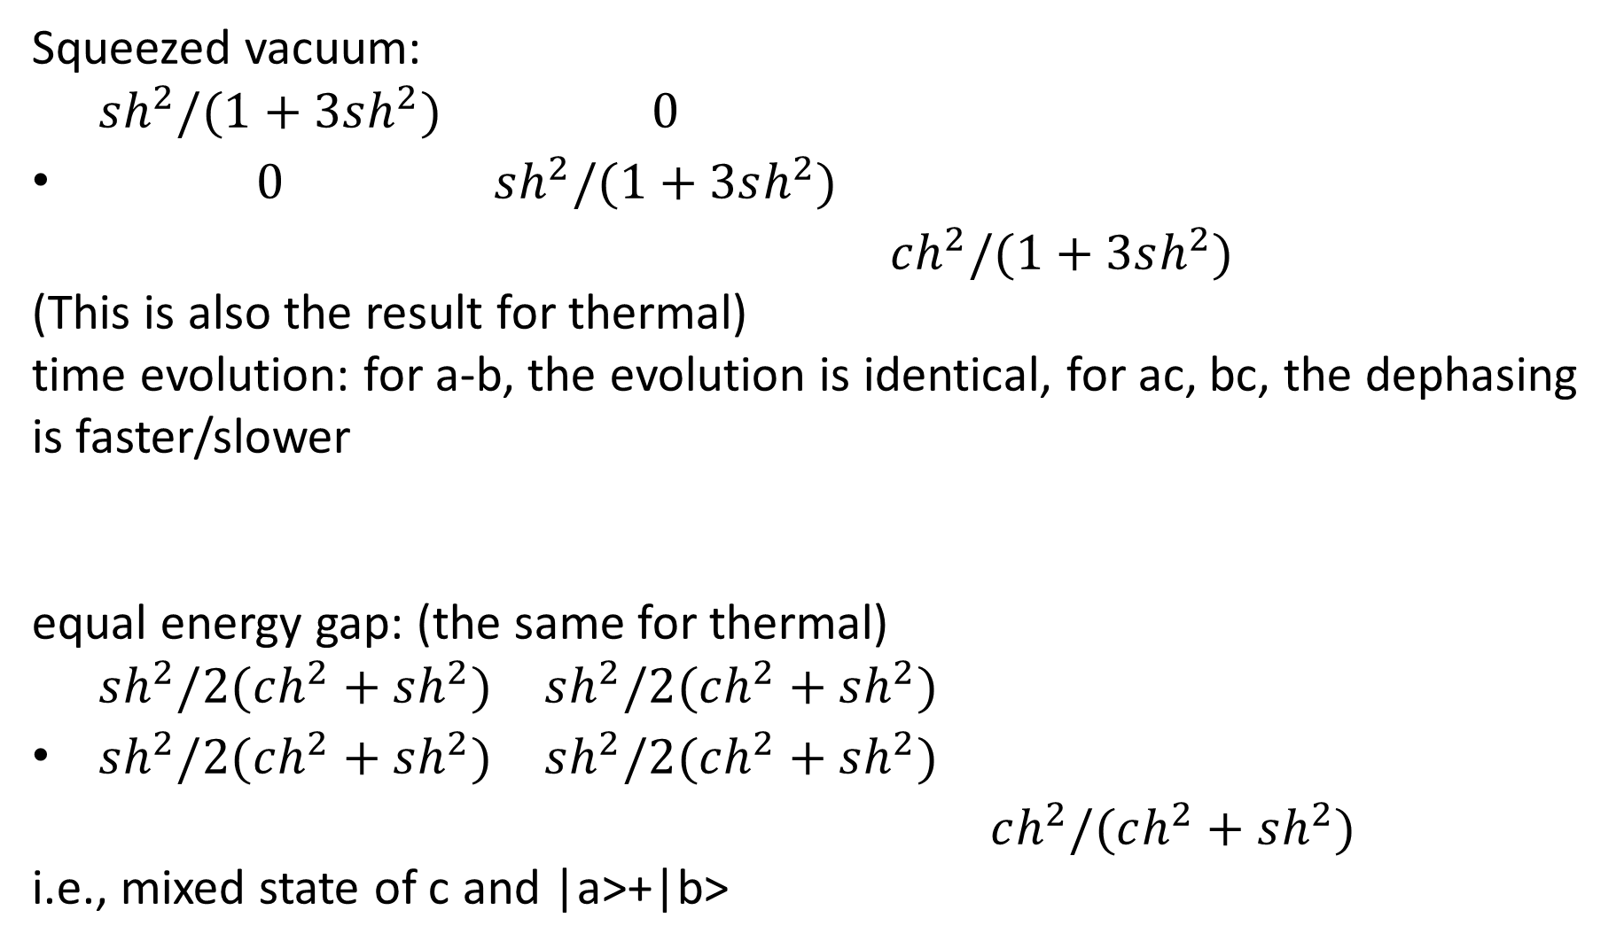
Final state
Squeezed vacuum:
$\begin{matrix}sh^{2}/(1+3sh^{2}) & 0 & \\ 0 & sh^{2}/(1+3sh^{2}) & \\ & & ch^{2}/(1+3sh^{2})\end{matrix}$
(This is also the result for thermal)
time evolution: for a-b, the evolution is identical, for ac, bc, the dephasing is faster/slower
equal energy gap: (the same for thermal)
$\begin{matrix}sh^{2}/2(ch^{2}+sh^{2}) & sh^{2}/2(ch^{2}+sh^{2}) & \\ sh^{2}/2(ch^{2}+sh^{2}) & sh^{2}/2(ch^{2}+sh^{2}) & \\ & & ch^{2}/(ch^{2}+sh^{2})\end{matrix}$
i.e., mixed state of c and |a>+|b>

Slide 5
Cos(2ri) | Cos(ri+rj)
1 | Cos(ri-rj)
1, $γ_{ii}^{′}=0→r_{i}=\frac{π}{4}+\frac{nπ}{2}→γ_{ij}^{′}=0 or±1→γ_{ij}=0$

Slide 6


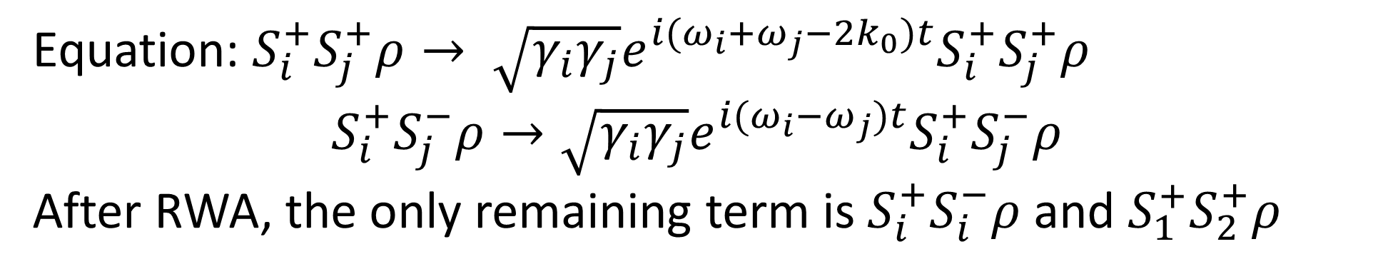
$$ω_{2}$$
$$ω_{1}$$
$ω_{a}−ω_{c}=2k_{0}$, $ω_{ab}−ω_{bc}≪ω_{ac}$ so $N\left(ω_{ab}\right)≈N(ω_{bc})$
Equation: $S_{i}^{+}S_{j}^{+}ρ→ \sqrt{γ_{i}γ_{j}}e^{i(ω_{i}+ω_{j}−2k_{0})t}S_{i}^{+}S_{j}^{+}ρ$
$$S_{i}^{+}S_{j}^{−}ρ→\sqrt{γ_{i}γ_{j}}e^{i(ω_{i}−ω_{j})t}S_{i}^{+}S_{j}^{−}ρ$$
After RWA, the only remaining term is $S_{i}^{+}S_{i}^{−}ρ$ and $S_{1}^{+}S_{2}^{+}ρ$

Slide 7
Nonlinear effect (quadrupole)

