Slide 1
A “different” squeezed vacuum

Slide 2
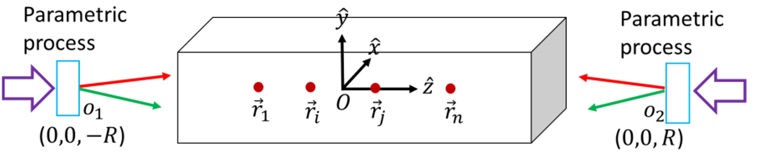
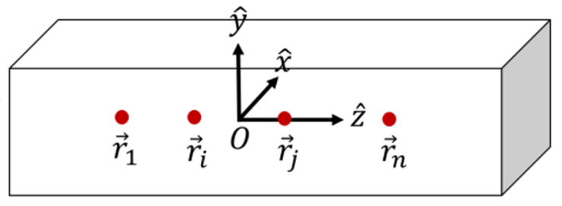

Slide 3
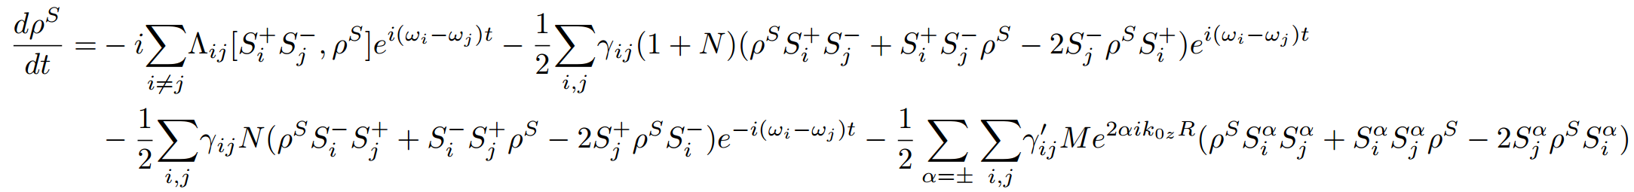
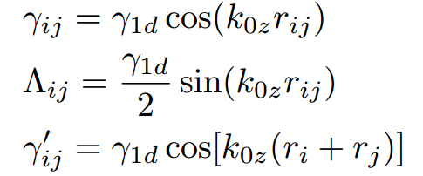




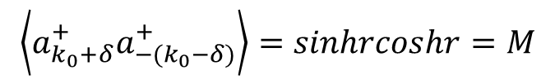
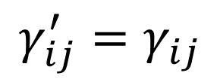
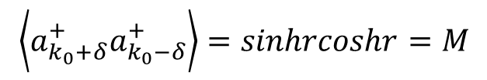
$${\vec{k}}_{0}+δ\vec{k}$$
$${\vec{k}}_{0}+δ\vec{k}$$
$$−{\vec{k}}_{0}+δ\vec{k}$$
$${\vec{k}}_{0}−δ\vec{k}$$
$$\left\langle a_{k_{0}+δ}^{+}a_{k_{0}−δ}^{+}\right\rangle =sinhrcoshr=M$$
$$\left\langle a_{k_{0}+δ}^{+}a_{{−(k}_{0}−δ)}^{+}\right\rangle =sinhrcoshr=M$$
$$γ_{ij}^{′}=γ_{ij}$$

Slide 4
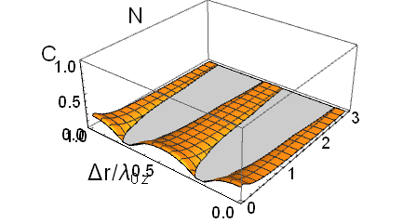
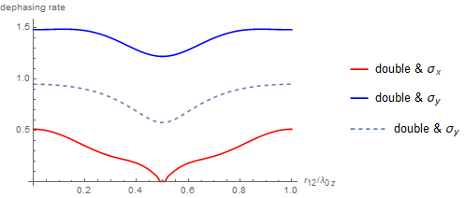
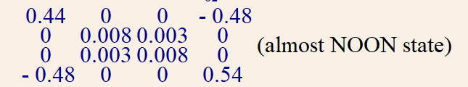
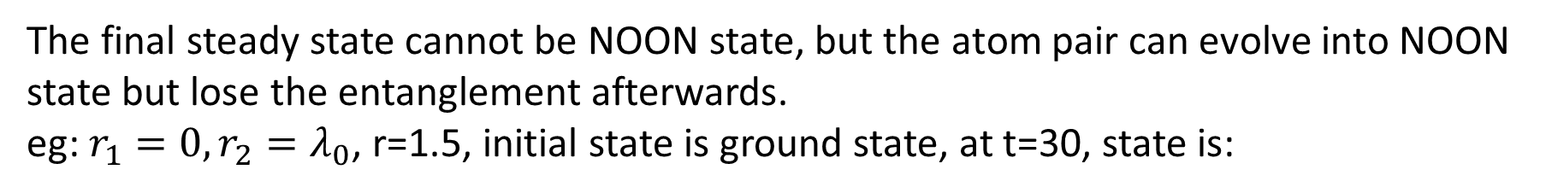
The final steady state cannot be NOON state, but the atom pair can evolve into NOON state but lose the entanglement afterwards.
eg: $r_{1}=0,r_{2}=λ_{0}$, r=1.5, initial state is ground state, at t=30, state is:

Slide 5
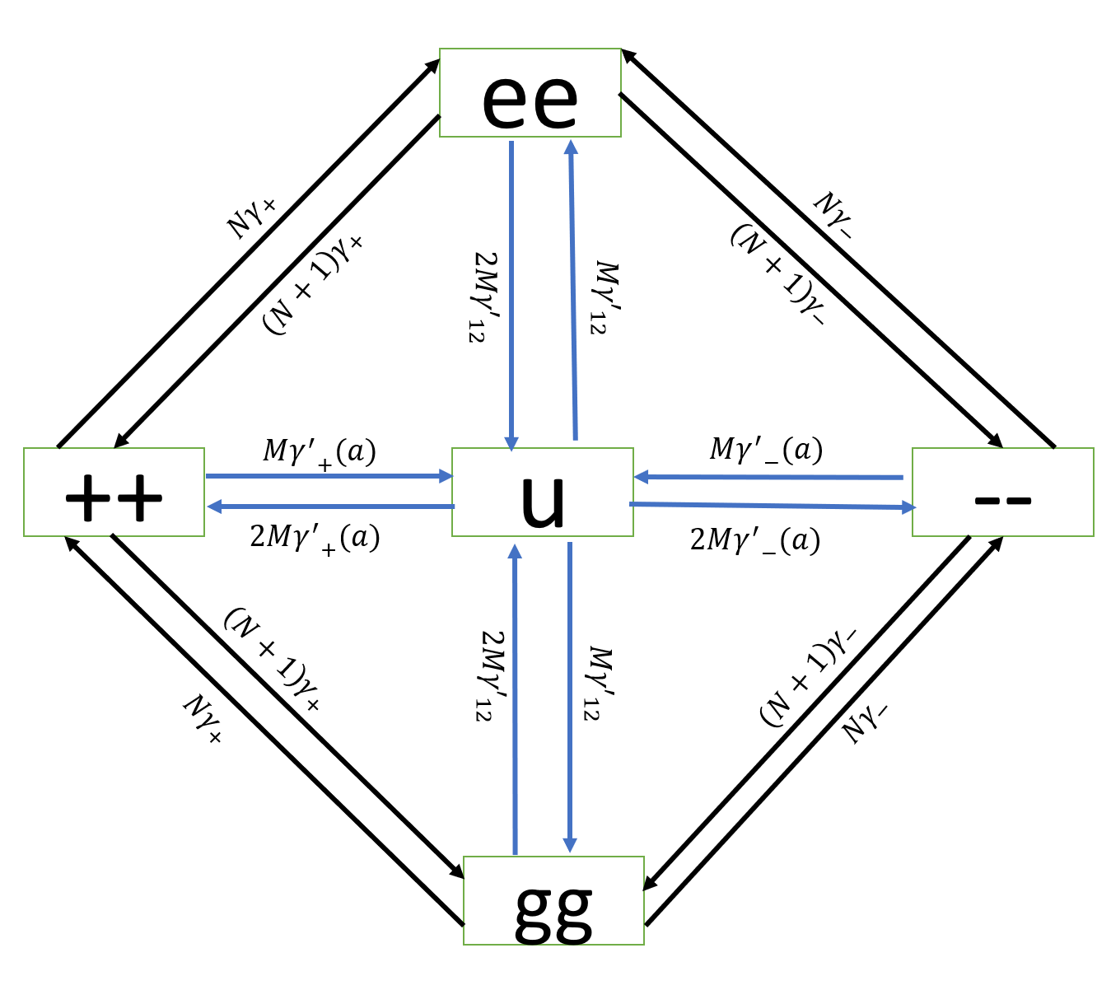
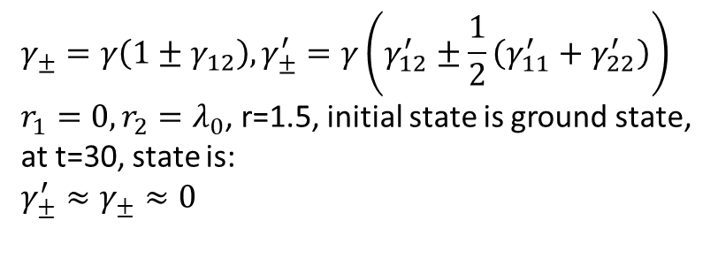
$$γ_{±}=γ\left(1±γ_{12}\right), γ_{±}^{′}=γ\left(γ_{12}^{′}±\frac{1}{2}\left(γ_{11}^{′}+γ_{22}^{′}\right)\right)$$
$r_{1}=0,r_{2}=λ_{0}$, r=1.5, initial state is ground state, at t=30, state is:
$$γ_{±}^{′}≈γ_{±}≈0$$

Slide 6
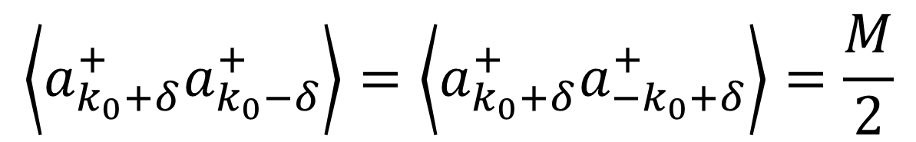
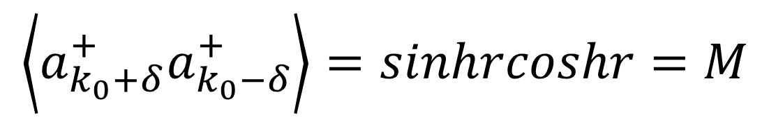
$$\left\langle a_{k_{0}+δ}^{+}a_{k_{0}−δ}^{+}\right\rangle =sinhrcoshr=M$$
$$\left\langle a_{k_{0}+δ}^{+}a_{k_{0}−δ}^{+}\right\rangle =\left\langle a_{k_{0}+δ}^{+}a_{−k_{0}+δ}^{+}\right\rangle =\frac{M}{2}$$

Slide 7
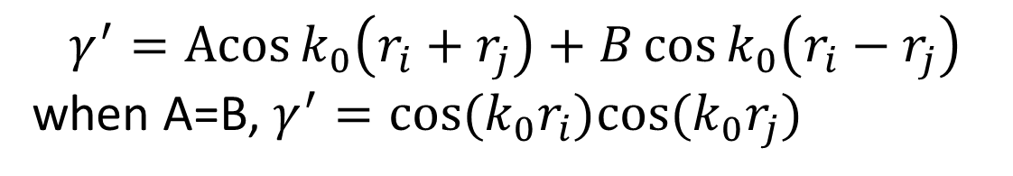






$${\vec{k}}_{0}+δ\vec{k}$$
$${\vec{k}}_{0}+δ\vec{k}$$
$$−{\vec{k}}_{0}+δ\vec{k}$$
$${\vec{k}}_{0}−δ\vec{k}$$
$$γ^{′}=cos⁡k_{0}(r_{i}+r_{j})$$
$$γ^{′}=cos⁡k_{0}(r_{i}−r_{j})$$
$$γ^{′}=\operatorname{Acos}{k_{0}\left(r_{i}+r_{j}\right)}+B\cos{k_{0}\left(r_{i}−r_{j}\right)}$$
when A=B, $γ^{′}=cos⁡(k_{0}r_{i})cos⁡(k_{0}r_{j})$

Slide 8
Three level atom in the squeezed vacuum

Slide 9






(b)
$$ω_{a}$$
$$ω_{0}+δω$$
$${2ω}_{0}$$
$$ω_{b}$$
(a)
$$ω_{0}−δω$$
$$ω_{c}$$

Slide 10
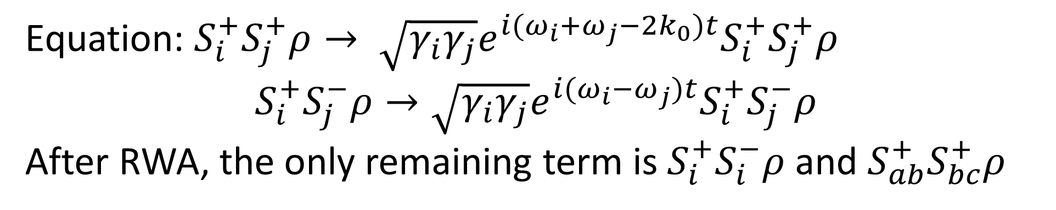
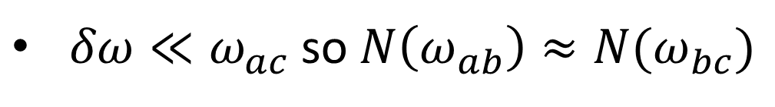
(b)
$$ω_{a}$$
$$ω_{0}+δω$$
$${2ω}_{0}$$
$$ω_{b}$$
$$ω_{0}−δω$$
$$ω_{c}$$
$δω≪ω_{ac}$ so $N\left(ω_{ab}\right)≈N(ω_{bc})$
Equation: $S_{i}^{+}S_{j}^{+}ρ→ \sqrt{γ_{i}γ_{j}}e^{i(ω_{i}+ω_{j}−2k_{0})t}S_{i}^{+}S_{j}^{+}ρ$
$$S_{i}^{+}S_{j}^{−}ρ→\sqrt{γ_{i}γ_{j}}e^{i(ω_{i}−ω_{j})t}S_{i}^{+}S_{j}^{−}ρ$$
After RWA, the only remaining term is $S_{i}^{+}S_{i}^{−}ρ$ and $S_{ab}^{+}S_{bc}^{+}ρ$

Slide 11

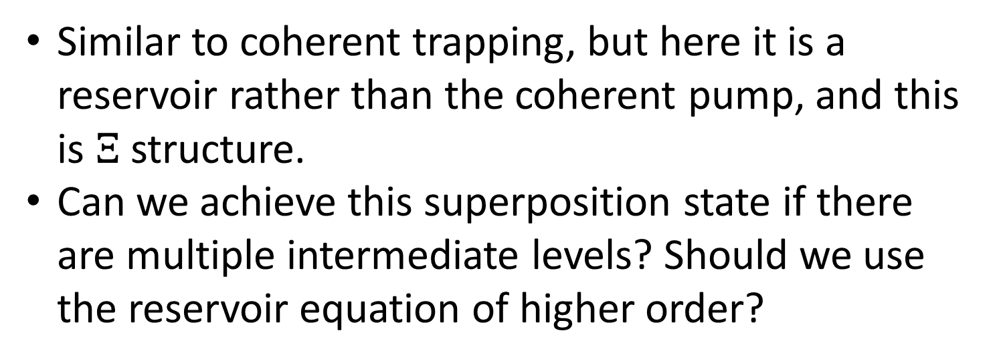




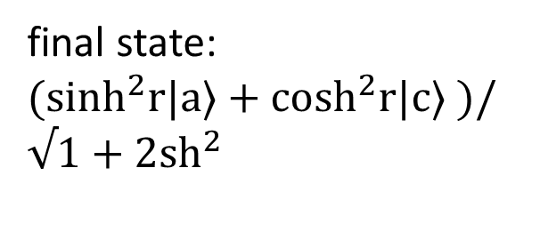
$$ω_{a}$$
$${\vec{k}}_{0}+δ\vec{k}$$
final state:
$(\sinh^{2}r|a⟩+\cosh^{2}r|c⟩ )/√1+2{sh}^{2}$
$$ω_{b}$$
$${\vec{k}}_{0}−δ\vec{k}$$
$$ω_{c}$$
Similar to coherent trapping, but here it is a reservoir rather than the coherent pump, and this is $Ξ$ structure.
Can we achieve this superposition state if there are multiple intermediate levels? Should we use the reservoir equation of higher order?

Slide 12
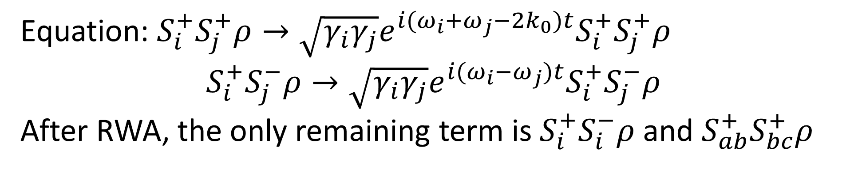




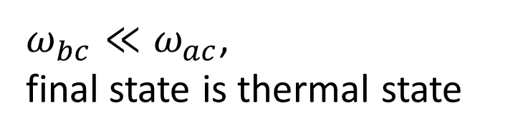
$$ω_{a}$$
$ω_{bc}≪ω_{ac}$,
final state is thermal state
$$ω_{b}$$
$$ω_{c}$$
$ω_{ac}+ω_{ab}=2k_{0}$
Equation: $S_{i}^{+}S_{j}^{+}ρ→\sqrt{γ_{i}γ_{j}}e^{i(ω_{i}+ω_{j}−2k_{0})t}S_{i}^{+}S_{j}^{+}ρ$
$$S_{i}^{+}S_{j}^{−}ρ→\sqrt{γ_{i}γ_{j}}e^{i(ω_{i}−ω_{j})t}S_{i}^{+}S_{j}^{−}ρ$$
After RWA, the only remaining term is $S_{i}^{+}S_{i}^{−}ρ$ and $S_{ab}^{+}S_{bc}^{+}ρ$

Slide 13
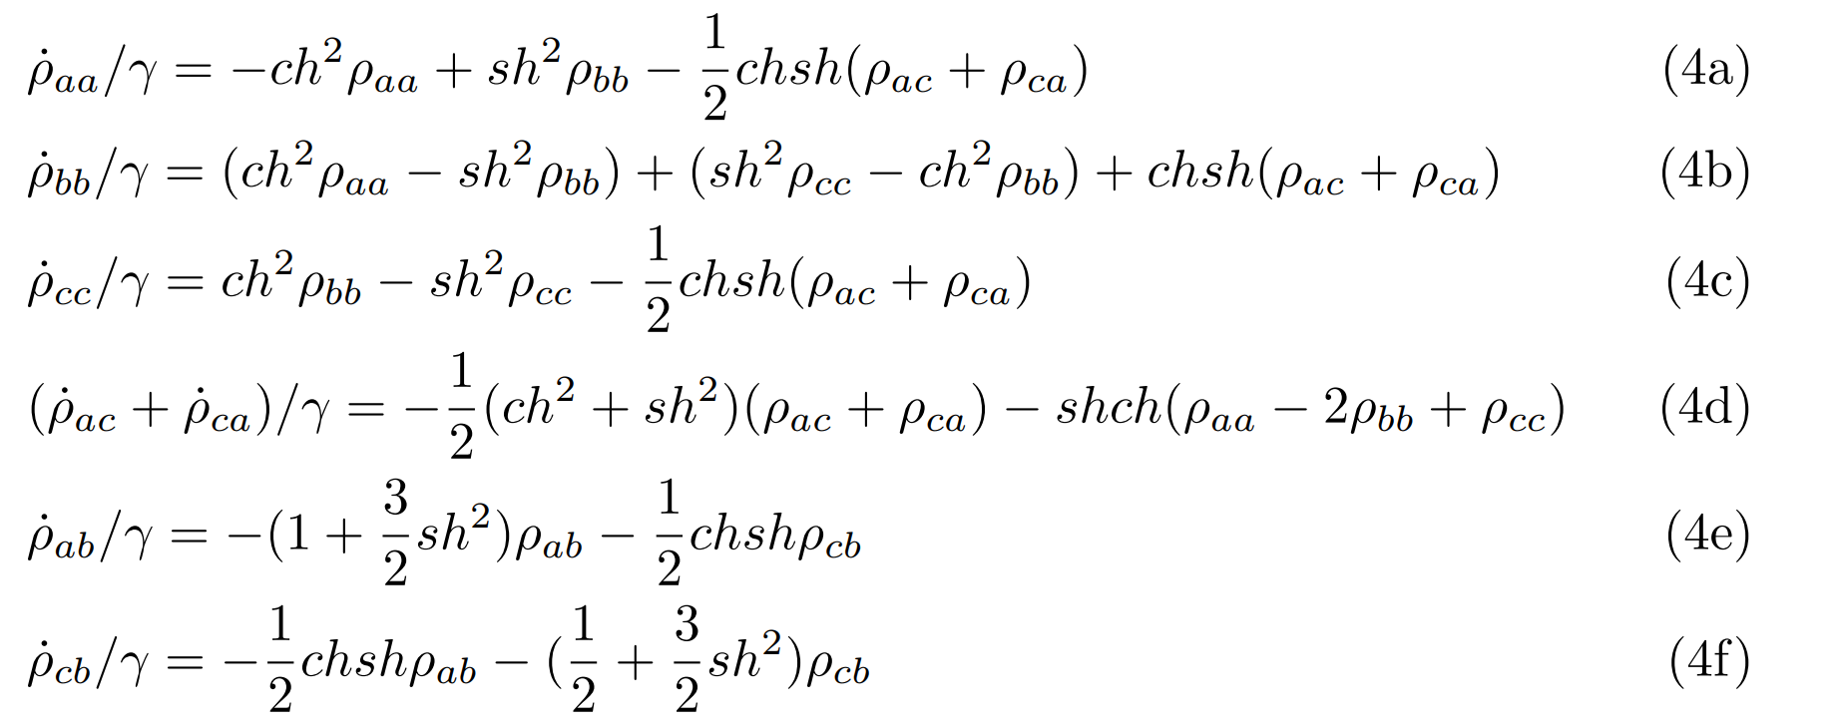

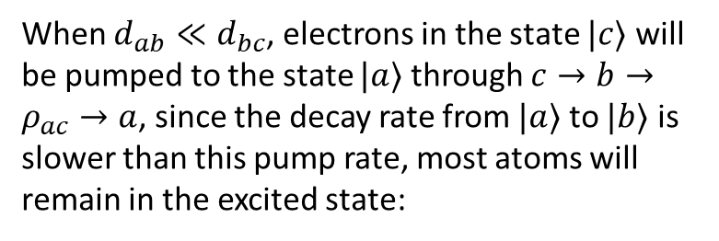






When $d_{ab}≪d_{bc}$, electrons in the state $|c⟩$ will be pumped to the state $|a⟩$ through $c→b→ρ_{ac}→a$, since the decay rate from $|a⟩$ to $|b⟩$ is slower than this pump rate, most atoms will remain in the excited state:
$$|a⟩$$
$$γ_{ab}$$
$$\sqrt{γ_{ab}γ_{bc}}$$
$$|b⟩$$
$$Re[ρ_{ac}]$$
$$γ_{bc}$$
$$|c⟩$$

Slide 14
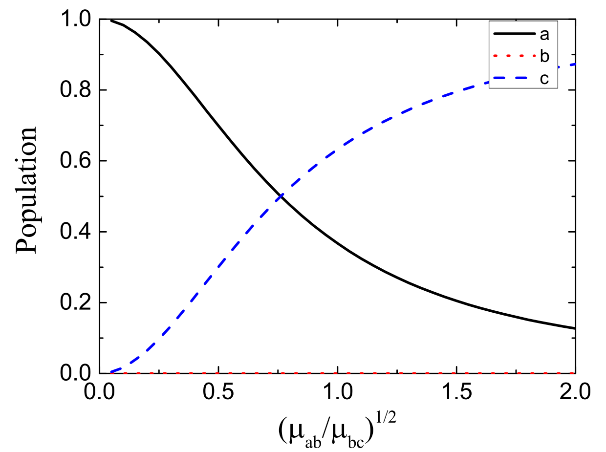
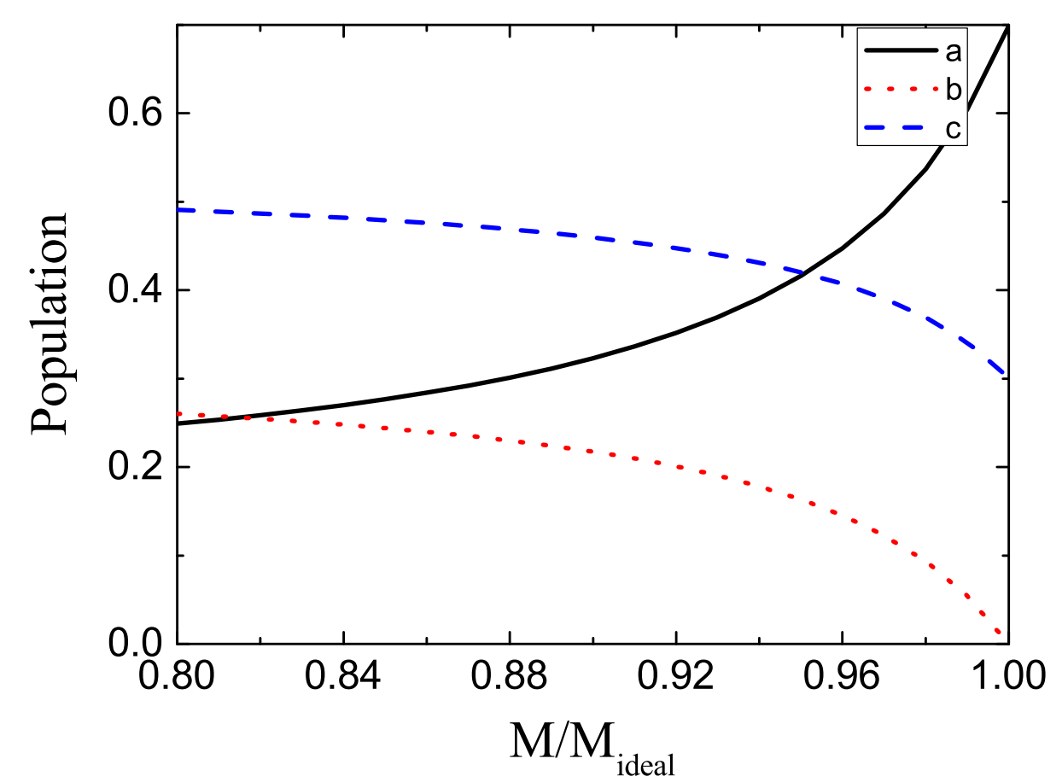
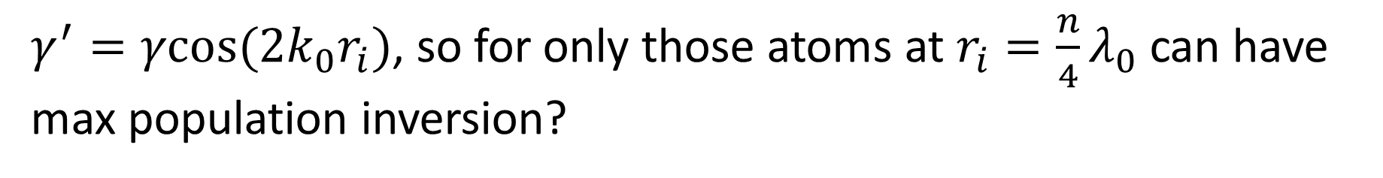
$γ^{′}=γcos⁡(2k_{0}r_{i})$, so for only those atoms at $r_{i}=\frac{n}{4}λ_{0}$ can have max population inversion?

Slide 16
$${\vec{k}}_{0}+δ\vec{k}$$
$${\vec{k}}_{0}+δ\vec{k}$$
$$−{\vec{k}}_{0}+δ\vec{k}$$
$${\vec{k}}_{0}−δ\vec{k}$$
$$\left\langle a_{k_{0}+δ}^{+}a_{k_{0}−δ}^{+}\right\rangle =sinhrcoshr=M$$
$$\left\langle a_{k_{0}+δ}^{+}a_{{−(k}_{0}−δ)}^{+}\right\rangle =sinhrcoshr=M$$
$$γ_{ij}^{′}=γ_{ij}$$

Slide 19
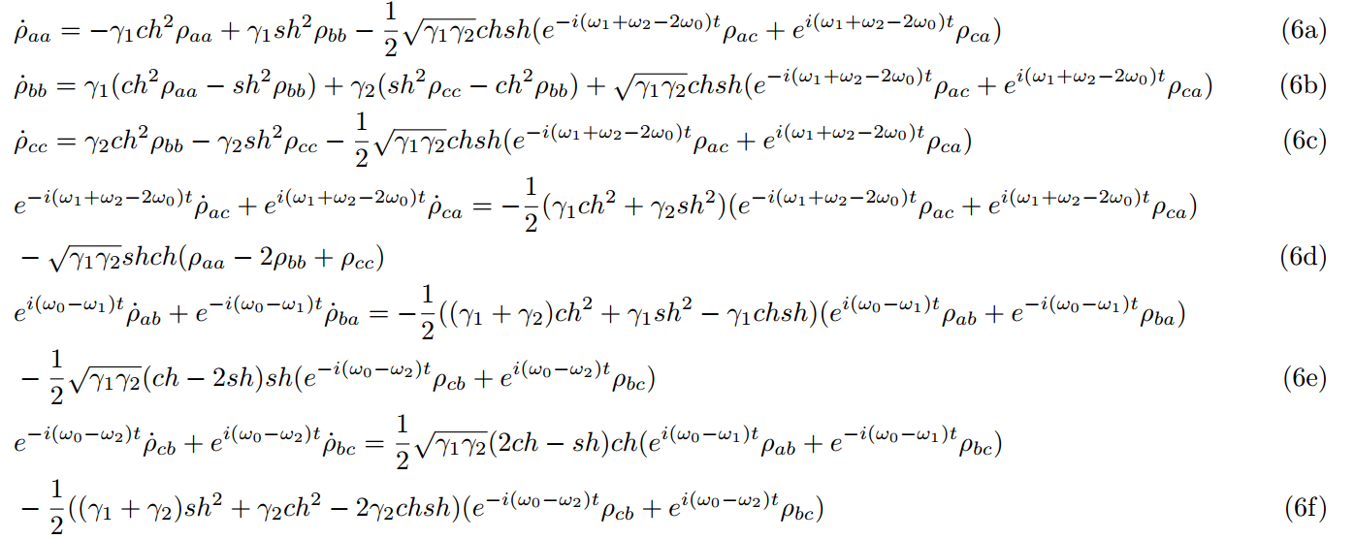
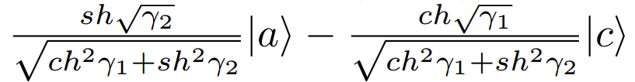

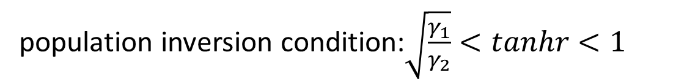
General steady state solution:
$$|a⟩$$
$$γ_{ab}$$
$$\sqrt{γ_{ab}γ_{bc}}$$
$$|b⟩$$
$$Re[ρ_{ac}]$$
population inversion condition:$\sqrt{\frac{γ_{1}}{γ_{2}}}<tanhr<1$
$$γ_{bc}$$
$$|c⟩$$

Slide 20
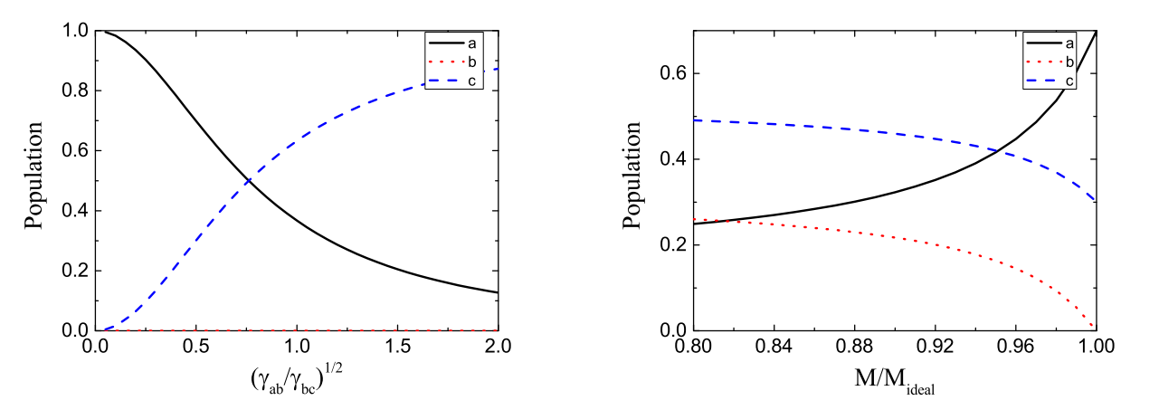

Slide 21
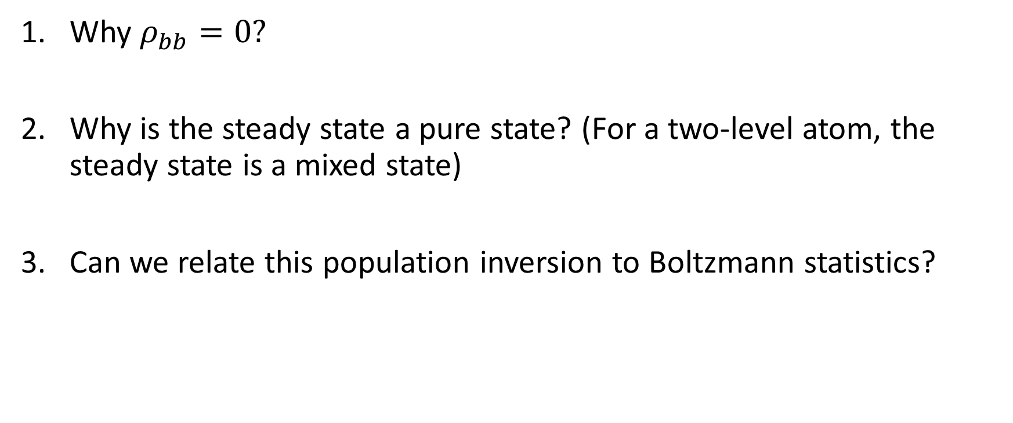
Questions:
Why $ρ_{bb}=0?$
Why is the steady state a pure state? (For a two-level atom, the steady state is a mixed state)
Can we relate this population inversion to Boltzmann statistics?

Slide 22
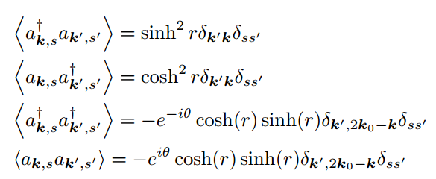
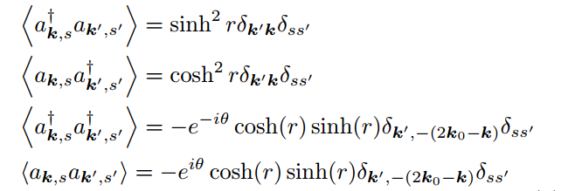
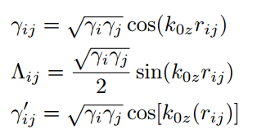
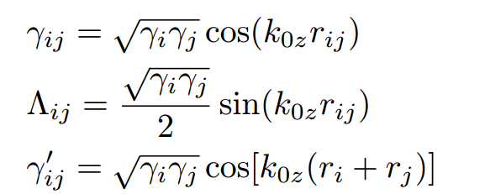
A group of atoms

Slide 23
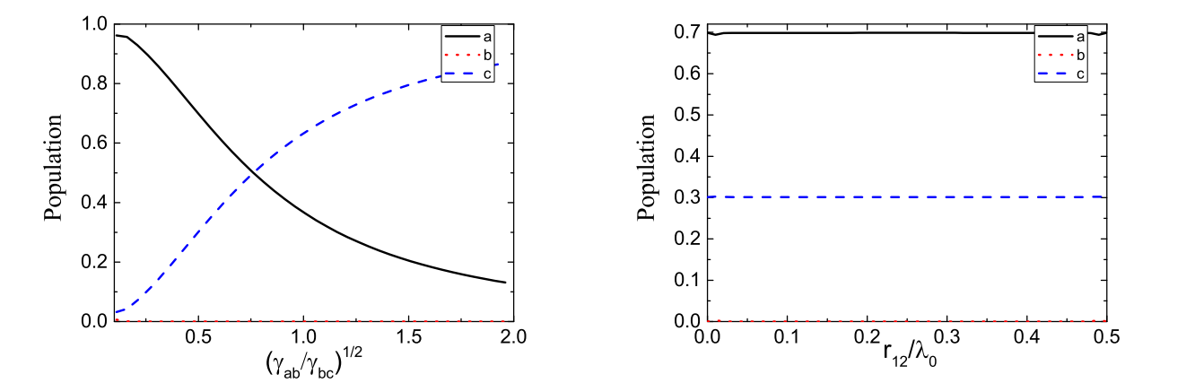

Slide 24

Questions:
Why does this population inversion only occur for $ω_{1}≠ω_{2}$?
what is S for $S|a⟩⟨b|S^{+}=c_{1}|a⟩⟨b|+c_{2}|b⟩⟨a|$?

Slide 26


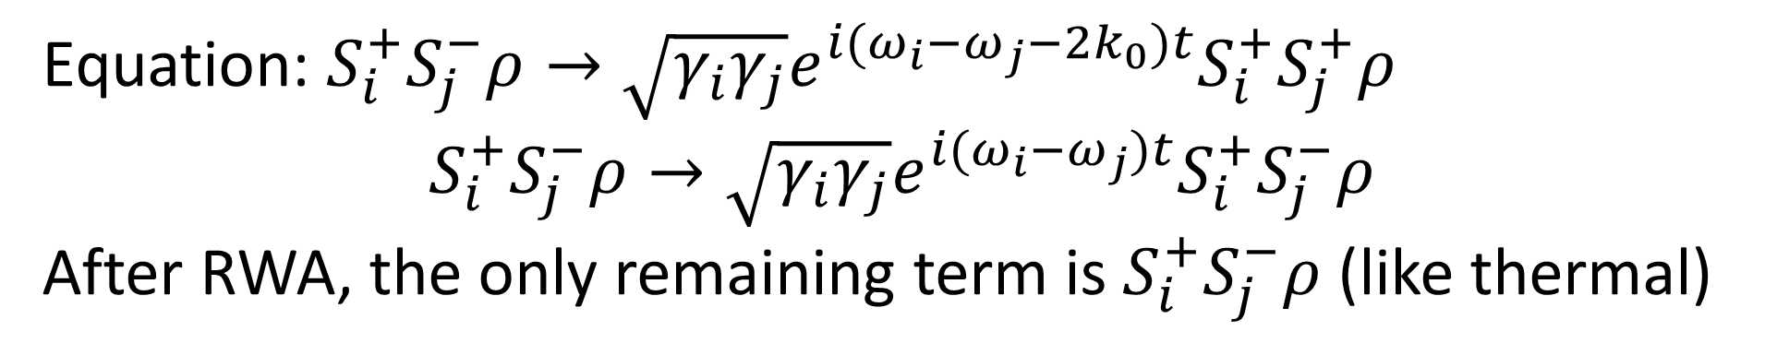


$$ω_{a}$$
$$ω_{b}$$
$$ω_{c}$$
$ω_{a}−ω_{b}=2k_{0}$
Equation: $S_{i}^{+}S_{j}^{−}ρ→\sqrt{γ_{i}γ_{j}}e^{i(ω_{i}−ω_{j}−2k_{0})t}S_{i}^{+}S_{j}^{+}ρ$
$$S_{i}^{+}S_{j}^{−}ρ→\sqrt{γ_{i}γ_{j}}e^{i(ω_{i}−ω_{j})t}S_{i}^{+}S_{j}^{−}ρ$$
After RWA, the only remaining term is $S_{i}^{+}S_{j}^{−}ρ$ (like thermal)

Slide 27
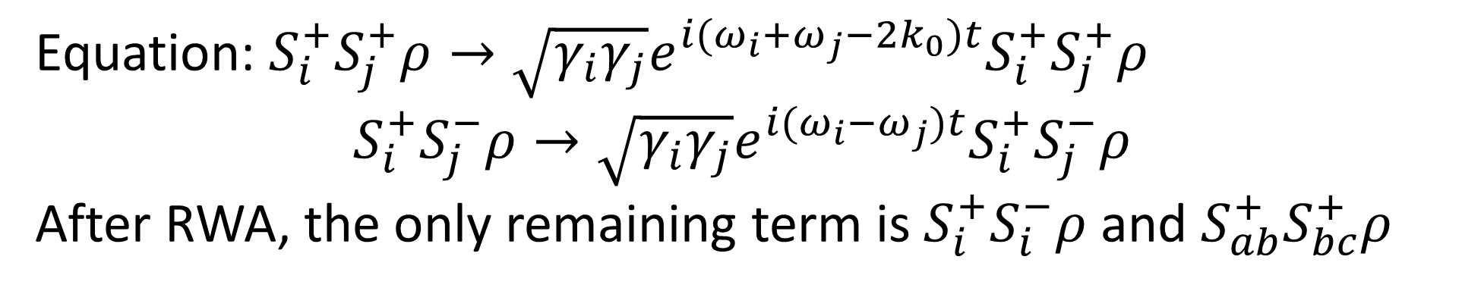






$$ω_{a}$$
$$σ^{+}$$
$$ω_{b}$$
$$σ^{−}$$
$$ω_{c}$$
$ω_{a}+ω_{b}=2k_{0}$
Equation: $S_{i}^{+}S_{j}^{+}ρ→\sqrt{γ_{i}γ_{j}}e^{i(ω_{i}+ω_{j}−2k_{0})t}S_{i}^{+}S_{j}^{+}ρ$
$$S_{i}^{+}S_{j}^{−}ρ→\sqrt{γ_{i}γ_{j}}e^{i(ω_{i}−ω_{j})t}S_{i}^{+}S_{j}^{−}ρ$$
After RWA, the only remaining term is $S_{i}^{+}S_{i}^{−}ρ$ and $S_{ab}^{+}S_{bc}^{+}ρ$

Slide 28
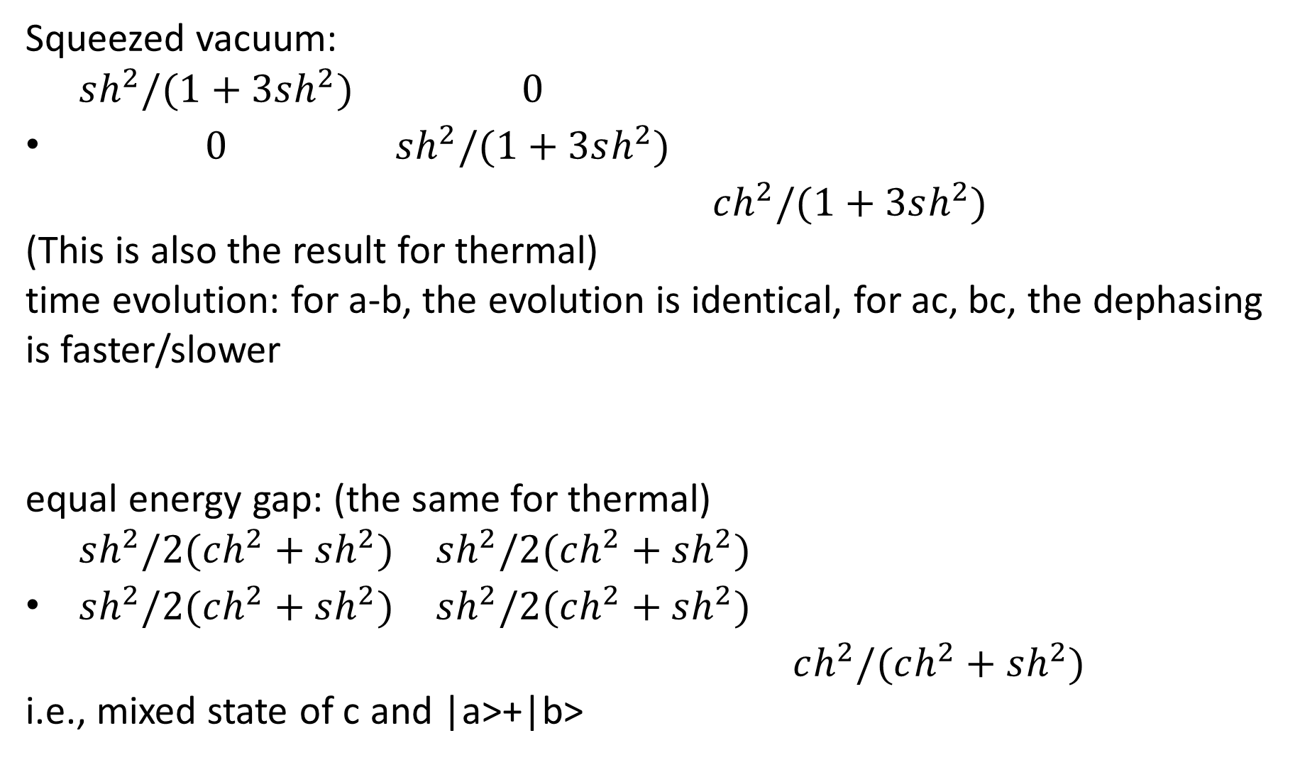
Final state
Squeezed vacuum:
$\begin{matrix}sh^{2}/(1+3sh^{2}) & 0 & \\ 0 & sh^{2}/(1+3sh^{2}) & \\ & & ch^{2}/(1+3sh^{2})\end{matrix}$
(This is also the result for thermal)
time evolution: for a-b, the evolution is identical, for ac, bc, the dephasing is faster/slower
equal energy gap: (the same for thermal)
$\begin{matrix}sh^{2}/2(ch^{2}+sh^{2}) & sh^{2}/2(ch^{2}+sh^{2}) & \\ sh^{2}/2(ch^{2}+sh^{2}) & sh^{2}/2(ch^{2}+sh^{2}) & \\ & & ch^{2}/(ch^{2}+sh^{2})\end{matrix}$
i.e., mixed state of c and |a>+|b>

Slide 29
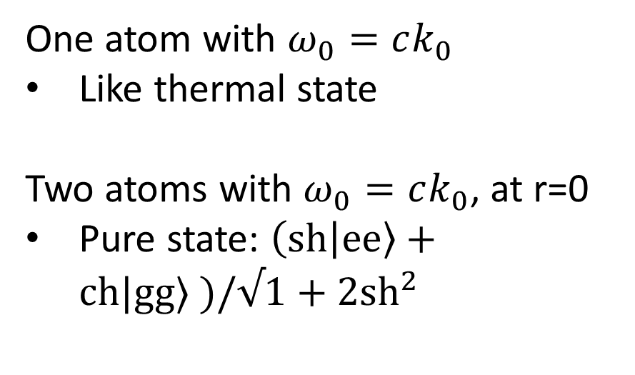
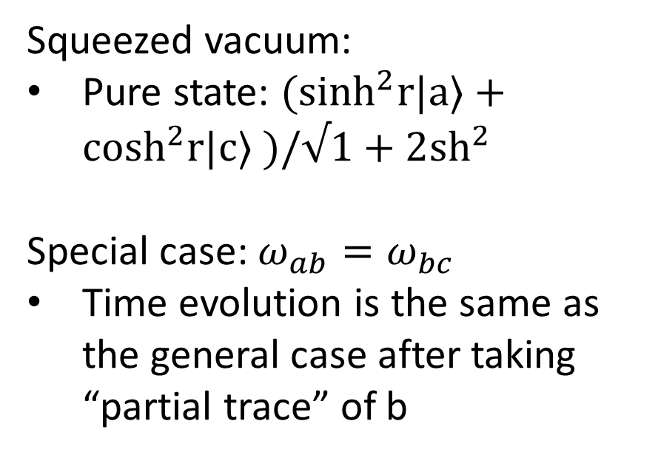
Final state
Thermal:
Boltzmann distribution
Mixed state
Squeezed vacuum:
Pure state: $(\sinh^{2}r|a⟩+\cosh^{2}r|c⟩ )/√1+2{sh}^{2}$
Special case: $ω_{ab}=ω_{bc}$
Time evolution is the same as the general case after taking “partial trace” of b
One atom with $ω_{0}=ck_{0}$
Like thermal state
Two atoms with $ω_{0}=ck_{0}$, at r=0
Pure state: $\left(sh | ee\right\rangle +ch|gg⟩ )/√1+2{sh}^{2}$

Slide 30
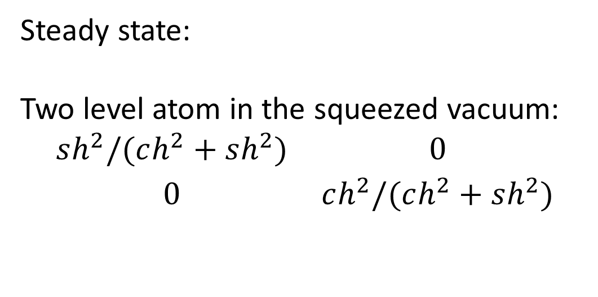
Steady state:
Two level atom in the squeezed vacuum:
$$\begin{matrix}sh^{2}/(ch^{2}+sh^{2}) & 0 \\ 0 & ch^{2}/(ch^{2}+sh^{2})\end{matrix}$$

Slide 31
Cos(2ri) | Cos(ri+rj)
1 | Cos(ri-rj)
1, $γ_{ii}^{′}=0→r_{i}=\frac{π}{4}+\frac{nπ}{2}→γ_{ij}^{′}=0 or±1→γ_{ij}=0$

Slide 32


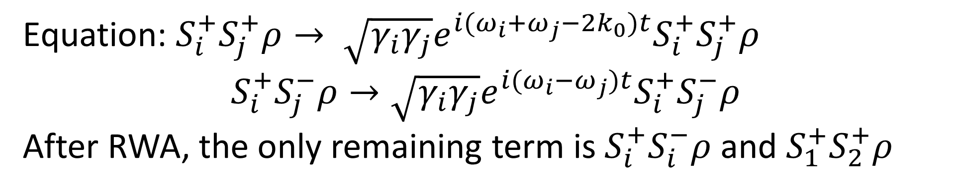
$$ω_{2}$$
$$ω_{1}$$
$ω_{a}−ω_{c}=2k_{0}$, $ω_{ab}−ω_{bc}≪ω_{ac}$ so $N\left(ω_{ab}\right)≈N(ω_{bc})$
Equation: $S_{i}^{+}S_{j}^{+}ρ→ \sqrt{γ_{i}γ_{j}}e^{i(ω_{i}+ω_{j}−2k_{0})t}S_{i}^{+}S_{j}^{+}ρ$
$$S_{i}^{+}S_{j}^{−}ρ→\sqrt{γ_{i}γ_{j}}e^{i(ω_{i}−ω_{j})t}S_{i}^{+}S_{j}^{−}ρ$$
After RWA, the only remaining term is $S_{i}^{+}S_{i}^{−}ρ$ and $S_{1}^{+}S_{2}^{+}ρ$

Slide 33
Nonlinear effect (quadrupole)

