Slide 1
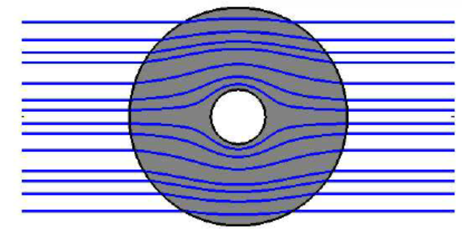
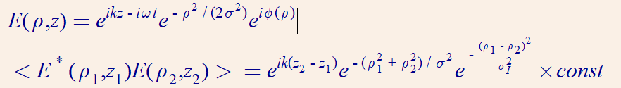
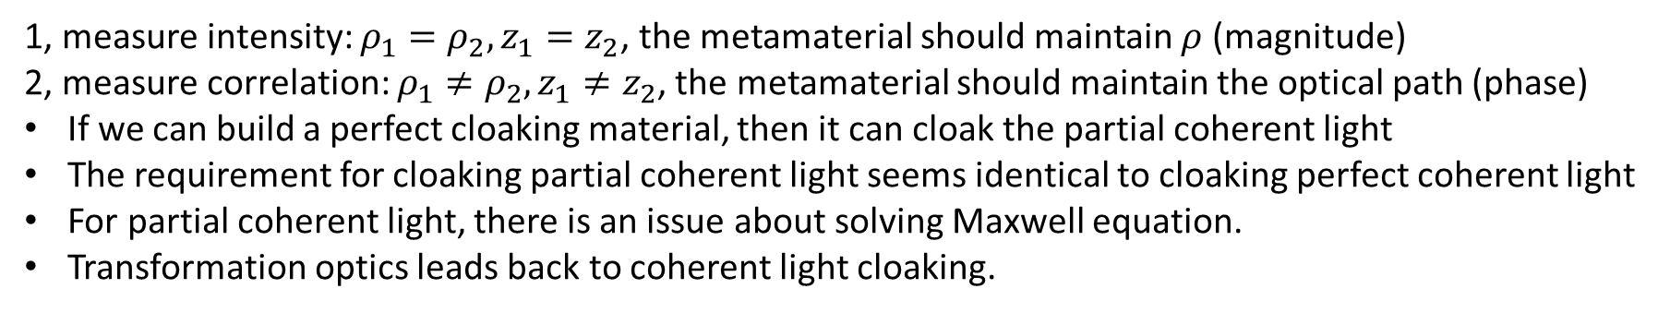
1, measure intensity: $ρ_{1}=ρ_{2},z_{1}=z_{2}$, the metamaterial should maintain $ρ$ (magnitude)
2, measure correlation: $ρ_{1}≠ρ_{2},z_{1}≠z_{2}$, the metamaterial should maintain the optical path (phase)
If we can build a perfect cloaking material, then it can cloak the partial coherent light
The requirement for cloaking partial coherent light seems identical to cloaking perfect coherent light
For partial coherent light, there is an issue about solving Maxwell equation.
Transformation optics leads back to coherent light cloaking.

