Slide 1
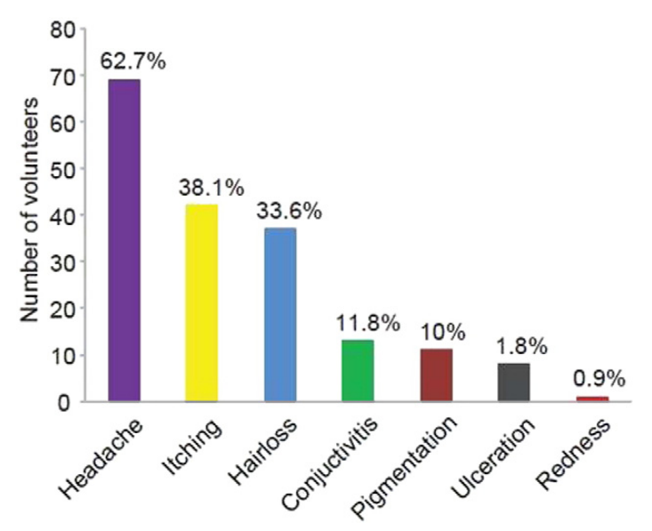
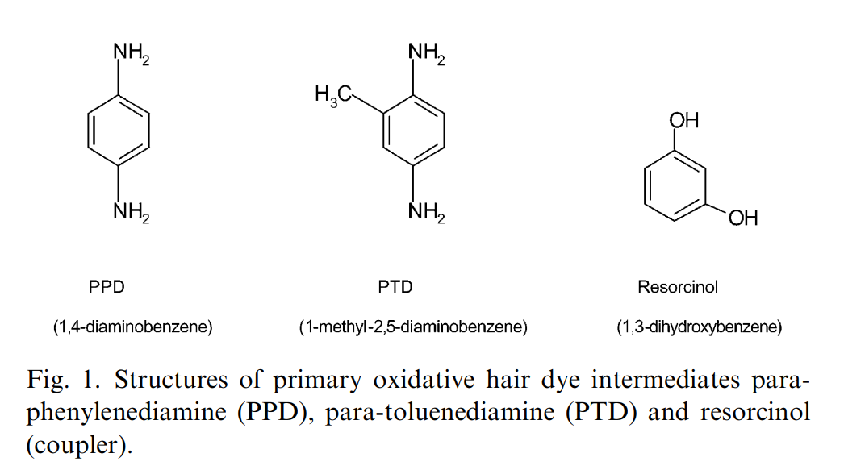
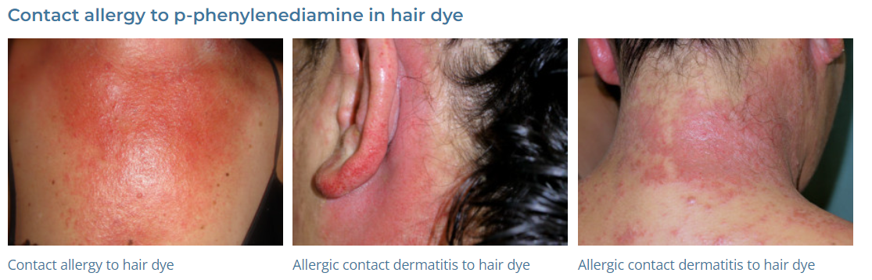
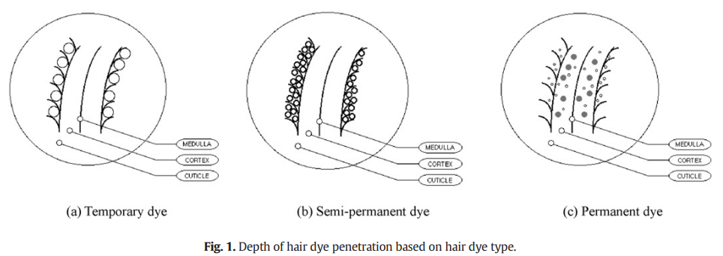
Patel et al., 2013
G.J. Nohynek et al. / Food and Chemical Toxicology 42 (2004) 517–543
K.-H. Kim et al. / Environment International 89–90 (2016) 222–227
allergy-to-paraphenylenediamine

Slide 2
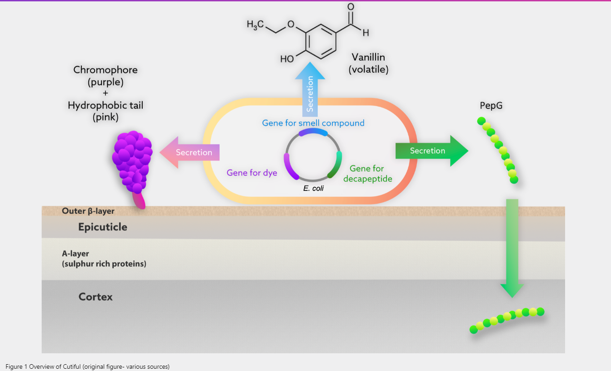
Aesthetically, hair dyes are also known to cause hair damage, as bleaching agents modify and deteriorate the ultrastructure of hair. Compounds such as ammonia, which is commonly used in dye products, are required to open the cuticle to allow pigment infiltration of the cortex. However, in many cases, the cuticle fails to re-seal leading to damage. Our solution is to use a protein-based chromophore to bind to the outer layer of the hair. This is a much safer alternative as it reduces the need for harsh chemicals and bleaching to get pigments into the hair (Figure 1).

Slide 3
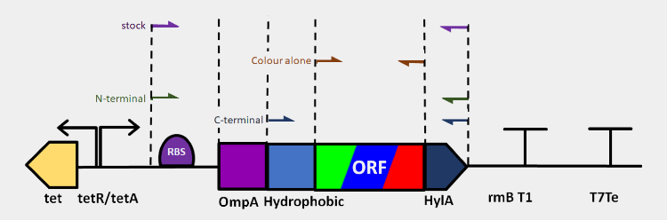
테트라사이클린이 없는 경우에는 TetR 단백질이 tet operon의 발현을 억제하여 tetA의 발현을 막습니다. 그러나 테트라사이클린이 존재하는 경우, 테트라사이클린과 TetR 사이의 상호 작용으로 TetR이 tet operon을 해제하고 tetA의 발현을 허용합니다.
Outer membrane peptide A (OmpA) | type II secretion system | cleaved by the secretion machinery in the plasma membrane of the bacterium. | secreted and released in an active mature form | reported high efficiency of secretion during high protein expression | N-terminal secretion signal sequences
α-hemolysin (HylA) | type I secretion system | efficient secretion of active correctly folded proteins to the culture supernatant | from the bacterial cytoplasm to the extracellular medium without a periplasmic intermediate of tagged proteins. | not become cleaved after trafficking across the bacterial membrane | C-terminal secretion signal
promoter (tetR) | strongly regulated promoter, minimises leakiness to avoid toxic protein aggregation and allows controlled expression
terminators (rrnB T1 terminator
T7 terminator
hydrophobic tag | we decided to adapt this to enable our coloured proteins to embed in the hydrophobic beta-layer of the cortex of hair. able to interact with the cuticle
pBBR1 origin of replication | the second highest copy number plasmid with around 20 copies per cell from BglBrick plasmids library | maximise production and lower cell burden by cloning the hair repair (decapeptide)

Slide 4
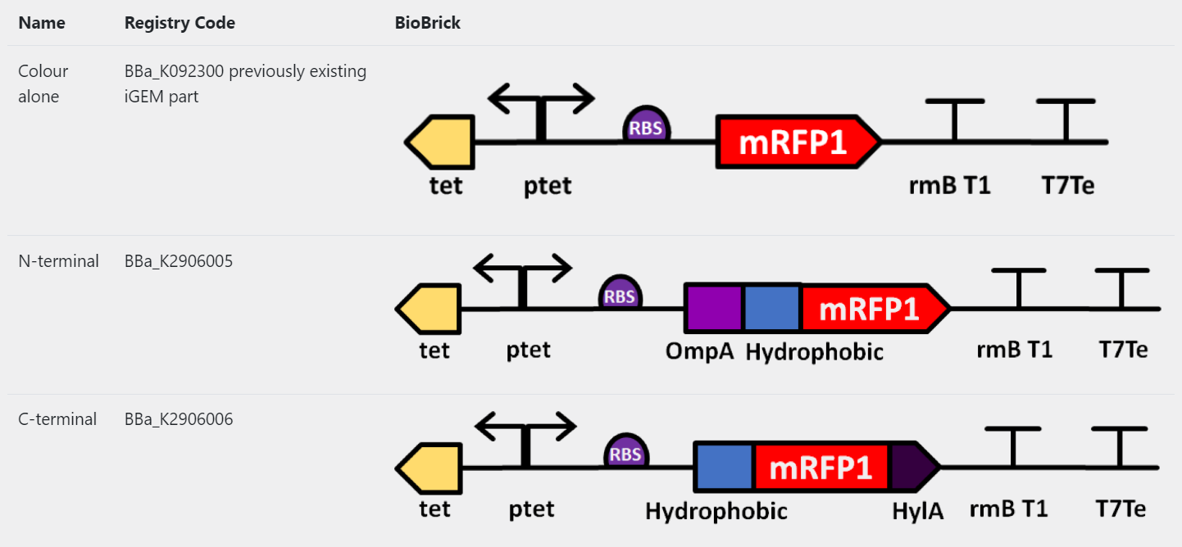
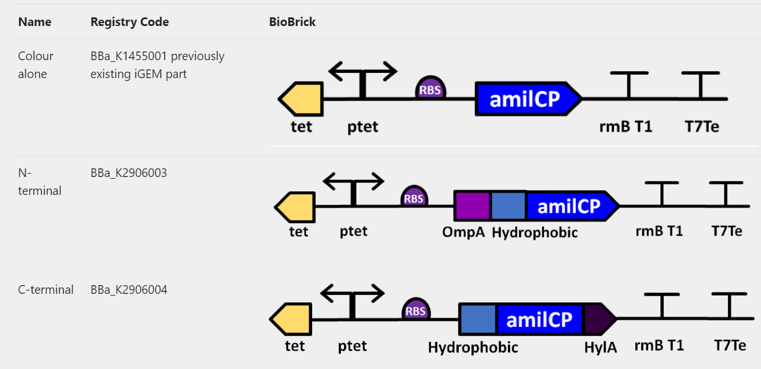
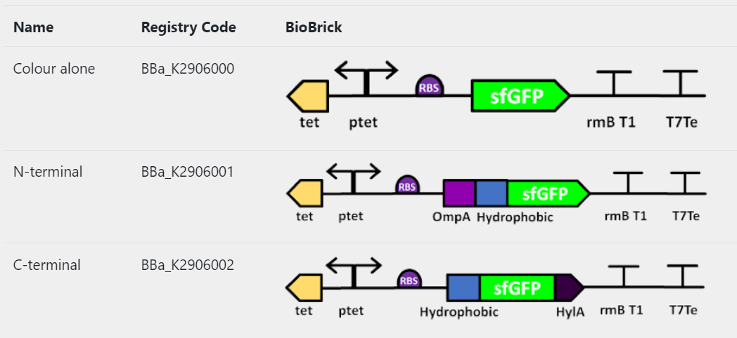

Slide 5
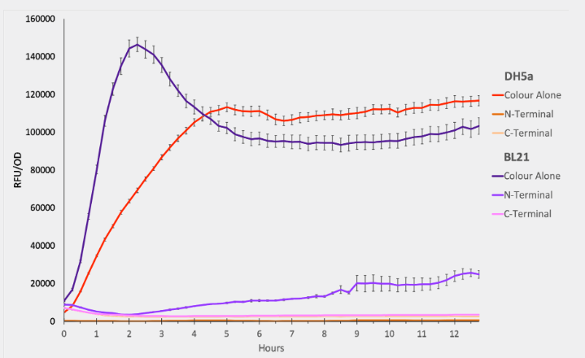

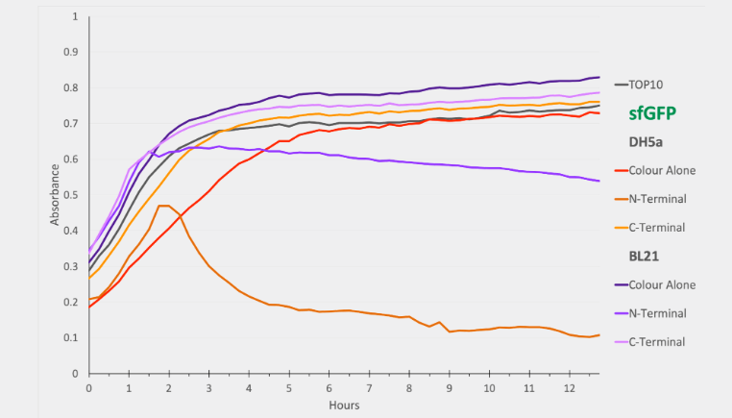

Slide 6
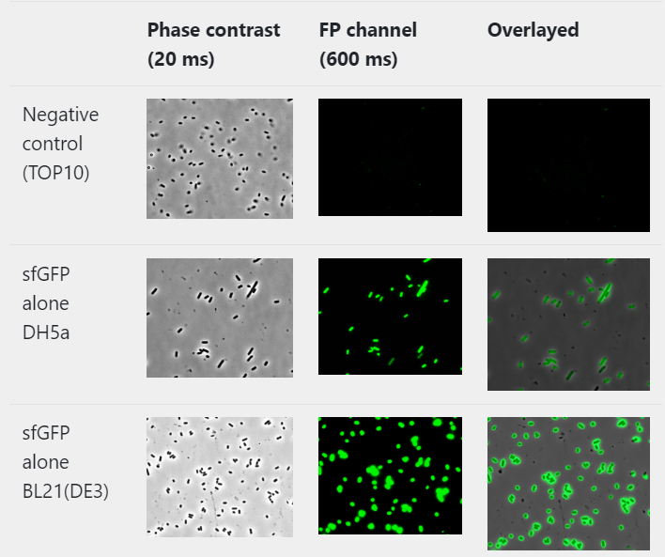
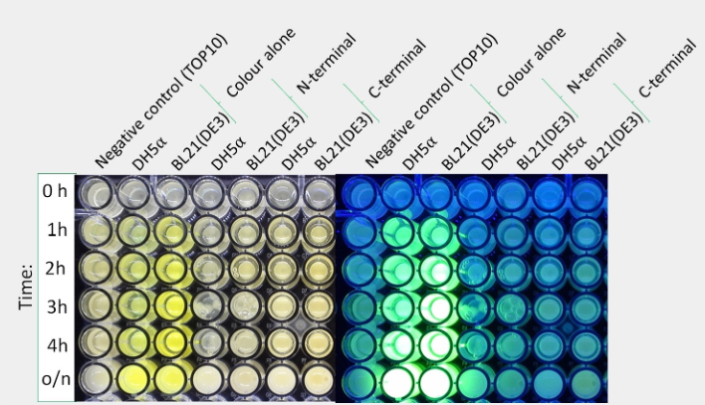
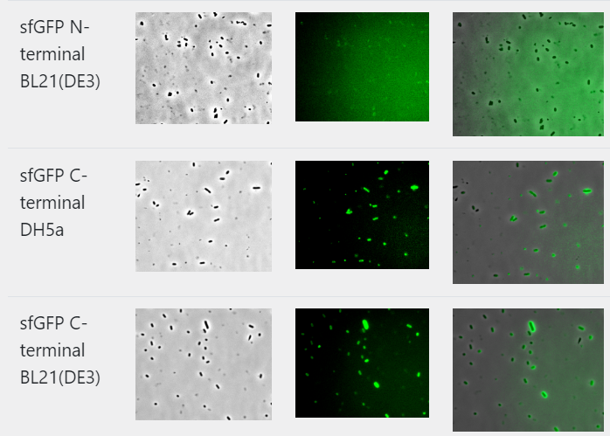

Slide 7
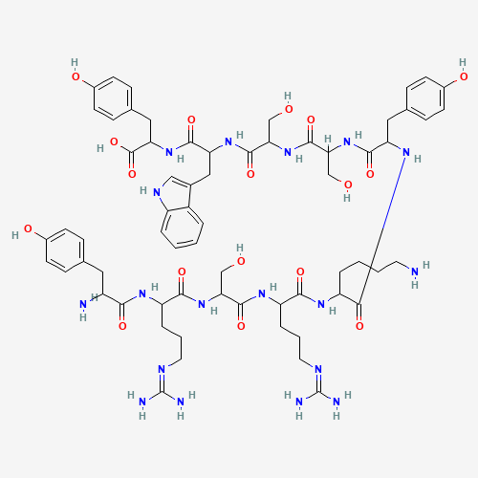
We selected this peptide due its affinity for hair; high straightening efficiency at low concentrations and straightening properties
increases the growth of cells that make pigment
The psychosocial impact of vitiligo on patients emphasizes the need for increased focus on its management.
치료용 약물
Cureus. 2023 Jul; 15(7): e41418.

Slide 8
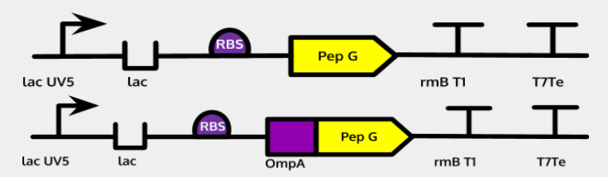

Slide 9
