Slide 1
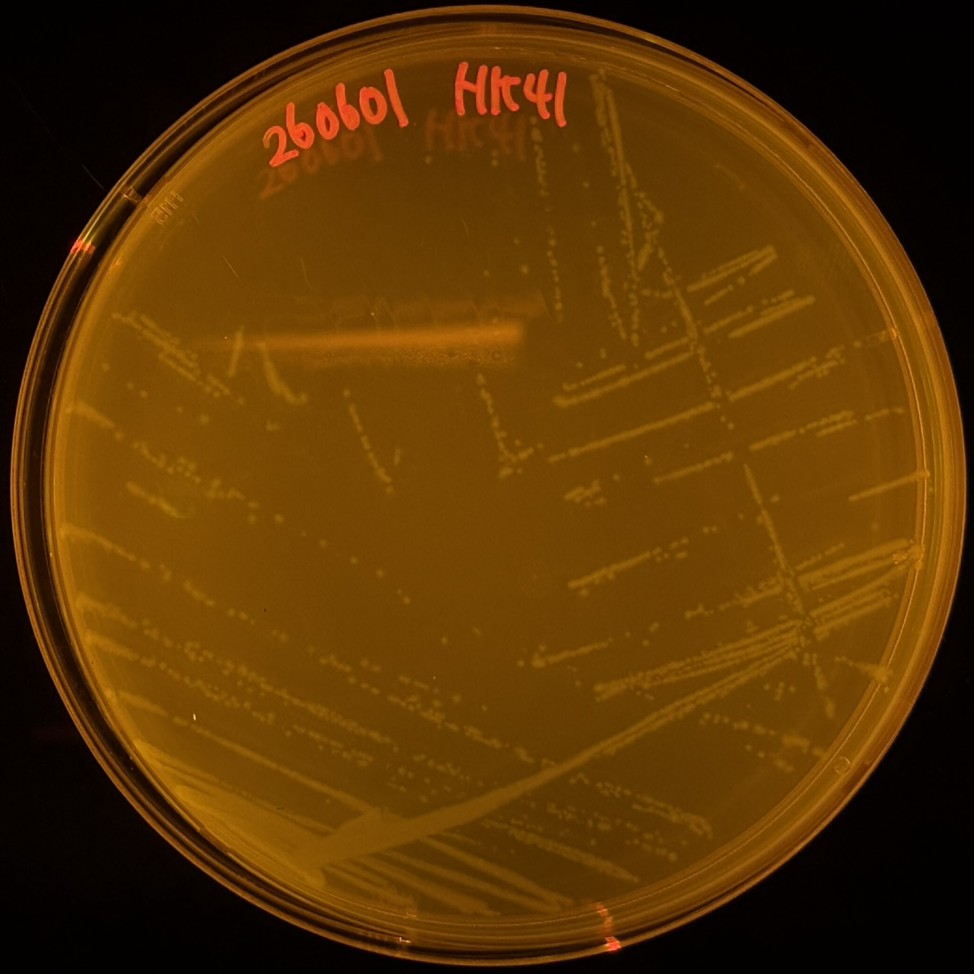
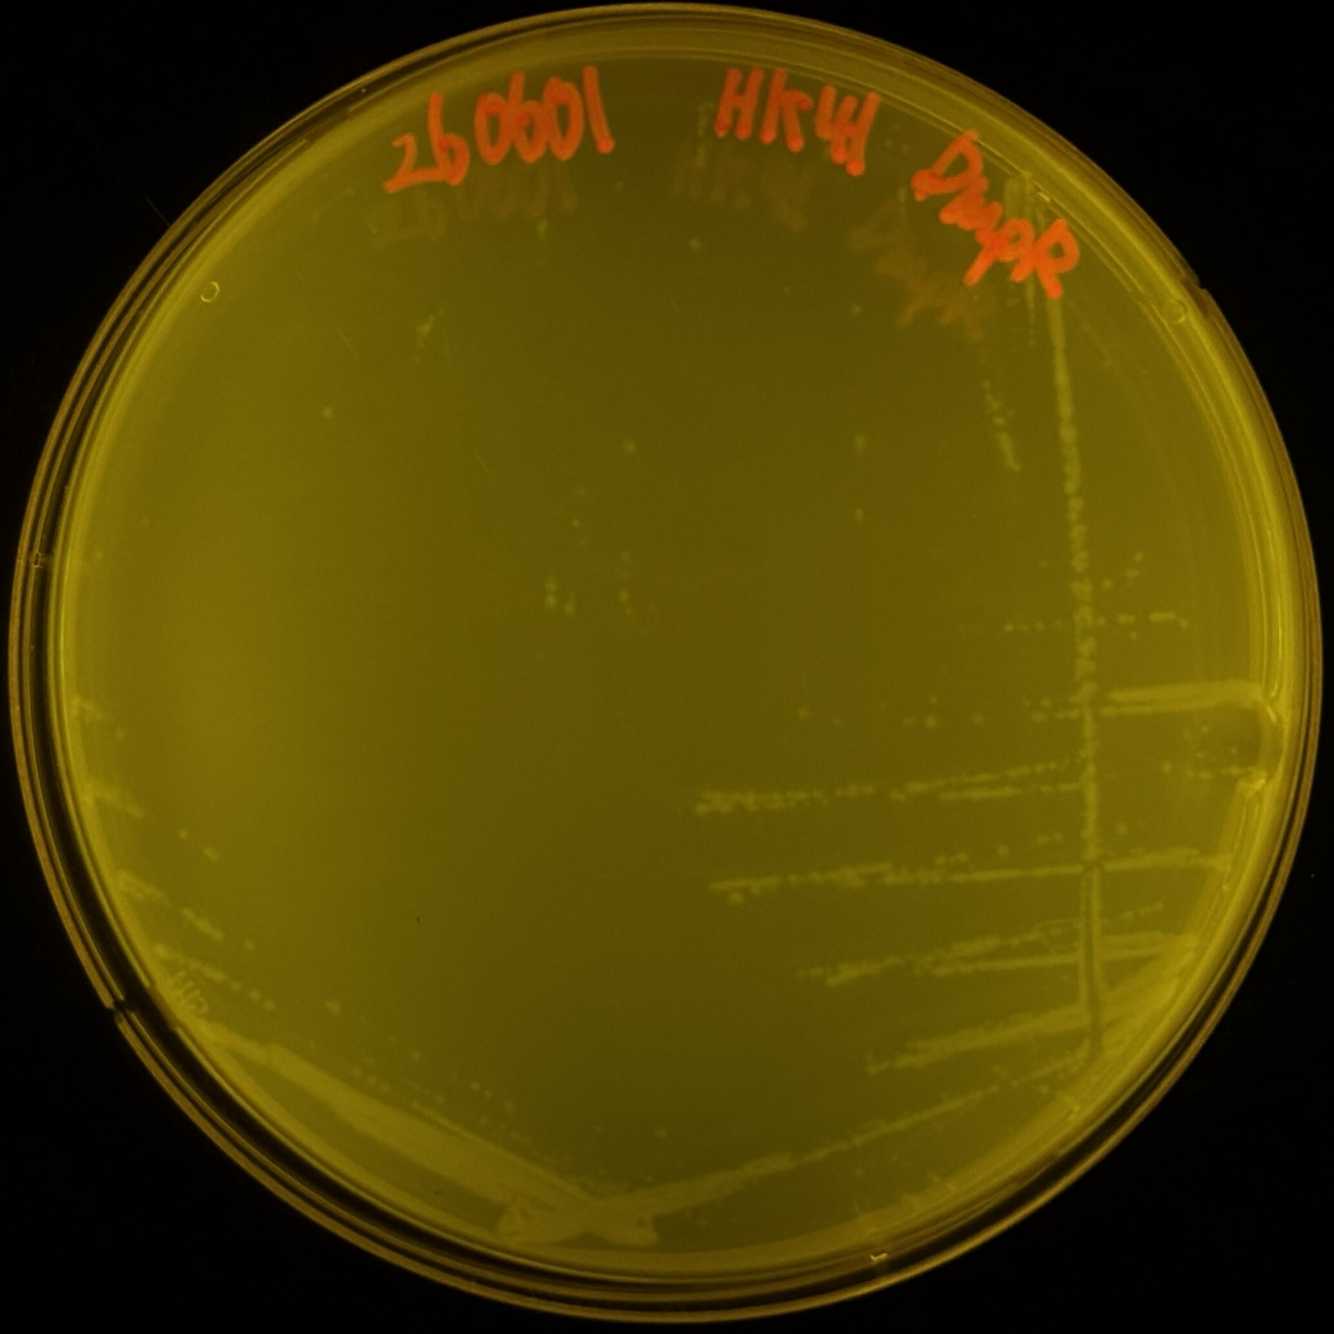
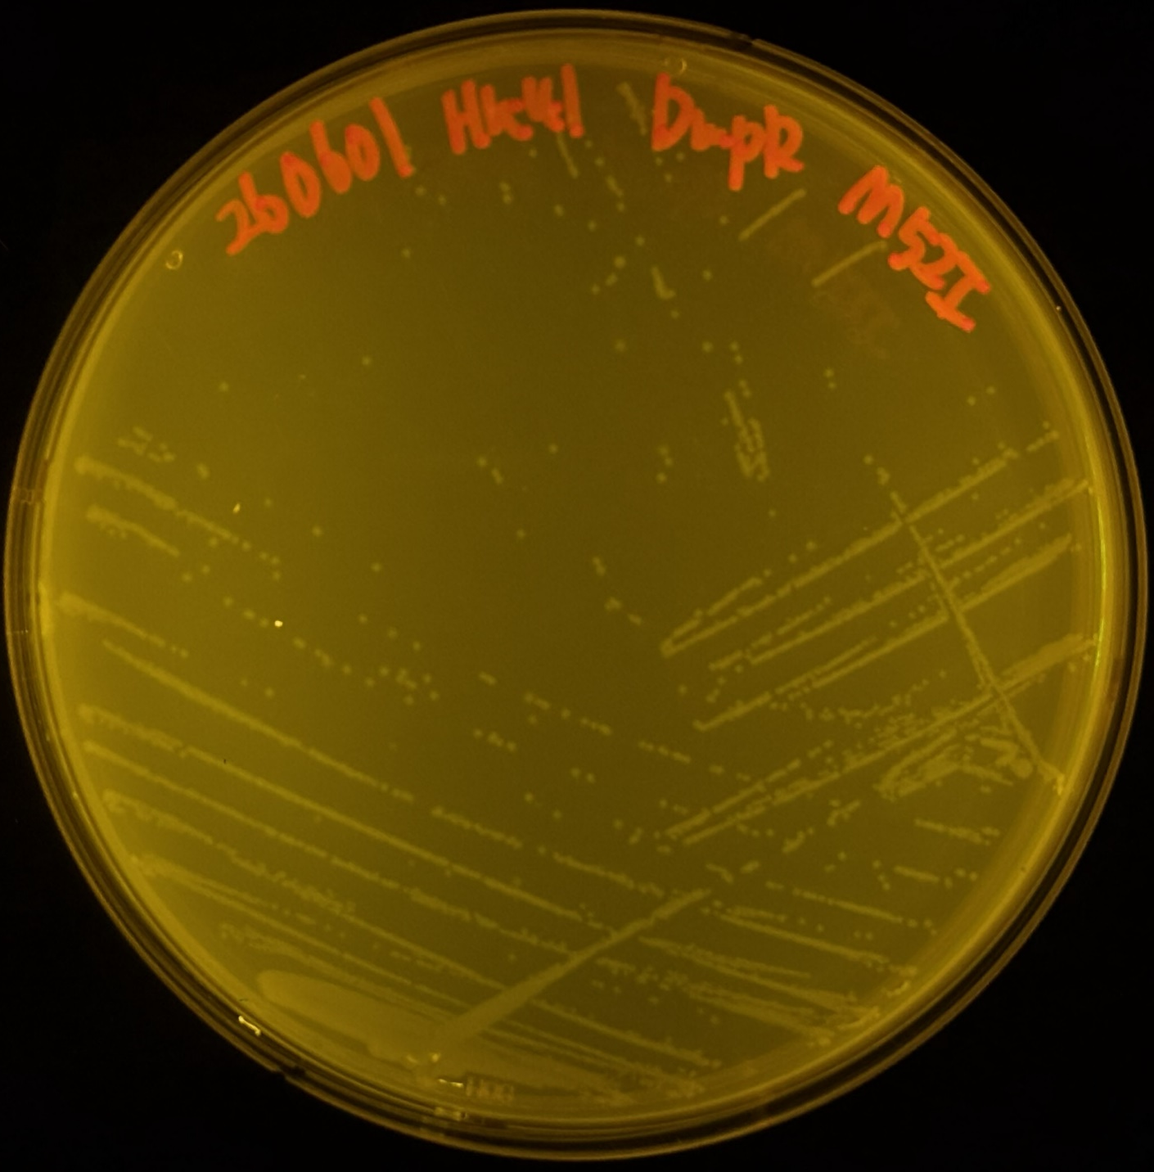
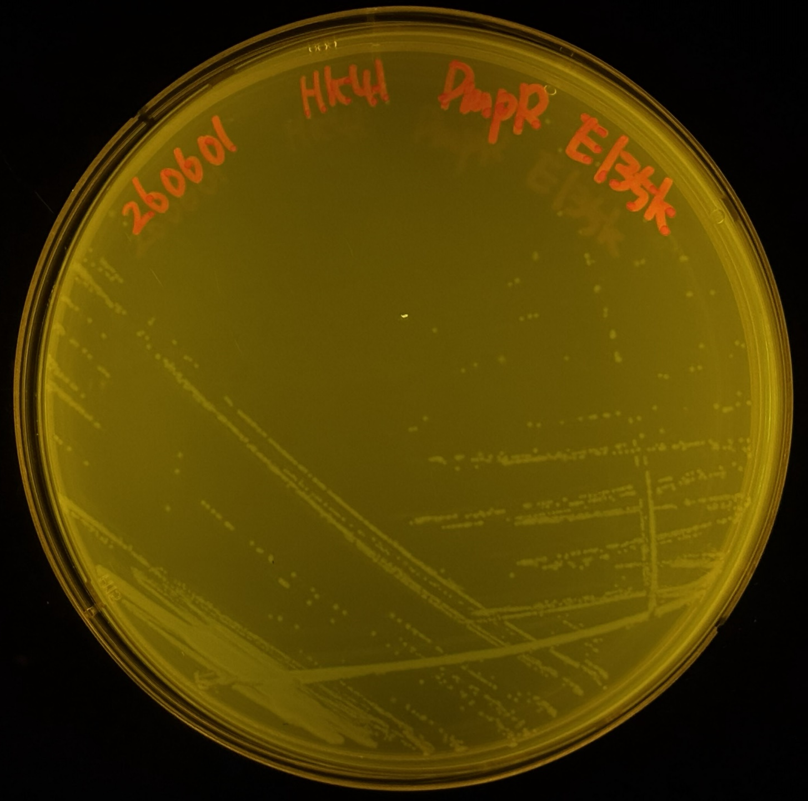
260614
LB FACS 24h이후 배양 test
library OD600 → 62.8
12uL 씩 따서 배양
o/n control
|sample| od600 |0.4 od600 |
|-------|----|--------|
|wt | 5| 160uL |
|e135k | 4.6 | 173uL |
|m52i | 5.23 | 153uL |
|nc | 4.68| 173uL |

Slide 2
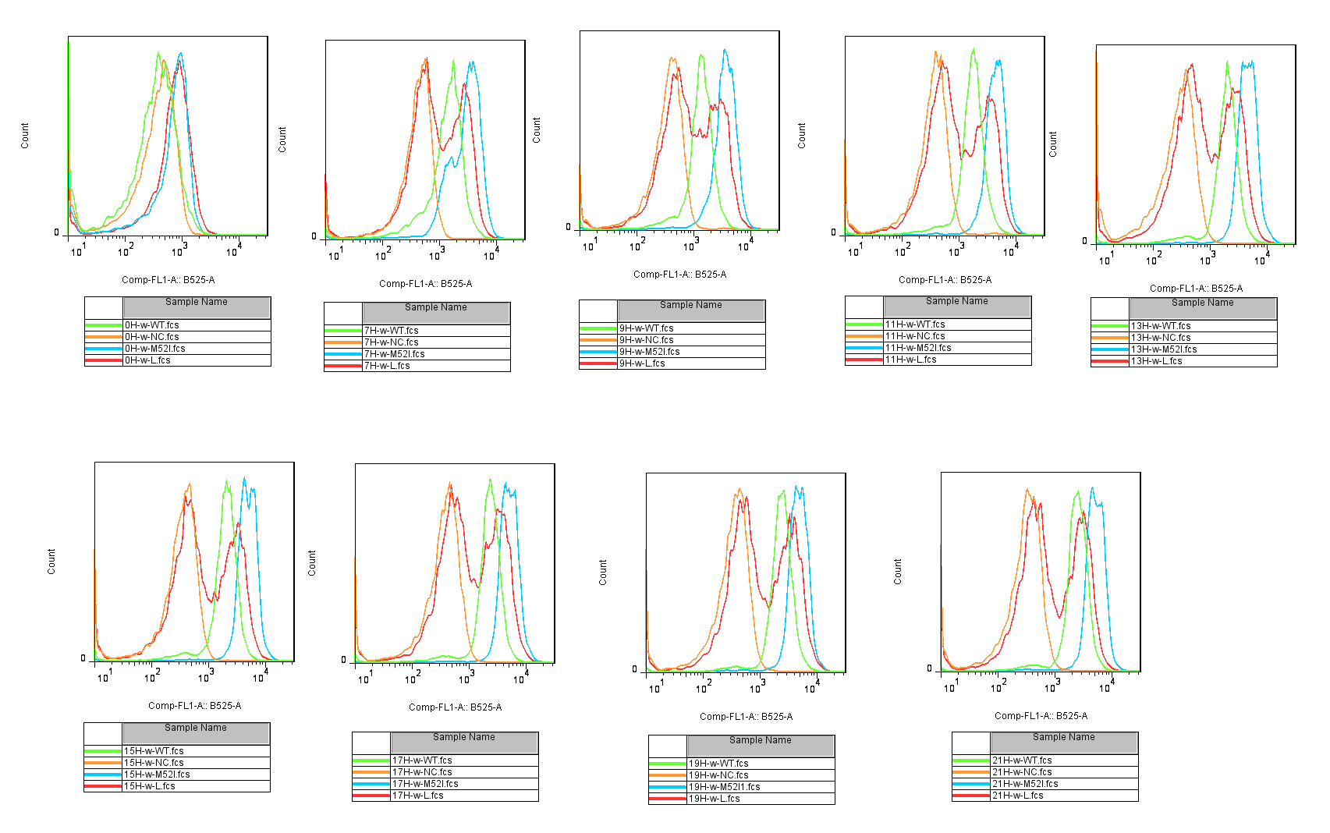
260614

Slide 3
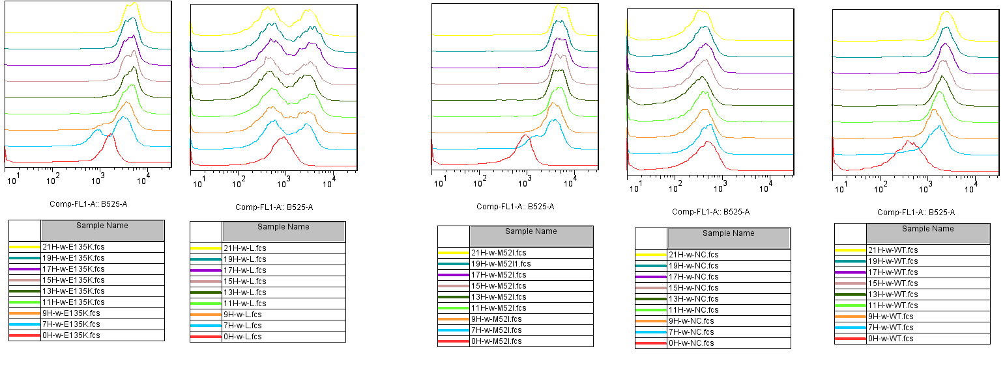
260614

Slide 4
260616
lb에서 o/n후 0.4 맞춰서 m9ace에서 배양시작
o/n 배양
|Sample | 1/10 희석 |
|--------|-------------|
|wt | 0.445 |
|e135k | 0.449 |
|m52i | 0.393 |
|nc | 0.489 |
|lib | 0.629 |
FACS 측정(0.4 맞춘 후, M9ace에서 배양)
m9-acetate 제작
4g/L acetate
0.2g/50mL Sodium acetate
5x m9 media 10mL +40mL DW
→ Filtering

Slide 5
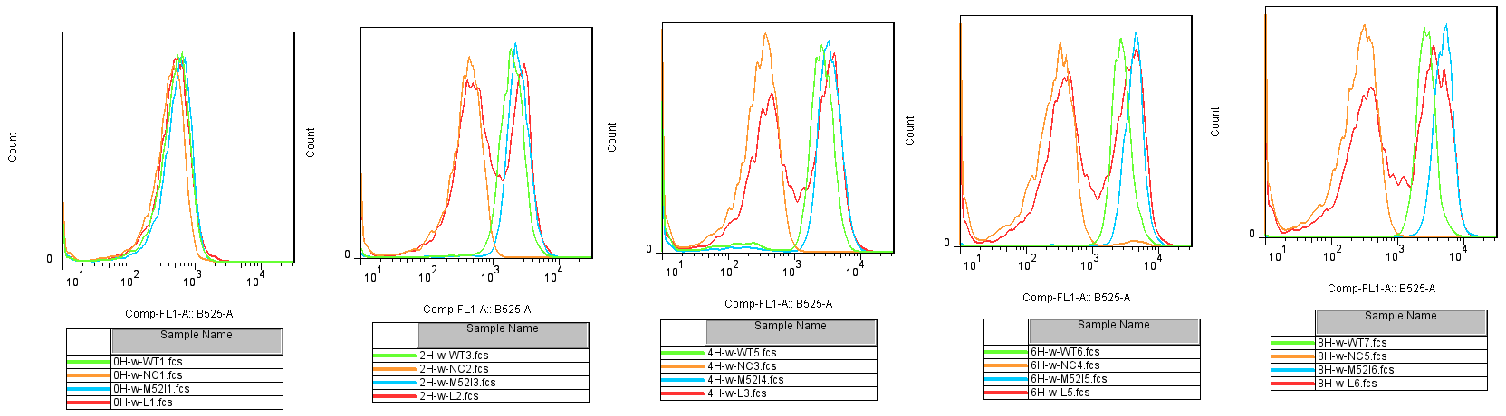
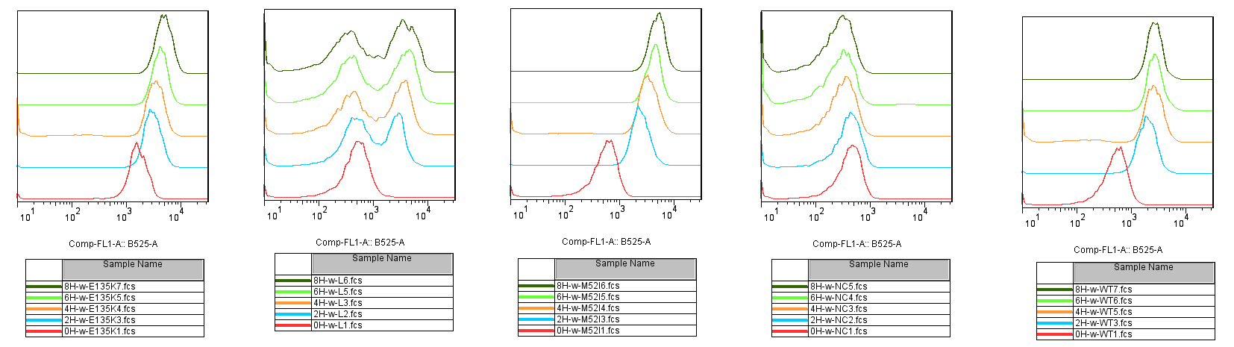
260617

Slide 6
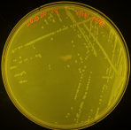
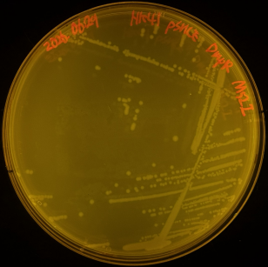
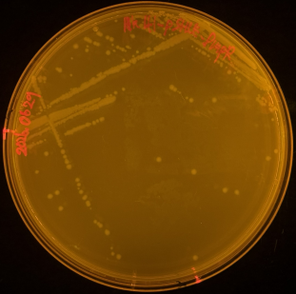
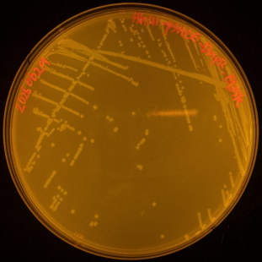
2607
→sample o/n → lb에서 0.4까지 키움 → m9ace로 옮겨서 facs측정
m9-acetate 제작
4g/L acetate
0.2g/50mL Sodium acetate
5x m9 media 10mL +40mL DW
→ Filtering

Slide 7
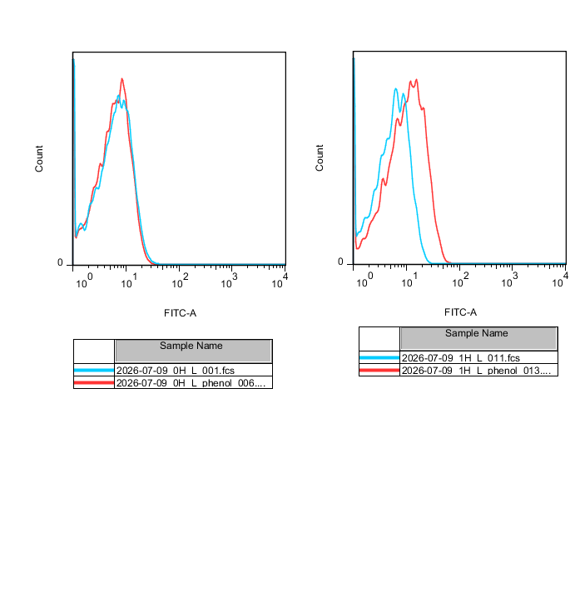
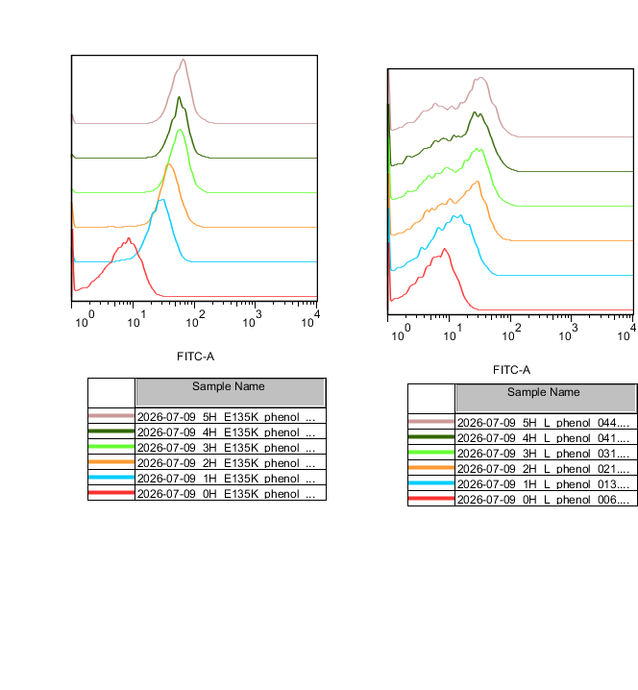
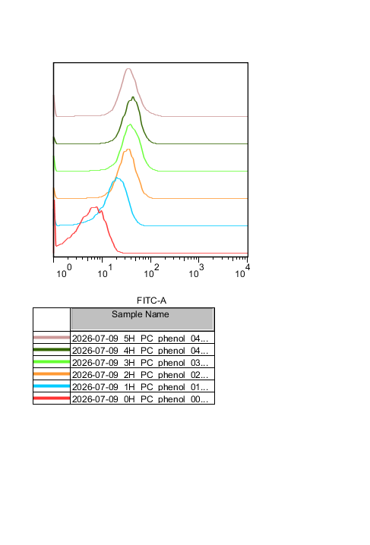
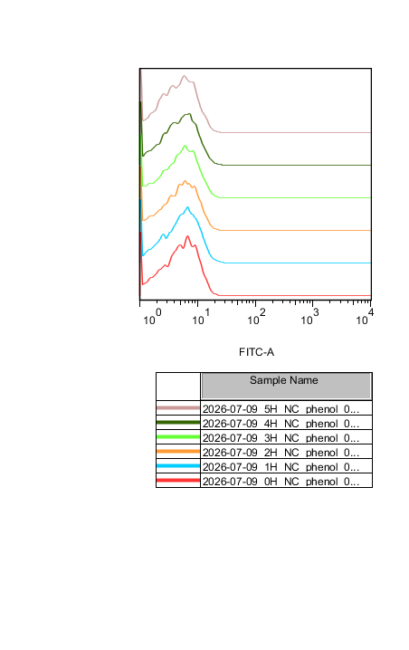
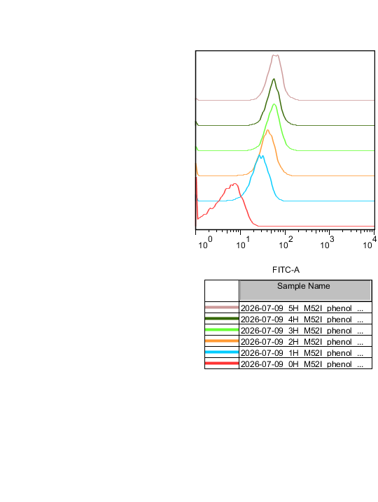
Gate
260709
1h
조건
Strain and Plasmid : HK41 pSHCE
Target transcription factor : DmpR
Reporter gene : eGFP(genome integration)
Phenol Conc. : 10 μM
Initial OD600 : 0.4
Growth media : M9-acetate
사용기기 : FACSAriaIII
Count
FITC-A
DmpR Mutant Library w/o phenol
DmpR Mutant Library w/ phenol
Library
Positive Control
Negative Control
DmpR
M52I
DmpR
E135K
5h
4h
3h
2h
1h
0h
FITC-A

Slide 8
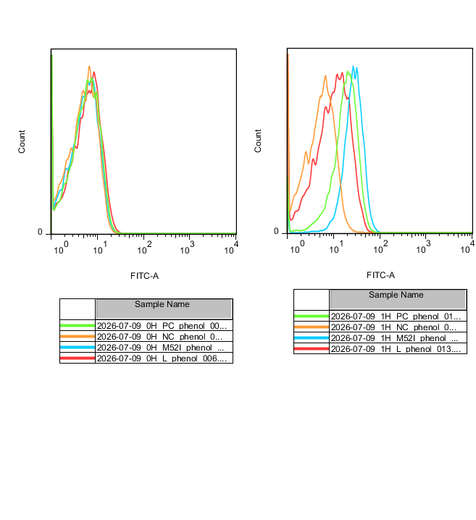
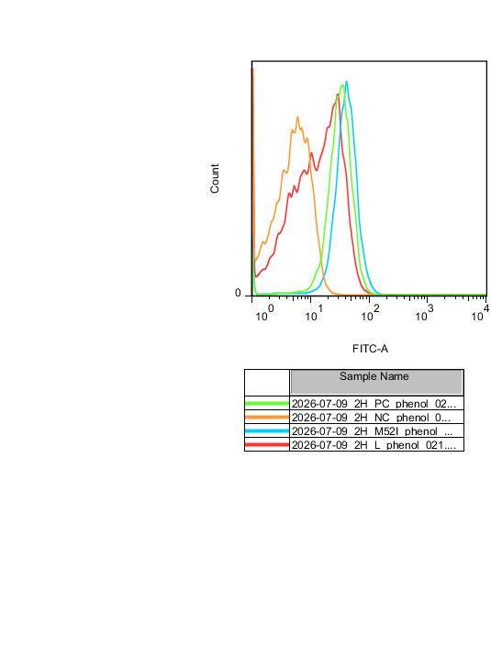
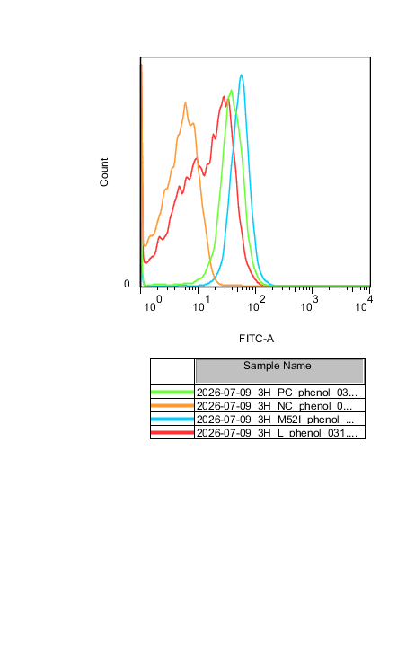
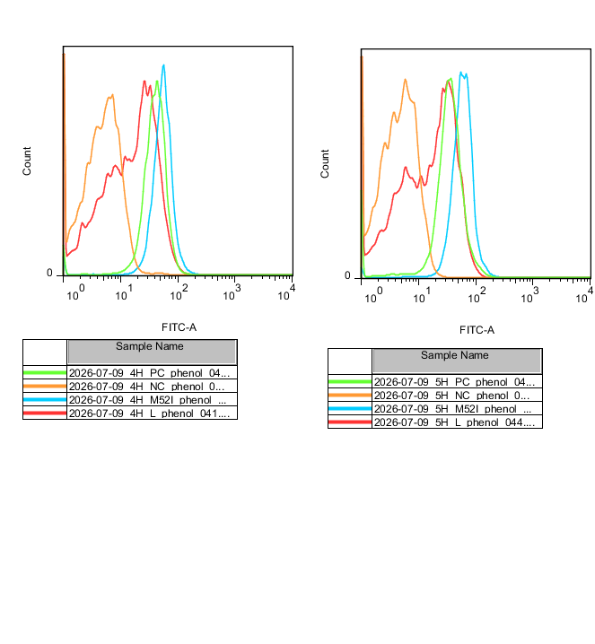
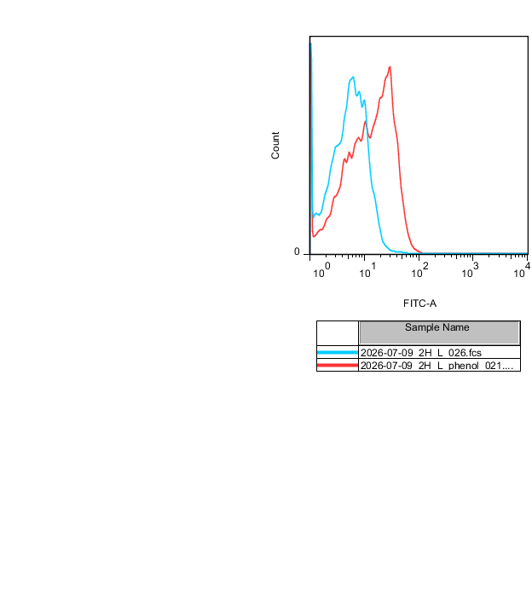
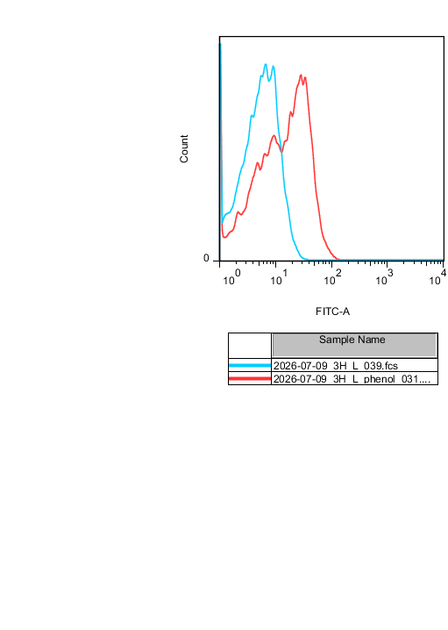
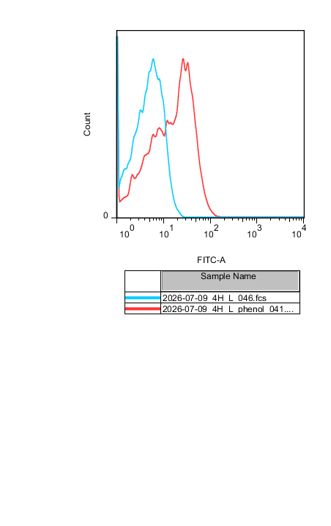
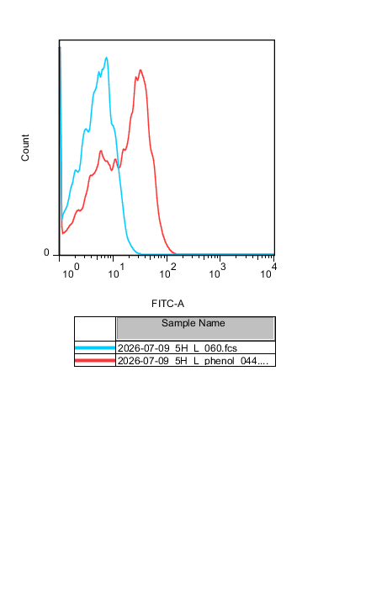
260709
0h
1h
2h
3h
4h
5h
Positive Control
Count
Negative Control
DmpR M52I
DmpR Mutant Library
FITC-A
0h
1h
2h
3h
4h
5h
Count
FITC-A
DmpR Mutant Library w/o phenol
DmpR Mutant Library w/ phenol

Slide 9
260709

Slide 10
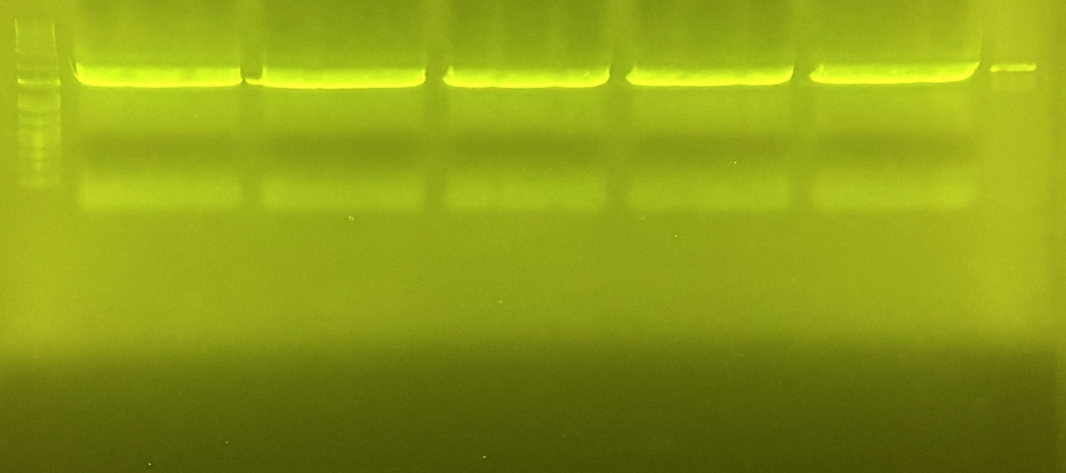
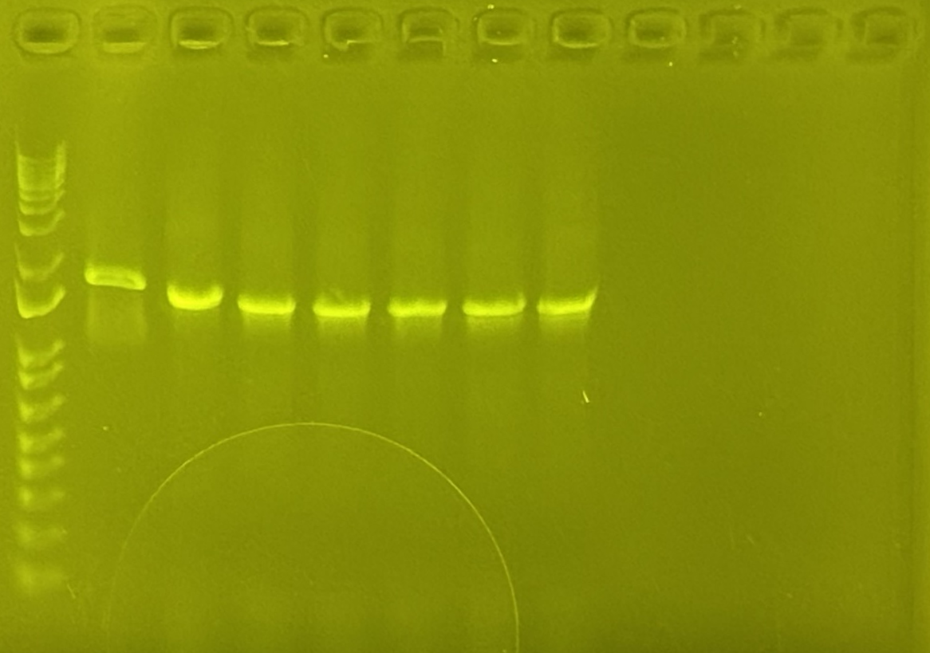
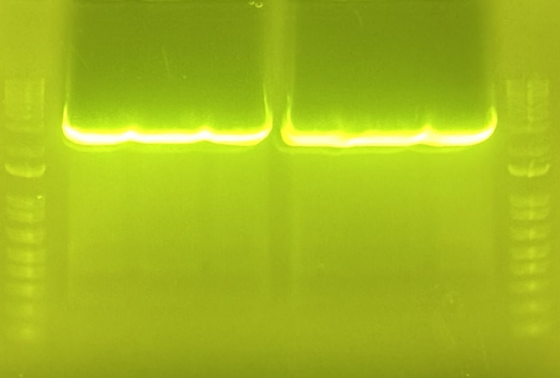
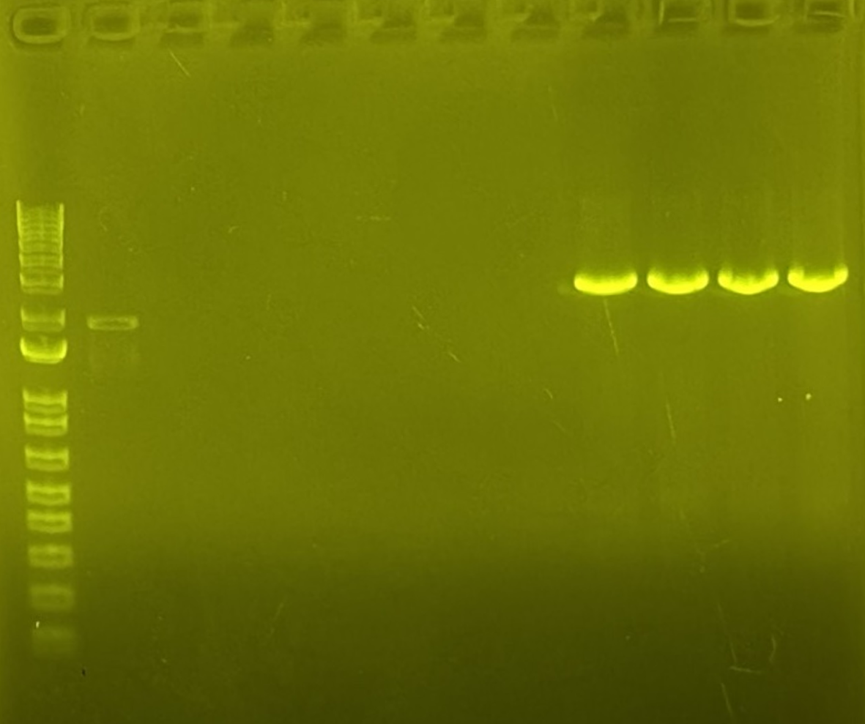
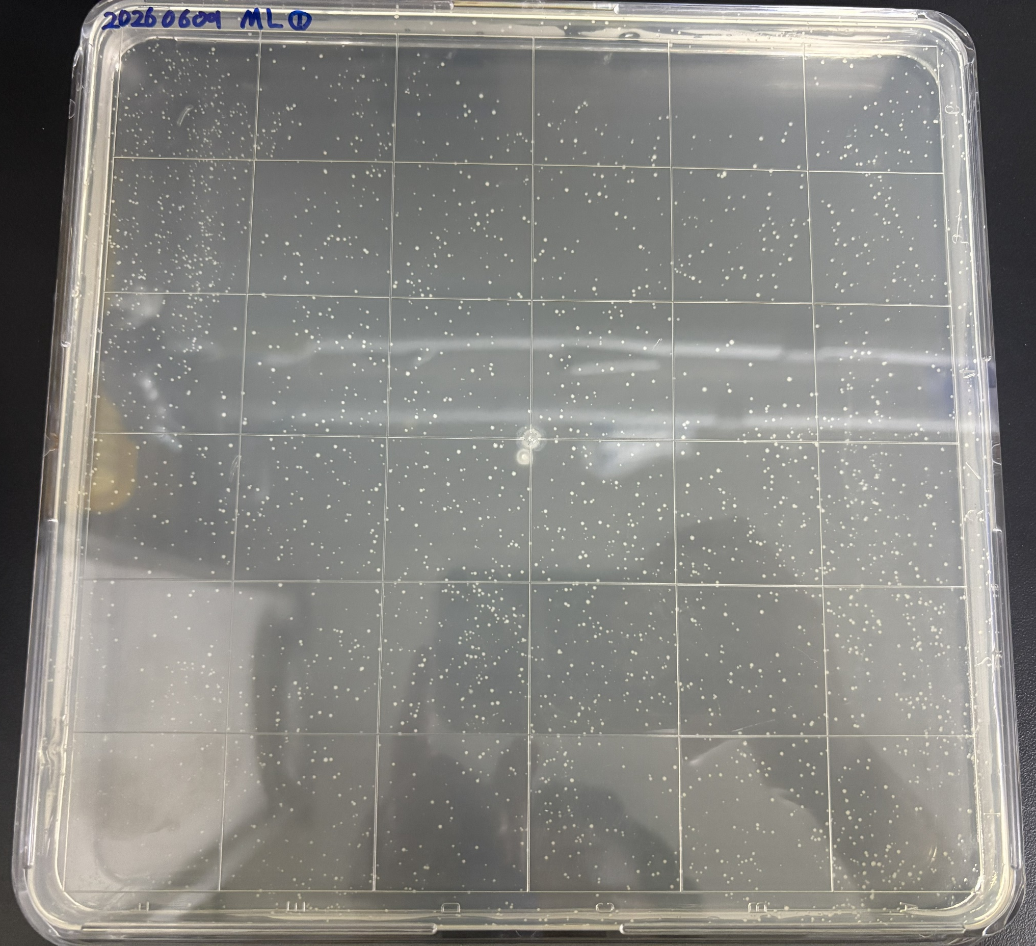
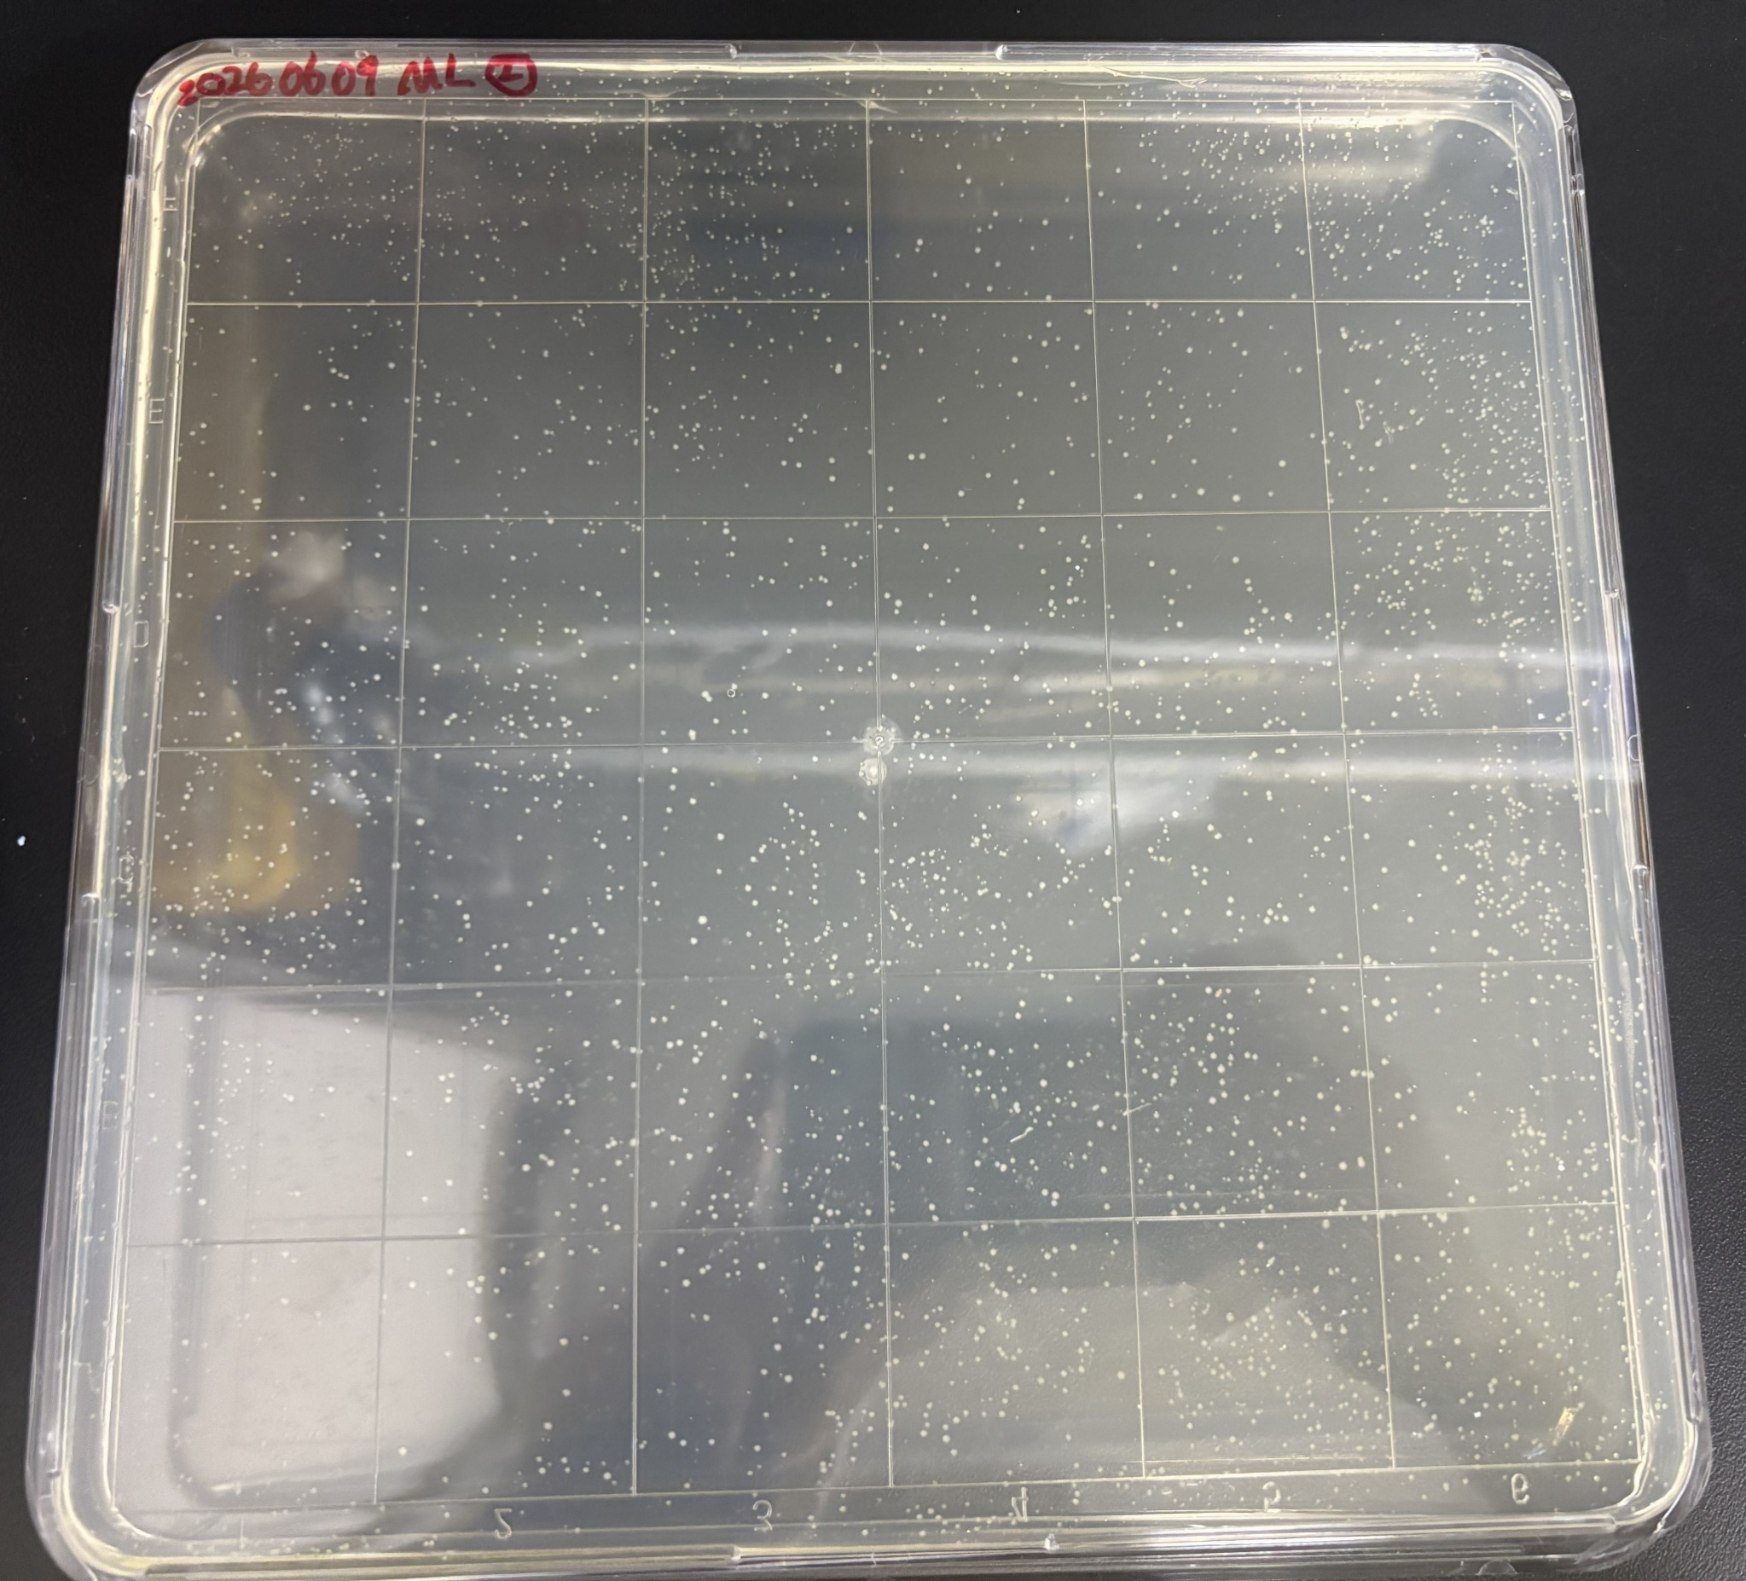
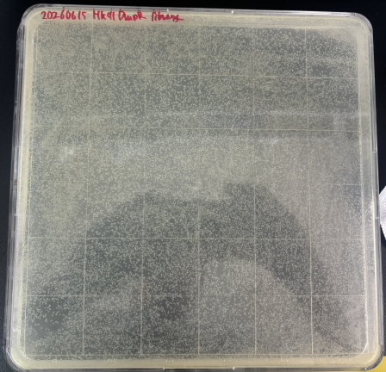
ML 제작
260604
- sample#1~#6
- vector #1~#4
260608
- insert 148.2ng/uL
vector 474.4ng/uL
vector 0.611uL
insert 2.43uL
DW 6.96uL
GA mixer 10uL
-----------------
Total 20uL
Thermocycler 37℃ 5min → 50℃ 1h
GA purification → #1 21.8ng/uL, #2 22.9ng/uL
260609
GA puri transformation 결과확인
260610
cell 회수 + Miniprep
cell회수용 buffer recipe
2xYT 15mL
30% glycerol 15mL
20% glucose 3mL
Cell 회수용 buffer 10mL 뿌리고 spread + 10mL 뿌리기
4℃ 2000xg 10min centri → OD600 측정
LB950uL + LIB 50uL → OD600 1.079 → OD600 0.661(1/2희석)
  26.44(총 OD600)
  LIBRARY 500uL +LB 1.5mL → Miniprep
260616
Library(HK41) cell 회수
10mL씩 2번 회수
Centrifuge시켜 1mL로 스탁제작
OD600
1/100배 → 1.369
1/200배 → 0.968
1/400배 → 0.533 → 평균 OD600 203.3
Random Mutagenesis
Sample #1~#6
PC
PC
Random Mutagenesis
Sample #1~#6
3kbp
2kbp
1.5kbp
3kbp
2kbp
1.5kbp
260611
40개 sample sanger seq
HC01484462
260615
LIBRARY(HK41) TF
library plasmid extract 50uL x2 → (lib 10uL+CP cell 200uL) X10
Library plasmid extract conc.(ng/uL)
#1 10ng/uL
#2 8.4ng/uL
Vector
#1~#4
3kbp
3kbp
PC
Random Mutagenesis
Sample #1~#6
Vector
#1~#4
2kbp
2kbp
1.5kbp
1.5kbp
3kbp
2kbp
1.5kbp

Slide 11
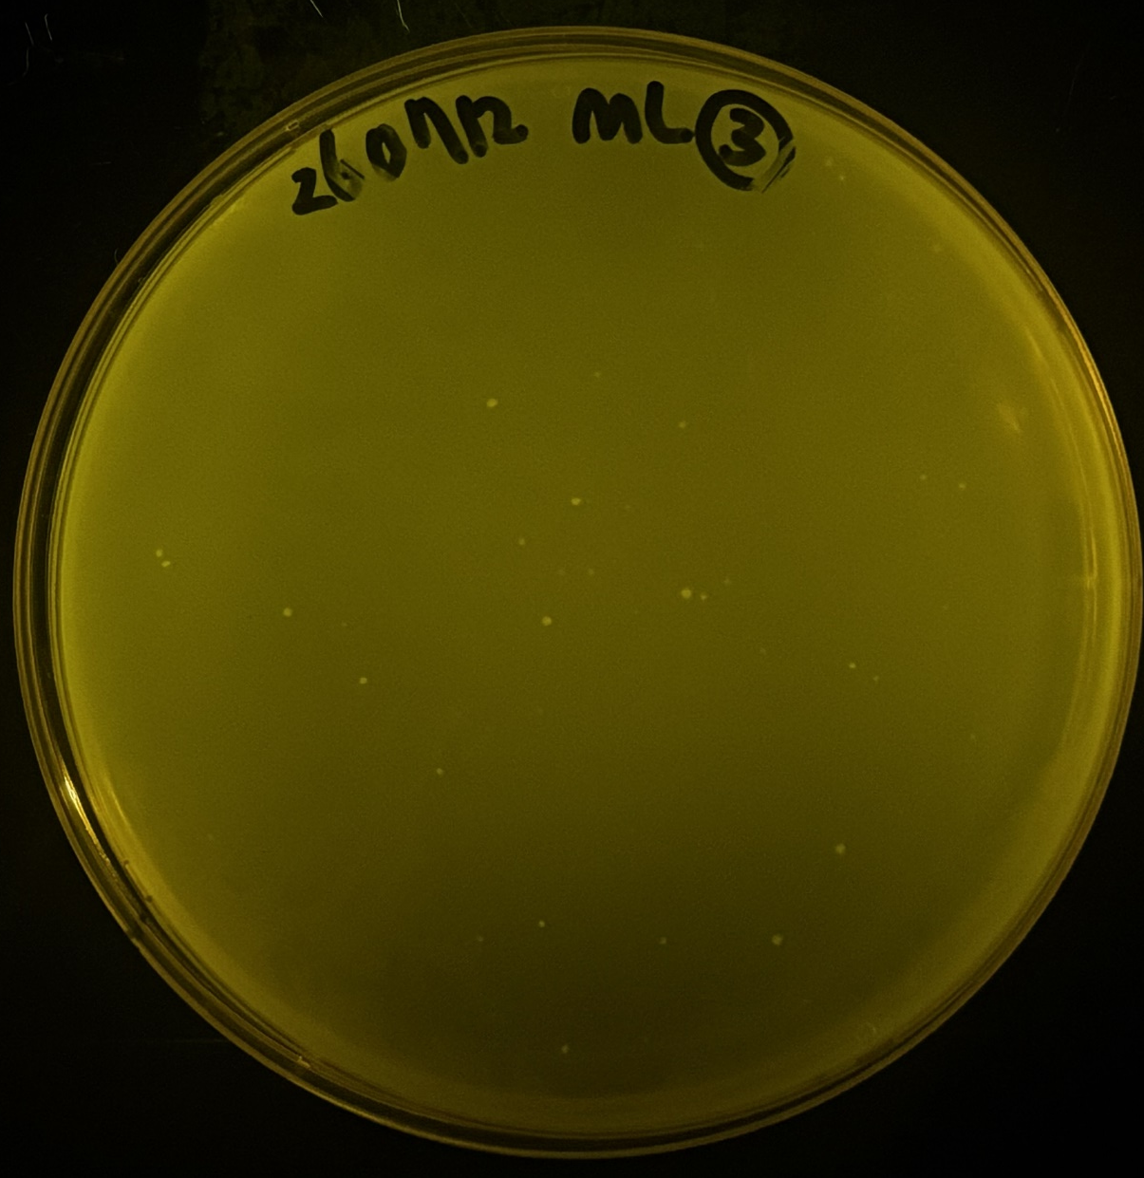
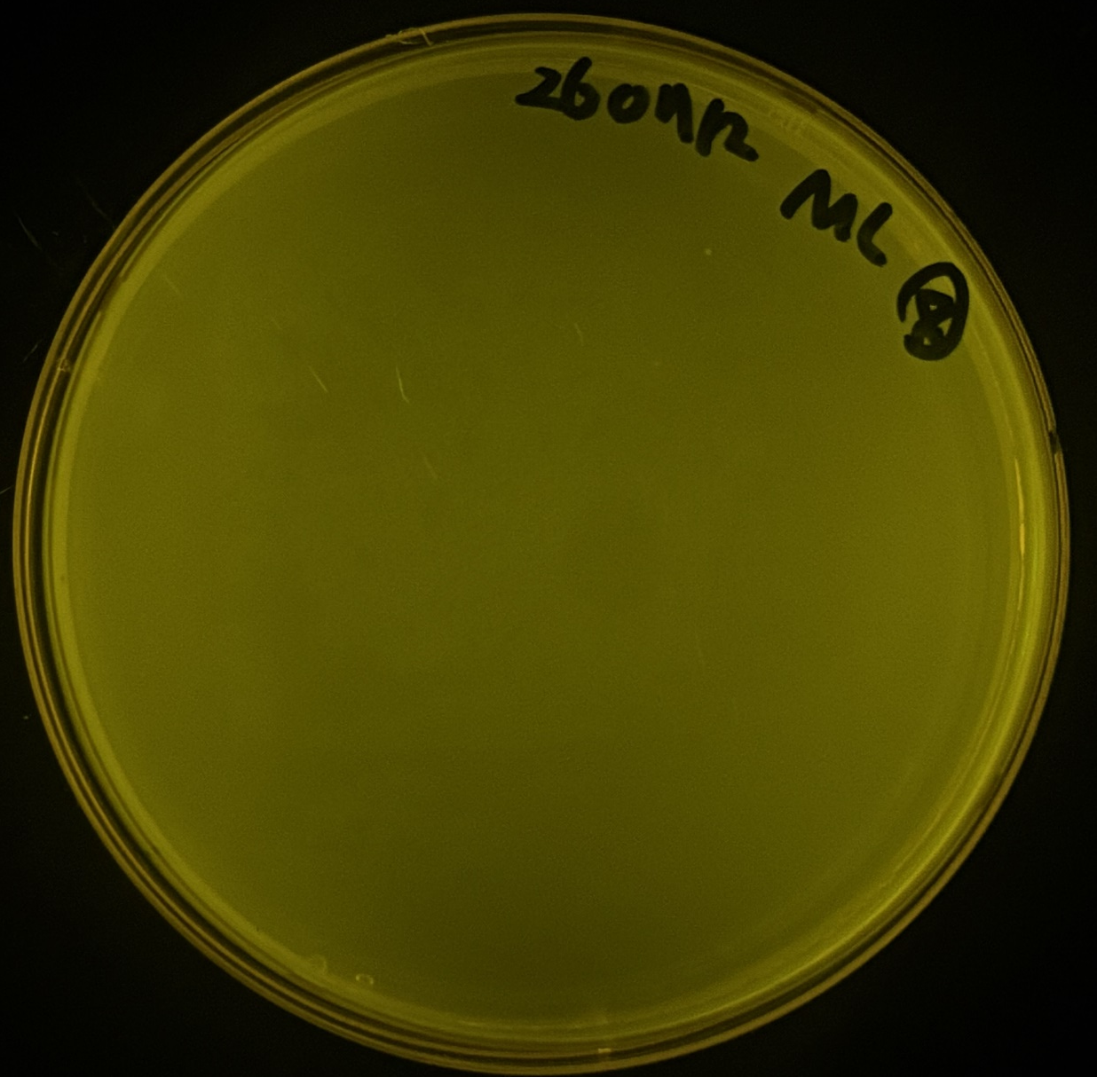
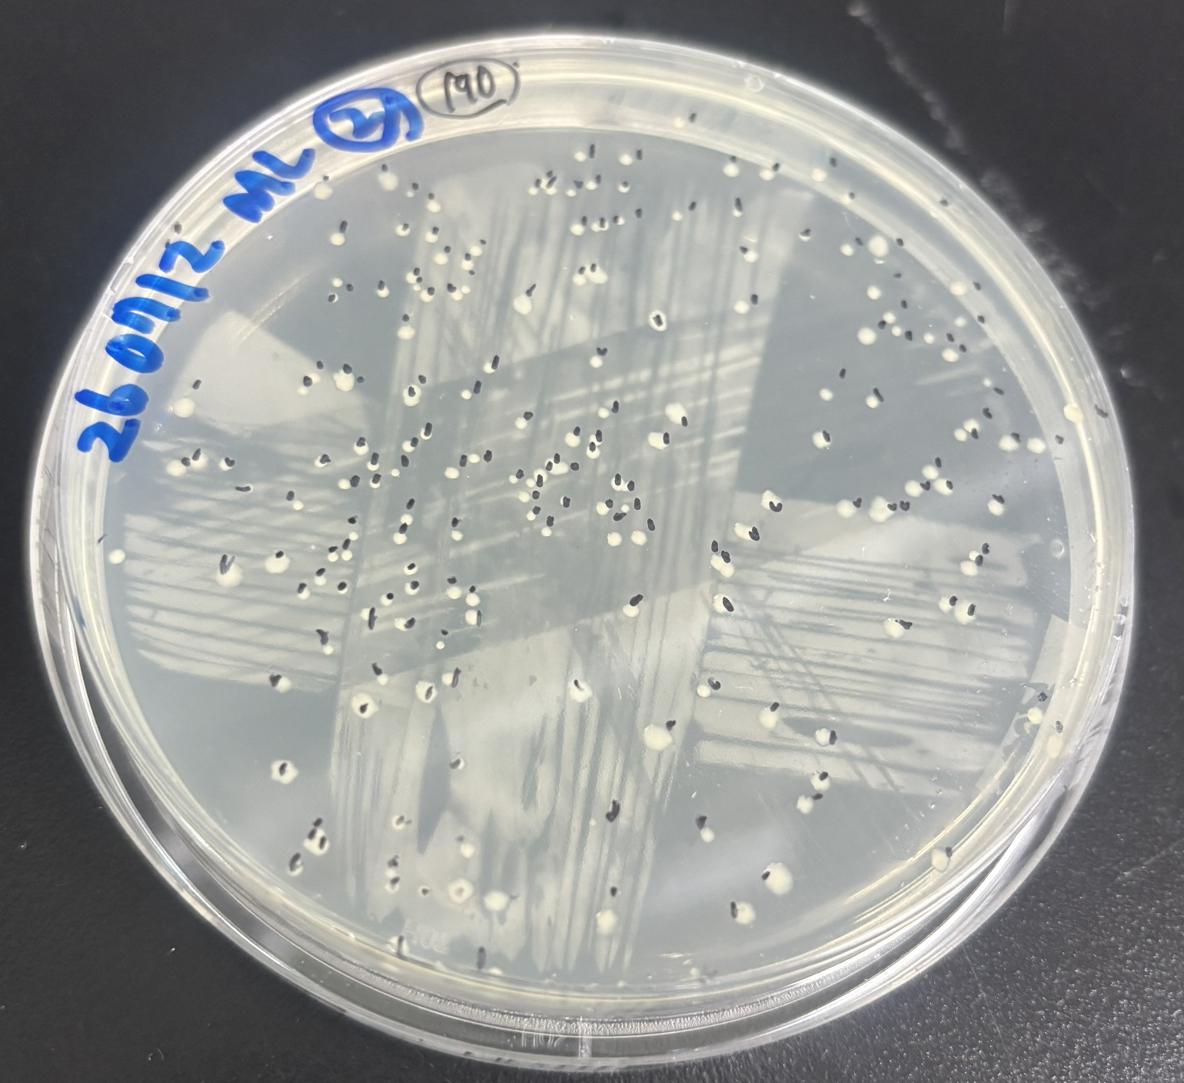
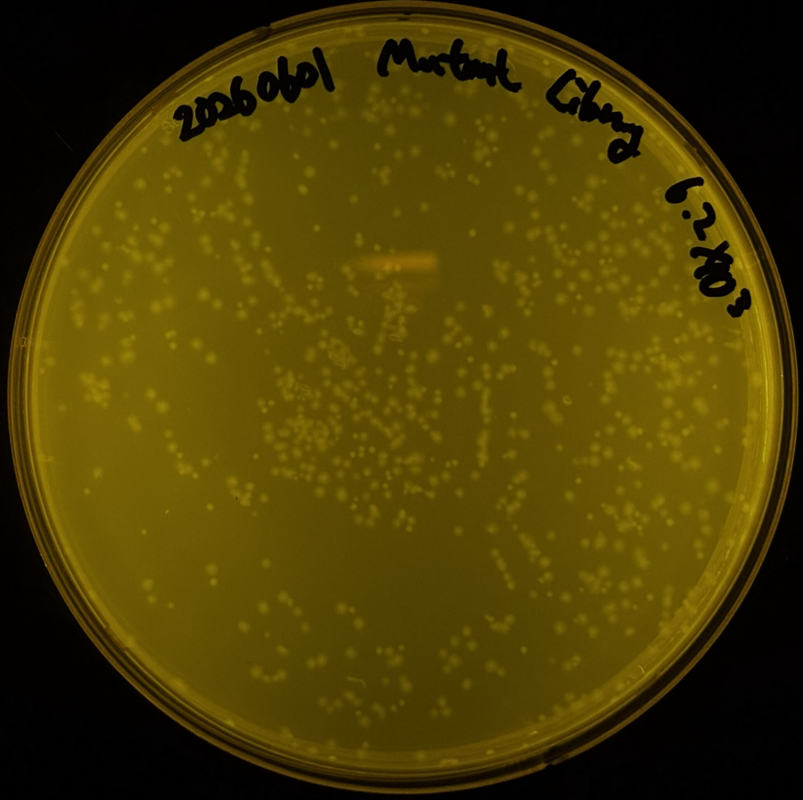
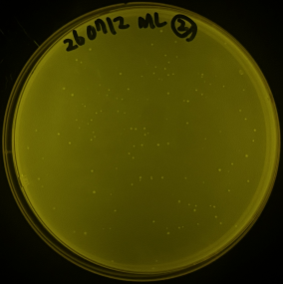
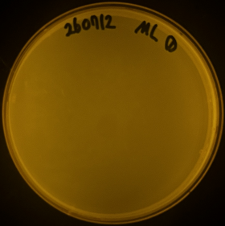
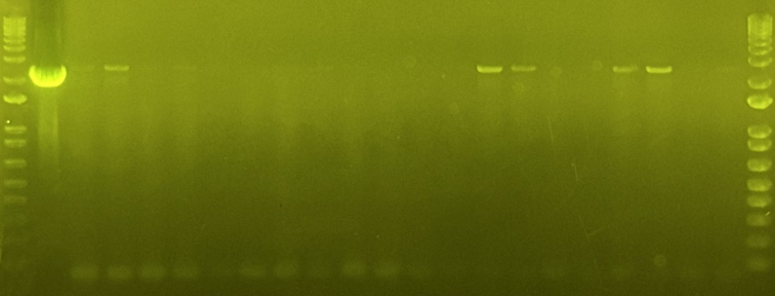
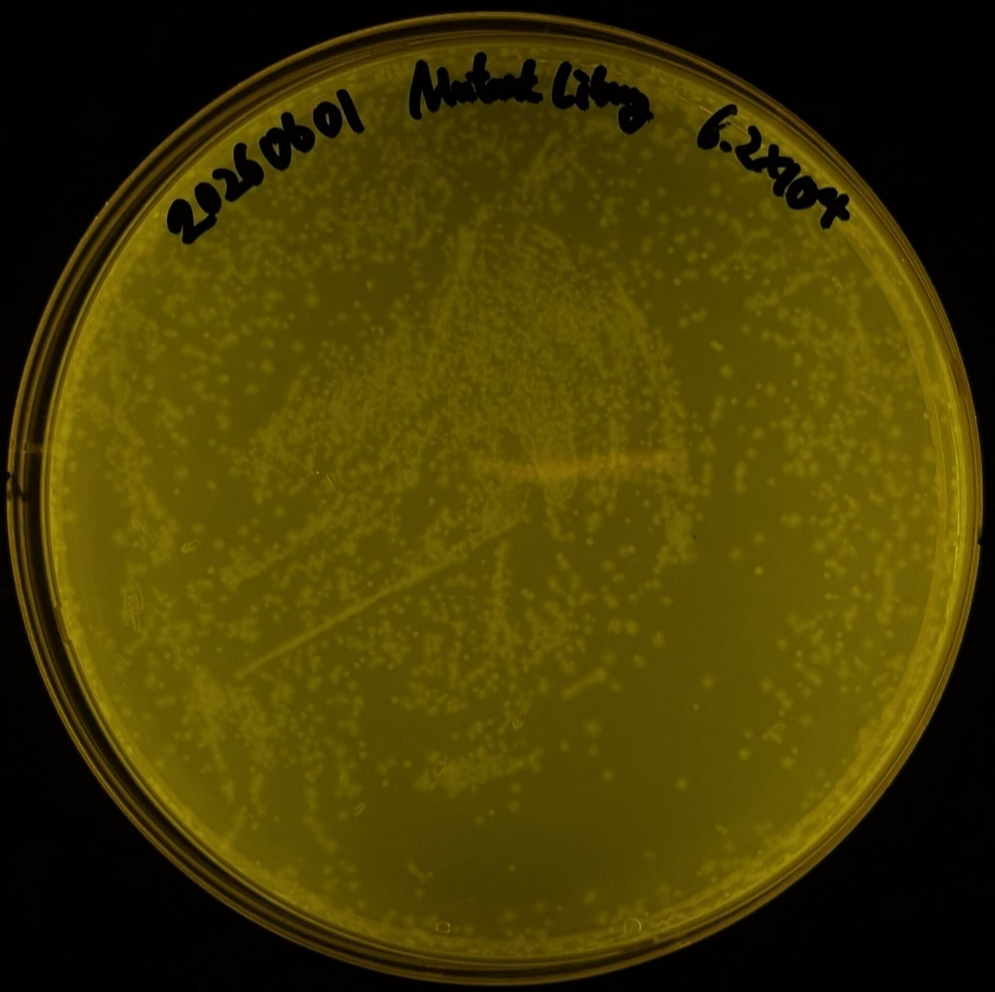
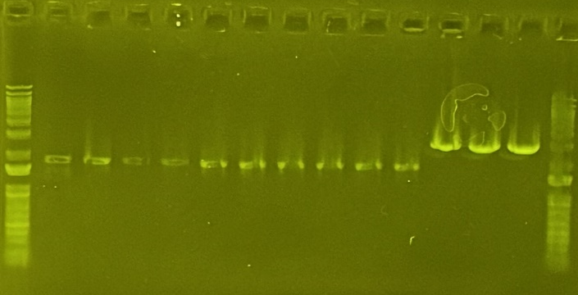
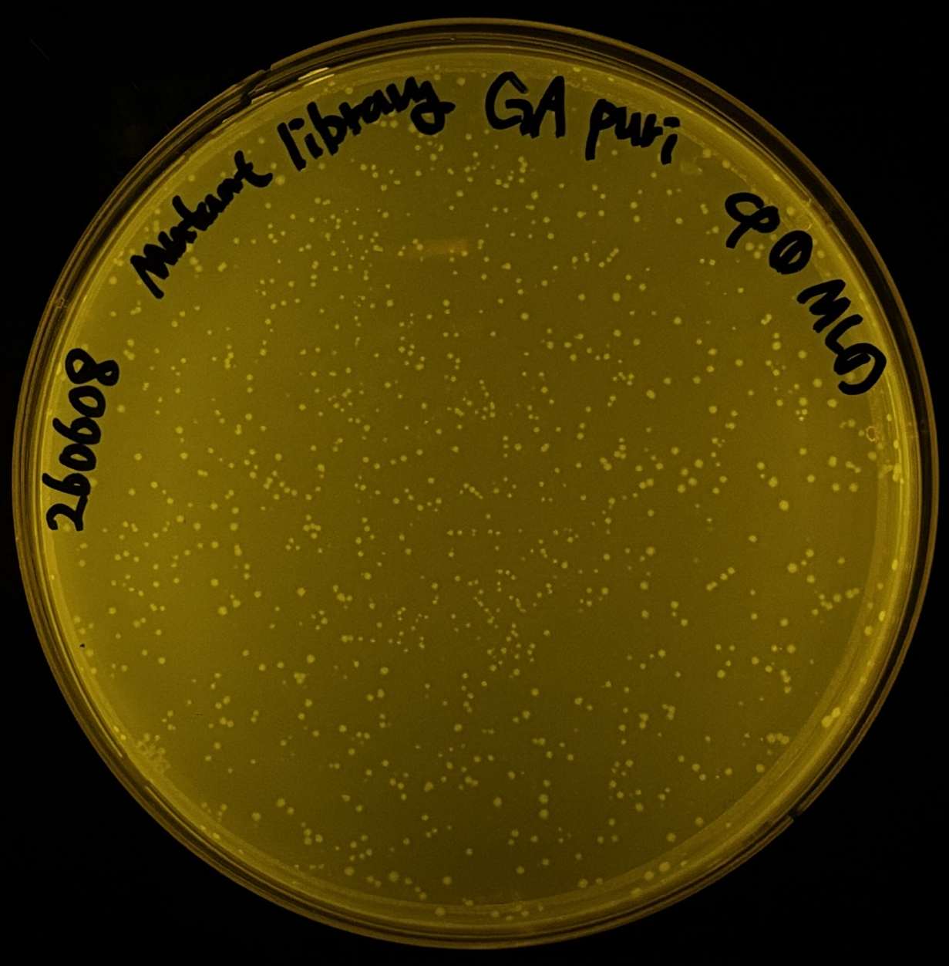
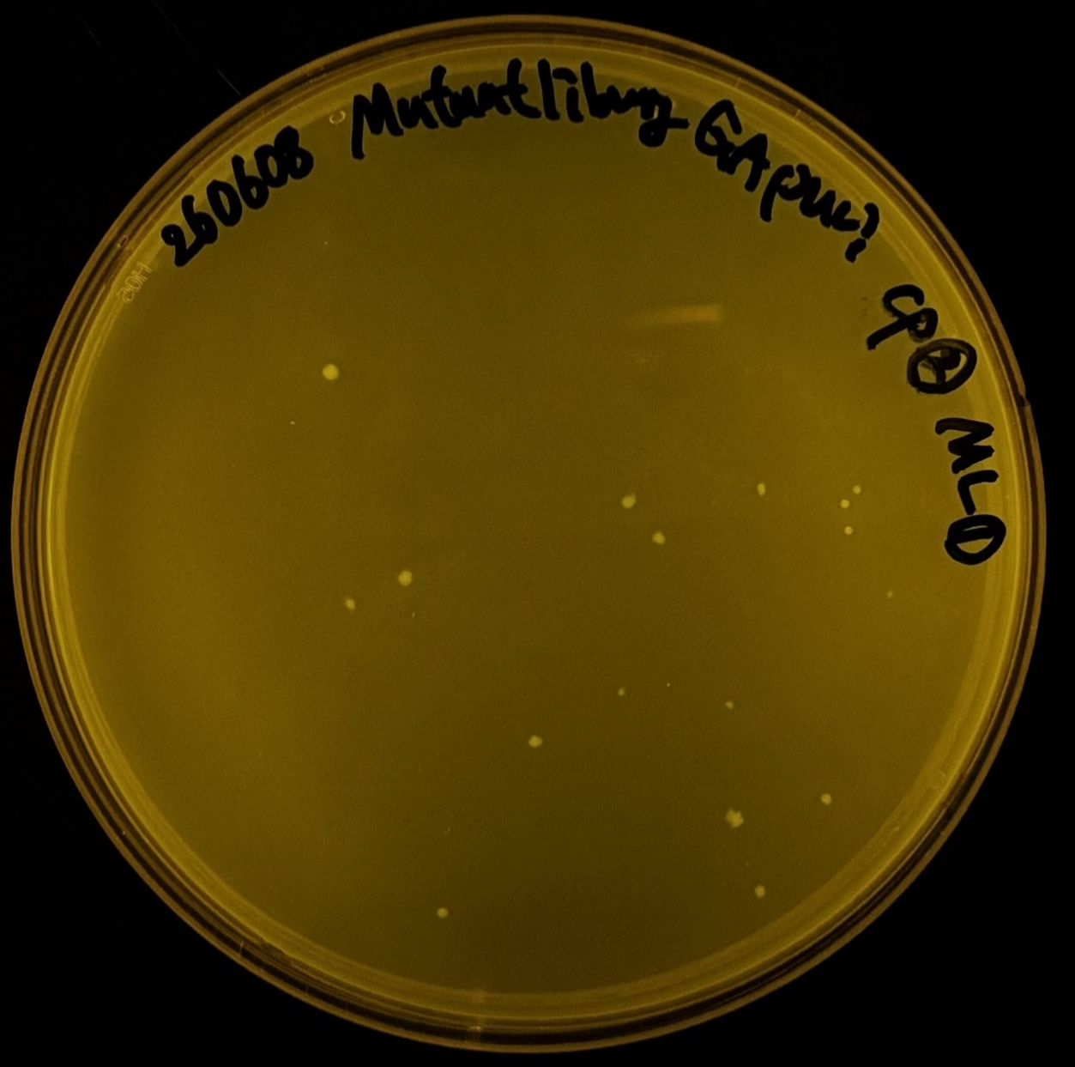
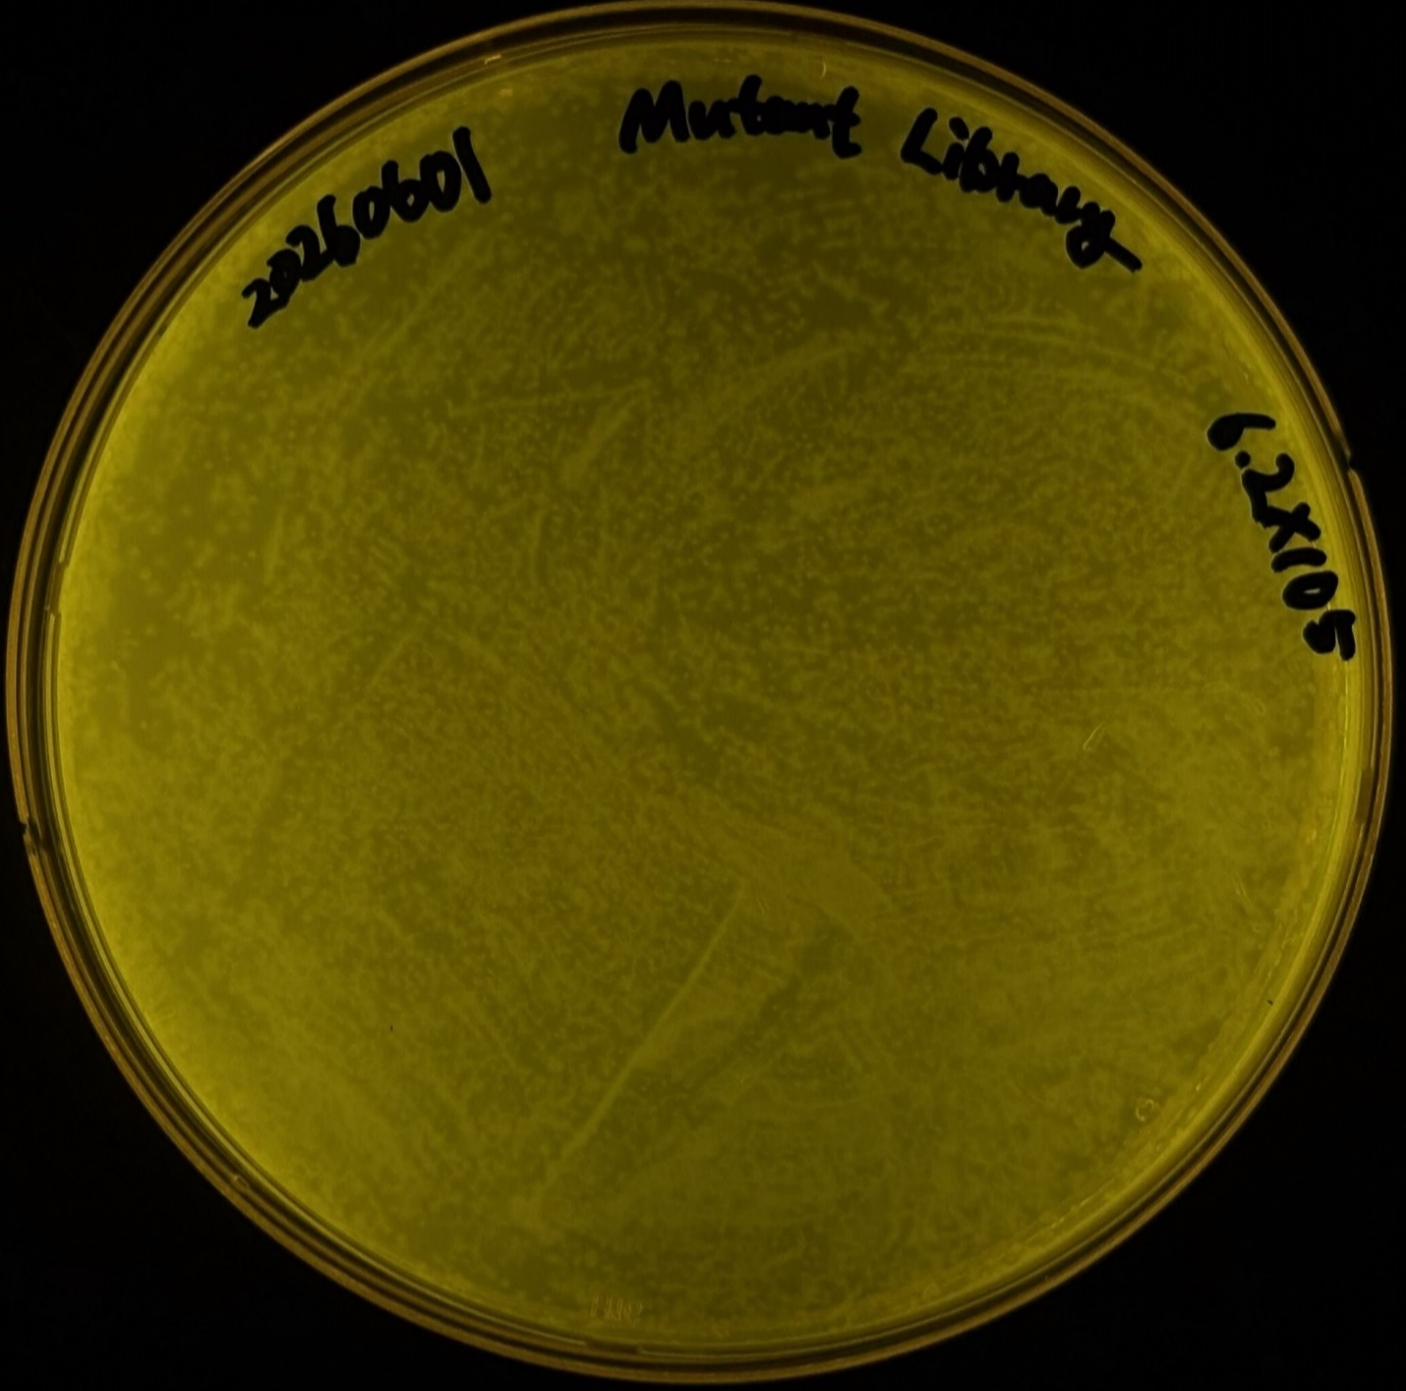
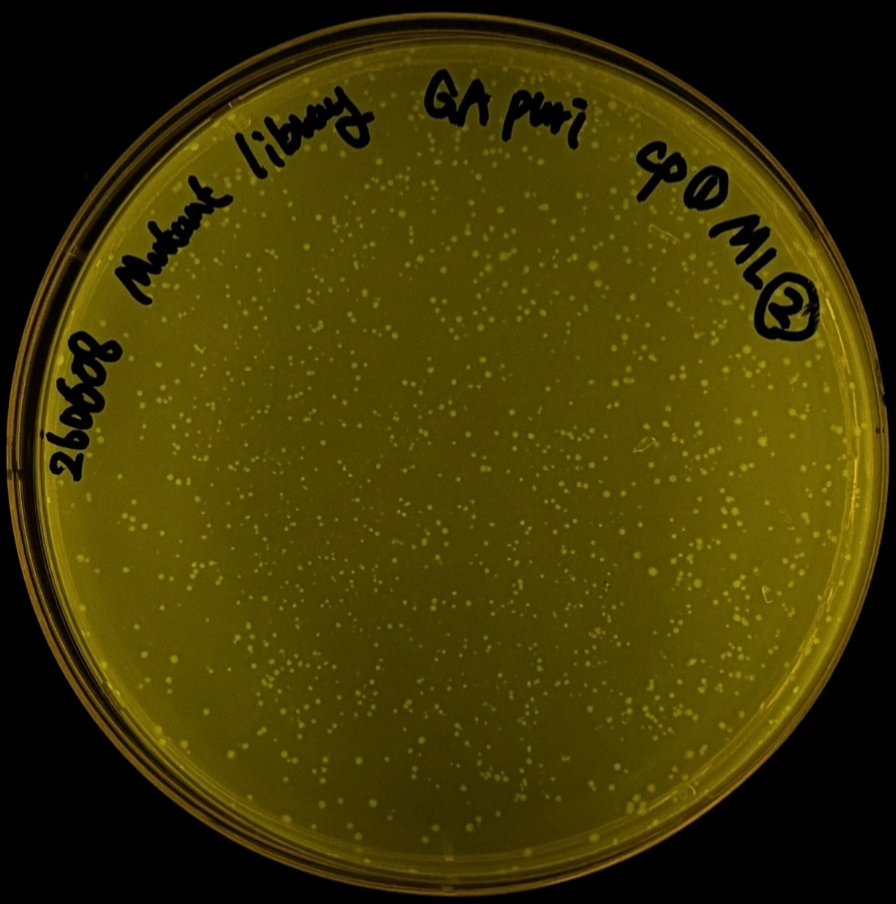
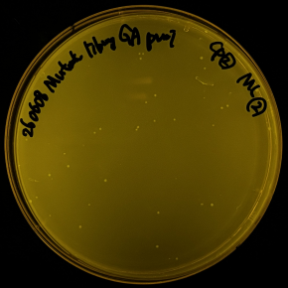
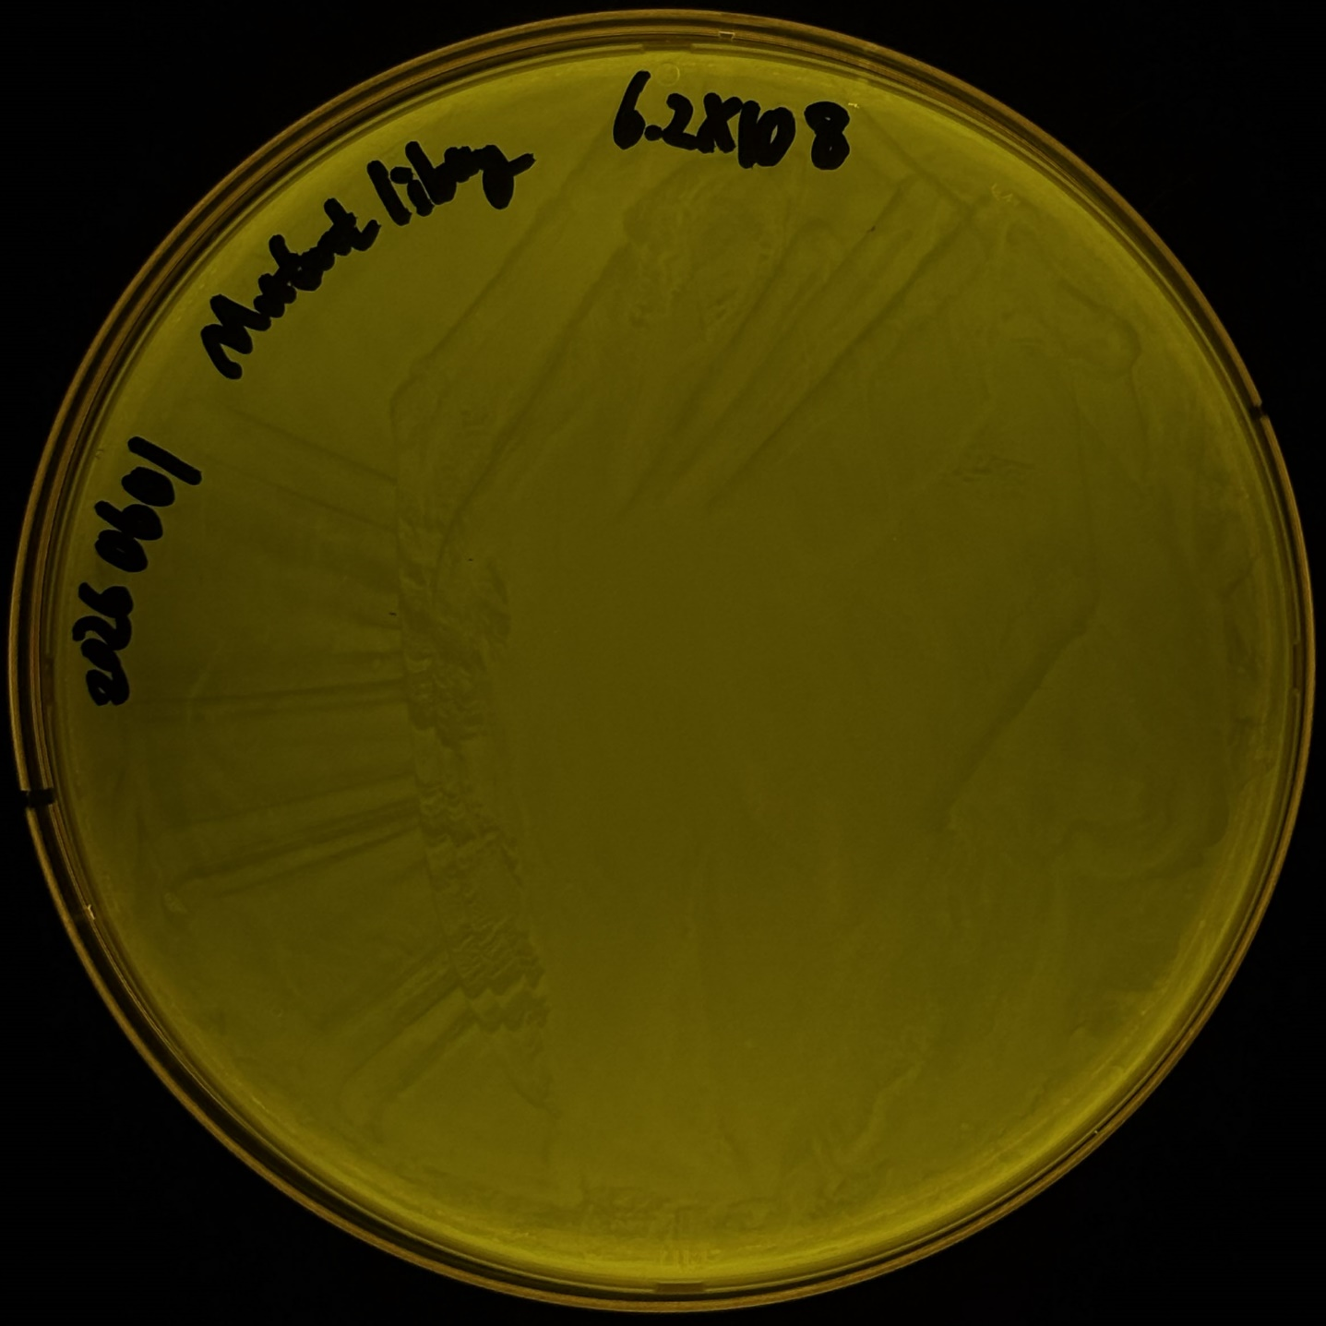
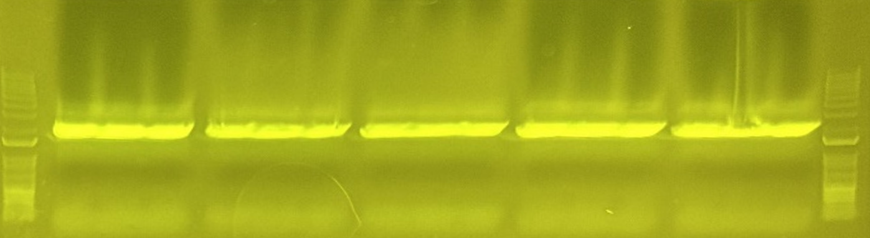
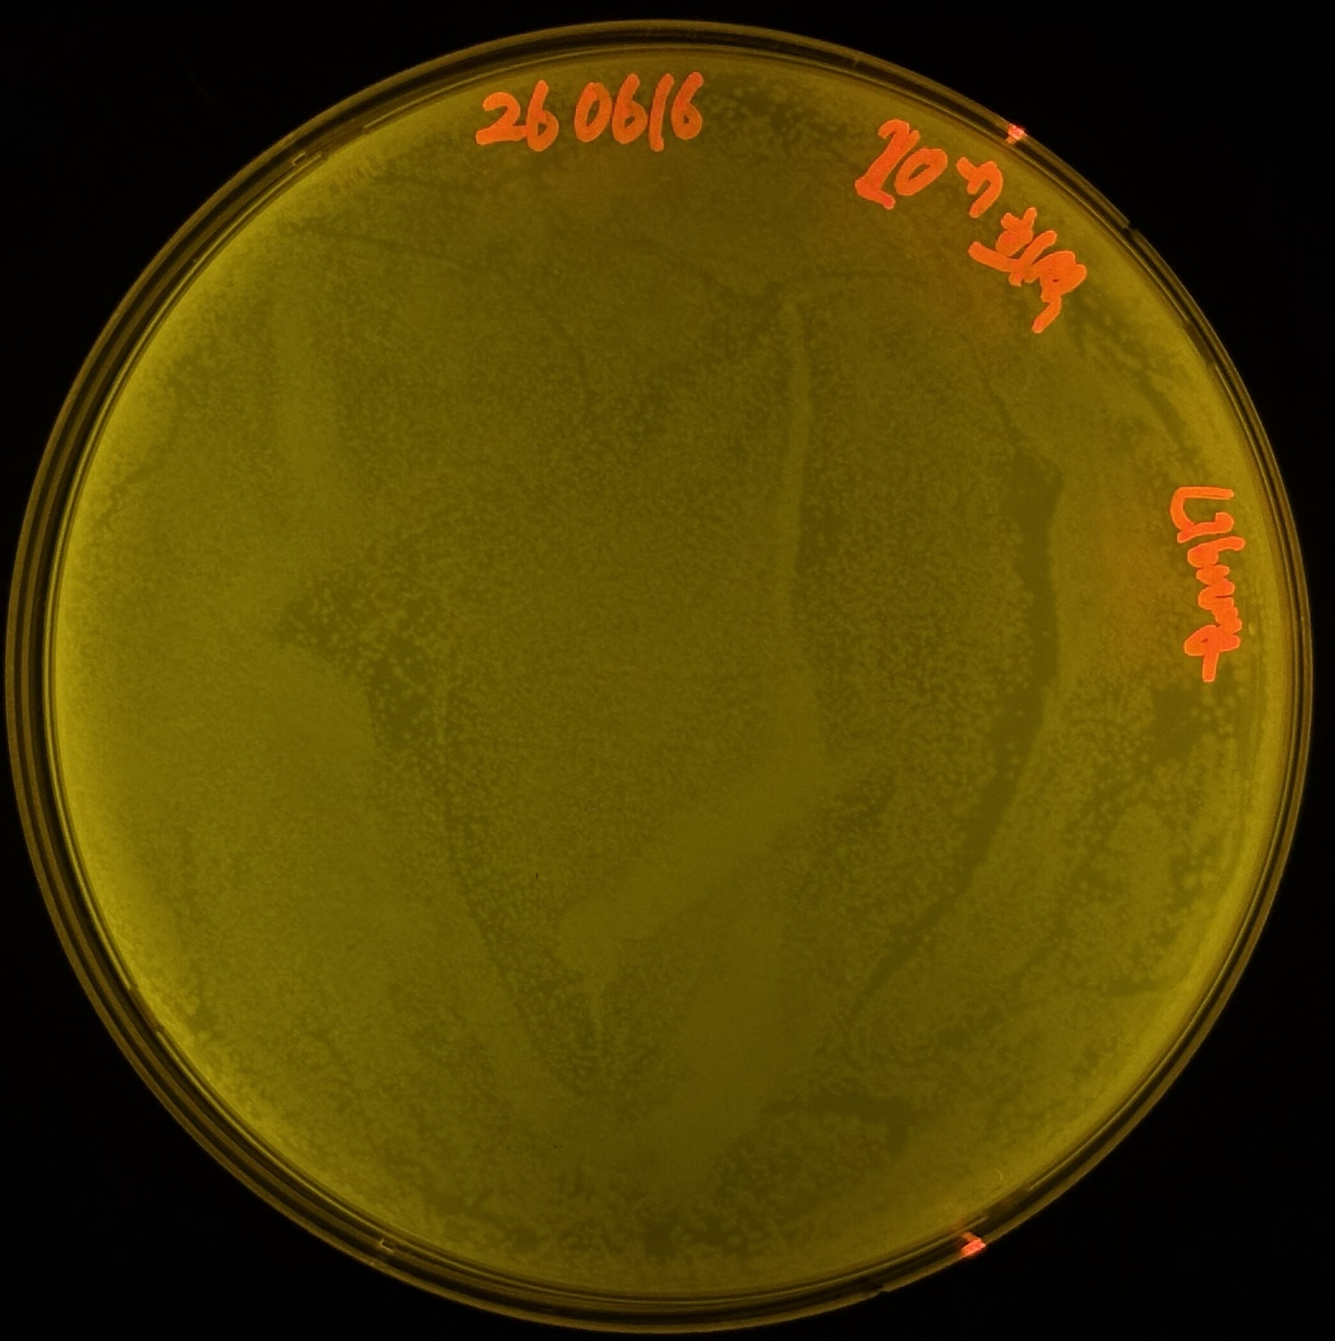
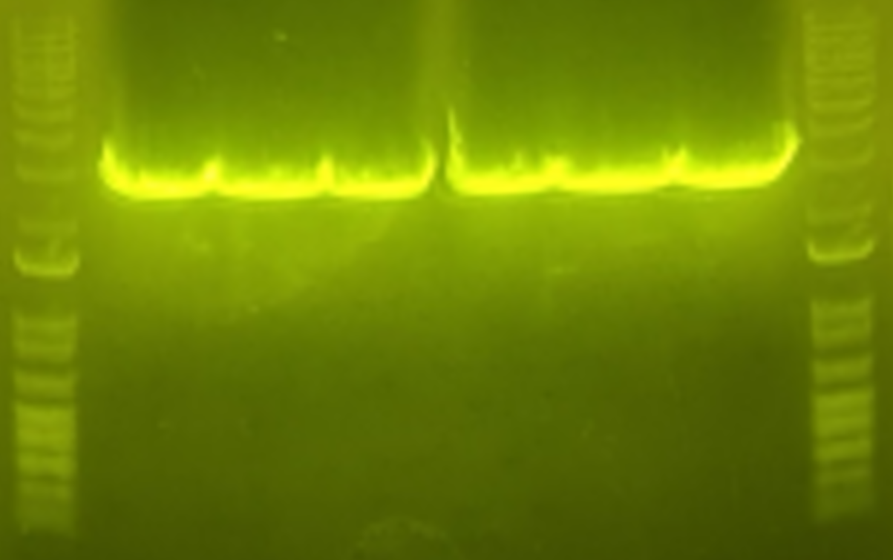
Mutant Library Quality Test
3kbp
PC
1 2 3 4 5 6 7 8 9 10 11 12 13 14 15 16 17 18 19 20
3kbp
2kbp
1.5kbp
2kbp
1.5kbp
Competent Cell #1
Mutant Library #1
Competent Cell #2
Mutant Library #1
PC
Random Mutagenesis
Sample #1~#6
Vector
#1~#3
3kbp
3kbp
2kbp
1.5kbp
2kbp
1.5kbp
Competent Cell #1
Mutant Library #2
Competent Cell #2
Mutant Library #2
Random Mutagenesis
Sample #1~#6
3kbp
3kbp
Vector
#1~#3
2kbp
2kbp
1.5kbp
1.5kbp
3kbp
3kbp
2kbp
2kbp
1.5kbp
1.5kbp

