Slide 1
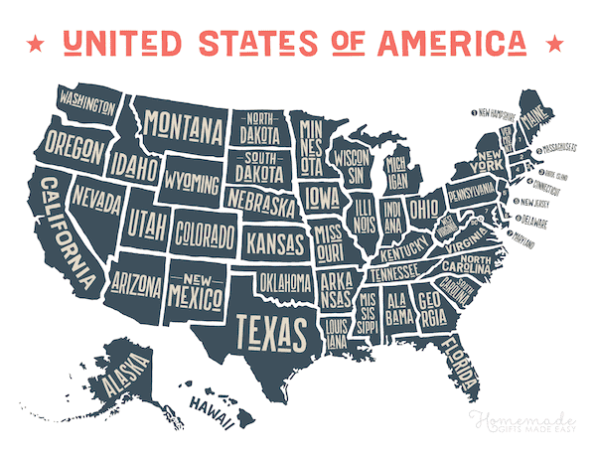
US Regional Sales Project
Youki Chiba
Interactive Tableau Visualization Here

Slide 2
The Goal Of The Project
Analyze Sales Trends
Identify Popular Products
Assess The Performance Of Different Sales Channels

Slide 3
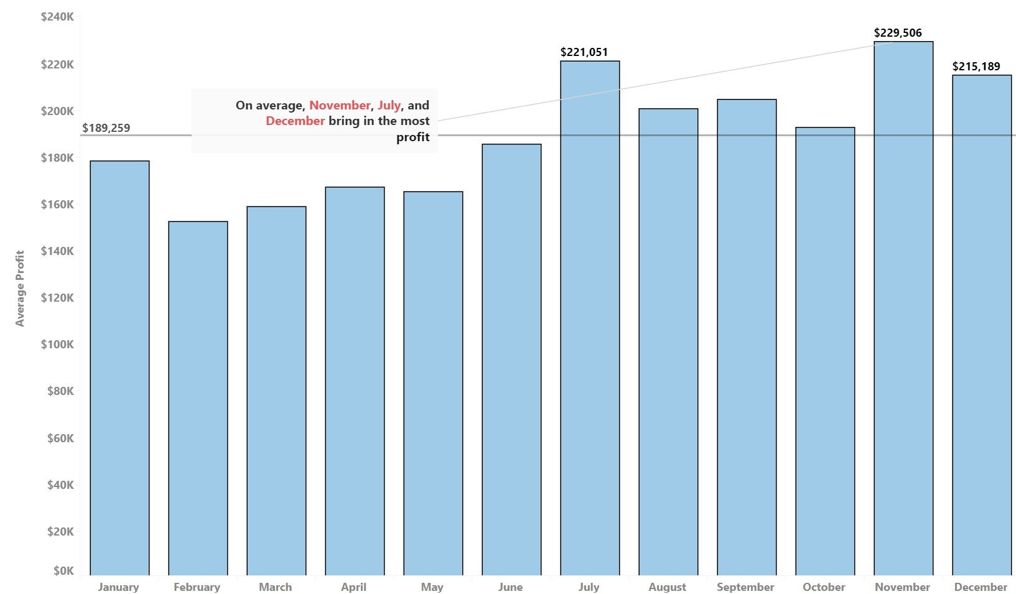
Analyzing Sales Trends
Plotted sales trends over time to identify seasonal patterns and changes in profit
On average, months after June perform better than months before

Slide 4
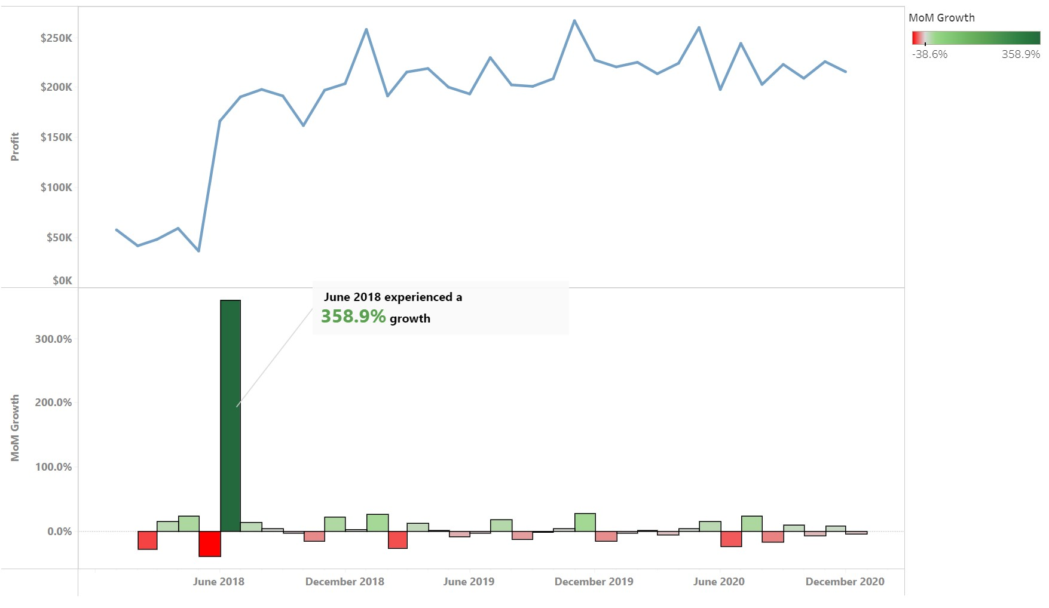
Why do months after June bring in more profit?
There was a sudden increase in profit during June 2018 which led to sustained higher profits in the months following
The relatively low profits before June 2018 incorrectly made it look like those months consistently underperform

Slide 5
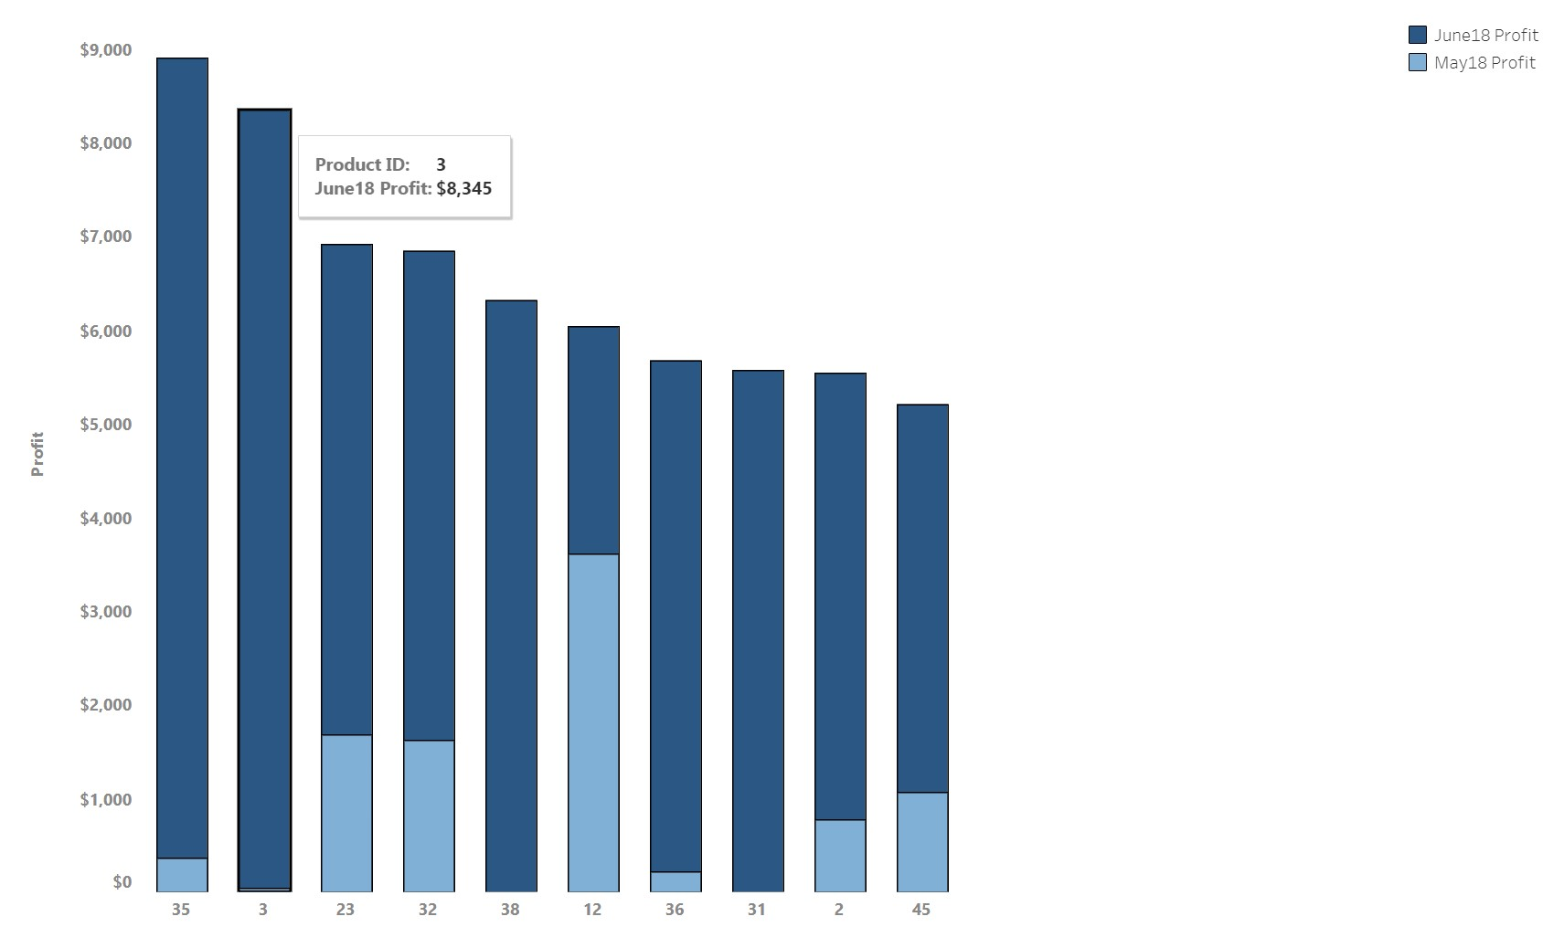
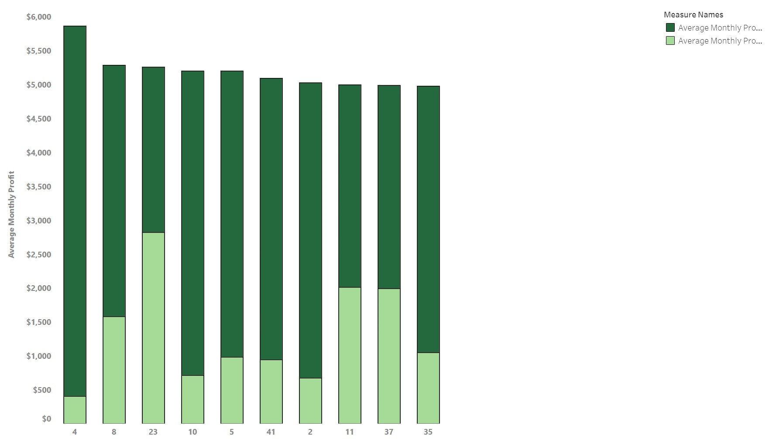
What caused the sudden increase in profit?
Explored possibilities by analyzing columns given in the dataset (Product ID, Sales Team ID, Store ID)
No product(s) were responsible for the increase because the increase was distributed among many products instead of being driven by outliers

Slide 6
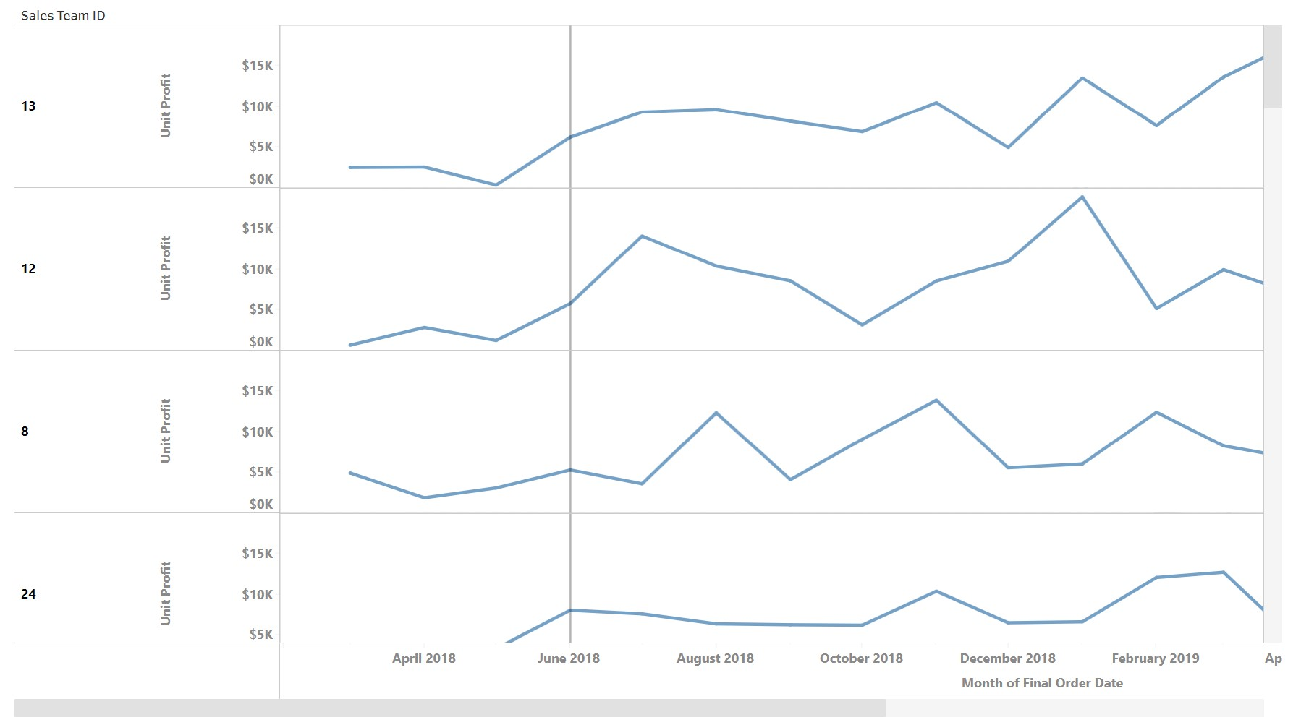
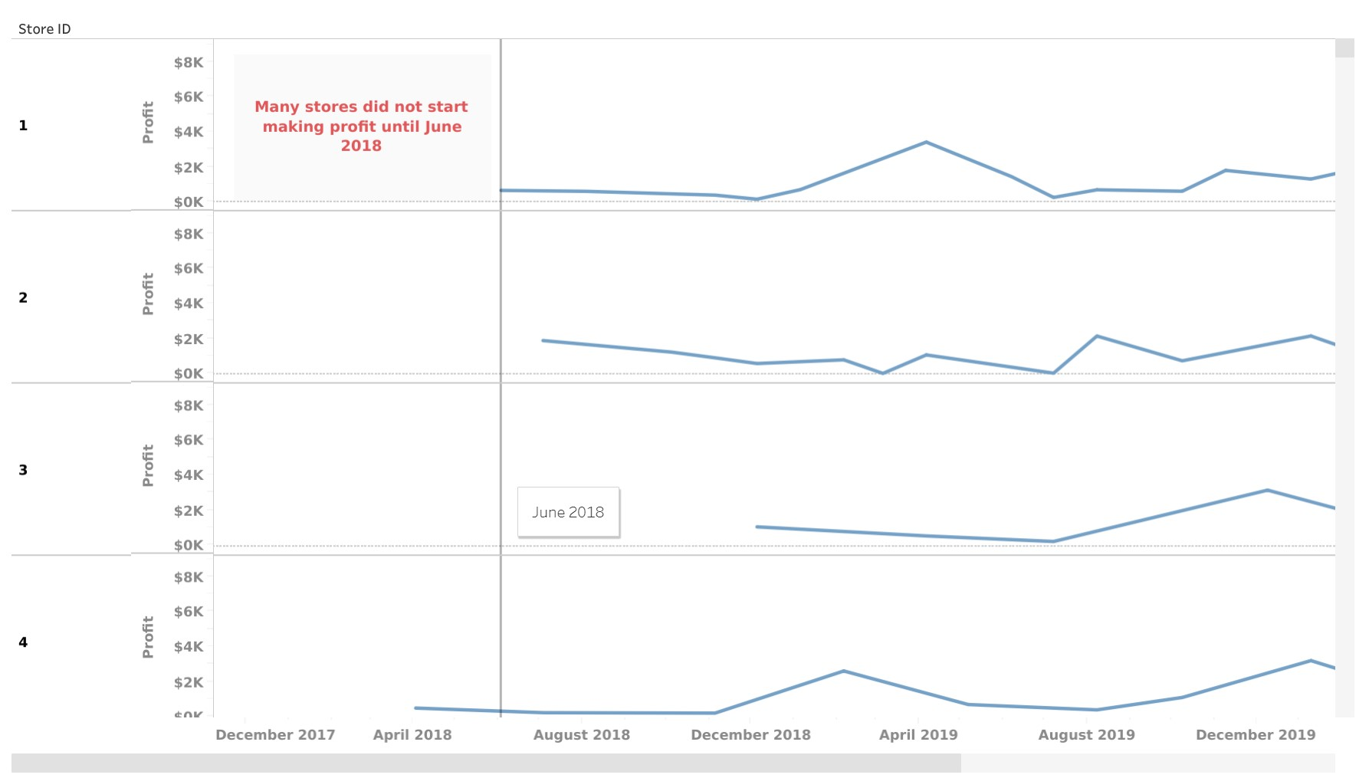
No team(s) were responsible for the increase. Similarly to products, many teams experienced an increase in profit in June 2018 but the increases were not significant enough to say they drove the increase
The opening of many stores during and after June 2018 caused the sudden increase

Slide 7
Recommendations Based On Sales Trend Analysis
Ensure that the supply chain is optimized to handle the increased demand from the new stores
Look into the cost of opening new stores and make sure there is adequate ROI
Consider opening more stores in areas with similar demographics or market potential

Slide 8
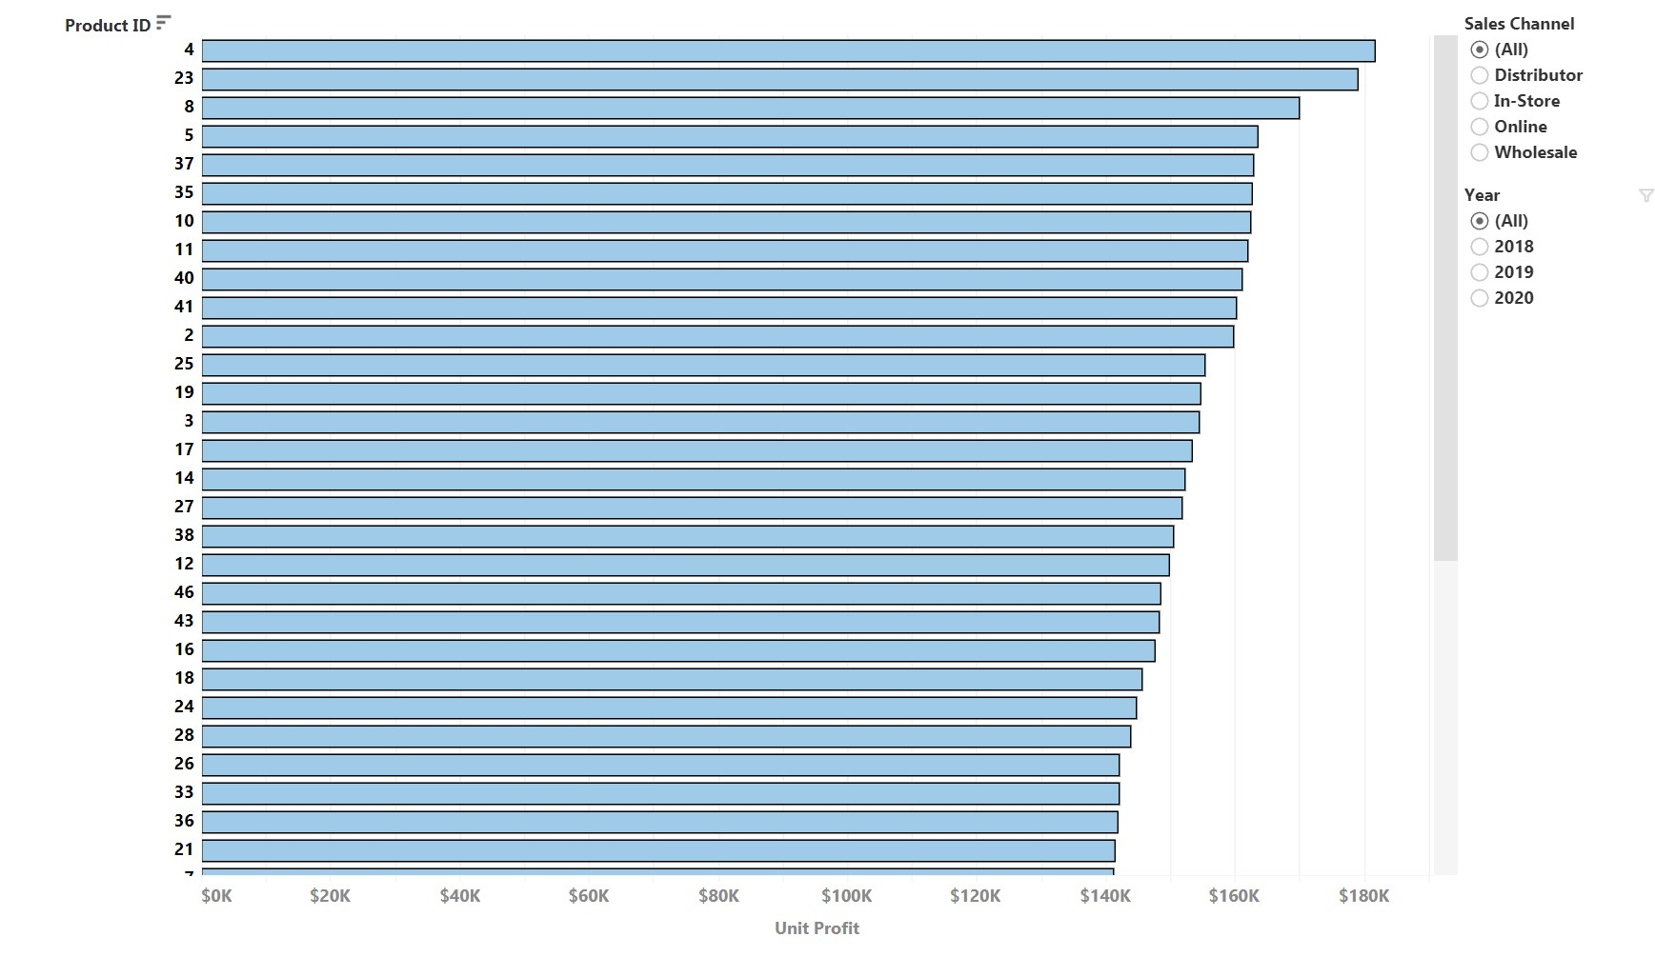
Identifying Popular Products
The top 3 most profitable products overall are Product ID #4, #23, and #8
The most profitable products can be filtered by sales channel and year

Slide 9
Recommendations Based On Popular Products
Consider bundle deals or promotions that include these high- performing products to increase sales of complementary items
Re-evaluate the pricing of top-performing products. If they are high in demand, there might be room for a slight price increase
Use insights from high-performing products to guide Research & Development. Understand what makes them profitable and see if those elements can be incorporated into new products or updates to existing ones

Slide 10
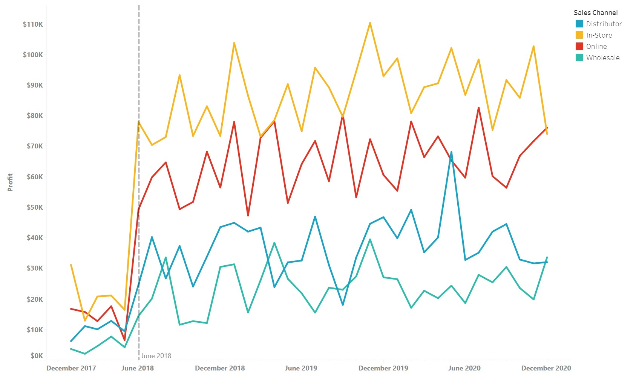
Assessing The Performance Of Sales Channels
Sales Channels Ranked By Profit
In-Store
Online
Distributor
Wholesale
Distributor Channel experienced a spike in profit during May 2020

Slide 11
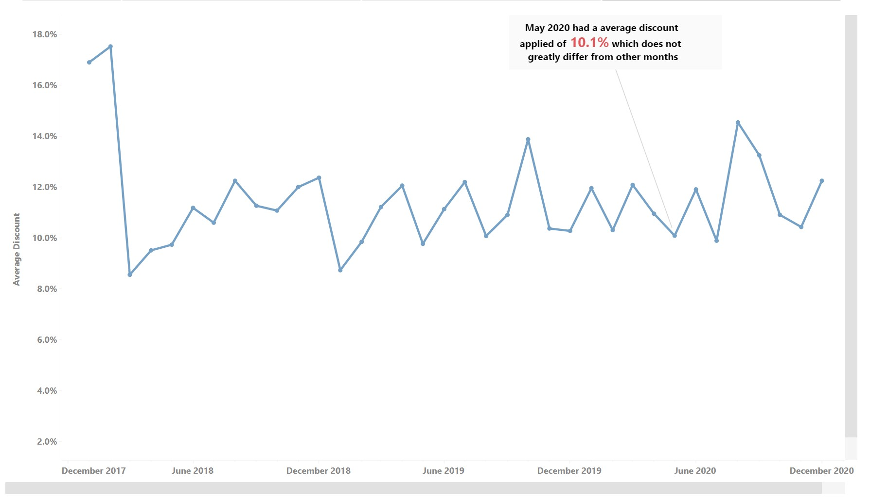
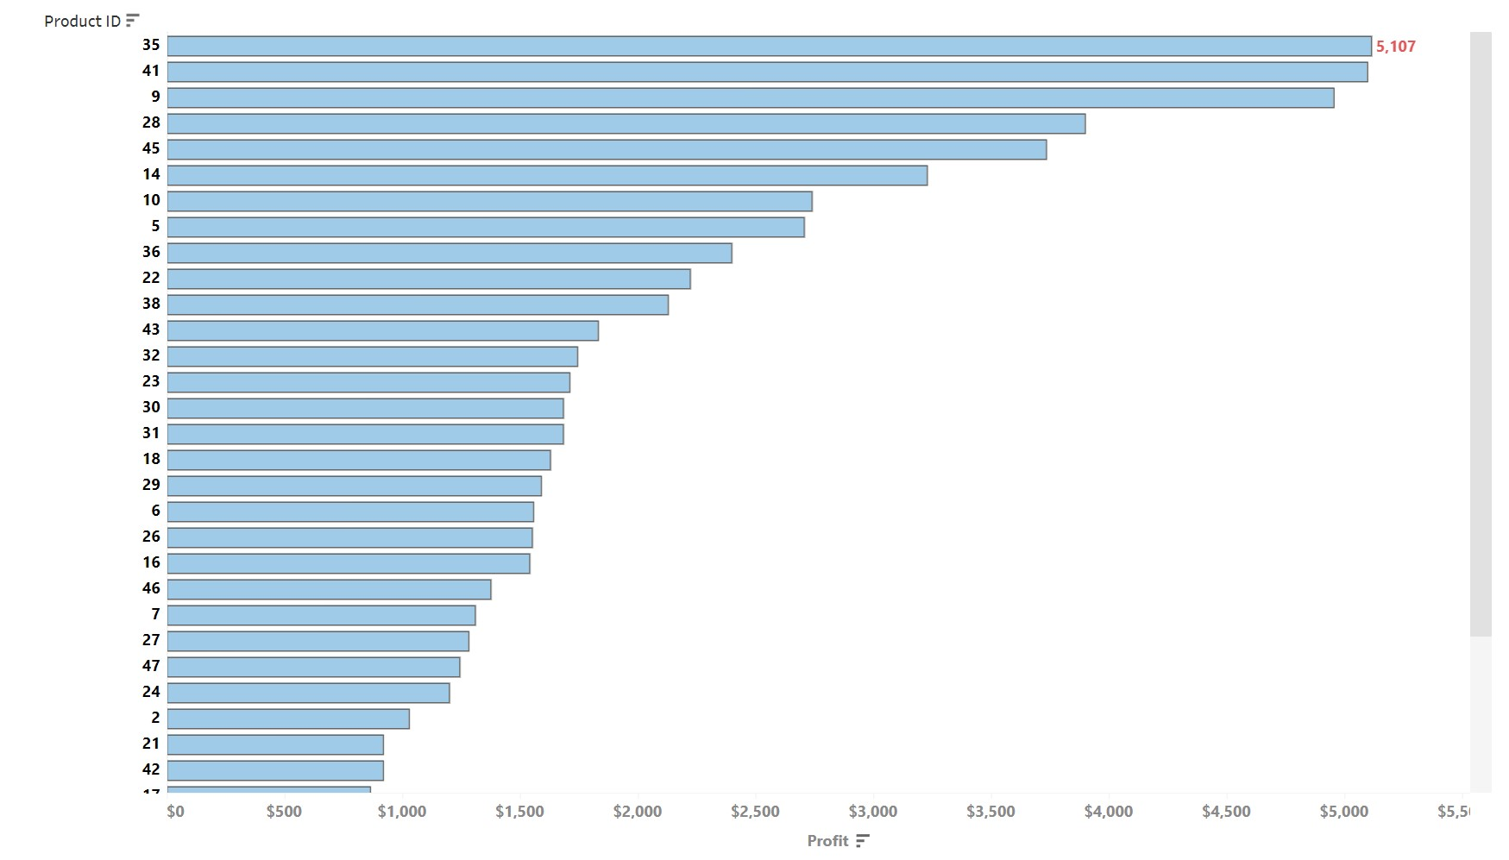
Explored what could have caused the increase by visualizing Product ID and Discount Applied columns
Discounts did not cause the increase. The discounts applied during May 2020 did not differ greatly from other months
No product(s) drove the sudden increase in profit. The profit from the top-performing product represents only about 7.5% of the total profit for the month

Slide 12
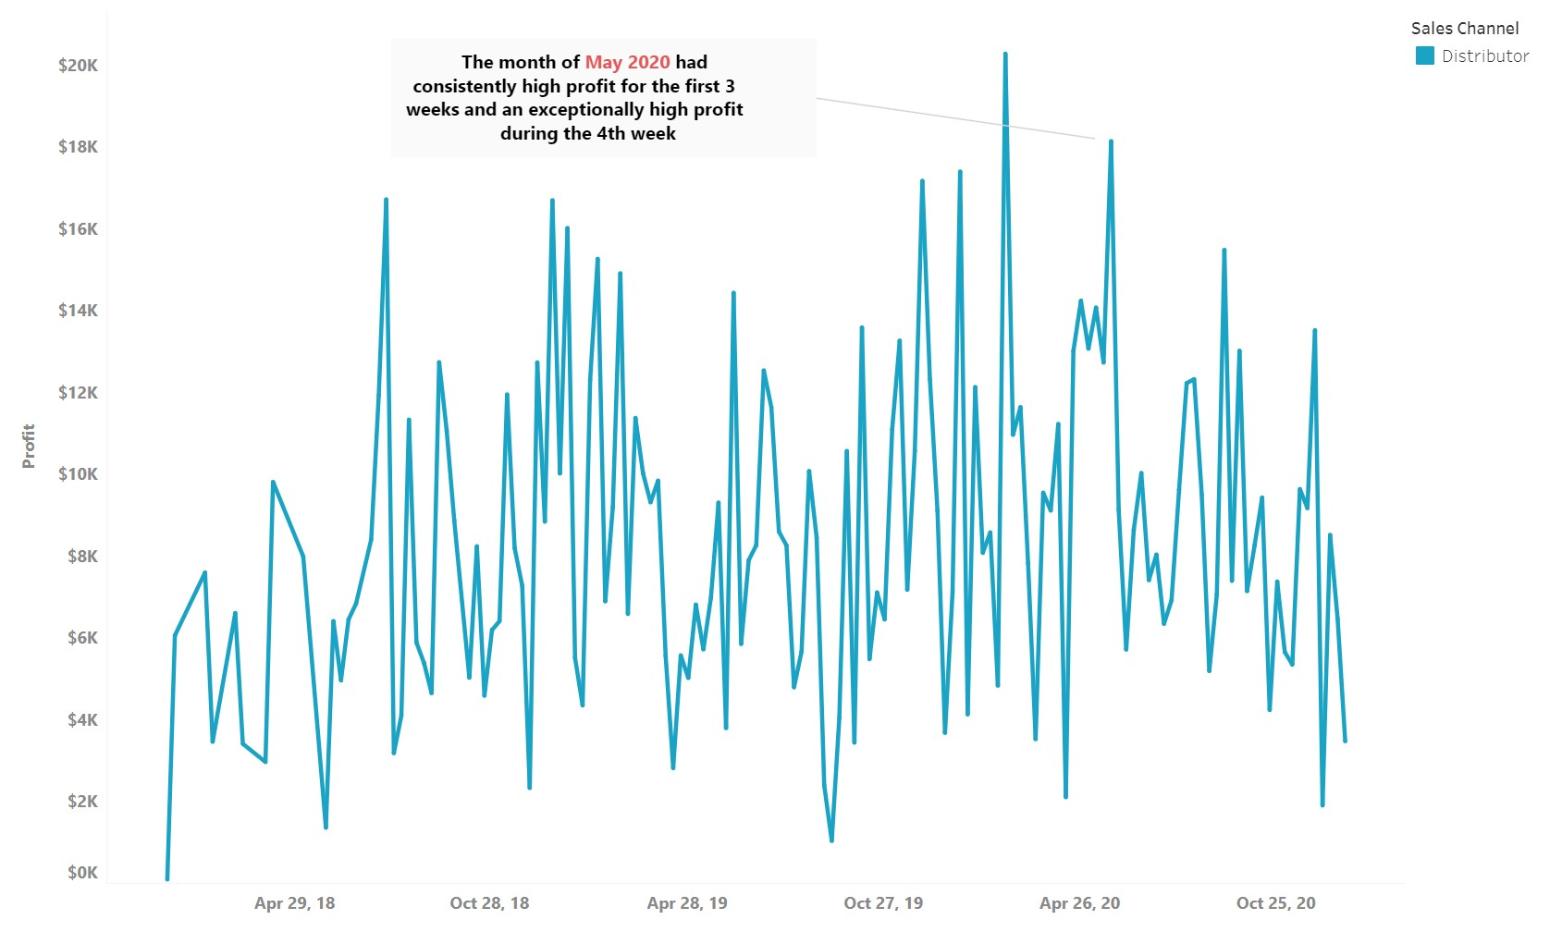
May 2020 had consistently high profit throughout the month compared to other months
External factors may have caused the increase in May 2020. Consider market trends or events that favored the Distributor Channel

Slide 13
Recommendations Based On Sales Channel Performance
Ensure seamless integration between in-store and online operations. For example, offer services like “Buy Online, Pick Up In-Store”
To encourage larger orders for the Wholesale Channel, consider offering tiered volume discounts
Consider opening more physical stores in strategic locations, especially in areas with similar demographics to currently successful stores

Slide 14
Thank You!
Interactive Tableau Visualization Here
Original Dataset Link
My LinkedIn Profile

