Slide 1

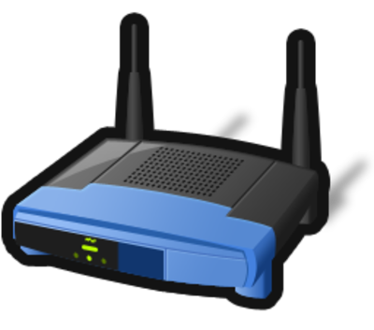


Physical perspective - Allocation View
Web Browser
http
IoTMS
Web Server
(apache-tomcat-8.0.23)
Internet
http
Web Browser
http
Port #8080(User)
Database
(mariadb-10.0.19)
TCP
Port #550
(Arduino)
Windows 7
TCP
Port #3250(Discovery)
TCP
Port #3250(Discovery)
first node
second node
arduino-1.0.6
arduino-1.0.6
Legend
Server
Machine
IoTMS
node
Door
Door
Arduino
node
Mail
box
Temp.
&Humi.
Alarm
Data
repository
SW on Machine
Proxi.
Light
Sensor
Actuator
User
Machine
Router

Slide 2
Develop Environment
Server side
Language : JAVA (jdk-1.8.0)
Database : mariadb-10.0.19
Web Server : apache-tomcat-8.0.23
IDE : eclipse-jee-luna-SR2 (Spring-4.0.4, Guava-18.0, JSON Simple-1.1.1)
Arduino side
IDE : Arduino-1.0.6

