Slide 1
5.1.3 Publish-Subscribe Pattern
우리는 IoTMS내에 주요 기능을 담당하는 module간의 message전달시 decouping을 강화하기 위하여 Publish-Subscibe Pattern의 Event bus를 사용하였다.
Promoted Quality Attributes | Description
Flexibility | Event bus로 각 모듈들이 decoupling되어 있어 각 모듈별로 SW 수정이 용이하다.
Testability | Event bus로 각 모듈들이 decoupling되어 있어 모듈별 test가 용이하다.
maintainability | Event bus로 각 모듈들이 decoupling되어 있어 각 모듈별로 debugging이 용이하다.
Promoted Quality Attributes | Description
Performance | 현재 event bus는 broad casting으로 message전달을 하기 때문에 subscribe들은 자신에게 불필요한 메시지를 필터링해야 한다. 그런데 Node추가시 처리하는 Node manger에서 보내는 메시지가 늘어나 메시지를 필터링하는데 부하가 걸리게 되어 전체적인 message처리 시간에 대한 performance가 저하된다.

Slide 2
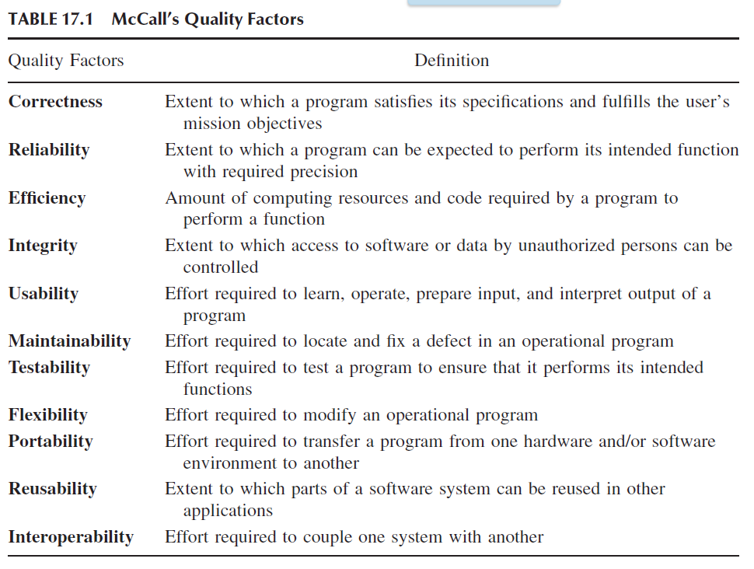
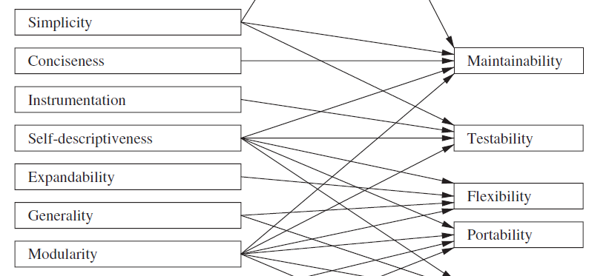
NaikSoftwareQuality(1).pdf
Maintainability: In general, maintenance refers to the upkeep of products
in response to deterioration of their components due to continued use
of the products. Maintainability refers to how easily and inexpensively
the maintenance tasks can be performed. For software products, there are
three categories of maintenance activities: corrective, adaptive, and perfective.
Corrective maintenance is a postrelease activity, and it refers to
the removal of defects existing in an in-service software. The existing
defects might have been known at the time of release of the product or
might have been introduced during maintenance. Adaptive maintenance
concerns adjusting software systems to changes in the execution environment.
Perfective maintenance concerns modifying a software system to
improve some of its qualities.
Testability : It is important to be able to verify every requirement, both explicitly
stated and simply expected. Testability means the ability to verify
requirements. At every stage of software development, it is necessary to
consider the testability aspect of a product. Specifically, for each requirement
we try to answer the question: What procedure should one use to
test the requirement, and how easily can one verify it? To make a product
testable, designers may have to instrument a design with functionalities
not available to the customer.
BCK page 167
Having high cohesion, loose coupling, and separation of concerns— all modifiability tactics (see Chapter 7)— can also help with testability.

Slide 3
5.3 Dynamic Perspective 메모[민연P5116]
5.3.1 Dynamic View of overall
UI
User DB
Log DB
e-mail
twitter
Rule DB
User Interface Manager
Log Manager
Message Manager
Rule Manager
A
B
: JSON event , from A to B
A
B
E v e n t B u s
: information, from A to B
A
B
: WiFi (TCP/IP) , from A to B
Communication
Manager
Node Manager
DB
1…*
Manager
1…*
Thing object
(Sensor, actuator...)
Node
Node object
Node object
WiFi module
Communication module
(Wifi, bluetooth…)
……
Things object List
rule thread object
actuators
sensors
Default
sensors
Home
Team2
Smart
mail box
50th
SA node
actuators
sensors
Default
sensors
SA node (Arduino)
……
user access

Slide 4
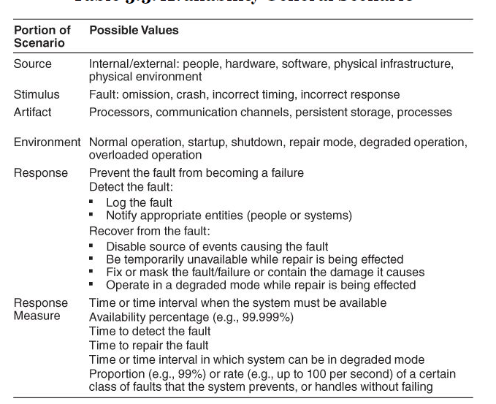
Scenario Title: Availability | Scenario ID: QA-01
Raw Quality Attribute Description: | Sensors availability
Source of Stimulus: | Sensors
Stimulus: | Sensor failure , sensor malfunction
Environmental Condition | Normal operation , The IoTMS has been installed and it works.
System Element: | • Sensors • IoTMS
System Response: | If a sensor value is not between normal range, the IoTMS recognizes malfunction or fault of sensors. And then the IoTMS sends alarm message to user. (The normal values ranges are configured according to sensor datasheet.)
Significant Measures: | The IoTMS sends alarm message to user in 10 seconds after recognizing malfunction or fault of sensors in 3 times consecutively.

Slide 5
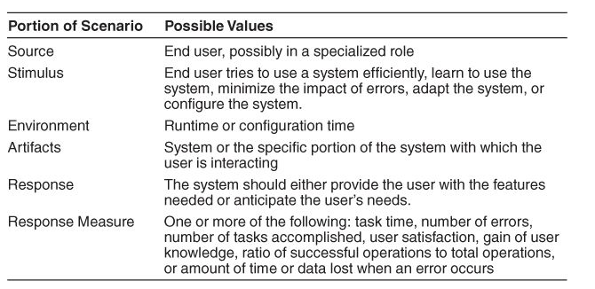
Scenario Title: Usability | Scenario ID: QA-02
Raw Quality Attribute Description: | UI(User Interface) Usability
Source of Stimulus: | User
Stimulus: | User tries to use IoTMS.
Environmental Condition | User configuration time IoTMS run time The user has logged into the IoTMS.
System Element: | UI of IoTMS
System Response: | When the user wants to change the settings of IoTMS or to get sensor value or to set actuator, the usage of UI should not be complicated.
Significant Measures: | UI depth is less than 3.

Slide 6
Scenario Title: Scalability | Scenario ID: QA-03
Raw Quality Attribute Description: | SA Nodes Scalability
Source of Stimulus: | User( Installer, DIY user ..etc. )
Stimulus: | Add another SA Nodes
Environmental Condition | IoTMS has one SA node.
System Element: | IoTMS , SA node
System Response: | When the user wants to add two or more SA node to their own IoTMS, 1. Install additional SA node at the home. 2. IoTMS find & connect additional SA Node on network. 3. complete.
Significant Measures: | IoTMS allow up to 50 SA Nodes.

Slide 7
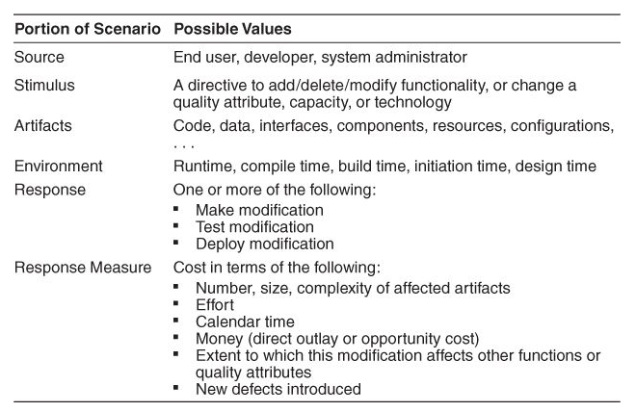
Scenario Title: Modifiability | Scenario ID: QA-04
Raw Quality Attribute Description: | communication protocol Modifiability
Source of Stimulus: | developer , 3rd party vendor , …etc
Stimulus: | new communication protocol between IoTMS and SA node
Environmental Condition | Current IoTMS communicate with SA node using WiFi only. New communication moldule’s compile time , build time
System Element: | Communication manager of IoTMS
System Response: | Emerging new protocol, SW developer make/test/deploy new communication protocol module.
Significant Measures: | Emerging new protocol, it is possible to be developed in 2 man-months.

Slide 8
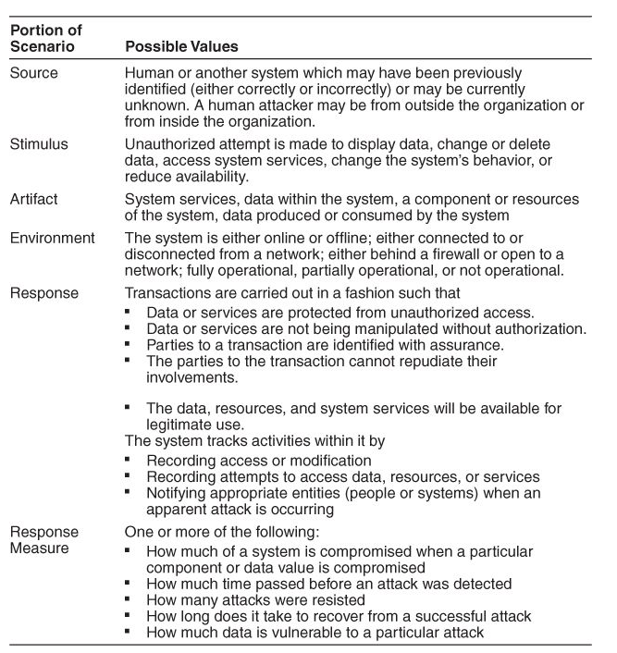
Scenario Title: Security | Scenario ID: QA-05
Raw Quality Attribute Description: | User access Security
Source of Stimulus: | unauthorized user
Stimulus: | unauthorized user tries to access IoTMS
Environmental Condition | IoTMS is online. IoTMS has a list of authorized users.
System Element: | IoTMS
System Response: | If the user is not in the list and tries to access to IoTMS , IoTMS dosen't allow login.
Significant Measures: | IoTMS never allow unauthorized user to access.

Slide 9
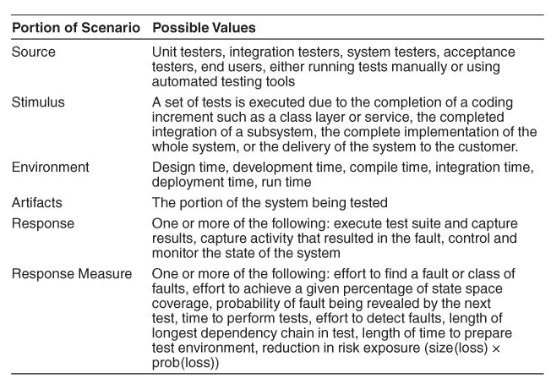
Scenario Title: Testability | Scenario ID: QA-06
Raw Quality Attribute Description: | SW module Testability
Source of Stimulus: | Test engineer , Test manager.
Stimulus: | SW module Test
Environmental Condition | SW module development time SW module integration time SW module deployment time SW module run time
System Element: | SW module of IoTMS SA node
System Response: | Test engineer test the quality of the software based on the test case , capture the results , feedback to the developers.
Significant Measures: | The 80% of test cases can be tested within 1 day.

Slide 10
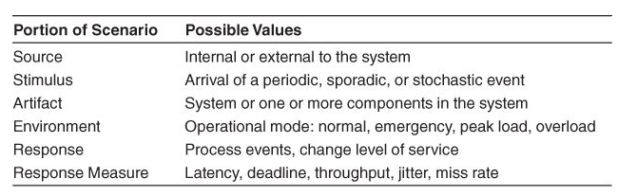
[민연P511]???
Scenario Title: Performance | Scenario ID: QA-07
Raw Quality Attribute Description: | IoTMS-SA node Response time Performance
Source of Stimulus: | User
Stimulus: | User's direct request to SA node.
Environmental Condition | normal operation mode of IoTMS
System Element: | IoTMS SA node
System Response: | When the user request to get sensor value, 1. IoTMS send the "get sensor value" message to SA node . 2. SA node measure sensor value. 3. SA node send "sensor value" message to IoTMS. 4. IoTMS display "sensor value". When the user request to set actuator status, 5. IoTMS send the "set actuator status" message to SA node. 6. SA node set actuator. 7. SA node send "complete actuator control" message. 8. IoTMS display "actuator status".
Significant Measures: | The response time of controlling(System Response 5~8) and monitoring(System Response 1~4) SA node is within 10 seconds.

Slide 11
Scenario Title: Availability | Scenario ID: QA-08
Raw Quality Attribute Description: | Logging history availability
Source of Stimulus: | Disk space
Stimulus: | The logging module fails to work when the disk space is full .
Environmental Condition | Normal operation : Logging module is logging history to Disk .
System Element: | Log Manager (SW) Disk (HW)
System Response: | IoTMS detect and notify Disk Full to administrator
Significant Measures: | Detect and notify Logging failure in 30 seconds by IoTMS

