Slide 1
Developer’s tutorial for Dynetica updated 5/8/2005
Lingchong You

Slide 2
Major goal
A multifunctional modeling software tailored towards analysis and design of biological networks of small and moderate sizes

Slide 3
Design philosophy
Ease of model construction, interrogation, and visualization
Flexibility
Functionality
Limitation: computation is not fully optimized.

Slide 4
Model representation
System
Substances
Parameters
Expressions
(composed of valid
mathematical
expressions)
Reactions

Slide 5
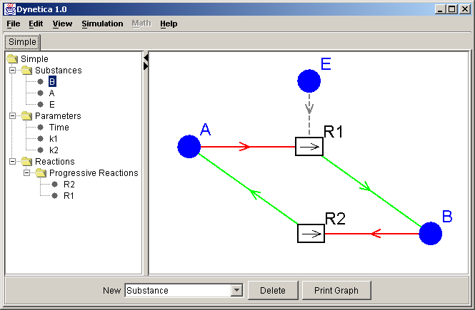
A hypothetical reaction network
Tree view
Graph view
Reaction | Stoichiometry | Kinetics
R1 | A → B | k1 * [A] * [E]
R2 | B → A | k2 * [B]

Slide 6
Algorithms
Deterministic
  Rugge Kutta (4th order) fixed time step
  Rugge Kutta Fehlberg (Variable time step)
Stochastic
  Direct method (from Gillespie 1977)
  First reaction method (from Gillespie 1976)
  Optimized direct method (partially from Gibson 2000)

Slide 7
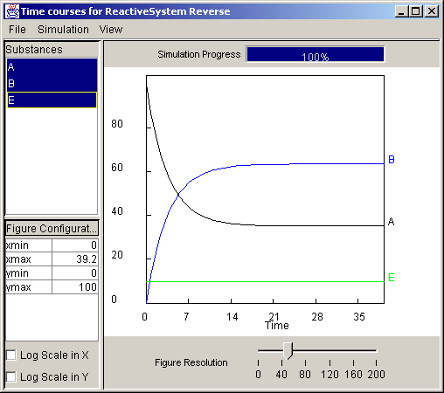
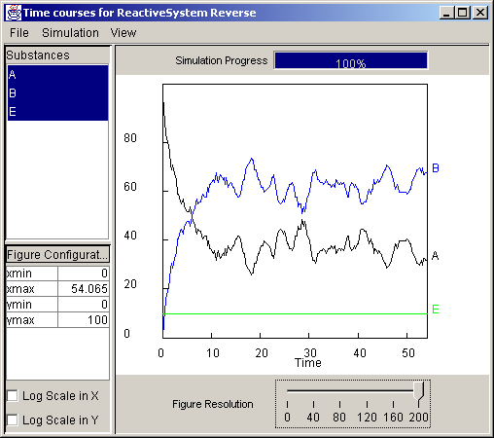
Model + Algorithm
→ Dynamics
Algorithm
Deterministic (RK4)
Stochastic (Gillespie, 1977)

Slide 8
Be cautious in using stochastic algorithms
Need to address:
Express substance levels in terms of molecular numbers.
Use elementary reactions
Optimized Direct Method doesn’t necessarily work better than Direct method, especially for small systems.

Slide 9
Basic sensitivity analysis
Parameters:
k1
k2
model
dynamics
How do parameter changes affect dynamics?

Slide 10
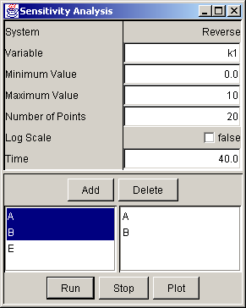
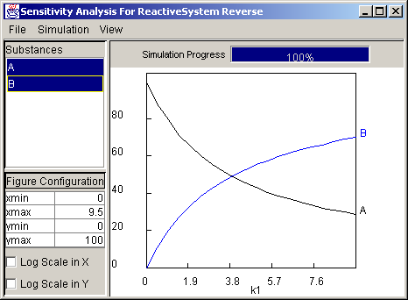
Example sensitivity analysis
Setup
Result
The dependence of equilibrated levels of A & B on k1 values

Slide 11
Information for developers
(Language: Java 1.5)

Slide 12
Key Dynetica packages & classes
dynetica
entity
expression
reaction
gui
algorithm
system
Substance
Math
functions
Progressive-
Reaction
Editors for
Various
Entities
Various
basic
algorithms
System-
Builder
Parameter
Expression
Parser
Equilibrated-
Reaction
System
Editors
Sensitivity
analysis
Reactive-
System
Expression-
Variable
Algorithm
Editors
Genetic-
System
Figure
Window
Other packages: exception & util

Slide 13
Information on key classes
See dynetica API for more details.

Slide 14
Entity
Everything represented in a model is an Entity
  But the class is not directly instantiated
Key characteristics:
  System (also an entity)
  Name
  Annotation

Slide 15
entity package: many classes derived from the Entity class have accompanying “Editors” in the gui package.
EntityVariable
(derived from Enity)
Substance
(SubstanceEditor)
Parameter
(ParameterEditor)
ExpressionVariable
(ExpressionEditor)
SimulationTimer
(One for each system)
Many classes in this package are specifically for use in a GeneticSystem: RNA, Protein, Ribosome, RNAPolymerase, etc
No need to consider these for most applications

Slide 16
EntityVariable (from Entity)
Parent class for Substance & Parameter
  Not directly used in a model
Key characteristics:
  Value
  Min
  Max

Slide 17
Substance (Derived from EntityVariable)
Represents a reacting species
  Example (with brackets): [S]
Key characteristics (plus those defined in Entity):
  Initial value (Initial level)
  Value (Current level)
  Values (store time courses)
  Rate expression
    created when system is constructed
  Reactions (whose rates are affected by the Substance)
  SubstanceEditor (defined in gui pacakge)

Slide 18
Parameter ( from EntityVariable)
Represents a parameter
  Example: P (no brackets)
Key characteristics (plus those defined in Entity):
  Default Value (currently treated the same way as Value – defined in EntityVariable)

Slide 19
ExpressionVariable (from Substance)
Represents a math expression
  Example: [S] * rand() * P (note the use of a math function)
Key characteristics:
  Expression (see above)
  Substances ( a list of substances that the expression contains).

Slide 20
SimulationTimer (from Parameter)
Represents the internal timer for simulations
  Each System has a single SimulationTimer
  Not shown in input files. Rather, it is generated when a system is constructed.
Key characteristics:
  timePoints (store a series of time points when a simulation is done).

Slide 21
Expression package: foundation for representing common mathematical expressions when defining reaction kinetics
GeneralExpression
(Interface)
Expression
LogicExpression
FunctionExpression
NonExpression
Basic: +, -, *, /, ^
Functions with
one parameter:
sin(x), cos(x), exp(x),
abs(x), …
Less than: <
Greater than: >
And: &&
Not: !
…
Functions with multiple
Parameters:
min(a, b, c)
max(a, b, c)
pulses(a,b,c,d)
…
Functions without
Parameters:
rand()
normal()
…
There are some exceptions

Slide 22
Customized functions
User can define customized functions in Dynetica system directory.
Basic functionality tested.
Not commonly used
  It might be easier to expand the mathematical functions defined in the expression package

Slide 23
Other essential classes in expression package
ExpressionConstants
  Defines expression types
  Defines methods to determine types of an expression (input as a String)
ExpressionBuilder
  Defined as a singleton class
ExpressionParser
  Builds upon ExpressionBuilder
  Parses mathematic expressions.

Slide 24
Reaction package
Reaction
Progressive-
Reaction
Equilibrated-
Reaction
MassAction
Equilibrated-
MassAction
Generator
Several specific reactions are defined for a GeneticSystem:
Transcription
Translation
…
Decay
Michaelis-Mention

Slide 25
Reaction class (from Entity)
Represents a reaction, e.g.:
  “A + 3 B -> 2D”
  Uses ReactionParser to interpret the reaction stoichiometry represented by a String
Characteristics:
  Stoichiometry ( defined as String)
  A list of substances involved in the reaction
    Substances are parsed into three categories: reactants, products, and catalysts.

Slide 26
ProgressiveReaction class
Represents a non-equilibrated reaction
  Recommended to use for vast majority of reactions
Characteristics:
  Kinetics, represented by a String
    Any mathematical expression that can be properly parsed by the ExpressionParser
  RateExpression, expression tree passed from Kinetics

Slide 27
Special progressive reactions
Generator – generation from unspecified precursors
  stoichiometry: → P
Decay – decay into unspecified products
  Stoichiometry: S →
Mass Action
Michaelis Menten

Slide 28
EquilibratedMassAction class
Represents a reversible reaction at equilibrium according to the mass action law
Characteristics: equilibrium constant (K).
Defines a constraint for the involved substances
  For: A + B → C + D (K), substance levels satisfy:
  K = ([C] * [D]) / ([A] * [B])
  For many cases, it’s preferable to break an equilibrated reactions into two reactions

Slide 29
algorithm package
Algorithm
Rugge Kutta
Rugge Kutta
Fehlberg
Direct
Method
First
Reaction
Method
Optimized
Direct
Method

Slide 30
System package
SimpleSystem
(extends Entity)
ReactiveSystem
GeneticSystem

Slide 31
SimpleSystem
(implements AbstractSystem interface)
Represents a system
Characteristics:
  Entities (defined as a HashMap), stores a list of entities that the system contains
    Entities are indexed by their names
  Basic methods to
    add, retrieve, remove, and rename entities
    save the system to a file

Slide 32
ReactiveSystem
(extends SimpleSystem)
Represents a model system
Key Characteristics:
  SimulationTimer
  Substances
  Parameters
  ExpressionVariables
  Reactions
    ProgressiveReactions
    EquilibratedReactions
  System tree (built on the above information)
  Algorithm
  Various methods to manipulate the items above
Items in red are stored in the Entities map

Slide 33
SystemBuilder
Constructs a model system from an input file.
Handles both ReactiveSystem & GeneticSystem (rarely used)
Allows easy (proper) expansion of input files without any revision of this class.

Slide 34
An example input file
Part I
Part II
dynetica.system.ReactiveSystem Lotka {
dynetica.entity.Substance X {
InitialValue { 100.0}
Min {0.0}
Max {1.7976931348623157E308}
X {371.5980629539951}
Y {212.52152907549873}
Annotation {
}
}
dynetica.entity.Substance Y {
InitialValue { 100.0}
Min {0.0}
Max {1.7976931348623157E308}
X {200.5513051365733}
Y {335.5969830755698}
Annotation { }
}
dynetica.entity.Parameter k1 {
Value { 0.1}
Min {4.9E-324}
Max {1.7976931348623157E308}
Annotation { }
}
dynetica.entity.Parameter k2 {
Value { 0.0010}
Min {4.9E-324}
Max {1.7976931348623157E308}
Annotation { }
}
dynetica.entity.Parameter k3 {
Value { 0.06}
Min {4.9E-324}
Max {1.7976931348623157E308}
Annotation { }
}
dynetica.reaction.ProgressiveReaction R1{
stoichiometry { -> X }
kinetics { k1 * [X] }
X {355.72397094430994}
Y {51.65632806512062}
Annotation {}
}
dynetica.reaction.ProgressiveReaction R2{
stoichiometry { X -> Y }
kinetics { k2 * [X] * [Y] }
X {179.52858773969655}
Y {155.6372361798049}
Annotation {}
}
dynetica.reaction.ProgressiveReaction R3{
stoichiometry { Y -> }
kinetics { k3 * [Y] }
X {69.65778247022936}
Y {315.75508263858416}
Annotation {}
}
dynetica.gui.NetworkLayout Layout {
width { 596}
height {588}
arrowSize {8.0}
margin {20}
lineWidth {0.5}
}
}

Slide 35
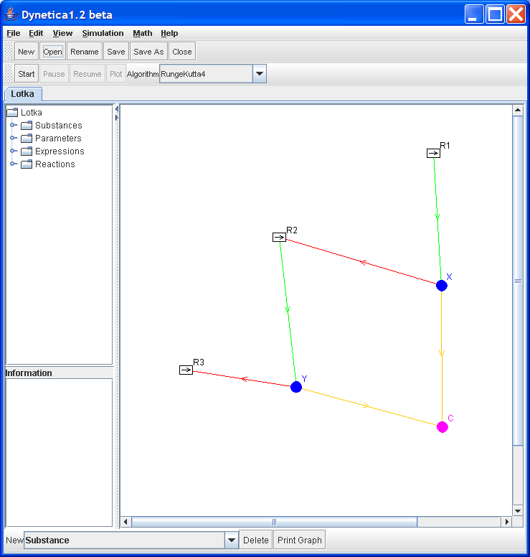
System constructed from the previous input file

Slide 36
Note
Like in C++ and Java, braces “{” and “}” are reserved for input files, and should not be used to represent system information (e.g. in names & annotations)
Normally you don’t need to deal with the input file directly, although it’s rather easy to understand & edit.

Slide 37
GUI
A separate GUI class is defined to handle each Entity that will be manipulated in dealing with a model system.
  E.g.: Substance, Parameter, ExpressionVariable, System, … each has its own “editor”.
All these editors are derived from javax.swing.JPanel class
Use a “form-based” development software to deal with GUI code -- NetBeans 4.1

Slide 38
Additional information
In Dynetica Package
Todo.txt
  Planned changes/revisions
Changelog.txt
  Recent changes

Slide 39
Particularly useful extensions
Compartments
  Allow definition of self-contained compartments
User-defined regulatory modules (like Simulink in Matlab)
  Shrinkable/Expandable in the GUI
  Facilitates hierarchical representation of models
Spatiotemporal models
Advanced sensitivity analysis
System optimization
  Related: network evolution, in terms of network structure and parameters
Interfacing with other packages
  Examples: Matlab, Mathematica, R, gnuplot, AUTO

Slide 40
SBML compatibility
  Direct loading of SBML documents
  Or: separate filter programs to translate between SBML and Dynetica files

