Slide 1
Effect of Solution Information Sharing between Tasks on the Search Ability of Evolutionary Multiobjective Multitasking Algorithms
Ryuichi Hashimoto¹, Naoki Masuyama¹
Yusuke Nojima¹, and Hisao Ishibuchi²
¹ Osaka Prefecture University
² Southern University of Science and Technology
Notes:
Thank you chair man,
I’m Ryuichi Hashimoto, from Osaka prefecture university in Japan.
Evolutionary multiobjective multitasking is to optimize multiple multiobjective optimization problems simultaneously.
In this presentation, I examine the effect of the common feature of Evolutionary multiobjective multitasking.

Slide 2
Overview
Introduction
Proposed Island Model
Computational Experiment
Conclusion
Notes:
This slide shows the overview of this presentation

Slide 3
Overview
Introduction
Proposed Island Model
Computational Experiment
Conclusion
Notes:
First, we explain about introduction of this presentation

Slide 4
Introduction
Multiobjective Optimization Problem :MOP
MOPs are optimization problems which have multiple objectives to be optimized simultaneously.
Better
The Pareto front
Characteristics
There exists a set of optimal solutions, called the Pareto front
Maximize f₂
Trade-off
Goal
To obtain a number of solutions approximating the Pareto front.
Maximize f₁
Better
Notes:
As I said before, evolutionary multiobjective multitasking is to optimize multiple multiobjective optimization problems simultaneously.
At first, we explain about multiobjective optimization problems, MOPs
MOPs are optimization problems which have multiple objective to be optimized simultaneously.
left figure shows that an example of MOPs.
There are two objectives to be maximized, f1 and f2.
The best solution is here (maximize two objectives simultaneously).
However, In generally, there is a trade-off relationship between objective functions
So, there is no such the best solution which maximizes both f1 and f2.
Instead, there is a set of Pareto optimal solutions, called the Pareto front.
A goal of MOPs is to obtain a number of solutions approximating the Pareto front

Slide 5
Introduction
Evolutionary Multiobjective Optimization Algorithm: EMOA
EMOAs are promising approaches to solve MOPs by using evolutionary computation.
Better
The Pareto front
Solution
Maximize f₂
Population
Maximize f₁
Better
Notes:
One of the approaches to solve MOPs is Evolutionary multiobjective optimization algorithm.
EMOA solve MOPs by using evolutionary computation.
Let me explain about how to solve MOPs by EMOA.
At first, initial solutions are randomly generated.
And then, by using crossover, mutation, and selection, we generate new solutions like this.
These operators are iterated until the termination condition is satisfied
EMOA is frequently used because EMOA can obtain a set of well-distributed solutions over the entire Pareto front

Slide 6

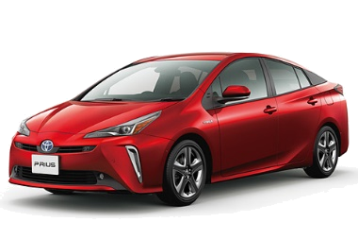
Introduction
Evolutionary Multiobjective Multitasking: EMOMT
EMOMT algorithms solve multiple MOPs (tasks) by a single run of evolutionary algorithms.
EMOA
EMOMT
Task A
Population A
Task A
Task B
Population B
Task B
Population
Different from EMOAs, solution information of each task is shared with other tasks in EMOMT algorithms.
Notes:
Recently, an idea of Evolutionary multiobjective multitasking (EMOMT) was proposed to solve multiple MOPs by a single population.
In EMOA (single tasking), one population is for one task. population A is for task A and population B is for task B.
However, In EMOMT, a single population is for multiple tasks. In other words, solutions for task A and solutions for task B are Coexist in a single population.
Different from EMOA and EMOMT is that…

Slide 7
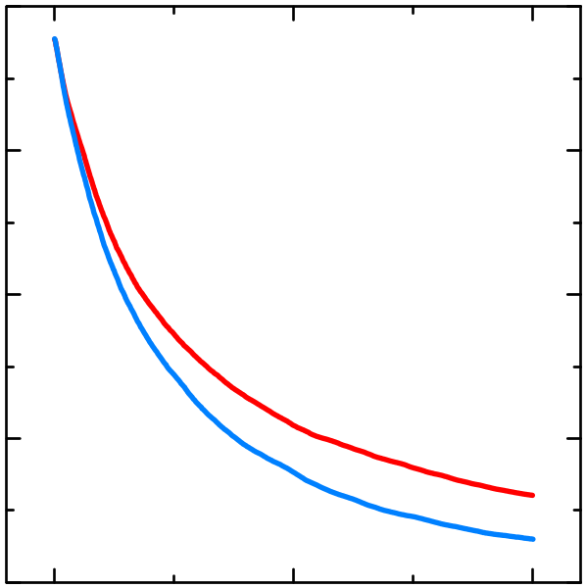
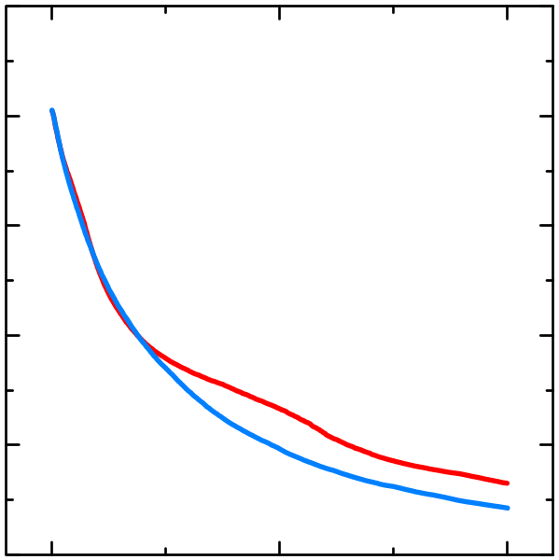
Introduction
Evolutionary Multiobjective Multitasking: EMOMT
EMOMT algorithms can obtain better results than EMOAs in both tasks.
4
2
2
1
Indicator value
(to be minimized)
0
Indicator value
(to be minimized)
0
-1
-2
EMOA
EMOA
-2
EMOMT
EMOMT
-4
-3
0
500
1000
0
500
1000
Generations
Generations
Task A
Task B
Solution information sharing is a key feature!!
Notes:
EMOMT algorithms can obtain better results than EMOAs in both tasks.
Therefore, EMOMT (Multitasking) is a promising approach!!

Slide 8
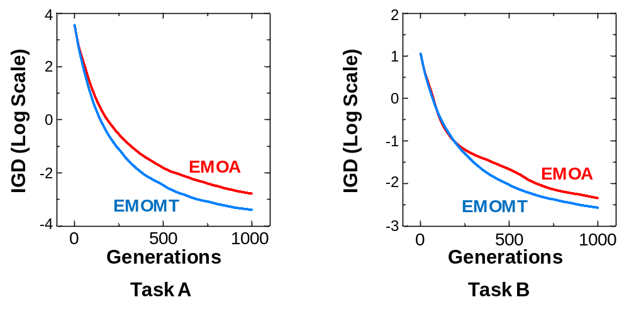
Introduction
Motivation of our research
However, the effect of solution information sharing on the search ability of the EMOMT algorithms have not been examined in detail.
it is difficult to clearly explain EMOMT algorithms have obtained better results than EMOA.
?
?
?
Why does EMOMT obtain better results than EMOA?
Notes:
However, the effect of solution information sharing on the search ability of the EMOMT algorithms has not been examined.
it is difficult to clearly explain EMOMT algorithms have obtained better results than EMOA.

Slide 9
Purpose and Approach
Purpose:
We examine the effect of solution information sharing on the search ability of EMOMT algorithms.
Approach:
we propose an island model for solving multiple tasks and examine the effect of solution information sharing by using the island model.
Notes:
In this presentation, We examine the effect of solution information sharing on the search ability of EMOMT algorithms

Slide 10
Overview
Introduction
Proposed Island Model
Computational Experiment
Conclusion

Slide 11
Proposed Island Model
It is a multi-population based algorithm. The number of the island is the same as the number of tasks.
The island model has two following parts.
  independent evolution in each island
  migration between islands
Migration
of solution
Island for task A
Island for task B

Slide 12
Proposed Island Model
The island model composes of two parts.
  Independent evolution in each island
  Migration between islands
Maximize f₂
Maximize f₂
Maximize f₁
Maximize f₁
Island for task A
Island for task B

Slide 13
Proposed Island Model
The island model composes of two parts.
  Independent evolution in each island
  Migration between islands
Maximize f₂
Maximize f₂
Maximize f₁
Maximize f₁
Island for task A
Island for task B

Slide 14
Proposed Island Model
The island model composes of two parts.
  Independent evolution in each island
  Migration between islands
This solution is evaluated by Task A.
This solution is evaluated by Task B.
Maximize f₂
Maximize f₂
Maximize f₁
Maximize f₁
Island for task A
Island for task B

Slide 15
Proposed Island Model
The island model composes of two parts.
  Independent evolution in each island
  Migration between islands
Maximize f₂
Maximize f₂
Maximize f₁
Maximize f₁
Island for task A
Island for task B

Slide 16
Proposed Island Model
The island model composes of two parts.
  Independent evolution in each island
  Migration between islands
Maximize f₂
Maximize f₂
Maximize f₁
Maximize f₁
Island for task A
Island for task B

Slide 17
Proposed Island Model
Parameters related to migration
  Migration interval (frequency of migration)
  Migration size (the number of migrated solution at once)
Maximize f₂
Maximize f₂
Maximize f₁
Maximize f₁
Island for task A
Island for task B

Slide 18
Proposed Island Model summary
The island model have two following advantages.
If the migration is not performed, the island model is the same as the independent execution of the EMOA.
Frequency and amount of solution information sharing can be arbitrarily specified.
we can easily analyze the effect of solution information sharing by comparing the search ability between the island model and the EMOA.

Slide 19
Overview
Introduction
Proposed Island Model
Computational Experiment
Conclusion
Notes:
大文字小文字の統一が全体的に取れていない．

Slide 20
Computational Experiment
Purpose
To examine effect of the solution information sharing on the search ability of the island model.
Algorithms
The island model
NSGA-II (A representative of EMOA)
Parameters
Migration Interval: {1, 5, 10, 15, 20, 25, 50, 100, 200, 250, 500}
Migration Size: {2, 10, 20, 30, 40, 50, 60, 70, 80, 90}
Termination Condition: 200,000 solution evaluations
Population Size: 100 for each task.
Performance Indicator: IGD

Slide 21
Benchmark Problem
Each Task
Each task has a different distance function in the formulation of the corresponding MOP.
A distance function of each task
The Pareto front
Name | Task A | Task B
CI+HS | Sphere | Mean
CI+MS | Rosenbrock | Mean
CI+LS | Rastrigin | Ackley
NI+HS | Rosenbrock | Sphere
NI+MS | Rosenbrock | Sphere
NI+LS | Griewank | Ackley
Maximize f₁
A distance calculated by a distance function
Maximize f₁

Slide 22
Benchmark Problem
Each Task
These problems can be divided into two categories based on an intersection degree of the global optima of the distance functions.
A distance function of each task
Complete intersection (CI):
Two tasks have the same global optima.
Name | Task A | Task B
CI+HS | Sphere | Mean
CI+MS | Rosenbrock | Mean
CI+LS | Rastrigin | Ackley
NI+HS | Rosenbrock | Sphere
NI+MS | Rosenbrock | Sphere
NI+LS | Griewank | Ackley
No Intersection (NI):
both tasks have different global optima.

Slide 23
Benchmark Problem
Each Task
These problems can be also divided into three categories based on the similarity of the distance functions.
A distance function of each task
High Similarity(HS):
Two tasks have high similarity.
Name | Task A | Task B
CI+HS | Sphere | Mean
CI+MS | Rosenbrock | Mean
CI+LS | Rastrigin | Ackley
NI+HS | Rosenbrock | Sphere
NI+MS | Rosenbrock | Sphere
NI+LS | Griewank | Ackley
Medium Similarity (MS): Two tasks have medium similarity.
Low similarity (LS):
Two tasks have low similarity.

Slide 24
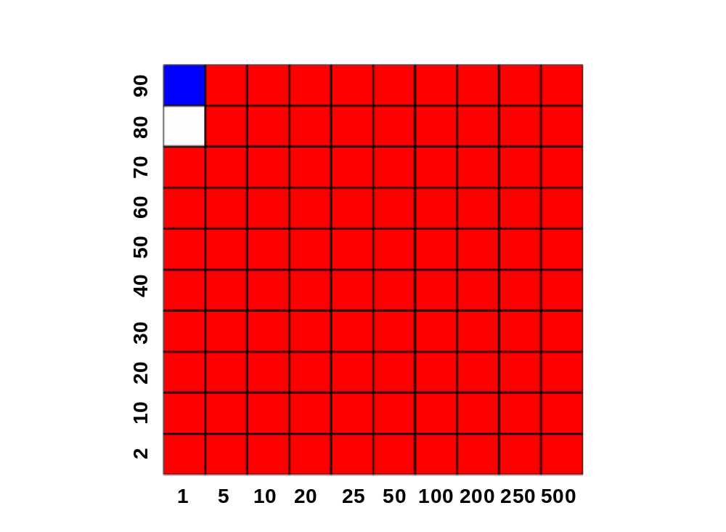
How to Show Results
: Better results obtained by the island model than NSGA-II.
: Better results obtained by NSGA-II than the island model.
Migration Size
Migration Interval

Slide 25
How to Show Results
: Better results obtained by the island model than NSGA-II.
: Better results obtained by NSGA-II than the island model.
(1) Migration size: Big
(2) Migration Interval: Short
Migration Size
A large amount of solution information is shared very frequency in the island model.
Migration Interval

Slide 26
How to Show Results
: Better results obtained by the island model than NSGA-II.
: Better results obtained by NSGA-II than the island model.
(1) Migration size: Small
(2) Migration Interval: Long
Migration Size
A small amount of solution information is shared less frequency in the island model.
Migration Interval

Slide 27

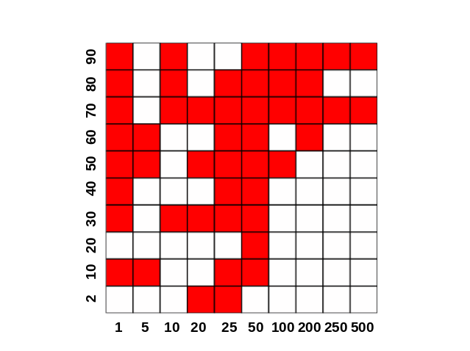
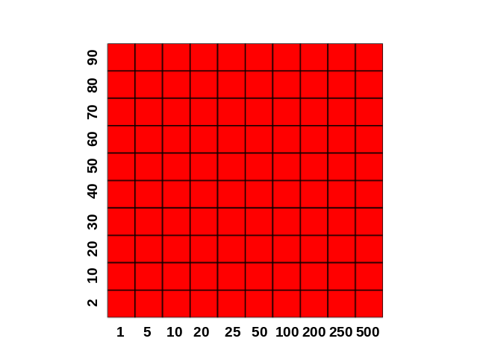
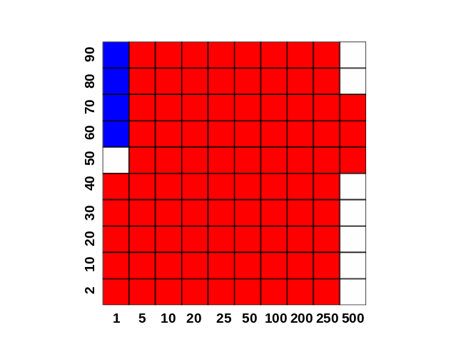
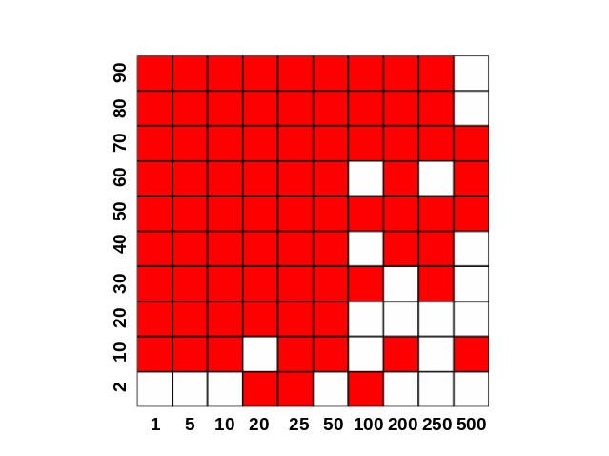
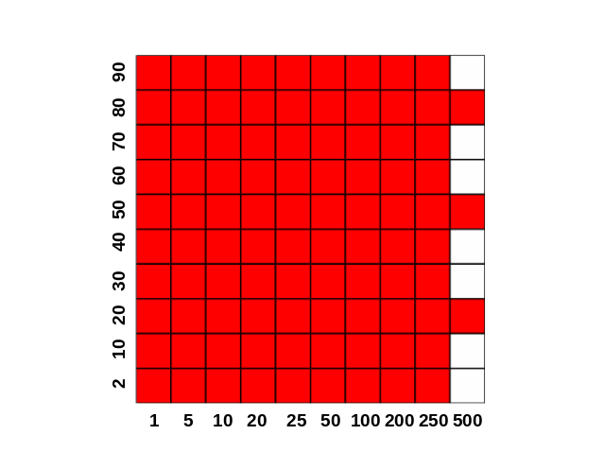
Results on
CI Problems
Better results by Island
Better results by NSGA-II
Regardless of the similarity, the island model obtained better results in many migration setting.
Task A
Migration Size
Migration Size
Migration Size
Task B
Migration Size
Migration Size
Migration Size
CI+HS
CI+MS
CI+LS
Migration Interval
Migration Interval
Migration Interval

Slide 28
Results on
CI Problems
Near-optimal solutions for the distance function of one task are likely to strongly help the search for the other task.
Solution for task A
distance variable x₂
Solution for task B
Move by solution
information sharing
An optimal solution
for both tasks.
distance variable x₁

Slide 29
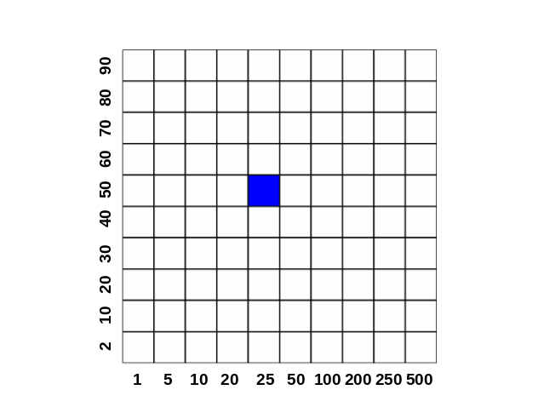
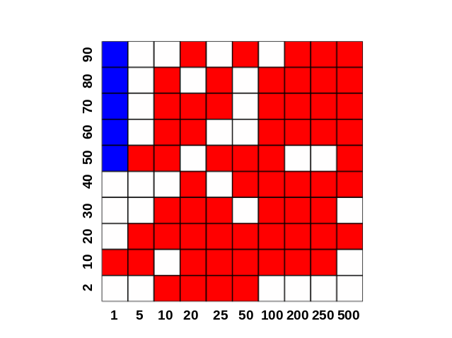
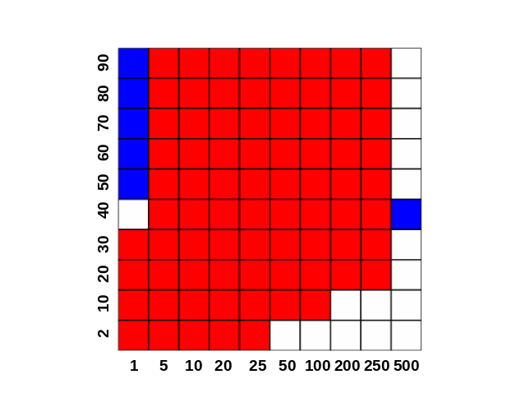
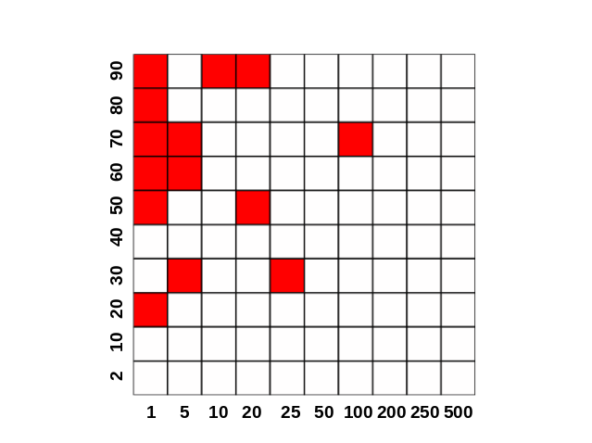
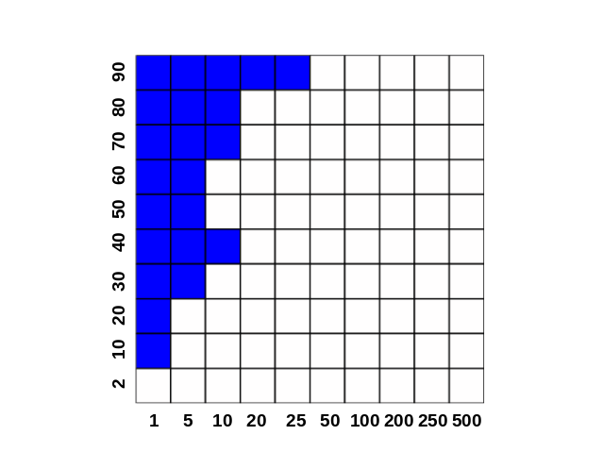
Results on
NI Problems
Better results by Island
Better results by NSGA-II
Contrary to intuition, the island model obtained the better results than NSGA-II.
Task A
Migration Size
Migration Size
Migration Size
Task B
Migration Size
Migration Size
Migration Size
NI+HS
NI+MS
Migration Interval
Migration Interval
Migration Interval
NI+LS

Slide 30
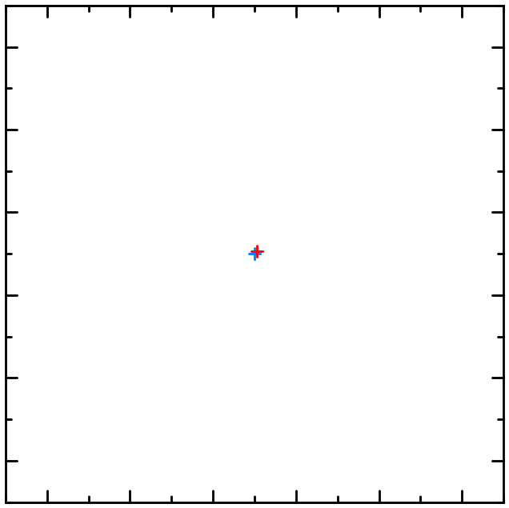
Benchmark Result
NI+HS
Contrary to intuition, the island model obtained the better results than NSGA-II.
Reason
Whereas the two tasks have different optimal solutions, they are close in the decision space.
1.0
Optimal solution
on the task A
0.8
0.6
0.4
0.2
Optimal solution
on the task B
0.0
0.0
0.2
0.4
0.6
0.8
1.0

Slide 31
Benchmark Result
NI+HS
Contrary to intuition, the island model obtained the better results than NSGA-II.
Reason
Whereas the two tasks have different optimal solutions, they are close in the decision space.
1.0
Optimal solution
on the task A
0.8
0.6
0.4
It is needed to develop the new benchmark problems where the distance of two optimal solutions can be arbitrarily specified.
0.2
Optimal solution
on the task B
0.0
0.0
0.2
0.4
0.6
0.8
1.0

Slide 32
Conclusion and Future work
Conclusion
We proposed the NSGA-II-based island model to examine the solution information sharing on the search performance of EMOMT algorithms.
Migration
of solution
Island for Task A
Island for Task B
Notes:
Lastly. I conclude this presentation.
(From the results in computational experiments, )The performance of MOEAs strongly depends on the three properties.
Therefore, Benchmark test suites with various properties are necessary for algorithm development.

Slide 33
Conclusion and Future work
From the experimental results, we found
  If two tasks have the same global optima, the solution information sharing (i.e., a migration in the proposed island model) improved the performance.
  It is needed to develop the new benchmark problems where the distance of two optimal solutions can be arbitrarily specified.
Future work
We examine the effect of the solution information sharing on the performance of our island model implemented with other EMOAs such as MOEA/D

Slide 34


Slide 35
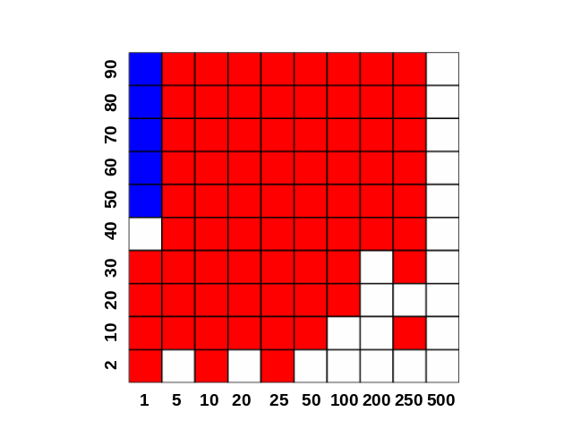
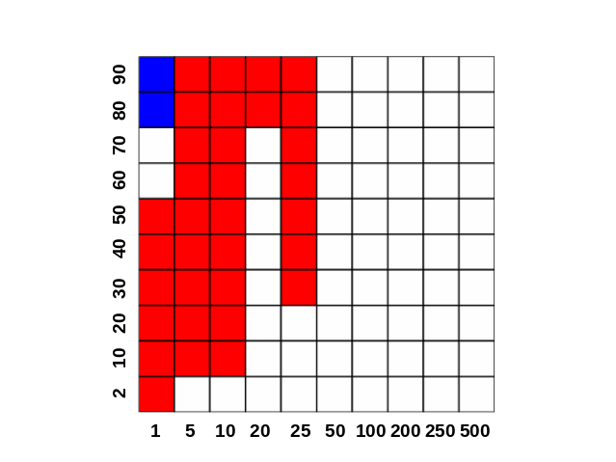
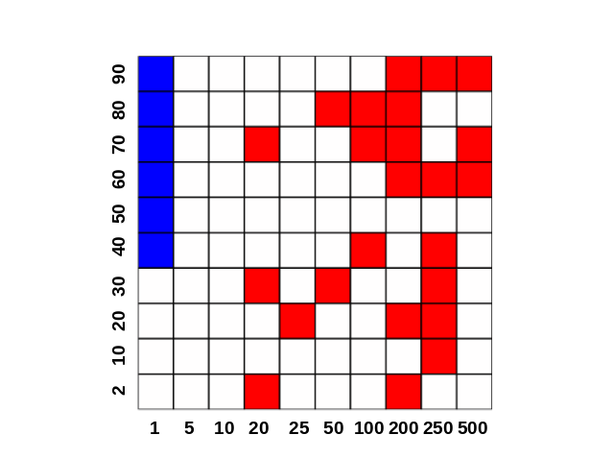
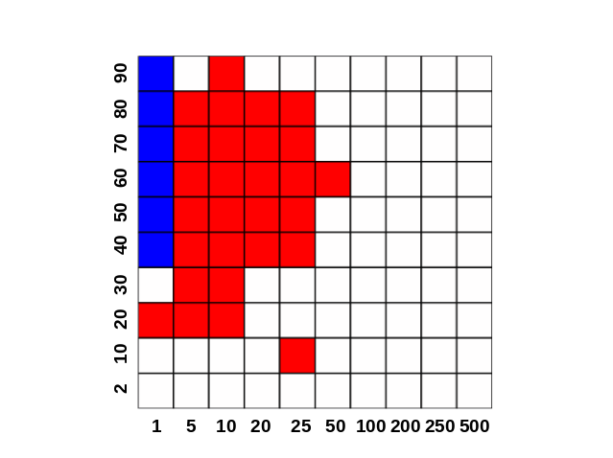
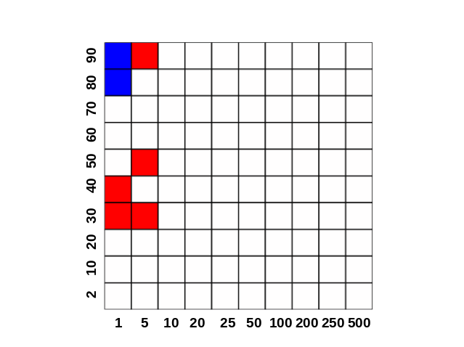

Results on
PI Problems
Better results by Island
Better results by NSGA-II
There are a lot of white dots in the results compared to the CI problems.
Task A
Migration Size
Migration Size
Migration Size
Task B
Migration Size
Migration Size
Migration Size
PI+HS
PI+MS
Migration Interval
Migration Interval
Migration Interval
PI+LS

Slide 36
Results on
PI Problems
Better results by Island
Better results by NSGA-II
In the task B in PI+LS, the island model always obtained better results than NSGA-II.
Task A
Migration Size
Migration Size
Migration Size
Task B
Migration Size
Migration Size
Migration Size
PI+HS
PI+MS
Migration Interval
Migration Interval
Migration Interval
PI+LS

Slide 37
Results on
PI Problems
Better results by Island
Better results by NSGA-II
In the task B in PI+LS, the island model always obtained better results than NSGA-II.
Task A
Migration Size
Migration Size
Migration Size
Task B
Migration Size
Migration Size
Migration Size
PI+HS
PI+MS
Migration Interval
Migration Interval
Migration Interval
PI+LS

Slide 38
Benchmark Problem
Each Task
Each task has a different distance function in the formulation of the corresponding MOP.
A distance functions of each task
Name | Task A | Task B
CI+HS | Sphere | Mean
CI+MS | Rosenbrock | Mean
CI+LS | Rastrigin | Ackley
PI+HS | Sphere | Rastrigin
PI+MS | Sphere | Rastrigin
PI+LS | Griewank | Ackley
NI+HS | Rosenbrock | Sphere
NI+MS | Rosenbrock | Sphere
NI+LS | Griewank | Ackley
The Pareto front
Maximize f₁
A distance Calculated by a distance function
Maximize f₁

Slide 39
Benchmark Problem
Characteristics
These problems can be divided into three categories based on the intersection degree of the global optima of the distance functions.
Name | Task A | Task B
CI+HS | Sphere | Mean
CI+MS | Rosenbrock | Mean
CI+LS | Rastrigin | Ackley
PI+HS | Sphere | Rastrigin
PI+MS | Sphere | Rastrigin
PI+LS | Griewank | Ackley
NI+HS | Rosenbrock | Sphere
NI+MS | Rosenbrock | Sphere
NI+LS | Griewank | Ackley
Complete intersection (CI):
Global optima of two task are same with respect to all variables
Partial Intersection (PI):
Global optima of two task are different with respect to a subset of variables.
No Intersection (NI):
Global optima of two task are different with respect to all variables.

Slide 40
Benchmark Problem
Characteristics
The nine problems can be also divided into three categories by the similarity in the fitness landscape of the distance functions
Name | Task A | Task B
CI+HS | Sphere | Mean
CI+MS | Rosenbrock | Mean
CI+LS | Rastrigin | Ackley
PI+HS | Sphere | Rastrigin
PI+MS | Sphere | Rastrigin
PI+LS | Griewank | Ackley
NI+HS | Rosenbrock | Sphere
NI+MS | Rosenbrock | Sphere
NI+LS | Griewank | Ackley
HS: Two tasks have high similarity.
MS: Two tasks have medium similarity.
LS: Two tasks have low similarity.

Slide 41
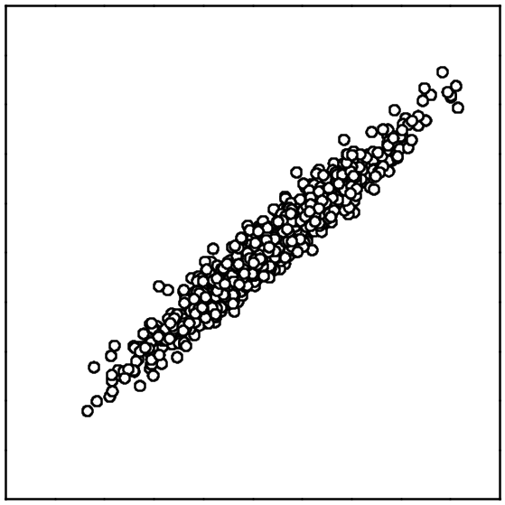
Benchmark Problem
Characteristics
In the HS problems, a good solution for one task is likely to be a good for the other task.
Name | Task A | Task B
CI+HS | Sphere | Mean
CI+MS | Rosenbrock | Mean
CI+LS | Rastrigin | Ackley
PI+HS | Sphere | Rastrigin
PI+MS | Sphere | Rastrigin
PI+LS | Griewank | Ackley
NI+HS | Rosenbrock | Sphere
NI+MS | Rosenbrock | Sphere
NI+LS | Griewank | Ackley
worse
Solution
A Distance function
value of Task B
better
worse
A Distance function
value of Task A

Slide 42
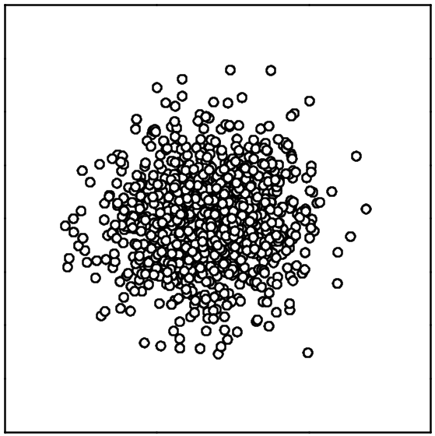
Benchmark Problem
Characteristics
In the LS problems, a good solution for one task is not likely to be a good for the other task.
Name | Task A | Task B
CI+HS | Sphere | Mean
CI+MS | Rosenbrock | Mean
CI+LS | Rastrigin | Ackley
PI+HS | Sphere | Rastrigin
PI+MS | Sphere | Rastrigin
PI+LS | Griewank | Ackley
NI+HS | Rosenbrock | Sphere
NI+MS | Rosenbrock | Sphere
NI+LS | Griewank | Ackley
worse
Solution
A Distance function
value of Task B
better
worse
A Distance function
value of Task A

Slide 43
Benchmark Problem
Each Task
In the HS problems, a good solution for one task is not likely to be a good for the other task.
A distance functions of each task
worse
Solution
Name | Task A | Task B
CI+HS | Sphere | Mean
CI+MS | Rosenbrock | Mean
CI+LS | Rastrigin | Ackley
NI+HS | Rosenbrock | Sphere
NI+MS | Rosenbrock | Sphere
NI+LS | Griewank | Ackley
A Distance function
value of Task B
better
worse
A Distance function
value of Task A

Slide 44
Benchmark Problem
Each Task
In the LS problems, a good solution for one task is not likely to be a good for the other task.
A distance functions of each task
worse
Solution
Name | Task A | Task B
CI+HS | Sphere | Mean
CI+MS | Rosenbrock | Mean
CI+LS | Rastrigin | Ackley
NI+HS | Rosenbrock | Sphere
NI+MS | Rosenbrock | Sphere
NI+LS | Griewank | Ackley
A Distance function
value of Task B
better
worse
A Distance function
value of Task A

Slide 45
Introduction
Evolutionary Multiobjective Multitasking: EMOMT
In EMOMT algorithms, solution information of each task is shared with other tasks on the search of each task.
Share
solution information
Task A
Task B
A. Gupta, Y. S. Ong, L. Feng, and K. C. Tan, “Multiobjective multifactorial optimization in evolutionary multitasking,” IEEE Transactions on Cybernetics, 47 (7) 1652–1665, 2017.
Notes:
In EMOMT, solution information is shared with each other on the search of each task like this.

Slide 46
Introduction
Evolutionary Multiobjective Optimization Algorithm (EMOA)
EMOAs are promising approaches to solve MOPs by using evolutionary computation.
Evolutionary computation
Better
The Pareto front
Crossover
& Mutation
Selection
Maximize f₂
Generation update
EMOA tries to obtain a set of well-distributed solutions over the entire Pareto front.
Maximize f₁
Better
Notes:
One of the approaches to solve MOPs is Evolutionary multiobjective optimization algorithm.
EMOA solve MOPs by using evolutionary computation.
Let me explain about how to solve MOPs by EMOA.
At first, initial solutions are randomly generated.
And then, by using crossover, mutation, and selection, we generate new solutions like this.
These operators are iterated until the termination condition is satisfied
EMOA is frequently used because EMOA can obtain a set of well-distributed solutions over the entire Pareto front

Slide 47
Introduction
Evolutionary Multiobjective Optimization Algorithm (EMOA)
EMOAs are promising approaches to solve MOPs by using evolutionary computation.
Evolutionary computation
Better
The Pareto front
Crossover
& Mutation
Selection
Maximize f₂
Generation update
EMOA tries to obtain a set of well-distributed solutions over the entire Pareto front.
Maximize f₁
Better
Notes:
One of the approaches to solve MOPs is Evolutionary multiobjective optimization algorithm.
EMOA solve MOPs by using evolutionary computation.
Let me explain about how to solve MOPs by EMOA.
At first, initial solutions are randomly generated.
And then, by using crossover, mutation, and selection, we generate new solutions like this.
These operators are iterated until the termination condition is satisfied
EMOA is frequently used because EMOA can obtain a set of well-distributed solutions over the entire Pareto front

Slide 48
Introduction
Evolutionary Multiobjective Optimization Algorithm (EMOA)
EMOAs are promising approaches to solve MOPs by using evolutionary computation.
Evolutionary computation
Better
The Pareto front
Crossover
& Mutation
Selection
Maximize f₂
Generation update
EMOA tries to obtain a set of well-distributed solutions over the entire Pareto front.
Maximize f₁
Better
Notes:
One of the approaches to solve MOPs is Evolutionary multiobjective optimization algorithm.
EMOA solve MOPs by using evolutionary computation.
Let me explain about how to solve MOPs by EMOA.
At first, initial solutions are randomly generated.
And then, by using crossover, mutation, and selection, we generate new solutions like this.
These operators are iterated until the termination condition is satisfied
EMOA is frequently used because EMOA can obtain a set of well-distributed solutions over the entire Pareto front

Slide 49
Introduction
Evolutionary Multiobjective Optimization Algorithm (EMOA)
EMOAs are promising approaches to solve MOPs by using evolutionary computation.
Evolutionary computation
Better
The Pareto front
Crossover
& Mutation
Selection
Maximize f₂
Generation update
EMOA tries to obtain a set of well-distributed solutions over the entire Pareto front.
Maximize f₁
Better
Notes:
One of the approaches to solve MOPs is Evolutionary multiobjective optimization algorithm.
EMOA solve MOPs by using evolutionary computation.
Let me explain about how to solve MOPs by EMOA.
At first, initial solutions are randomly generated.
And then, by using crossover, mutation, and selection, we generate new solutions like this.
These operators are iterated until the termination condition is satisfied
EMOA is frequently used because EMOA can obtain a set of well-distributed solutions over the entire Pareto front

Slide 51
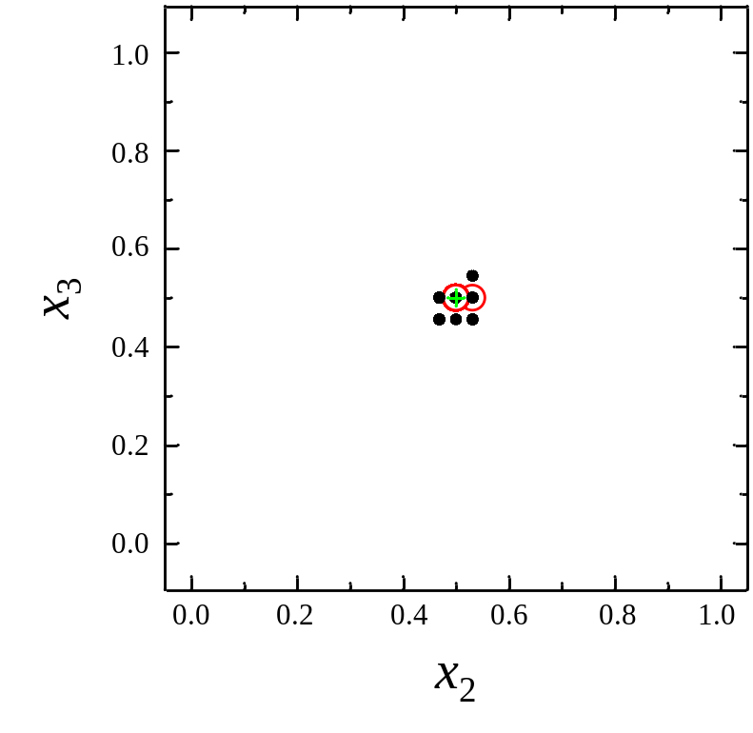
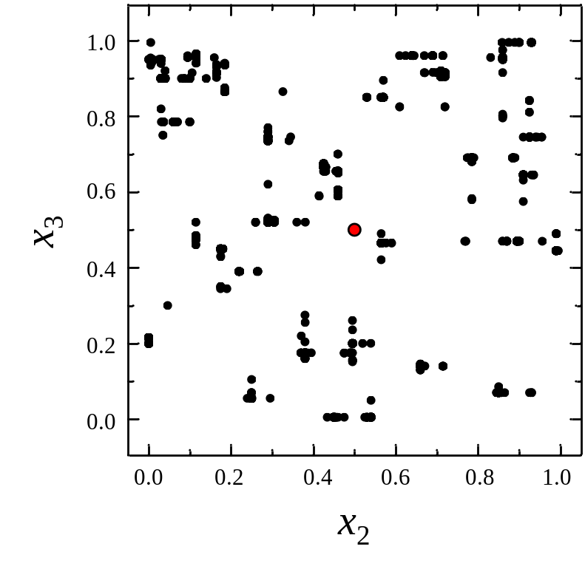
Benchmark Result
PI+LS
Solutions migrating to the task B often have better
than the solutions of the task B.
Solution obtained by NSGA-II
Optimal solution
Task A (Easy task)
Task B (Difficult task)

Slide 52
What is NSGA-II?
NSGA-II solves a MOP by using following two solution criteria.
(1) non-dominated sorting for good convergence
(2) diversity maintenance scheme for good distribution
(1)
(2)
Rank1
a
Rank2
b
Maximize f₂(x)
Maximize f₂(x)
a+b
Rank3
called crowding distance
Maximize f₁(x)
Maximize f₁(x)
Rank 1 > Rank 2 > Rank 3
(Solutions with Rank 1 are desirable)
Solutions having Bigger crowding
distance are desirable.

Slide 53
Benchmark problem
Characteristics of similarity
Similarity： Spearman’s rank correlation coefficient
High Similarity
Low Similarity
A good solution for one task is
likely to be a good for the other task
A good solution for one task is not likely to be a good for the other task.
worse
worse
Solution
Solution
Distance function
value of Task B
Distance function
value of Task B
better
worse
better
worse
Distance function
value of Task A
Distance function
value of Task A

Slide 54

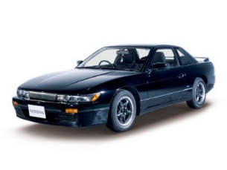
Evolutionary multi-tasking
Handling multiple search space
In order to handle multiple tasks simultaneously, all solutions are generated in a unified search space.
Task 1
Projection
A unified search space
Task 2

Slide 55
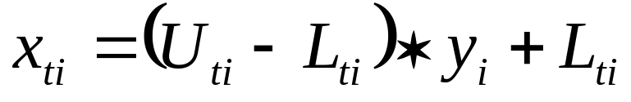
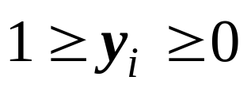
Evolutionary multi-tasking
Handling multiple search space
A unified search space
y₁ | y₂ | y₃ | y₄ | y₅ | y₆ | y₇ | y₈
Projection
Task 1
x₁₁ | x₁₂ | x₁₃ | x₁₄ | x₁₅ | x₁₆ | x₁₇ | x₁₈
Task 2
x₂₁ | x₂₂ | x₂₃ | x₂₄ | x₂₅ | x₂₆ | x₂₇ | x₂₈
U_{ti}: a upper limit of x_{ti}
L_{ti}: a lower limit of x_{ti}
t : a task number
i : a variable number

Slide 56
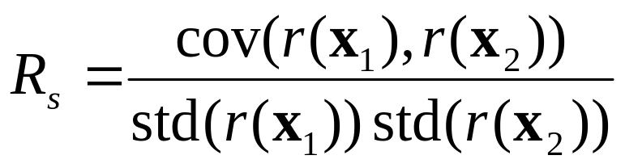
Benchmark Problem
Similarity
Similarity in two tasks is calculated Sperman’s rank correlation coefficient is calculated for similarity calculation.
X₁: Solutions for Task 1,
X₂: Solutions for Task 2,
R(x_{t}): A Rank of X_{t} for Task t,
std(X): standard deviation of X,
cov(X, Y): Covariance of X and Y.
To calculate similarity, 1,000,000 solutions in the unified search space are randomly generated and evaluated with both tasks.

Slide 57
Results on
CI problems.
Better results by Island
Better results by NSGA-II
near-optimal solutions for the distance function of one task are likely to strongly help the search for the other task.
Task A
Migration Size
Migration Size
Migration Size
Task B
Migration Size
Migration Size
Migration Size
CI+HS
CI+MS
CI+LS
Migration Interval
Migration Interval
Migration Interval

