Slide 1

Angular
Instructor : Youssef RAFII
From 23 To 26/12/2019

Slide 2

Training plan
ANGULAR
First Day
Introduction & Versions
TypeScript
Second Day
Databinding
Third Day
Directives
Routing
Fourth Day
Forms
Making Http Requests
Basics
Observables
Pipes
Services & Dependency Injection
Installation

Slide 3
First Day
Introduction & Versions
Installation
TypeScript
Basics

Slide 4

Introduction & Versions
ANGULAR
From Wikipedia
Angular is a TypeScript-based open-source front-end web application platform led by the Angular Team at Google and by a community of individuals and corporations. Angular is a complete rewrite from the same team that built AngularJS.
Angular is a Javascript Framework which allows you to create reactive Single Page Applications (SPAs)

Slide 5
Introduction & Versions
ANGULAR
2
May 2016
Complete Re-Write of AngularJs
OOP

Slide 6
Introduction & Versions
ANGULAR
March 2017
Angular 2 compatible
Lot of performance improvement
Animation features are separated from @angular/core to @angular/animation
Adding HttpClient (Make http API as deprecated)
Conditionally disable animations
4

Slide 7
Introduction & Versions
ANGULAR
5
November 2017
Build optimizations
improvements of the perfs
Compiler Improvements

Slide 8
Introduction & Versions
ANGULAR
6
May 2018
No major breaking changes
RxJS v6
Angular CLI Changes: Two new commands have been introduced
— ng update <package> — ng add <package>

Slide 9
Introduction & Versions
ANGULAR
7
October 2018
TypeScript 3.1 Support
Angular CLI prompt user

Slide 10
Introduction & Versions
ANGULAR
8
May 2019
Internal changes
@angular/http is no longer supported, use @Angular/common/http instead
ViewChild changed temporary

Slide 11




Installation
ANGULAR
 | Node JS | https://nodejs.org/en/download/releases/
 | Git | https://git-scm.com/downloads
 | VsCode | https://code.visualstudio.com/
 | Angular Cli | https://cli.angular.io/

Slide 12
Angular Cli
ANGULAR
Installation:
npm install -g @angular/cli
Create an angular project:
ng new my-app
Start the project:
ng serve –p PORT

Slide 13
TypeScript(Types)
ANGULAR
In typeScript, type System represents different types of datatypes which are supported by TypeScript.
BUILT-IN DATA TYPE | KEYWORD | DESCRIPTION
Number | number | It is used to represent both Integer as well as Floating-Point numbers
Boolean | boolean | Represents true and false
String | string | It is used to represent a sequence of characters
Void | void | Generally used on function return-types
Null | null | It is used when an object does not have any value
Undefined | undefined | Denotes value given to uninitialized variable
Any | any | If variable is declared with any data-type then any type of value can be assigned to that variable

Slide 14
TypeScript(Classes)
ANGULAR
TypeScript is object oriented JavaScript. TypeScript supports object-oriented programming features like classes, interfaces, etc. A class in terms of OOP is a blueprint for creating objects. A class encapsulates data for the object.
class Car {
//field
engine:string;
//constructor
constructor(engine:string) {
this.engine = engine
}
//function
disp():void {
console.log("Engine is : "+this.engine)
}
}

Slide 15
TypeScript(Interfaces)
ANGULAR
An interface is a syntactical contract that an entity should conform to. In other words, an interface defines the syntax that any entity must adhere to.
interface IPerson {
firstName:string,
lastName:string,
sayHi: ()=>string
}

Slide 16
Basics: Components
ANGULAR
Components are the most basic UI building block of an Angular app. An Angular app contains a tree of Angular components.
Home
Tasks

Slide 17
Basics: Components creation
ANGULAR
Angular components can be created manually or by using angular cli
ng generate component tasks --spec false or shortly (ng g c tasks --spec false)
Component creation manually:
@Component({
selector:'app-server',
templateUrl:'./server.component.html’,
styleUrls: ['./server.component.css']
})
export class ServerComponent{
}
Declare component in the app.module
@NgModule({
declarations: [
AppComponent, ServerComponent
]

Slide 18
Basics: Component selector type
ANGULAR
app-root: used as <app-root>
[app-root]: used as <div app-root>
.app-root: used as <div class="app-root">

Slide 19
Basics: Databinding
ANGULAR
Databinding = communication between ts code and what you see (html)
String Interpolation
Allow us to display information from typescript in the html code like variables or functions. E.g.: {{name}}
Property binding
[property]: indicate to angular that we want to dynamically bind some property of the tag. E.g.:
<button [disabled]="activeVar"></button>

Slide 20
Basics: Databinding
ANGULAR
Event binding
Event binding allows you to listen for certain events such as keystrokes, mouse movements, clicks, and touches.
<button (click)="doSomething()"></button>
Two-Way-databinding
For Two-Way-Binding to work, you need to enable the ngModel directive by adding the FormsModule to the imports[] array in the AppModule.
With two way databinding we combine property and event binding.
<input type="text" [(ngModel)]="name">

Slide 21
Basics: Directives
ANGULAR
An Attribute directive changes the appearance or behavior of a DOM element.
There are three kinds of directives in Angular:
Components—directives with a template.
Structural directives—change the DOM layout by adding and removing DOM elements.
Attribute directives—change the appearance or behavior of an element, component, or another directive.

Slide 22
Basics: NgIf
ANGULAR
<p *ngIf="boolean"></p>
With else
<p *ngIf="boolean; else elseBlock "></p>
<ng-template #elseBlock>
</ ng-template>

Slide 23
Basics: NgStyle
ANGULAR
<p [ngStyle]="{backgroundColor:getColor()}"></p>
getColor(){
return this.status==='done'? 'green': 'red';
}

Slide 24
Basics: NgClass
ANGULAR
<p [ngClass]="{online: status===done}"></p>
.online {
color: red;
}

Slide 25
Basics: NgFor
ANGULAR
*ngFor="let s of students"
Get the index
*ngFor="let s of students; let ind=index"

Slide 26
Second Day
ANGULAR
Components & Databinding
Directives
Pipes

Slide 27
Binding To custom property
ANGULAR
@Component({
selector: 'app-student-child’,
template: `
<h3>Name: {{student.name}}</h3>
` })
export class StudentChildComponent {
@Input() student: Student;
}
@Component({
selector: 'app-student-parent’,
template: `
<app-student-child *ngFor="let std of students " [student]="std">
</app-student-child> ` })
export class StudentParentComponent {
students []=[];
}

Slide 28
Binding To custom property(alias)
ANGULAR
@Component({
selector: 'app-student-child’,
template: `
<h3>Name: {{student.name}}</h3>
` })
export class StudentChildComponent {
@Input(‘stdElm’) student: Student;
}
@Component({
selector: 'app-student-parent’,
template: `
<app-student-child *ngFor="let std of students " [stdElm]="std">
</app-student-child> ` })
export class StudentParentComponent {
students []=[];
}

Slide 29
Binding To custom event(1/2)
ANGULAR
@Component({
selector: 'app-voter’,
template: `
<h4>{{name}}</h4>
<button (click)="vote(true)" [disabled]="didVote">Agree</button>
<button (click)="vote(false)" [disabled]="didVote">Disagree</button>
` })
export class VoterComponent {
@Input() name: string;
@Output() voted = new EventEmitter<boolean>();
didVote = false;
vote(agreed: boolean) {
this.voted.emit(agreed);
this.didVote = true;
}
}

Slide 30
Binding To custom event (2/2)
ANGULAR
@Component({
selector: 'app-vote-taker’,
template: `
<h2>Should mankind colonize the Universe?</h2>
<h3>Agree: {{agreed}}, Disagree: {{disagreed}}</h3>
<app-voter *ngFor="let voter of voters" [name]="voter" (voted)="onVoted($event)">
</app-voter>
` })
export class VoteTakerComponent {
agreed = 0; disagreed = 0;
voters = [‘Ahmed', ‘Taha’, ‘Yassine’];
onVoted(agreed: boolean) {
agreed ? this.agreed++ : this.disagreed++;
}
}
@Output allows you to make the eventEmitter listenable from the outside

Slide 31
Local reference
ANGULAR
<input
type="text"
class="form-control"
#serverNameInput>
<button
class="btn btn-primary"
(click)="onAddServer(serverNameInput)">Add Server</button>
onAddServer(name:HtmlInputElement){
console.log(name.value);
}

Slide 32
Custom directives
ANGULAR
@Directive({
selector: '[appBasicHighlight]'
})
export class BasicHighlightDirective implements OnInit{
constructor(private elementRef:ElementRef){}
ngOnInit(){
this.elementRef.nativeElement.style.backgroundColor='green';
}
}
Must be declared in the app.module
<p appBasicHighlight> Style with basic directive</p>
Creation with CLI: ng g d nom_directive

Slide 33
Directives Linstener
ANGULAR
@HostListener('mouseenter')
mouseOver(eventData:Event){
this.elementRef.nativeElement.style.backgroundColor='yellow';
}
@HostListener('mouseleave')
mouseLeave(eventData:Event){
this.elementRef.nativeElement.style.backgroundColor='transparent';
}

Slide 34
Using HostBinding to Bind to Host Properties
ANGULAR
Bind style.backgroundColor to the property backgroudColor:
@HostBinding('style.backgroundColor') backgroundColor:string='transparent';
@HostListener('mouseenter') mouseOver(eventData:Event){
this.backgroundColor='yellow';
}
@HostListener('mouseleave') mouseLeave(eventData:Event){
this.backgroundColor='transparent';
}

Slide 35
NgSwitch
ANGULAR
<div [ngSwitch]="value">
<p *ngSwitchCase="5">Value is 5</p>
<p *ngSwitchCase="10">Value is 10</p>
<p *ngSwitchCase="100">Value is 100</p>
<p *ngSwitchDefault>Value is default</p>
</div>

Slide 36
Using Pipe
ANGULAR
{{ server.instanceType | uppercase}} | {{ server.started | date}}
Parametrizing Pipes
{{ server.started | date:'fullDate'}}
Chaining Multiple Pipes
{{ server.started | date:'fullDate'| uppercase}}
Server{
instanceType:’medium’,
started: new Date(23,2,2019),
name:’ Dev Server’
}

Slide 37
Creating a Custom Pipe
ANGULAR
Must be declared in the app.module
import { PipeTransform } from "@angular/core";
@Pipe({
name:'shorten'
})
export class ShortenPipe implements PipeTransform{
transform(value:any){
if(value.length>10){
return value.substr(0,10)+'...';
}
return value;
}
}
{{ server.name | shorten }}
Creation with angular CLI: Ng g p namePipe

Slide 38
parametrizing a custom pipe
ANGULAR
transform(value:any, limit: number){
if(value.length>limit){
return value.substr(0,limit)+'...';
}
return value;
}
{{ server.name | shorten:5 }}
{{ server.name | shorten:5:arg2:arg3:… }}

Slide 39
Third Day
ANGULAR
Services & Dependency Injection
Routing
Observables

Slide 40
Creating new Service
ANGULAR
export class LoggingService{
logStatusChange(status:string){
console.log(‘Change f the service to:'+status);
}
}
@Component({
…
providers: [LoggingService]
})
export class NewAccountComponent {
constructor(private logService:LoggingService){}
onCreateAccount(accountName: string, accountStatus: string) {
…
this.logService.logStatusChange(accountStatus);
}
}

Slide 41
Hierarchical Injector
ANGULAR
AppModule
AppComponent
Any Other Component
Same instance of Service is available Application-wide
Same instance of Service is available for all Components(but Not for other service)
Same instance of Service is available for the Component and all its child components

Slide 42
Injecting Services into others
ANGULAR
First of all the Service must be provided in the app.module
Inject the service into with the constructor
Must add the @Injectable() annotation in the service that will inject the other
@Injectable() tell to angular that this class can inject other service

Slide 43
Services in Angular 6+
ANGULAR
@Injectable({providedIn: 'root’})
export class MyService { ... }
This is exactly the same as:
export class MyService { ... }
and
import { MyService } from './path/to/my.service’;
@NgModule({
providers: [MyService]
})
export class AppModule { ... }
Instead of adding a service class to the providers[] array in AppModule , you can set the following config in @Injectable() :

Slide 44
Setting up and Loading Routes
ANGULAR
const appRoutes:Routes=[
{path:'',component:HomeComponent},
{path:'users',component:UserComponent},
{path:'services',component:ServersComponent}
];
@NgModule({
declarations: [
...],
imports: [
…,
RouterModule.forRoot(appRoutes)
],
…
})
app.component
<router-outlet></router-outlet>
allows to specify the loading location of the routes

Slide 45
Navigating with Router Links
ANGULAR
<ul>
<li class="active"><a routerLink="/">Home</a></li>
<li><a routerLink="/servers">Servers</a></li>
<li ><a routerLink="/users">Users</a></li>
</ul>

Slide 46
Styling Active Router Links
ANGULAR
<ul>
<li routerLinkActive="active"><a routerLink="/">Home</a></li>
<li routerLinkActive="active"><a routerLink="/servers">Servers</a></li>
<li routerLinkActive="active"><a routerLink="/users">Users</a></li>
</ul>
<li routerLinkActive="active" [routerLinkActiveOptions]="{exact:true}">
<a routerLink="/">Home</a>
</li>
[routerLinkActiveOptions]="{exact:true}“
Do not activate the routerLinkActive only if the url is exactly ‘/’

Slide 47
Navigating Programmatically
ANGULAR
<button (click)="onLoadServer()">Load Servers</button>
constructor(private router :Router) { }
onLoadServer(){
this.router.navigate(['/servers']);
}

Slide 48
Child(Nested) Route
ANGULAR
{
path:'servers', component:ServerComp, children:[
{path:':id', component:ServerComp},
{path:':id/edit', component:EditComp}
]
}
Must add <router-outlet></router-outlet> in the Html of the ServerComp component

Slide 49
Passing Parameters to Routes
ANGULAR
const appRoutes:Routes=[
…
{path:'users/:id/:name',component:UserComponent},
…
];
constructor(private route:ActivatedRoute) { }
ngOnInit() {
this.user={
id:this.route.snapshot.params['id'],
name:this.route.snapshot.params['name']
}
}

Slide 50
Fetching Route Parameters Reactively
ANGULAR
ngOnInit() {
this.user={
id:this.route.snapshot.params['id'],
name:this.route.snapshot.params['name']
}
this.route.params
.subscribe(
(params:Params){
this.user.id=params[‘id’];
this.user.name=params[‘name’];
}
);
}

Slide 51
QueryParams
ANGULAR
<a [routerLink]="['/servers',5,'edit']" [queryParams]="{allowEdit:'1'}"></a>
Or programmatically
this.router.navigate(['/servers',5,'edit'],{queryParams:{allowEdit:'1'}});
How to access these values
this.route.snapshot.queryParams
With observable:
this.route.queryParams.subscribe();

Slide 52
Redirecting and Wildcard Routes
ANGULAR
…
{path:'not-found',component:PageNotFoundComponent},
{path:'**', redirectTo:'/not-found’}
…
The path:'**’ must be the last route in the appRoutes

Slide 53
Observables
ANGULAR
An Observable is an object allowing to make the “link” between publishers and subscribers.
Angular makes use of observables as an interface to handle a variety of common asynchronous operations.
Observables will emit events which will be intercepted by observers.

Slide 54
Observers
ANGULAR
A handler for receiving observable notifications implements the Observer interface.
NOTIFICATION TYPE | DESCRIPTION
next | Required. A handler for each delivered value. Called zero or more times after execution starts.
error | Optional. A handler for an error notification. An error halts execution of the observable instance.
complete | Optional. A handler for the execution-complete notification.

Slide 55
Subscribe to an observable
ANGULAR
// Create simple observable that emits five values const myObservable = of(1, 2, 3,4,5);
myObservable.subscribe(
(data:number) => { console.log(data); },
error => { console.log(error); alert(error.message); },
() => { console.log('Completed!'); }
);

Slide 56
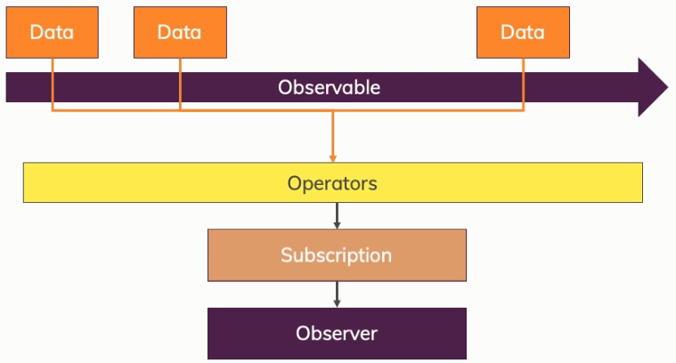
Operators
ANGULAR

Slide 57
Operators
ANGULAR
private firstObsSubscription: Subscription;
ngOnInit() {
…
this.firstObsSubscription = myObservable.pipe(
filter(data => { return data < 4; }),
map((data: number) => { return 'Round: ' + (data + 1); })
).subscribe(
data => { console.log(data); },
error => { console.log(error); alert(error.message); },
() => { console.log('Completed!'); }
);
}

Slide 58
Unsubscription
ANGULAR
private firstObsSubscription: Subscription;
ngOnDestroy(){
this. firstObsSubscription.unsbscribe();
}

Slide 59
Fourth Day
ANGULAR
Forms
Making Http Requests

Slide 60
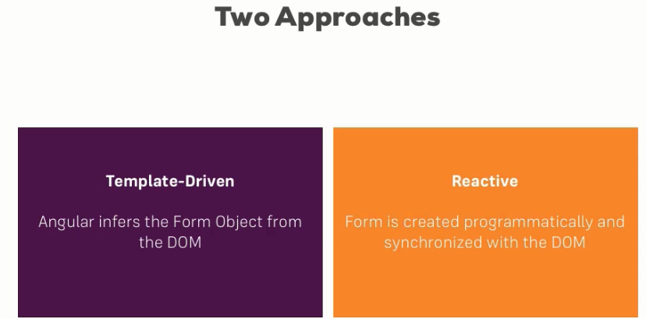
Forms
ANGULAR

Slide 61
TD: Registering the Controls
ANGULAR
First of all the module FormsModule must be imported in the app.module
To register a control we have to add NgModel and a name for this control
<form>
<input type="text" id="username" class="form-control" ngModel name="username">
</form >

Slide 62
TD: Submitting and Using the Form
ANGULAR
<form (ngSubmit)="onSubmit(f)" #f="ngForm">
...
</form >
import { NgForm } from '@angular/forms’;
…
onSubmit(form:NgForm){
console.log(form);
}

Slide 63
TD: Adding Validation to check User Input
ANGULAR
<input type="text"
id="username"
class="form-control"
ngModel
name="username"
required minlength="4">

Slide 64
TD: Using form state
ANGULAR
<button type="submit" [disabled]="!f.valid">Submit</button>
input.ng-invalid, select.ng-invalid {
border: 1px solid red;
}

Slide 65
TD: Outputting Validation Error Messages
ANGULAR
<input type="email" id="email"
class="form-control" ngModel name="email"
required email #email="ngModel">
<span class="help-block" *ngIf="!email.valid && email.touched">
Please enter a valid email
</span>

Slide 66
TD: Using ngModel with Two-Way-Binding
ANGULAR
<div class="form-group">
<textarea class="form-control" name="questionAnswer" rows="3" [(ngModel)]="answer">
</textarea>
</div>
<p>Your reply:{{answer}}</p>

Slide 67
TD: Grouping Form Controls
ANGULAR
<div id="user-data" ngModelGroup="userData" #userData="ngModelGroup">
… control s here
</div>
<p *ngIf="!userData.valid && userData.touched">user Data is invalid</p>

Slide 68
TD: Handling Radio Buttons
ANGULAR
<div class="radio" *ngFor="let g of genders">
<label>
<input type="radio" name="gender" ngModel [value]=g>{{g}}
</label>
</div>
genders=['male','female'];

Slide 69
TD: Using Form Data
ANGULAR
user={
username:'',
email:'',
secretQuestion:'',
answer:'',
gender:''
};
…
onSubmit(){
this.user.username=this.myForm.value.userData.username;
this.user.email=this.myForm.value.userData.email;
this.user.gender=this.myForm.value.gender;
this.user.secretQuestion=this.myForm.value.secret;
this.user.answer=this.myForm.value.questionAnswer;
}

Slide 70
TD: Reset a form
ANGULAR
this.myForm.reset();

Slide 71
Reactive: Creation of the form
ANGULAR
Must import the ReactiveFormsModule in app.module.ts
signupFrom: FormGroup;
ngOnInit(){
this.signupFrom= new FormGroup({
'username': new FormControl(null),
'email': new FormControl(null),
'gender': new FormControl('male')
});
}

Slide 72
Reactive: Syncing HTML and Form
ANGULAR
<form [formGroup]="signupFrom">
<div class="form-group">
<label for="username">Username</label>
<input
type="text"
id="username"
formControlName="username"
class="form-control">
</div>
...
</form>

Slide 73
Reactive: submit de form
ANGULAR
<form [formGroup]="signupFrom" (ngSubmit)="onSubmit()">
…
<form>
onSubmit(){
console.log(this.signupFrom);
}

Slide 74
Reactive: Validation
ANGULAR
this.signupFrom= new FormGroup({
'username': new FormControl(null, Validators.required),
'email': new FormControl(null, [Validators.required,Validators.email]),
'gender': new FormControl('male')
});

Slide 75
Reactive: Getting Access to Controls
ANGULAR
<span
*ngIf="!signupFrom.get('username').valid && signupFrom.get('username').touched"
class="help-block">
Please enter a valid username
</span>
input.ng-invalid.ng-touched{
border: 1px solid red;
}

Slide 76
Reactive: Group Control
ANGULAR
<div formGroupName="userData">
<div class="form-group">
<label for="username">Username</label>
<input type="text" id="username" formControlName="username" class="form-control”>
</div>
<div class="form-group">
<label for="email">email</label>
<input type="text" id="email" formControlName="email" class="form-control">
</div>
</div>
this.signupFrom= new FormGroup({
'userData':new FormGroup({
'username': new FormControl(null, Validators.required),
'email': new FormControl(null, [Validators.required,Validators.email])
})
});

Slide 77
Arrays of Form Controls (FormArray)
ANGULAR
ngOnInit(){
this.signupFrom= new FormGroup({
…,
'hobbies':new FormArray([])
});
}
<div formArrayName="hobbies">
<h4>Your hobbies</h4>
<button class="btn btn-default" type="button" (click)="onAddHobby()">
Add Hobby</button>
<div class="form-group" *ngFor="let hobby of getControls(); let i=index">
<input type="text" class="form-control" [formControlName]="i">
</div>
</div>

Slide 78
Arrays of Form Controls (FormArray)
ANGULAR
getControls() {
return (<FormArray>this.signupForm.get('hobbies')).controls;
}
onAddHobby(){
const control=new FormControl(null,Validators.required);
(<FormArray>this.signupFrom.get('hobbies')).push(control);
}

Slide 79
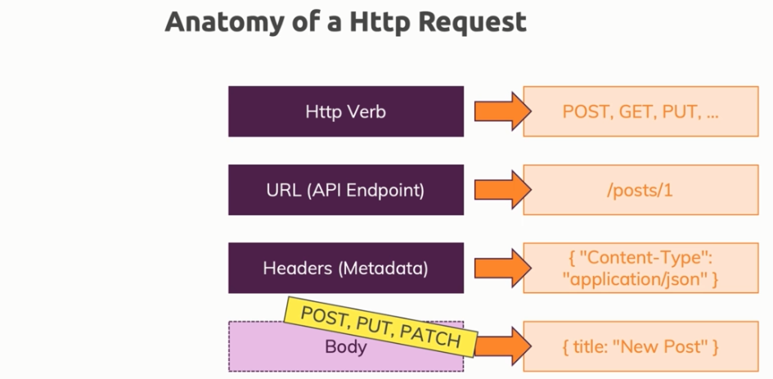
Making HTTP Requests
ANGULAR
must import the module HttpClientModule in app.module
import { HttpClientModule } from '@angular/common/http'

Slide 80
Sending a POST Request
ANGULAR
constructor(private http: HttpClient) {}
addHero (hero: Hero): Observable<Hero> {
return this.http.post<Hero>(this.heroesUrl, hero);
}
this.heroesService .addHero(newHero)
.subscribe(
hero => this.heroes.push(hero)
);

Slide 81
Sending a PUT Request
ANGULAR
constructor(private http: HttpClient) {}
updateHero (hero: Hero): Observable<Hero> {
return this.http.put<Hero>(this.heroesUrl, hero);
}

Slide 82
GETting Data
ANGULAR
private fetchPosts() {
this.http
.get(url)
.subscribe(posts => {
console.log(posts);
});
}

Slide 83
Delete request
ANGULAR
deleteHero (id: number): Observable<{}> {
const url = `${this.heroesUrl}/${id}`; // DELETE api/heroes/42
return this.http.delete(url);
}
this.heroesService .deleteHero(hero.id).subscribe();

Slide 84
Handling Errors
ANGULAR
this.postService.fetchPosts().subscribe(posts=>{
this.loadedPosts = posts;
}, error => {
this.error = error.message;
}
);
<div class="alert alert-danger" *ngIf="error">
<h1>An error has occured</h1>
<p>{{error}}</p>
</div>

Slide 85
Setting Headers
ANGULAR
return this.http
.get<{ [key: string]: Post }>(
url,
{
headers: new HttpHeaders({'Custom-header' : 'hello'})
}
)

Slide 86
Adding Query Params
ANGULAR
let searchParams = new HttpParams();
searchParams = searchParams.append('print', 'pretty');
searchParams = searchParams.append('custom', 'key');
return this.http
.get<{ [key: string]: Post }>(
url,
{
headers: new HttpHeaders({'Custom-header' : 'hello'}),
params: searchParams
}
)

Slide 87
Introducing Interceptors
ANGULAR
export class AuthInterceptorService implements HttpInterceptor {
intercept(req: HttpRequest<any>, next: HttpHandler) {
const modifiedReq = req.clone({
headers: req.headers.append('Auth', 'xyz')
});
return next.handle(req);
}
}
@NgModule({
…
providers: [{provide : HTTP_INTERCEPTORS, useClass: AuthInterceptorService, multi : true}],
…
})

Slide 88

QUESTIONS
ANGULAR

Slide 89
SESSION END
ANGULAR
MERCI
pour
votre
ATTENTION

