Slide 1

Merger and Acquisitions By Tech. Companies
Acquisitions Dataset

Slide 2
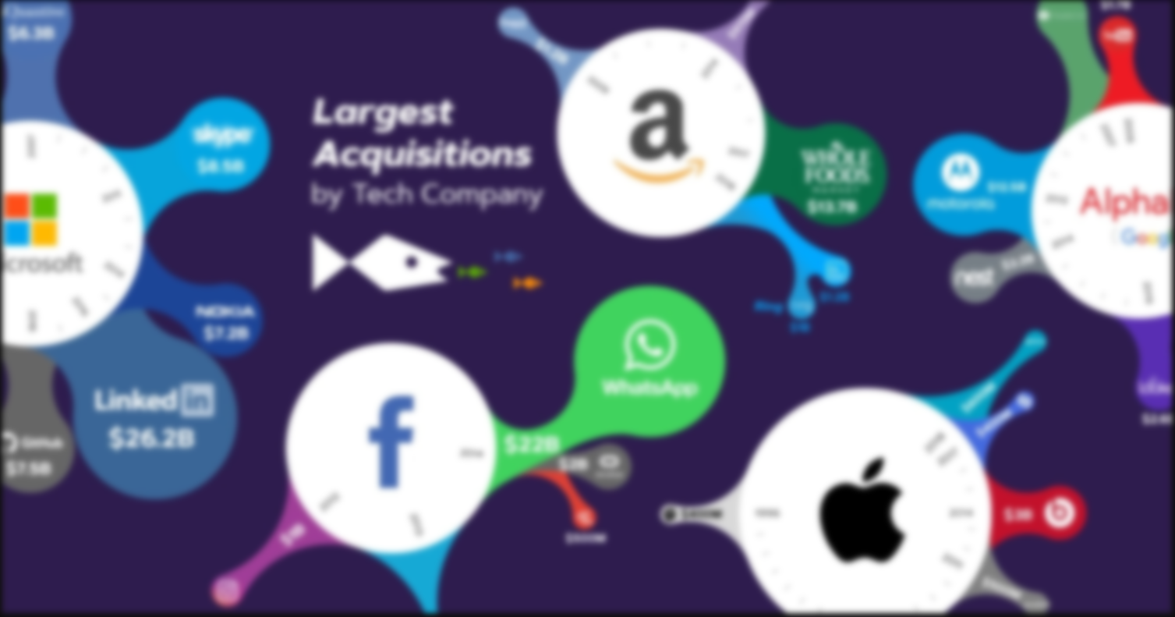

This dataset contains
Microsoft, Google, IBM, Hp , Apple
Disney
1455 rows × 10 columns

Slide 3

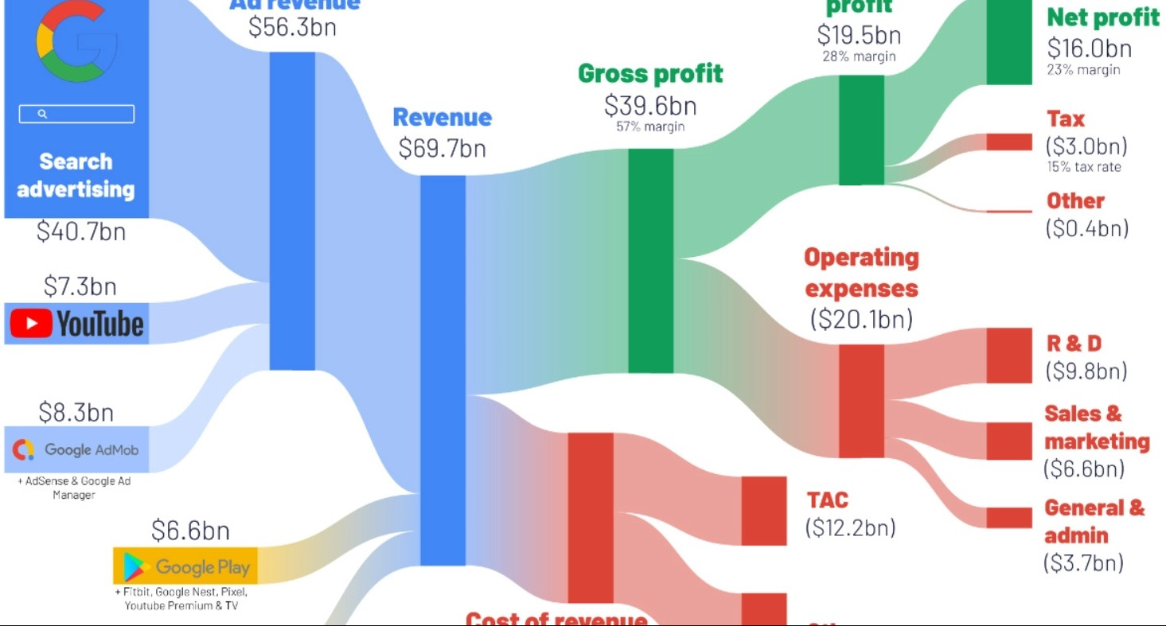

The attributes include the date
Year : Year of the acquisition 2010-2015
Acquired Company :name of the company acquired
Acquisition Price :value or the cost of acquisition
Business :business use-case of the acquisition
Country : the country from which the acquisition was made.
Acquisition Month :Month of the acquisition
ID : identify every row
Category: empty
Derived Products: Google Cloud Platform
Android
Amazon Web Services
YouTube

Slide 4


Tasks and Analysis Ideas
Highest Number of Acquisitions
What is the year of firist Acquisition & Big one ?
What is the rate of acquisition of each parent company?
What is the average spend of each parent company during its acquisitions?
Which parent company has spent the most money on a single acquisition?

Slide 5




THANK YOU!
Younan Iskander
younaniskander2001@gmail.com
010-166-94946 (whats)

