Slide 1
Small Artist Discovery
SA
D:
CS 564
Group 16
Anna Kim, Brett Fisher, Hunter Droegkamp, Yewon Lee

Slide 2
Outline
D:
Application description
Implementation
Database overview
Application architecture
Interfaces
Evaluation & Demonstration
Conclusions

Slide 3
Application Description
D:
Primary function:
Allow users to discover unpopular music artists by searching a genre or filtering by other musical criteria
Domain:
Web-based
Importance of database:
Keep record of all songs, artists, albums, genres
Store user info and preferences for each user

Slide 4
Application Description
D:
2 ways of searching:
Slider Search: user adjusts sliders of each audio feature (danceability, tempo, etc.)
Genre Search: user picks up to 3 genres and a list of songs from those genres are returned
Result list/User preferences
Return a list in descending order of popularity
After searching, each song will feature a check box where the user can “Like” or “Dislike” the song
Notes:
Within the slider filter
At most 3 genres

Slide 5
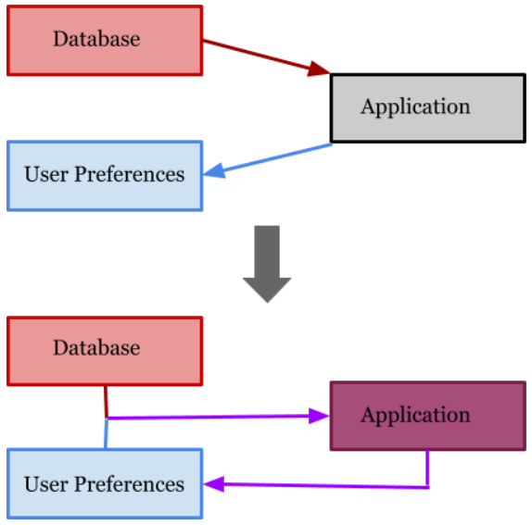
Application Architecture
D:

Slide 6
Data
D:
Free Music Archive: A Dataset For Music Analysis https://github.com/mdeff/fma
Over 100,000 Creative Commons-licensed tracks
Contains information for each song, artist, album, genre
Audio features extracted from Echonest for each song
Our Database
4 initial tables (Song, Artist, Album, Genre), 2 more created in application (User, Review)
Song is largest table with 14,264 records
Notes:
Data cleaning??

Slide 7
Evaluation & Demonstration
D:
1. Test SQL
→ Slider search result query
→ Review table update with new user creation
2. Test connected backend (php & SQL) and frontend (html & css)
→ Connected Log in & Create account & Genre Search pages
→ Seach pages’ frontend features/functions

Slide 8
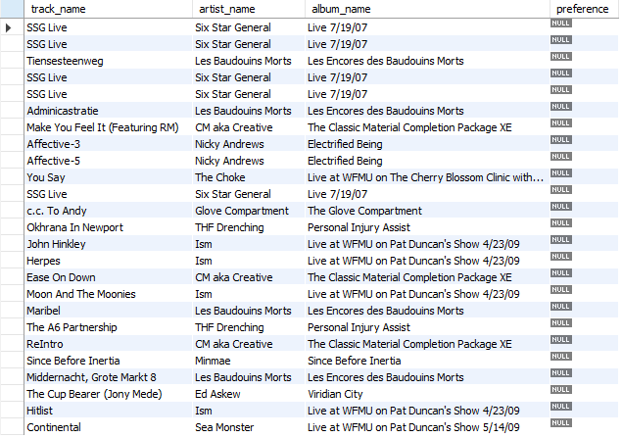
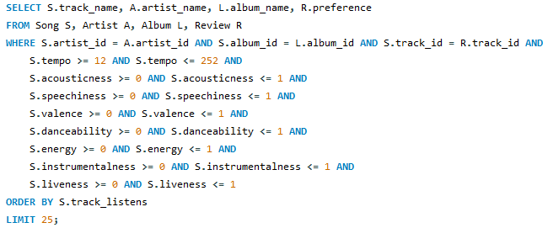
Slider Search Results Evaluation
D:
Base test with no sliders adjusted:
Query takes over 30 seconds to run - DBMS max runtime must be increased
Ordered by least to most listens that matches with .csv file? YES
No result potentially missing? YES
Proper columns shown? YES

Slide 9
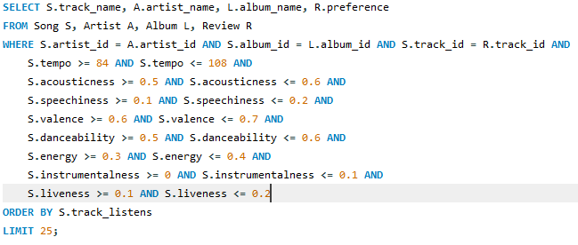
Slider Search Results Evaluation
D:
Adjust sliders to be the minimum around features for 20th least popular song:
“ReIntro” returned? YES
Runtime now only .016 seconds

Slide 10
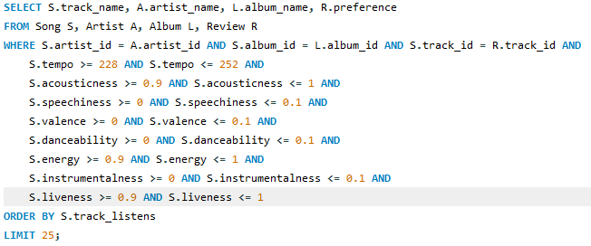

Slider Search Results Evaluation
D:
Set extreme, very small ranges for the sliders to see if there are any results:
Any rows returned? NO
This is not necessarily a bad thing, it just means the data doesn’t contain songs for every combination of slider ranges

Slide 11
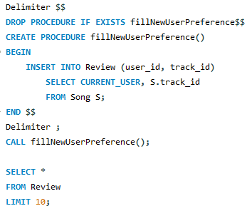
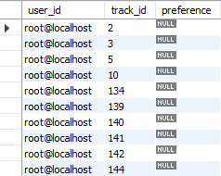
Test procedure to insert rows for each song in Review table when new user is created:
D:
14264 rows inserted in Review for each song? YES
User_id all the same with current user? YES
Track_id matches first 10 in .csv file? YES
Preference column left untouched? YES

Slide 12
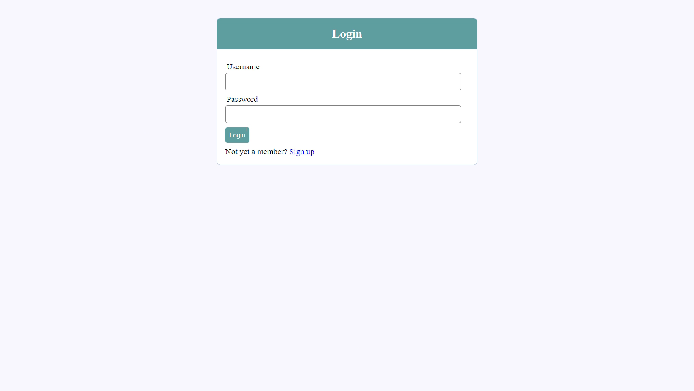
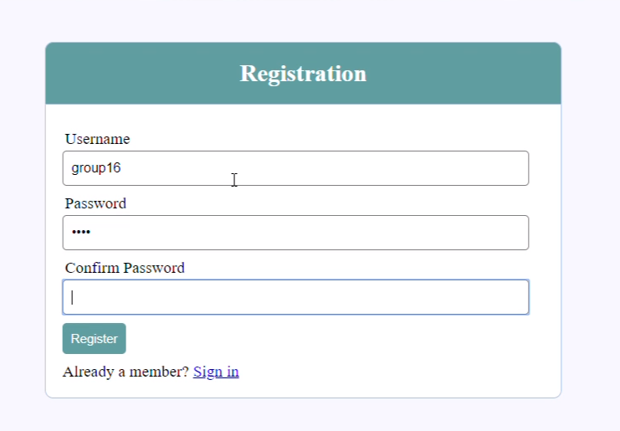
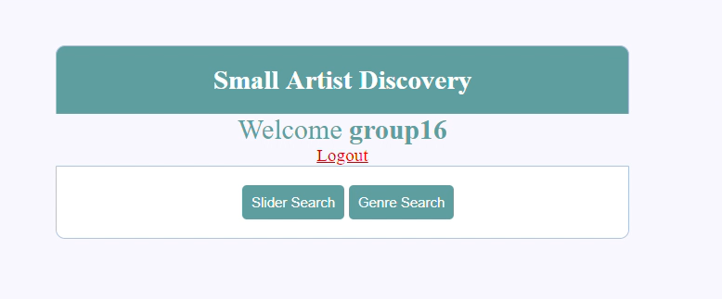
Interfaces
D:
<Login page>
<sign up / registration page>
<Main/Home page>
Search buttons on the main page
Notes:
For the interface we used PHP

Slide 13
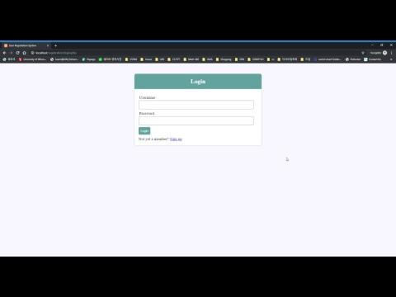
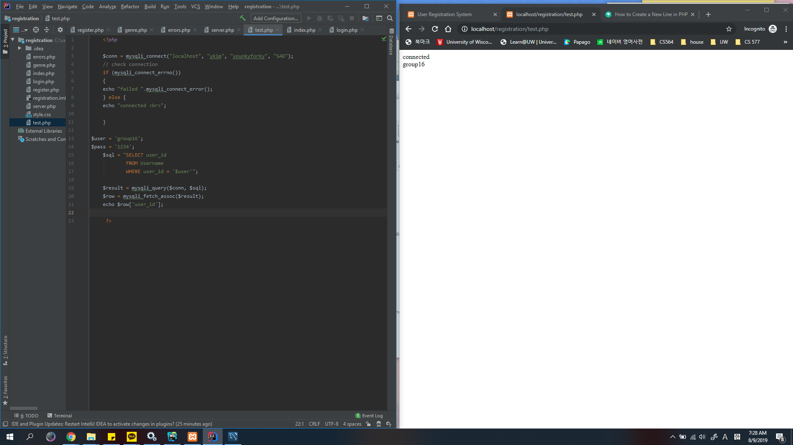
Connected Log-in & Create account & Genre Search pages
D:
<Log-in and Register pages>
<Actual output of user_id in database>

Slide 14
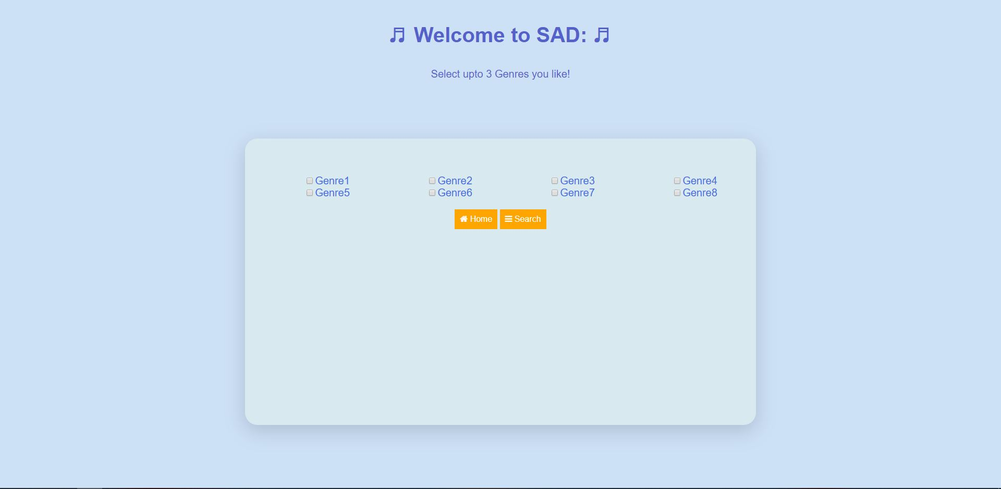
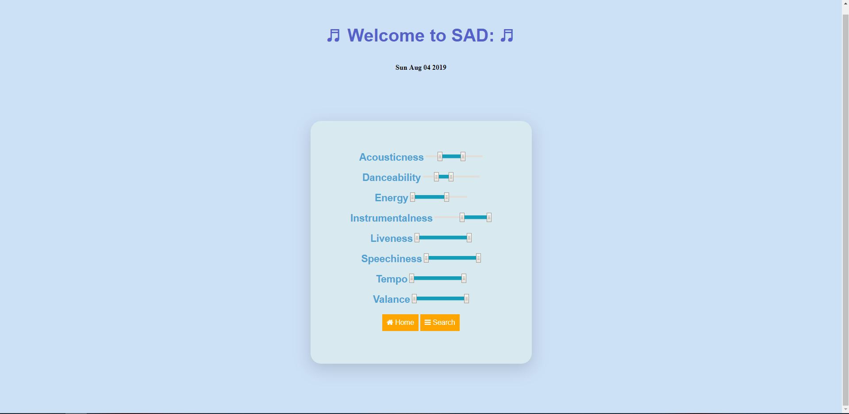
Interfaces
D:
users will select at least one / upto three genres they like, than click search
<Sliders Search page>
<Genre Search page>
In the slider search, users will adjust sliders to their liking then click search

Slide 15
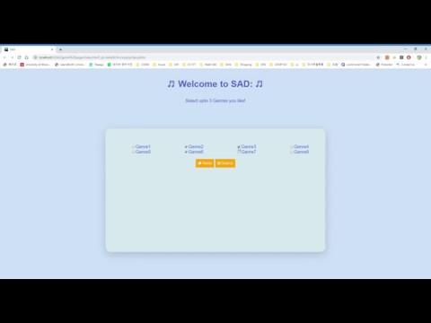
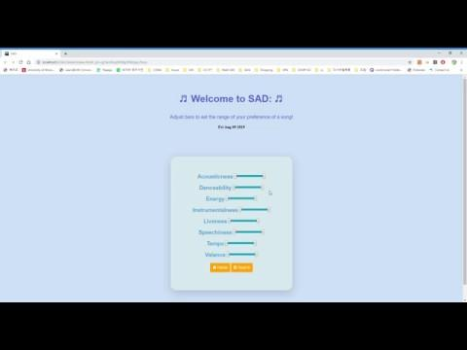
Search pages’ frontend features/functions
D:
<Genre page user interface>
<Sliders page user interface>

Slide 16
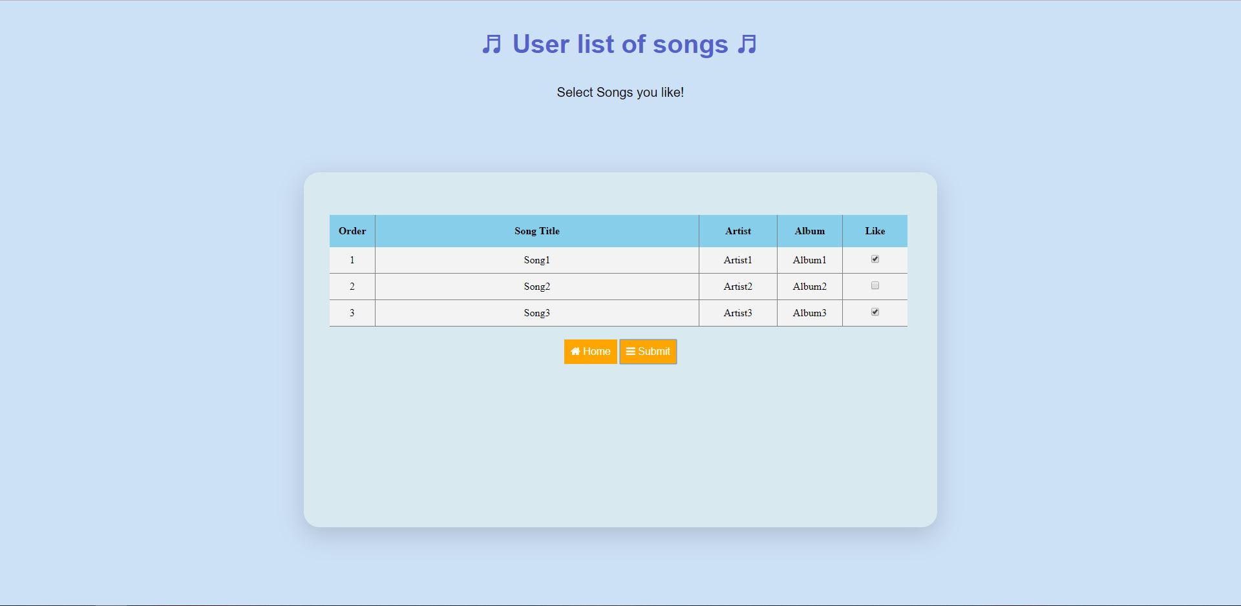
Interfaces
D:
<User list of songs page>
A list of songs is returned with columns for row number, song, artist, album, and preference checkbox

Slide 17
Conclusion
D:
Relational schema is actually a useful way of visualizing the data tables
Database design becomes much less confusing after creating ER diagram and checking for normalization
Diagrams help clarify what is and is not necessary in an application
SQL queries are fairly translatable to data summarizing in other languages ( PHP, R, Python, etc.)
Stored Procedure is used to provide control structure such as loop
Steps needed to be taken in data cleaning phase to make sure no NULL values were contained in the data (keys cannot have any NULL)
PHP, HTML, CSS, MySQL, XAMPP, Python
Notes:
Relational schema and ER diagram: find primary key and realize which table to create (user and review table for us)
Order
Preference song print: stored procedure
Using HTML and CSS for the frontend
Connect mySQL and PHP
Using xampp (web server/ database connection) PHP, MySQL
Python used for data cleaning

Slide 18
Thank you D: !

