Slide 1

StudyPal
TROY HACKATHON 2026
AI STUDY BUDDY
Track 2 · Language Models · AI Study Pal
AI STUDY PAL / BUDDY
PRODUCT PREVIEW · mock
StudyPal
What are the four necessary
conditions for deadlock?
StudyPal
from Operating Systems Midterm Notes
Turn your course materials into a tutor
that cites every answer.
All four must hold: mutual exclusion,
hold-and-wait, no preemption, circular wait [1]
Operating Systems Midterm Notes
p.3 · Mutual exclusion / Hold and wait …
Not reading for you — making sure you actually learn.
Every AI answer links back to the source page.
Click [1] → open the source page
3-min live demo
Troy Hackathon 2026 · Track 2
Notes:
Opening line: StudyPal answers only from the materials you upload, every claim clicks back to the source, and it loops from Q&A into 'find your weak spots, then review them'. Three minutes end to end.

Slide 2
PROBLEM · Why we need a new tool
AI study assistants stall on three problems
Dropping a PDF into a chat box doesn't make learning happen.
01
02
03
Answers you can't trust
Learned today, gone tomorrow
No clear next step
Models hallucinate with confidence. Students
can't verify, so they won't use it for real work.
'I get it' isn't 'I remember it'. No testing
or review means knowledge resets to zero.
Where you're weak, what to review, how to
budget your time — all guesswork.
So they either copy it blindly, or stop using it.
So every exam becomes a from-scratch cram.
So review becomes re-reading the whole book.
Hallucination
Forgetting
No direction
Tools stop at Q&A — learning needs a loop.
three problems · one loop
StudyPal · Troy Hackathon 2026
02 / 14
Notes:
Set up the problem: untrustworthy answers, forgetting, and no direction. These aren't model-quality problems — they're product-shape problems: Q&A only, with no verification and no review loop.

Slide 3
SOLUTION · The claim
One loop: ask → find weak spots → review them
Not reading for you — making sure you learn, and every answer is verifiable.
1
Upload materials
2
Cited Q&A
3
Quizzes + cards
4
Profile + plan
PDF / PPTX / DOCX / MD
parsed, chunked, indexed locally
→
Every claim carries [n]
click back to the source page
→
Auto-generated tests and cards
answers graded, self-ratings logged
→
Mastery and gaps,
plus a 3-hour study plan
→ ask within ~30s
→ every sentence checkable
→ weak spots visible
→ next step is clear
↺ The loop: weak spots you find become the next round of practice and flashcards
◆
Only answer from materials
no outside knowledge
◆
Say "not found"
refuse rather than invent
◆
Index stays local
only snippets reach the model
From "reading" to "knowing where you're stuck" — all in one web page.
StudyPal · Troy Hackathon 2026
03 / 14
Notes:
One sentence: StudyPal owns verification and the loop. Upload, ask, quiz, flashcards, profile, plan — all six share the same materials and mastery data.

Slide 4
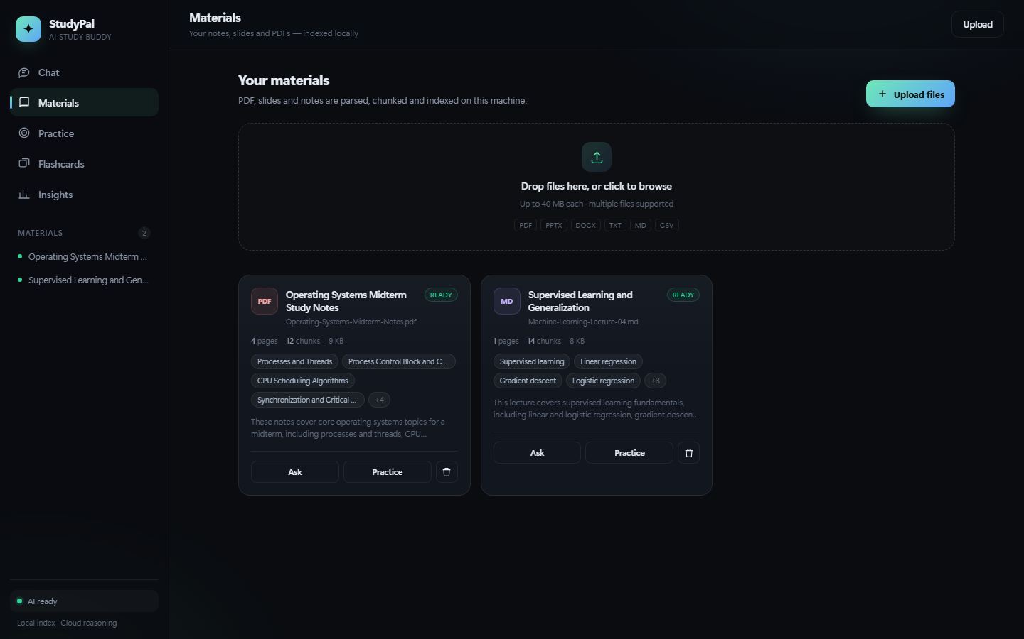
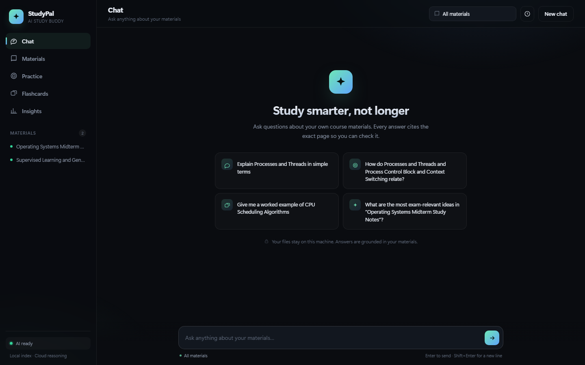
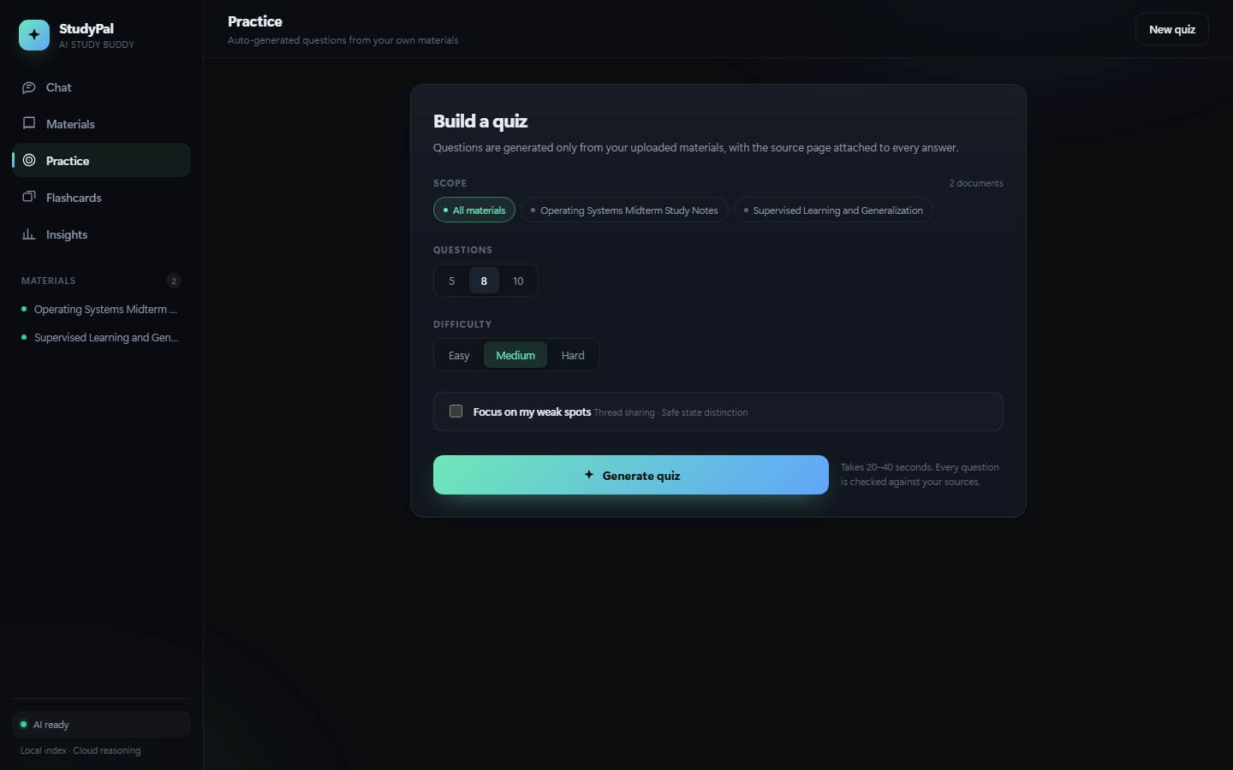
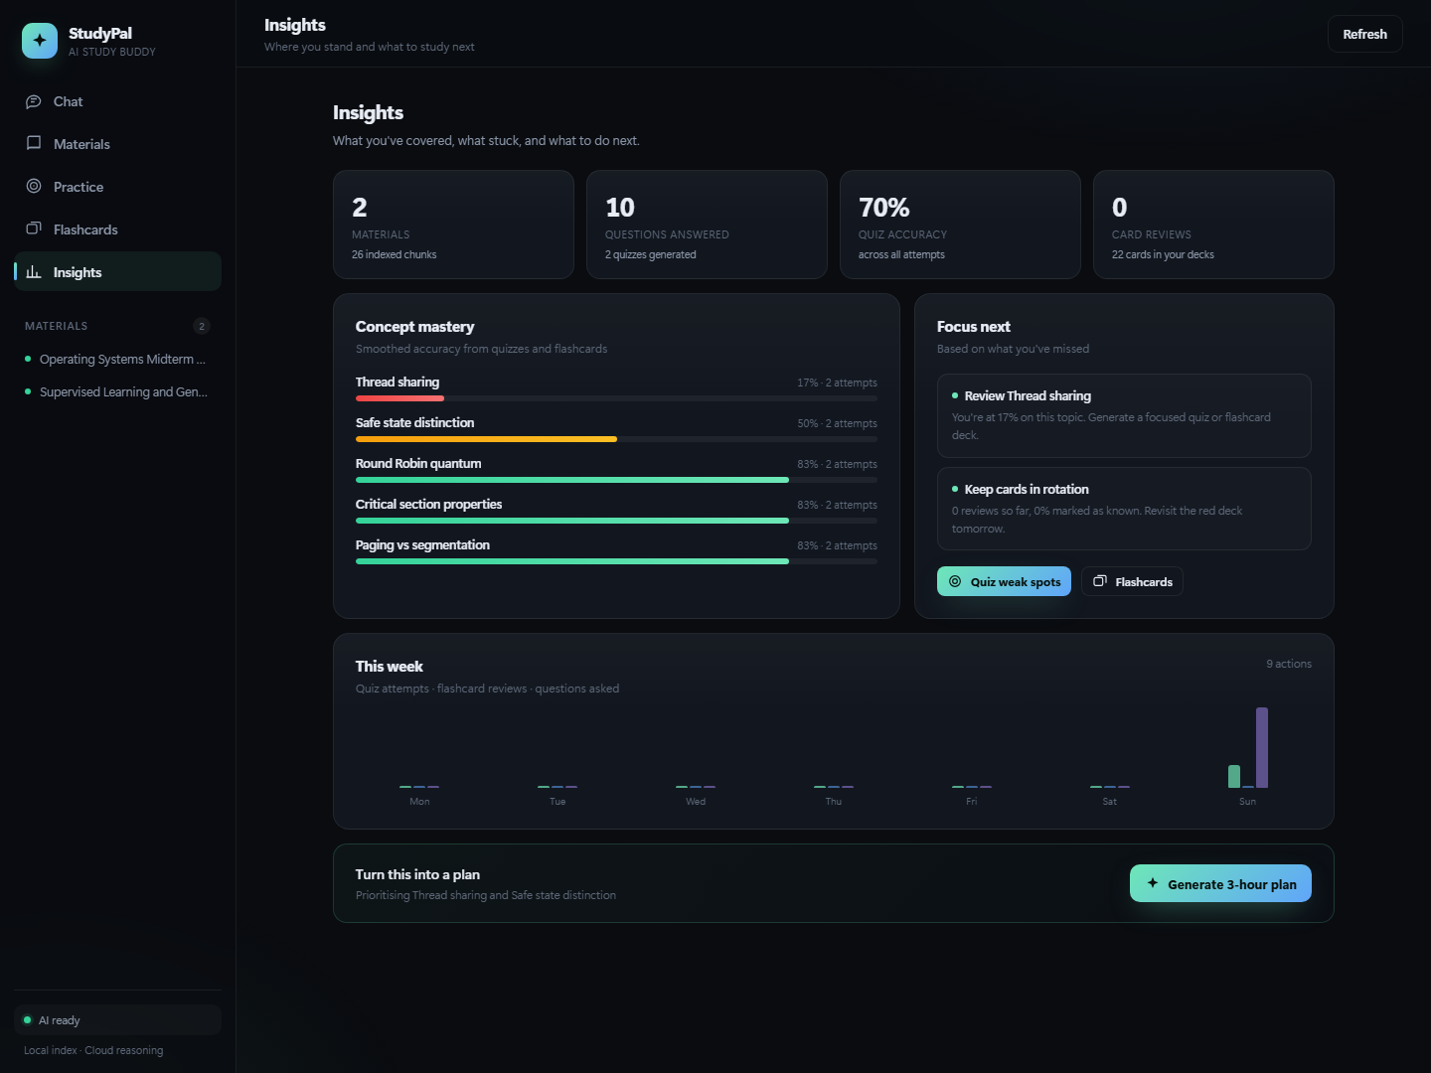
PRODUCT · Five modules
One full pipeline in a single web page
Chat is the entry point; the real difference is data shared across materials, quizzes, flashcards and insights.
M
Materials
Upload = indexed; title, summary and topic tags extracted
C
Chat
Answers only from materials, every sentence cited to a page
P
Practice
3–20 multiple choice, instant feedback + explanations, graded
F
Flashcards
3D flip, self-rate "got it / missed it" → writes to mastery
I
Insights
Mastery, weak spots, 7-day activity and a study plan
StudyPal · Troy Hackathon 2026
04 / 14
Notes:
Five modules aren't five demos — they share documents, concepts and mastery. Screenshots: Materials, Chat, Practice, Insights; Flashcards is shown live by flipping cards.

Slide 5
CORE 01 · CHAT
Every answer links back to the source
Answers aren't "plausible" — they're checkable on the spot.
RAG
How citations work
01
Retrieve
Dense cosine + BM25, fused with RRF → top 6 chunks
02
Constrain
Prompt only allows the retrieved snippets; force [n] per sentence
03
Verify
Click a marker → document name, page and source drawer
Q
What are the four conditions for deadlock?
mock
Mutual exclusion, hold-and-wait, no preemption, circular wait [1]
Operating Systems Notes · p.3
open source →
Chat · suggested questions generated from your materials' topics
Can't find it? We say so: nothing in your materials, no inventing — and we suggest what to upload.
StudyPal · Troy Hackathon 2026
05 / 14
Notes:
The demo isn't about a clever answer — it's about verifiability: click [1] to open page 3; then ask something not in the materials and watch it say 'not found'. That's the biggest difference from a generic chatbot.

Slide 6
CORE 02 · PRACTICE + FLASHCARDS
Understanding isn't knowing: quiz, grade, recall
Every answer and self-rating writes back to the same mastery store.
Practice · auto-generated
3–20 q's
• 3–20 multiple choice, Easy / Medium / Hard
• Instant feedback: right/wrong + explanation + source page
• Server-side grading; target only your weak concepts
• Results page lists weak concepts and wrong answers
Flashcards · active recall
4–30 cards
• 4–30 cards, 3D flip; Space to flip, ← / → to self-rate
• "Missed / got it" writes straight into mastery
• Missed concepts surface first in the next deck
• Review history persists — run another deck anytime
Practice · scope / count / difficulty / weak-spots only
Every question and card traces back to its source — review isn't guesswork.
StudyPal · Troy Hackathon 2026
06 / 14
Notes:
Quizzing isn't a gimmick, it's measurement: miss two questions and the weak concept appears immediately. Flashcards are keyboard-driven — flip three live, and the self-ratings feed the same mastery store.

Slide 7
CORE 03 · INSIGHTS
Knowing what you don't know beats cramming
Mastery is a number earned by quizzes and flashcards — not a feeling.
Concept mastery
quizzes + flashcards, accumulated across modules
Weak spots
below 72% → Focus next (17% in the screenshot)
Learning rhythm
7-day activity bars — gaps are visible at a glance
Next step
one-click 3-hour plan, down to specific concepts
The loop closes here:
weak spots become the next round of practice.
Insights · mastery / weak spots / 7-day activity / study plan
StudyPal · Troy Hackathon 2026
07 / 14
Notes:
This is the closer: mastery bars, weak spots, seven-day activity, then a generated 3-hour plan. Show the judges that 'measured' turns directly into 'what to do next'.

Slide 8
ARCHITECTURE
Retrieval on-device, generation in the cloud
Thousands of chunks with no vector database; a laptop runs the whole demo.
Browser
vanilla HTML / CSS / JS · no build · no CDN · fetch + SSE
FastAPI · single process
routes / upload / background index / SSE / stats
SQLite (WAL)
Ollama · on-device
DeepSeek · cloud
documents · chunks · FTS5
quizzes · cards · mastery
vectors as float32 BLOBs
nomic-embed-text · 768d
local embeddings, zero cost
auto-falls back to BM25
deepseek-flash · 1M ctx
streams, no local GPU
sees only retrieved snippets
One query's data flow
Query → Dense cosine + BM25 → RRF fuse → Top-6 chunks → forced [n] cites → SSE stream
Materials and index never leave the machine; the cloud sees only the retrieved snippets.
StudyPal · Troy Hackathon 2026
08 / 14
Notes:
One sentence: no-build browser, single-process FastAPI, SQLite + FTS5 for storage, Ollama for local embeddings, DeepSeek in the cloud. Retrieval is fully local; only the top-6 snippets leave the machine.

Slide 9
STACK
Every choice serves "demo in 6 hours"
No Node, no vector database, no local GPU — just a laptop.
Layer
Choice
Why
Frontend
vanilla HTML / CSS / JS SPA
demo machine has no Node; zero build, zero CDN
Backend
FastAPI + Uvicorn
async streaming, type validation, one-file start
Storage
SQLite + FTS5
single file, zero ops; CJK bigram keeps Chinese searchable
Vectors
Ollama nomic-embed-text
local and free; DeepSeek has no embedding endpoint
Generate
DeepSeek deepseek-flash
cloud inference, 1M context, no local GPU
Stream
SSE
low time-to-first-token, better demo feel
Every choice points to the same thing: zero install, zero wait, zero live-demo failures.
StudyPal · Troy Hackathon 2026
09 / 14
Notes:
The stack isn't trendy — it's subtraction toward '6 hours, on a laptop, demoable'. Note: DeepSeek has no embedding endpoint, which is why vectors run locally on Ollama.

Slide 10
PRIVACY & ENGINEERING
Demoable, and survives follow-ups
"Don't crash" is a feature: privacy is design, not a claim.
PRIVACY BY DESIGN
Engineering for "no crashes"
Local-first
Background index
upload returns instantly; status processing → ready / failed
• Files, chunks, vectors, index — all on-device
• Only retrieved snippets are sent to the cloud model
• No accounts, no tracking, no external CDN
• Ollama down → auto-falls back to pure BM25
JSON repair retry
parse failure → repair, then regenerate on fallback
Similarity cutoff
drops recalls below top×0.75 to stop cross-doc bleed
Data boundary
Scanned-PDF check
no text layer → clear error, never a fake success
On-device: files · chunks · vectors · index
Cloud: only the retrieved snippets
Follow-up rewrite
"what about its downsides?" still hits the context
Materials never leave the machine; the model never sees the whole file.
Current scope: no OCR, no multi-user, no auth — a local study tool; scope is written into the README.
StudyPal · Troy Hackathon 2026
10 / 14
Notes:
Volunteer the limits — it scores points: local-first, snippets only, no accounts. The engineering (background indexing, JSON repair, similarity cutoff) exists purely for on-stage stability.

Slide 11
WHY IT SCORES
Every rubric line has an implementation
Not features for their own sake — each item is verifiable live.
Criterion
Weight
Implementation
Innovation & Creativity
20%
verifiable citations + mastery loop + local-first architecture
Technical Excellence
20%
dense + BM25 + RRF, SSE, JSON repair retry, background indexing
Functionality & Completeness
20%
upload → Q&A → quiz → grade → flashcards → insights → plan, all working
Impact & Usefulness
15%
solves "untrustworthy answers" and "don't know what to review"
Teamwork & Collaboration
15%
decoupled front/back end + full docs, modules build in parallel
Presentation & Pitch
10%
3-min script + real screenshots + live-operable
Can explain it, and can run it live — that's our definition of "done".
StudyPal · Troy Hackathon 2026
11 / 14
Notes:
Judges care most about whether it's actually finished. Map each criterion to a working feature and stress that every one can be opened and verified — not adjectives on a slide.

Slide 12
LIVE DEMO · 3 MIN
Three minutes, one full learning loop
Live, not a video; every step has a visible state change.
0:00
Materials Drag in the OS notes; ~30s to parse, chunk and index locally
Demo prep
Chat Ask the four deadlock conditions; stream the answer; click [1] → page 3
✓
Two real slide decks built in
0:30
✓
Backup recording for offline
1:00
Chat Ask something not in the materials; it says "not found"
✓
Retrieval works offline; only generation needs net
1:20
Practice Generate 5 Medium questions; miss 2 on purpose; watch weak spots appear
✓
Rehearse the citation drawer
2:10
Flashcards Generate 8 cards; Space to flip, → to mark "got it"
127.0.0.1:8000
Insights Mastery updates; generate a 3-hour plan to close
3:00 closer:
leave the plan on screen.
2:40
Closer: from reading to knowing where you're stuck — the whole loop, in one page.
StudyPal · Troy Hackathon 2026
12 / 14
Notes:
Run it tight: 30s materials, 30s citation, 20s 'not found', 50s quiz, 30s flashcards, 20s insights + plan. Leave a visible UI state at each step.

Slide 13
ROADMAP
From "demoable" to "daily driver"
Go deep on one loop first, then widen; clear scope makes it credible.
NOW · shipped
NEXT · 3 months
LATER · a semester
demoable today
go deeper on the loop
from personal tool to course tool
·
Cited Q&A + source drawer
·
OCR for scanned / handwritten notes
·
Multi-user + course spaces
·
Auto quiz, grading, mastery
·
SM-2 spaced repetition + missed-question drills
·
Canvas LMS integration
·
Flashcards + review history
·
Chinese embeddings (bge-m3)
·
Mobile + offline sync
·
Insights profile + 3-hour plan
·
Export study packs
·
Exam-risk prediction
·
Local hybrid retrieval
·
Per-document card filtering
Current scope: answers only from uploaded materials; scanned PDFs need OCR first; single-user, local.
StudyPal · Troy Hackathon 2026
13 / 14
Notes:
Three tiers, so it doesn't look like 'we want to do everything'. OCR and SM-2 are the most valuable next steps — they directly strengthen ingestion and the review loop.

Slide 14
StudyPal
AI STUDY BUDDY
Thanks
Q & A
[1]
Not reading for you — making sure you actually learn.
Every answer has a source.
p.3 · verified
↗
github.com/youneedhelp111/Troy-hackthone
Live demo
Track 2 · Language Models
Troy Hackathon 2026
StudyPal · Troy Hackathon 2026
14 / 14
Notes:
Leave the repo link and Q&A on screen. Close by repeating the positioning one more time — not reading for you, but making sure you learn, with a source on every answer.

