Slide 1
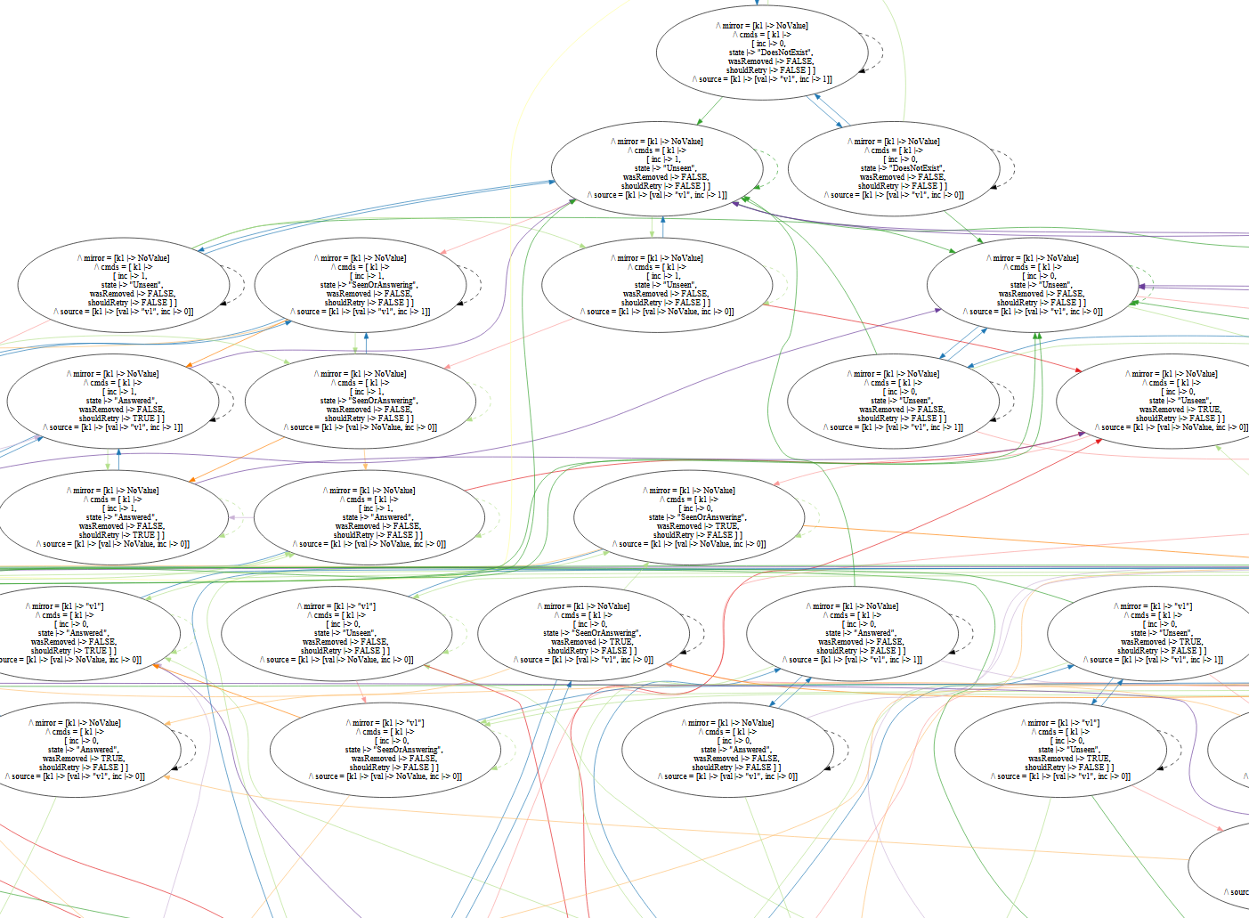

Kayfabe
Star Dorminey (she/her)
sterling.dorminey@gmail.com
Microsoft Azure WAN

Slide 2
About Me
Senior SDE in Microsoft Azure WAN.
Interests:
  Scheduler algorithms
  Graph algorithms
  Distributed systems design
  Formal methods, obviously

Slide 3
Motivation
Had a complex distributed system to implement.
Specified protocols in TLA+.
Tricky, order-sensitive bugs still occurred in implementation.
How do I check my program against the specification?

Slide 4
Testing Strategies

Slide 5
Tradeoffs between testing methods
Implementation as refinement of spec
(e.g. seL4, Dafny, SPARK/ADA)
Model-based testing
Evidence for
compliance
with spec
Closeness to
implementation
Effort
Practicality
Trace Checking (Ron Pressler 2003)
Traditional unit tests

Slide 6
What is Kayfabe?
An attempt to test implementing programs via TLA+/TLC:
Supports trace checking (program execution against TLA+ spec.)
Supports model-based testing (stepping program through TLC model.)
Currently supports C# as a target language, other bindings possible.
This presentation focuses on model-based testing, since trace checking is already described in Pressler’s paper.

Slide 7
Trace Checker: Idea
Idea from Ron Pressler (2003): https://pron.github.io/files/Trace.pdf Capture traces from program execution.
Convert traces to a TLA+ sequence, include that as a constant in the model, with line number as variable.
Have the Next action enable the action that corresponds to each line, increase line number.
Use TLC to check that the resulting behavior:
  Doesn’t violate invariants.
  Doesn’t deadlock.

Slide 8
Trace Checker: Evaluation
Pros
Cons
Easy to use/homebrew.
Easily adapted to legacy code.
  You can use this to document code you don’t understand as a spec, then test your assumptions!
Ensures your spec doesn’t go stale.
Useful for root-cause analysis, since your spec gives you a high-level traceback.
Not a testing method, only retrospective.
No real guarantees – you aren’t exploring edge cases.
You need an unbroken sequence of traces from start, or a checkpointing strategy.
Accomplishing this from prod traces can be non-trivial.

Slide 9
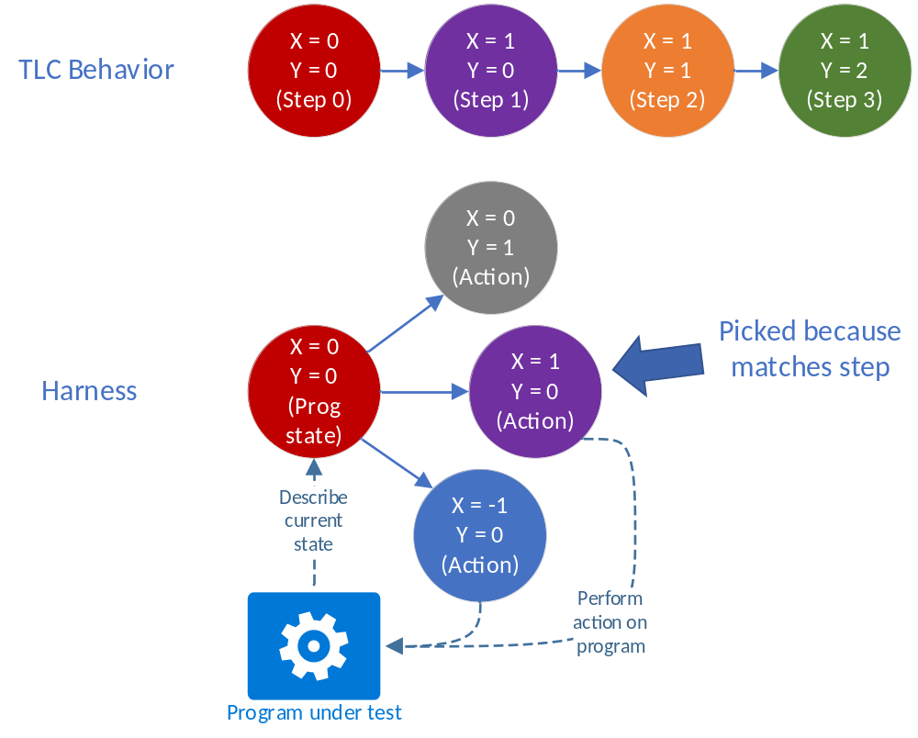
Model-Based Testing: Kayfabe Model Player

Slide 10
Model Player
Assume: you can only reset the program, capture its state and map actions to future states.
Idea: capture the TLC state graph after model checking, then explore every state/transition in the implementation. Check that program state conforms to model at each state in the graph.
How:
Run TLC, capturing the full state graph.
Calculate the minimal spanning sequences of behaviors that visit every state (or transition) at least once.
Devise a harness that, for each behavior, at each step:
  Checks program state against current TLC model state.
  Select a program action that promises a state matching the next step, and
  Execute it.

Slide 11
Model Player: Evaluation
Pros
Cons
Deterministic test of highly-concurrent code.
Exhaustive w.r.t. model.
Eliminates hand-crafted scenario tests.
Simply crank up model size to catch more bugs.
Doesn’t require rewriting in a checked language.
May require refactoring to get the required introspection for model bindings.
Harness development has a bit of a learning curve.
Plays only legal action sequences, so you risk testing only happy paths.
Harness will be complex if model doesn’t closely resemble program.
Inefficient with large models.

Slide 12
Model Player: Blindspots
Hidden variables:
  Model player assumes that TLC state represents closure of entire program state, since multiple orders of TLC states aren’t tested.
  If two program states map to the same TLC state, only one will be tested.
  Infeasible to eliminate all hidden variables, so capture the most important ones.
Random numbers:
  How do you express a GUID in TLA+? In such a way that TLC can check a model that generates random GUIDs? How do you bind that between model and implementation?
  Requires a correspondence mapping, but this involves trickery and may artificially limit the model.
  This downside applies to trace checking too! Or any model-based testing system. (If you know a better strategy, shoot me an email!)

Slide 13
Kayfabe Model Player Architecture

Slide 14
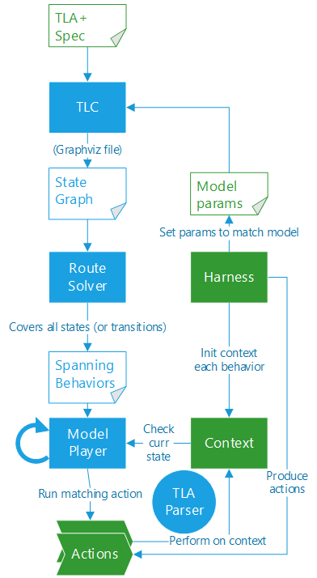
System Architecture
There are four user-provided components to these tests:
TLA+ Spec / Model Params
Context: the current state of the system under test. Actions alter the system by modifying the context.
Actions: the next possible states of the context/model. They can be checked for enablement, and run by mutating the context.
Harness: provides an initialized context for every Reset(), and produces all possible next actions given the current context.
First, TLC is run, and produces a state graph of the execution.
The state graph is fed into the route solver, which computes the minimal set of spanning behaviors over the state graph.
These behaviors are then fed into the model player, which plays each behavior using the harness.
The TLA+ parser serializes/deserializes program data structures into/out of TLA+ expressions.

Slide 15
Model Player: Steps
The Model Player first Reset()s the harness to produce a fresh Context. Next, for each step in the behavior, it:
Gets the current state of the context, in TLA+-serializable form, and checks that the actual state matches the expected state.
Gets the list of possible next states from the harness, then checks that only one enabled state matches the next state value.
Runs the Action, which mutates the context.
Moves onto the next step, then repeats.
Once a behavior is finished, the player Resets() and continues with the next behavior.
Notes:
Note: test actions (e.g. user input or external side effects) are also modeled as actions.

Slide 16
Routing Algorithm: Problem Description
Assume wlog that there’s one Init state; the digraph comes from TLC.
State Inspection Problem:
Problem: Given a digraph and a root node, compute the minimal set of paths from the root node which visit every node at least once, subject to a reset penalty for restarting at the root.
Complexity: NP-Hard (Traveling Salesman). Proof: Make a fully-connected graph, where each node is a city, and each edge is travel cost to the other cities. Draw zero-cost edges to each node from the root, and have an infinite restart penalty. The solution to this problem is the Traveling Salesman Problem (TSP.)

Slide 17
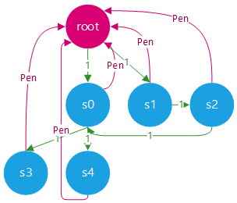
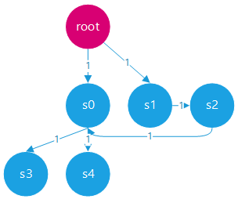
Routing Algorithm: Graph Construction
1.
2.
Init state is the root node, and each edge in the TLC state graph has weight 1.
We can restart from any node, so draw edges back to root (with cost Pen)

Slide 18
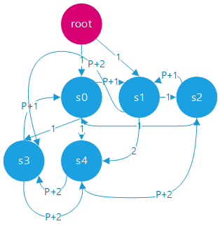
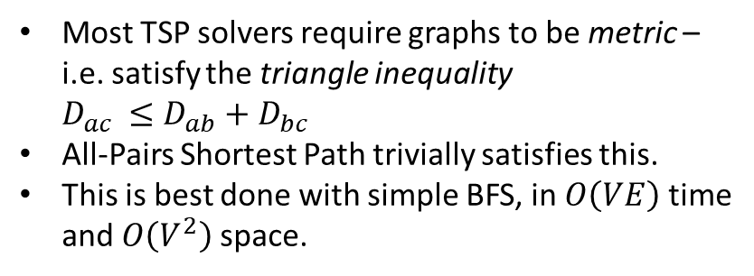
Routing Algorithm: Graph Construction 2
Most TSP solvers require graphs to be metric –
i.e. satisfy the triangle inequality
$D_{ac }≤D_{ab}+D_{bc}$
All-Pairs Shortest Path trivially satisfies this.
This is best done with simple BFS, in $O\left(VE\right)$ time
and $O\left(V^{2}\right)$space.
3.
Compute All-Pairs Shortest Path to produce the final graph.

Slide 19
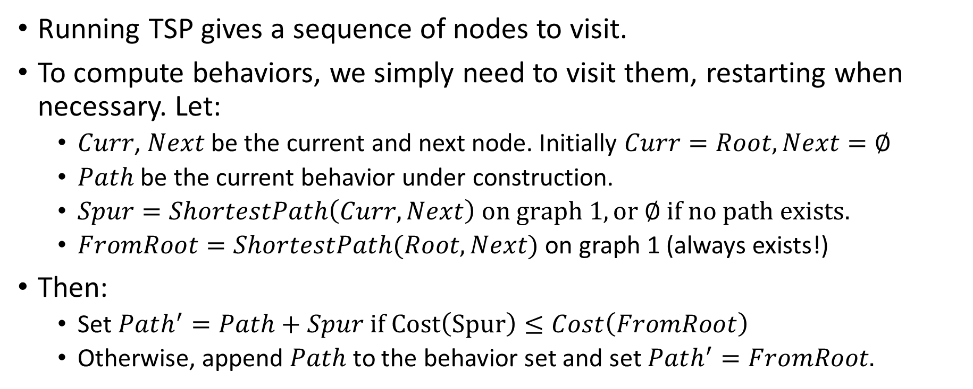
Routing Algorithm: Computing the Tour
Running TSP gives a sequence of nodes to visit.
To compute behaviors, we simply need to visit them, restarting when necessary. Let:
  $Curr$, $Next$ be the current and next node. Initially $Curr=Root, Next=∅$
  $Path$ be the current behavior under construction.
  $Spur=ShortestPath\left(Curr, Next\right) on graph 1, or ∅ if no path exists.$
  $FromRoot=ShortestPath(Root, Next)$ on graph 1 (always exists!)
Then:
  Set $Path^{′}=Path+Spur if Cost\left(Spur\right)≤Cost\left(FromRoot\right)$
  Otherwise, append $Path$ to the behavior set and set $Path^{′}=FromRoot.$

Slide 20
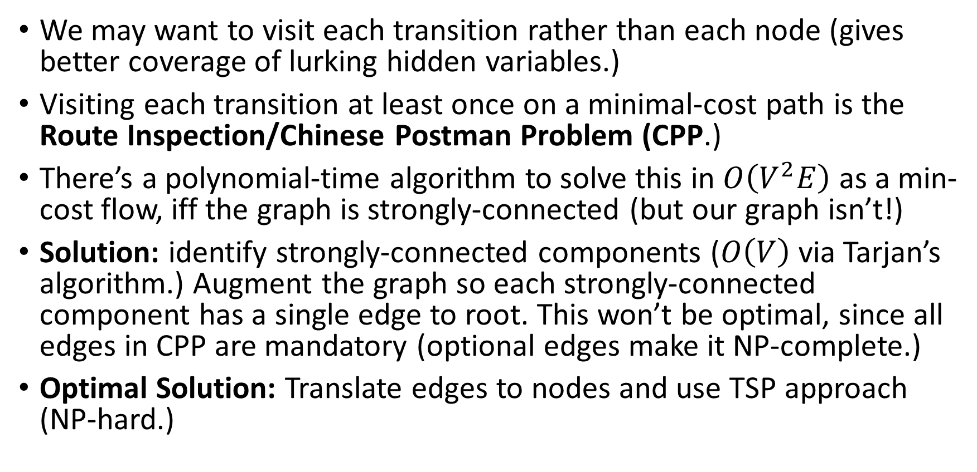
Transition Inspection Problem
We may want to visit each transition rather than each node (gives better coverage of lurking hidden variables.)
Visiting each transition at least once on a minimal-cost path is the Route Inspection/Chinese Postman Problem (CPP.)
There’s a polynomial-time algorithm to solve this in $O\left(V^{2}E\right)$ as a min-cost flow, iff the graph is strongly-connected (but our graph isn’t!)
Solution: identify strongly-connected components ($O\left(V\right)$ via Tarjan’s algorithm.) Augment the graph so each strongly-connected component has a single edge to root. This won’t be optimal, since all edges in CPP are mandatory (optional edges make it NP-complete.)
Optimal Solution: Translate edges to nodes and use TSP approach (NP-hard.)

Slide 21
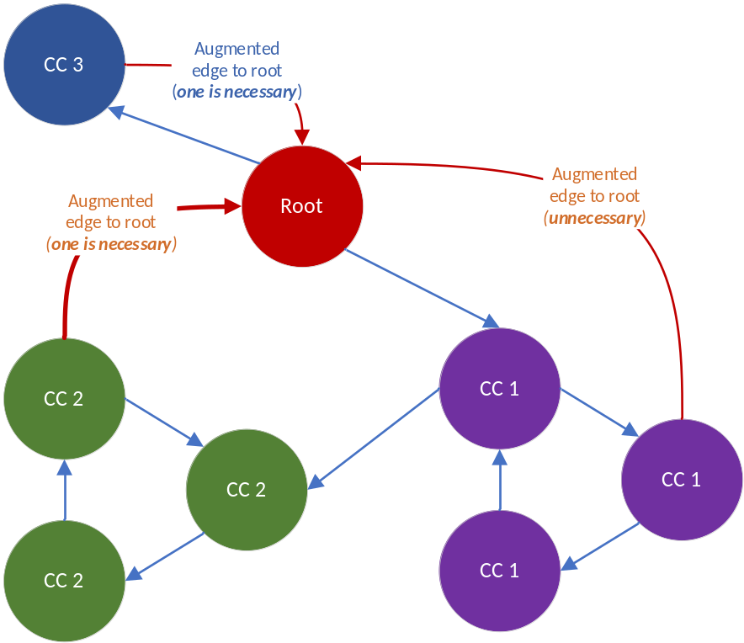
Chinese Postman Approach - Example
Without edge augments, you could only visit CC1 and CC2 but not CC3
Simplest approach is to augment each strongly-connected component with edges.
Over-augmentation causes needless revisits.

Slide 22
Implementation Notes

Slide 23
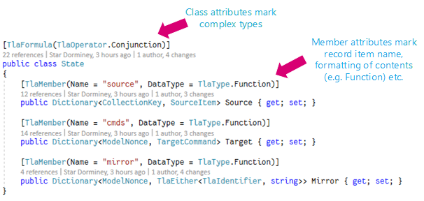
TLA+ Serialization
TLA+ parser built on Pidgin (parser combinator.)
Primitive types (e.g. Nat, BOOLEAN, string) can be serialized automatically.
Standard complex types have default serialization (e.g. List<-> Sequence, Dictionary <-> Function), but can be overridden.
Since TLA+ isn’t typed, polymorphism allowed via TlaEither<TSome, TOther>
These are equivalent
/\ mirror = (<<<<"c1", "k1">>, "s1">> :> NoValue
@@ <<<<"c1", "k1">>, "s2">> :> NoValue)
/\ cmds = ( <<<<"c1", "k1">>, "s1">> :>
[ inc |-> 0,
state |-> "DoesNotExist",
wasRemoved |-> FALSE,
shouldRetry |-> FALSE ] @@
<<<<"c1", "k1">>, "s2">> :>
[ inc |-> 0,
state |-> "DoesNotExist",
wasRemoved |-> FALSE,
shouldRetry |-> FALSE ] )
/\ source = (<<"c1", "k1">> :> [val |-> NoValue, inc |-> 0])

Slide 24
TSP Solver
Used Google’s or-tools for TSP solving, since it has bindings to many languages.
Doesn’t have an approximation solver for asymmetric TSPs (Christofides algorithm only works for symmetric), so use the simple greedy Path Cheapest Arc strategy for the first solution with no guarantees, then Guided Local Search.
Since no guarantees, we set a time limit on the solver.
TSP actually isn’t the bottleneck, since any solution order is valid, and first solution is simple and greedy – we just get better results the longer we go.

Slide 25
How to use

Slide 26
How to build a Kayfabe model harness
Define Data contracts
Define Execution context
Define State mapping function
Implement Harness
Implement Actions

Slide 27
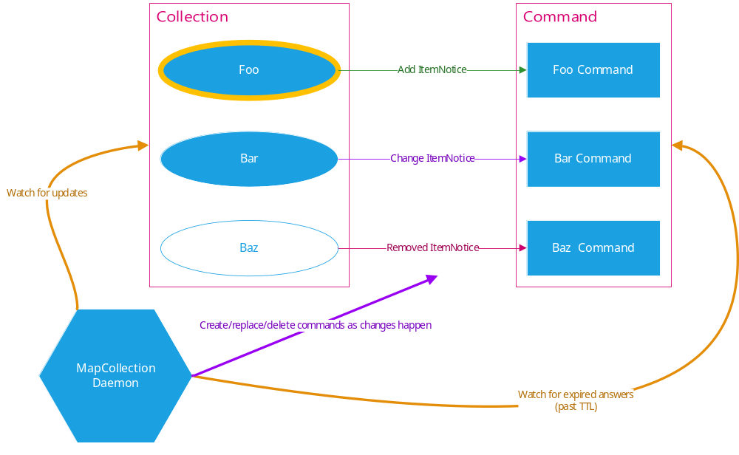
Example: MapCollection
Daemon that watches a source then activates target commands when collection items change or responses expire.
In the test, these commands simply update a target collection to reflect the source collection.
Temporal property: eventual consistency.

Slide 28
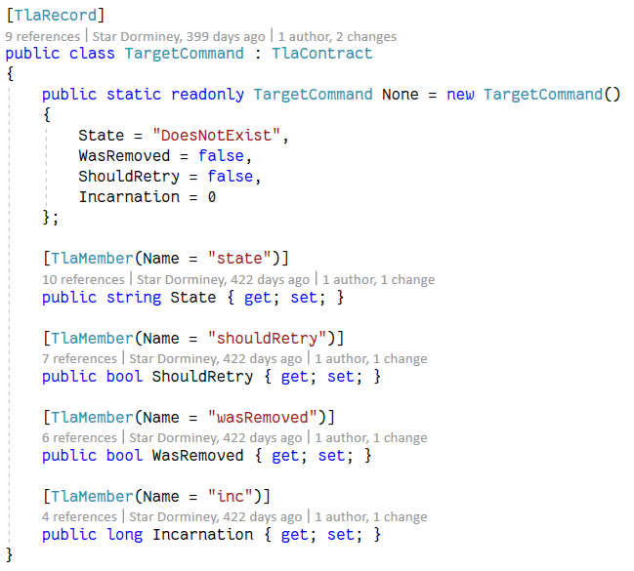
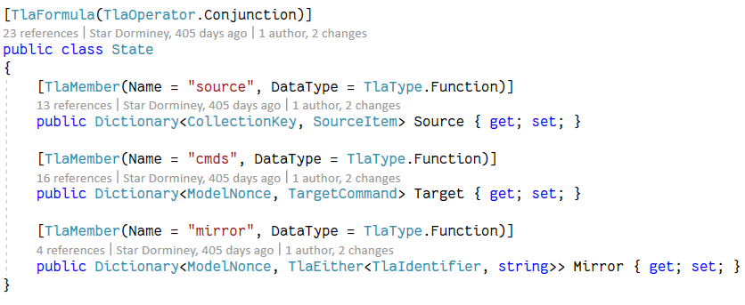
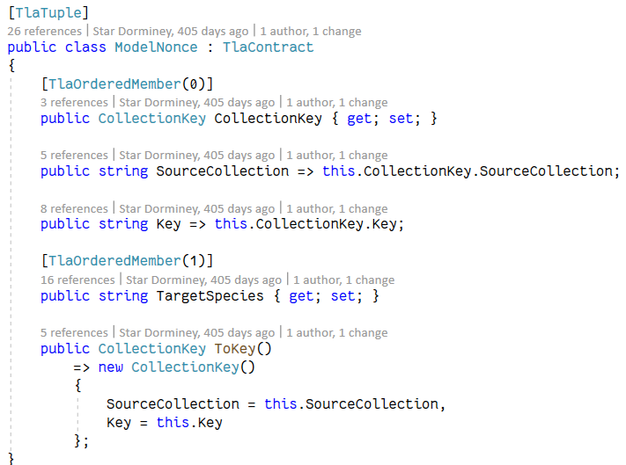
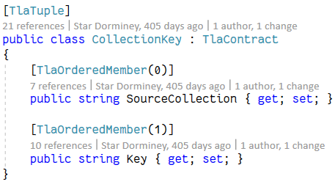
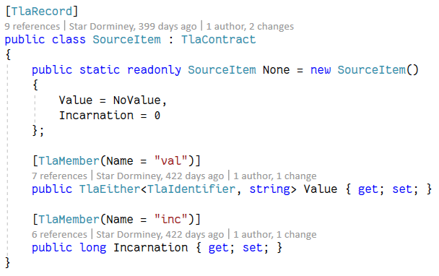
1. Data Contracts
This summarizes the whole
current program state.

Slide 29
2. Execution Context
Context is completely up to you.
Fresh context is returned by Reset()
Context is passed when it’s time to get next actions.
Actions use the context to execute their action when triggered.

Slide 30
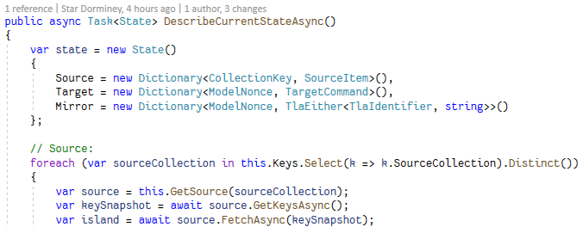
3. State Mapping Function
Returns a TLA+-serializable State when called.
Requires introspection into program state.

Slide 31
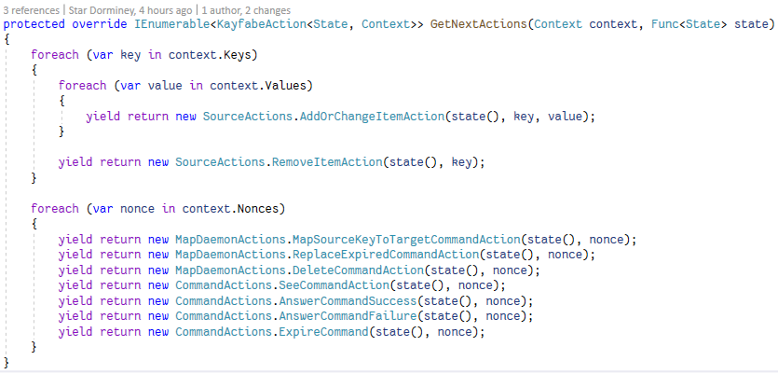
4. Harness
Harness supplies the TLC config:
  Constants in TLA+-serializable syntax, model values, invariant and property names, and the specification to execute.
2. Harness provides the context lifecycle methods:
  Reset() – returns a fresh context, tears down old context if necessary.
  DescribeCurrentState() – returns a State representing the current state in TLC form.
  GetNextActions() – a bit like a spec’s Next axiom, but enablement checks are optional (returned actions are a superset of available TLC actions.)

Slide 32
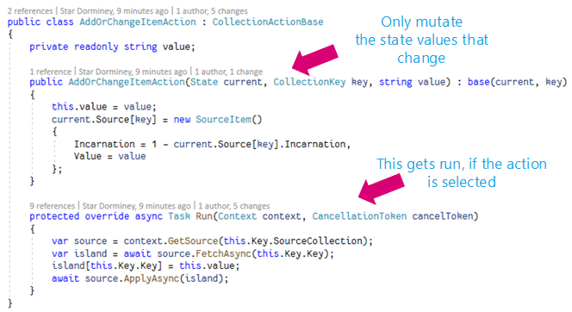
5. Implementing Actions
Each action gets a copy of the current state. The constructor mutates it to match the successor state that it promises.
Model player selects the single action that matches the next state in the behavior, then Run()s it.

Slide 33
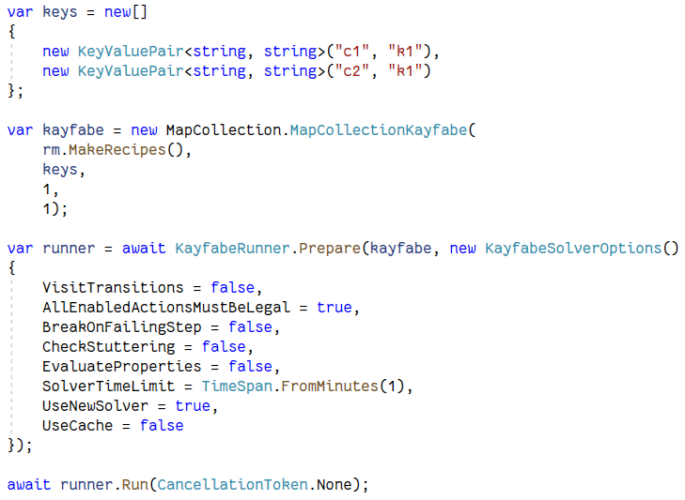
6. Running the Test
Instantiate the harness.
Call Prepare() to run TLC and the route solver.
Call Run() to execute the model player and run the behaviors.
Debugging: you can break on the step that fails, and have the full TLC trace to guide you.

Slide 34
Future Work / Extensions

Slide 35
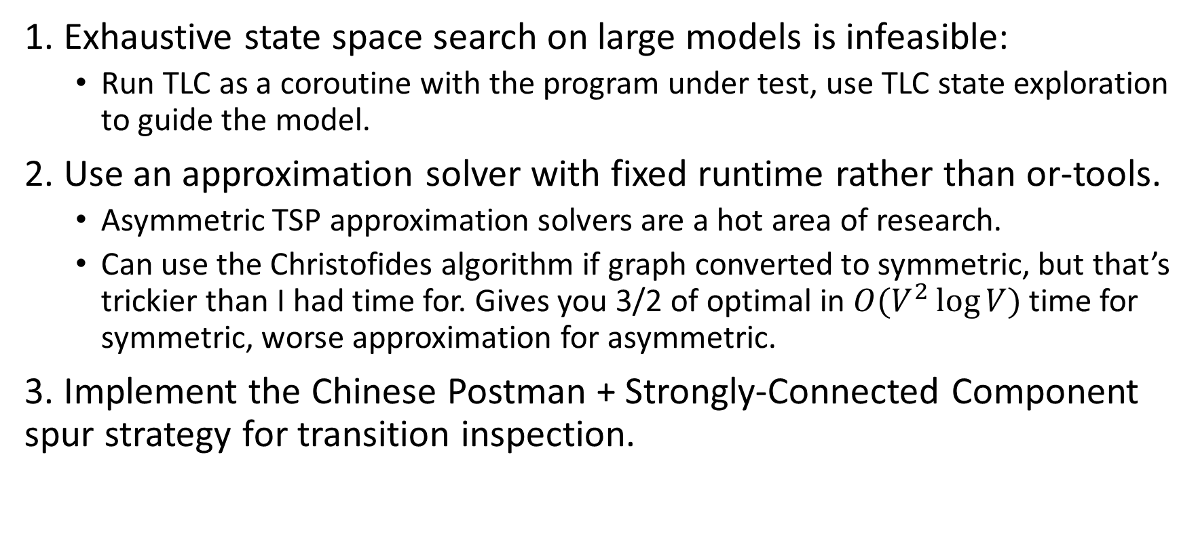
Routing Algorithm Alternatives
1. Exhaustive state space search on large models is infeasible:
  Run TLC as a coroutine with the program under test, use TLC state exploration to guide the model.
2. Use an approximation solver with fixed runtime rather than or-tools.
  Asymmetric TSP approximation solvers are a hot area of research.
  Can use the Christofides algorithm if graph converted to symmetric, but that’s trickier than I had time for. Gives you 3/2 of optimal in $O(V^{2}\log{V)}$ time for symmetric, worse approximation for asymmetric.
3. Implement the Chinese Postman + Strongly-Connected Component spur strategy for transition inspection.

Slide 36
Thank you!
Currently working on open-sourcing Kayfabe.
Collaboration is welcome!
Feel free to contact me if you’re interested in this testing approach, or want to know when the code is released.

