Slide 1



Specification-Driven Development
With TLA+
Guo Hua Zhou Xuan

Slide 2
Outline of this talk
The motivation for this work
The Design of the framework
  Our Specification-Driven Development toolkit (sedeve-kit)
  The workflow of using the kit
Using the framework mapping design to implementation
  I/O automata abstraction
  Model I/O automata with TLA+ and verify correctness
  Translate the design to implementation
A case study
  Raft Consensus Protocol

Slide 3
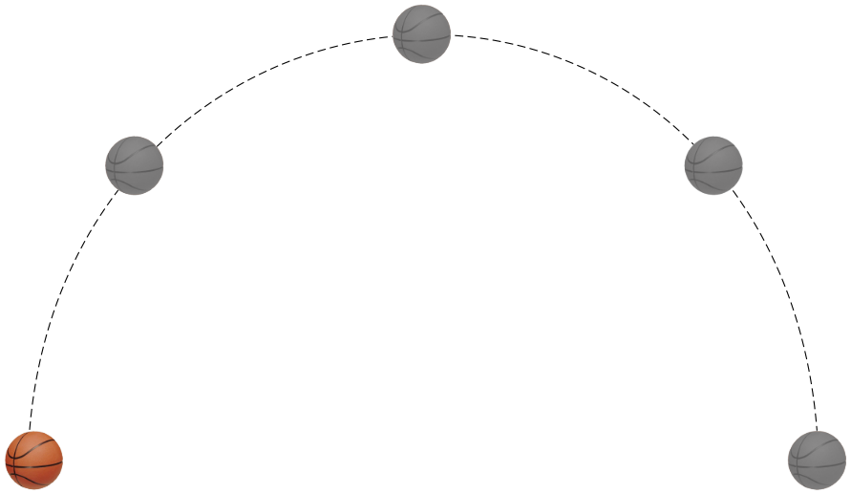
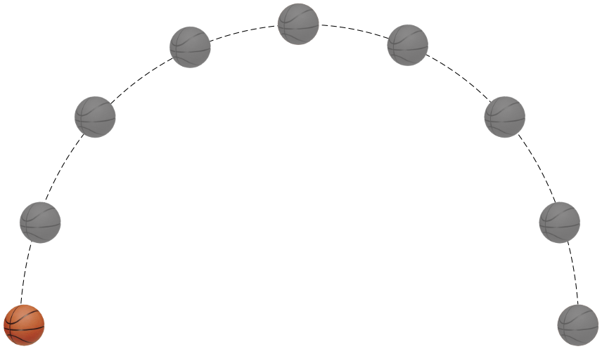
Motivation
How to bridge the gap between design and implementation?
  Make the implementation exactly a refinement of the design
Design
Implementation
Refinement
animation only with keyframe
high-quality animation

Slide 4
The idea
The basic idea
  System implementation guided by specification
  Use a model checker to explore valid state space of the design
  Use a model to generate a test case to verify the implementation
  Use test to check the keyframes

Slide 5
Related work
[Dorminey, 2020] Dorminey, S. (2020). Kayfabe: Model-based program testing with tla+/tlc.
[Schvimer et al., 2020] Schvimer, J., Davis, A. J. J., and Hirschhorn, M. (2020). extreme modelling in practice. Proc. VLDB Endow., 13(9):1346–1358.
[Wang et al., 2023] Wang, D., Dou, W., Gao, Y., Wu, C., Wei, J., and Huang, T. (2023). Model checking guided testing for distributed systems. In Luna, G. A. D., Querzoni, L., Fedorova, A., and Narayanan, D., editors, Proceedings of the Eighteenth European Conference on Computer Systems, EuroSys 2023, Rome, Italy, May 8-12, 2023, pages 127–143. AC

Slide 6
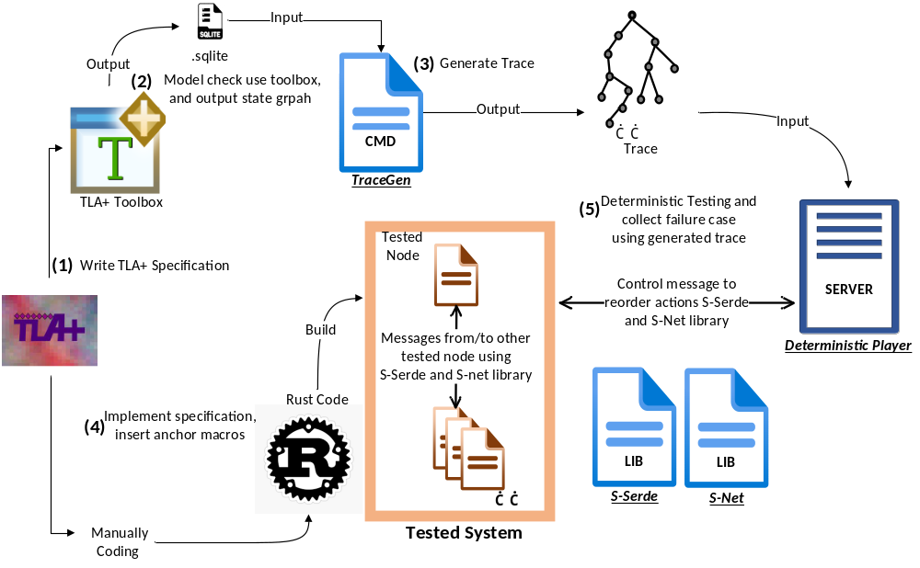
The architecture of sedeve-kit
TraceGen： generating trace/test case
Deterministic Player: Run deterministic testing controlled by the test case
S-Serde: Serialized/Deserialized message
S-Net: Library to build network channel

Slide 7
The Workflow
1. Utilize I/O automata to define the system
2. Verify correctness and generate the model's state space
3. Create a set of test cases from the model's state space
4. Develop the program based on specification and map macro anchors
5. Conduct deterministic testing and identify inconsistencies between the design and implementation

Slide 8
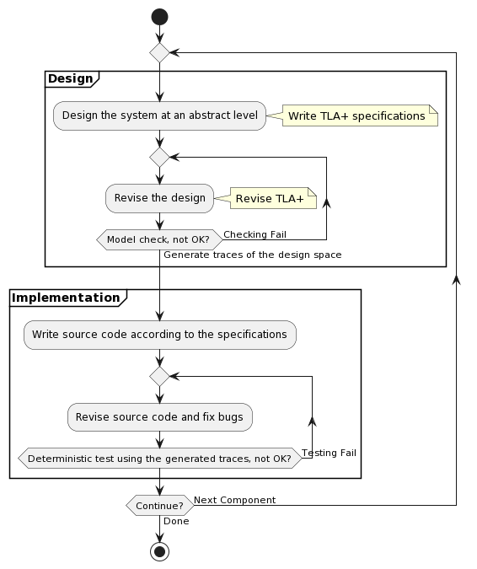
The Workflow
We repeat this procedure until all the test cases pass successfully.
This process is iterative and can evolve continuously.

Slide 9

I/O automata
We use the Input/Output automata (I/O automata or automata) abstraction to formalize the system
  Nancy A. Lynch, Mark R. Tuttle: Hierarchical Correctness Proofs for Distributed Algorithms. PODC 1987: 137-151

Slide 10
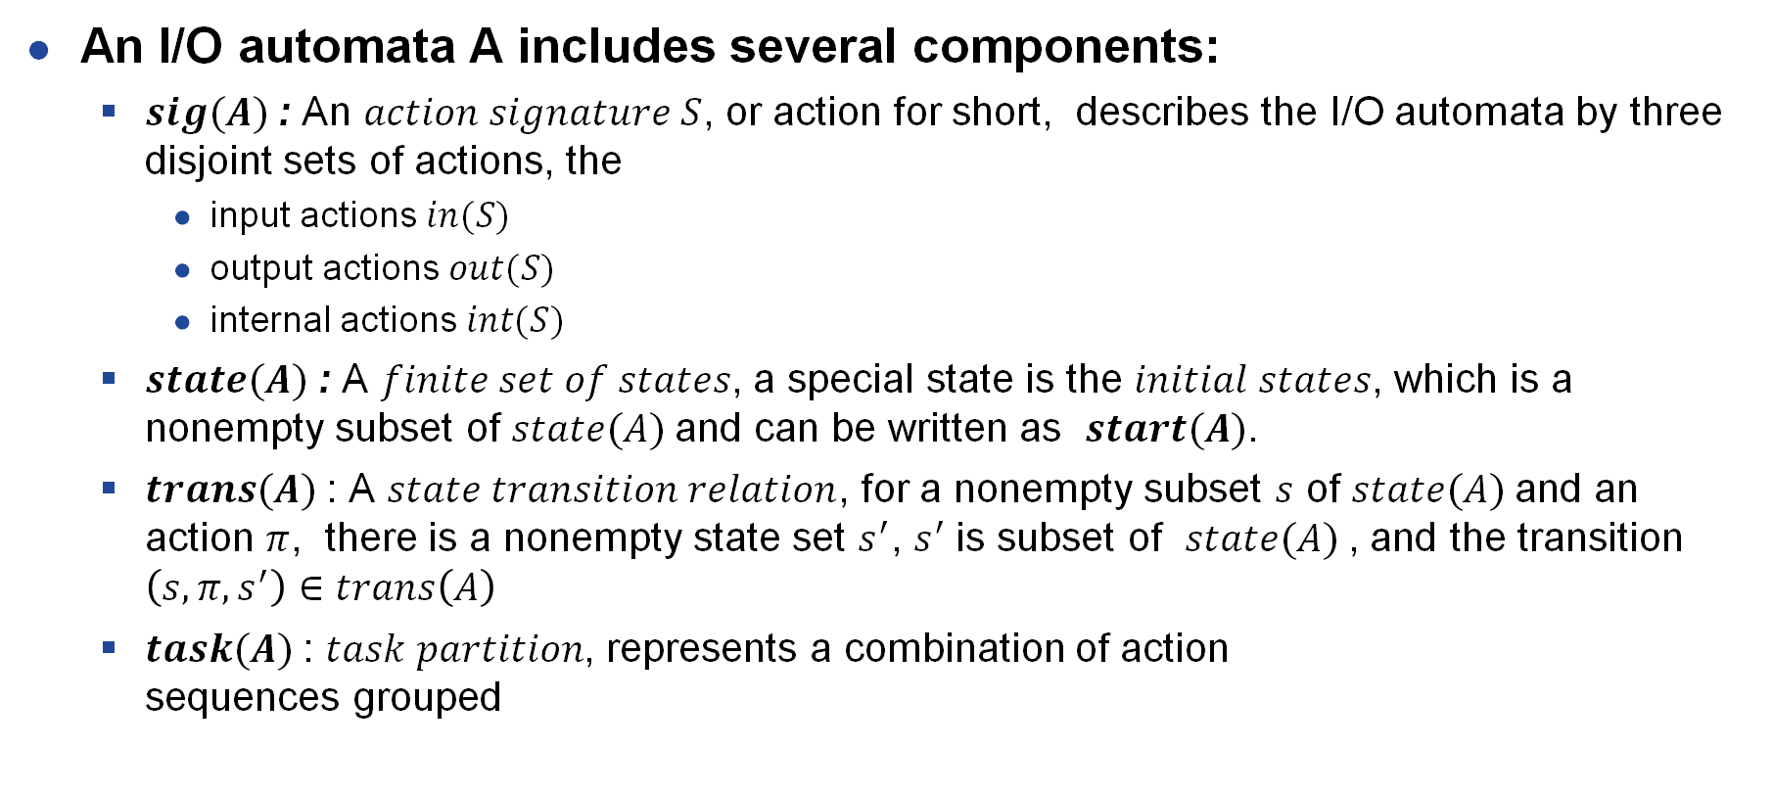
I/O automata
An I/O automata A includes several components:
  $sig(A)$: An $action signature S$, or action for short, describes the I/O automata by three disjoint sets of actions, the
    input actions $in(S)$
    output actions $out(S)$
    internal actions $int(S)$
  $state(A)$: A $finite set of states$, a special state is the $initial states$, which is a nonempty subset of $state(A)$and can be written as $start(A)$.
  $trans(A)$: A $state transition relation$, for a nonempty subset $s$ of $state(A)$and an action $π$, there is a nonempty state set $s^{′}$, $s^{′}$is subset of $state(A)$, and the transition $\left(s,π,s^{′}\right)∈trans\left(A\right)$
  $task(A)$: $task partition$, represents a combination of action
  sequences grouped

Slide 11
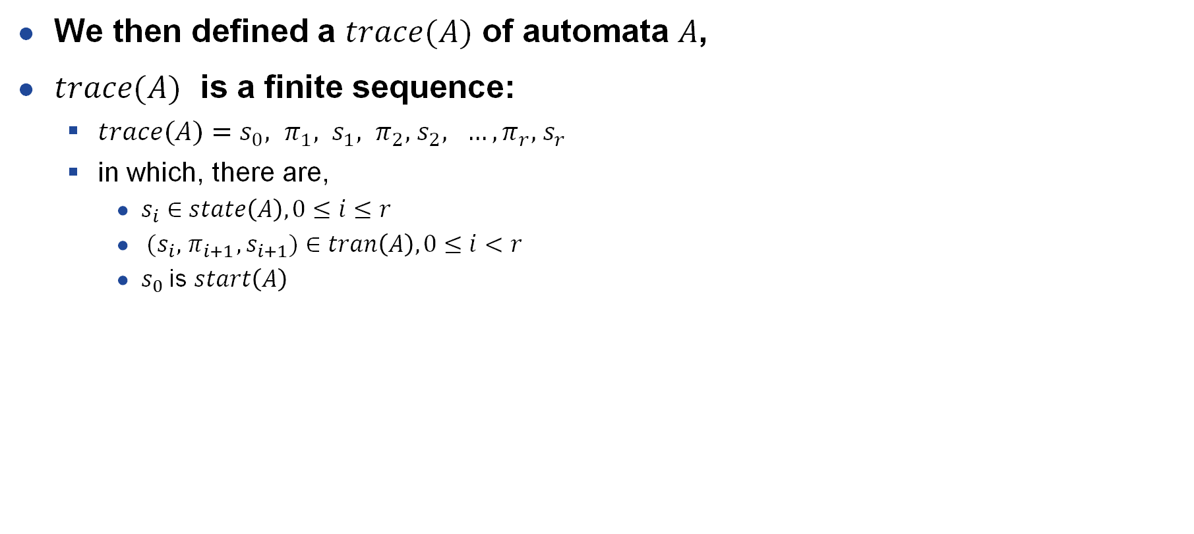
I/O automata
We then defined a $trace(A)$ of automata $A$,
$trace(A)$ is a finite sequence:
  $trace(A)=s_{0}, π_{1}, s_{1}, π_{2}, { s}_{2}, …,π_{r}, { s}_{r}$
  in which, there are,
    $s_{i}∈state\left(A\right), 0≤i≤r$
    ${(s}_{i},{ π}_{i+1},s_{i+1})∈tran\left(A\right), 0≤i<r$
    $s_{0}$ is $start\left(A\right)$

Slide 12
Specifying System Using I/O automata
The developer must identify the system events
  that should be defined as actions in each I/O automata
  and their respective action types (input, output, or internal)
  not all system events need to be modeled as actions
    Ex, sequential code operating within the same thread
  non-deterministic behavior is difficult to test, and needs to be modeled as actions
    Node Failures
    Concurrency
    Asynchronous messages that can be lost, arrive out of order or be duplicated
Use the I/O automata to generate a trace set

Slide 13
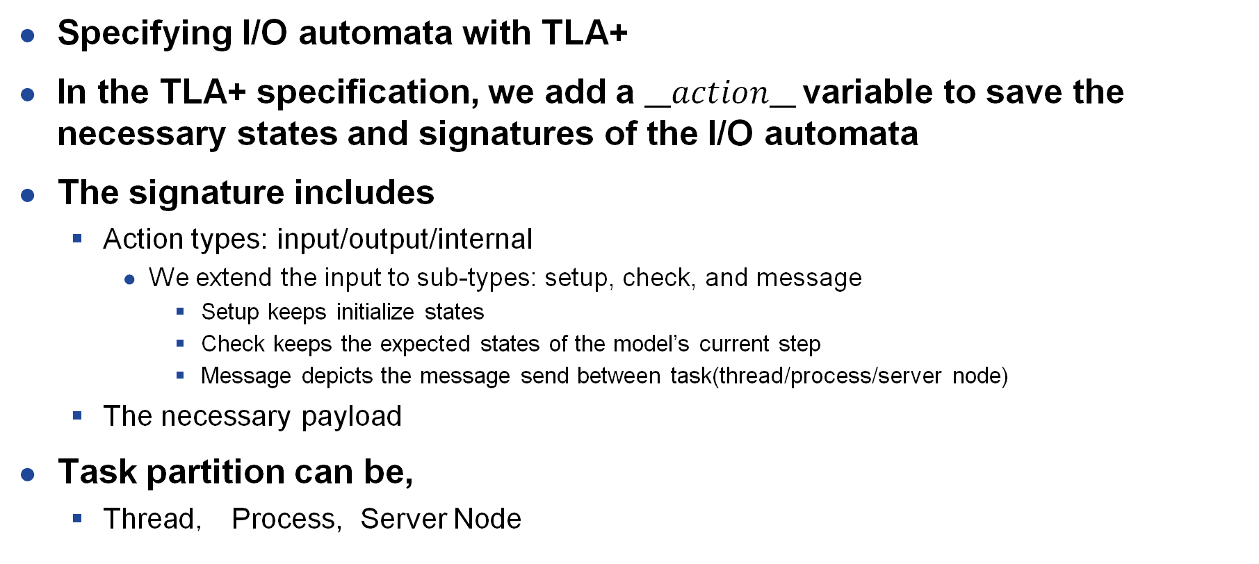
Specifying System Using I/O automata
Specifying I/O automata with TLA+
In the TLA+ specification, we add a $__action__$variable to save the necessary states and signatures of the I/O automata
The signature includes
  Action types: input/output/internal
    We extend the input to sub-types: setup, check, and message
      Setup keeps initialize states
      Check keeps the expected states of the model’s current step
      Message depicts the message send between task(thread/process/server node)
  The necessary payload
Task partition can be,
  Thread， Process, Server Node

Slide 14
Model checking and verifying correctness
Run the TLC model checker to verify the correctness
  Safety and Liveness
Make sure the model is bounded
  Unbounded model cannot generate a finite trace set
Control the model size
  Use view to ignore some untrivial variable
  Symmetry and view need some tricky to generate continuous trace
    Add a UUID to each action, record each action UUID and its previous state’s action UUID
    Only continuous trace could be left for testing
  Use a staged approach
  Limit the boundary of each operator
    Introducing auxiliary variables to limit the count of operators creating large state space

Slide 15
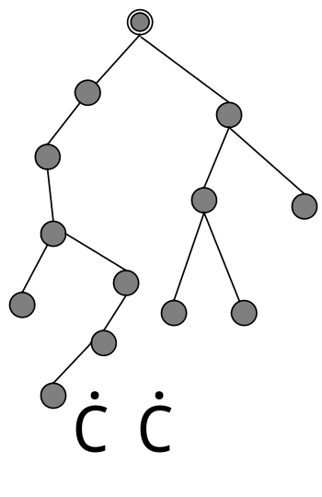
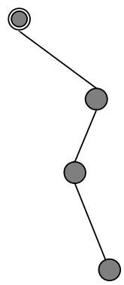
Trace Generate
State Space Graph
Initially, We try to use the dumped .dot file
  Soon, we found some limitations
  Not efficient for large models,
  Lots of I/O, serialize/deserialize, parse
Then, we try to override the operators
  We override SaveAction, which can save action to SQLite database file
  SaveAction has
    batched I/O， less serialize/deserialize and parse
TraceGen reads the SQLite database and constructs trace
Trace

Slide 16
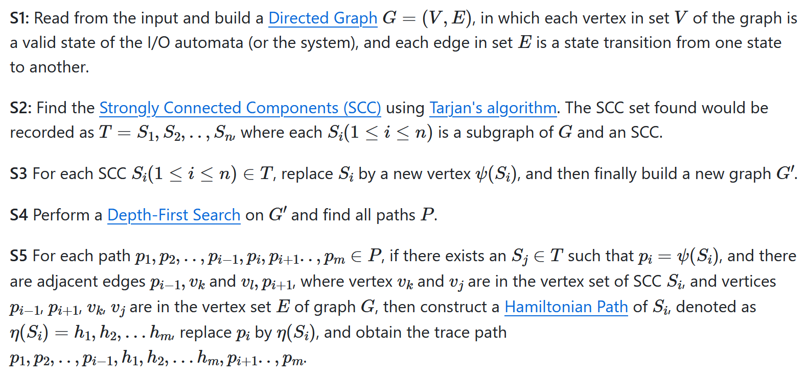
Algorithm to generate trace

Slide 17
Develop following the specification guidance
We implement the system as a refinement of the specification
To run deterministic testing by the model, the system has some limitations
  The non-deterministic behavior must be prevented
  Non-deterministic behaviors, likes lost or duplicated messages, random algorithms
  All the non-determinism behavior can be considered an input action and simulated as an incoming message from a network channel
Insert macros in the anchor position
  Action Anchor Macro
  Mapping to I/O automata

Slide 18
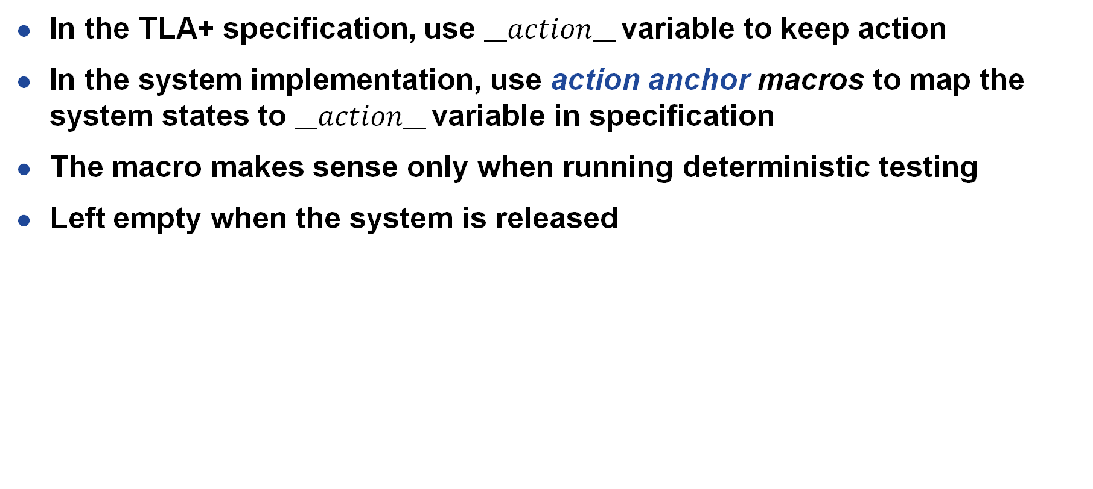
Action anchor macro
In the TLA+ specification, use $__action__$variable to keep action
In the system implementation, use action anchor macros to map the system states to $__action__$variable in specification
The macro makes sense only when running deterministic testing
Left empty when the system is released

Slide 19
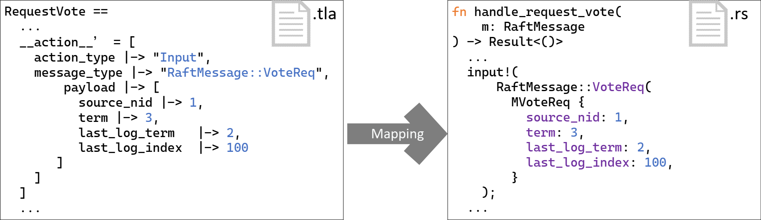
Action anchor macro, an example
Raft Vote Request message
Mapping I/O automata to implementation
Mapping __action__ variable to action anchor macro

Slide 20
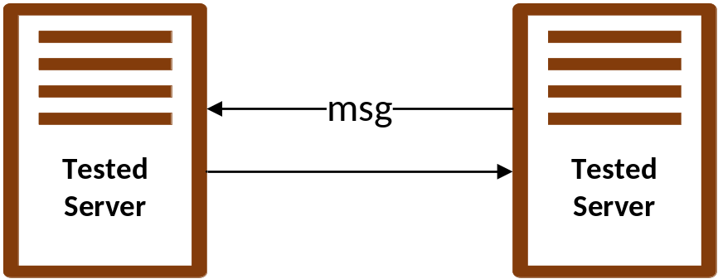
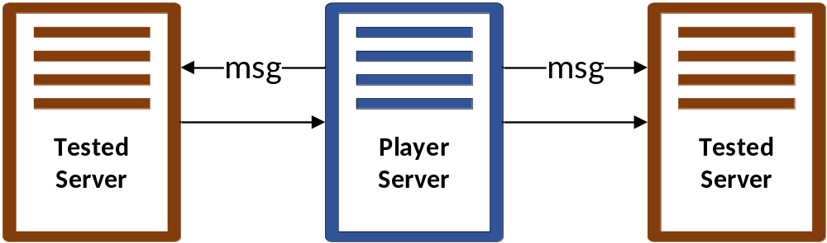
Deterministic testing
Normal Processing
To run deterministic testing
  The tested system needs to override the network channel
  Our S-Net, S-Serde library can directly communicate to the deterministic player channels
Deterministic Testing

Slide 21
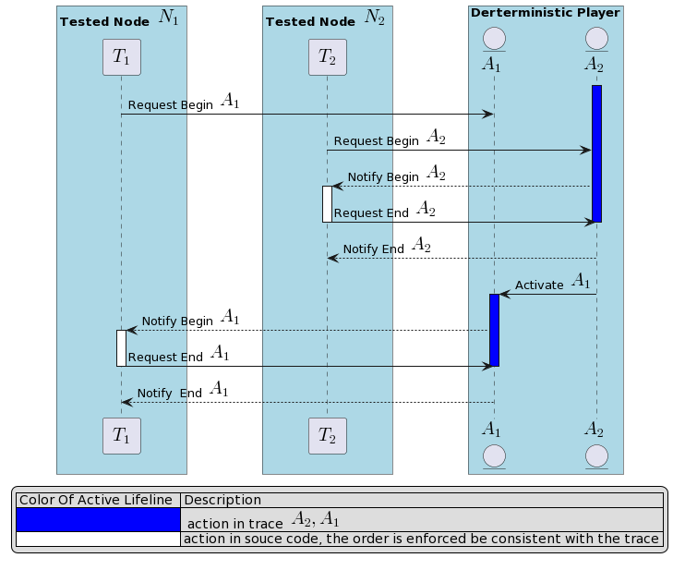
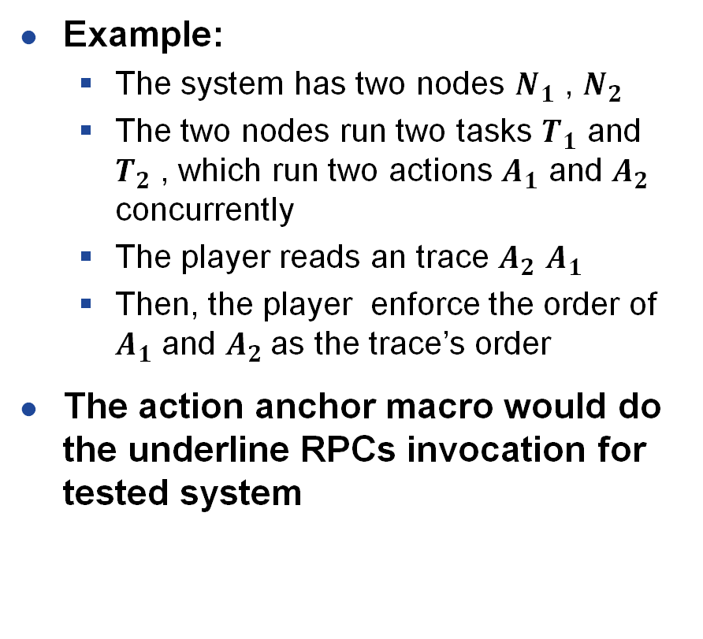
Testing controlled by the deterministic player
Example:
  The system has two nodes $N_{1}$ , $N_{2}$
  The two nodes run two tasks $T_{1}$ and $T_{2}$ , which run two actions $A_{1}$ and $A_{2}$ concurrently
  The player reads an trace $A_{2}$ $A_{1}$
  Then, the player enforce the order of $A_{1}$ and $A_{2}$as the trace’s order
The action anchor macro would do the underline RPCs invocation for tested system

Slide 22
Testing controlled by the deterministic player
If there is any inconsistency between the trace and tested node, then we consider it an inconsistency between design and implementation
The tool identifies inconsistency by the following event:
  E1: No such action received by the player at a step
    The player receives no expected action message which should be in a trace
  E2: Unrecognized action by the player at a step
    The player receives an action message from the tested system, but it is not in a trace steps
  E3: Inconsistent state value
    The tested system receives a check input action message, but its state does not meet the tested system's current state
E1 and E2 would trigger a message timeout
E3 needs the developer to implement assertion
  report the error

Slide 23
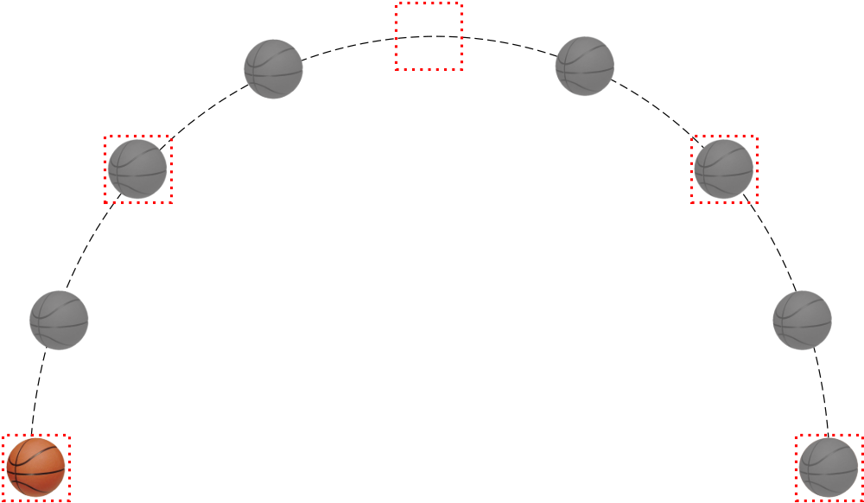
Inconsistency E1
Lost the keyframe

Slide 24
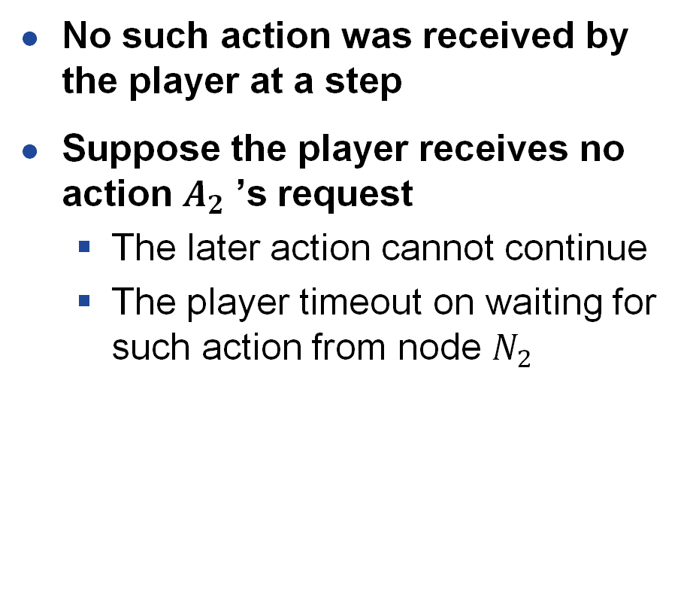
Inconsistency E1
No such action was received by the player at a step
Suppose the player receives no action $A_{2}$ ’s request
  The later action cannot continue
  The player timeout on waiting for such action from node $N_{2}$
X
timeout

Slide 25
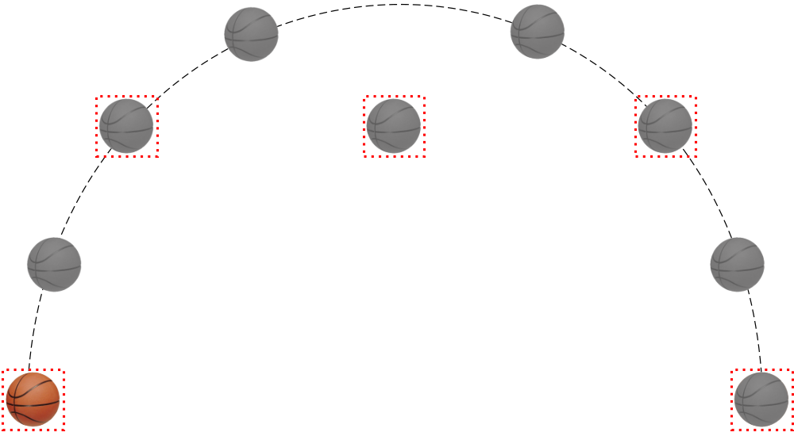
Inconsistency E2
Error keyframe
Error location

Slide 26
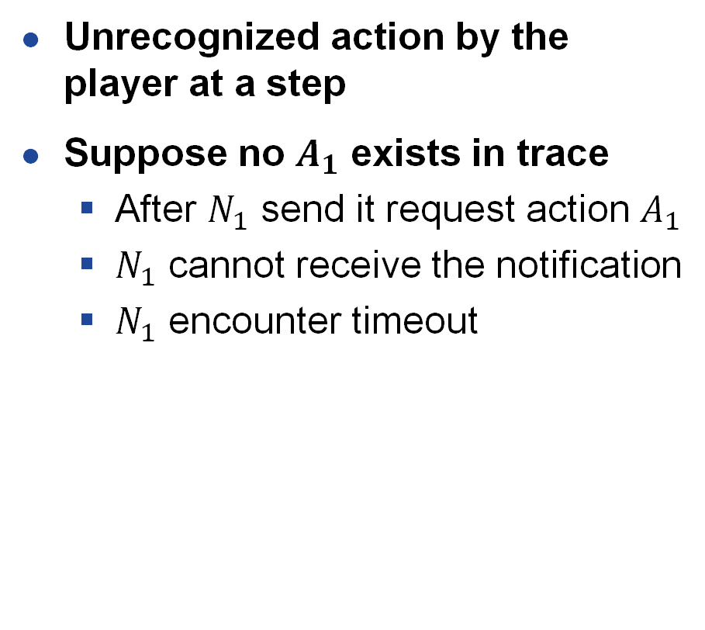
Inconsistency E2
Unrecognized action by the player at a step
Suppose no $A_{1}$ exists in trace
  After $N_{1}$ send it request action $A_{1}$
  $N_{1}$ cannot receive the notification
  $N_{1}$ encounter timeout
timeout
X

Slide 27
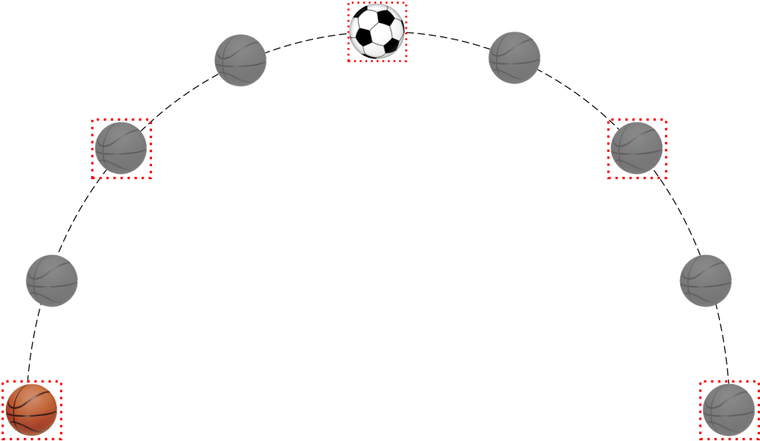
Inconsistency E3
Error keyframe
Error object

Slide 28
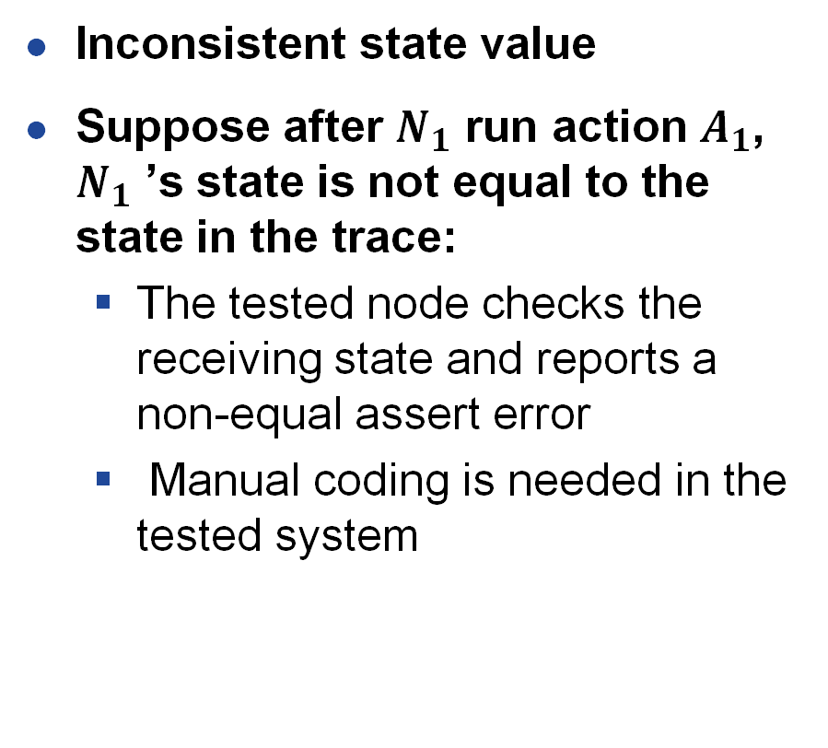
Inconsistency E3
Inconsistent state value
Suppose after $N_{1}$ run action $A_{1}$, $N_{1}$ ’s state is not equal to the state in the trace:
  The tested node checks the receiving state and reports a non-equal assert error
  Manual coding is needed in the tested system
assert failure

Slide 29
Develop Raft consensus
Raft is a consensus and fault-tolerance algorithm
  We implemented the Raft protocol under the guide of TLA+ specification,
  which contains
    leader election
    log replication
    log compaction
    node reconfiguration(still under development)

Slide 30
Specify Raft at two level
Abstract Level
  Assuming Atomic Communication
  The abstract level’s state can generate the initial state for the concrete level’s state
Concrete Level
  Send/Receive Asynchronized Communication
  A refinement of the abstract specification
Use a staged approach
  Divide Raft into two stages, Vote and Replicate
  Initial state of abstract model + Vote/Replicate of concrete model
  Continue to generate valid initial states using the concrete model
  Iterative stages with new initial states

Slide 31
Run TLC model check
TLC Model Setting
  3 nodes
  2 values
  Limit boundary
    3, count of increasing terms
    3, count of replicate request/response messages
    3, count of vote request/response messages
    2, count of restarting
  Use symmetrical sets and views
Finally,
  Generate 41920889 distinct states
  We got 8205852 traces, and all these cases pass
  Finding bugs in both the design and implementation

Slide 32
Our tools and specifications are open and available on GitHub
  [Scupt, 2024] Scupt (2024). sedeve-kit. https://github.com/scuptio/sedeve-kit/
  [Scupt, 2024] Scupt (2024). TLA+ spec. https://github.com/scuptio/tlaplus-specification
Our TLA+ verified Raft implementation will be open-source later
  After,
    Finishing re-configuration protocol and more testing

Slide 33
Thank You
Q and A
Contacts: guohua@scupt.com

