Slide 1
TLA+ @ LinkedIn: Ambry & Venice
Zac Policzer & Ankur Agrawal
@LinkedIn
Notes:
Hello and thank you for coming! My name is Zac and with me today is Ankur, and we're going to talk to you today about Ambry and Venice, and how we use TLA+ at LinkedIn for these platforms.

Slide 2

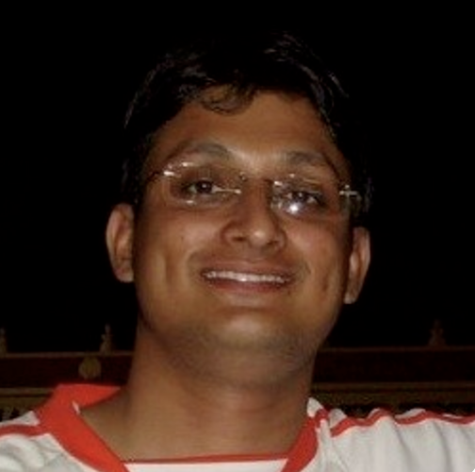
Zac Policzer
Ankur Agrawal
Venice Engineer
Ambry Engineer
Notes:
Ankur and I have a combined total of 16 years of working on data platforms at LinkedIn. Both us have a particular affinity for working on replication protocols for distributed systems and we have both found great value in using TLA+ in our work.

Slide 3
Agenda
What is Venice?
  Verifying Leap Frog With TLA+
What is Ambry?
  Leveraging TLA+ within Ambry
Notes:
We’re going to break this talk up into four main parts. For the first half of this talk, I'll walk through Venice and what problems it solves, and then move on to how we have used TLA+ in Venice by doing some spec driven development on an algorithm we call Leap Frog. Afterwards, Ankur will close out this talk by presenting Ambry, and what components within Ambry we have modeled using TLA+ and what it's taught us.

Slide 4

What is Venice?
Notes:
Let's dive into it! Starting things off, what is Venice?

Slide 5
Derived Data Store
Hosts data derived from other data
  AI training output (feature storage)
  Materialized views
  Forward Indexes
Notes:
Venice is a database that specializes in hosting derived data. What is derived data exactly? Well, we define derived data to mean data which has been processed, formatted, inferred, maybe tossed around a little, from other data sources. Some examples of this would be the output of batch processing jobs, stream processing jobs, or AI model training. In fact, at LinkedIn our AI engineers get a lot of leverage out of Venice. As an example a team may run a model training job once a day, or multiple times a day and this training will output a large dataset. Venice is able to consume that data set and make it available for querying from online applications at low latency.

Slide 6
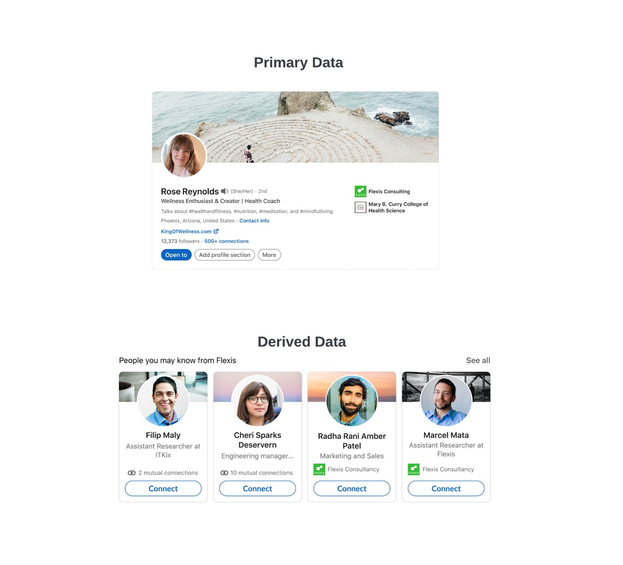
Primary Data & Derived Data @ LinkedIn
Notes:
To explore the topic of derived data a bit more concretely here we can see examples of primary data vs. Derived data at LinkedIn. A member profile is an example of primary data. It's data which is generated from a primary source. In the case here, our primary source is... You! That's right, you! Proud LinkedIn members! (hopefully) And the data direct from this source would be your profile. As you add things to your profile and interact with the site, and as other members in your network provide updates and interact with the site, we stream those updates into our Hadoop Grid. From there, we'll train models and compute input features and at least once a day (sometimes more) we'll build our derived data set. In the case shown on the slide here, that derived data set is powering a LinkedIn feature called, "People You May Know", which is a feature that drives LinkedIn growth and member engagement.

Slide 7
Venice at a Glance
Most popular storage choice for ML features at LinkedIn
Async data ingestion from Hadoop, Samza, and online applications with high write throughput
Online reads at low latency
2.5K+ Venice Stores in production
7+ years in production
Benchmarked At a Million Ops / Sec / Node
Open Source! https://github.com/linkedin/venice
Notes:
Today at over 2k production stores, Venice powers many products at LinkedIn along with people you may know, like term and title standardization, search verticals and even some security edge services. We target a p99 SLA of single digit ms for single key lookups and for some instantiations of Venice which leverage low latency clients we are targeting a p99 that is sub ms.
We proudly open sourced Venice live at strange loop and have been building a community of users and contributors ever since.

Slide 8
Verifying Leap Frog With TLA+
Notes:
So now that we know what Venice is, let's get to why we're all here. How are we using TLA+ in Venice?

Slide 9





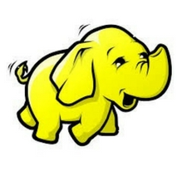
Venice Architecture
Da Vinci Client
Venice Fast Client
Venice Thin Client
fdf
Apps
Venice Producer
fdf
Samza/Flink
Kafka Topics
Venice-server
Venice-router
Venice Table Writer
Azkaban
Venice Push Job
Venice Controller
Notes:
To make this discussion a little less abstract, let's look at Venice's architecture. This diagram represents what Venice internally looks like within a single data center. The upper services represent the client libraries and services involved in the Venice online read path, and the lower rectangle here represents the Venice cluster control plane. As you can see, data is published and moved around within Venice by producing data into Kafka. A popular pub/sub broker in the industry which was developed at LinkedIn.

Slide 10
Active/Active Architecture
No Single Point of Failure
Faster/More Efficient than Previous Architecture
New CRDT Operations (which are cool!)
Notes:
A few years ago, the Venice team found itself in a position where it needed to move to an Active/Active architecture for writes. Previously, writes to Venice were serialized through a single channel. This had the advantage of being simple to reason about and administer, but had several downsides otherwise. Writes were slow and ate up cross data center bandwidth and the write channel was a site up concern as a single point of failure for Venice. Moving to an active/active architecture was an opportunity for us to solve these problems and add new features to boot! We could also now offer new write operation types to our customers.

Slide 11
Active-Active Replication
0 hops to local, 1 hop to remote
Producer
RT Buffer DC1
Venice Leader Replica
Store WAL
DC1
Venice Follower Replica
Producer
RT Buffer DC2
Venice Leader Replica
Store WAL
DC2
Venice Follower Replica
Producer
RT Buffer DC3
Venice Leader Replica
Store WAL
DC3
Venice Follower Replica
Notes:
The architecture we settled on to achieve this had us introduce a new concept to Venice called the Venice Leader Follower state model. In this model, we have venice leader servers actively pulling data cross data center and publishing it to follower nodes. These leaders actively pull data from all other data centers in a full replication mesh. Each writer publishing data is able to have it’s data pulled in directly with no cross data center hop for the venice cluster local to it, and then remote data centers get the data with a single hop.
So, everything was looking good!

Slide 12
Eventual Consistency (Hopefully…)
Potential Sources of Errors:
Kafka Unclean Leader Election
Faulty Software Versions
Other outages…
Notes:
However, as it turns out, even with a solid design, things can happen. In Venice, servers bootstrap out of Kafka, and Kafka is how we’re transmitting client operations. Any imaginable outage of Kafka is one where data integrity might be at risk. And then beyond Kafka, we could have errors in new versions of the software. Recall, we're building an entirely new replication architecture! So we will be iterating a lot. Venice servers in different data centers are all consuming write events individually now and transmitting to local replicas. This implies that Venice leader servers in different data centers at potentially different software versions need to come to deterministic conclusions. This itself isn’t insurmountable… But it does mean we need to keep these sorts of things in mind...

Slide 13
Data Consistency Validation
Fast and efficient Validation with Leap Frog, Developed with TLA+
Notes:
So. To be able to be defensive to these sorts of outages, we devised Leap Frog, and it's the development of Leap Frog where we first began leveraging TLA+

Slide 14
Data Consistency Validation
Leap Frog
  Batch and/or Streaming Algorithm
  Works off of CRDT’s
  Detects Divergence in all scenarios where it can occur
Notes:
So I'm going to take a little bit of time to give an overview of Leap Frog. I do this with some trepidation because as you will see later, I have had a bad track record in communicating this algorithm to other. Briefly, Leap Frog is an algorithm that can generically be applied to any database where it’s possible to consume that databases write ahead log for two replicas that you are trying to compare. It does so by consuming the changelog of these two replicas and making determinations on the results of those changelogs to see if they diverge.

Slide 15
Leap Frog
Initialize Starting Points
Determine if:
  Data is Consistent or
  Data is Not Consistent yet or
  Data Diverges
Repeat
Notes:
The algorithm works in two stages. The first, is to determine starting points in changelogs of the two replicas. It could be at the beginning, or it could be at the tail of the last compaction. It really depends case by case. The next step is to look at records either from a compacted view of the dataset, or, row by row in the changelog. Which you choose depends where you are trying to run leap frog (either in batch settings like on HDFS or in stream processing). It then comes to one of three conclusions. The dataset is either consistent (all data is replicated, no inconsistencies) the data is not consistent yet (which will be the case for some amount of data at the tail for eventually consistent systems) or the data has diverged. Then the process repeats.

Slide 16
Leap Frog Illustrated
DC1 Topic
Key: fizz Value: toad TS: {5, 200}
Key: foo Value: horse TS: {10, 101}
Key: bar Value: fox TS: {0, 100}
Offsets
Notes:
Let’s watch this in action. Here, I have the changelog for one replica. Each event in the changelog has a key, a value and a vector of offsets that we’ve labeled TS. This vector is meant to represent event ID’s which correlate to upstream events transmitted by different sites. Since we’re comparing two sites our vector has two components. To dissect one of these, the first event in this changelog represents a row keyed by bar, with a value of fox, and a TS that says this key was altered at offset 0 from one site and offset 100 from another site.

Slide 17
Leap Frog Illustrated
DC1 Topic
DC2 Topic
Key: fizz Value: toad TS: {5, 200}
Key: fizz Value: frog TS: {5, 150}
Key: foo Value: horse TS: {10, 101}
Key: foo Value: mule TS: {3, 250}
Key: bar Value: fox TS: {0, 100}
Key: bar Value: fox TS: {0, 100}
Offsets
Offsets
Notes:
Now we introduce our second replica on another site. We can see, that at the head of our topic, the second site has slightly different values for some keys.

Slide 18
Leap Frog Illustrated
DC1 Topic
DC2 Topic
Key: fizz Value: toad TS: {5, 200}
Key: fizz Value: frog TS: {5, 150}
Key: foo Value: horse TS: {10, 101}
HWM: {10,200}
Key: foo Value: mule TS: {3, 250}
HWM: {5,250}
Key: bar Value: fox TS: {0, 100}
Key: bar Value: fox TS: {0, 100}
Offsets
Offsets
*HWM: High Water Mark
Notes:
We then get the highwatermark over a section of the changelog of each replica we’re comparing. The highwatermark is defined as a vector which contains the highest offsets of the updates we’ve heretofore seen from different sites. Looking at these two replicas, we can see that the DC2 topic has a high watermark with a component which is larger then the DC1 Topic, but lower for another. This tells us that the DC2 Topic has events from one site that DC1 does NOT have, but also is short some events form another site.

Slide 19
Leap Frog Illustrated
DC1 Topic
DC2 Topic
Key: foo Value: burro TS: {10, 300}
HWM: {10,300}
Key: fizz Value: frog TS: {5, 199}
Key: fizz Value: toad TS: {5, 200}
Key: fizz Value: frog TS: {5, 150}
Key: foo Value: horse TS: {10, 101}
HWM: {10,200}
Key: foo Value: mule TS: {3, 250}
HWM: {5,250}
Key: bar Value: fox TS: {0, 100}
Key: bar Value: fox TS: {0, 100}
Offsets
Offsets
*HWM: High Water Mark
Notes:
In order to make our comparison, we need to have one of these replicas completely ahead of the other. We’re gonna select one of these replicas and have it ‘leap’ over the other. Our leap should make sure that all component vectors of the high water mark have progressed beyond the other replica we’re seeking to compare.

Slide 20
Leap Frog Illustrated
DC1 Topic
DC2 Topic
Key: foo Value: burro TS: {10, 300}
HWM: {10,300}
Key: fizz Value: frog TS: {5, 199}
Key: fizz Value: toad TS: {5, 200}
Key: fizz Value: frog TS: {5, 150}
Key: foo Value: horse TS: {10, 101}
HWM: {10,200}
Key: foo Value: mule TS: {3, 250}
HWM: {9,250}
Key: bar Value: fox TS: {0, 100}
Key: bar Value: fox TS: {0, 100}
Offsets
Offsets
*HWM: High Water Mark
Notes:
So Now Let’s compare our keys. Our first key is bar. Both replicas have the same value for the key. They are consistent! No problem here.

Slide 21
Leap Frog Illustrated
DC1 Topic
DC2 Topic
Key: foo Value: burro TS: {10, 300}
HWM: {10,300}
Key: fizz Value: frog TS: {5, 199}
Key: fizz Value: toad TS: {5, 200}
Key: fizz Value: frog TS: {5, 150}
Key: foo Value: horse TS: {10, 101}
HWM: {10,200}
Key: foo Value: mule TS: {3, 250}
HWM: {9,250}
Key: bar Value: fox TS: {0, 100}
Key: bar Value: fox TS: {0, 100}
Offsets
Offsets
*HWM: High Water Mark
Notes:
Now let’s look at key foo. In DC1 key foo is set to value horse, and in DC2 it’s set to mule. Initially the key in DC2 was based on a state where the highwatermark that was not completely ahead of the other replica. Now that it’s moved ahead, we see it has a value of burro. Since the key values are not the same they’re not consistent. But that doesn’t necessarily mean they diverge. The record timestamp vector indicates that the value in DC2 was updated by some message which is beyond the highwatermark of DC1. This indicates that while the records aren’t consistent, they might be consistent later. So we don’t flag these rows for now.

Slide 22
Leap Frog Illustrated
DC1 Topic
DC2 Topic
Key: foo Value: burro TS: {10, 300}
HWM: {10,300}
Key: fizz Value: frog TS: {5, 199}
Key: fizz Value: toad TS: {5, 200}
Key: fizz Value: frog TS: {5, 150}
Key: foo Value: horse TS: {10, 101}
HWM: {10,200}
Key: foo Value: mule TS: {3, 250}
HWM: {9,250}
Key: bar Value: fox TS: {0, 100}
Key: bar Value: fox TS: {0, 100}
Offsets
Offsets
*HWM: High Water Mark
Notes:
Now we get to key fizz where something interesting happens. Key fizz has differing values. Looking at the record in DC1, it’s record TS vector falls below the highwatermark of DC2. This means, that the replica represented by DC2 has seen all events that are pertinent to the final row result of the record in DC1. The same is true vice versa. The replica represented by DC1 has a high watermark that supersedes the TS vector for key fizz in DC2. So what does this mean?

Slide 23
Leap Frog Illustrated
DC1 Topic
DC2 Topic
Key: foo Value: burro TS: {10, 300}
HWM: {10,300}
INCONSISTENCY!!
Key: fizz Value: frog TS: {5, 199}
Key: fizz Value: toad TS: {5, 200}
Key: fizz Value: frog TS: {5, 150}
Key: foo Value: horse TS: {10, 101}
HWM: {10,200}
Key: foo Value: mule TS: {3, 250}
HWM: {9,250}
Key: bar Value: fox TS: {0, 100}
Key: bar Value: fox TS: {0, 100}
Offsets
Offsets
*HWM: High Water Mark
Notes:
An inconsistency! The methodology of this algorithm asserts that both replicas have enough information to come to the same conclusion, but did not for some reason. Maybe it was missing events, maybe it was an inconsistency in how the data was computed, maybe there was a solar eclipse, interesting, but that’s for whoever is debugging this issue to figure out. In our case, the leap frog algorithm has done it’s job and flagged the error.

Slide 24
Leap Frog Illustrated
Topic A
Topic B
Key: buz Value: sheep TS: {1, 300}
Key: foo Value: Burro TS: {10, 201}
HWM: {10,300}
Key: foo Value: burro TS: {10, 300}
HWM: {10,300}
Key: fizz Value: frog TS: {5, 199}
Key: fizz Value: toad TS: {5, 200}
Key: fizz Value: frog TS: {5, 150}
Key: foo Value: horse TS: {10, 101}
HWM: {10,200}
Key: foo Value: mule TS: {3, 250}
HWM: {9,250}
Key: bar Value: fox TS: {0, 100}
Key: bar Value: fox TS: {0, 100}
Offsets
Offsets
*HWM: High Water Mark
Notes:
And then finally to finish out the algorithm steps, after doing our comparison, we now choose DC1 to be our ”Leap” DC and have it jump forward in time so that it now has a high watermark that is greater then DC2. We now see that key foo did become eventually consistent between the two replicas, and the whole thing repeats itself so long as we have data to compare

Slide 25
Simple...... right?
Notes:
Ok. So I know that was a little fast. And. If at this point you're wondering what just happened, you are in good company.

Slide 26
It Started With a One Pager
"It is not enough to take a snapshot of data in each DC and compare them and expect them to be the same. The reason for this is that each DC will be at different points in the event stream relative to other DC's..."
--Excerpt from Venice A/A Multi DC Test Plan
Notes:
Leap Frog was something I cooked up while writing a test plan for the new replication architecture. While exploring the various test scenarios we'd run the Venice architecture through, I came to realize that we would need a robust way to determine if two Venice servers in two data centers would become consistent. Ideally, this would be something we could use both for testing and for alerting on the site. Initially, I thought the algorithm was something kind of intuitive. So I didn't think to waste much breath or ink on it. I wrote a one page addendum to my testing document that explained the process and gave a single example for how it might work.

Slide 27
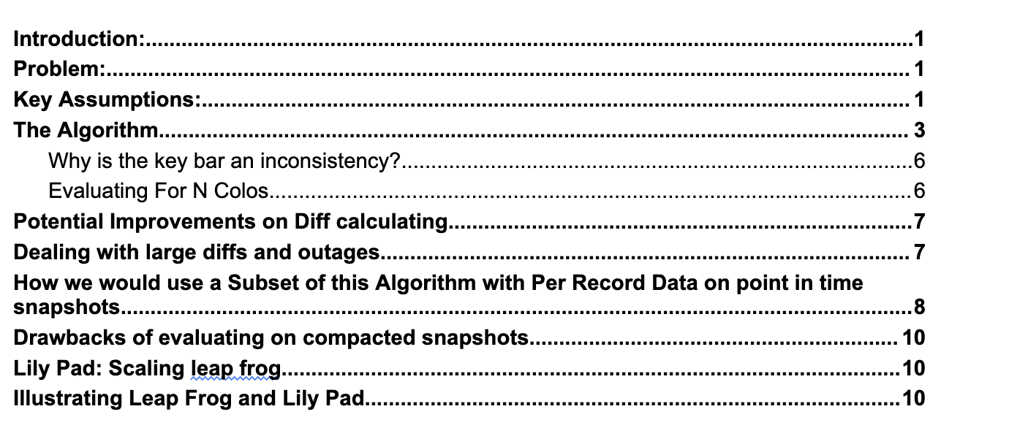
Which Grew to a 10 Pager....
Notes:
Well. Straight forward is a notion easily derailed. As we discussed how the comparison algorithm would work, we realized we would have to work through more examples to be certain that it could in fact detect problems for the scenarios that we were worried about. So a larger document was produced to go through the base algorithm to make sure we were all on the same page. And from there, we deliberated even further.

Slide 28
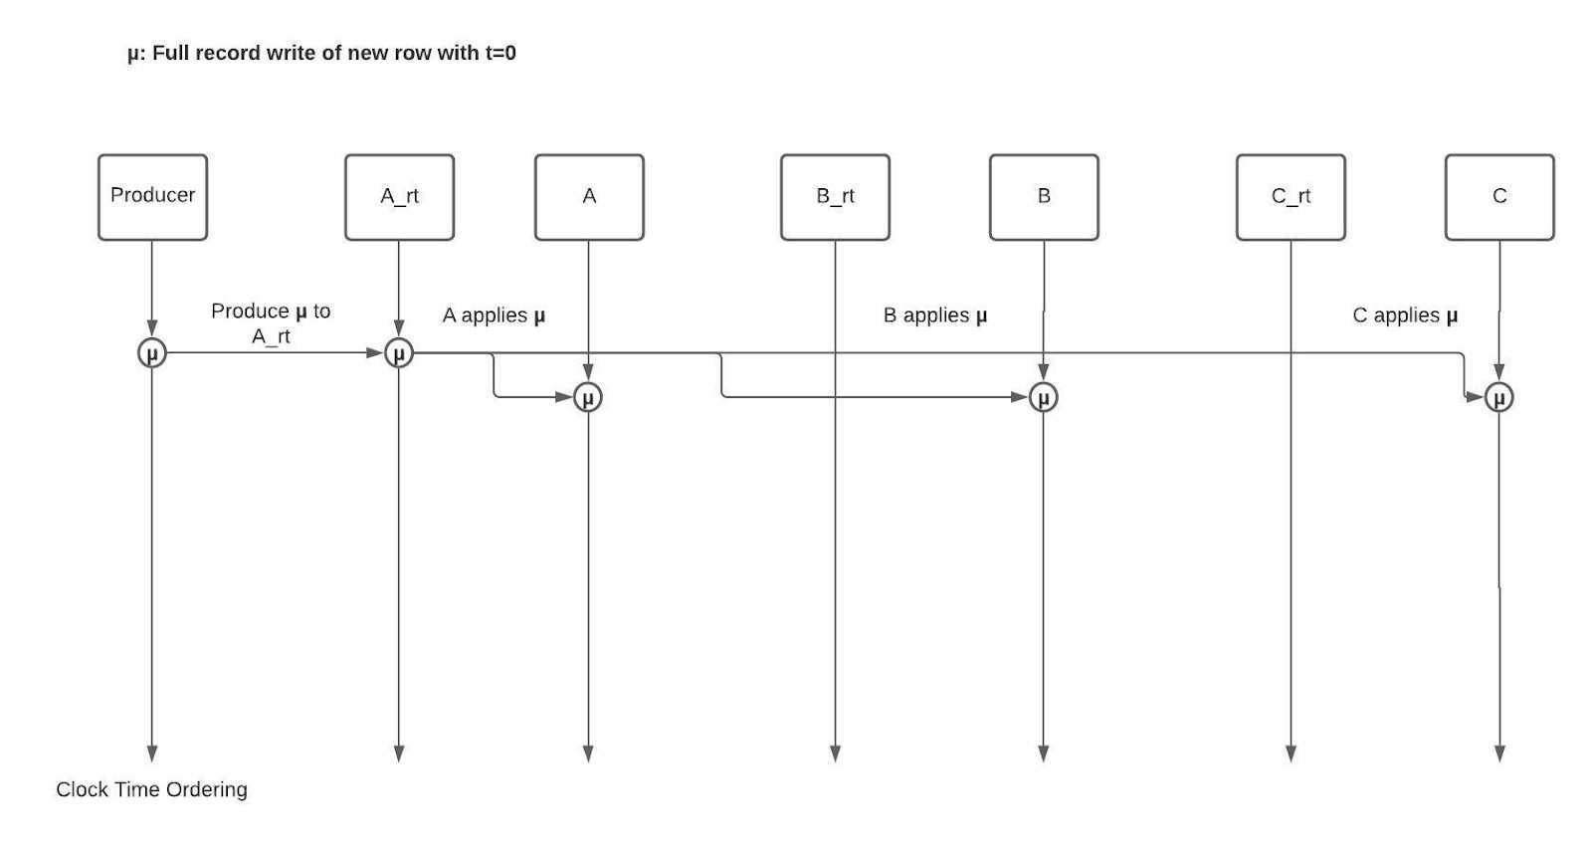

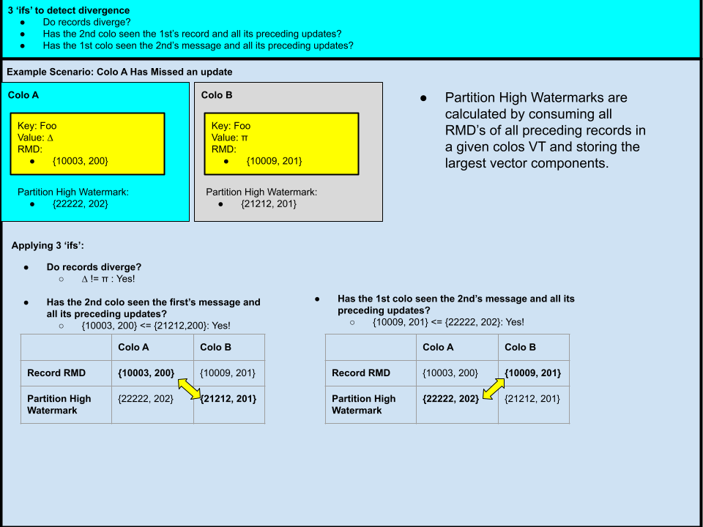
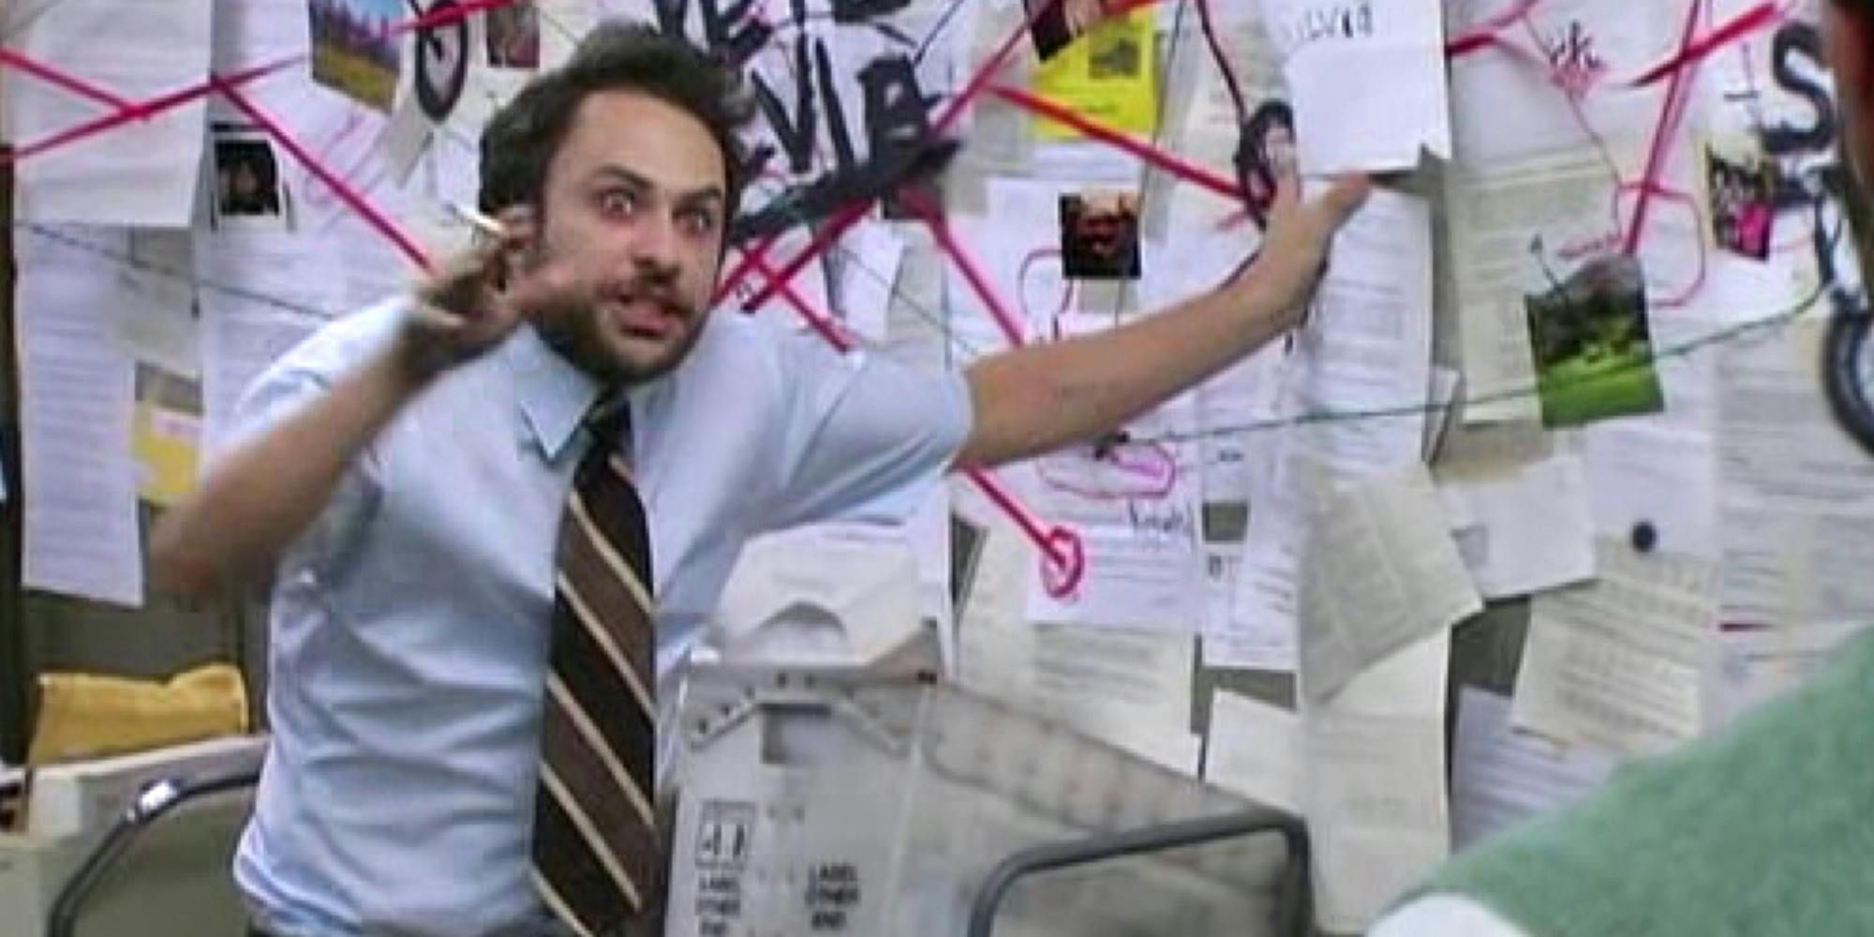
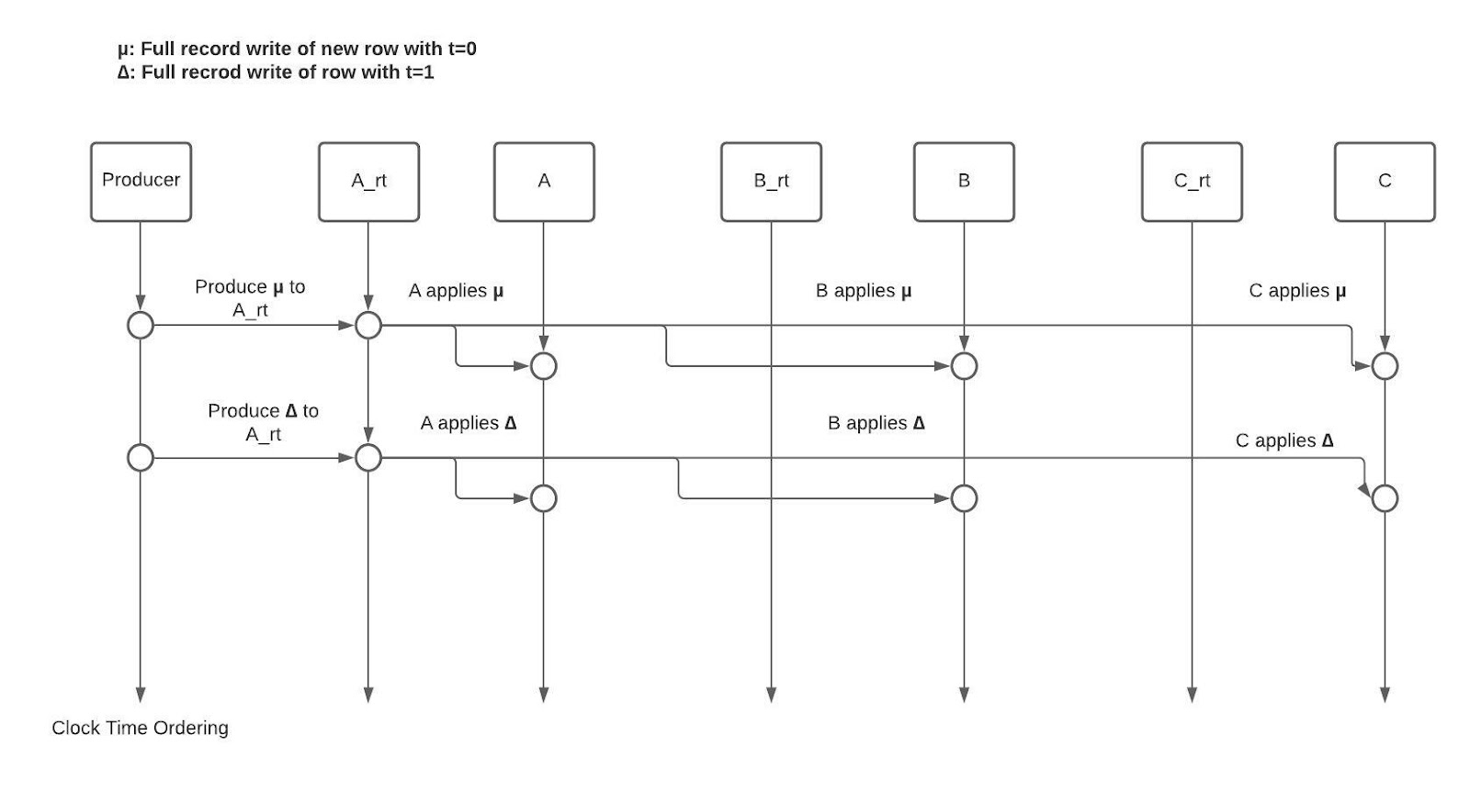
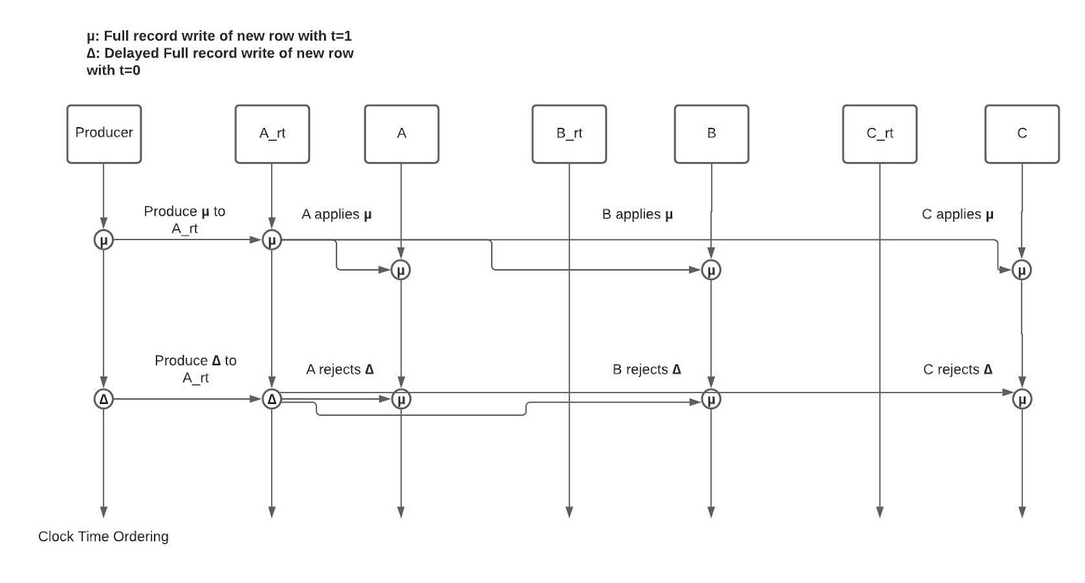

And Then We Started Drawing Pictures....
Notes:
And then finding that prose was failing us we sought more basic methods. It turns out even with a simple algorithm, discussing and working through all the myriad ways things could go wrong was no easy task. What was worse, Leap Frog started to get more complex as we became increasingly concerned about edge cases and were no longer confident that the base algorithm could be applied to all scenarios we were worried about.

Slide 29
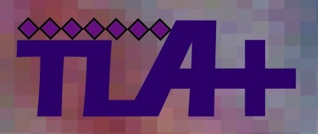
To The Rescue!
Notes:
So, this what when I began exploring using TLA+ for modeling Leap Frog. After all this deliberation I was no longer even sure that Leap Frog would work. It was already a high cost effort at this point to even spend all the hours documenting and deliberating on the algorithm, let alone what it might cost us to implement something that didn't even work. Spending the time to learn TLA+ and write a spec seemed like an easy investment to make.

Slide 30
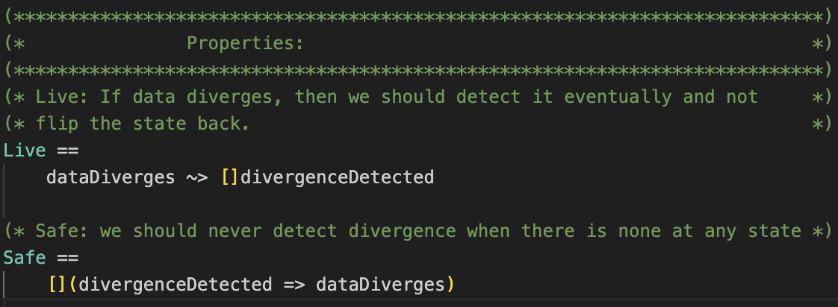
Writing The Spec
Notes:
The first thing we thought about when trying to write our spec was probably what many spec writers think about. What Properties do we need? Well. Our the properties we chose reflects what we would find desirable in this system. We want this comparison to inform either a test result, or, an alert. This means that it must both
Detect inconsistencies when they exist
And
Do NOT detect inconsistencies when there are none.
(also TypeOk, because good spec writers eat broccoli and check type constraints)
These properties are critical for both tests and alerts. IF an alert or test is flaky, you won't pay attention to it, and in some ways, thats just as bad as an alert or test which doesn't detect anything at all.

Slide 31
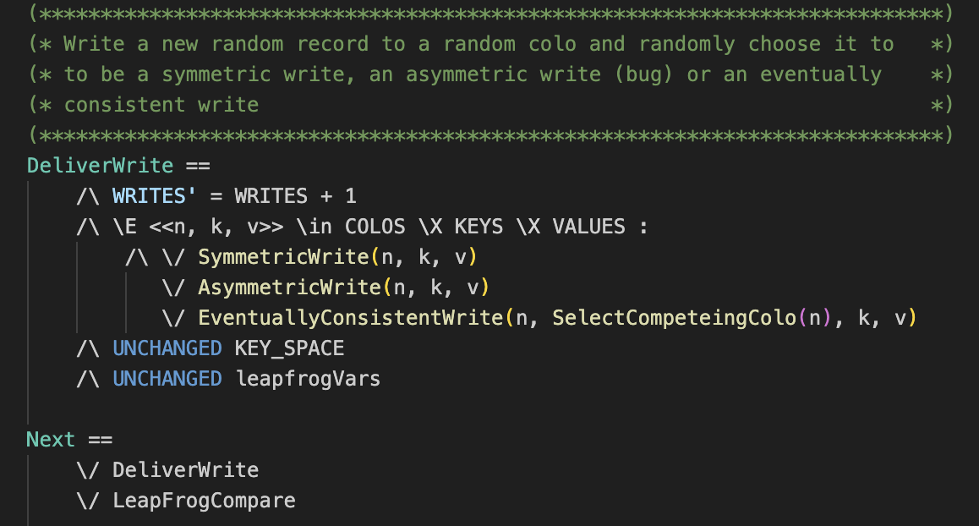
Writing The Spec
Notes:
Next we set about defining the model. Our model just needs to account for the the three situations we talked about earlier. A write which is eventually consistent, a write which is fully consistent, or, a write which is not consistent and diverges. We express all of these as separate potential states, and, allow for the leap frog comparison to run in between any of those, just as it would in production!

Slide 32
Gotchas Uncovered Before Implementation
Last Write Problem
  If the error is the last write, you won't catch it
Reusing Offsets Breaks Things
  If high watermark is unreliable, then the check is also
Notes:
So, now armed with our spec, we began running the model checker. It's here that we started to find the edge cases. The first edge case that we ran into, was that Leap Frog can only detect an inconsistency AFTER the next write. This is because we need highwatermarks to proceed. If the last write to your store is the one that "got away" to speak, then you won't detect it. If it takes a long time for that next write to show up if ever, you will lose all forensics eventually that would otherwise help you to figure out what caused the error in the first place.
Second, the model checker was quick to point out that in the initial implementation of the spec, it allowed for offsets of messages to potentially get reused. If this ever happened, all bets were off.

Slide 33
Set Up Alerts That Monitor Critical Conditions
Last Write Problem
  Use Heartbeats!
Reusing Offsets Breaks Things
  Set up metrics and alerts when messages are out of sequence
Notes:
Having these things flagged by the model checker saved us an awful lot of headache. I'm sure there are many folks in this room who have had to add new metrics only AFTER a specific outage type in production. A key learning our team took away from using TLA+ is that TLA+ makes clear what you are assuming to be absolutely true in order for things to work. If you know what must be true in order for things to work, that tells you, you should really put an alert on it. A spec can go a long way towards informing the operations side of a system. Given the edge cases that were flagged, we knew we could take simple steps to be aware of them. First, to avoid the last write problem, we just need to make certain that the last write isn't a user write. To this end, we leverage heartbeating in the replication channel. Next, to make sure that offsets aren't reused, we have simple checking in the server ingestion code that can detect and flag when something like that has happened (essentially, observing if offsets ever regress below the current watermark).

Slide 34
The Code We Wrote Got Smaller
Simpler Rules proven to cover more cases
Notes:
Another big win we got was that, for all the complications we began to introduce when writing the prose version of the algorithm, we found with the TLA+ spec we could apply less steps to cover all the scenarios. We now knew the code could be very straight forward to write, and simple code could cover all edge cases. With this, we were able to proceed quickly with the high confidence we had gained through the spec we had written.

Slide 35
Leap Frog In Action
Verified our architecture
  Being Able to rely on Leap Frog helped us test, verify, and monitor our replication architecture
Flagged Real Issues
Notes:
Now with our spec and a green model checker, we knew we were ready to implement. We started running Leap Frog as part of our test suite as we stressed the new architecture. Issues that were flagged, we knew we could take seriously thanks to the confidence that we had in this implementation thanks to the TLA+ spec.

Slide 36
Refinement Made Refactors Easy
New Constraints introduced
  New Metadata types demanded a smaller footprint
  Needed to Verify if Leap Frog could do the same with less
Notes:
Now one last win to call out, after we had written and started using Leap Frog to monitor inconsistencies, there a came day where we had to make some refactors. The metadata that we were maintaing per record was going to grow to a prohibitive size for what we had to store on disk. This meant that we could only store a limited amount of this metadata in the write ahead log, which would trim down what data was available at time of running the comparison.
Well. Thankfully, refinement makes exploring this space easy. We could iterate quickly on different ideas with the same properties and invariants that we were relying on, and prove that yes, we COULD do the same worth with less information. No large docs or crazy diagrams needed this time!

Slide 37
Spec Driven Development with TLA+
Speedier Iteration
More Efficient Communication
Informs Ops
Refinement: Can Refactor Safely And Quickly
Notes:
So summing up this part of the talk. We have found great value in practicing spec driven development with TLA+. TLA+ enables us to have clear and high bandwidth communication about a spec, and allows to avoid the usual firing squad of counter examples one must often field during the RFC stage of designs. TLA+ is also useful in informing the operational side of things by highlighting what pieces are critically important when running your system. And also, we have seen in Venice that as requirements have changed, we can iterate faster thanks to refinement in TLA. With Refinement and the before mentioned advantages, refactoring doesn't mean we have to start the whole process over again.

Slide 38
Future Work
Open Sourcing of all Leap Frog components (the spec is open source though!)
Notes:
Future work here, we'd like to write a paper on Leap Frog at some point, and open source all it's components. Today, the initial leap frog implementation relies on a few non open sourced LinkedIn technologies, but we're now working to get it into the open source repo on github. At least the spec is open sourced, and you can take a look at it.

Slide 39
Future Work
Your Contributions!
  (check out the open bugs on GitHub for ideas on how to contribute!)
  venicedb.org
Notes:
And then most important future work of all, your potential contributions! We open sourced Venice with the intent of building a developer community around it. So do please come check it out. I have filed a backlog of good first time contributor items for anyone curious. So please take a look, we’re eager for external contributors.

Slide 40

What is Ambry?
Architecture Overview
Replication Overview
Ambry-TLA+ Motivation
The Spec and Refinements
Notes:
Hi everyone, I am going to spend sometime talking about how Ambry is leveraging or planning to leverage TLA+.
In essence, I am going to show you how we are using TLA+ as a more formal way to reason about enhancements in Ambry.
Here's a quick overview of the agenda for next 10 mins. I am going tell you about what Ambry is, and give a high level overview of Ambry’s architecture, do a little bit of deep-dive into Ambry’s replication protocol and then finally use that deep dive give you a flavor of atleast one problem we are exploring TLA+ for.

Slide 41
What is Ambry?

Slide 42
Blob Store
LinkedIn’s Blob Store
Distributed, Highly Available, Horizontally Scalable, Reliable Handle Store
Created at Linkedin
Open-Sourced in 2016 github.com/linkedin/ambry
Notes:
Ambry is LinkedIn's blob store. Its a distributed storage system that is designed to be highly available, horizontally scalable and very reliable. It was created at LinkedIn and open sourced in 2016. Do checkout our github repo to learn more.

Slide 43
Features
Multi-leader Cross-site Replication
Strong Get-after-Put Guarantee
At-rest Compression
At-rest & on-the-wire Encryption
Advanced Blob-Storage Features
Named Blobs
TTL
Notes:
As you can see, Ambry is a feature packed storage system. In the interest of time I want to highlight two key features real quick. Ambry stores multiple copies of its data in geo-replicated replicas. Any of these replicas can accept blob uploads -- its a multi leader system.
Given a multi-leader system, Ambry is unique in providing Strong get-after-put guarantee. That means if a blob is uploaded in one of the data centers, and is followed by a GET from a remote datacenter immediately after upload, the GET is always guaranteed to succeed.

Slide 44
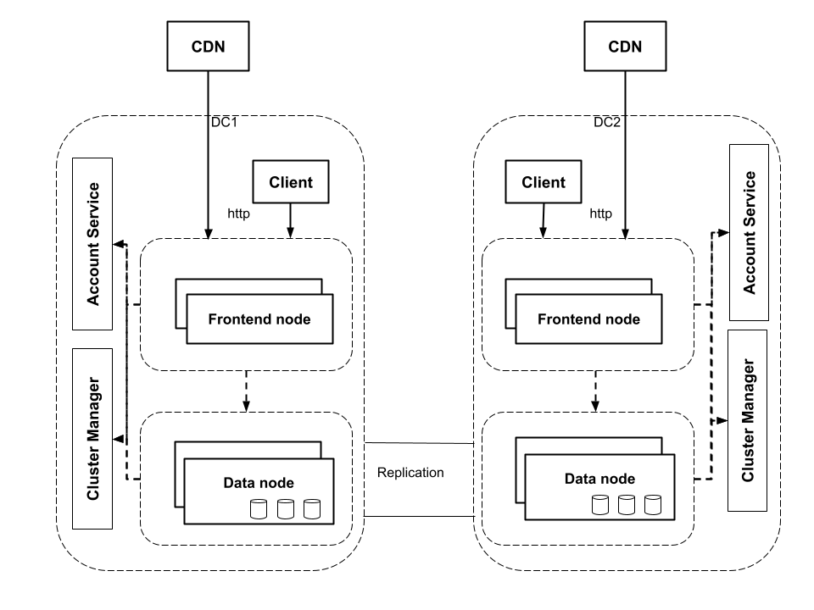
Architecture - 10K Feet View
Notes:
Here's a very high level view of Ambry's architecture. Data nodes, Frontends and Cluster Managers are three main components. Data nodes provide the persistence layer and store Ambry's data. Ambry randomly groups data into virtual units called partitions. Each partition has multiple replicas for redundancy and availability. A disk on a data node can contain replicas of multiplepartitions.
Frontends receive the http requests from clients, perform some preprocessing like access check, enc-dec, compression etc, determine the partition, and route the requests to data nodes containing the replicas of the partition.
Cluster manager keeps track of the state and health of the cluster and location of the various replicas of each partition.

Slide 45
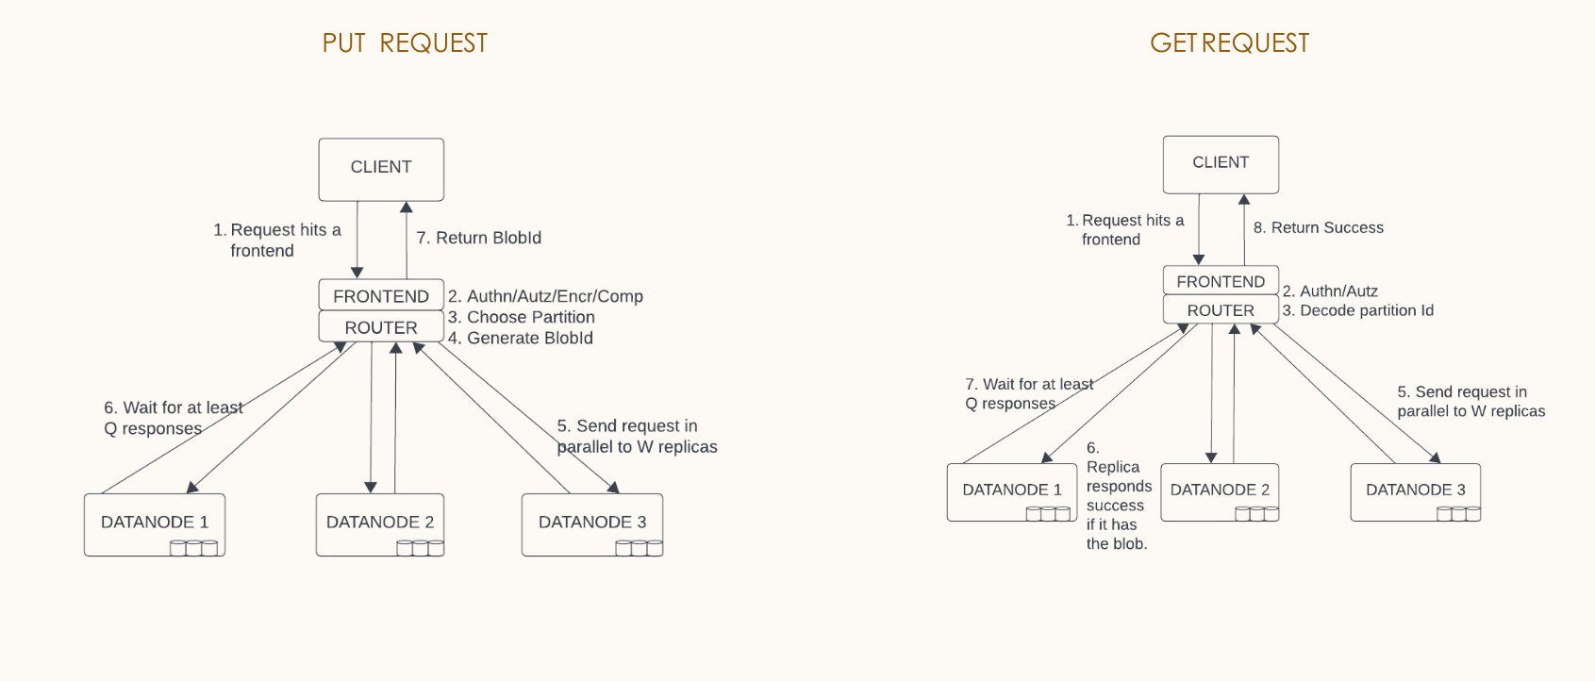
Quorum Based Consistency
Notes:
Ambry uses quorum based consistency model to trade-off high availability and performance, with strong persistence guarantees. The quorum policy is configurable. As an example, as shown in the diagram, on a put request, ambry sends the data to three replicas of a partition in parallel. A separate configuration defines the success target, which is the number of replicas that should return success for frontend to return success to the client.

Slide 46
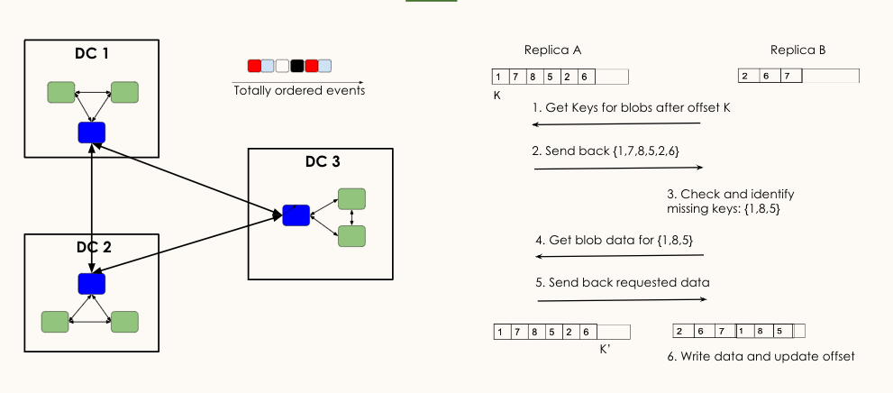
Asynchronous Replication
Notes:
In the last slide we saw how we use quorum to synchronously write data to multiple, but a sub-set, of all the replicas. Other replicas learn about this data via asynchronous replication. This replication tracks the ordered log of each replica. A typical replication topology uses all-to-all replication in local data center while a designated leader replica does cross-data center replication.
An example is shown in the right. It’s a pull based replication system where the replica initiating the replication pulls the data from its peers. In order to track its progress, each replica maintains a replica token against its peers. In the first step of a replication cycle, the Replica B requests for the next set of data from Replica A after the replica token K. The replica A responds to by sending the next set of updates and a new replication token to be updated when the changes are consumed. Replica A check the missing blobs in its log and requests the data for the missing blob. Finally it writes the missing data and updates in its log and advances the replication token.

Slide 47
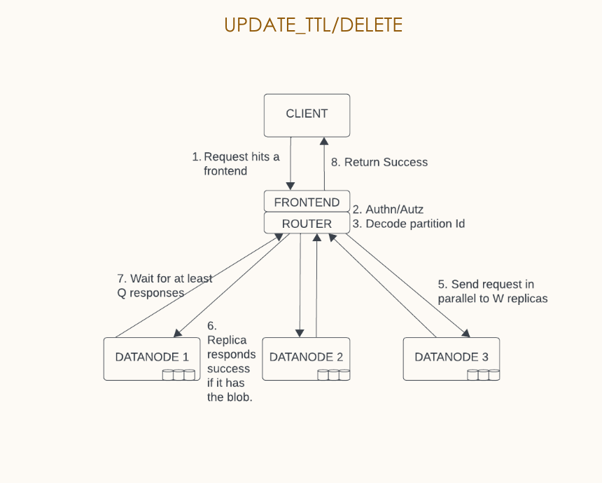
Metadata Operations
Notes:
In Ambry the blobs are append only.
Other than GET and PUT, Ambry also supports delete and ttl_update which are called metadata operations. The quorum consistency applies to metadata operations as well.
Note that the only update that the update-ttl API allows currently, is to make the blob permanent.

Slide 48
So, Why TLA+?
Notes:
So now that we know a little bit about Ambry is, lets take a look into why we started using TLA+ for Ambry.

Slide 49
Building Simple Systems is Complex!!!
Building simple large scale distributed data systems is hard!
Keeping them simple, as they evolve, is harder!!!
Notes:
Building simple systems is complex. Turns out, keeping them simple, as they evolve, is harder.
Over the years, we have evolved Ambry multiple times since it was built, to add more features and optimization to it.
When thinking about and designing all those changes, we have had similar problems like Zac mentioned earlier. Multiple brainstorming sessions, going through different corner cases, long documents trying to prove that everything will work in all the corner cases, and concerns around the complexity added to the system etc.

Slide 50
Problem – Efficient Metadata Operations
As we scaled Ambry's clusters, and new, high throughput use-cases onboarded to Ambry, we needed to make Ambry's metadata operations more scalable and robust.
Turns out there was no simple solution, it needed enhacements for a lot of the core components – Replication, Compaction, Frontend, Storage Layer.
Notes:
Lets look at one such design problem that I faced in Ambry, that led me to explore TLA+
As we scaled Ambry's clusters, and new, high throughput use-cases onboarded to Ambry, last year, we realized that we needed to make Ambry's metadata operations more scalable and robust. Without going into too much details, in the interest of time, this needed enhancements to a lot of the core components of Ambry – Replication, Compaction, Frontend and Storage layer.

Slide 51
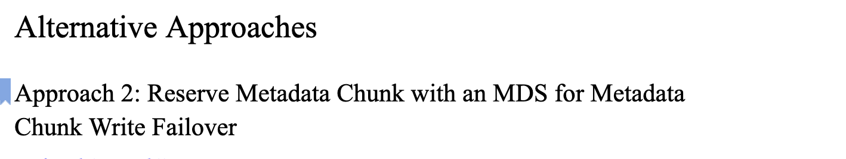
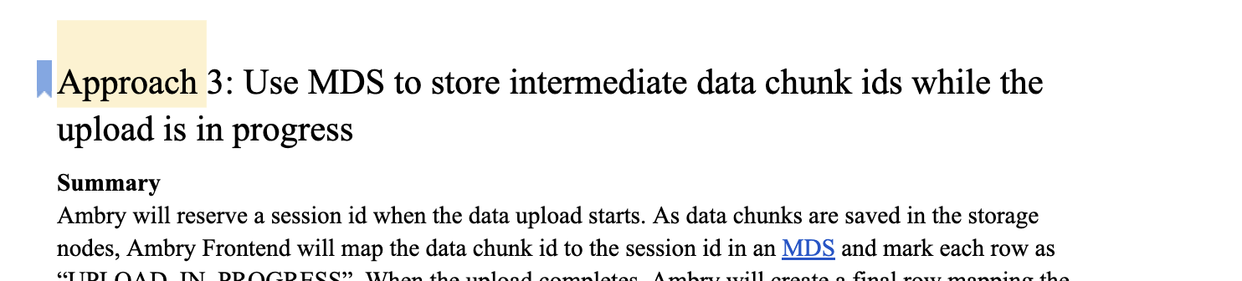
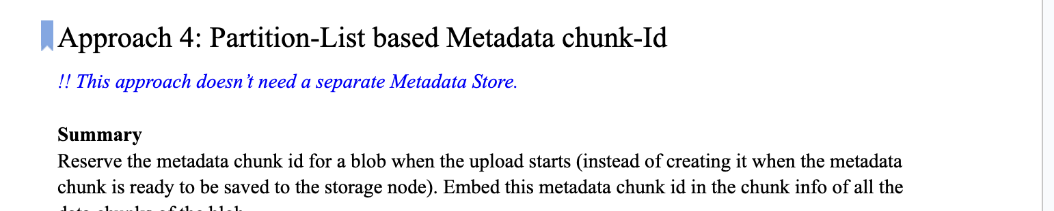
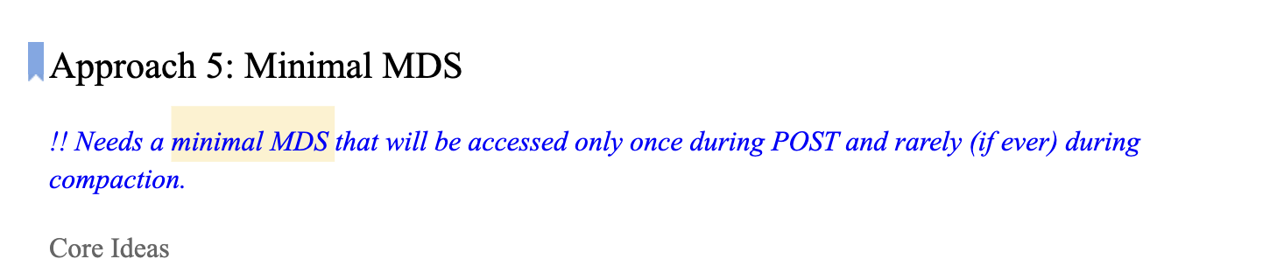
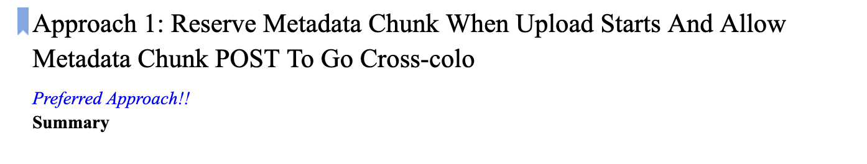
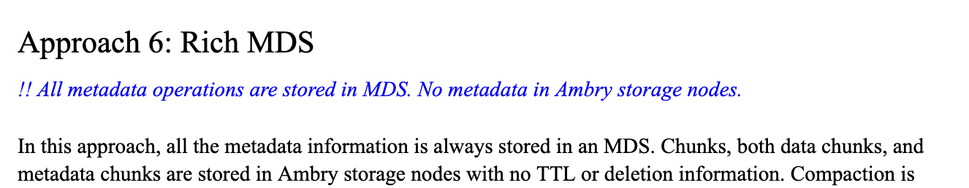
Solution– Efficient Metadata Operations
Explored at least seven different design choices.
Reason about correctness and complexity of each of them on a doc and in meetings.
  Over 30 pages of documents
  Over 35 diagrams
Countless hours spent reasoning about complexity, and defending against corner cases
Notes:
As we thought about the problem, and explored multiple designs, even after eliminating the ones that had high complexity and other dependencies, we ended up exploring 7 different deisgn choices. For each of them we reasoned about correctness and complexity and corner cases around a doc. There was at least one doc that was 30 pages long, and we had over 35 diagrams for the various deisngs, attempting to demonstrate the correctness and safety.
We spent countless hours reasoning about the complexity, and thinking about corner cases. And while our final solution was pretty elegant and simple, it led to a multi-quarter implementation effort, and without building it first, there are no formal way to prove that it will indeed work and not lead to any safety violation of existing guarantees of the system.

Slide 52
Keeping them simple is harder!!
How to validate the design?
How to keep the design simple?
How to reason about complexity in a deterministic way?
How to explore the entire state space deterministically?
How to reason about correctness & corner cases "formally"?
Ambry & TLA+ - Motivation​
Notes:
Based on the experience while designing metadata operations, we felt that there had to be a better way to validate the design. While discussing about corner cases in a doc or in meetings is indeed invaluable, we felt that we needed to have a more scientific way to represent our design decisions, and to use that as a basis to talk about simplicity and validate corner cases. And there has to be an easy way to explore the entire state space of a design deterministically.

Slide 53
Inspired by initial success of Venice.
  Very similar challenges and motivations.
Very early stages of use.
Ambry & TLA+ - Motivation​
Notes:
That brought us to TLA+.
The things I am going to talk about, in the next few mins, are much more modest than what Zac and Venice have achieved with TLA+, and it actually is inspired by the initial success that they have had with TLA+. Although Ambry is in very early stages of exploring formal methods, the motivations for the most part are very similar to Venice.

Slide 54
How Does TLA+ Help?
Create a base spec to prove that a component works.
Create refinements on top of the base spec to reason about future enhancements.
Notes:
Lets look at how can TLA+ help with some of the concerns we just talked about to "keep it simple".
Since I have explored it for enhancements in Ambry, I will just stick to refinements, and propose a two step solution – create a base spec to prove that a component works. And then Create refinements on top of the base spec to reason about future enhancements.

Slide 55
Sample Problem
Enhance the TTL Update API to enable users to extend the TTL of a blob to a specific value.
Notes:
In the interest of time, I will just talk about the first problem that I explored TLA+ for, and which can illustrate everything that I have talked about.
What I am going to show you is that how I was able to create a base spec for one of the components, and then create a small quick refinement on top of it for a new feature enhancement, to demonstrate not only that the new feature meets its own correctness guarantees, but also that exiting guarantees are not violated.
When we were thinking about efficient metadata operations, one of the things that we did want to explore later, was to enhance the ttl update API in Ambry. As I showed earlier, currently ttl update can only make a blob permanent. We wanted to explore enhancement of the ttl update API
Note that there are more nuances for it to work end to end. But For the purpose of this talk, I want to claim that there is a way to reason about all those nuances, and we will just focus on conflict handling during replication.

Slide 56
Sample
Problem
Requirements For Replication
In the presence of conflicting TTL updates, the largest TTL value wins.
If a replica has multiple TTL updates, the latest one should have the highest value.
Notes:
Here are the new requirements on replication that we identified due to the enhance to the ttl update API.

Slide 57
Support Update of TTL Value
Create a base spec to prove that replication works.
Create refinements on top of the base spec to reason about future enhancements.
Notes:
Using our template from the last slide, we have two steps – 1. create a base spec to prove that replication works and it meets proper safety and eventual consistency guarantees – 2 create refinements on top of the base spec to reason about future enhancements – that they meet the new correctness guarantees and don't violate any of the existing guarantees.

Slide 58
Step 1
Create a base spec to prove that replication works.
Notes:
So as a step 1 we created a base spec to prove that replication works.

Slide 59
Replica Log
  Each operation (PUT/DELETE/UPDATE_TTL) represents a message that is appended to a replica log
Replica Tokens
Replica States
Writing The Spec
Defining the state space
Notes:
I am the good TLA+ spec writer that Zac referred to and I do eat my broccoli.
So we started with defining the state spec for replication. There are three main states – the replica log where eacc operation is appended, the replica token that each replica maintains against all its peers to track progress, and the state of the replica.

Slide 60
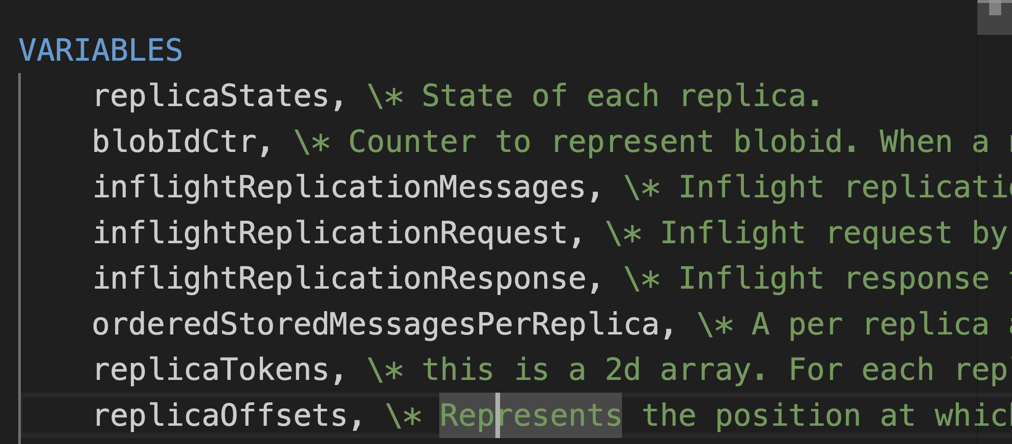
Writing The Spec
Defining the state space

Slide 61
Bootstrapping
Leader
Standby
Offline
Writing The Spec
Defining the state transitions due replica health
Notes:
Each replica can in one of the multiple states, but it can take writes only for Leader and Standby states.

Slide 62
Put Operation
Delete Operation
Ttl Update Operation
Writing The Spec
Defining the state transitions due to operations
Notes:
The replicas should support three operations that can change their state.

Slide 63
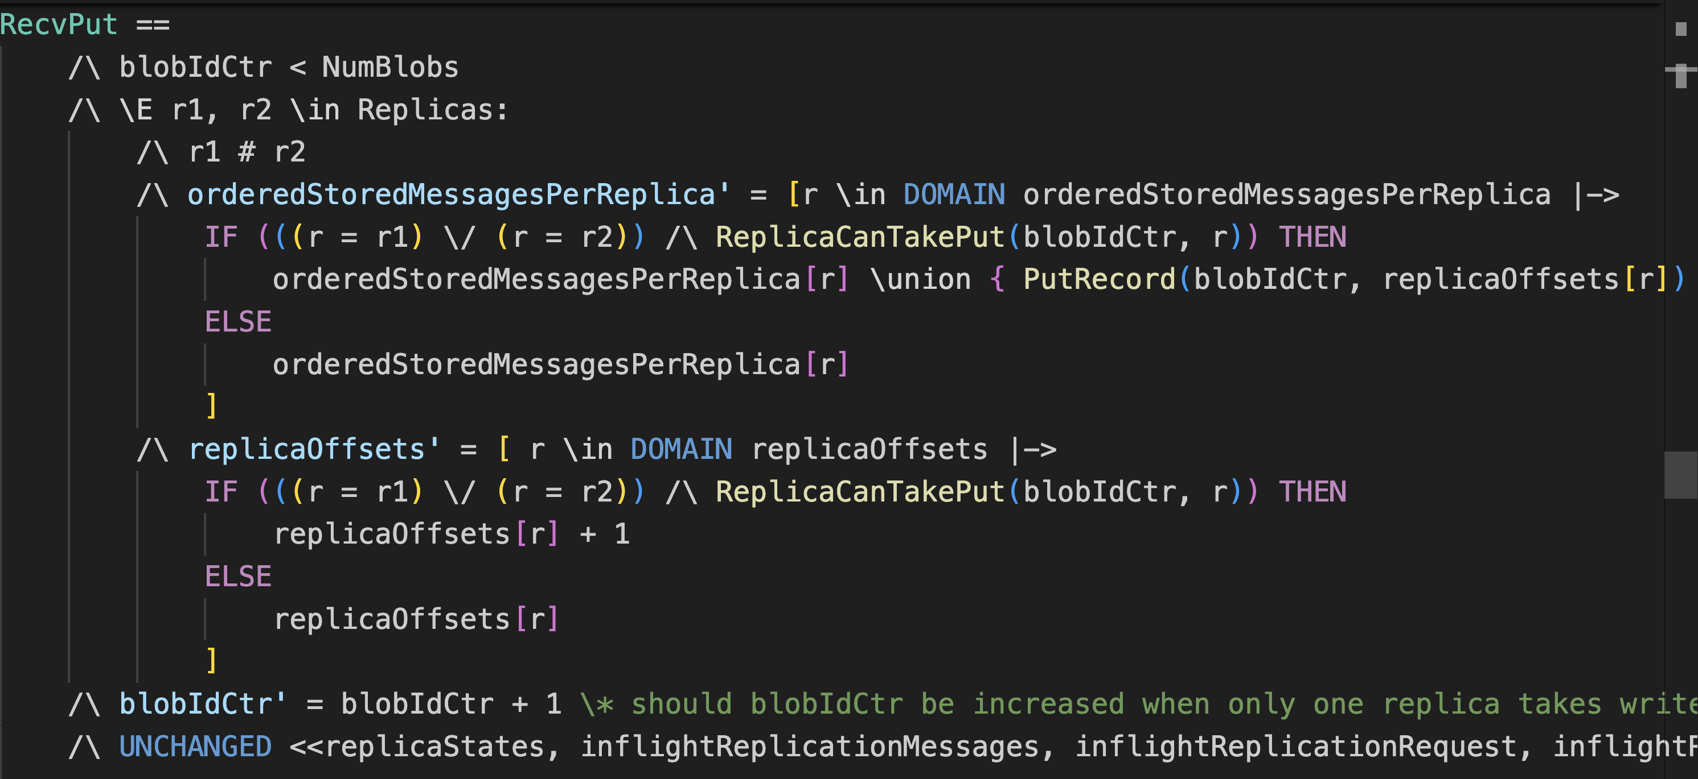
Writing The Spec
Defining the supported operations - PUT
Notes:
For each of these operations, there is a condition in the spec to check if the operation can be accepted by the replica. For example, for Put the check is to ensure that replica is up and it doesn't already have the blob.

Slide 64
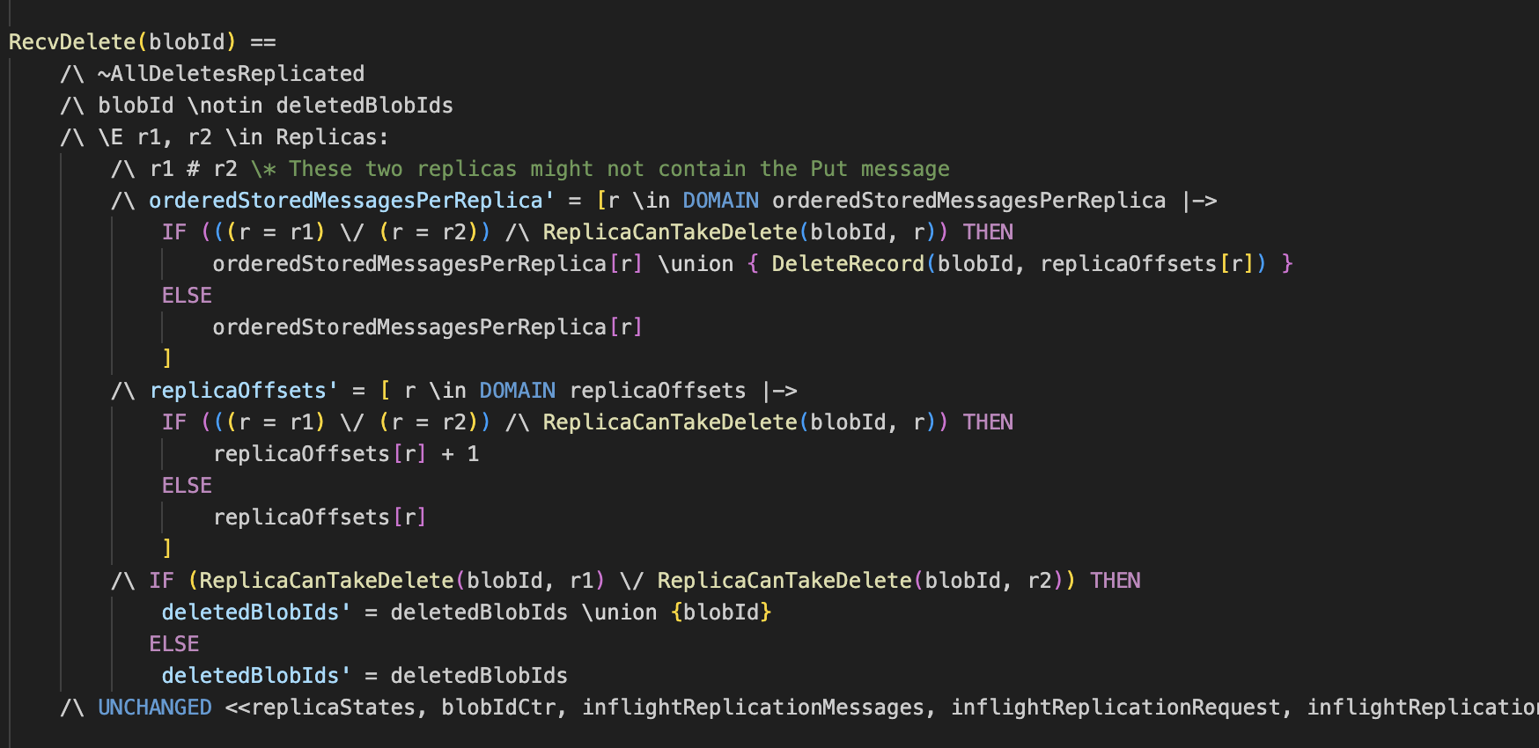
Writing The Spec
Defining the supported operations - DELETE
Notes:
For delete the check is that replica is up and has the blob.

Slide 65
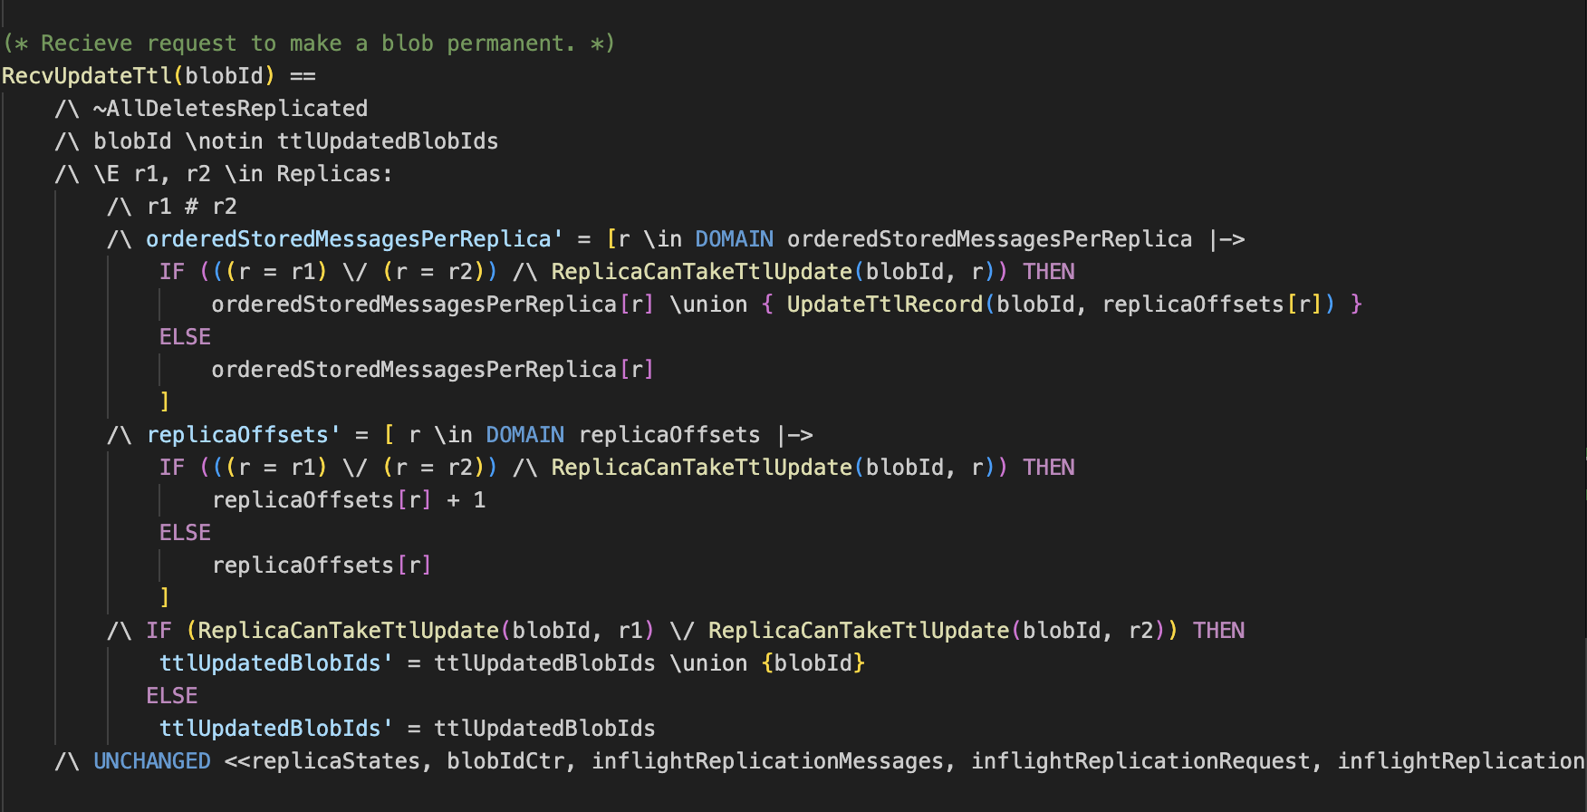
Writing The Spec
Defining the supported operations – TTL_
UPDATE
Notes:
And for TTL update the check is that replica is up and has the blob and the blob is not already delete.

Slide 66
Send Replication Request
Receive Request For Replication
Handle Replication Response
Writing The Spec
Defining the state transitions due to replication
Notes:
We also defined state transitions due to replication. Each replica makes progress with asynchronous replication, by pulling data from its peers.

Slide 67
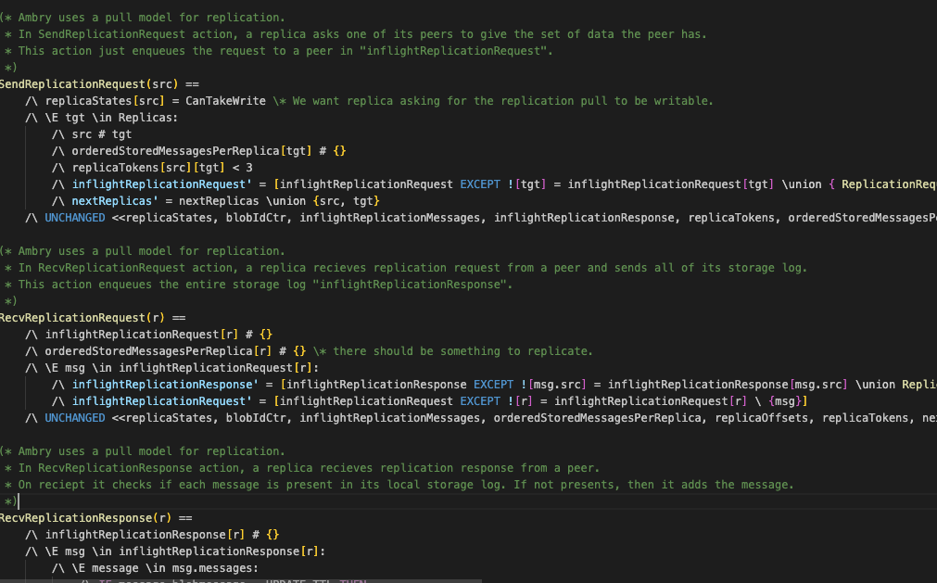
Writing The Spec
Defining the replication state transitions

Slide 68
No replica should have TTL update for blob before PUT or after delete
No replica should have delete for a blob before PUT
Writing The Spec
Safety Checks
Notes:
Finally we defined some safety checks to ensure that after each state transtion, the safety conditions are not violated. A couple of them are shown here.

Slide 69
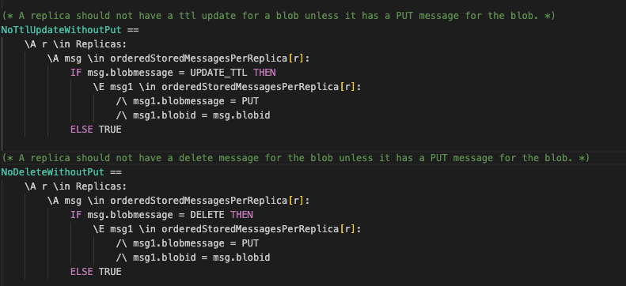
Writing The Spec
Proving safety & correctness

Slide 70
Step 2: Refine or Modify the Base Spec
Requirements
In the presence of conflicting TTLupdates, the largest ttl value wins.
If a replica has multiple TTL updates, the latest one should have the highest value.
Notes:
Now that the we have the TLA+ spec for replication in place, let me show you how simple it was to enhance it to support the enchanced TTL update API
We already looked at the requirement earlier.

Slide 71
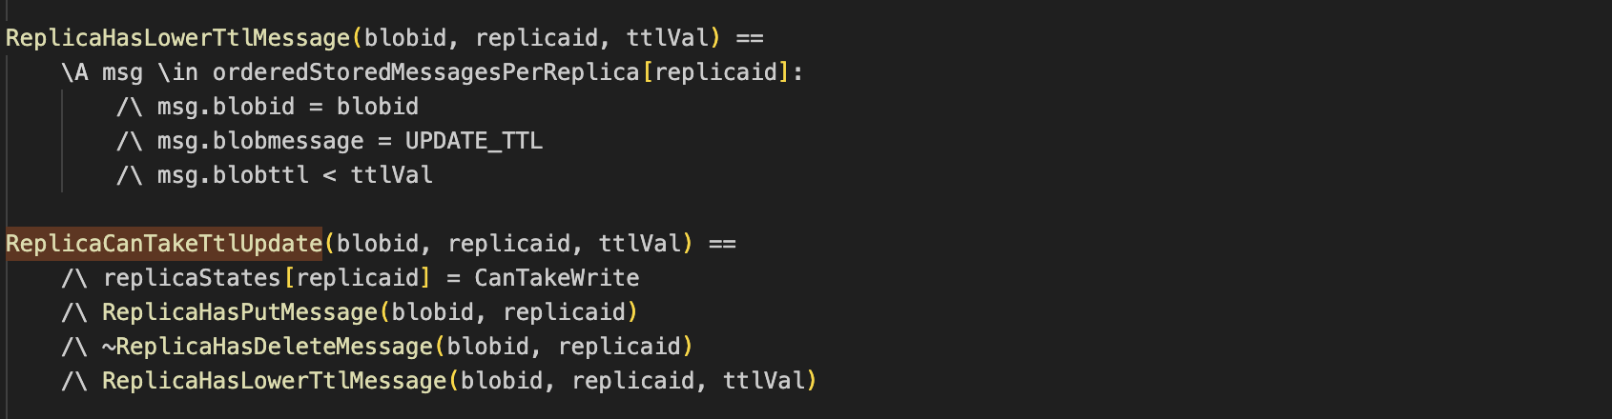
Refining The Spec
Refining the condition for TTL_UPDATE
Notes:
In order to meet this requirement all we needed to do was to update the check for ttlUpdate operation in the spec, and add a new check that says TTL can be updated to the new value only if the replica didn’t have ttl message with a larger TTL value.

Slide 72
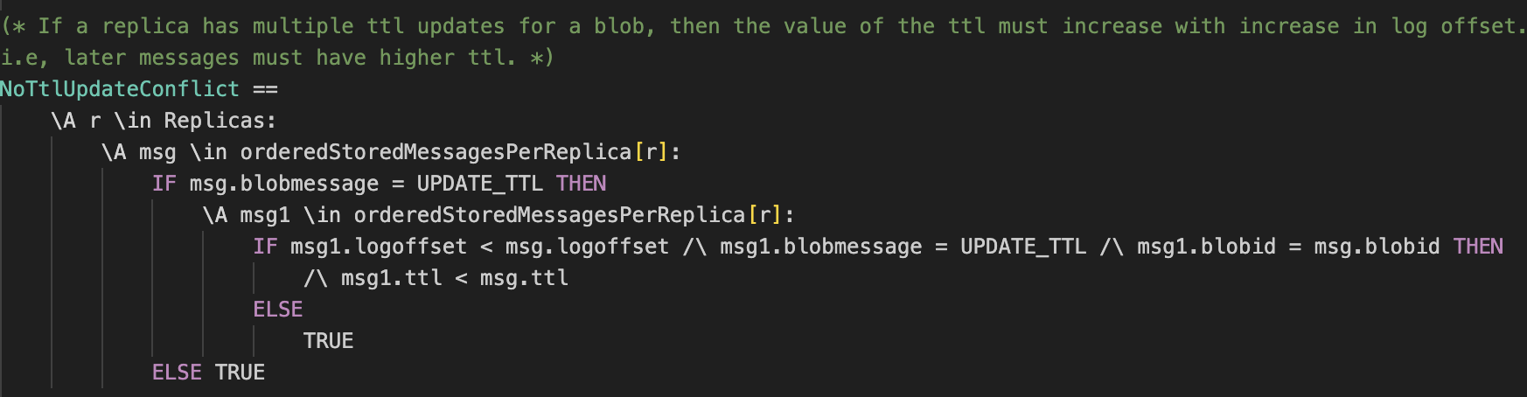
Refining The Spec
Adding more safety and correctness checks
Notes:
And we added another safety check to ensure that for each blob, the latest ttl udpate has the highest value.
That’s all, these were the only changes needed to show that the new API can meet its requirements without voilating any of the existing guarantees.

Slide 73

Future Work
Creating spec for other components like Compaction, Storage Formats, Router etc.
github.com/ankagrawal/AmbryTLA
Notes:
That’s all I had for you today. We obviously have a lot of work left to do in terms of writing the spec for all the components and tying them together.

Slide 74

Questions? Fire Away!
Or, for more information, please checkout
github.com/linkedin/venice
venicedb.org/
github.com/linkedin/ambry
Notes:
And with that, I'd like to now open us up to questions!

Slide 75
Thank you
Notes:
Thanks!

