Slide 2
Histogram of Vector

Slide 3
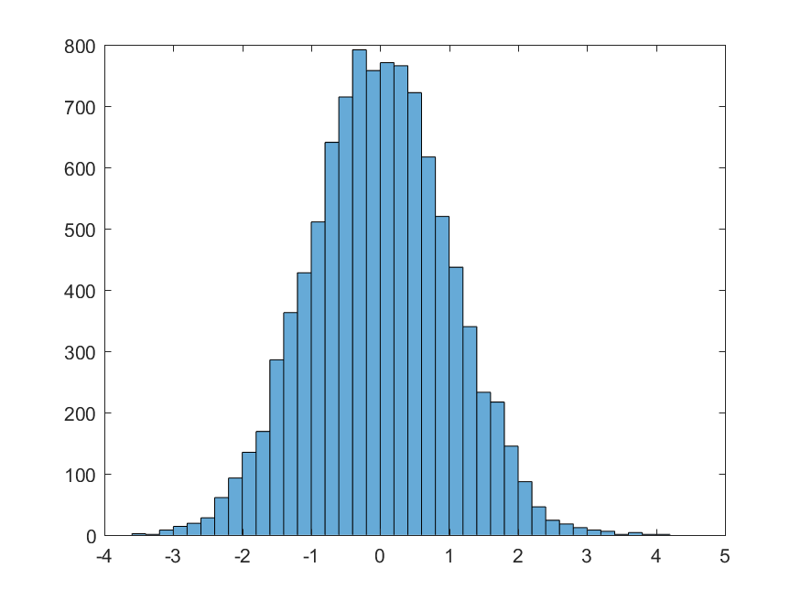
Histogram of Vector

Slide 4
What You Can Do with histogram
Create histogram plot of x
Specify:
Number of bins
Edges of the bins
Plot into a specified axes

