Slide 1
LSS
Life Sciences Suite
Connect Operations.
Control Quality.
Trace Everything.
Commercial launch narrative
2026
Notes:
[Sources]
- LSS Marketing & Advertising Master Plan / supplied LSS architectural documentation.
[/Sources]

Slide 2
LSS - LIFE SCIENCES SUITE
The batch story is often scattered.
When operations and quality live apart, each investigation begins with reconstruction.
ERP
QMS
Documents
Manual files
Transactions
Decisions
Approvals
Exceptions
The question is not “Do we have data?”
It is “Can we follow the decision?”
LSS / 02
Designed to support regulated workflows - configuration and validation remain the organisation's responsibility.
Notes:
[Sources]
- LSS Marketing & Advertising Master Plan / supplied LSS architectural documentation.
[/Sources]

Slide 3
LSS - LIFE SCIENCES SUITE
A connected environment changes the conversation.
LSS is designed to link operational context and quality workflows.
QUALITY
OPERATIONS
LSS
TRACEABILITY
CONTROLLED
WORKFLOWS
LSS / 03
Designed to support regulated workflows - configuration and validation remain the organisation's responsibility.
Notes:
[Sources]
- LSS Marketing & Advertising Master Plan / supplied LSS architectural documentation.
[/Sources]

Slide 4
LSS - LIFE SCIENCES SUITE
LSS starts with a modular architecture.
Each layer has a distinct job - and each customer scope is verified before it is marketed.
Industry extensions
Pharmaceutical / Device / Plastics / Cosmetics / Laboratory
Life Sciences Core
QMS / controlled workflows / traceability
Community extensions
OCA components and supporting services
ERP foundation
Odoo 19 Community / PostgreSQL
LSS / 04
Designed to support regulated workflows - configuration and validation remain the organisation's responsibility.
Notes:
[Sources]
- LSS Marketing & Advertising Master Plan / supplied LSS architectural documentation.
[/Sources]

Slide 5
LSS - LIFE SCIENCES SUITE
Show the workflow - not the menu.
A credible demonstration answers a real operational question end to end.
RECEIVE
ASSESS
MAKE
DECIDE
TRACE
Material
and lot
Status
and checks
Batch
context
Quality
workflow
Linked
story
Every stage creates context for the next decision.
LSS / 05
Designed to support regulated workflows - configuration and validation remain the organisation's responsibility.
Notes:
[Sources]
- LSS Marketing & Advertising Master Plan / supplied LSS architectural documentation.
[/Sources]

Slide 6
LSS - LIFE SCIENCES SUITE
The value is better-connected context.
Not “compliance in a box.” A more coherent place to execute, assess, and explain the work.
LESS
MORE
CLEARER
manual reconstruction
visible ownership
operational context
Intended outcomes are confirmed against your workflow, configuration, and validation programme.
LSS / 06
Designed to support regulated workflows - configuration and validation remain the organisation's responsibility.
Notes:
[Sources]
- LSS Marketing & Advertising Master Plan / supplied LSS architectural documentation.
[/Sources]

Slide 7
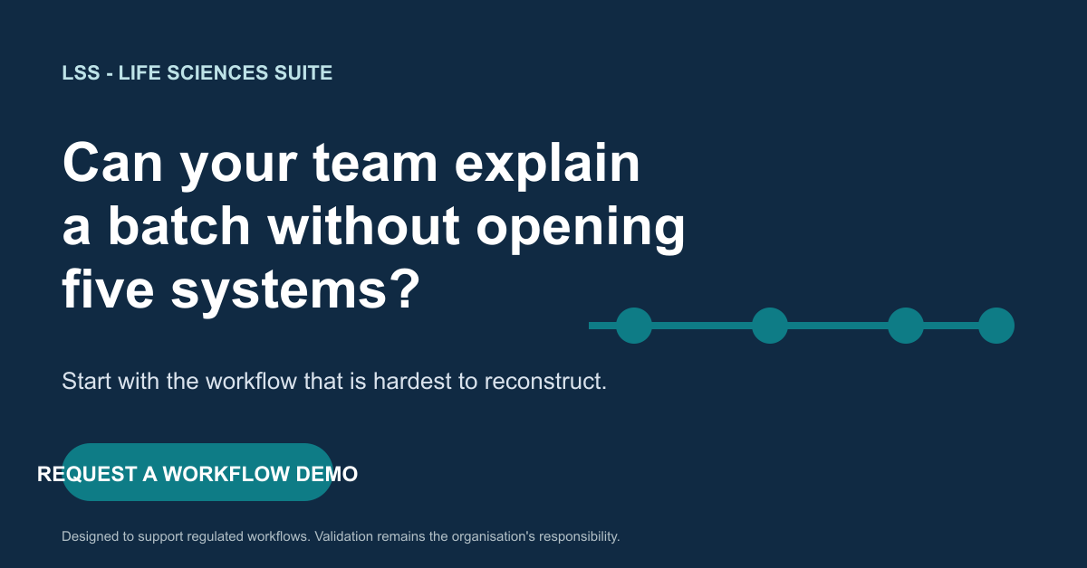
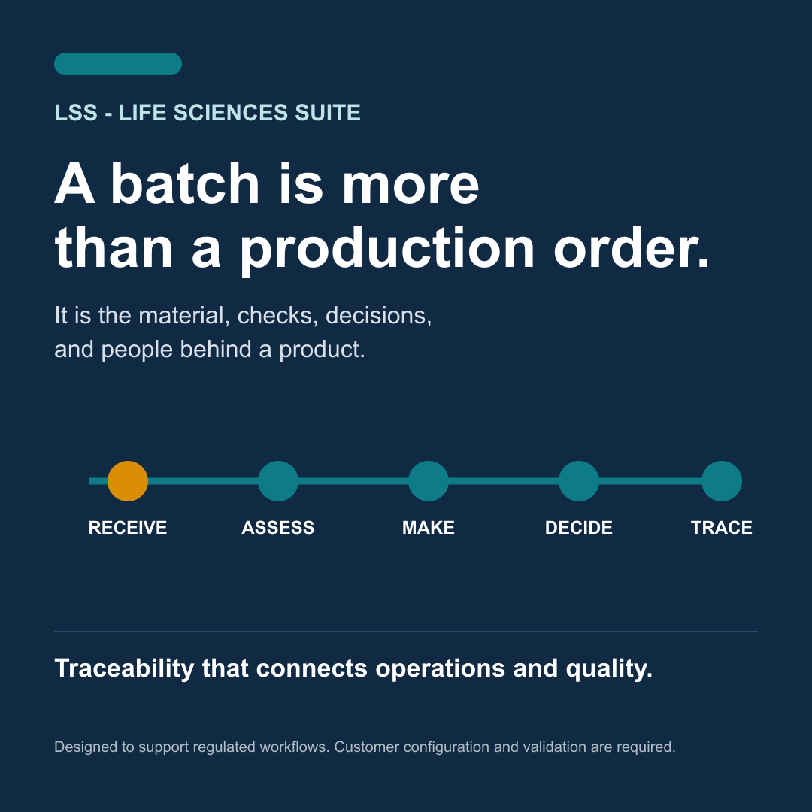
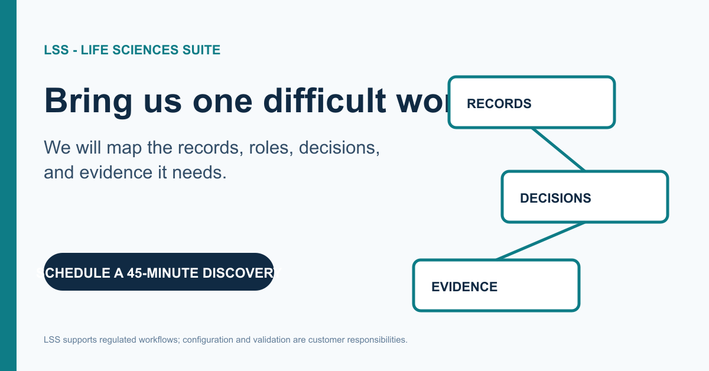
LSS - LIFE SCIENCES SUITE
One strong idea. Many useful formats.
“See the complete journey of a batch” turns into ads, social content, PLV, and a workflow demo.
RETARGETING
ADVERTISING
SOCIAL
LSS / 07
Designed to support regulated workflows - configuration and validation remain the organisation's responsibility.
Notes:
[Sources]
- LSS Advertising, Social Media & PLV Package / internally produced campaign assets.
[/Sources]

Slide 8
LSS - LIFE SCIENCES SUITE
Different buyers enter through different problems.
Lead with the handoff they own, then connect their need to the wider operating story.
CEO / COO
Visibility and decision confidence
Quality
Deviations, CAPA, documents, evidence
Operations
Material status, batch execution, handoffs
IT / CIO
Architecture, integration, governance
LSS / 08
Designed to support regulated workflows - configuration and validation remain the organisation's responsibility.
Notes:
[Sources]
- LSS Marketing & Advertising Master Plan / supplied LSS architectural documentation.
[/Sources]

Slide 9
LSS - LIFE SCIENCES SUITE
Industry relevance makes the story credible.
The platform conversation changes with the product, process, and regulatory context.
PHARMACEUTICAL
Material to batch to decision
MEDICAL DEVICES
Device record and controlled change
MEDICAL PLASTICS
Process parameters and lot context
COSMETICS
Formula, ingredient, packaging context
LABORATORIES
Sample, result, and release context
LSS / 09
Designed to support regulated workflows - configuration and validation remain the organisation's responsibility.
Notes:
[Sources]
- LSS Marketing & Advertising Master Plan / supplied LSS architectural documentation.
[/Sources]

Slide 10
LSS - LIFE SCIENCES SUITE
Trust starts with precise claims.
The strongest launch language is specific about what LSS is designed to support - and candid about what must be verified.
Use
Never say
Designed to support
Configured and validated
according to requirements
Guaranteed compliance
FDA approved
100% compliant
LSS / 10
Designed to support regulated workflows - configuration and validation remain the organisation's responsibility.
Notes:
[Sources]
- LSS Marketing & Advertising Master Plan / supplied LSS architectural documentation.
[/Sources]

Slide 11
LSS - LIFE SCIENCES SUITE
Launch the message only when the proof is ready.
The capability matrix turns an architectural story into a responsible commercial programme.
01
PRODUCT
TRUTH
02
DEMO
TRUTH
03
REGULATORY
TRUTH
04
BRAND
TRUTH
05
SALES
TRUTH
Verification gives marketing a better story - because the story can be demonstrated.
LSS / 11
Designed to support regulated workflows - configuration and validation remain the organisation's responsibility.
Notes:
[Sources]
- LSS Marketing & Advertising Master Plan / supplied LSS architectural documentation.
[/Sources]

Slide 12
Bring one difficult
workflow.
We will map the records, roles, decisions, and evidence it needs.
REQUEST A WORKFLOW DEMO
[website] / [email] / [phone]
LSS - Life Sciences Suite
Notes:
[Sources]
- LSS Marketing & Advertising Master Plan / supplied LSS architectural documentation.
[/Sources]

