Slide 1
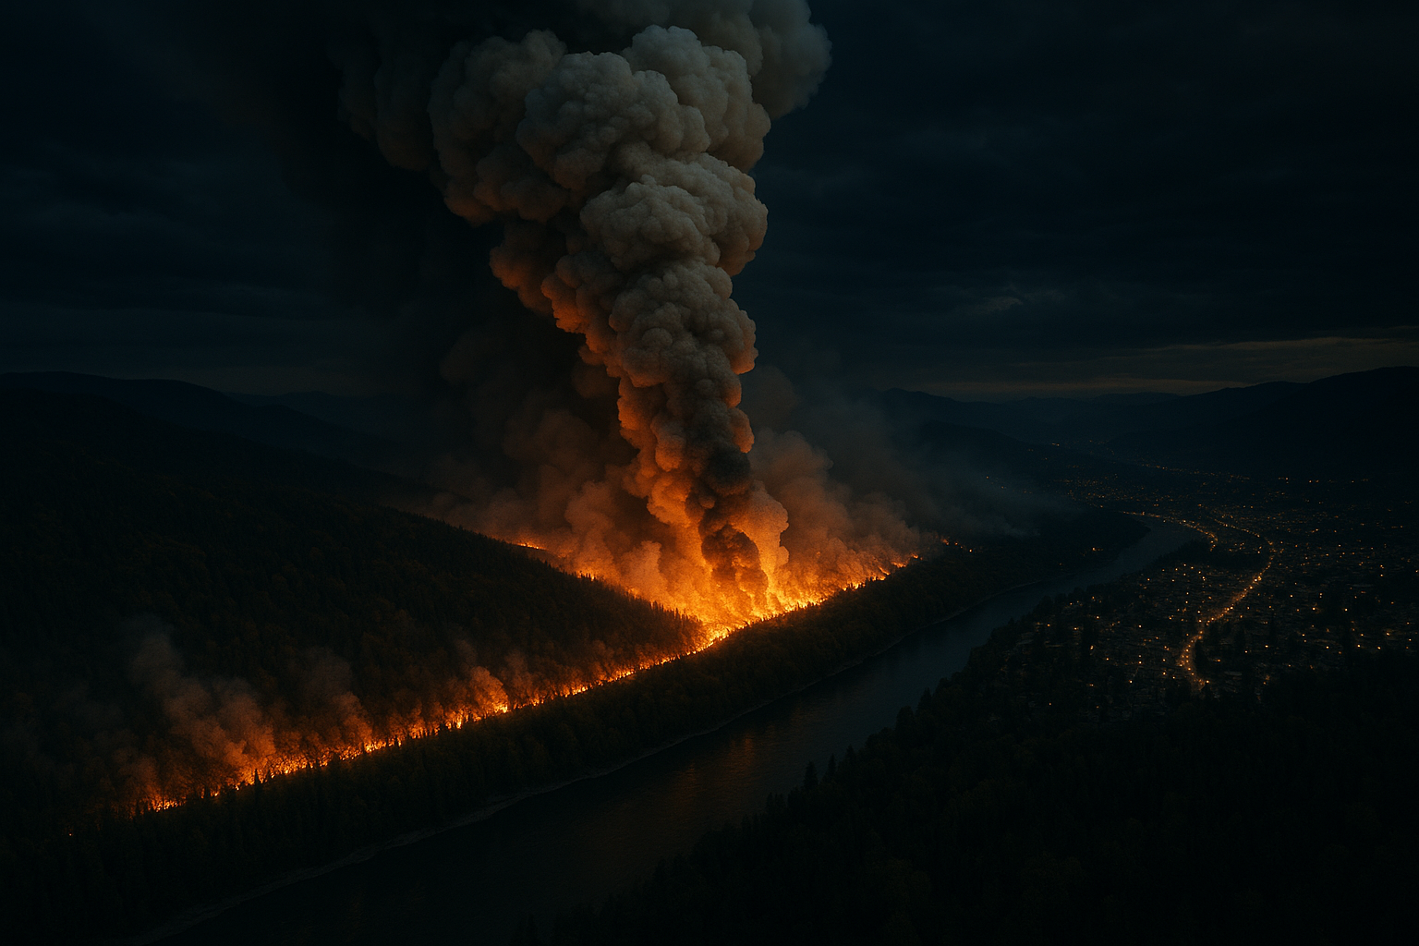
WILLIAMS LAKE, BC · JULY 21, 2024
5:45 PM.
A tree hits a power line. Rank 4 fire in under an hour.
440 properties evacuated · 3,000 on alert · 40 minutes to get a situational picture.
FireGuard

Slide 2

THE COORDINATION GAP
Today, a complete situational picture takes 40–45 minutes to assemble.
Identify affected zones
GIS analyst queries a separate provincial system
Check shelter availability
Phone calls to ESS facility coordinators
Find open routes
Manual DriveBC check, cross-reference road feeds
Interpret satellite data
FIRMS requires GIS expertise to read
Update field crew maps
Separate workflow on a different system
The fire doesn't wait.

Slide 3

FIREGUARD
Satellite hotspot detected. 60 seconds to a complete picture.
NASA FIRMS
Hotspot streamed in real time
Google Cloud
FastAPI ingests, seeds Elasticsearch MCP
Elasticsearch MCP
Zones · shelters · roads queried in parallel
Gemini
Agent reasons, evaluates routes, runs what-ifs
Mapbox
Brief + annotated map delivered to operator

Slide 4
ELASTIC TRACK · MCP INTEGRATION
Elasticsearch MCP is the evidence layer.
fireguard_search_zones
geo_distance query on evacuation zone centroids
fireguard_search_shelters
geo_distance query on ESS facility locations
fireguard_search_road_events
geo_shape intersection on road event polygons
fireguard_evaluate_route
route checked against indexed fire + road constraints
fireguard_search_events
FIRMS hotspot search by location, radius, and time
Every agent decision is grounded in a real Elasticsearch query. No hallucination.

Slide 5
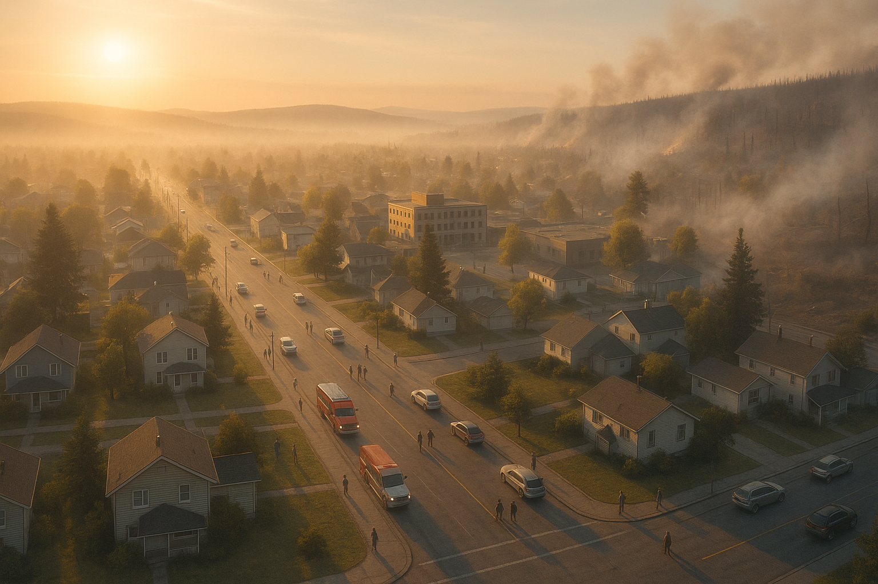
IMPACT
40 min → 60 sec
3,440
$621M
8 tools
time to situational picture
properties at risk, real incident
BC wildfire suppression 2024
parallel Elasticsearch MCP queries
Real event. Real satellite data. Real Elasticsearch MCP queries. Real evacuation brief in under a minute.
github.com/youneslaaroussi/fireguard
FireGuard · Google Cloud Rapid Agent Hackathon · Elastic Track

