Slide 1
Big Mountain Resort Ticket Pricing Analysis

Slide 2
Problem Identification
Resort’s pricing strategy is to charge a premium above the average ticket price of resorts in its market segment
Strategy is not adequate to efficiently capitalize on facilities
Resort wants to implement a more-data driven business strategy
What is the optimal ticket price that the resort should charge its customers?

Slide 3
Recommendation
Increase ticket prices from $81 to $95.87±10.39
Close the least used run
Increase the vertical drop down by 150 feet
Install an additional chair lift
Experiment by closing 2, 5 and 8 runs

Slide 4
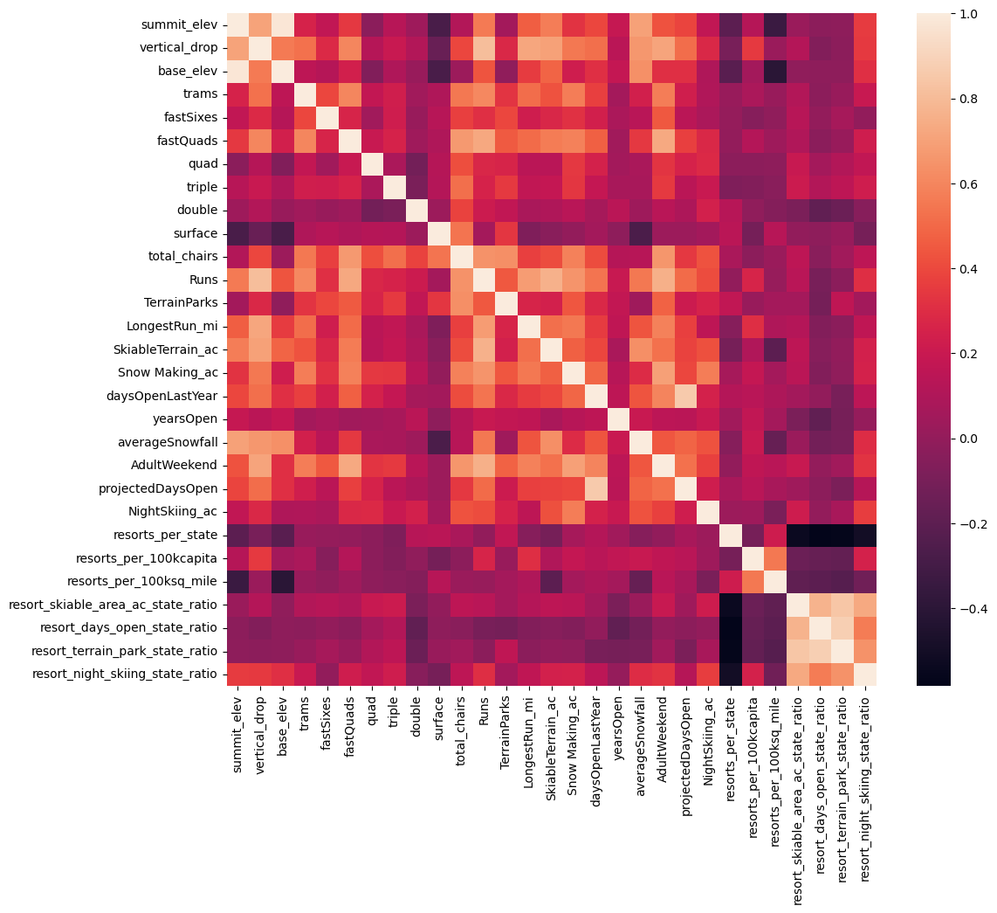
Exploratory Data Analysis
Features with highest correlation
fastQuads
Runs
Snow Making_ac
vertical_drop
total_chairs

Slide 5
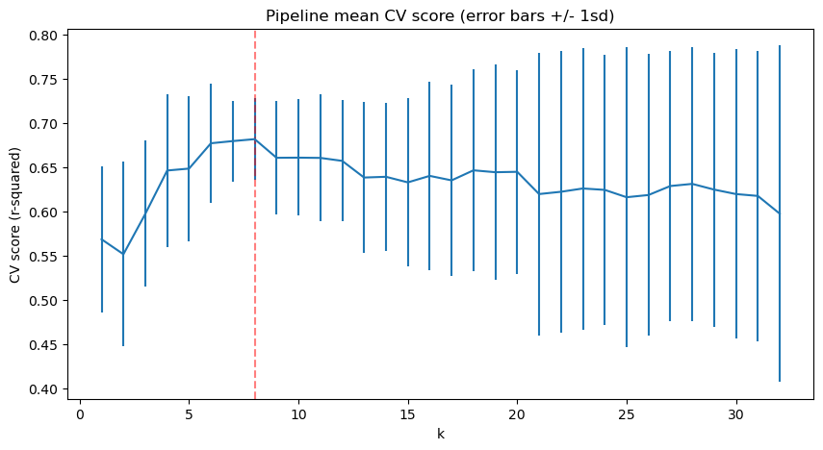
Linear Regression Model
K = 8 best features:
vertical_drop 10.767857
Snow Making_ac 6.290074
total_chairs 5.794156
fastQuads 5.745626
Runs 5.370555
LongestRun_mi 0.181814
Trams -4.142024
SkiableTerrain_ac -5.249780

Slide 6
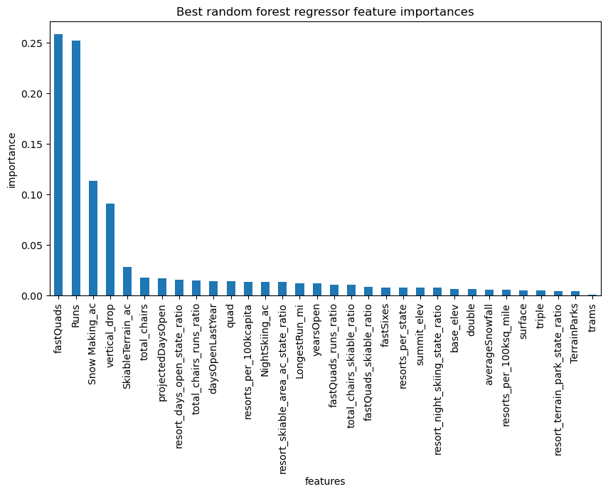
Random Forest Regression Model

Slide 7
Performance and Analysis
The random forest regression model provides better performance
 | Linear Regression | Random Forest Regression
Cross validation R² (train set) | 0.68 | 0.71
Cross validation MAE (train set) | 10.5 | 9.64
Cross validation MAE (test set) | 11.79 | 9.54

Slide 8
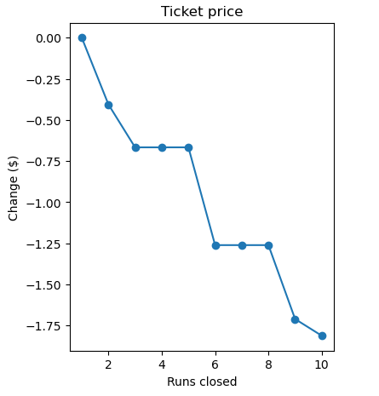
Scenario Modeling
Scenario 1: Permanently closing down up to 10 of the least used runs.
Scenario 2: Increase the vertical drop by adding a run to a point 150 feet lower. This increases support for ticket prices by $1.99 and revenue by $3,474,638.
Scenario 3: Same as scenario 2 but adding 2 acres of snow making cover. This also increases support for ticket prices by $1.99 and revenue by $3,474,638.
Scenario 4: : Increase the longest run by 0.2 miles to boast 3.5 miles length, requiring additional snow making coverage of 4 acres. No difference in ticket price support.

Slide 9
Conclusion
The resort has superior features and can achieve more revenue and profits by increasing ticket prices
More operating costs information is needed such as the cost of maintaining runs and the cost to increase in vertical drop
This model can be incorporated into an easier interface or an app that business analysts can use to predict ticket prices in different scenarios

