Slide 1
T-NSA-700
devops-07
Charles Robertson - Paul Managau - Youness Bennaj - Clément Scherpereel

Slide 2
Summary
Project overview
Management
Requirements
Organization
Challenges
Demonstration

Slide 3
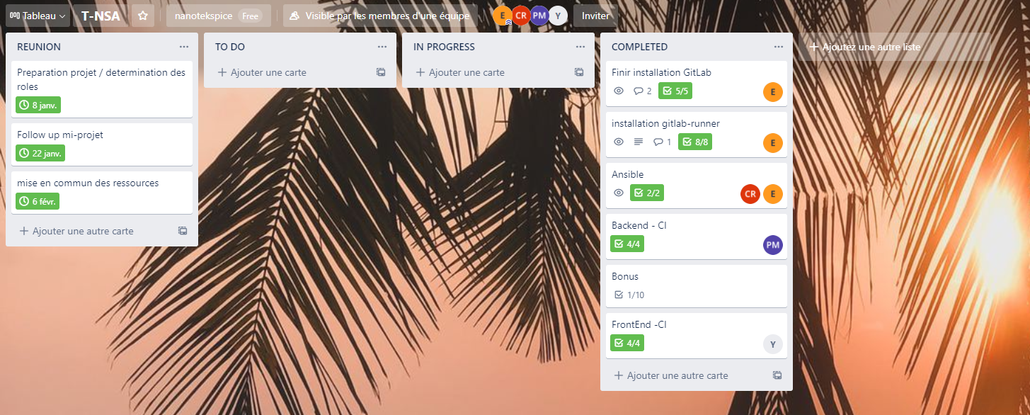
Projet Management

Slide 4
Project requirements
Virtual machines
Front
Back
Database

Slide 5
Project requirements
Gitlab server
Host repositories
Manage pipelines

Slide 6
Project requirements
Gitlab runners
Use to run pipelines
Test
Build
Deploy

Slide 7
Project requirements
Ansible playbooks
Installation of services/dependencies
Separate into “roles”
Called by a “playbook”

Slide 8
Project requirements
Gitlab CI/CD
Trigger multiples stages
test
build
deploy

Slide 9
Organisation

Slide 10
Gitlab Server
Ubuntu 20.04
SSL/HTTPS
domain name

Slide 11
Gitlab Runner
3 available runners
Shared for all the projects on the Gitlab server
Runners use an Ubuntu environment

Slide 12
Ansible
Front
Roles
Playbook
Encrypt sensibles data (ansible-vault)
Use Unit Test and check if the build work
Build & deploy applications
Use artifacts for the build

Slide 13
Ansible
Back & Database
Roles
Common
Php
Laravel
Composer
Apache2
Build
MySQL
Encrypt sensibles data (ansible-vault)
Tags
build
deploy

Slide 14
CI - Fontend
Frontend CI
If push:
install_dependencies
install npm packages dependencies
store in cache
test_app
install chromium
run test
build_app-test
run build
generate artifact
If deploy new release:
build_app
install npm packages dependencies
run build
deploy
install ansible dependencies
run ansible deploy playbook

Slide 15
CI - Backend
Build
Set env variables for DB (.env)
Import dependencies
git
zip
npm
composer
Run production
Create artifacts
Test
Generate key (.env)
Run unit tests

Slide 16
Front Runner Time
Front:
CI Testing: 00:09:38
CI Deploying: 00:05:46
Downtime: No Downtime

Slide 17
Back Runner Time
Back:
CI Testing: 00:08:38
CI Deploying: 00:08:19
Downtime: No Downtime

Slide 18
Challenges

Slide 19
Gitlab Runner

Slide 20
Ansible
Syntax
Logic
Beginner

Slide 21
CI - Front
Time optimization ~ 9 minutes (dependencies installation)
Install Chromium (chromium on Ubuntu 20.4)
Beginner at CI pipeline
Hard to find accurate information
Artifact

Slide 22
CI - Back
Beginner in CI
Env variables and runners
Runtime for dependencies set up
Jobs and artifacts

Slide 23
Demonstration

