Slide 1
Libuv usages & internals
牟卫洋

Slide 2
Contents
Libuv basics
Libuv design overview
Libuv usages
Libuv internals
Questions
References

Slide 3
Libuv basics
Blocking VS non-blocking
Synchronous VS asynchronous
BIO, NIO and AIO
Event & callback
epoll

Slide 4
Libuv basics
What is libuv?
multi-platform event-driven asynchronous I/O library
Multi-platform
Unix(Linux/BSDs/AIX/Solaris) and Windows
Event-driven
register callback for each event, callback will be called after event happens
Asynchronous I/O library
others include libevent and libev

Slide 5
Libuv basics
Handle
long-lived objects capable of performing operations while active (get its callback called), such as TCP/UDP, tty and timers
Request
short-lived objects, performed over handles (write/connect) or standalone (getaddrinfo)

Slide 6
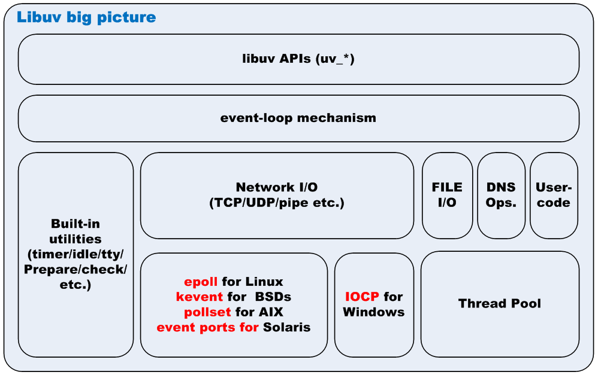
Libuv design overview

Slide 7
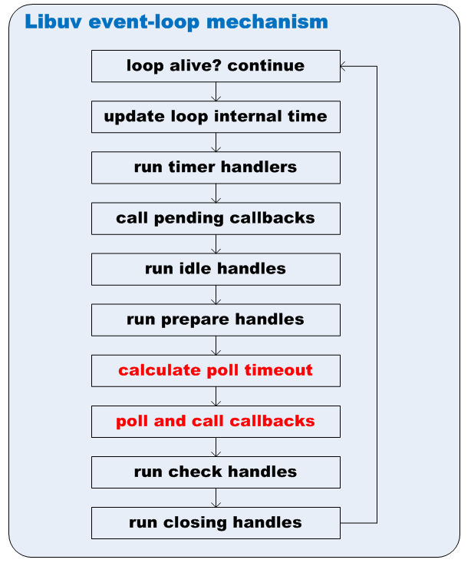
Libuv design overview

Slide 8
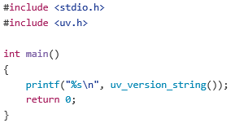
Libuv usages
Download source code
$ git clone https://github.com/libuv/libuv; cd libuv
Automation or benchmark test $ ./gyp_uv.py -f ninja
$ ninja -C out/Debug
$ cd out/Debug
$ ./run-tests
$ ./run-benchmarks
Install headers and shared library
$ ./autogen.sh
$ ./configure
$ make
$ sudo make install
$ sudo ldconfig
Simple API test
$ gcc version.c -luv
$ ./a.out
$ 1.8.1-dev

Slide 9
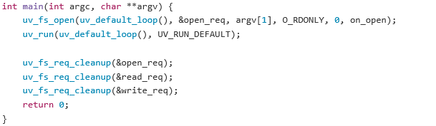
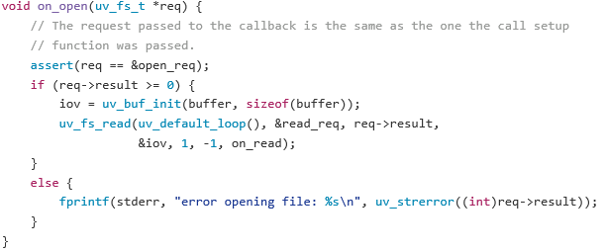
Libuv usages
A simple example – uvcat

Slide 10
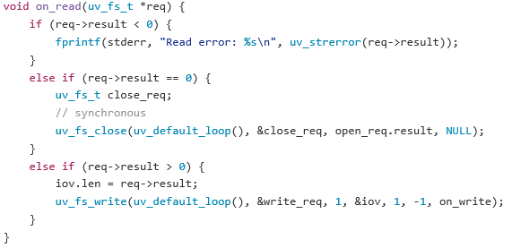
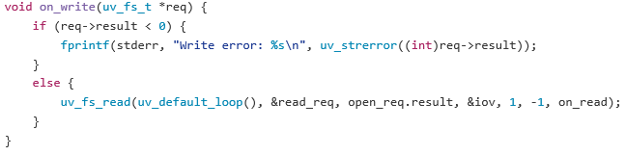
Libuv usages
A simple example – uvcat (cont.)

Slide 11
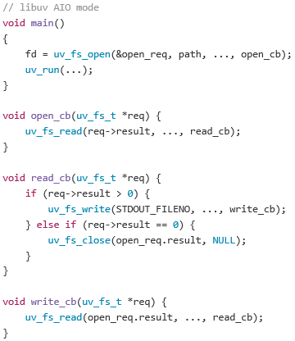
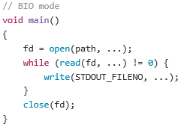
Libuv usages
Normal BIO VS libuv AIO

Slide 12
Libuv internals
How cross-platform?
For compilation, use cross-platform GYP build tool
For asynchronous I/Os, use Unix libev and Windows IOCP
Epoll for Linux (uv__io_poll -> epoll_wait sycall)
Kqueue for Mac OS X and other BSDs (uv__io_poll -> kevent)
Pollset for IBM-AIX (uv__io_poll -> pollset_poll)
Event ports for Sun-Solaris (uv__io_poll -> port_getn)
IOCP for Windows (uv_io_poll -> GetQueueCompletionStatus)
For threadpoll, use high-level abstracted APIs + MT libraries
Pthread for POSIX Unix (uv_thread_create -> pthread_create)
Built-in MT APIs for Windows (uv_thread_create ->_beginthreadex)

Slide 13
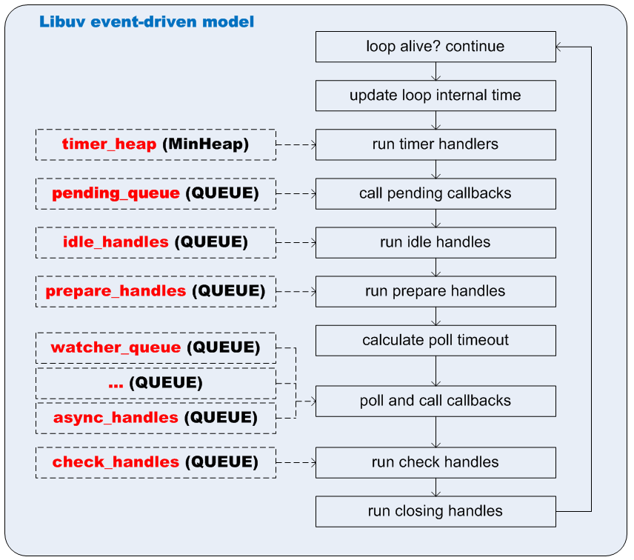
Libuv internals
Event-driven model
Components:
Registered callbacks
Event queues
Poll mechanism
Steps
1. registered callback
2. add to queue when event happens
3. poll queues in loop
4. call registered callbacks

Slide 14
Libuv internals
FS event-driven model
Components
Blocking FS Operations: worker threads in threadpoll
Event loop: main thread
Inner-Thread Communication : pipe-based async handle

Slide 15
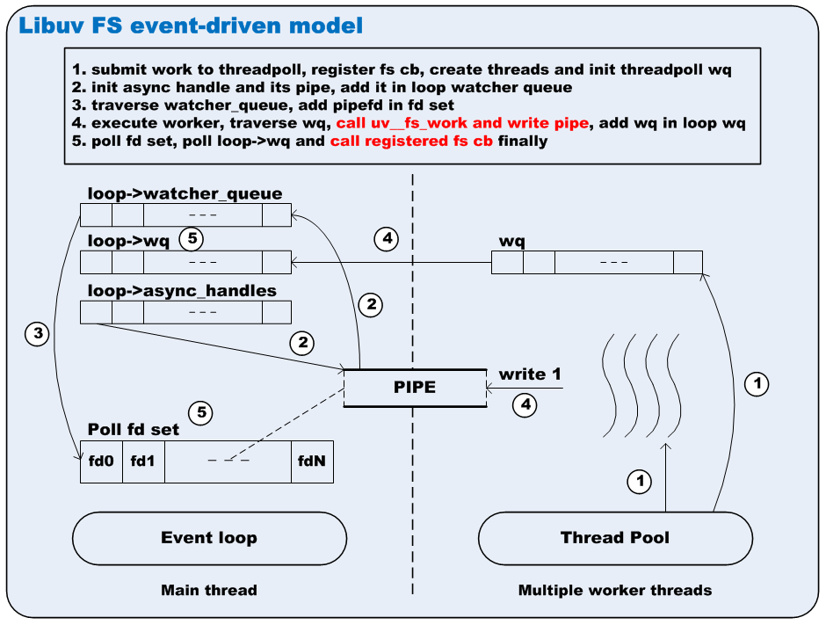
Libuv internals

Slide 16
Libuv internals
FS event-driven model (cont.)
Steps and source code trace
1. submit work to threadpoll, register fs cb, create threads and init threadpoll wq
uv_fs_XXX(CB) -> POST -> uv__work_submit(uv__fs_work, uv__fs_done)
2. init async handle and its pipe, add it in loop watcher queue
uv_loop_init -> uv_async_init -> uv__async_start
3. traverse watcher_queue, add pipefd in fd
setuv_run -> uv__io_poll -> uv__epoll_ctl
4. execute worker, traverse wq, call uv__fs_work, write pipe, add wq in loop wq
worker -> uv__fs_work -> uv__async_send
5. poll fd set, call registered fs cb finally
Uv__io_poll -> uv__async_io -> uv__async_event -> uv__work_done -> uv__fs_done -> fs cb

Slide 17
Questions
epoll is NIO or AIO ?
What is the relationship between epoll and libuv ?
What is the difference between libev and libuv ?

Slide 18
References
Libuv source code
https://github.com/libuv/libuv
uvbook (intro ebook, examples and ex-examples)
http://nikhilm.github.io/uvbook/An%20Introduction%20to%20libuv.pdf
https://github.com/nikhilm/uvbook
https://github.com/thlorenz/libuv-dox/
Libuv official API documentation
http://docs.libuv.org/en/v1.x/

Slide 19
Thank you !

