Slide 1
Modeling of Complex Biological Systems Class Project
Younginn Park

Slide 2
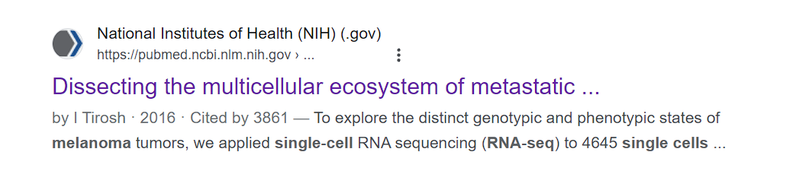
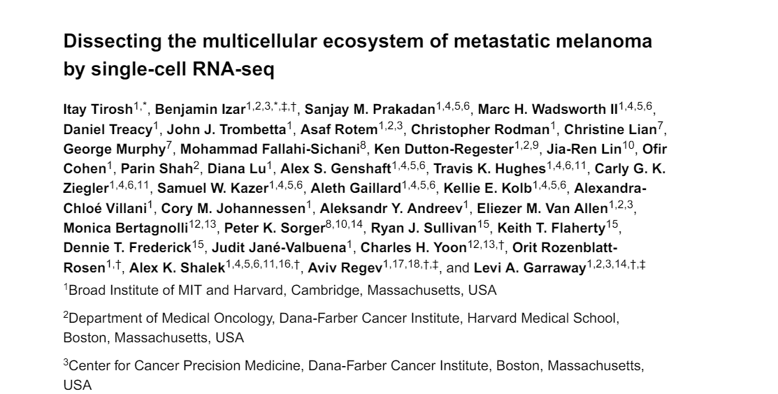

Slide 3
Study outline
To explore the distinct genotypic and phenotypic states of melanoma tumors we applied single-cell RNA-seq to 4,645 single cells isolated from 19 patients, profiling malignant, immune, stromal and endothelial cells.
Cell cycle analysis (whole exome sequencing, single-cell RNA-seq), spatial context (immunofluorescence staining, spatial analysis), and a drug resistance program (further cell culture experiments, drug sensitivity testing)

Slide 4
Data description
Input dataset (GSE72056) contains processed count matrix with metadata (patient/biopsy number, if-malignant, cell type)
SMART-Seq2 and Illumina NextSeq 500
Expression levels normalized using log-TPM and scaled

Slide 5
Goal 1 - dimensionality reduction
Replicate cluster analysis from the study - the original study used t-SNE implementation in Matlab with dim=15
Evaluate this approach - check if other dimensionality reduction methods might give better visualizations

Slide 6
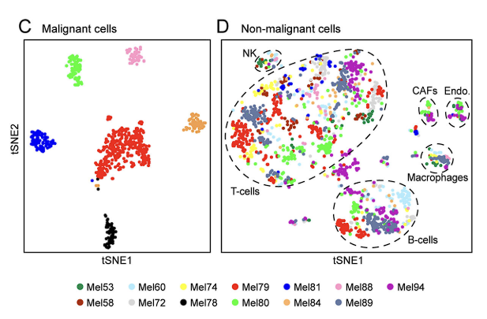
Goal 2 - cluster analysis
The original study was able to cluster different tumor cells in case of malignant cells using DBscan. Attempting to improve the method, experimenting with k-means and KNN.
Notes:
The original study had to subset the tumors to get the visualization - could it be done better?

Slide 7
Goal 3 - trajectory analysis
The original study conducted cell cycle analysis using marker gene annotations, identification of phase specific genes and classification for malignant cells in conjunction with PC analysis.
“Malignant cells within the same tumor displayed transcriptional heterogeneity associated with the cell cycle, spatial context, and a drug resistance program.”

Slide 8
Goal 3 - trajectory analysis
Conduct trajectory analysis for malignant cells (Monocle3) in order to understand the step-by-step changes in cell states over time (pseudotime) and compare with the results obtained in the cell cycle analysis original study.
Things to consider: no two tumors are the same (shown in cluster analysis of the original study), so possibly doing a trajectory analysis on each of the tumors separately might be a good idea.

