Slide 1
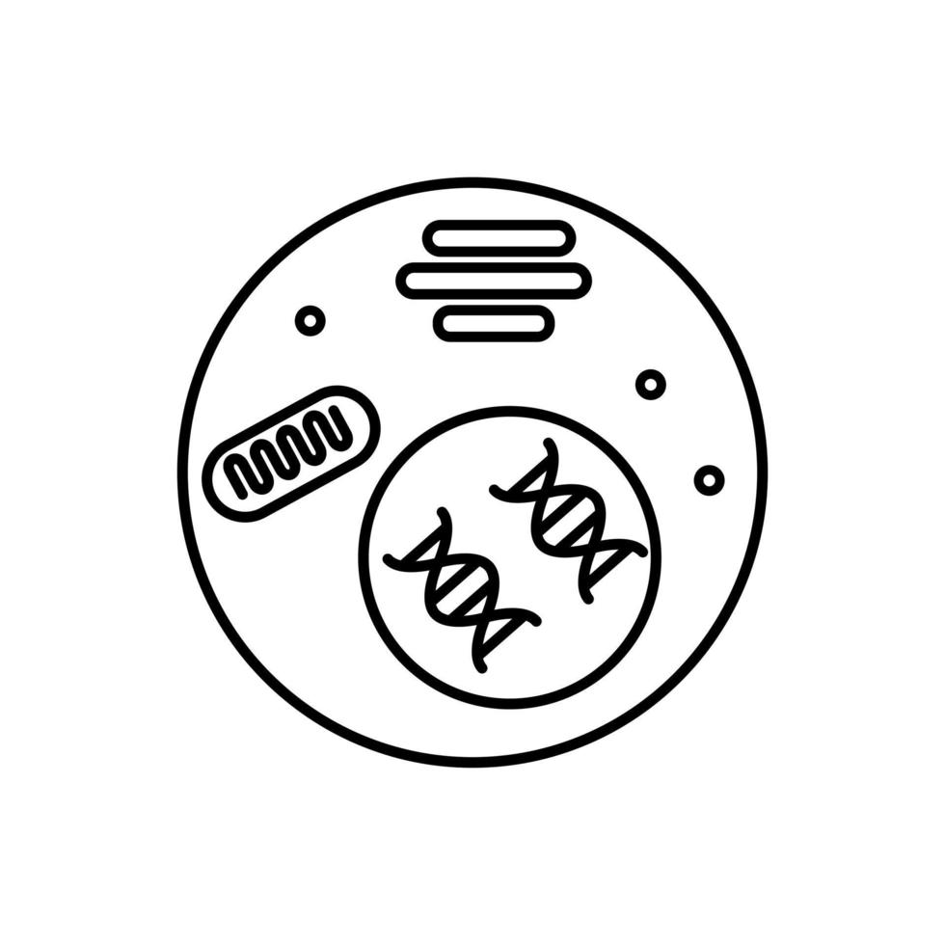
Evaluation and re-analysis of scRNA study on cellular subpopulations from melanoma
Younginn Park

Slide 2

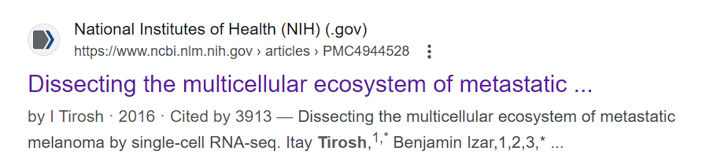

Original study
Dissecting the multicellular ecosystem of metastatic melanoma by single-cell RNA-seq, Tirosh et al 2016
Exploration of distinct genotypic and phenotypic states of melanoma
Profiling malignant, immune, stromal, and endothelial cells
Melanoma - skin cancer that starts in melanocytes
Notes:
Tumor cellular diversity poses both challenges and opportunities for cancer therapy. This is exemplified by the varied clinical efficacy achieved in malignant melanoma with targeted therapies and immunotherapies. Immune checkpoint inhibitors can produce clinical responses in many patients with metastatic melanomas (3–7); however, the genomic and molecular determinants of response to these agents remain incompletely understood.

Slide 3
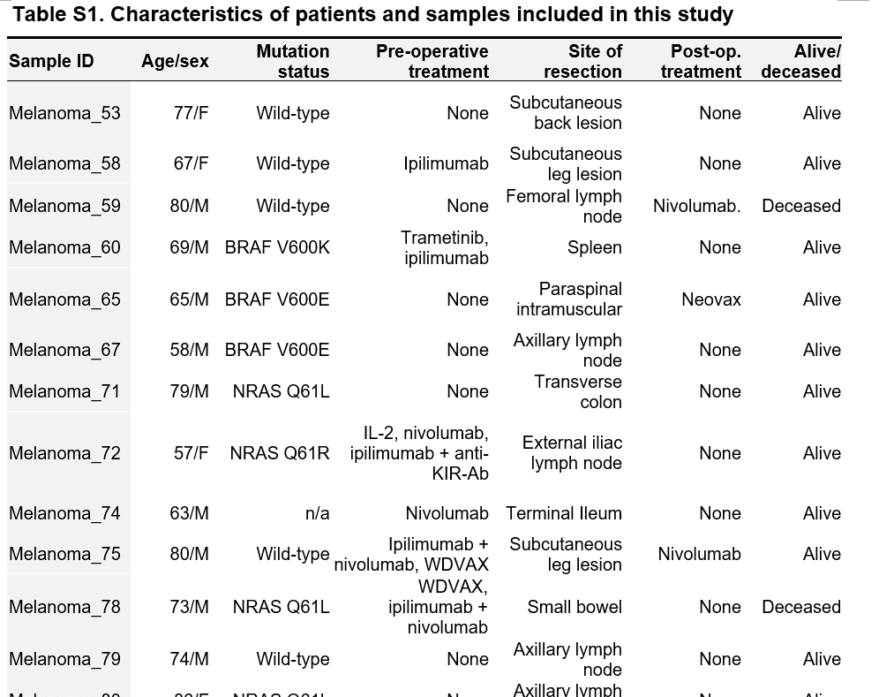
Original study design
In total 4645 malignant, immune, and stromal cells isolated from 19 freshly procured human melanoma tumors
10 metastases to lymphoid tissues, 8 to distant sites (e.g. intramuscular tissue and gastrointestinal tract), and one primary acral melanoma.
Notes:
We measured single-cell RNA-seq profiles from 4645 malignant, immune, and stromal cells isolated from 19 freshly procured human melanoma
tumors that span a range of clinical and therapeutic backgrounds (short description of the table)
Acral - concerning hands or feet (“extremities”)
Genotypic information was available for 17 of the 19 tumors, of which 4 had activating mutations in BRAF and 5 in NRAS oncogenes; eight patients had BRAF/NRAS wild-type melanomas

Slide 4
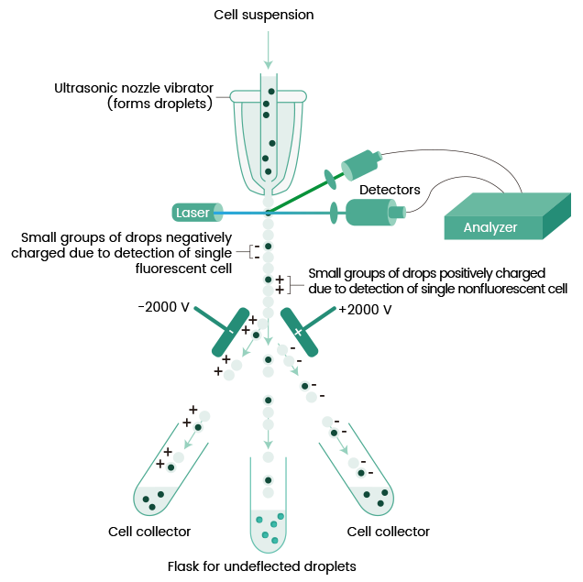
Single cell isolation method
Individual cells were isolated using FACS (Fluorescence-activated Cell Sorting, type of flow cytometry), this process included manual removal of doublets
SMART-Seq2 was used for amplification and Illumina NextSeq 500 for sequencing
https://www.sinobiological.com/category/fcm-facs-facs
Notes:
Though it was interesting to show, a bit different than methods like droplets or wells
Cells are labeled with fluorescent markers that bind to specific proteins or nucleic acids. The cell suspension is funneled into a flow cytometer, where cells pass through a laser beam one at a time.The fluorescence emitted by each cell is detected, and cells are sorted based on their fluorescence intensity. Sorted cells are directed into different collection tubes.

Slide 5
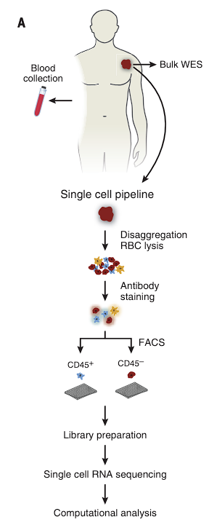
Diagram of the basic workflow

Slide 6
scRNA-seq data
The scRNA-seq data provided by the authors (GSE72056) was already processed in many ways - basic normalization (TPM), cells were filtered by the number of detected genes (min. 1,700)
Expression matrix = 4,645 cells x 23,686 features
3,256 non-malignant cells, 1,257 malignant cells
No information about technical variables
Metadata - tumor ID, if malignant, type of immune cell

Slide 7
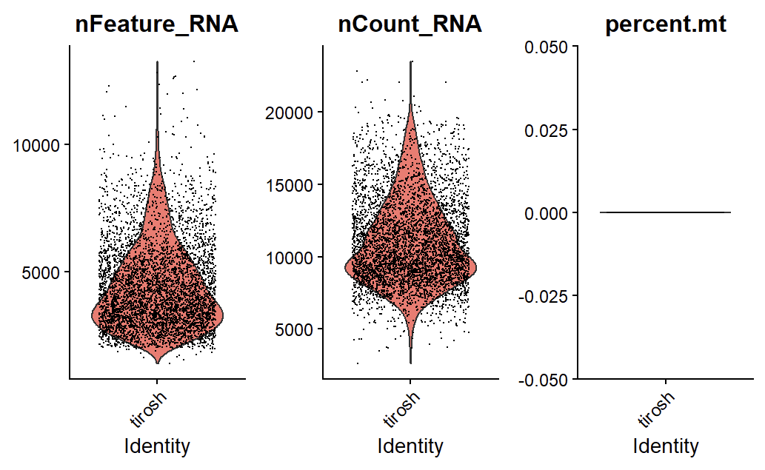
Notes:
Distribution of n_features, n_counts and percent.mt (since the method used was different than the one used during classes, I wasn’t sure if I used a proper way to count mitochondrial genes, but it also was the only method I could find)

Slide 8
Methods - cluster analysis
t-SNE (dim=15, Matlab implementation), marker identification and visualization, clustering using DBscan
“Since the complexity of tSNE visualization increases with the number of tumors we restricted the analysis to the 13 tumors with at least 100 cells, and for the malignant cell analysis we further restricted the analysis to 6 tumors with >50 malignant cells.”

Slide 9
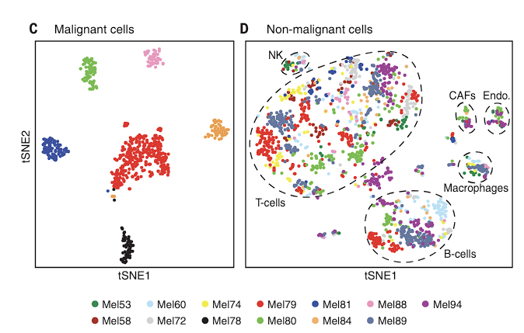
Results - cluster analysis
“To define cell types from the non-malignant tSNE analysis we used a density clustering method, DBscan. This process revealed six clusters for which the top preferentially expressed genes included multiple known markers of particular cell types.”
Results of t-SNE run on malignant cells (left) and non-malignant cells (right
Notes:
In this way, we identified T cell, B-cell, macrophage, endothelial, CAF (cancer-associated fibroblast) and NK cell clusters

Slide 10
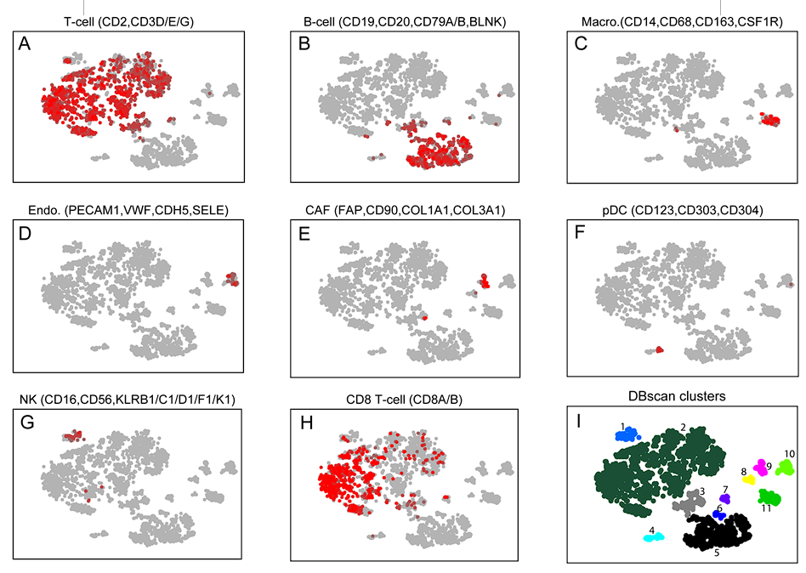
Results

Slide 11
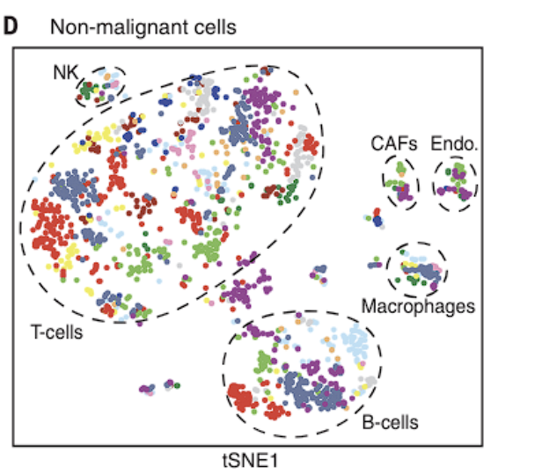
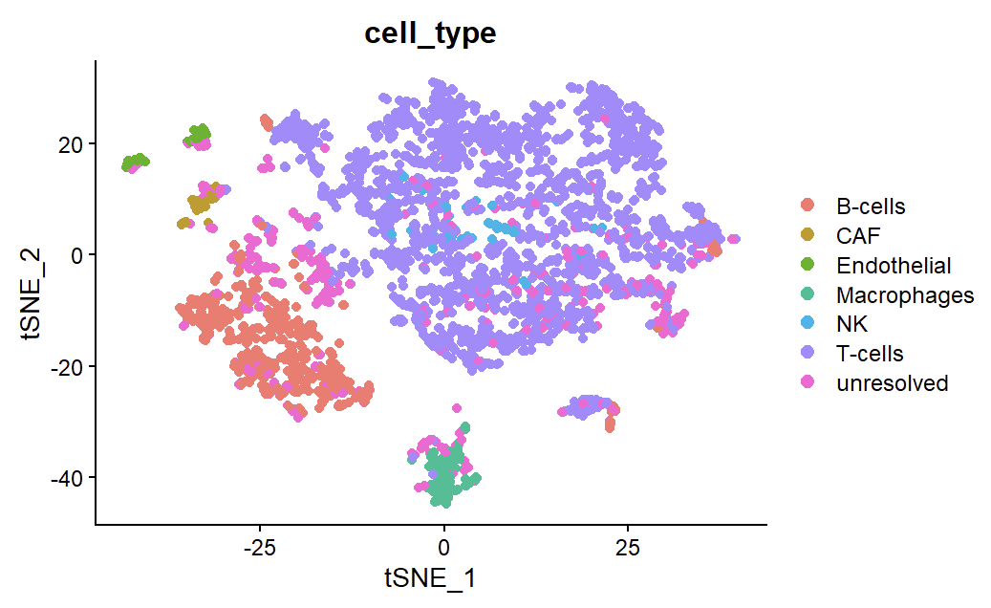

Reconstruction - non-malignant cells
Notes:
Problem with NK cells merging in with T-cells

Slide 12
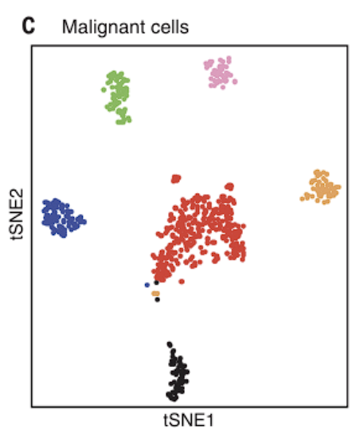
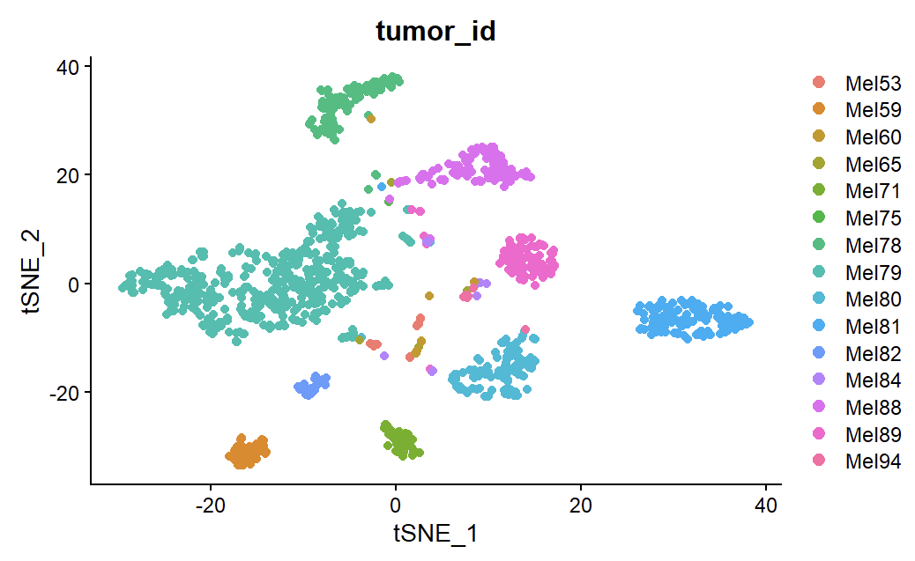
Reconstruction - malignant cells

Slide 13
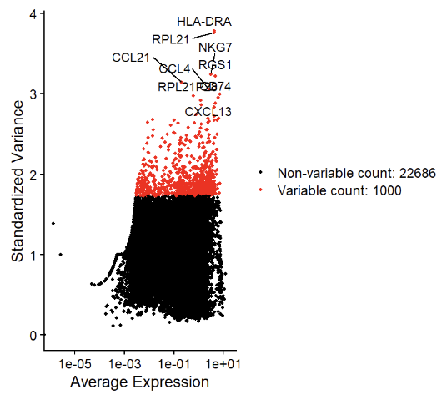
Improvement - basic feature selection
Most variable 1,000 features (vst method) analysis in Seurat

Slide 14
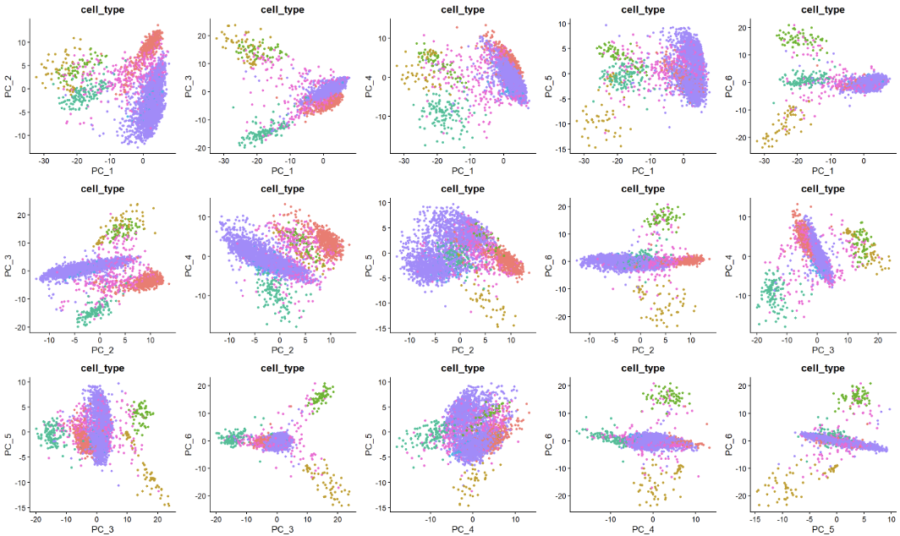
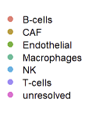
PCA after VariableFeatures
Notes:
Basic linear dimension reduction before fancy non-linear ones. No combination of 2 PCs gave clean cell type clusters

Slide 15
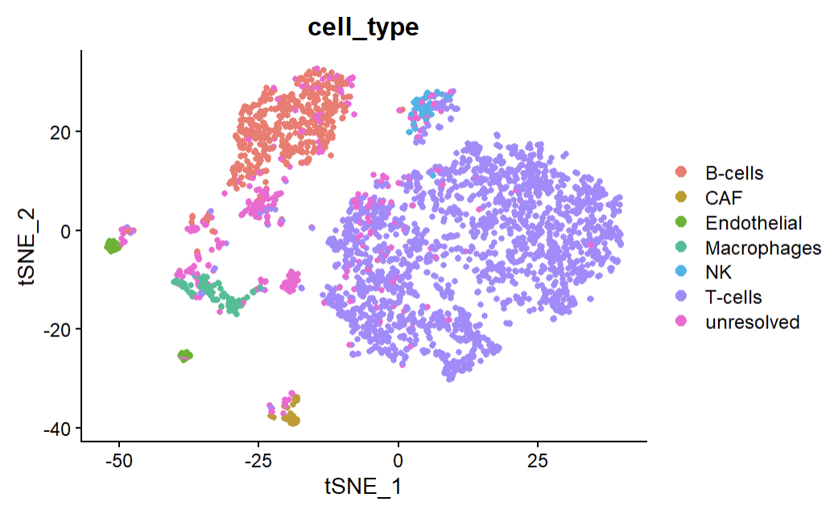
t-SNE after VariableFeatures

Slide 16
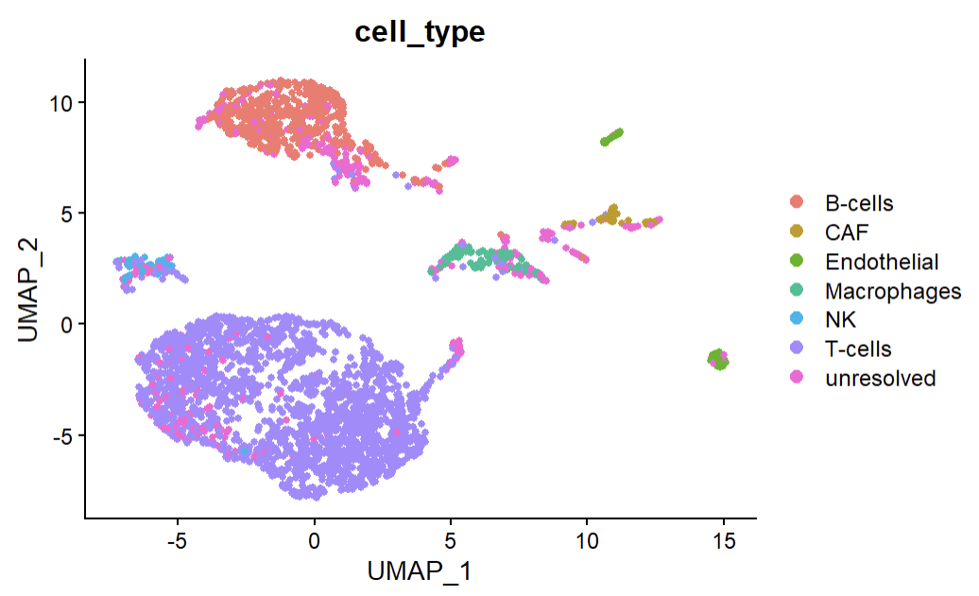
UMAP after VariableFeatures
Different n_neighbors were tested (=10 gave visually the best results)

Slide 17
Discussion - cluster analysis
Improvement from the original study - all tumor sample data was preserved, complete view of inter-tumor differences
Jackstraw feature selection might be worth considering for better feature selection

Slide 18
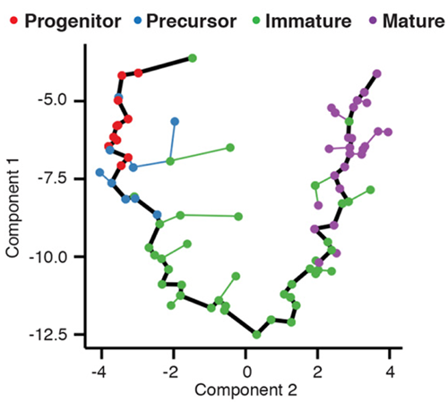
Trajectory analysis
Cells in a sample can display differing states even if they come from the same population undergoing the same process.
Time-related (temporal) processes have inherently described cell “trajectories” in them
Problem definition: order the cells in a sample in pseudo-time (units of stages in a process) using clustering and graph methods
Trajectory of olfactory neuron development in mice,
https://cole-trapnell-lab.github.io/projects/sc-trajectories/

Slide 19
Original study
“[...] all tumors harbored malignant cells from two distinct transcriptional cell states, such that tumors characterized by high levels of the MITF transcription factor also contained cells with low MITF and elevated levels of the AXL kinase”

Slide 20
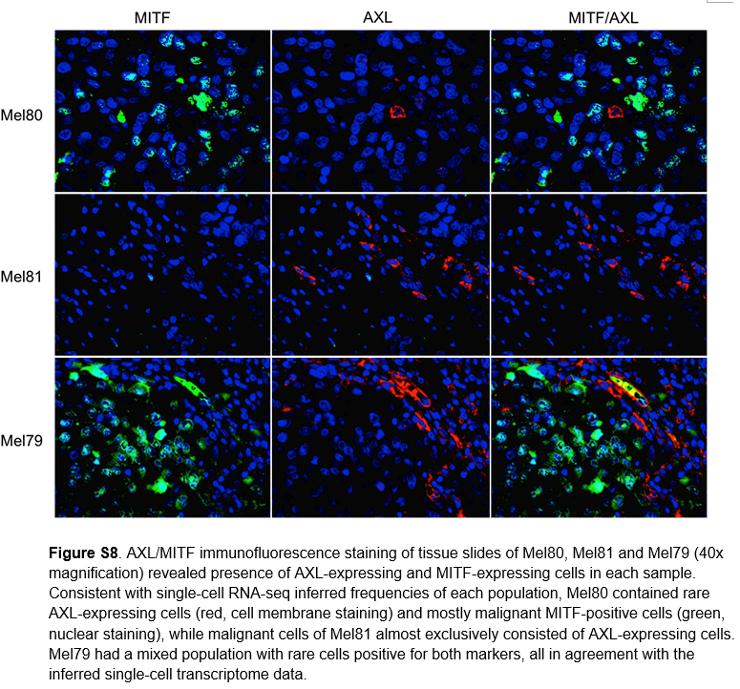
Immunohistochemistry analysis

Slide 21
Biological context - melanoma profiles
Two transcription profiles that were being focused on for malignant cells - MITF and AXL - both have great influence on prognosis, treatment response; both oncogenes
MITF - regulator in melanoma, crucial for the development, differentiation, and survival of melanocytes
AXL - invasive and metastatic behavior of melanoma, attractive target for cancer therapies
Inverse correlation - High MITF levels are typically associated with low AXL expression (high proliferation, low metastasis cancer phenotype) and vice versa

Slide 22
PCA and correlation study
“PC2-6, which were associated with the cell cycle (PC2 and 6), regional heterogeneity (PC3) and MITF expression program (PC4 and 5).”
“The top 100 MITF-correlated genes across the entire set of malignant cells were defined as the MITF program, and their average relative expression as the MITF-program cell score. The average expression of the top 100 genes that negatively correlate with the MITF program scores were defined as the AXL program and used to define AXL program cell score.”

Slide 23
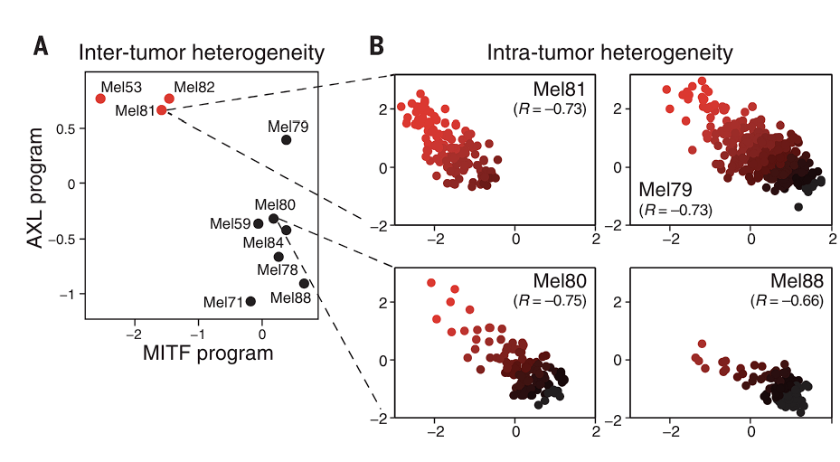
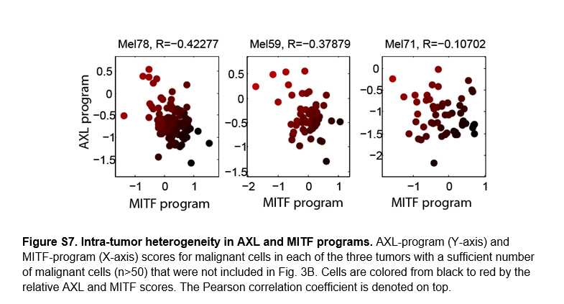
Inter- and intra-tumor heterogeneity
Notes:
Limitations
Heterogeneity was identified, but analysis and visualization was limited to the context of MITF and AXL programs - easier to analyze, but doesn’t provide a complete picture of the sample
Methods were primarily based on PC analysis, clustering and correlation analysis with known marker genes (TCGA data as reference) - can I do it “better” with trajectory analysis? Can trajectory analysis give a clearer visualization?

Slide 24
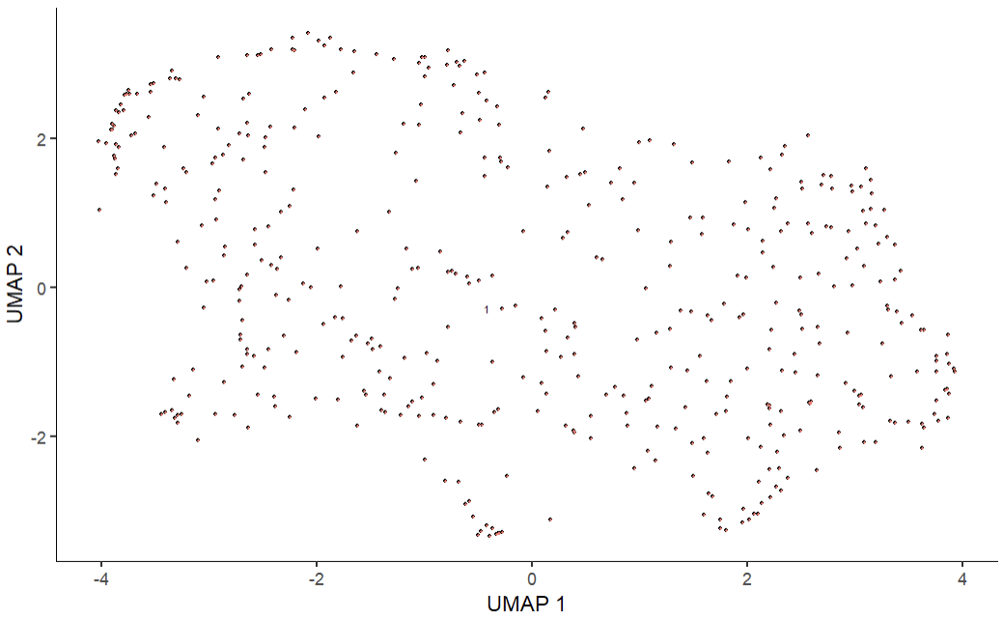
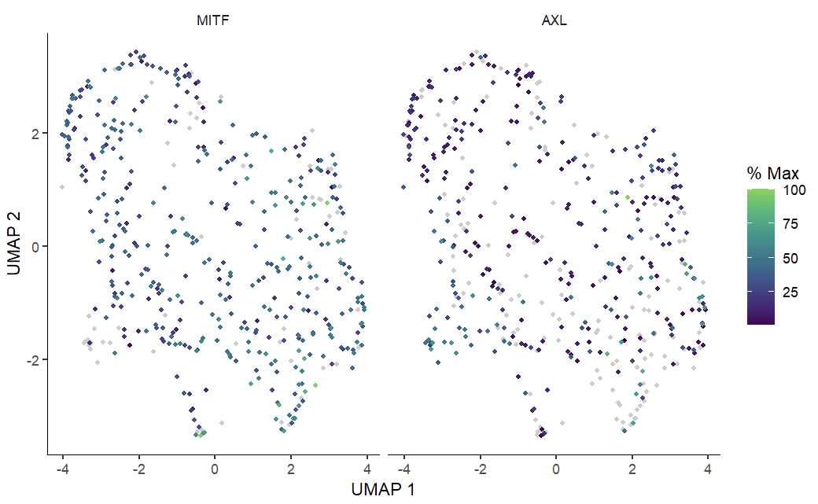
Analysis on Mel79
UMAP in Monocle3
First challenge - no clear intra-cellular clusters/heterogeneity
Notes:
Reconstruction of intracellular heterogeneity using AXL and MITF based feature selection and scatterplotting (like in the study)
like in the original study - (it has the most cells)

Slide 25
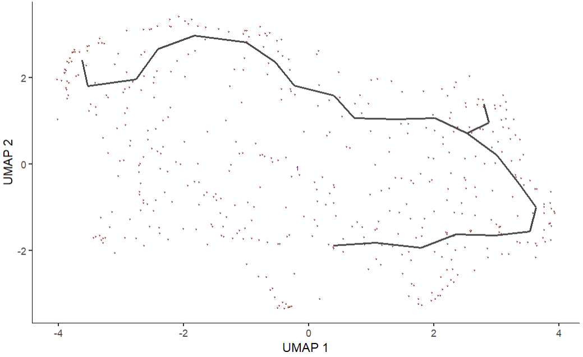
Learning the graph

Slide 26
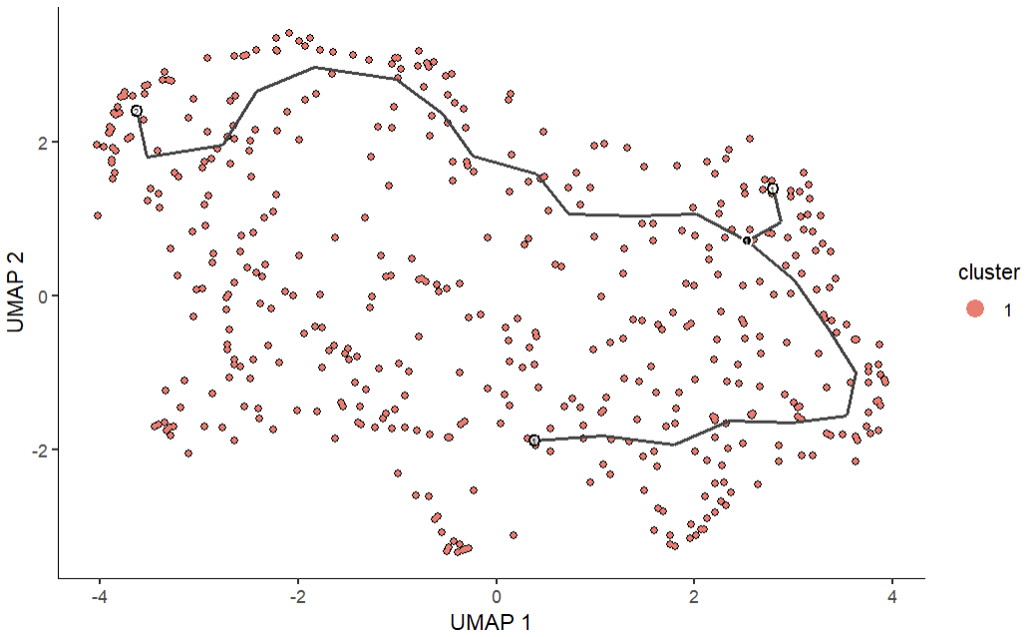
Learning the trajectory

Slide 27
Discussion - trajectory analysis
The user has to input the beginning node in the learned path manually - for now I was mostly going in to this analysis blindly
Might be worth considering different dimension reduction methods
Consider feature selection - like the one used in the previous section

Slide 28
Possible further enhancement
The data/cell count wasn’t too great for a single tumor sample (Mel79 - 468 malignant cells, which is roughly a third of all malignant cells in the dataset)
The original study also analyzed cytotoxic and exhaustion programs in T-cells (Mel75) - can also be treated as a trajectory problem in an analogous way, although the are more cell-to-cell interaction aspect that have to be taken into consideration

Slide 29
References
Tirosh I, Izar B, Prakadan SM, Wadsworth MH 2nd, Treacy D, Trombetta JJ, Rotem A, Rodman C, Lian C, Murphy G, Fallahi-Sichani M, Dutton-Regester K, Lin JR, Cohen O, Shah P, Lu D, Genshaft AS, Hughes TK, Ziegler CG, Kazer SW, Gaillard A, Kolb KE, Villani AC, Johannessen CM, Andreev AY, Van Allen EM, Bertagnolli M, Sorger PK, Sullivan RJ, Flaherty KT, Frederick DT, Jané-Valbuena J, Yoon CH, Rozenblatt-Rosen O, Shalek AK, Regev A, Garraway LA. Dissecting the multicellular ecosystem of metastatic melanoma by single-cell RNA-seq. Science. 2016 Apr 8;352(6282):189-96. doi: 10.1126/science.aad0501. PMID: 27124452; PMCID: PMC4944528.

