Slide 1

Librarian Helper
DdokDdokHaZo
1115125 차지은
1215141 김자영

Slide 2

Introduction
Contents
Introduction
Previous works
System overview & architecture
Implementation
Conclusion & Future work
References
Librarian Helper
Librarian Helper

Slide 3

Introduction
Motivation
When our team visited the library
to get some books for our project,
we saw an librarian who was troubled
by arranging books.
Just at that moment,
we made a resolve to help the librarian!
Librarian Helper
Librarian Helper

Slide 4
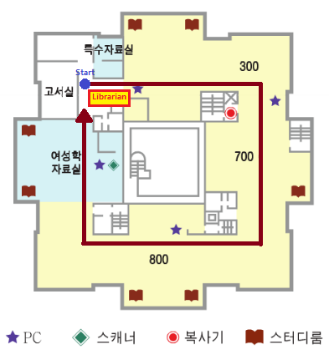


Introduction
Introduction
This is the program helping librarian
organize the books.
Using this program, SmartCAR will
carry books to where librarian want
they to be.
Librarian Helper
Librarian Helper

Slide 5
Introduction
Preview
1) You have to start at start position
(Put SmartCAR at the start point)
<library map>
Librarian Helper
Librarian Helper

Slide 6
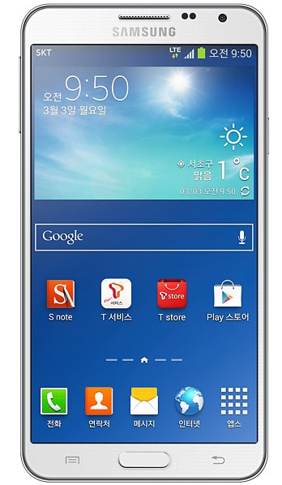
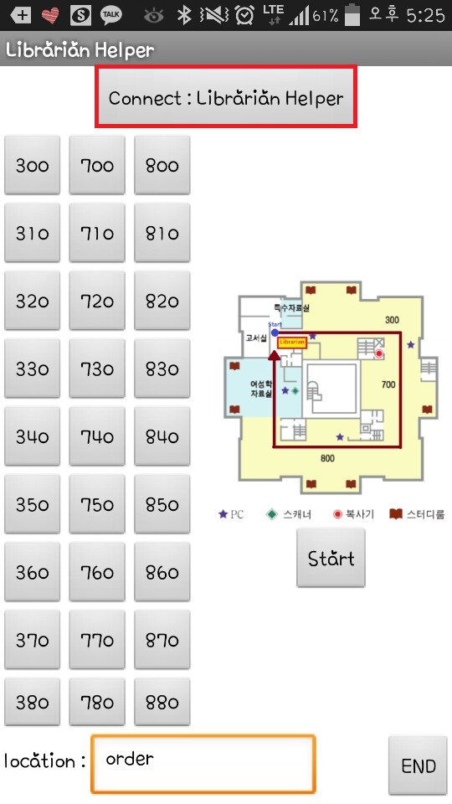
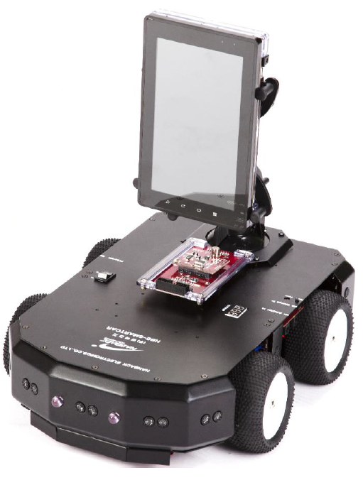

Introduction
Preview
2) Connect SmartCAR and android device
by using Bluetooth
Librarian Helper
Librarian Helper

Slide 7
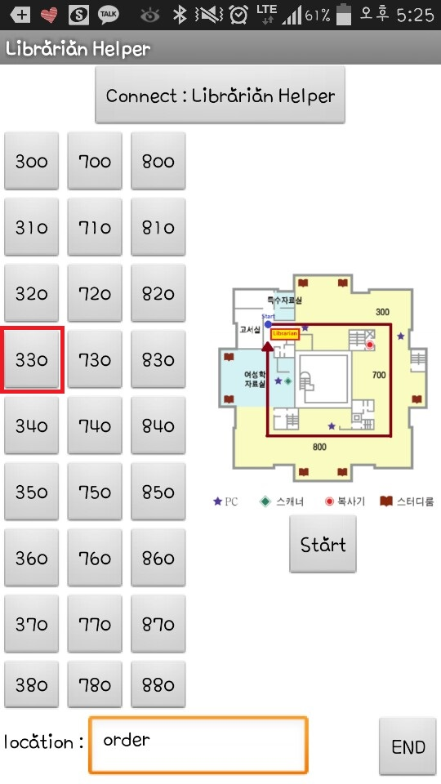
Introduction
Preview
3) Put your order by click the button
(The position that you want to go)
4) Then, the SmartCAR moves to the point
(in the direction which has less sections)
Librarian Helper
Librarian Helper

Slide 8
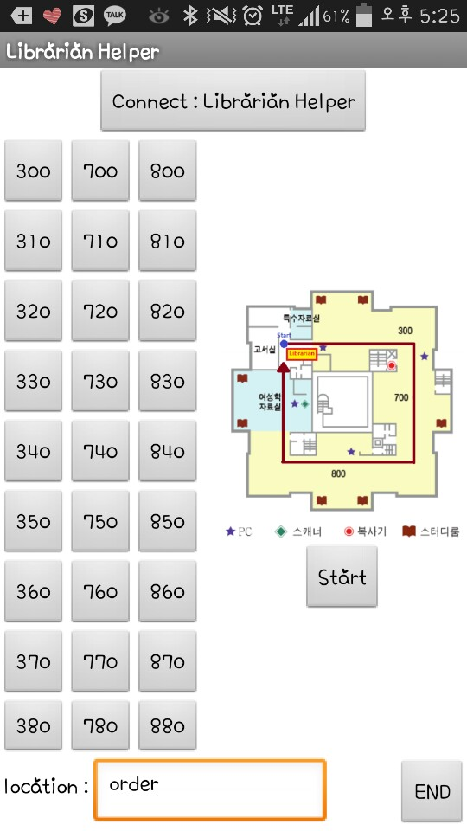
Introduction
Preview
5) Put other order
(The position that you want to go)
6) Then, the SmartCAR moves to the point
(in the direction which has less sections)
Librarian Helper
Librarian Helper

Slide 9
Introduction
Preview
7) If you put an order with back position
8) the SmartCAR turns and moves to the point
(in the direction which has less sections)
Librarian Helper
Librarian Helper

Slide 10
Introduction
Preview
9) If you click the ‘Start’ button
10) the SmartCAR moves to the start point
(in the direction which has less sections)
Librarian Helper
Librarian Helper

Slide 11
Introduction
Preview
11) If you click the ‘END’ button
12) the SmartCAR moves to the start point
(in the direction which has less sections),
Disconnect the Bluetooth connection
and then, program is terminated
Librarian Helper
Librarian Helper

Slide 12
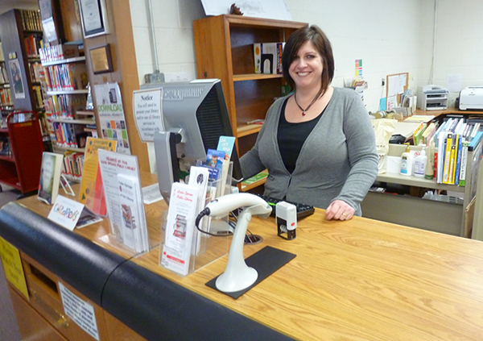
Introduction
Main contribution
Makes librarian happy!!
Lighten librarian’s toil
Improve efficiency
Librarian Helper
Librarian Helper
Notes:
이 프로그램의 적용 전에는 무거운 책들을 정리하려면 나눠서 여러 번 왔다 갔다 해야 했지만
SmartCAR를 적용함으로써 한번에 모든 책을 정리할 수 있어 일을 더 효율적으로 할 수 있다.

Slide 13
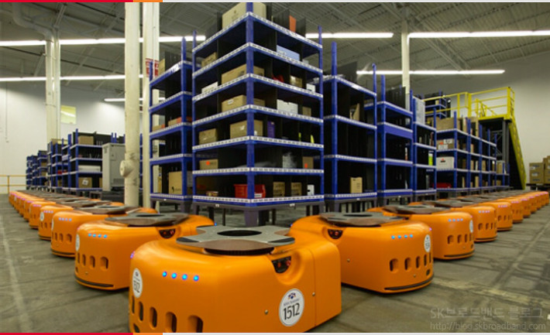
Previous Work
Previous works
Kiva
Use at Amazon’s logistics center
Kiva recognizes commands transmitted wirelessly and delivers goods to employee
Kiva recognizes goods by barcode
Librarian Helper
Notes:
키바는 세계 최대의 인터넷 서점이자 종합 쇼핑몰인 아마존에서 이용하는 로봇으로 실제로 물류 센터에 약 1만 5000대의 키바 로봇을 배치하여 적극적으로 이용하고 있습니다. 언뜻 보면 로봇청소기의 모습을 한 키바의 주 업무는 물품 창고 안에서 무선으로 전송된 명령을 인식하여 명령에 맞는 적절한 물품들을 실어물품 분류하는 직원들에게 물품을 전달해주는 역할을 합니다. 쉽게 예를 들어 보겠습니다. 물품 분류 직원이 책과 같이 창고에서 원하는 물품이 있을 경우 키바 에게 무선으로 명령을 내립니다. 키바는 창고바닥에 있는 스티커의 바코드를 스캔 하여 이동하고 그 책(물품)들이 담긴 선반을 직접 싣고 직원들에게 전달해줍니다. 직원들은 이로 인해 물건을 찾는 시간이 줄어들게 되며 무거운 물건 또한 로봇이 대신 싣기 때문에 체력적인 소모를 방지할 수 있게 됩니다. 무려 340kg 정도까지물건을 들 수 있는 이 로봇은 직원들의 업무보조역할로 4~5명의 몫을 충분히 할 수 있다고 전해지며 앞으로 최대 9,900억원대에 달하는 아마존의 인건비를 절감할 전망이라고 합니다.

Slide 14
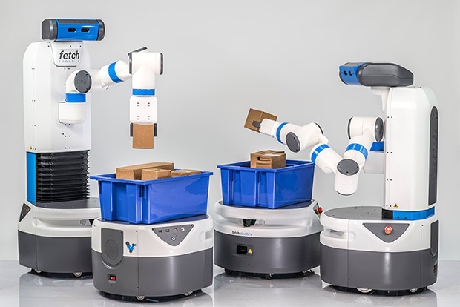
Previous Work
Previous works
Fetch & Freight
Made by ‘Fetch Robotics’
‘Fetch’ picks things up and puts it on the ‘Freight’
‘Freight’ carries things
Librarian Helper
Notes:
페치 로보틱스(Fetch Robotics)가 선보인 페치 앤 프레이트(Fetch & Freight)도 포장된 상품을 운박하는데 최적화된 형태를 가진 로봇인데요. 한 개의 긴 팔을 이용해 물건을 집고 옮기는 페치(Fetch)와 머리 위에 바구니를 이고 다니며 페치가 담아주는 물건을 잘 받아 옮겨주는 프레이트(Freight)가 한 조가 되어 움직이는 식인데요. 주어진 업무를 스스로 수행하고 충전까지 스스로 움직이고 팔로 6kg의 짐을 들어 싣고 원하는 곳으로 옮길 수 있다니, 여러모로 유용할 것 같은데요

Slide 15
Previous Work
Similarity & Difference
 | Librarian Helper | Fetch & Freight | Kiva
Similarity | - They help people to carry things - They move with wheels - They have start point
Difference | - Command with mobile device - Follow the line - One librarian commands - One robot car | - Customer gives an order then they work - Figure out land feature by using 2D laser scanner - Customer orders goods then Fetch and Freight bring goods - Two robots work together (Fetch grabs and puts things on Freight's basket) | - Command with mobile device - Scan sticker barcode - One employee commands one Kiva - One robot car
 |  | Can recognize objects
Librarian Helper

Slide 16




System overview & Architecture
System overview
User gives commands to SmartCAR by android device using Bluetooth.
SmartCAR calculates distance and moves in closer direction.
SmartCAR moves by sensing the lines on library’s floor using infrared sensor.
Librarian Helper
Librarian Helper
Notes:
우리는 인프라레드 센서가 필요하고 폰에서 명령을 주면 거리값을 계산해서 더 가까운 방향을 찾아 받은 위치로 이동한다

Slide 17
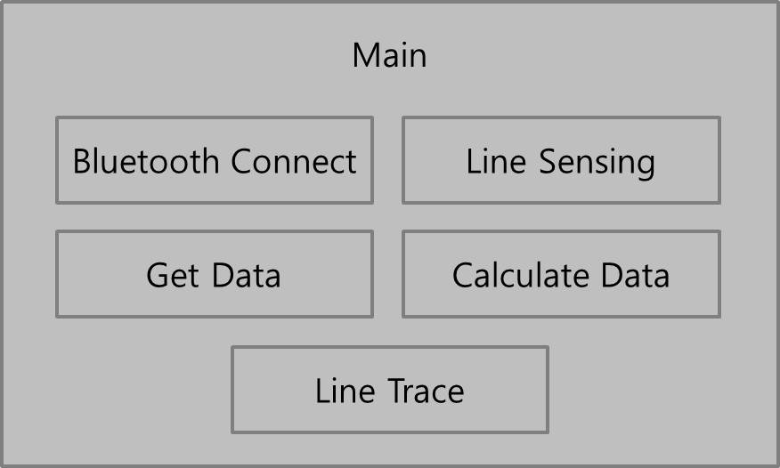
System overview & Architecture
Block diagram
Librarian Helper
Librarian Helper

Slide 18
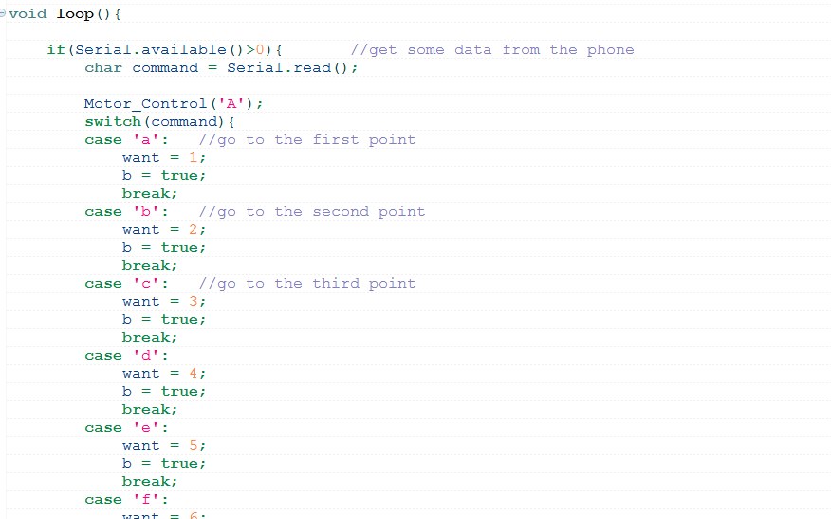
System overview & Architecture
Core functionality
1) Get data from android device
Librarian Helper
Librarian Helper

Slide 19
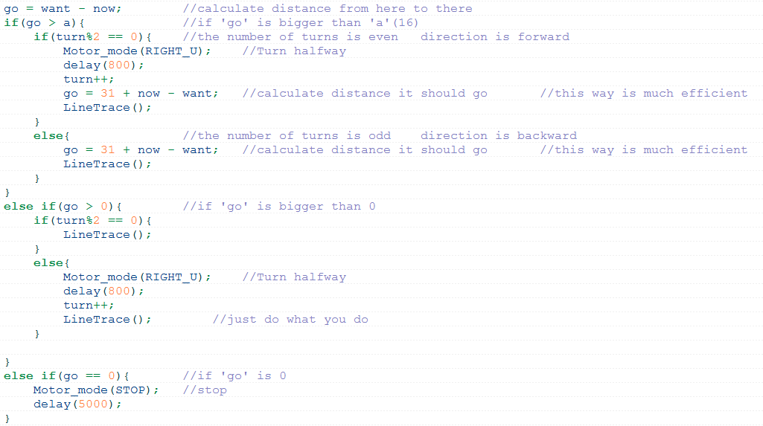
System overview & Architecture
Core functionality
2) Calculating the distance and direction and Moving to the spot
Librarian Helper
Librarian Helper

Slide 20
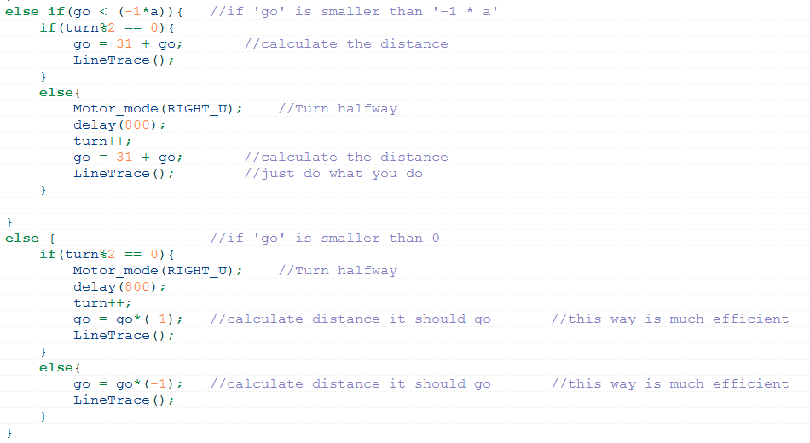
System overview & Architecture
Core functionality
2) Calculating the distance and direction and Moving to the spot
Librarian Helper
Librarian Helper

Slide 21
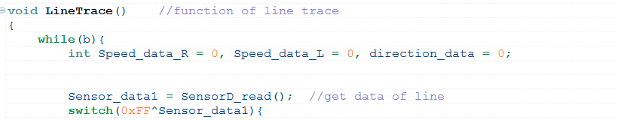
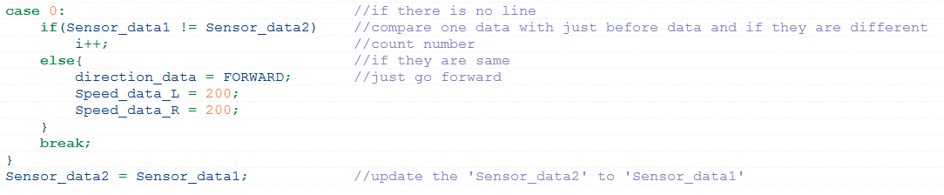
System overview & Architecture
Core functionality
2) Calculating the distance and direction and Moving to the spot
(During line tracing)
Librarian Helper
Librarian Helper
Notes:
선 없는 지점 spot으로 인식하는 거 말하기

Slide 22
Implementation
Development environment
Hardware - PC (Windows7) - SmartCAR (한백전자) - Android device (Samsung Galaxy note3)
Software - AndroX Studio - MIT App Inventor 2 Beta
Librarian Helper
Librarian Helper

Slide 23
Implementation
Evaluation scenario
Scenario | Verification
When user click a button, SmartCAR moves to the point | O
Moving in closer direction by calculating distance (click the button ‘890’ in start position) | O
When user want prior position, SmartCAR turns and go to the position | O
When user click the start button, SmartCAR moves to the start position | O
When user click the start button, the android application is terminated and the SmartCAR moves to the start position | O
Librarian Helper
Librarian Helper

Slide 24
Conclusion & Future work
Summary
Librarian Helper
Librarian Helper

Slide 25
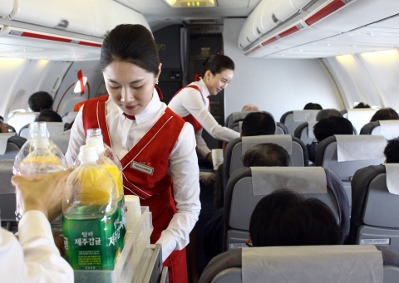
Conclusion & Future work
Implication
Library guidance services
In-flight service
Librarian Helper
Librarian Helper

Slide 26
Conclusion & Future work
Limitation
Only the place covered with lines can be visited
Can’t avoid obstacles
Fixed start position
Can’t use stairs
Librarian Helper
Librarian Helper

Slide 27
Conclusion & Future work
Future work
Put the function avoiding obstacles
Extend the map
Librarian Helper
Librarian Helper

Slide 28
References
References
이화여자대학교 도서관 웹 브로셔 : http://lib2.ewha.ac.kr/web_bro/ko/ebook.htm
Kiva : http://blog.skbroadband.com/1553
Fetch & Freight : http://www.neoearly.net/2467800 : http://phys.org/news/2015-04-warehouse-robots-freight-aim-ease.html
Librarian Helper
Librarian Helper

Slide 29
Thank You
Librarian Helper

Slide 30
Q&A
(Plz in Korean☺)
Librarian Helper

