Slide 1
Simulation of
spike induced field in turtle's cortex
Wenbin Yang
Bachelor Thesis Project

Slide 2
Experiment background

Slide 4
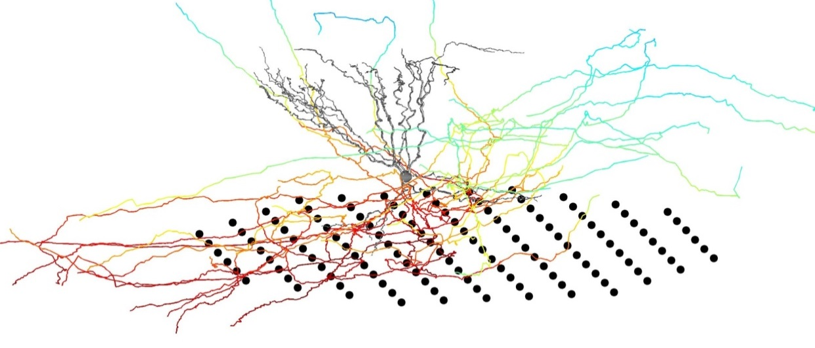
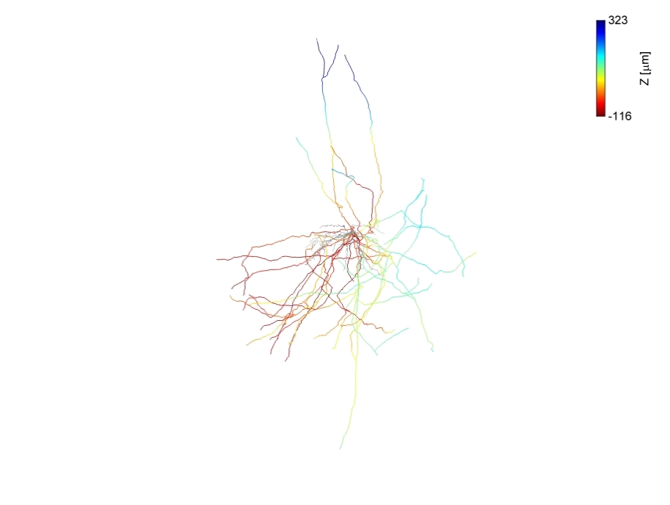
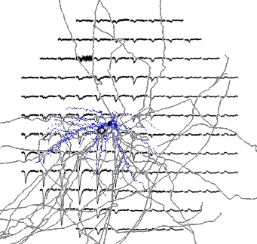
Correspondence between neuronal morphology and LFP
Pictures from Mark

Slide 5
Simulation

Slide 6
Simulation goals
Reproduce experiment results
If succeed, which means we can use the mechanism underlying the simulation to explain the formation of LFP pattern
Predicting power
Try to implement the active membrane mechanism, to include some high filtering effect;
Inverse problem, try different morphologies to get different LFP pattern; inversely use LFP pattern to determine neuronal morphology.

Slide 7
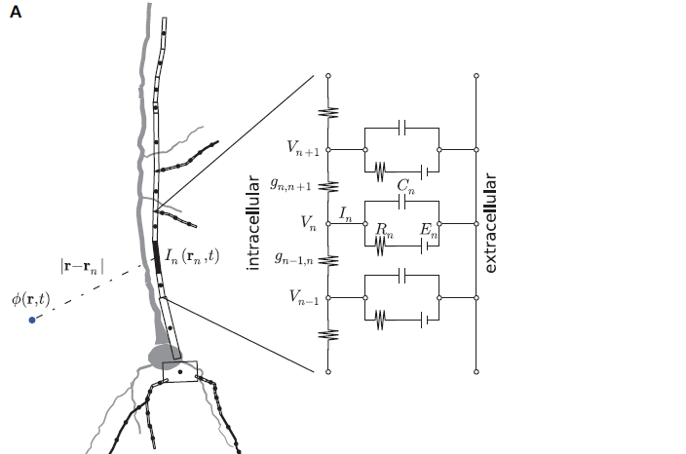
Compartmental Modeling
How to make a biological neuron digital?
Adapted from Linden et al. 2006

Slide 8
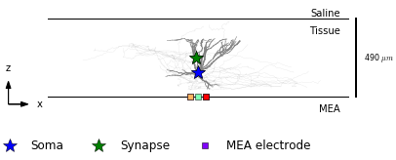
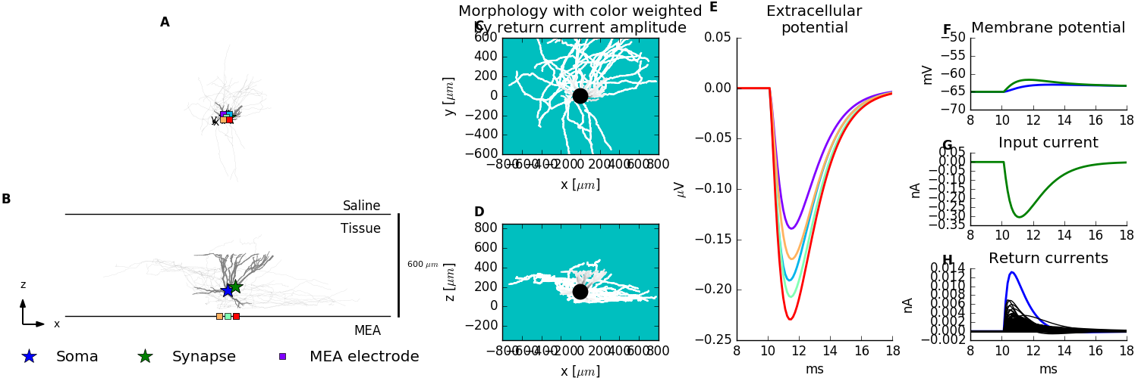
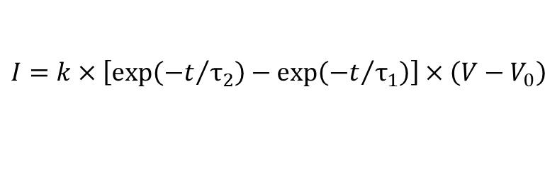
Return Current
z
Synaptic
input
$$I=k×\left[exp\left({−t}/{τ_{2}}\right)−exp\left({−t}/{τ_{1}}\right)\right]×\left(V−V_{0}\right)$$
k: the weight factor
τ₁,τ₂: the time constant
V: the membrane potential
V₀: rest membrane potential
Return
current
MEA

Slide 9
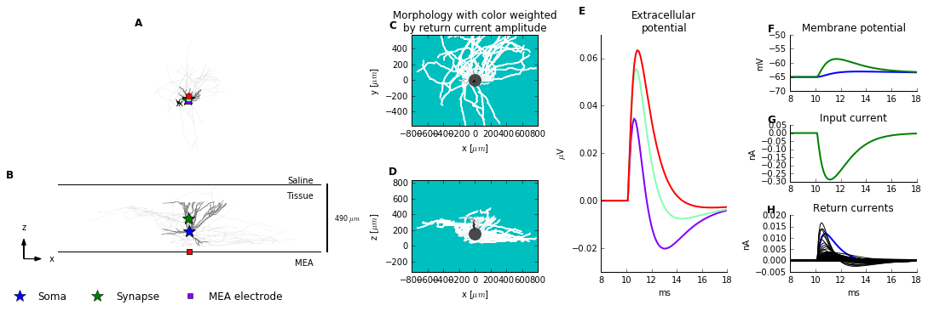
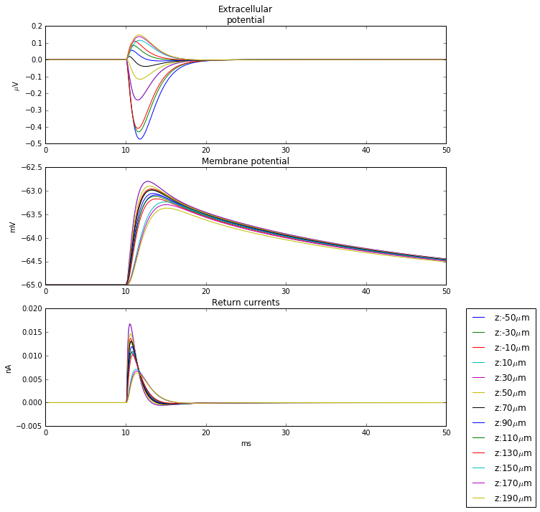
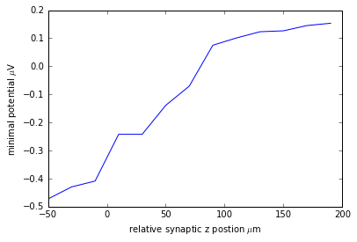
Extracellular potential versus z-position of synaptic input
Set soma position as (0,0,0)
Set a single electrode at (0,0,-150)
Insert synaptic input from
z=-50 to z=190 μm
(20μm a trial)
high z
low z
time/ms
Extrema Potential (μV)
Extracellular Potential (μV)

Slide 10
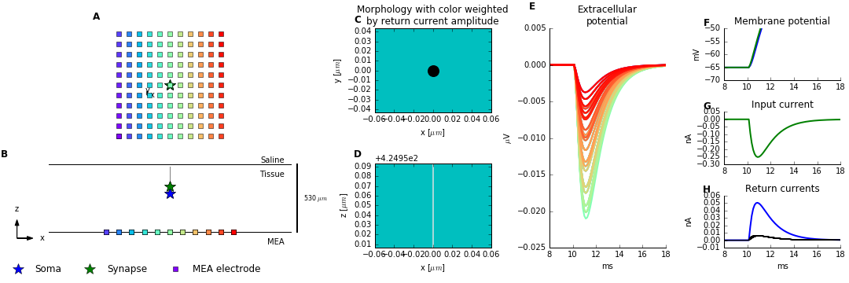
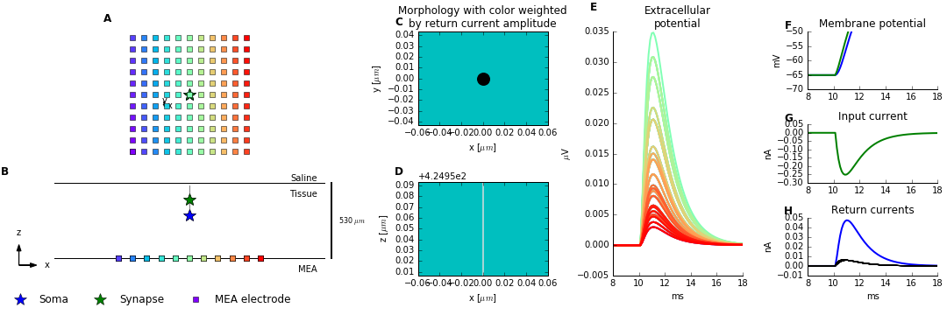
Soma doesn't contribute so much as we thought before
Cut unrelated part
Soma: 300, syn: 60
Soma: 300, syn: 110

Slide 11
The simulation idea
Make a kernel of potential field around soma of specific neuron.
Then use interpolation method to superimposed all influence of all synapses.

Slide 12
Radically average the LFP
State it in a different way
Average over φ for each r position.
Synaptic
input
Return
current
MEA

Slide 13
Average over z-zone
z=140 um
Synaptic
input
z=130 um
Return
current
MEA

Slide 14

Get kernel function
$$V\left(z,r\right)$$
z
Synaptic
input
Return
current
r
MEA
r is the distance between the projected point of synapse and the site on the MEA.
Different z positions for MEA

Slide 15
make the kernel (basic idea and illustration)
L2 pyramidal kernel
L1 inhibitory kernel
L3 inhibitory kernel (with morphology image)

Slide 16
LFP pattern changes with different height of the L2
We are trying to investigate how the height of L2 changes the LFP pattern. Especially for those inversion points.

Slide 17
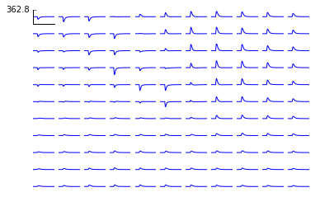
LFP pattern changes with different height of the L2
L2 cell layer to MEA is 10 um
Best fit, and inversion points

Slide 18
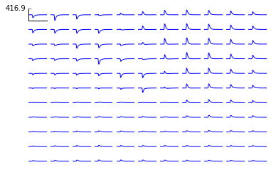
LFP pattern changes with different height of the L2 layer
L2 cell layer to MEA is 20 um

Slide 19
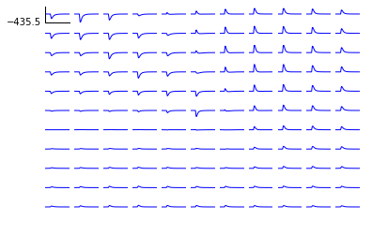
LFP pattern changes with different height of the L2 layer
L2 cell layer to MEA is 30 um

Slide 20
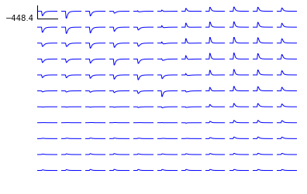
LFP pattern changes with different height of the L2 layer
L2 cell layer to MEA is 40 um

Slide 21
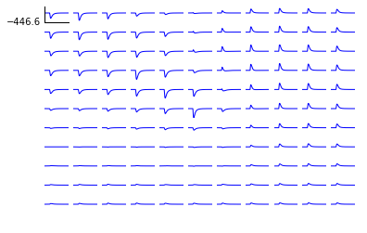
LFP pattern changes with different height of the L2 layer
L2 cell layer to MEA is 50 um

Slide 22
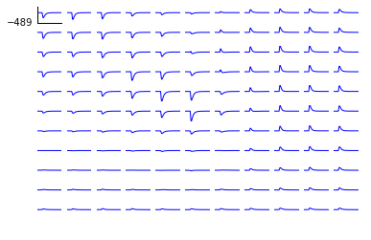
LFP pattern changes with different height of the L2 layer
L2 cell layer to MEA is 60 um

Slide 23
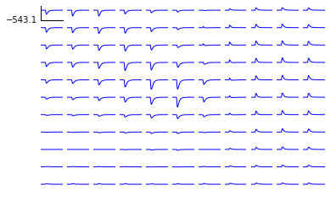
LFP pattern changes with different height of the L2 layer
L2 cell layer to MEA is 70 um

Slide 24
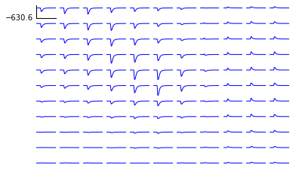
LFP pattern changes with different height of the L2 layer
L2 cell layer to MEA is 80 um

Slide 25
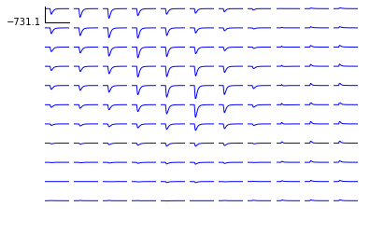
LFP pattern changes with different height of the L2 layer
L2 cell layer to MEA is 90 um

Slide 26
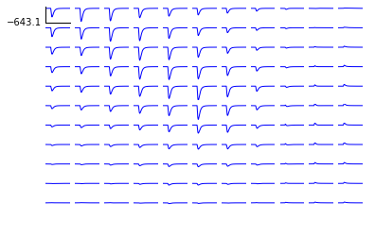
LFP pattern changes with different height of the L2 layer
L2 cell layer to MEA is 100 um

Slide 27
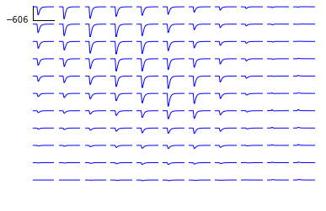
LFP pattern changes with different height of the L2 layer
L2 cell layer to MEA is 110 um

Slide 28
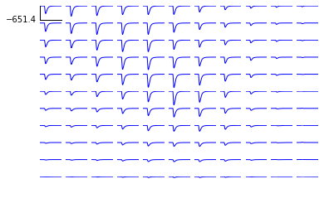
LFP pattern changes with different height of the L2 layer
L2 cell layer to MEA is 120 um

Slide 29
LFP pattern changes with different z-shift between L2 layer and soma of stimulated neuron
We are trying to find a suitable relative position for stimulated neuron and L2, because this relative distance is hard to measure in the experiment.
Also, we want to investigate how this distance changes the LFP pattern.

Slide 30
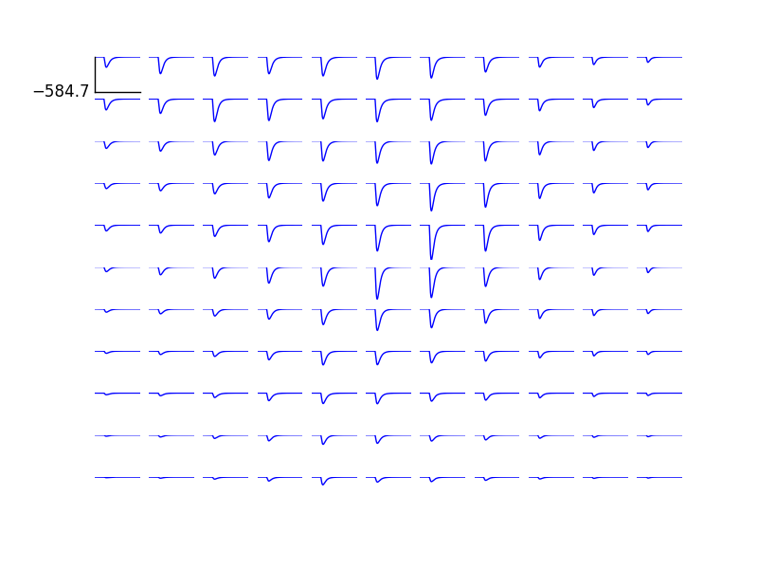
LFP pattern changes with different z-shift between L2 layer and soma of stimulated neuron
z-shift is -50 um

Slide 31
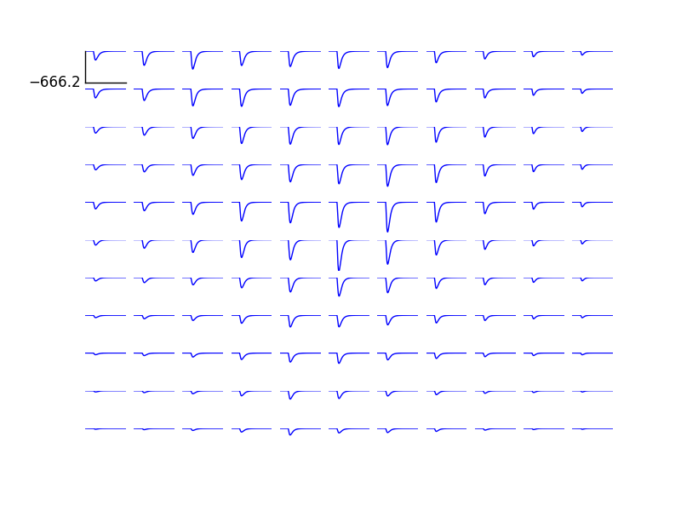
LFP pattern changes with different z-shift between L2 layer and soma of stimulated neuron
Stress the variance and correspondence with morphology
z-shift is -40 um

Slide 32
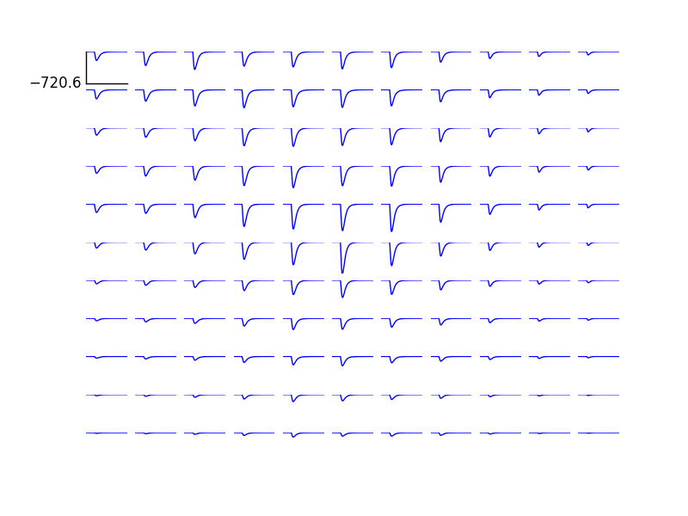
LFP pattern changes with different z-shift between L2 layer and soma of stimulated neuron
z-shift is -30 um

Slide 33
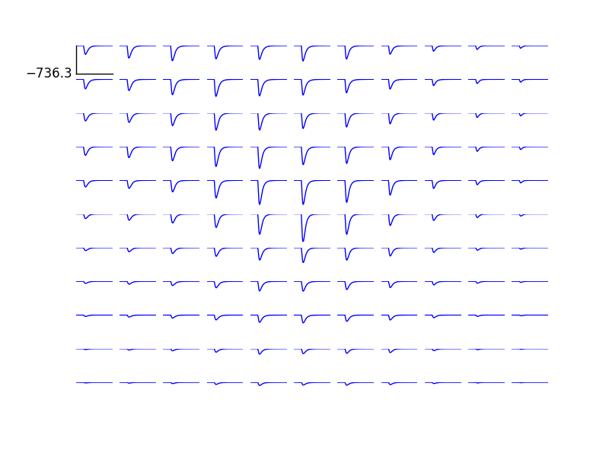
LFP pattern changes with different z-shift between L2 layer and soma of stimulated neuron
z-shift is -20 um

Slide 34
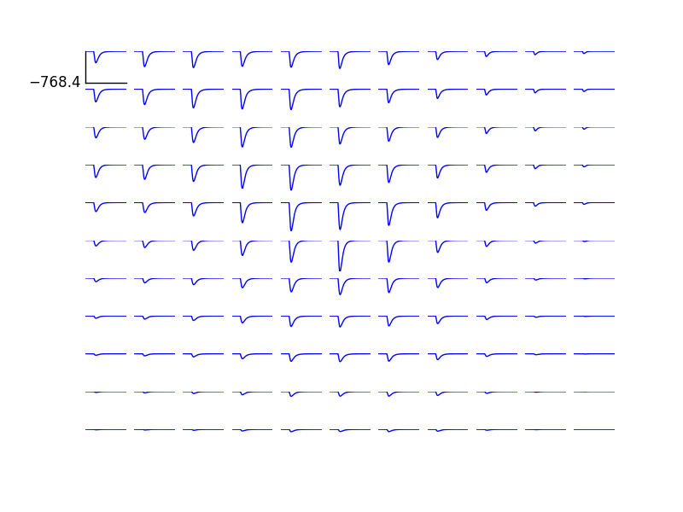
LFP pattern changes with different z-shift between L2 layer and soma of stimulated neuron
z-shift is -10 um

Slide 35
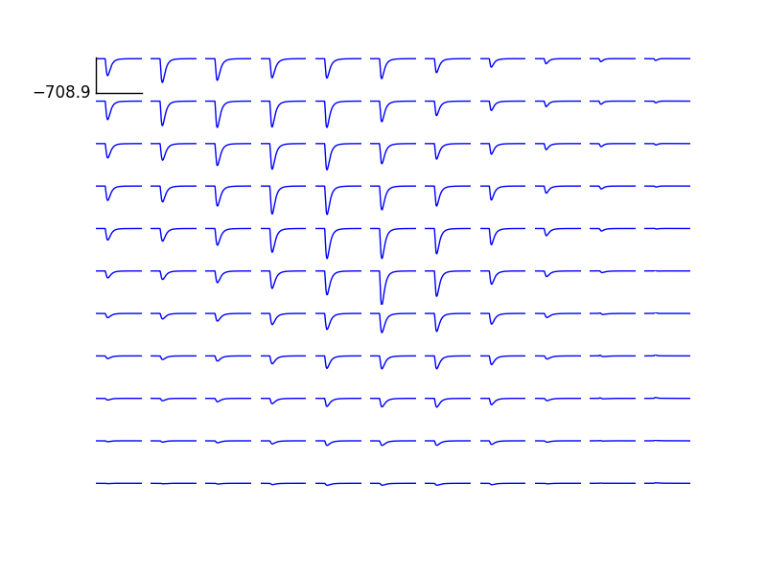
LFP pattern changes with different z-shift between L2 layer and soma of stimulated neuron
z-shift is 0 um

Slide 36
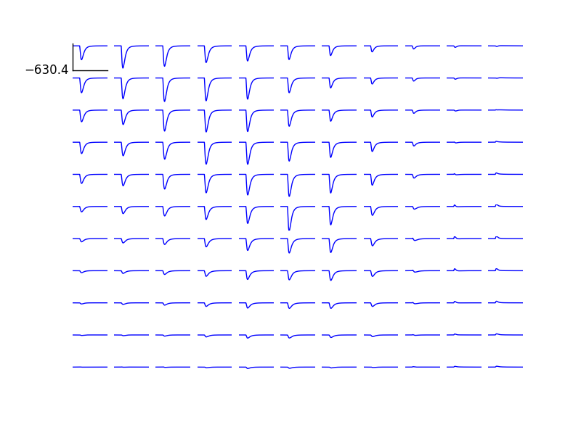
LFP pattern changes with different z-shift between L2 layer and soma of stimulated neuron
z-shift is 10 um

Slide 37
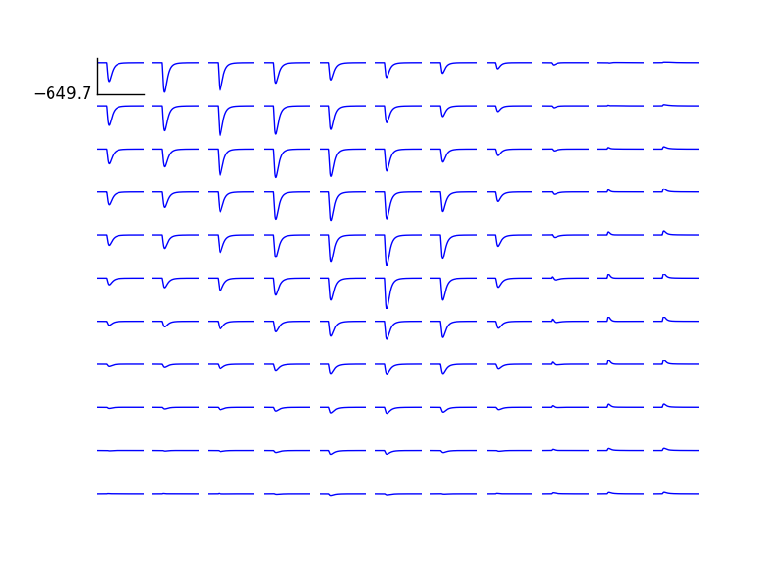
LFP pattern changes with different z-shift between L2 layer and soma of stimulated neuron
z-shift is 20 um

Slide 38
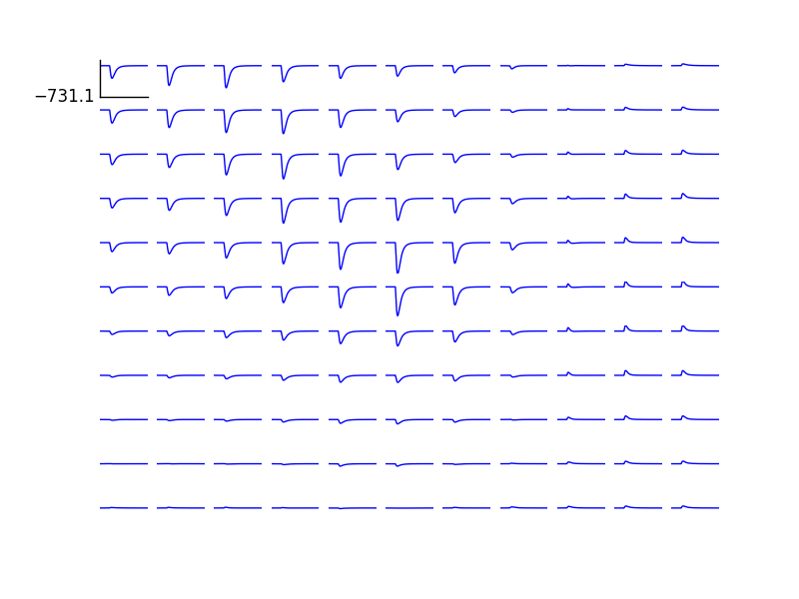
LFP pattern changes with different z-shift between L2 layer and soma of stimulated neuron
z-shift is 30 um

Slide 39
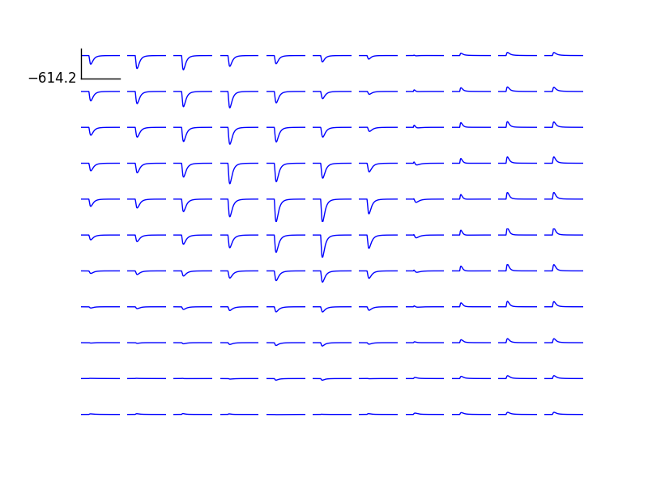
LFP pattern changes with different z-shift between L2 layer and soma of stimulated neuron
z-shift is 40 um

Slide 40
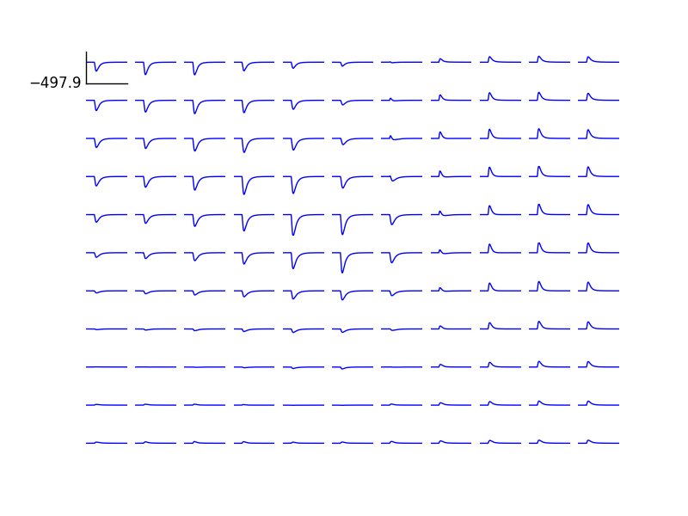
LFP pattern changes with different z-shift between L2 layer and soma of stimulated neuron
z-shift is 50 um

Slide 41
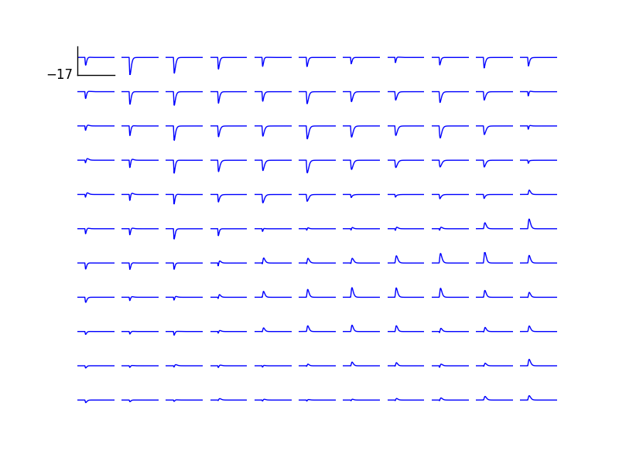
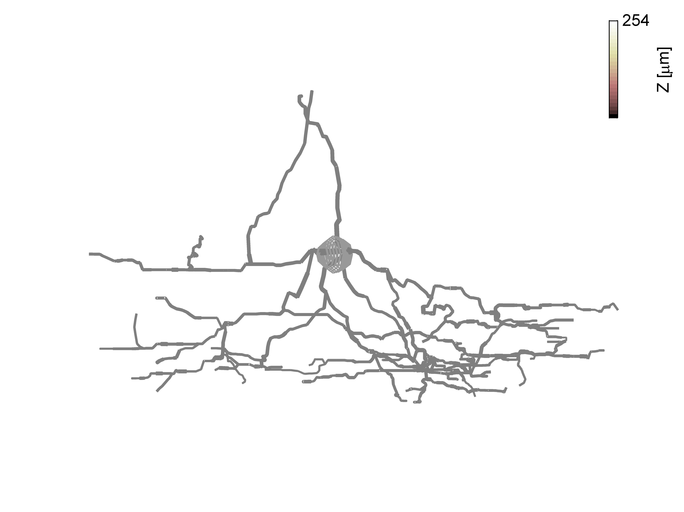
L1 inhibitory neuron
The effect is negligible

Slide 42
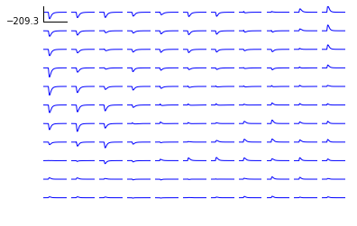
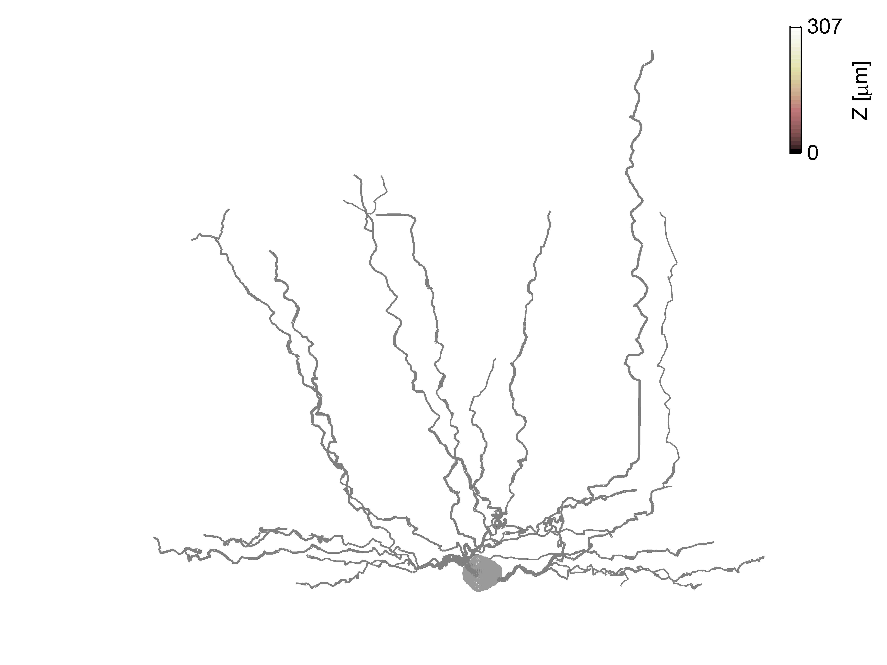
L3 inhibitory neuron
Re-do the simulation
The effect is negligible, because the ratio of cell density in L2 and in L3 is 5.
L3 to MEA is 10 um, and the height of stimulated pyramidal neuron is at 110 um

Slide 43
Predicting power
1.active membrane
1.1 Propagation of AP
1.1.1 Delay
1.1.2 Amplitude
2. ???

Slide 44
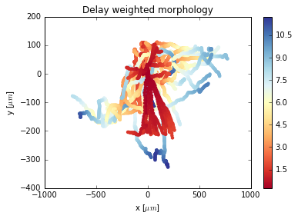
Delay of action potential
side view
Invert the morphology and drop the dendrites

Slide 45
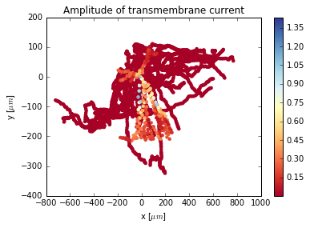
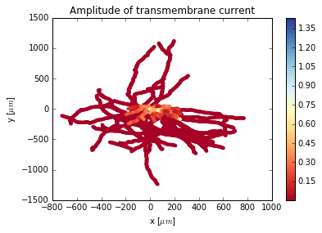
Amplitude
Invert the morphology and drop the dendrites

Slide 46
Acknowledgements
Thank Mark for great help and patience!
Thank Mike for providing experiment data!
Thank Torbjørn for his great packages and help of improving the code!
Thank Gilles for giving me this precious chance to be here!
Thank other members in the group!

Slide 47
References

Slide 48
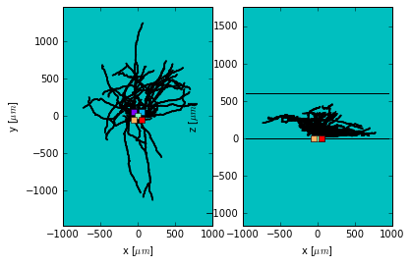
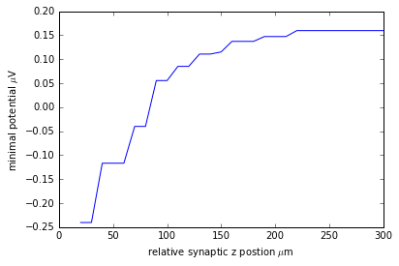
Averaged real neuron

Slide 49
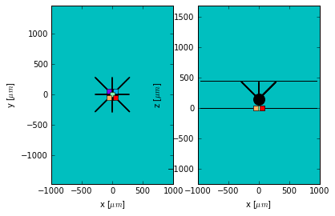
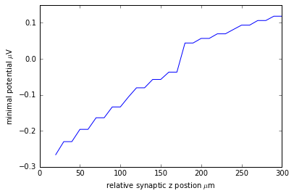
Radical symmetry neuron

Slide 50
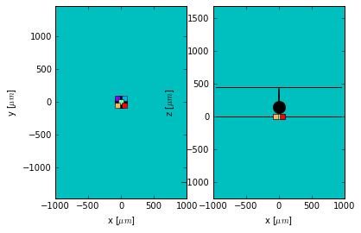
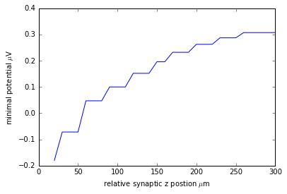
Simplest Neuron Model

Slide 51
Soma doesn't contribute so much as we thought before
Soma: 300, syn: 60
Soma: 300, syn: 110

Slide 52
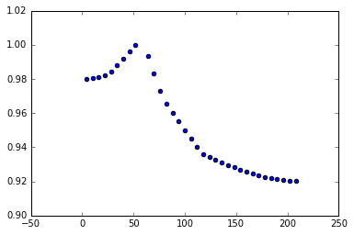
soma position won't change the distribution of return current
soma 10: syn 60
soma 300:
syn 60:

Slide 53


Flat star, can see some inversion change
syn_x:255
LFP pattern, not sure if the oritation is right

Slide 54

L1 inhibitory neuron contributes nothing
the amplitude of L2 pyramidal neuron is about -700

Slide 55

LFP of active membrane

Slide 59
Content
Experiment background
The correspondence between morphology and LFP (recap)
What they do in the experiment and set-ups (need to be clarified)
Simulation goals and results
Reproduce the experiment results
Simulation method (compartmental modeling and return current) (recap)
Homogeneous assumption test (recall)
How to do the simulation (basic idea) (make the kernel) (draw a picture, make it clear)
Sim with the kernel(pyramidal) (done, organize the figures)
Height of L2 cell layer
Height of zShift
Sim with L3 inhibitory neuron: (easy)
The effect is negligible
Sim with L1 inhibitory neuron: (easy)
The effect is negligible
Predicting power: (a few results)
active membrane
Propagation of AP
Delay (done)
Amplitude (done)

Slide 60
How to build a homogeneous kernel
Elaborate it, 3 steps, 1. insert a single synapse; 2. radically average the LFP with synaptic position as centre. 3. average over the the z-zone.
Average it radically

