Slide 1
Simulation of
spike induced field in turtle's cortex
Wenbin Yang
Bachelor Thesis Project

Slide 2
Outline
Experiment Background
Simulation Method
Simulation Results

Slide 3
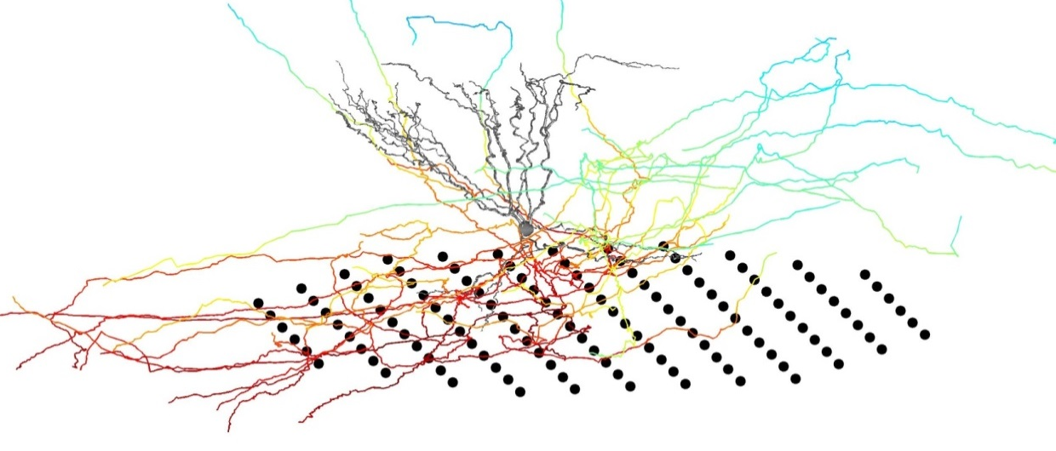
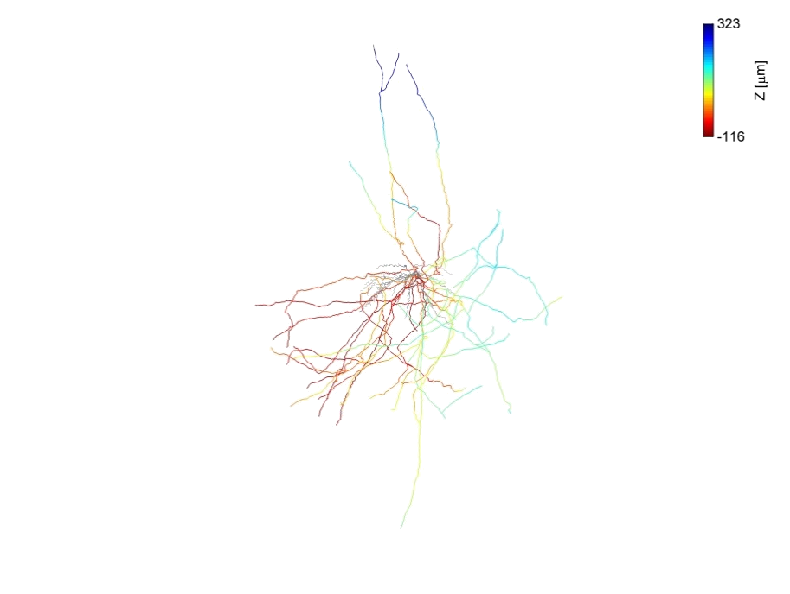
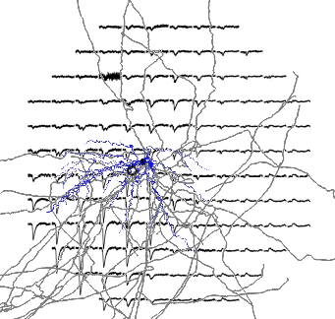
Correspondence between neuronal morphology and LFP
Pictures from Mark

Slide 4
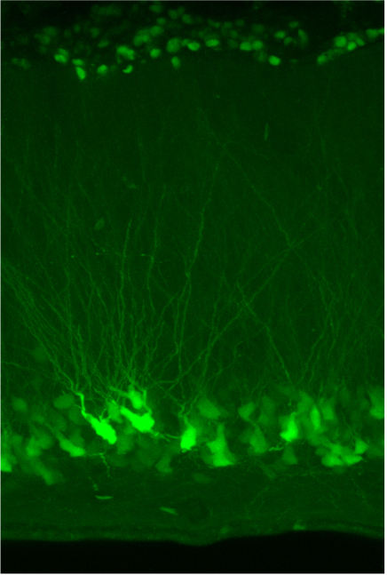
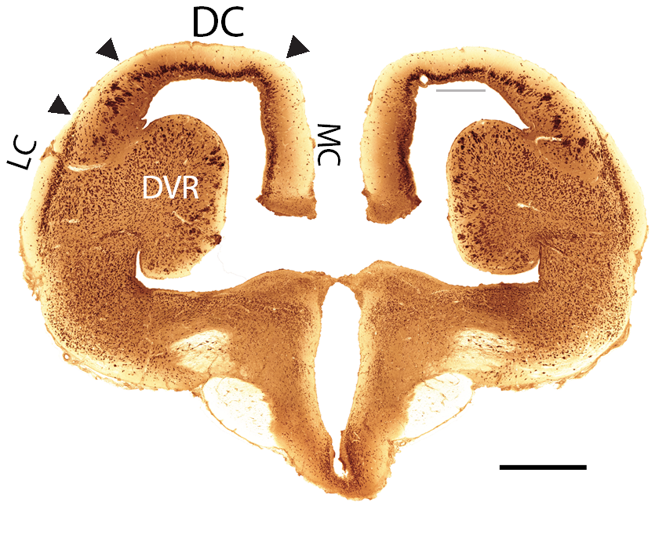
Neural architecture of cortex in turtle
CaMKIIa-EGFP
L1 – thalamic drive, inhibitory cells, apical dendrites
L2 – principle cell layer
L3 – inhibitory cells, initial axon segments
axon
spike
MEA
ventricle
1mm
NeuN
Pictures from Mark

Slide 5
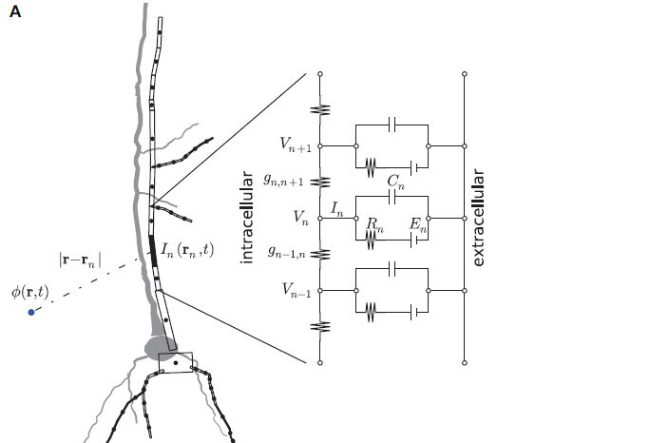
Compartmental Modeling
How to make a biological neuron digital?
Adapted from Linden et al. 2006

Slide 6
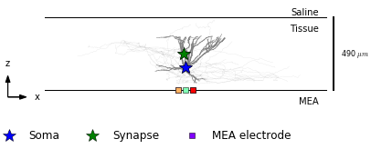
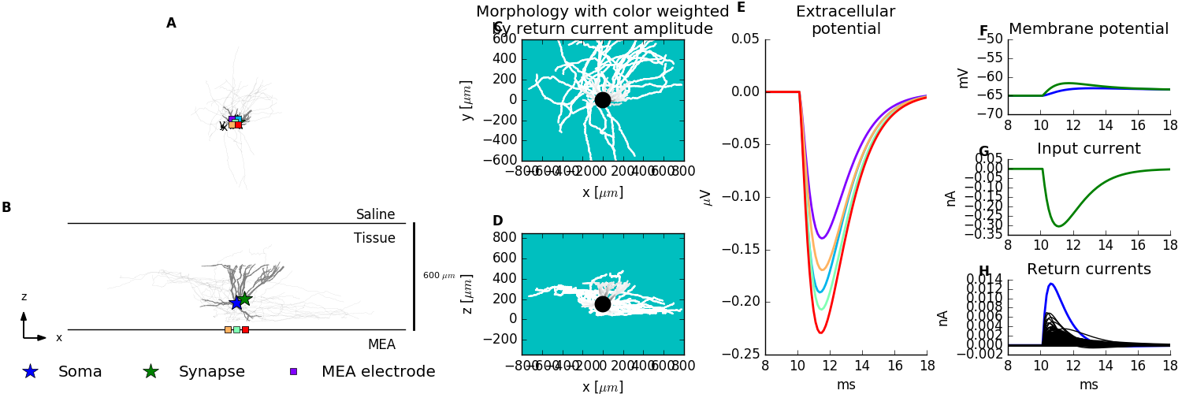
Return Current
z
Synaptic
input
k: the weight factor
τ₁,τ₂: the time constant
V: the membrane potential
V₀: rest membrane potential
Return
current
MEA

Slide 7
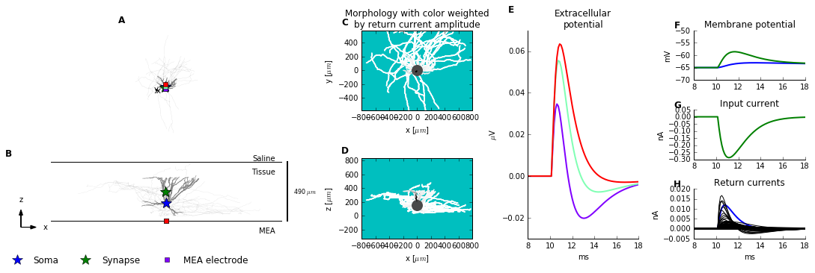
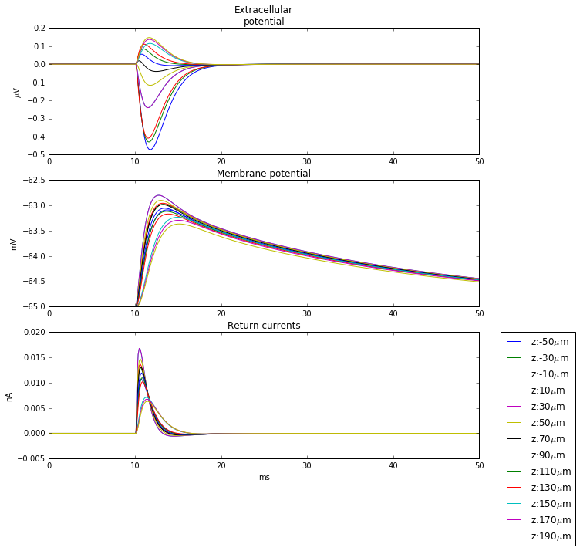
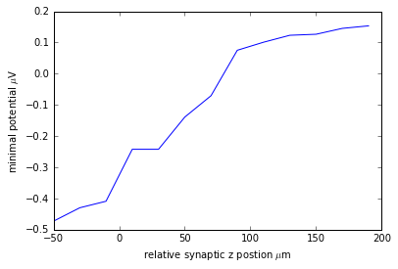
Extracellular potential versus z-position of synaptic input
Set soma position as (0,0,0)
Set a single electrode at (0,0,-150)
Insert synaptic input from
z=-50 to z=190 μm
(20μm a trial)
high z
Extracellular Potential (μV)
Extrema Potential (μV)
low z
time/ms

Slide 8
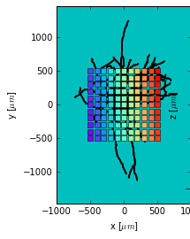
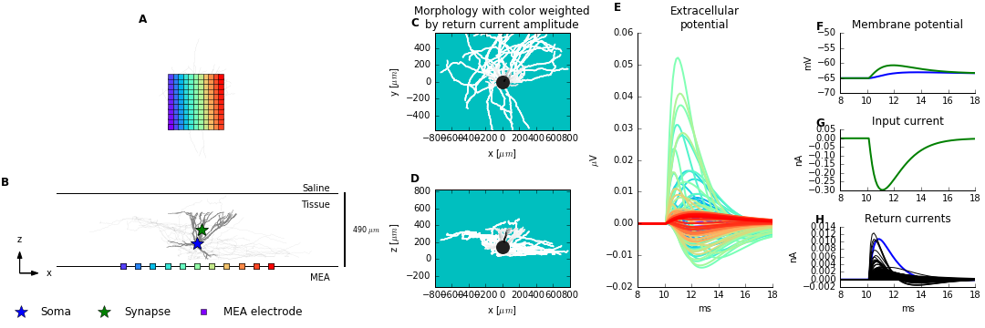
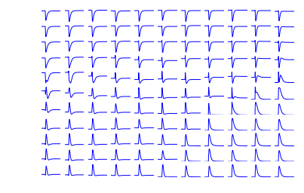
Single spike input and LFP pattern on MEA
Soma: (0,0,0)
synaptic input:
(20, 0, 100)
y
(-500,-500)
x

Slide 9
Summary
Plot the extracellular potential versus
different z-position of synaptic input, which
fit well with the return current theory
Get the LFP pattern of single spike input on
a typical pyramidal neuron.

Slide 10
Acknowledgement
Thank Mark for great help and patience!
Thank Mike for providing experiment data!
Thank other members in the group!

Slide 11
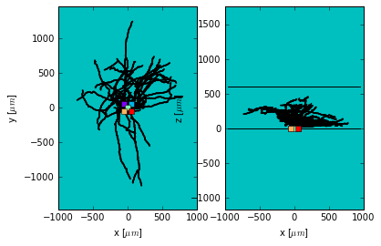
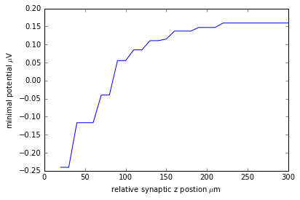
Averaged real neuron

Slide 12
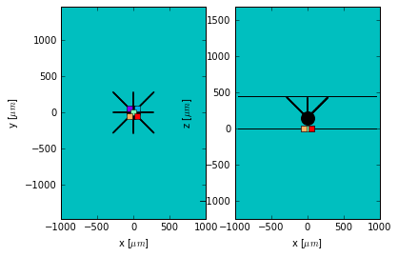
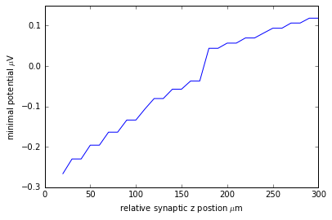
Radical symmetry neuron

Slide 14
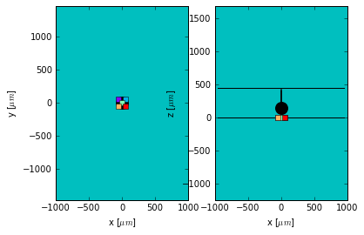
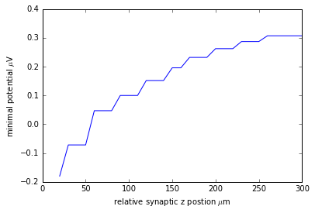
Simplest Neuron Model

