Slide 1
Project_Study_3
Reconstruction From
Two Planar Cross Sections
1. Paper review
Department of Mathematics
Gyeongsang National University
Youngmin Shin
Notes:
이번에는 The use of mathematics in computer Games 라는 컴퓨터 게임에 사용되는 수학이라는 기사를 리뷰해봤습니다.

Slide 2
1. Abstract & Introduction
p1
A
B
Notes:
컴퓨터 게임에 세상을 3d로 나타내는 방법들이 흥미로울 것 같아 이 주제를 설정해 공부해보았습니다.

Slide 3
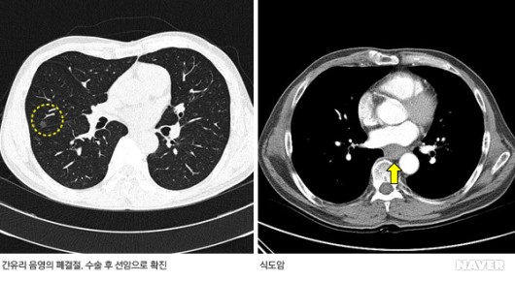
1. Abstract & Introduction
p1
CT
(computed tomography)
Notes:
https://terms.naver.com/entry.naver?docId=927612&cid=51007&categoryId=51007
Tomography : 단층촬영

Slide 4
1. Abstract & Introduction
p1
Cahn-Hilliard Equation
-Equation of mathematical physics which describes the process of phase separation.
Notes:
https://terms.naver.com/entry.naver?docId=927612&cid=51007&categoryId=51007
Tomography : 단층촬영

Slide 5
1. Abstract & Introduction
p1
Cahn-Hilliard Equation
-Equation of mathematical physics which describes the process of phase separation.
Implicit Method
Notes:
https://terms.naver.com/entry.naver?docId=927612&cid=51007&categoryId=51007
Tomography : 단층촬영

Slide 6
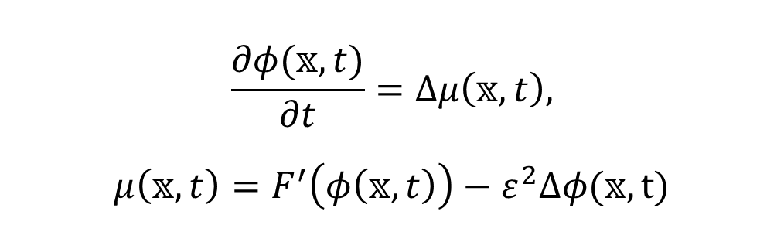
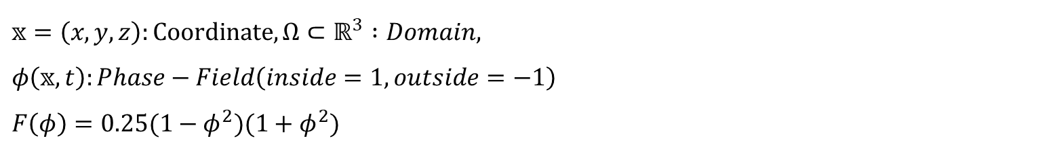

2. Reconstruction Process
p1
Cahn-Hilliard Equation
$$\frac{∂φ(𝕩, t)}{∂t}=∆μ\left(𝕩, t\right),$$
$$μ\left(𝕩, t\right)=F^{′}\left(φ\left(𝕩, t\right)\right)−ε^{2}∆φ(𝕩, t)$$
$$𝕩∈Ω, 0<t≤T$$
$𝕩=\left(x, y, z\right):Coordinate, Ω⊂ℝ^{3} :Domain,$
$φ\left(𝕩, t\right):Phase−Field\left(inside=1, outside=−1\right)$
$F\left(φ\right)=0.25(1−φ^{2})(1+φ^{2})$
Notes:
https://terms.naver.com/entry.naver?docId=927612&cid=51007&categoryId=51007
Tomography : 단층촬영

Slide 7




2. Reconstruction Process
p1
$$S_{2}$$
$$φ_{top}(x, y)$$
A
B
$$S_{1}$$
$$φ_{bottom}(x, y)$$
Notes:
https://terms.naver.com/entry.naver?docId=927612&cid=51007&categoryId=51007
Tomography : 단층촬영

Slide 8

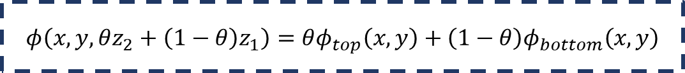



2. Reconstruction Process
p1
$$S_{2}$$
$$φ_{top}(x, y)$$
A
B
$$S_{1}$$
$$φ_{bottom}(x, y)$$
$$φ\left(x, y, θz_{2}+\left(1−θ\right)z_{1}\right)=θφ_{top}\left(x, y\right)+\left(1−θ\right)φ_{bottom}\left(x, y\right)$$
Notes:
https://terms.naver.com/entry.naver?docId=927612&cid=51007&categoryId=51007
Tomography : 단층촬영

Slide 9
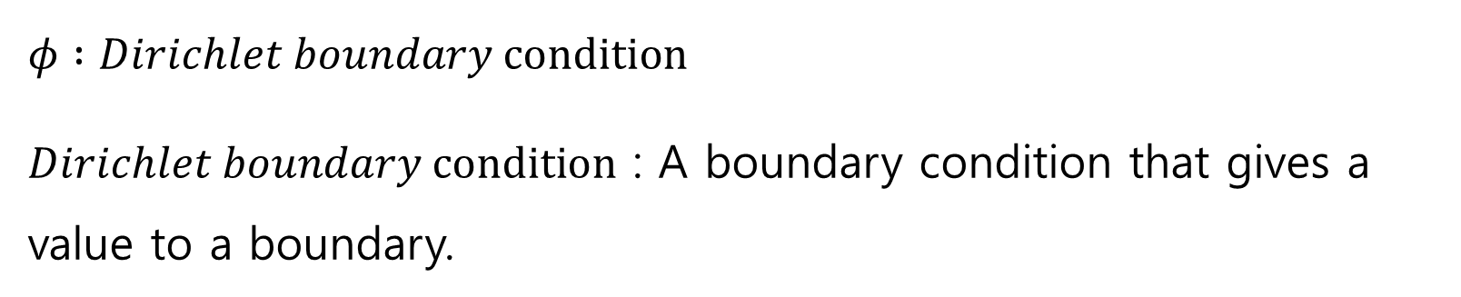
2. Reconstruction Process
p1
Boundary condition
$φ :Dirichlet boundary condition$
$Dirichlet boundary condition$ : A boundary condition that gives a value to a boundary.
Time
Notes:
https://terms.naver.com/entry.naver?docId=927612&cid=51007&categoryId=51007
Tomography : 단층촬영

Slide 10
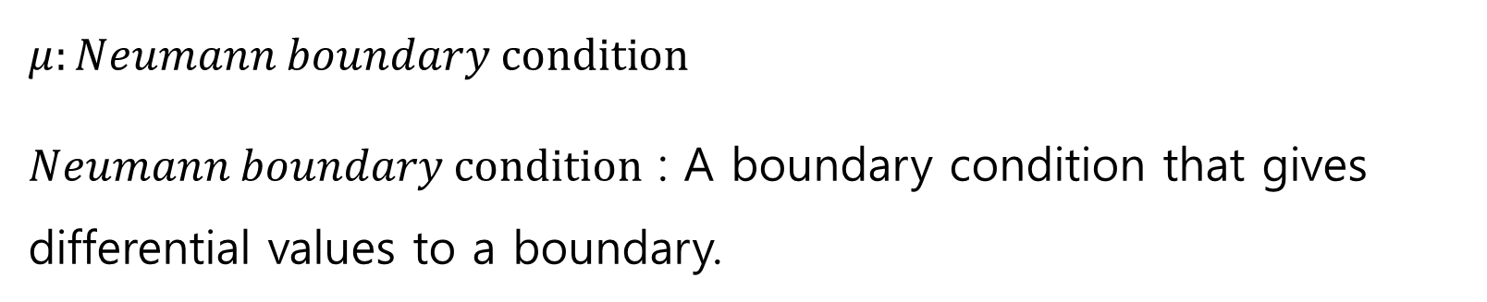
2. Reconstruction Process
p1
Boundary condition
$μ:Neumann boundary condition$
$Neumann boundary condition$ : A boundary condition that gives differential values to a boundary.
Space
Notes:
https://terms.naver.com/entry.naver?docId=927612&cid=51007&categoryId=51007
Tomography : 단층촬영

Slide 11
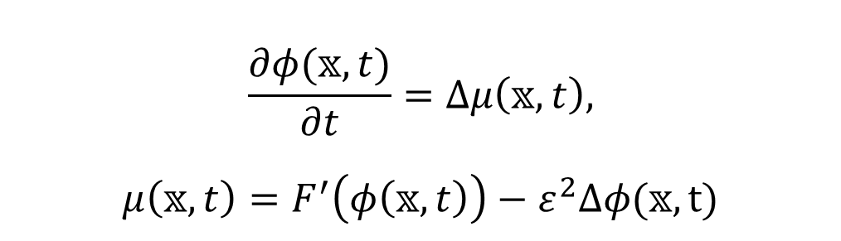
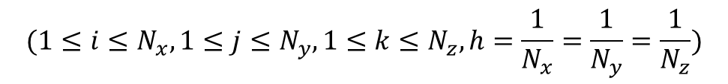
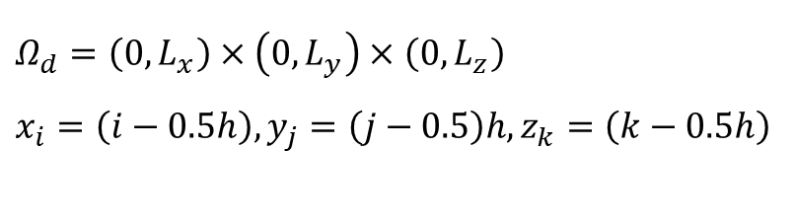

3. Numerical Solution
p1
Cahn-Hilliard Equation
$$\frac{∂φ(𝕩, t)}{∂t}=∆μ\left(𝕩, t\right),$$
$$μ\left(𝕩, t\right)=F^{′}\left(φ\left(𝕩, t\right)\right)−ε^{2}∆φ(𝕩, t)$$
$$𝕩∈Ω, 0<t≤T$$
$Ω_{d}=\left(0, L_{x}\right)×\left(0, L_{y}\right)×\left(0, L_{z}\right)$
$x_{i}=\left(i−0.5h\right), y_{j}=\left(j−0.5\right)h, z_{k}=\left(k−0.5h\right)$
$$(1≤i≤N_{x}, 1≤j≤N_{y}, 1≤k≤N_{z}, h=\frac{1}{N_{x}}=\frac{1}{N_{y}}=\frac{1}{N_{z}})$$
Notes:
https://terms.naver.com/entry.naver?docId=927612&cid=51007&categoryId=51007
Tomography : 단층촬영

Slide 12


3. Numerical Solution
p1
Approximation
$$∆t=\frac{T}{N_{t}}$$
$$φ_{ijk}^{n}≈φ(x_{i}, y_{j}, z_{k}, n∆t)$$
Notes:
https://terms.naver.com/entry.naver?docId=927612&cid=51007&categoryId=51007
Tomography : 단층촬영

Slide 13
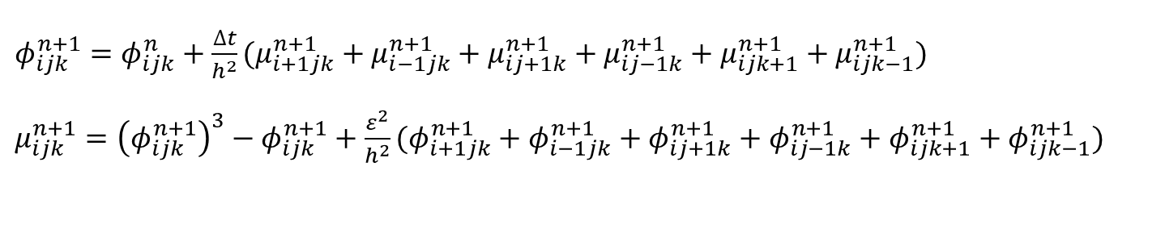

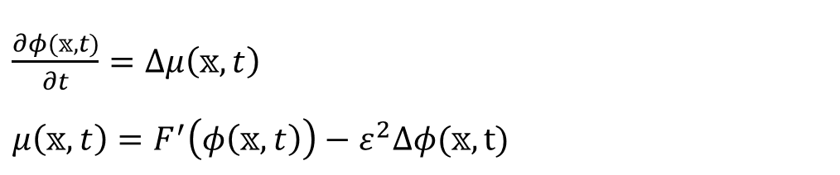
3. Numerical Solution
p1
Discretization
$\frac{∂φ(𝕩, t)}{∂t}=∆μ\left(𝕩, t\right)$
$μ\left(𝕩, t\right)=F^{′}\left(φ\left(𝕩, t\right)\right)−ε^{2}∆φ(𝕩, t)$
$$𝕩∈Ω, 0<t≤T$$
$φ_{ijk}^{n+1}=φ_{ijk}^{n}+\frac{∆t}{h^{2}}(μ_{i+1jk}^{n+1}+μ_{i−1jk}^{n+1}+μ_{ij+1k}^{n+1}+μ_{ij−1k}^{n+1}+μ_{ijk+1}^{n+1}+μ_{ijk−1}^{n+1})$
$μ_{ijk}^{n+1}={\left(φ_{ijk}^{n+1}\right)}^{3}−φ_{ijk}^{n+1}+\frac{ε^{2}}{h^{2}}(φ_{i+1jk}^{n+1}+φ_{i−1jk}^{n+1}+φ_{ij+1k}^{n+1}+φ_{ij−1k}^{n+1}+φ_{ijk+1}^{n+1}+φ_{ijk−1}^{n+1})$
Notes:
https://terms.naver.com/entry.naver?docId=927612&cid=51007&categoryId=51007
Tomography : 단층촬영

Slide 14

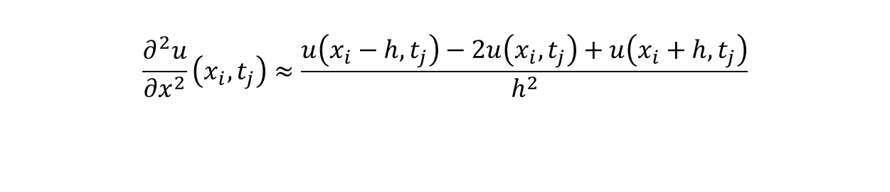
3. Numerical Solution
p1
Discretization
Implicit method
central difference method
$$\frac{∂u}{∂t}\left(x_{i}, t_{j}\right)≈\frac{u\left(x_{i}, t_{j}\right)−u(x_{i}, t_{j}−k)}{k}$$
$$\frac{∂^{2}u}{∂x^{2}}\left(x_{i}, t_{j}\right)≈\frac{u\left(x_{i}−h, t_{j}\right)−2u\left(x_{i}, t_{j}\right)+u\left(x_{i}+h, t_{j}\right)}{h^{2}}$$
Notes:
https://terms.naver.com/entry.naver?docId=927612&cid=51007&categoryId=51007
Tomography : 단층촬영

Slide 15
3. Numerical Solution
p1
Gauss-Seidel iteration
To solve the equation, we use A, which is used in Linear system of equations.
Notes:
https://terms.naver.com/entry.naver?docId=927612&cid=51007&categoryId=51007
Tomography : 단층촬영

Slide 16
Thank you!

