Slide 1
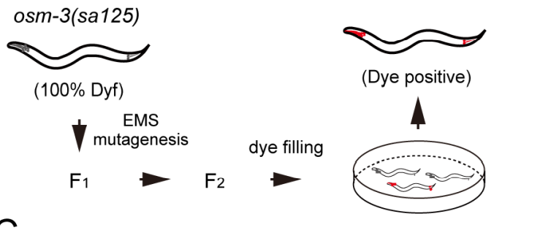
Osm-3 p802
G444E
Mapping
Whole Genome Sequencing
Phenotype II
dye-filling
Phenotype I
Compare with wildtype
And Mapping samples
~300 Single nucleotide variation due to EMS
Can focus on about ¼ length of a Chromosome

Slide 2
But why not
Screening
Screening
5-6 Samples
50-100 Samples
Mapping
Sequencing
1 month
Analyze
Sequencing
Next-gen seq is becoming cheaper
Can get a lot of allele and gene once a screen
Mapping free
Accurate and save a lot of money

Slide 3
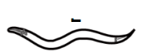
Step 1: Creat a SNP pool with SNPs have impact on amino acid
Tag
Impact SNP pool
Of Sup 1
Suppressor mutant 1
taglist
NEKL-4 SNP
SNP of all
……

Slide 4
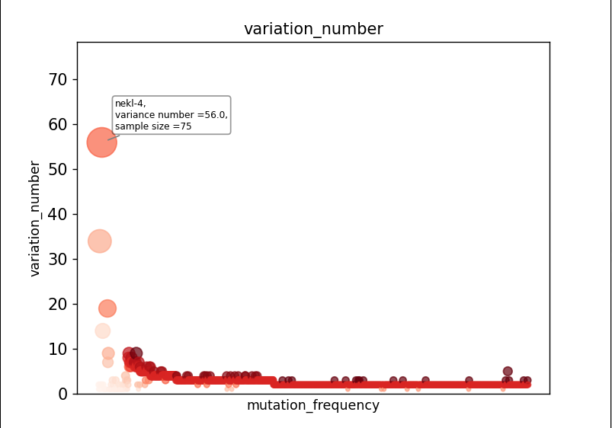
Sample size = 95

Slide 5
Step 2: Remove low possibility SNPs
Gene
Gene
Gene
1.If Nekl-4 is a suppressor
You can hardly find another suppressor
Gene In nekl-4 SNP pool
Gene
SNP Pool
Of All Input
SNP Pool
2.Because that almost all the SNPs in
SNP pool have an impact on protein
structure and amino acid. Genes linked
to the SNPs in the suppressor pool
can be considered as ‘not likely’ as well
Gene
Of Nekl-4 mutant
Gene
(intersection factor = 3%)
Problem: Impact SNP cannot be decided easily so there
might be a lot of false-negative cases

Slide 6
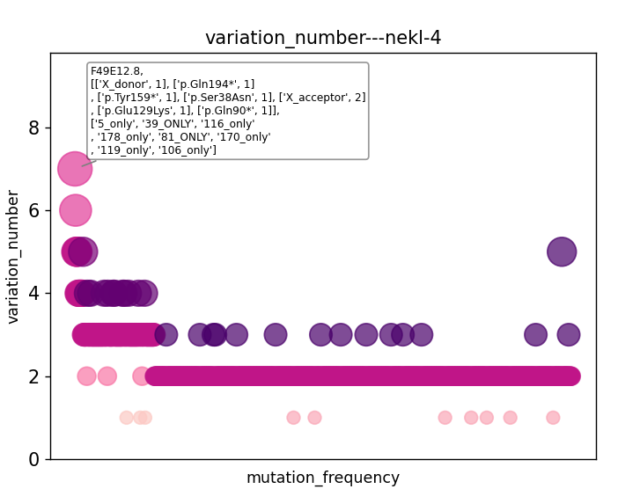

Slide 7
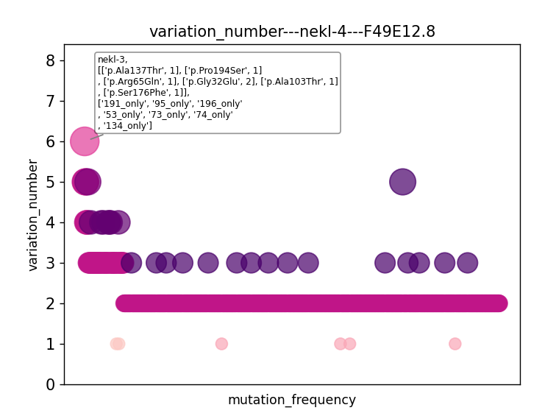

Slide 8
Using statistical model to distinguish genes
(Why suppressors can exclude each other)
Gene A= 75
Gene B = 7
If genes are randomly distributed:
c
n
95-n
1
2
3
4
5
6
.
.
.
95
+
+
+
+
+
+
+
P(A+,B+)=
n
P(++)
(1-P(++))
95
When suppressor screening:
H0 : B is not a suppressor
P = P(A+,B+)*P(no-sup)
P(no-sup)=n(no sup SNP)/(n(all SNP)-n(A SNP))
What about the P adjustment when multiple comparison?

Slide 9
To explain the reason that nekl-4 share a suppressor mutant with nekl-3
1. P(no-sup) = (9703-95)/(9703-75)
c
n
95-n
2. P(nekl-4+,nekl-3+) =
n
P(++)
(1-P(++))
95
3.P(++) = (7/95)*(75/95) = 0.0582
When one of them is no-suppressor mutation:
c
n
95-n
2. P(nekl-4+,nekl-3+) =
n
* 0.0582
* 0.9418
* P(no-sup)
95

Slide 10
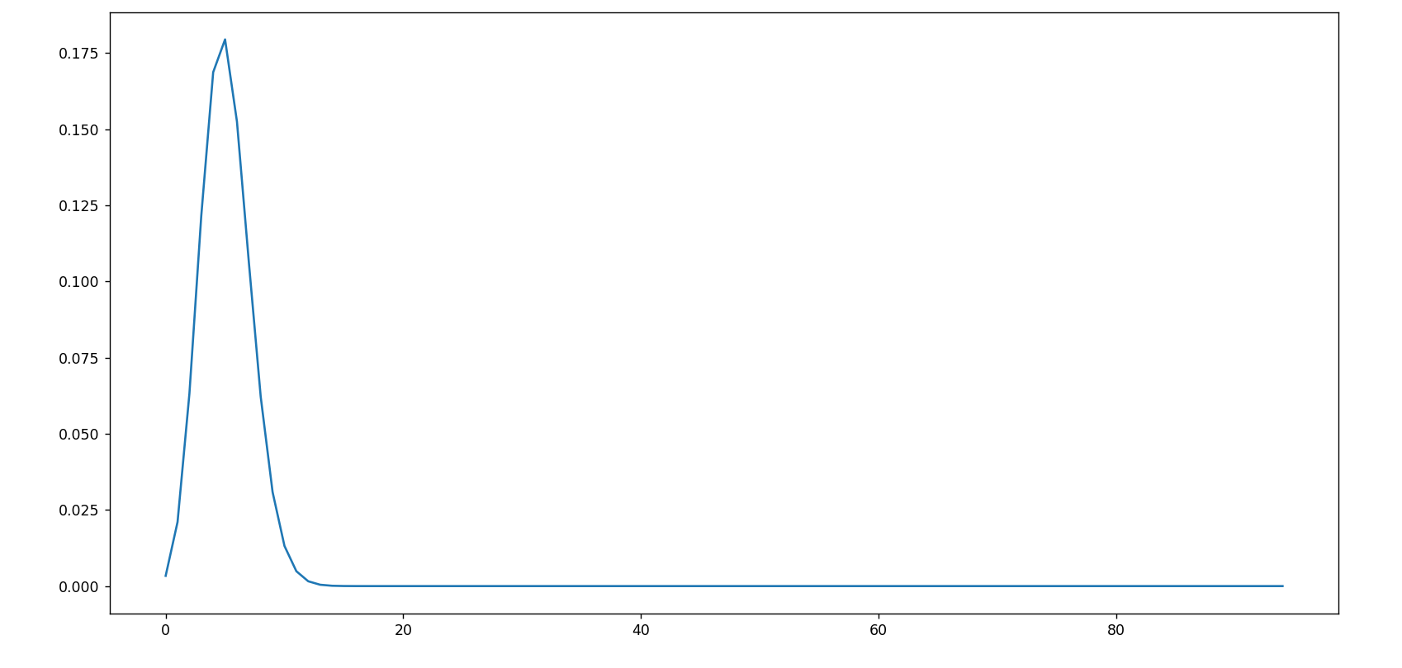
Both them are no-suppressor mutations: nekl-4(75) vs nekl-3(7)
c
n
95-n
P(nekl-4+,nekl-3+) =
n
* 0.0582
* 0.9418
*P(no sup)
95
P < 0.05: x<2.04 or x > 8.4

Slide 11
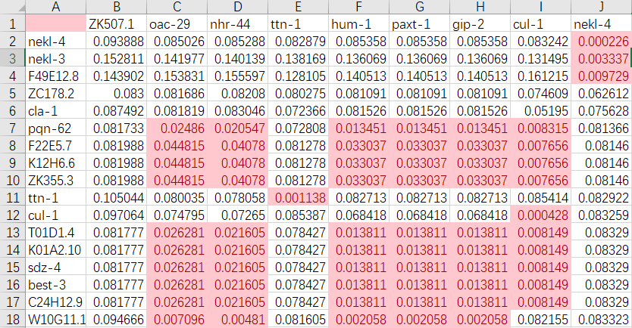
Gene to gene p value
P<0.05: n<a suppressor n>b enhancer?

Slide 12
SNP pool of
osm-3(sa125) suppressors
Unc-89
Nekl-4
ttn-1
Gene x

Slide 13
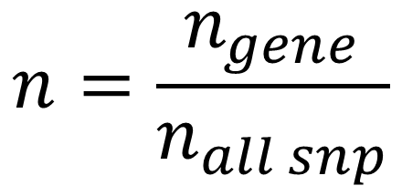
Toy data：Che-3, osm-3, unc-89, let-418
gene
Sample size
SNP number
Gene a
Gene b
Gene c
Gene d
95
98
43
175
95000
98000
43000
175000
26
5
5
3
6
2
1
1
33
32
16
45
1 (+1)
0 (+1)
0 (+1)
1 (+1)
Che-3
osm-3
unc-89
let-418
1. normalization
$$n=\frac{n_{gene}}{n_{all snp}}$$

Slide 14
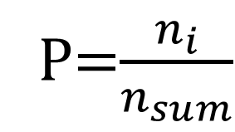
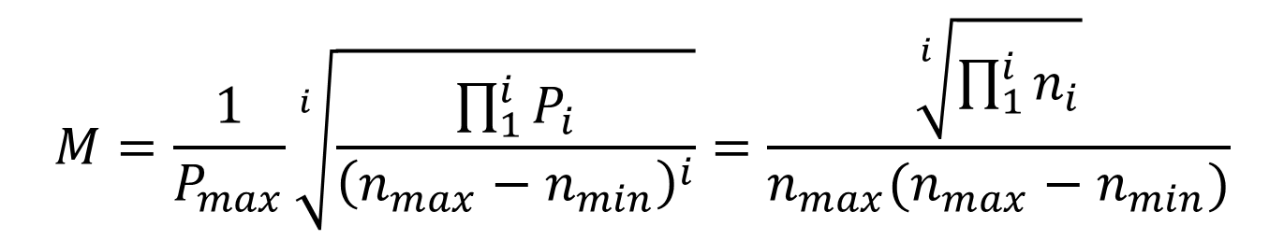
Get the M score of a gene in different screenings
$$M=\frac{1}{P_{max}}\sqrt[i]{\frac{\prod_{1}^{i}{P_{i}}}{{\left(n_{max}−n_{min}\right)}^{i}}}=\frac{\sqrt[i]{\prod_{1}^{i}{n_{i}}}}{n_{max}(n_{max}−n_{min})}$$
P=$\frac{n_{i}}{n_{sum}}$
gene
Sample size
Gene a
Gene b
SNP number
Gene c
Gene d
95
98
43
175
95000
98000
43000
175000
0.391
-
-
-
2.129
-
-
-
7.552
-
-
-
-
-
23.5
-
Che-3
osm-3
unc-89
let-418
Conclusion:
Gene a and Gene b might be the candidate of che-3 screening, Gene c and Gene d is a trash

Slide 15
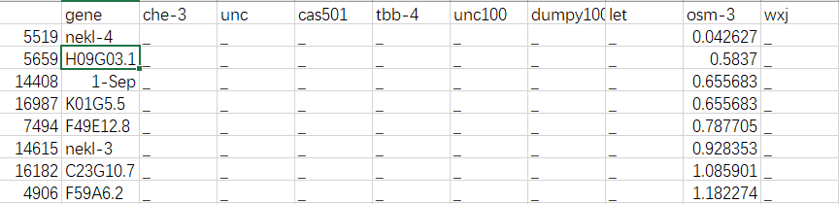
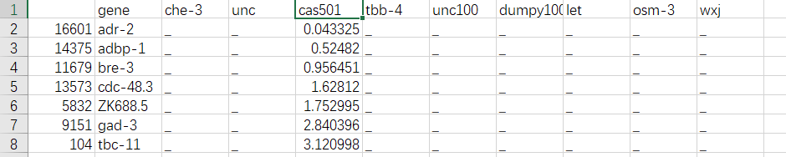
Osm-3 G444E
Dyf-5 T164E

Slide 16
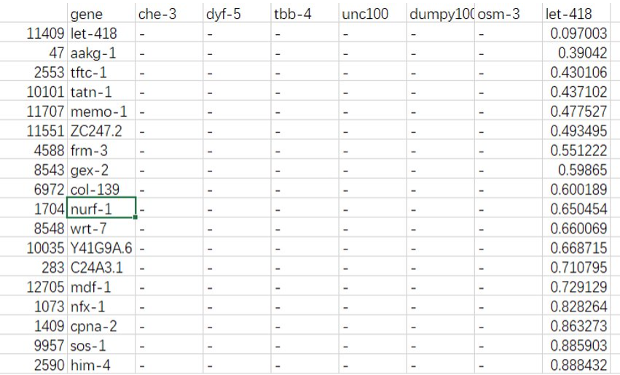
Let-418

Slide 17
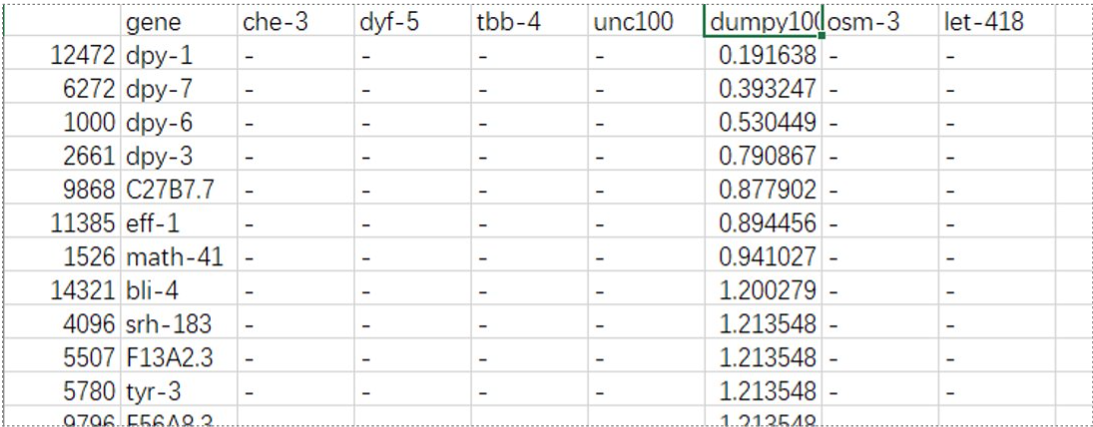
dumpy

Slide 18
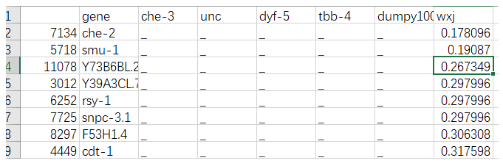

Slide 19
Unsolved problems：
Unexpected noise？
Alignmentみたいな点数システムを作りたい

Slide 20
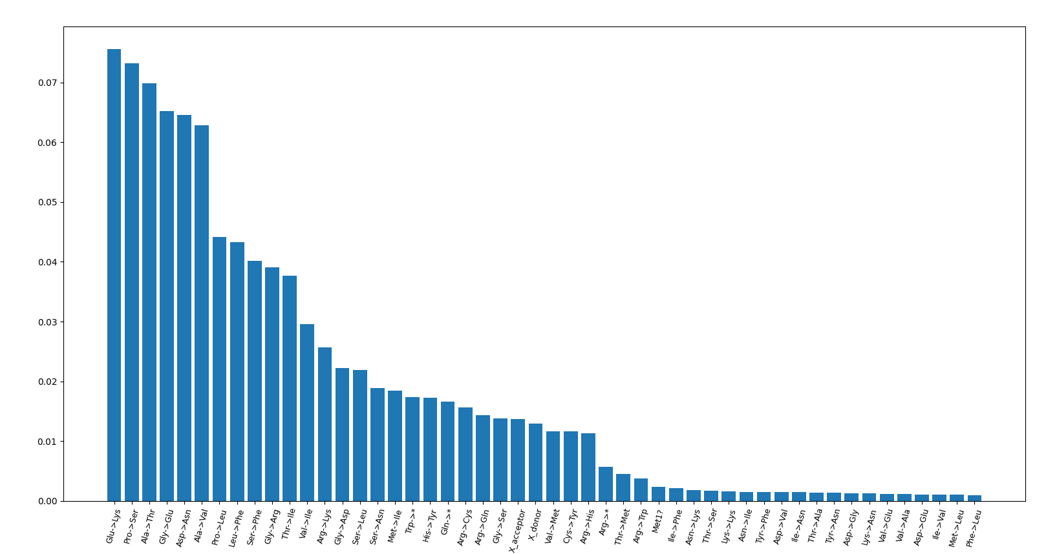
TBB-4(sa127)

Slide 21
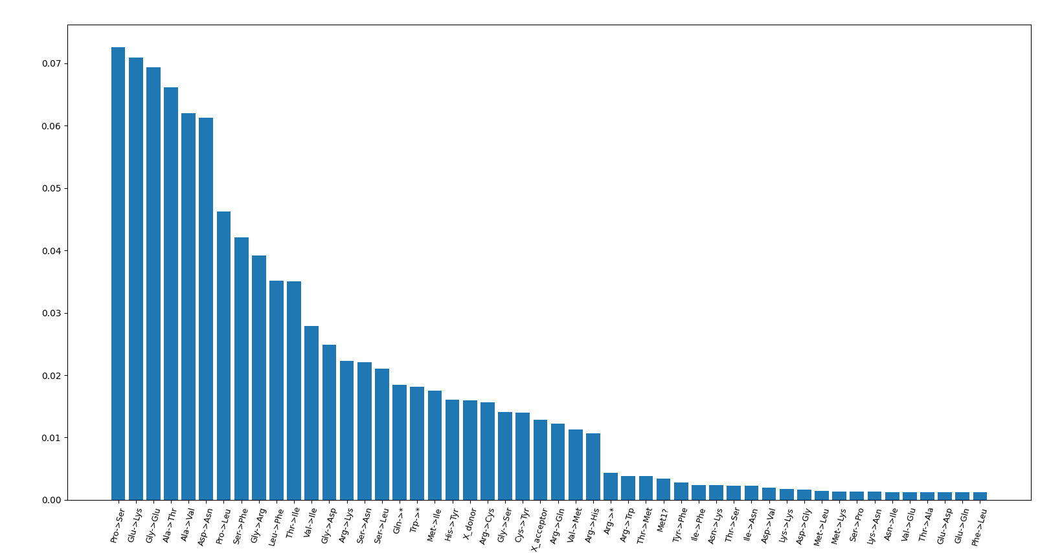
dumpy

Slide 22
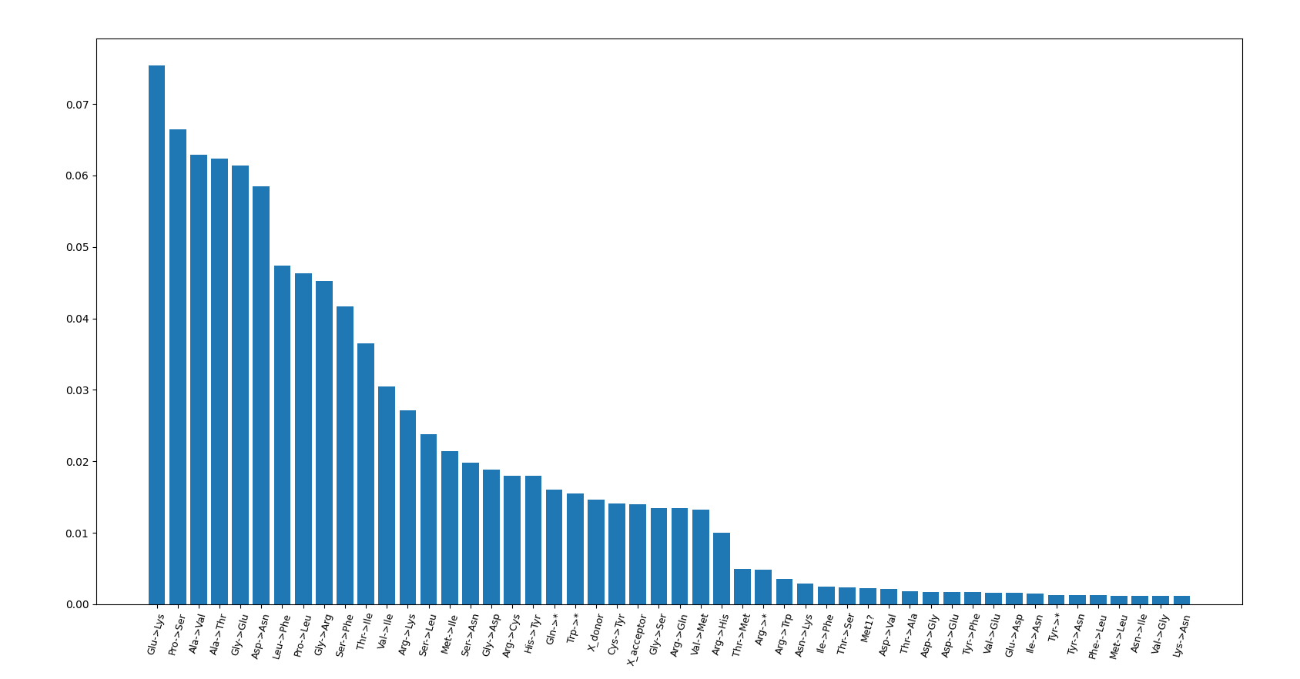
Dyf-5(cas501)

Slide 23
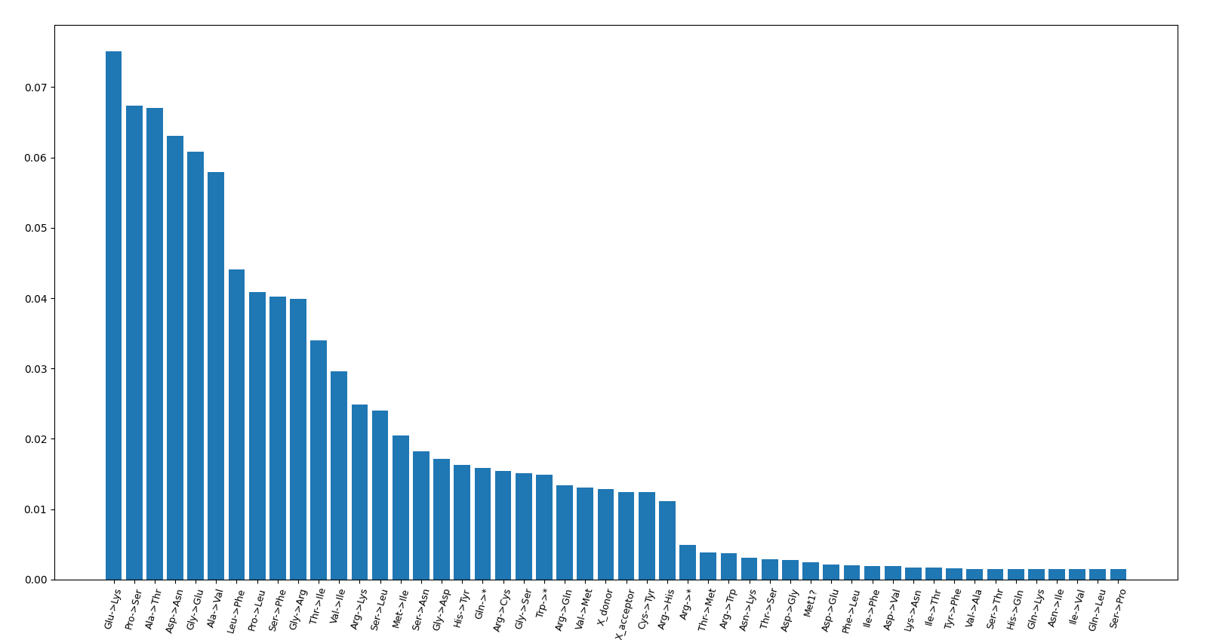
Che-3

Slide 24
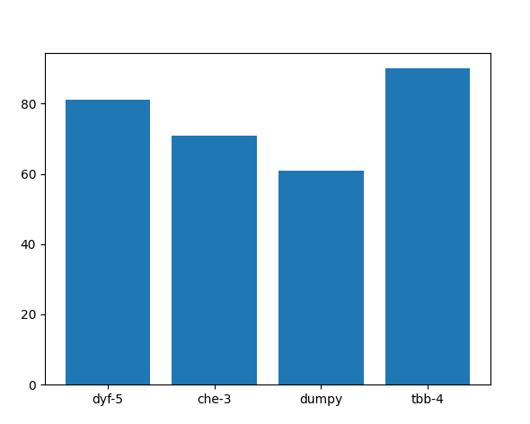
Impact mutation per sample

Slide 25
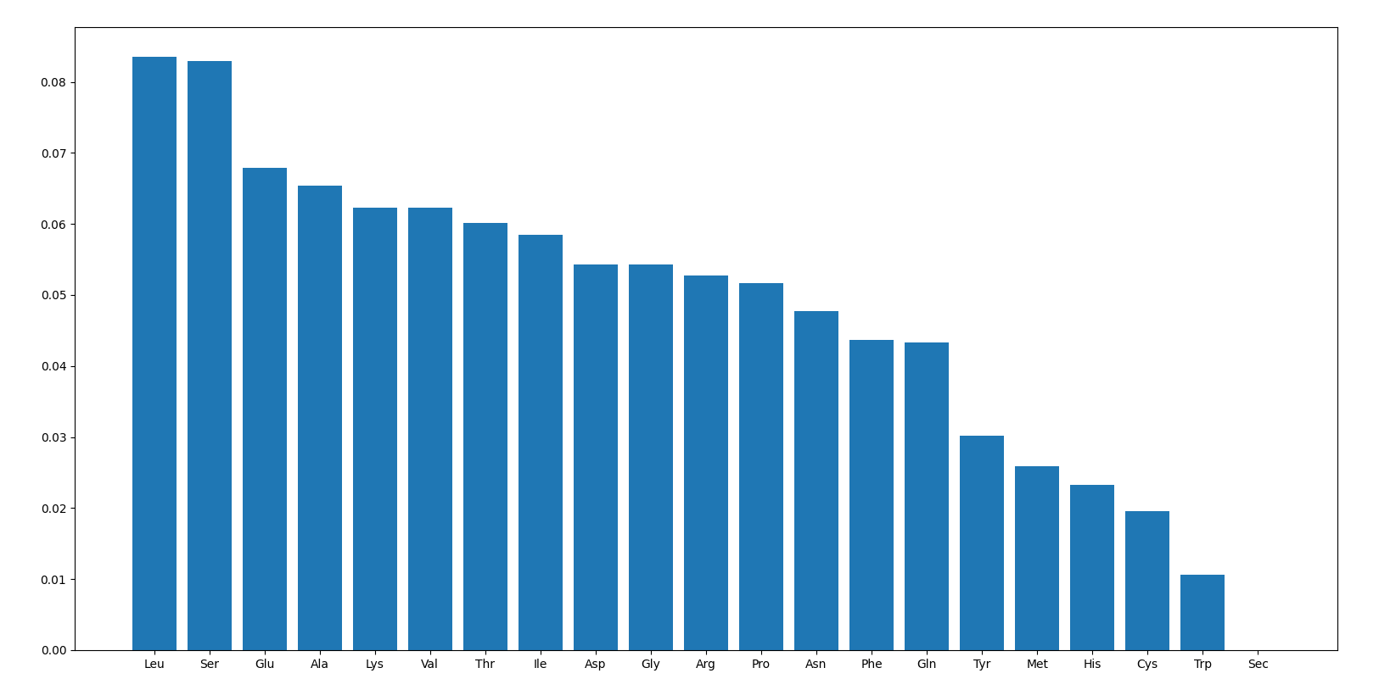
Amino acid frequency

Slide 26
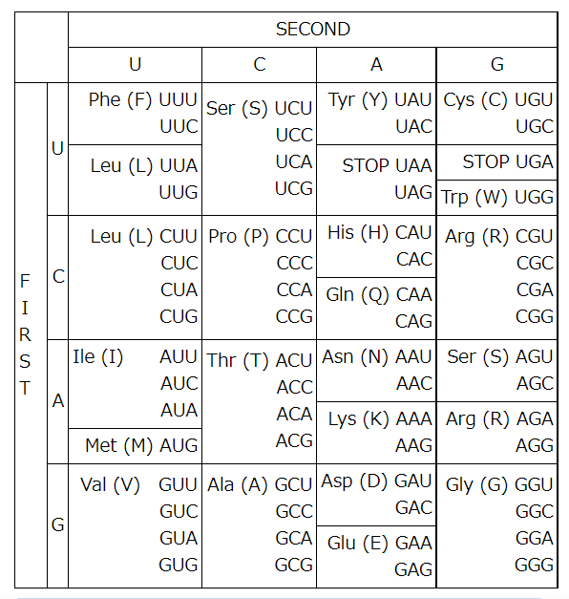
C>U or G>A

Slide 27
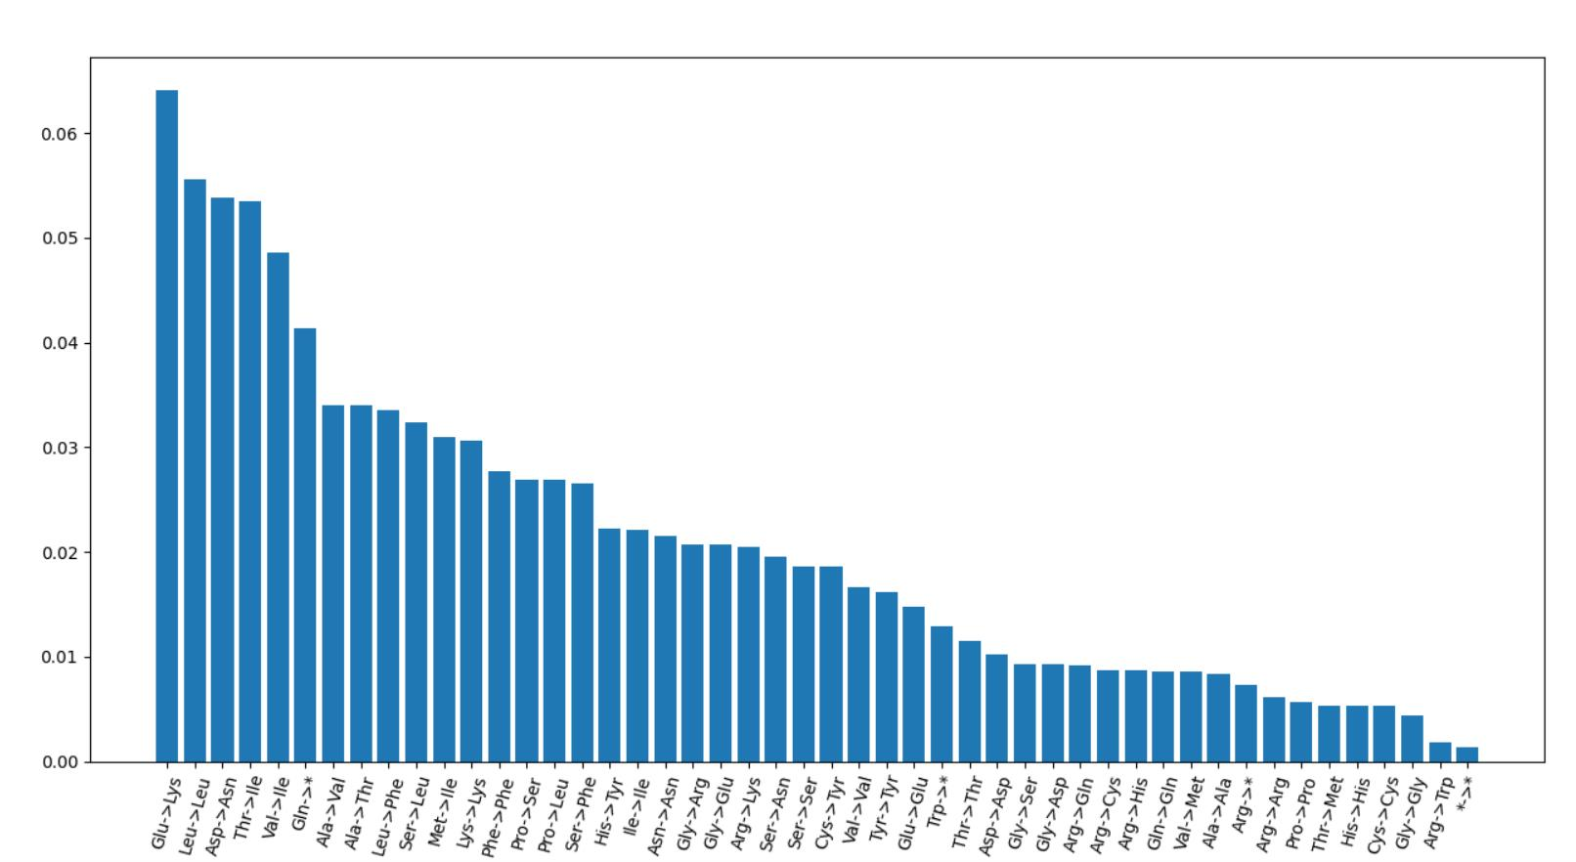
Take codon usage, amino acid count, and EMS-induced codon change into consideration
1
5
6
2
3
4

Slide 28
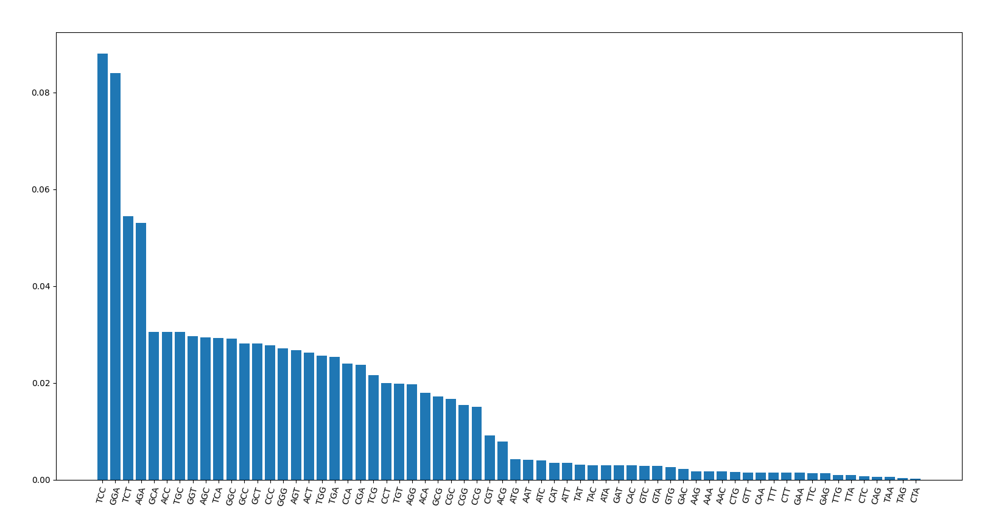
Neighbor base-pairs?
dumpy

Slide 29
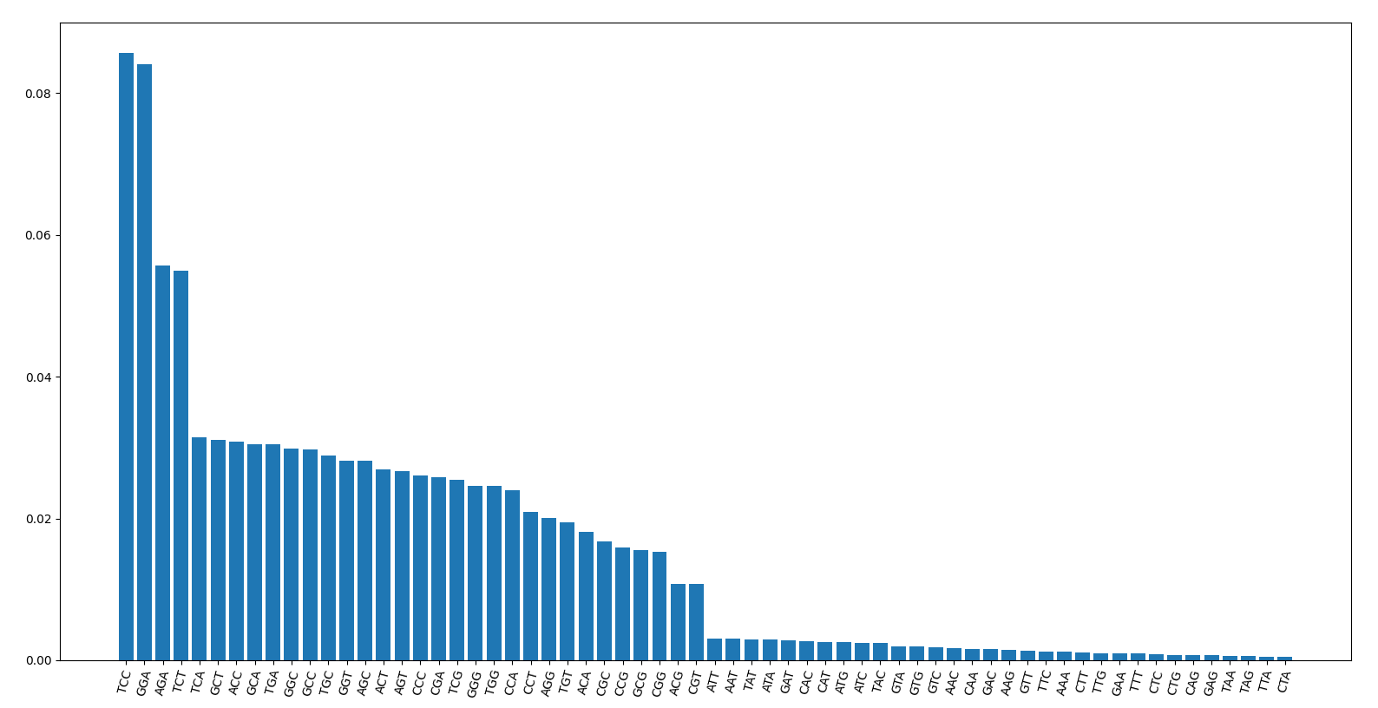
Tbb-4

Slide 30
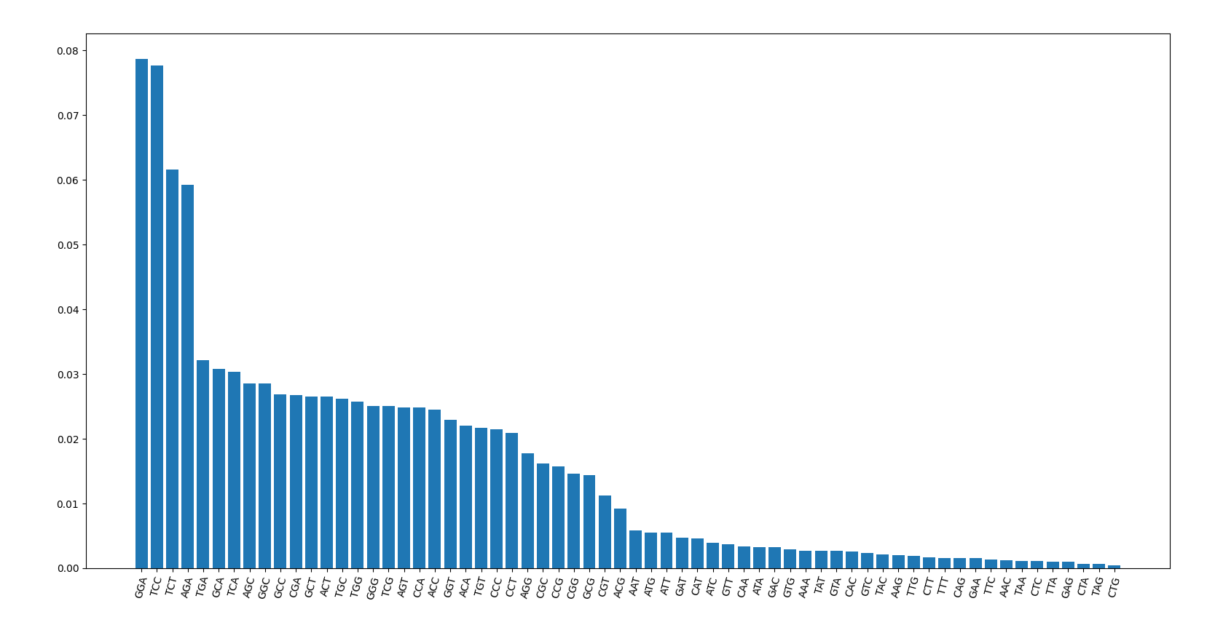
Che-3

Slide 31

Dyf-5

Slide 32
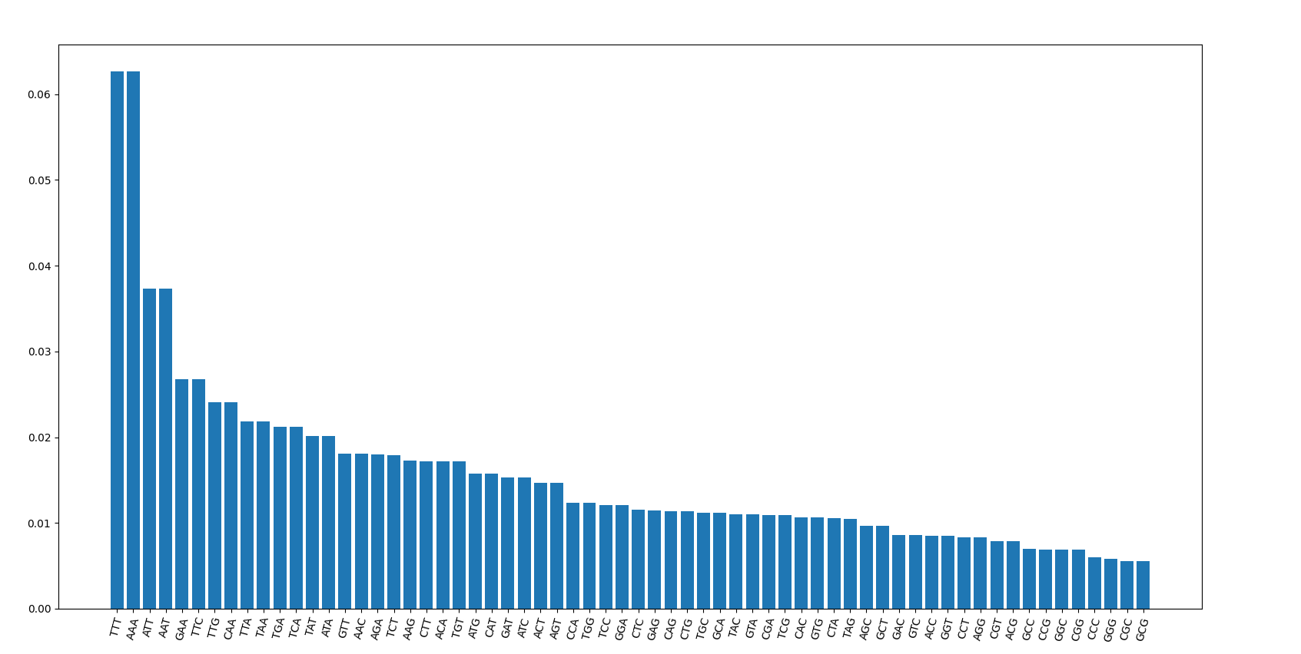
Neighbor combination of C elegans genome
TCT
AGA
TCC
GGA

Slide 33
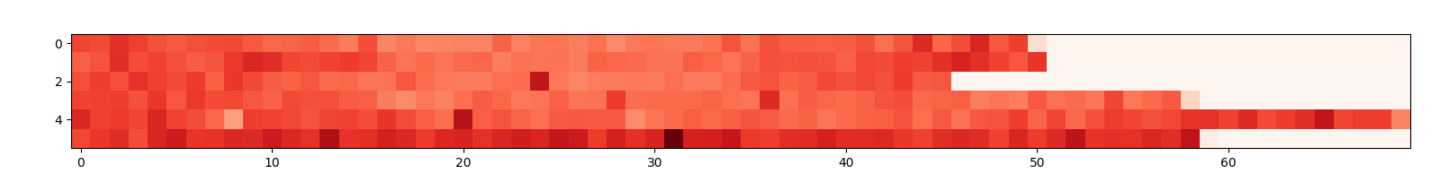
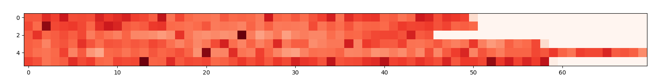
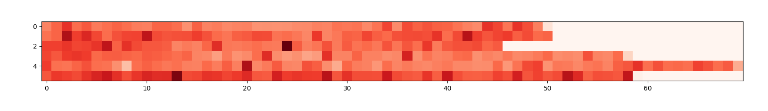
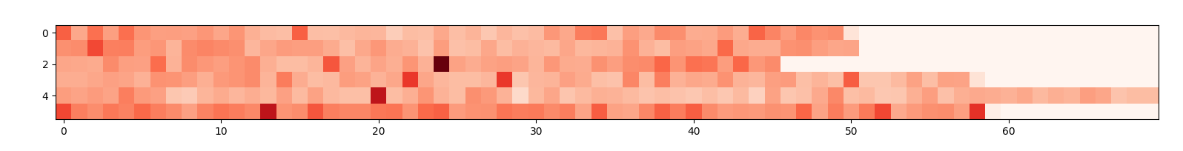
Mutation frequency per 300000 base
tbb-4 (438)
tba-5 (195)
dumpy (256)
unc (120)

Slide 34
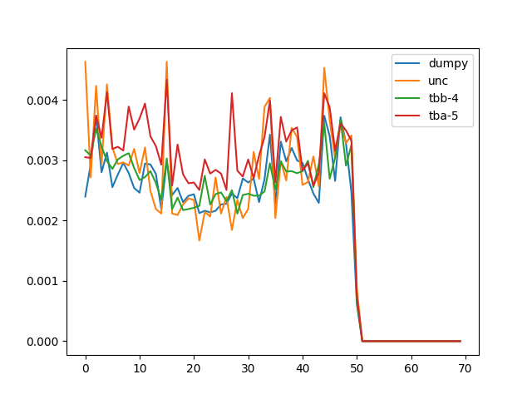
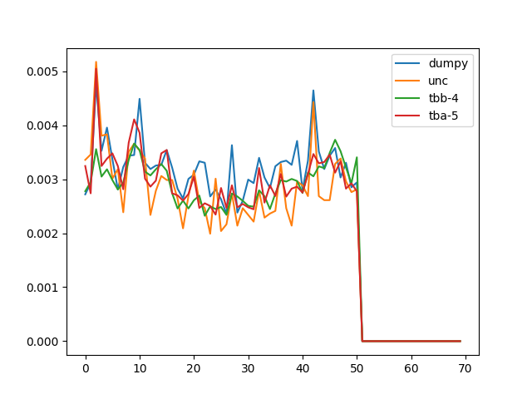
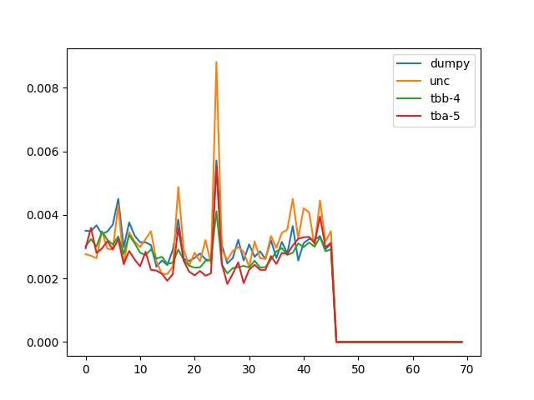
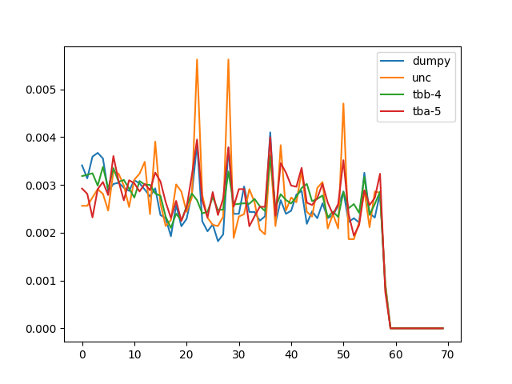
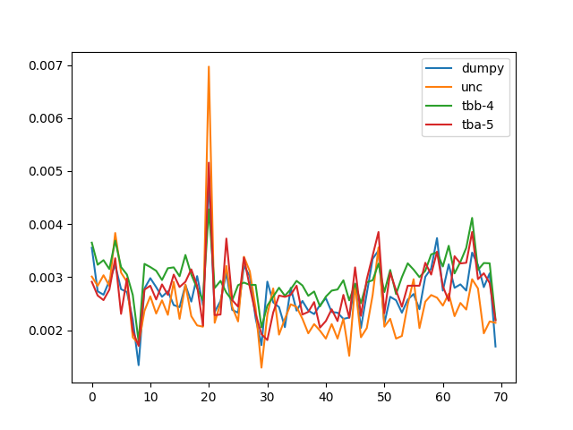
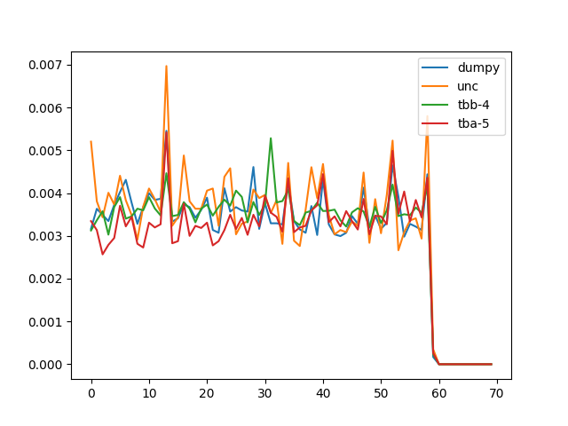
Mutation frequency per 300000 base
I
II
III
IV
V
X

Slide 35
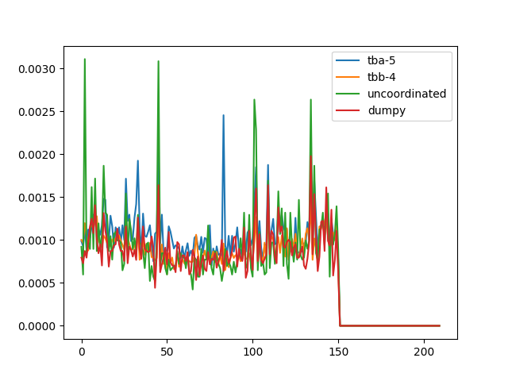
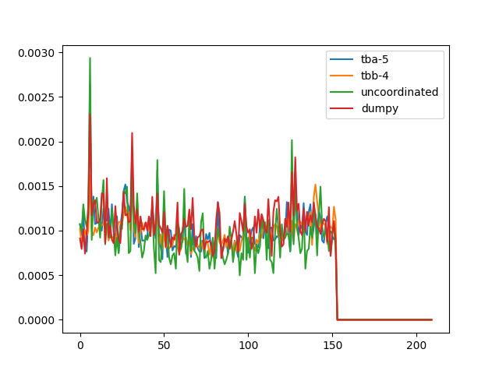
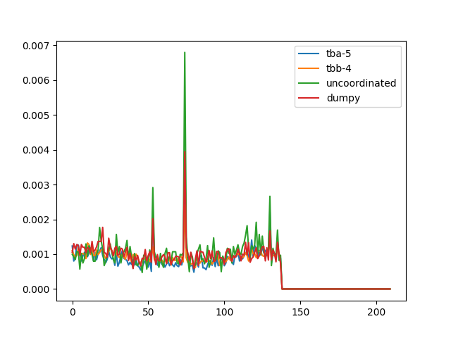
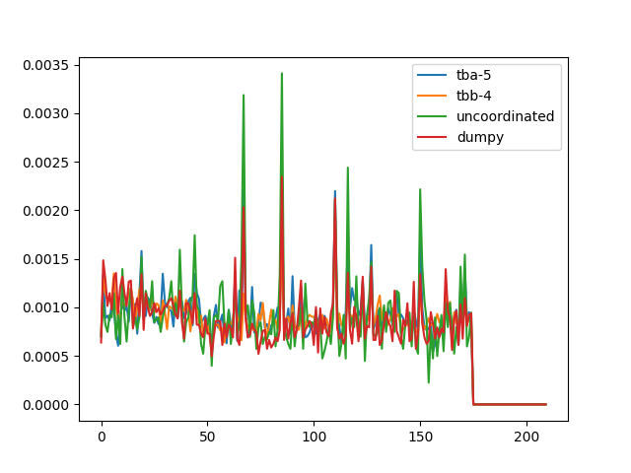
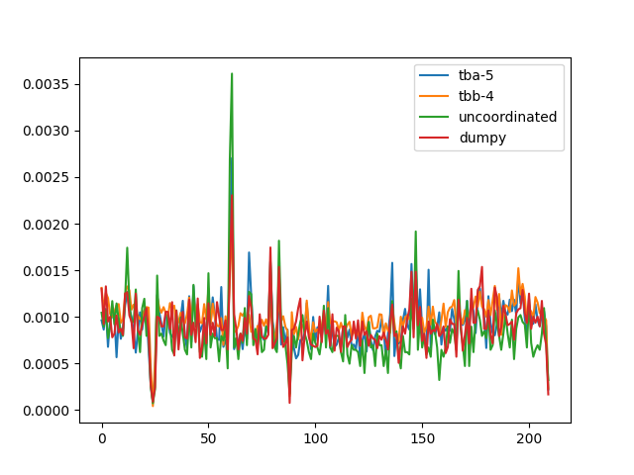
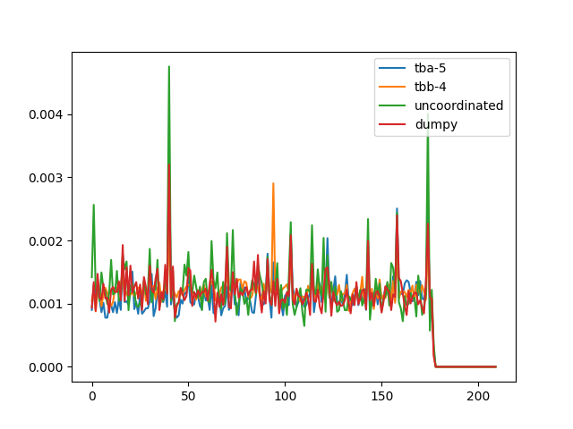
I
II
III
IV
V
X

Slide 36
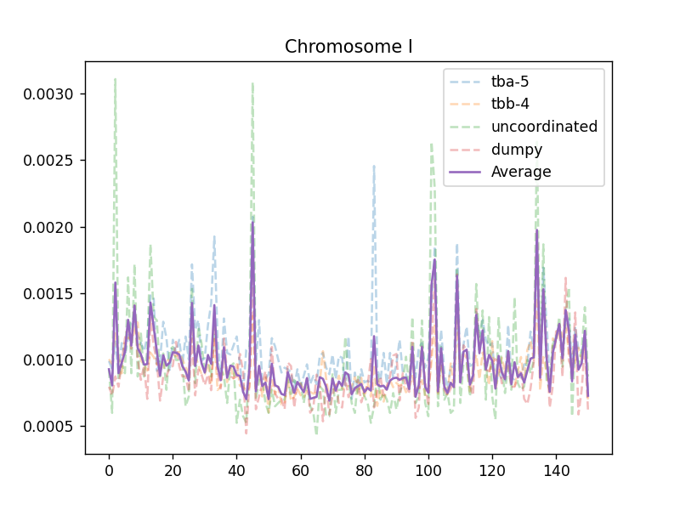
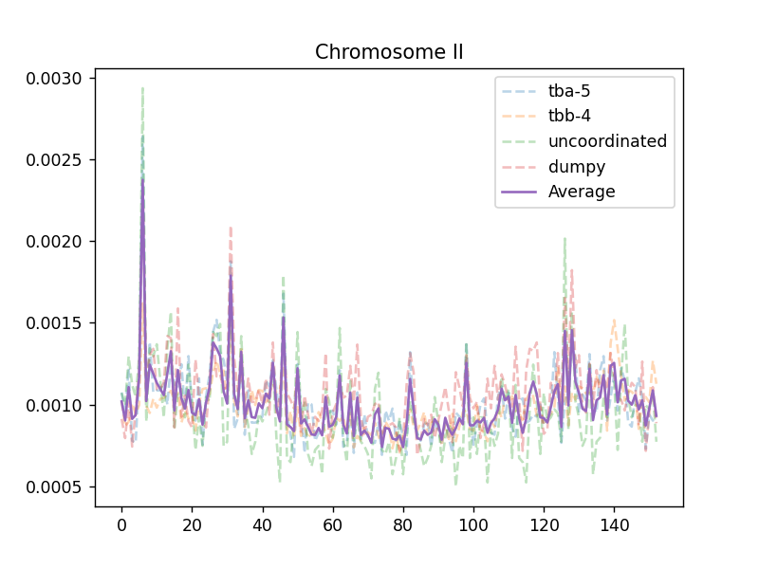
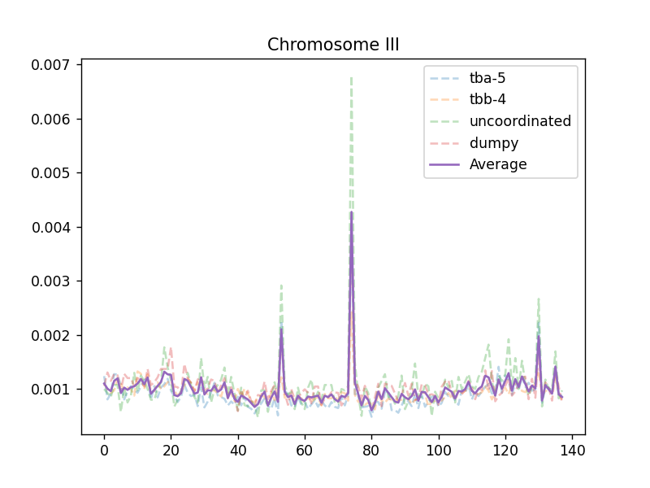
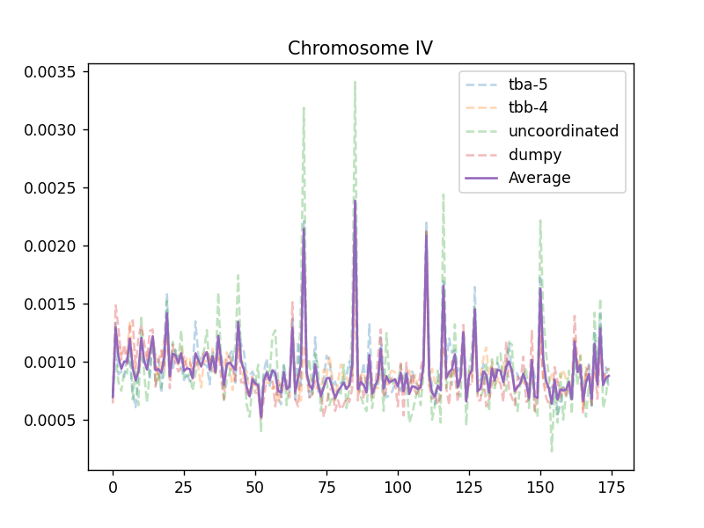
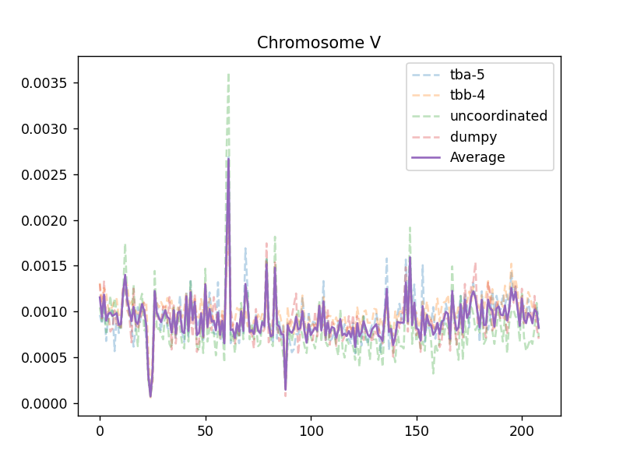
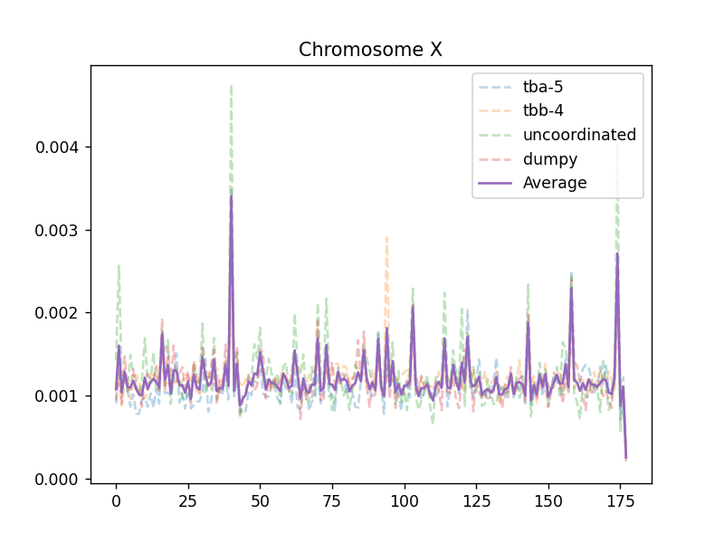

Slide 37
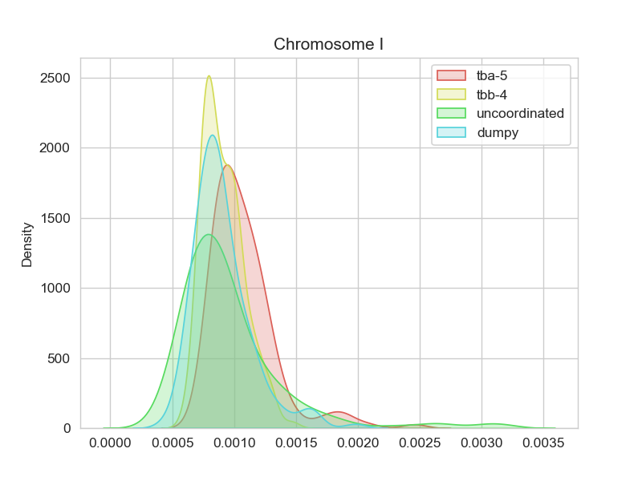






Slide 38


Std.

Slide 39


High frequency outlier
（≥Mean ± std）
Low frequency outlier
（≤Mean ± std）

Slide 40


High frequency outlier
（≥Mean ± 2*std）
Low frequency outlier
（≤Mean ± 2*std）

Slide 41

thriple-base in high freq region

Slide 42

thriple-base in low freq region

Slide 43

Residue（high-low）

Slide 44

High-std

Slide 45

Low-std
Percentage of A-T,G-C

Slide 46




A/T percentage
dumpy
P(MUT)
lg(P(MUT))
A/T percentage
2
P(A/T) – 0.6
(P(A/T) – 0.6)

Slide 47


P=3.150339e-25
Spearman = -0.2286
y = -21.59x-7.587
P(MUT)
lg(P(MUT))
P(A/T) – 0.6
(P(A/T) – 0.6)

