Slide 1
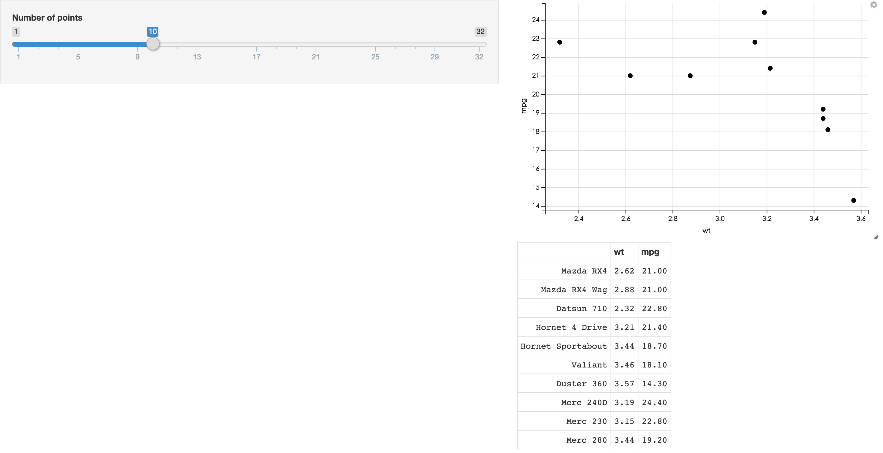
Homework 4
https://jmchang.shinyapps.io/ggvisExample/

Slide 2
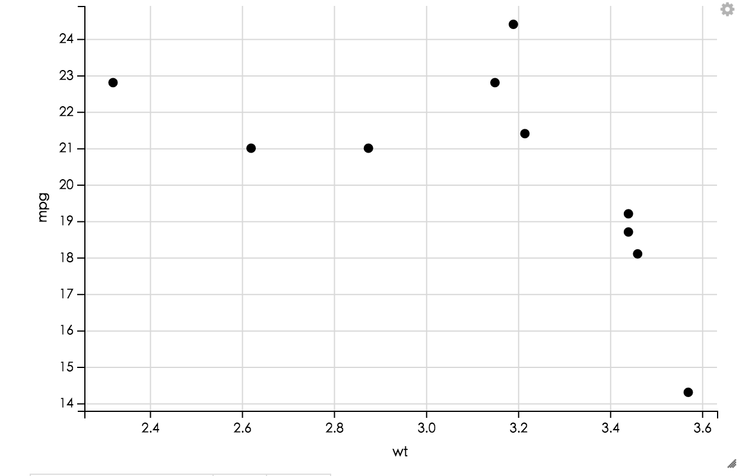
Homework 4
https://<yourname>.shinyapps.io/hw4/
Please make a shiny interactive web site to show the evaluation result of attached methods.
Select option
Method
method1
method2
…
sensitivity
1-specificity
method1
persons,prediction,reference,pred.score
person1,male,male,0.807018548483029
person2,male,male,0.740809247596189
person3,female,male,0.0944965328089893
person4,female,female,0.148418645840138

