Slide 1
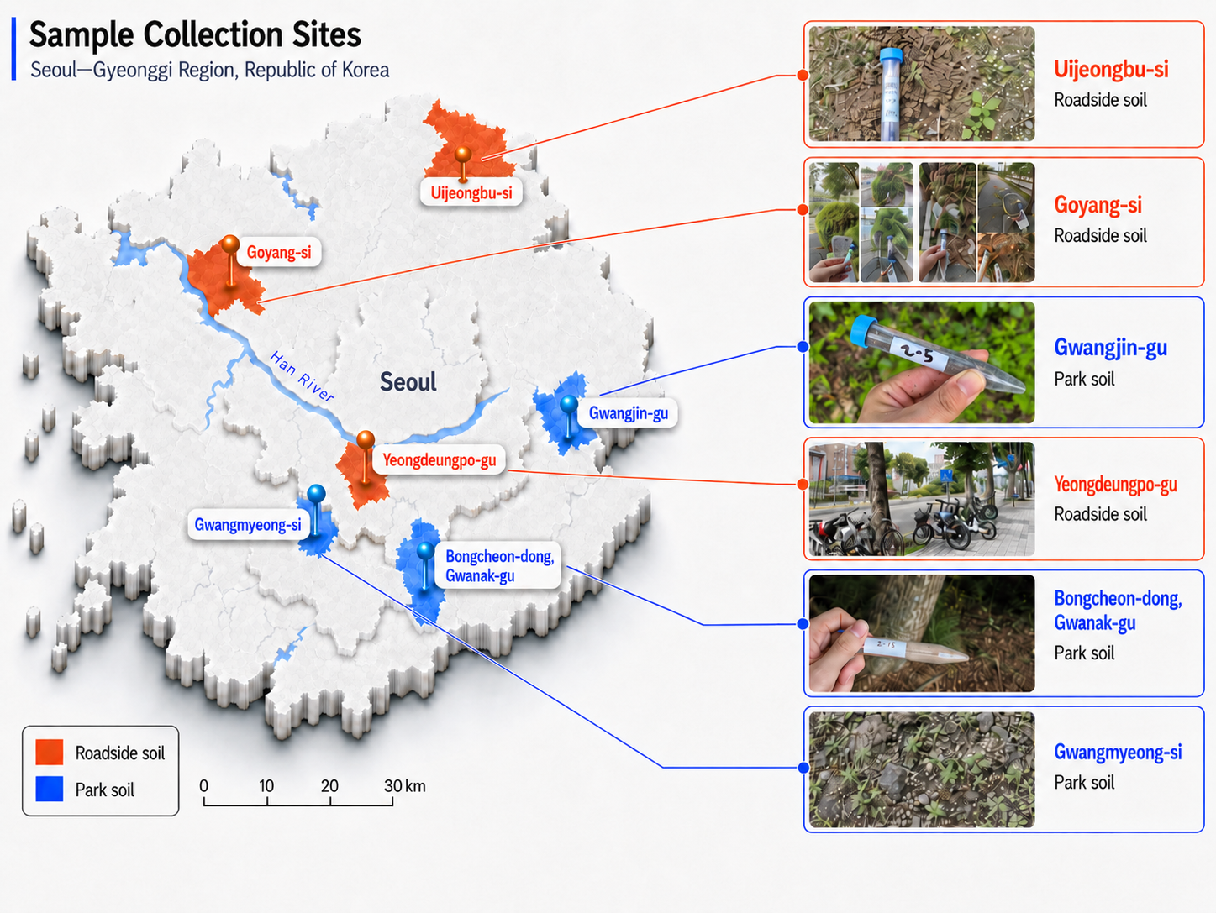
토양 채취 지역 사진

Slide 2
sampling 도식화

Slide 4
Metis 배양 조건 OD값 table

Slide 5
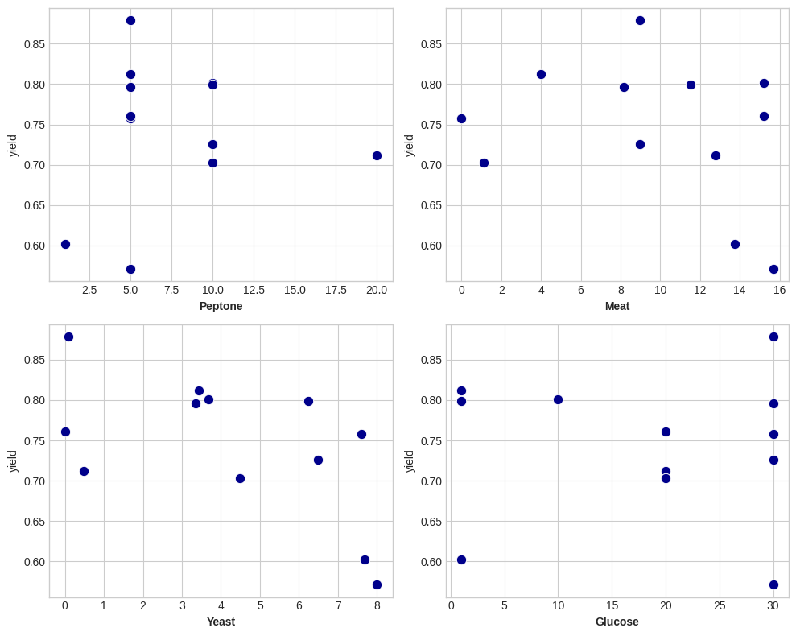
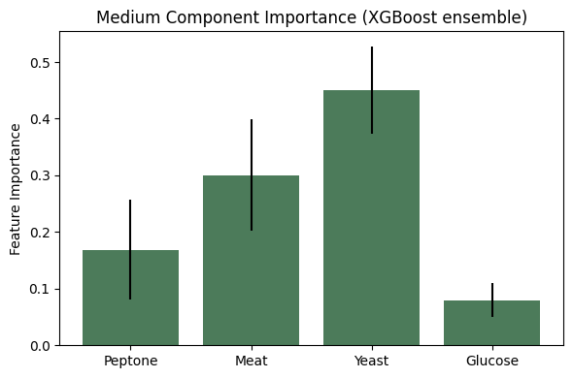
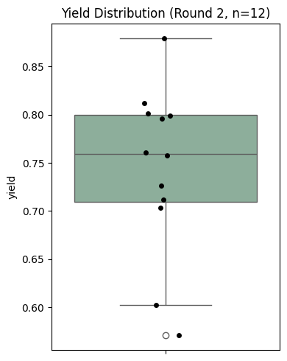
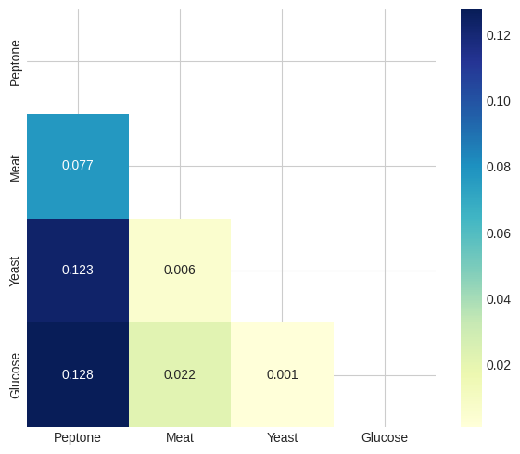
Metis 배양 조건 최적화에 대한 scale-up results

Slide 6
box plot (Alpha diversity)
A
Observed
Chao1
ACE
60
60
60
40
40
40
Observations
Observations
Observations
20
20
20
0
Soil
Park Soil
0
Soil
Park Soil
0
Soil
Park Soil
B
Shannon
Simpson
Fisher
4
1.0
1.0
3
0.8
0.8
Observations
Observations
Observations
2
0.6
0.6
1
0.4
0.4
Soil
Park Soil
Soil
Park Soil
Soil
Park Soil
Soil
Park Soil

Slide 7
box plot (Beta diversity)
A
Bray-Curtis Index
Jensen-Shannon Divergence
Jaccard Index
0.6
0.50
0.25
0.3
0.25
0.0
0.00
[14.8%]
[20.9%]
[10.1%]
0.00
-0.3
-0.25
-0.25
-0.6
-0.50
-0.50
-0.4
0.00
0.4
-0.4
-0.2
0.0
0.2
0.4
-0.4
0.00
0.4
[20.7%]
[26.3%]
[14.9%]

Slide 8
PCoA

Slide 9
Clustering

Slide 10
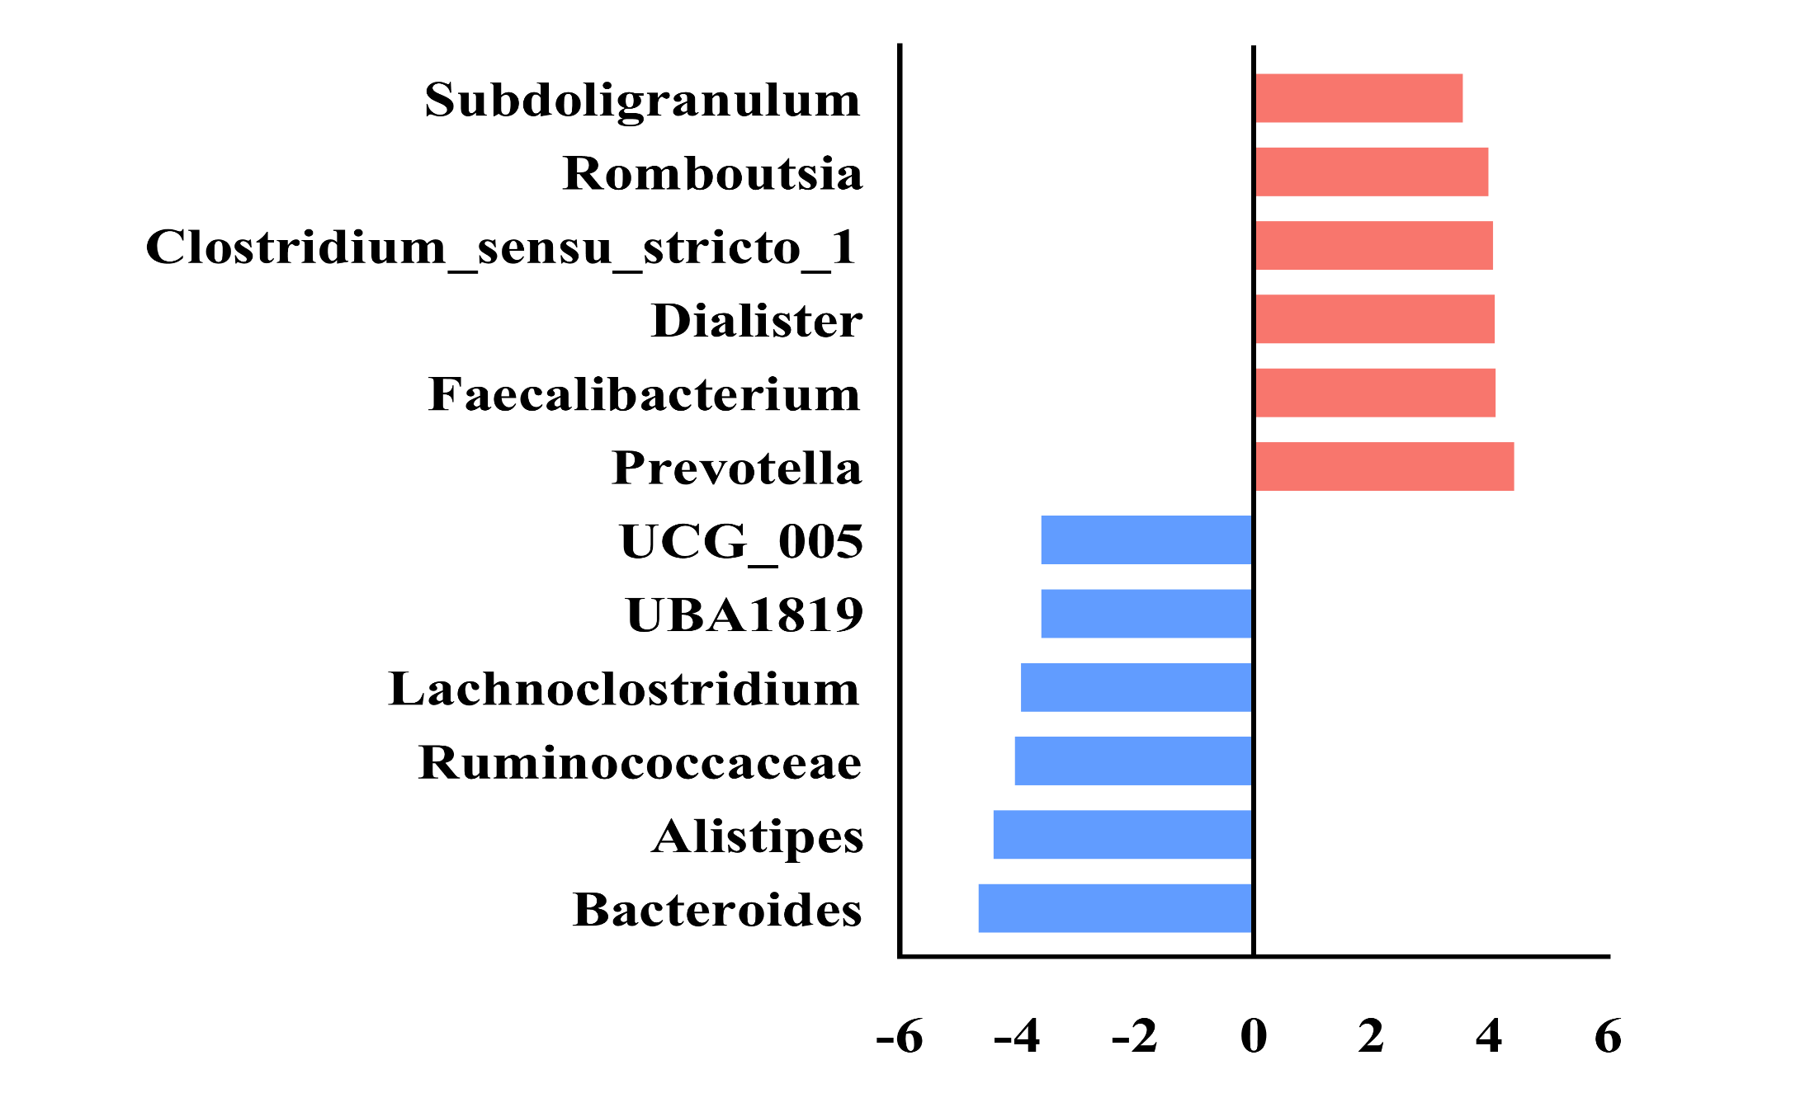
LEfSe
Subdoligranulum
Romboutsia
Clostridium
Sensu stricto 1
Dialister
Faecalibacterium
Prevotella
Features
UCG_005
UBA1819
Lachnoclostridium
Ruminococcaceae
Alistipes
HC
Bacteroides
OVCF
- 6
- 4
- 2
0
2
4
6
LDA Score

Slide 11
Figure5. Taxonomic

