Slide 1
Mass Storage

Slide 2
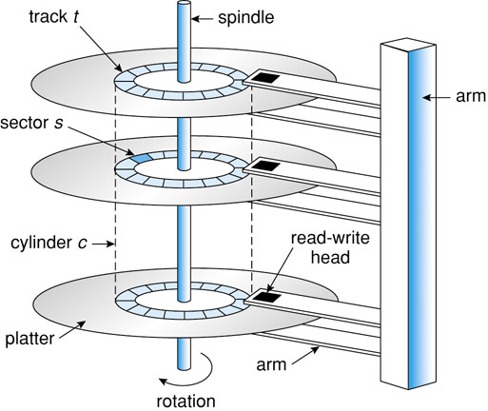
Magnetic Disks
Parts
Components of delay
Seek Time – Move head
Latency – Spin sector under head
Transfer Rate – Read data
I/O bus connection
Disk controller

Slide 3
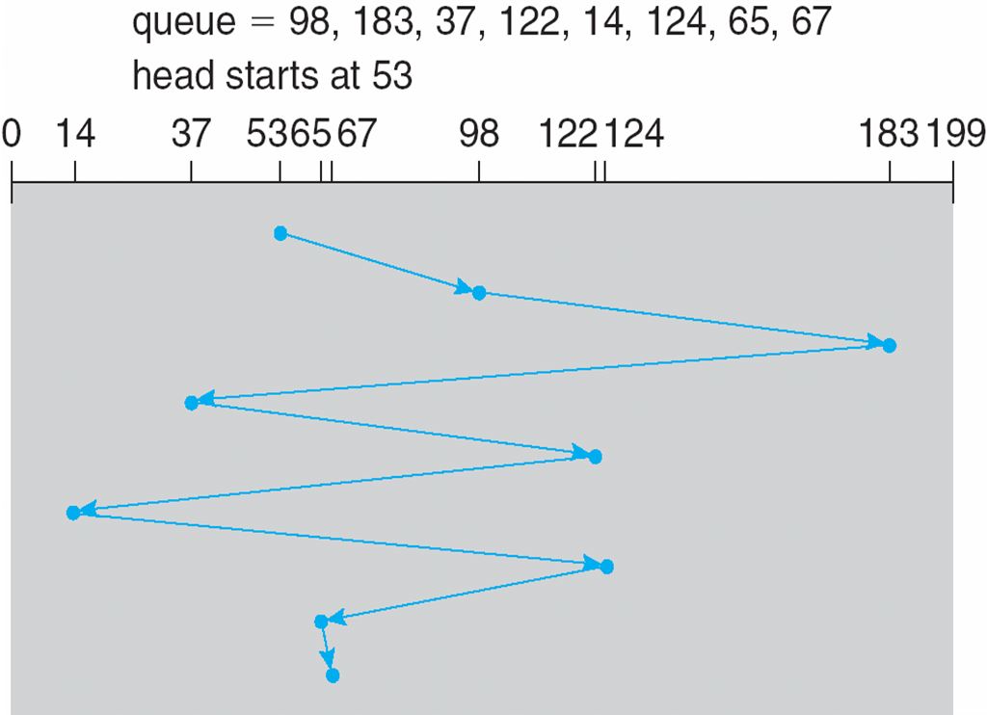
Disk Scheduling
Need to minimize seek and latency
To which cylinder do I next move the head?
Does it matter?
Consider FCFS
Total head movement = 640 cylinders

Slide 4
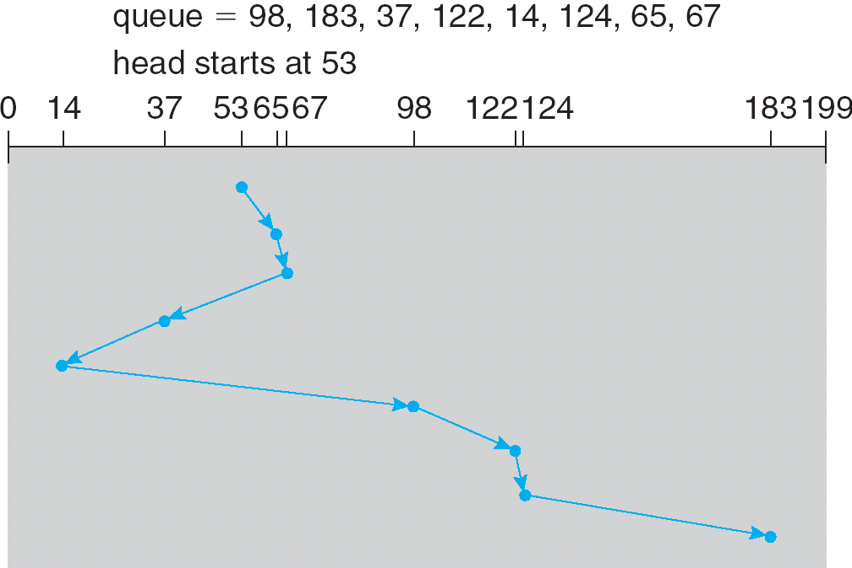
Shortest Seek Time First (SSTF)
FCFS exhibits wild swings
Idea: Go to nearest cylinder
Total head movement = 236 cylinders

Slide 5
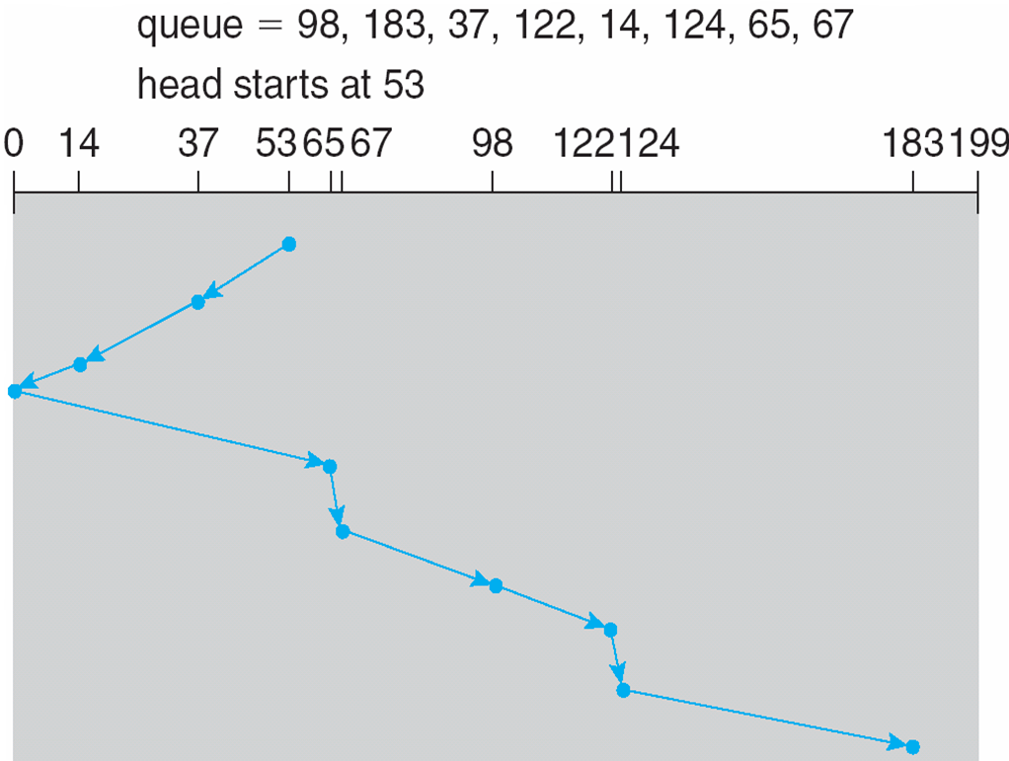
Scan (AKA Elevator)
SSTF may cause starvation (like SJF)
Idea: Keep moving in the same direction
Total head movement = 208 cylinders

Slide 6
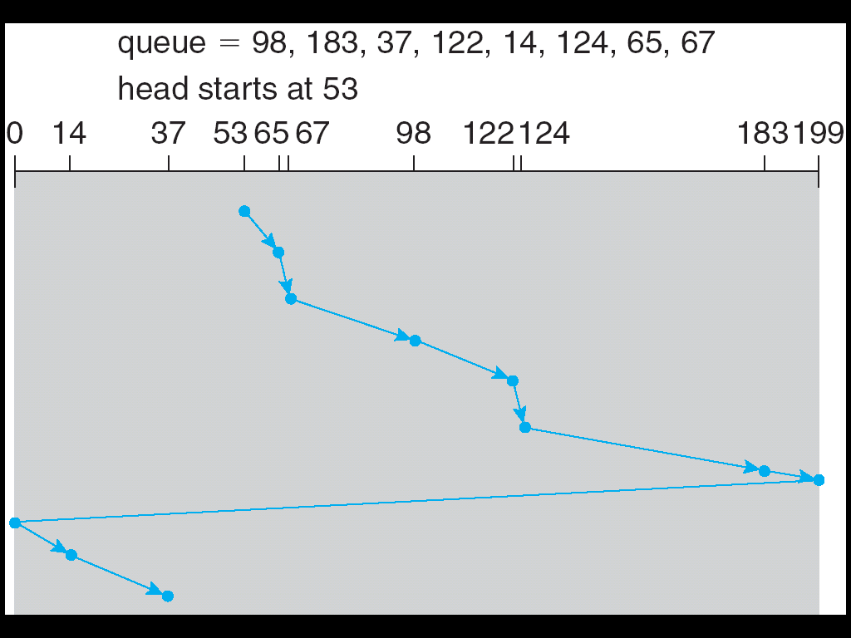
Circular Scan (C-Scan)
When Scan finishes a pass, it first covers the cylinders it just completed
Idea: Always scan from lowest to highest
Reduces average wait time
Look/C-Look is a variant of Scan where arm stops at final request (instead of min/max cylinder)

Slide 7
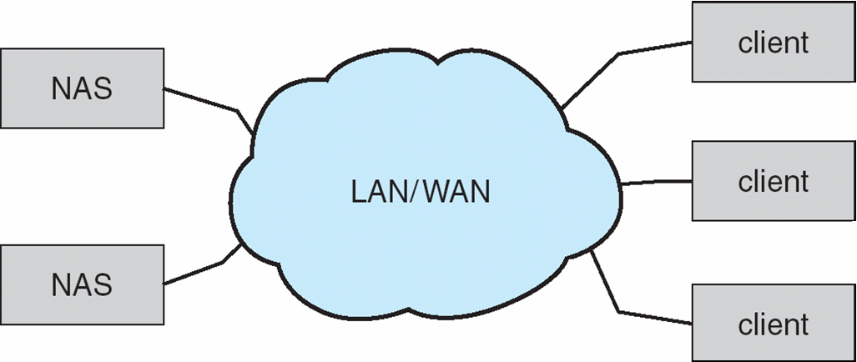
Network-Attached Storage (NAS)
Individual storage systems accessible over network (as opposed to local bus in host-attached storage)
NFS (*NIX) and CIFS, Common Internet File System (Microsoft Standard)

Slide 8
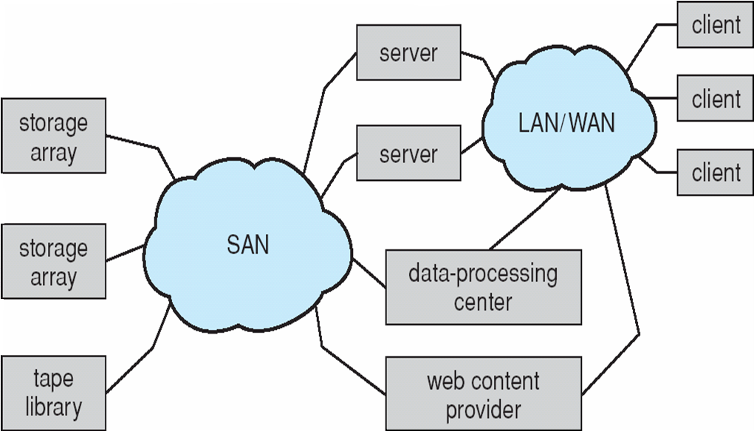
Storage-Area Network (SAN)
NAS congests shared network
SAN uses dedicated network
Connects storage units and servers using specialized (i.e., not TCP/IP) protocols

Slide 9
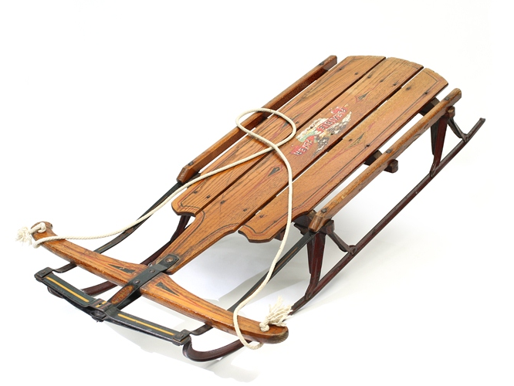
RAID
Single disk slow (even with good scheduling)
Idea: Spread data over several smaller (cheaper) disks and read in parallel
Redundant Array of Independent (originally Inexpensive) Disks
SLED (Single Large Expensive Disk)

Slide 10
RAID 0 - Striping
How do we spread data over disks?
Place interleaved chunks of data on separate disk
Advantage: Parallel I/O
High I/O request rate OR
High data transfer capacity
0, 4, 8, 12…
1, 5, 9, 13…
2, 6, 10, 14…
3, 7, 11, 15…
RAID 0

Slide 11
Data Lost
Disk failure?
Can recovery from backup but
Most recent changes are lost
Replacement of disk and restoration = downtime
Multiple disks increase chance of failure
If disks each have MTTF of 20,000 hours
RAID with 4 disk have MTTF of 5,000 hours
Solution
Mirror data on multiple disks
If one disk fails, you can continue operation
Reads can be serviced by disk with minimum seek/latency
Writes must be performed to all copies (in parallel)
0,4,8,12…
1,5,9,13…
2,6,10,14…
3,7,11,15…
0,4,8,12…
1,5,9,13…
2,6,10,14…
3,7,11,15…
RAID 1 - Mirroring

Slide 12
RAID with Parity Blocks
RAID 2-4 – Various Parity Strategies
RAID 5 (Block Distributed Parity) - RAID 4 but distribute parity blocks
RAID 6 (P+Q Redundancy) – RAID 5 with additional redundancy information (needs N+2 disks), but can recover from 2 disk failures
blk1
blk2
blk3
blk4
p(0-3)
blk5
blk6
blk7
p(5-8)
blk8
RAID 5

Slide 13
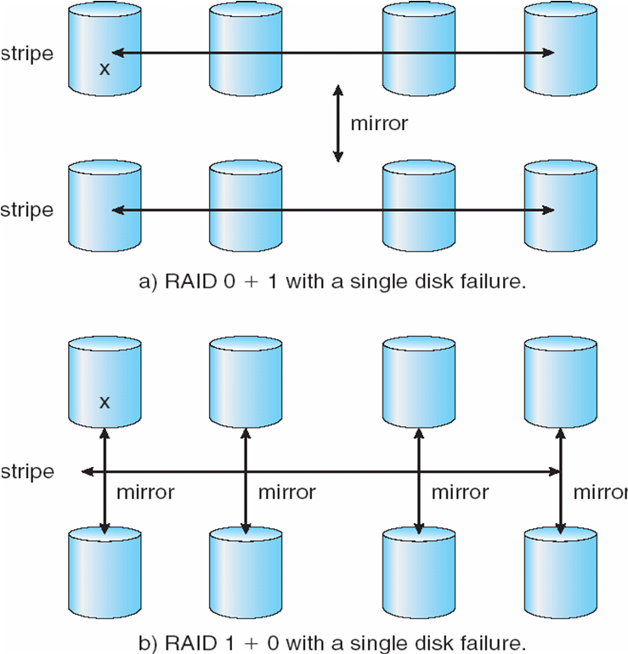
RAID 0+1
Stripe then mirror
Given 8 disks
Divide into 2 sets of 4 disks
Stripe (RAID 0) across the first set
Mirror (RAID 1) across the second set

Slide 14
RAID 1+0
Mirror then stripe
Given 8 disks
Divide into 4 sets of 2 disks
Mirror (RAID 1) each set
Stripe (RAID 0) across all sets

Slide 15
0+1 and 1+0: What’s the diff?
Fault tolerance!
Drive 3 Fails
RAID 0+1 – Loses stripe (1-4)
RAID 1+0 – All drives except 3 continue to operate
Now Drive 6 Fails
RAID 0+1 – Loses second stripe (5-8) and operation halts
RAID 1+0 – All drives except 3 and 6 continue to operate
1
2
3
4
1
3
5
7
5
6
7
8
2
4
6
8
RAID 0+1
RAID 1+0

Slide 16
Tertiary Storage
Characteristics
Large data storage
Inexpensive (per byte)
Removable (Slow access)
Large seek time (Slow access)
CD, DVD, Magnetic Tape, etc.

Slide 17
Magnetic Tape
Removable cartridges of tape
Poor random access so typically used for backup
Tape material stretches and contracts
Difficult to accurately perform random writes
Typically append-only or overwrite

Slide 18
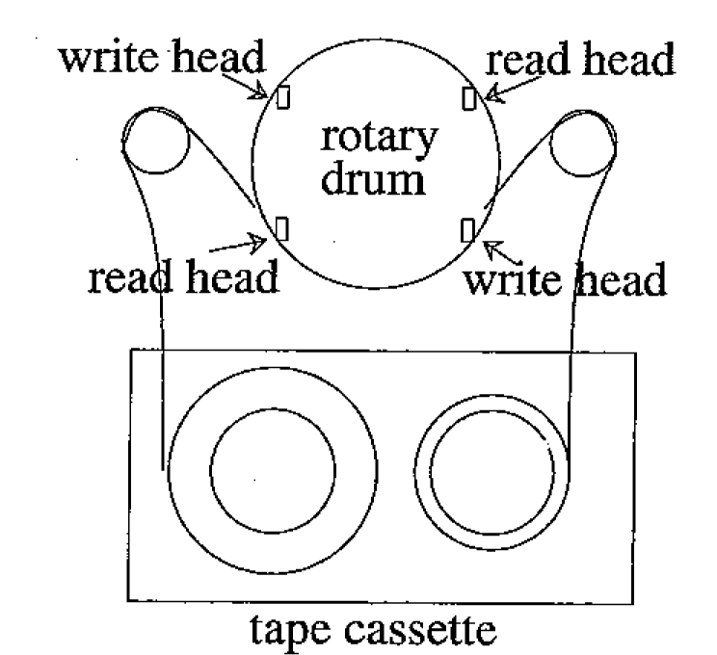


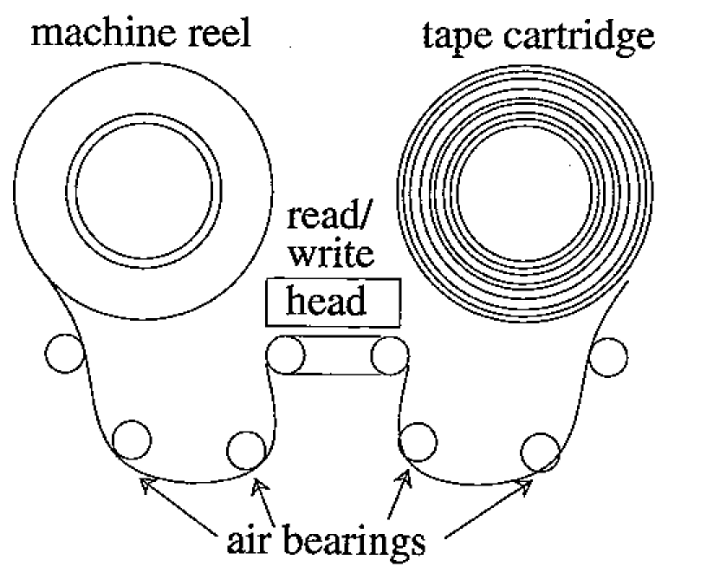
Tape Types
Linear – Bits
Written in lines perpendicular to tape edge
Read by stationary head
Helical – Bits
Written at an angle (10-20⁰) across tape
Decreases intersymbol interference allowing greater bit density (i.e., more bits-per-inch)
Allows greater data rate and faster seek
Read by rotating head
Destructive! (Think sander)
Tape Jukeboxes

Slide 19
CD-ROM
Compact Disc, Read-Only Memory
Offspring of videodisc technology from the early 70s
CD-ROM is digital data format built on top of CD audio standard
Audio standard provided a mechanism for reading a byte
CD-ROM added standard file system
Leveraged cheap audio CD manufacturing technology for CD-ROMs
CD designed for audio applications
High-storage capacity
Moderate transfer rates
Poor seek performance
CD-ROM seek time is 500msec and can take over a second
Magnetic disks average seek time is around 25 msec
Data encoded by burning (or not) pits into the surface
Read a CD with a laser: Lands reflect light; pits scatter

Slide 20
DVD
Digital Video Disc or Digital Versatile Disc
Formats: DVD +/- R/RW
Speed: 1x DVD-ROM = 1.321 MB/s (9x CD)
Video encoded as MPEG-2
Country codes

Slide 21
DVD Size
Much larger than CD
Smaller pit length (~2.08x)
Tighter tracks (~2.16x)
Slightly larger data area
7 times a standard CD-ROM
Dual-layer discs
Double-sided

