Slide 1
File Systems

Slide 2
Main Memory
Problems with memory…
Limited Capacity
Already using secondary storage to compensate
Cost
Expensive per byte
Persistence
Process termination, machine crashing, output from one process as input to another, etc.
Portability
Share with different computers, off-site backup, etc.

Slide 3
Secondary Storage
Cannot put everything in main memory so…
Write data to secondary (or below) storage
How do we write to secondary storage?
Device writes sequence of bytes
Burning questions
Where to write (disk sharing)?
For next process, where to read?
Need structure

Slide 4
File Abstraction
Logical storage unit mapped by OS to device
User view
Named collection of bytes (defined by user)
Untyped or typed
Examples: text, source, object, executables, application-specific
Permanently and conveniently available
Operating system view
Map bytes as collection of blocks on physical non-volatile storage device
Magnetic disks, tapes, NVRAM, battery-backed RAM
Persistent across reboots and power failure

Slide 5
File Metadata
System information associated with each file
Name – Symbol for user access
Type – Generalization of the kind of data in file
Location – Pointer to file on device/disk.
Size – Current file size (blocks, bytes, etc.)
Permission – Controls file operation (e.g., read, write, delete, etc.) access
Protection – Controls file use (e.g., read-only)
Access – File locks
Special – File properties (e.g., hidden, system, archivable, etc.)
Usage data – Time (creation, modification), date, owner
Metadata is stored on disk

Slide 6
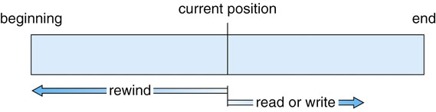
File Operations
Create
Read/Write
Sequential Access
Random Access
Relative Offset
Absolute Offset
Get/Set Attributes
Rename
Delete
Truncate

Slide 7
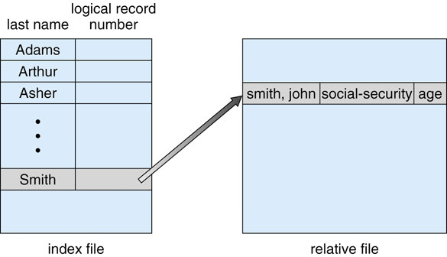
Internal File Structure
OS writes sequence of bytes
Application can encode complex structure
Type
Associates file with purpose and/or application
Determines internal structure
Determined by
Extension
Magic number (at the start of file)
OS Metadata

Slide 8
Directories
Need to store many files
Directory contains a set of files
Operations
Create/Delete file
List directory contents
Search for a file
Navigate directory

Slide 9
Directory
Single-level directory
Each file has unique name
Special part of disk holds directory listing
<file name, meta-data index> pairs
Simple
Problem: Each file must have a unique name

Slide 10
Tree-Structured Directory
Directory contains both files and other directories
Top-level directory is called the root (e.g. “/” in *NIX)
Each process designates a current/working directory
Paths
Tells you where a file or directory is in the tree
Absolute – Path specified from the root (e.g., /var/log/apache/error.log)
Relative – Path specified from the current/working directory (e.g., apache/error.log)
Path Separator – Special character in path name separating directories (‘/’ for *NIX, ‘\’ for Windows)
Special relative directory paths
‘.’ – current directory
‘..’ – parent directory

Slide 11
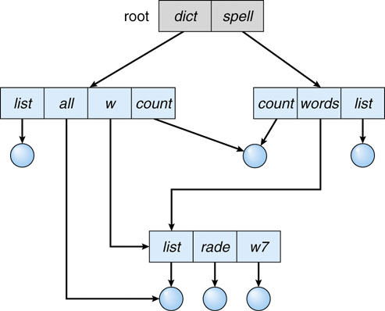
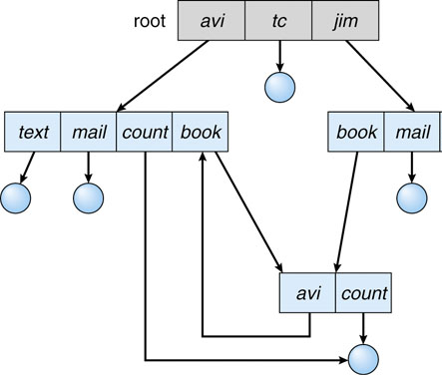
Graph Directories
More general than tree structure
Add connections across the tree
Create links from one file (or directory) to another
Types - Acyclic and General
General graph directory structures allow loops which complicates search (infinite loops)

Slide 12
Links
A link is a reference to a file/directory
Useful for sharing files/directories
A file/directory can be shared by giving each person her own link (pointer to it)
ln <existing-file> <new name>
In directory ~fendt
ln example.c /home/www/ex.c
/
/home/fendt/example.c
and
bin
home
tmp
/home/www/ex.c
www
fendt
a.txt
tucker-todo.txt
g.txt

Slide 13
Creating Links
Changes to a file affect every link
% cat file_a
This is file A.
% ln file_a file_b
% cat file_b
This is file A.
% echo “appending this to b” >> file_b
% cat file_b
This is file A.
appending this to b
% cat file_a
This is file A.
appending this to b

Slide 14
Linking Directories?
Should it be permitted?
Problem: Cycles in a file system degrade performance
Avoid traversing portion of file system multiple times
Determine deletion: Reference count may be non-zero, even if there is no possible way to refer (find) to file or directory
Self-referencing
How do we guarantee no cycles?
Allow only links to file not subdirectories
Garbage collection (mark everything that can be accessed via root directory then delete everything else)
Every time a new link is added use a cycle detection algorithm to determine whether it is OK?

Slide 15
Link Types
Links come in two flavors
Hard link
Reference (file system specific) to start of file on disk
Link and original file must be on same file system
Often indistinguishable from original file
Symbolic link
Indirect reference to a file
Stores the pathname of the file that it points to
Symbolic links can link across file systems

Slide 16
File Locking
What happens when
two processes edit the same file?
one process reads what another process is in the middle of updating?
We need to coordinate
Most OSs provide file locks
File locking is really record locking
Lock range of bytes (not necessarily entire file)

Slide 17
Lock Types
Enforcement
Mandatory: OS enforces lock (Windows)
Advisory: Software must enforce (*NIX)
Operation
Read: Allows many readers and no writers
Writer: Allows only one writer and no readers

Slide 18
File Locking Example
SummerLockingWriter.java
RandomAccessFile JavaDoc
FileChannel
FileLock (shared, byte range, etc.)
Can lock byte range (not needed here; just for example)
Run (and leave running)
SummerLockingDisplay.java
Run – Explain Exceptions (truncation race) and bad sum (write race)
Enable locking and run on NFS
Doesn’t work. Why? In Linux 2.6 kernel, cache coherency was weakened for efficiency impacting lock sharing. Can add mount option to fix (noac) – See http://nfs.sourceforge.net
Run on local FS (/tmp) – Compare execution time with and w/o locks
sumWriter.c
Man fcntl and lock types
Why does or doesn’t it work?

