Slide 1
Security

Slide 2
Security Services
Confidentiality – Control who can see what
Integrity – Prevent unauthorized modification of data
Authentication – Verify identity of data source
Availability – Prevent denial of service
Accessibility – Control who can receive service

Slide 3
Points of Compromise
Physical – Inappropriate site access
Human – Compromise credential holder
Social engineering (phishing, pretexting, etc.)
Operating system – Compromise protector
Network – Compromise transport

Slide 4
Cryptography: Security Primitive
Encryption – Limit who can use data
Based on certain things being hard to compute
Plaintext – Original data
Ciphertext – Encrypted text
Symmetric Key
Single key for both encryption and decryption
E_{k}(E_{k}(M)) = M
Alphabet-Shift
Key is number of letters to shift in alphabet
“Cat” with K=3 is “Fdw”
Problem: Only 26 keys
Requirements
Hard to compute key
Hard to compute plaintext from ciphertext
True even when given plaintext/ciphertext pairs

Slide 5
Symmetric/Secret Key Encryption
Data-Encryption Standard (DES)
56-bit key + 8 bit parity = 64 bits
No longer considered secure
Triple DES
DES repeated
2 or 3 key variants up to 168 bit key
Advanced Encryption Standard (AES)
128 to 256 bit keys
Cipher Types
Block Cipher – Works in chunks of bits (e.g., AES, etc.)
Stream Cipher – Works in bytes/bits (e.g., RC4)
Generates keystream of keys for encryption

Slide 6

Steganography
Hide secret in plain sight
Writing, sound, image
Must know “key” to extract secret
Used to watermark copyrighted work
Original Image
Original Image +
Complete text of 5 Shakespeare plays

Slide 7
Symmetric Key Problems
Key Distribution Problem
Need to provide secret key for private channel
Need private channel to send secret key
Go to 1
Nonrepudiation
Bob claims Alice agreed to pay him
Produces email encrypted with shared, secret password as proof
Who could have encrypted the email?

Slide 8
Asymmetric/Public Key Encryption
Entity assigned two keys: public and private
Public (P) key (surprise) is widely distributed
Private (S) key is kept as a secret
Encrypt with P (S); decrypt with S (P)
E_{p}(E_{s}(M)) = M and E_{s}(E_{p}(M)) = M
RSA
Requirements
Hard to compute private key, even when give public key
Hard to compute plaintext from ciphertext
True even when given plaintext/ciphertext pairs

Slide 9
Using Asymmetric Key Encryption
Bob and Alice
Secret Keys: SB and SA
Public Keys: PB and PA
Privacy – Encrypt w/ receiver public key
E_{PA}(M) – Only Alice knows SA so…
Authentication – Encrypt w/ sender private key
E_{SB}(M) – Only Bob knows SB so…
Also provides non-repudiation (only Bob knows…)
“Digital Signature”
Privacy and Authentication
E_{SB}(E_{PA}(M))

Slide 10
Slow: Asymmetric Encryption at Play
Asymmetric encryption about 1000 times slower than symmetric encryption
Idea for privacy
Generate random session key, K
Encrypt message with K, E_{k}(M)
Encrypt K with public key, E_{PA}(K)
Send E_{k}(M) and E_{PA}(K)
Only Alice can decrypt K and K need to decrypt M
K is fixed-length and small so cheap to encrypt with asymmetric encryption
M encrypted with cheaper symmetric encryption
Authentication?

Slide 11
One-Way Hash Functions
One-way (“cryptographic”) hash functions f(M)
Generates fixed-size fingerprint of data
Computing f(M) easy
Finding M’ such than f(M) = f(M’) hard
Idea for authentication
Generate hash, f(M)
Encrypt hash with private key, E_{SB}(f(M))
Send M and E_{SB}(f(M)) = Digital signature
Receiver receives message, M*, and signed hash, SH
Receiver verifies that f(M*) = E_{PB}(SH) to know if M* = M
Why do we need to use a one-way hash?

Slide 12
Key Distribution
Bob sends Alice email signed with his private key
Alice needs Bob’s public key
Options
Out-of-band communication of key (practical?)
Trusted intermediary
Certificate: User identity and public key signed by trusted third party
Certificate Authority: Trusted third party whose public key is already distributed
Solution
Bob sends Alice his certificate signed by certificate authority
Alice verifies Bob’s signed public key
Alice verifies email from Bob with his public key

Slide 13
Attacks
Social engineering
Tricking a user into giving up critical information or performing a task
Phishing
Pretexting – Requesting information for seemingly legitimate purpose
Social networks – Password access/reset by answering challenge questions based on “private” information accessible through social networks
Kevin Mitnick – Famous hacker used social engineering almost exclusively to compromise major corporations, government, etc. See The Art of Deception

Slide 14
Attacks
Logic Bomb – Code that when activated causes damage
Trap Door – Special code that when triggered circumvents normal security
Spoofing – Fake login screen (used in phishing)

Slide 15
Buffer Overflow Attack
Consider the following code
Provide filename longer than buffer can hold
Return address
Parameters Local vars
int processFile(char *filename) {
char path[1024];
strcpy(path, "/usr/log/");
strcat(path, filename);
// File processing
}
path
SP
Create special filename that overwrites return address to execute something evil
Solutions
Constrained string functions: strncpy(), snprintf, etc.
Testing using programs like valgrind/electric fence
Use source code analyzers

Slide 16
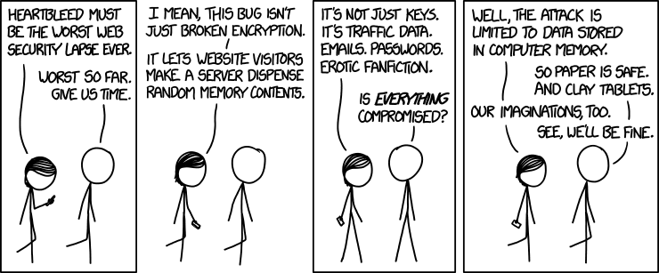
Heartbleed Attack
xkcd.com/1353/
In 2014, a flaw was discovered in OpenSSL, an SSL library used by almost 70% of websites.
This flaw fully compromises all past, present, and future (if key not changed) communication: "This compromises the secret keys used to identify service providers and to encrypt the traffic, the names and passwords of the users and the actual content. Without using any privileged information or credentials, we were able to steal from ourselves the secret keys used for our X.509 certificates, user names and passwords, instant messages, emails and business critical documents and communication.”

Slide 17
Heartbleed (Actual) Code
TLS heartbeats contain: a type (request/response), payload length (16-bit), and payload (up to 64KBs). The proper response to a heartbeat request is a response “…carrying an exact copy of the payload…” [RFC6520]
#ifndef OPENSSL_NO_HEARTBEATS
int tls1_process_heartbeat(SSL *s) {
...
unsigned short hbtype;
unsigned int payload;
unsigned int padding = 16; /* Use minimum padding */
/* Read type and payload length first */
hbtype = *p++;
n2s(p, payload); COPIES NEXT TWO BYTES (SHORT) INTO payload AND INCREMENTS p
pl = p;
...
if (hbtype == TLS1_HB_REQUEST) {
...
/* Enter response type, length and copy payload */
*bp++ = TLS1_HB_RESPONSE;
s2n(payload, bp);
memcpy(bp, pl, payload); payload NEVER CHECKED IF LONGER THAN MESSAGE
memcpy() is allowed to copy payload bytes of memory, irrespective of the size of the actual message payload. What if payload = 64KB, but actual payload is 1 byte?

Slide 18
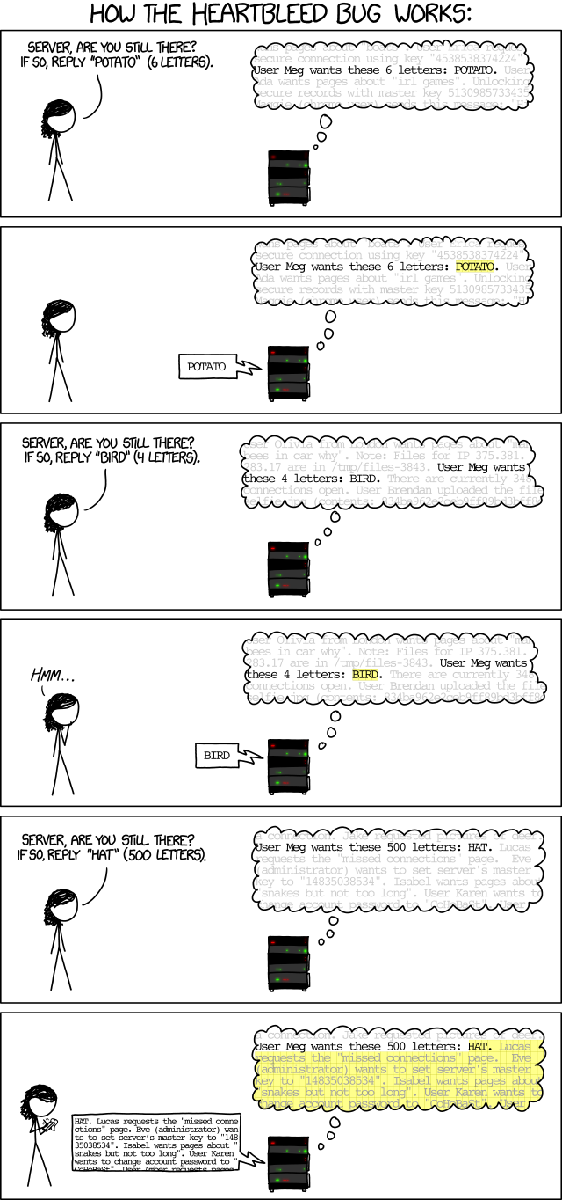
http://xkcd.com/1354/

Slide 19
Format String Attack
What does the following code do?
What does the following code do?
Consider the first printf again with
char *name; … printf(name);
Return address
Parameters Local vars
name
int i;
printf(“123%n\n”, &i); // i = 3
SP
name = “123%n456%n”
printf assumes 3 parameters on stack (format string and 2 integers for %n
Similar problems and solutions to buffer overflow attack

Slide 20

Code Injection Attack
Source:
XKCD.com
Actual team names entered in the ICPC system
(DROP TABLE Teams)
(DELETE FROM Teams WHERE name NOT LIKE ‘ZZZ’)
What’s going on?
Dynamic queries…
SELECT * FROM teams WHERE teamname = $teamname
Script to cat files from secret directory
void secretCat(char *name) {
char *SECRETCMD = "cat /usr/secret/";
int len = strlen(SECRETCMD) + strlen(name) + 1;
char *cmd = malloc(len);
snprintf(cmd, len, "%s%s", SECRETCMD, name);
system(cmd);
free(cmd);
}

Slide 21
Privilege Escalation Attack
Trick system into giving me access rights that I don’t have
Example on *NIX
Files in /etc/cron.d treated like cron entries and executed as root
Regular user cannot write to /etc/cron.d
Trick
Set current directory to /etc/cron.d
Force core dump (dumps to current directory)
Program designed so core dump is properly formatted cron file

Slide 22
Malware
Malicious Software
Not just to be mean anymore…
Organized crime creates botnets (robot network) of zombies (you) to do bidding
Extortion
DDoS Attack
Keylogger (identity theft)
Spambot

Slide 23
Malware to Myware
How do I get some of this fine malware…
Trojan Horse - Get victim to execute software that installs evil software
path trick – Rename evil program to actual or mistyped program name
“free software” – Embed evil software

Slide 24
Virus
Code that can replicate itself by attaching to another program, document, file system, etc.
Typically injected as part of legitimate program or document
When executed/opened, it attempts to infect other programs/documents (and other evil)
Types
Memory resident - Stays resident in memory
Boot Sector – In MBR (executes before OS)
Macro – Part of a document scripting language
Source Code – Changes source, not executable
etc.
Spreads by tricking users into executing/opening/using infected executable/document/resource

Slide 25
Malware
Worm
Self-replicating program
Like a virus but doesn’t need host
Typically exploits bugs in OS
Spyware
Rootkit – Hidden malware designed to control some aspect of system
Sony added rootkit through music CDs that prevented copy system calls to/from CD

Slide 26
Defense Mechanisms
Attacks on vulnerable system
Defective software running services
Scan ports until find service then attack
Response to network stimuli identifies OS, etc.
Firewall
Control which traffic makes it to a host
Can deny or allow based on source/destination port/IP address
Problem: Still leaves some ports open

Slide 27
Defense Mechanisms
Code signing – Sign code with secret key of trusted party
Virtual machines – Operate code in VM sandbox that limits capabilities (e.g., Java)
Jailing – Temporarily run code in controlled environment and look for problems

Slide 28
Antivirus
Database of virus fingerprints
Scan executables, documents, etc.
Polymorphic viruses encrypt themselves to trick fingerprints
Antivirus software can watch for unusual behavior (i.e., system calls)

Slide 29
Intrusion Detection
Signature-based – Known patterns in system or network traffic
Misses new (zero-day) attacks (false negative)
Anomaly-based – Anomalous behaviors within system
Misidentify behavior as intrusion (false positive)
Tripwire – Monitor system for unexpected modifications (e.g., Fingerprint critical files like login). Must protect tripwire data (store on CD)
Honeypot – Isolated machine designed to attract attacks. Can be used to analyze or even contain attacks
Logging behavior, audit system (e.g., review configuration, analyze logs, etc.), and account for system resources (e.g., look for sudden changes)

Slide 30
System Security
Authentication
Validate user identity
Authorization
Determine user permissions
Let’s start with authentication

Slide 31

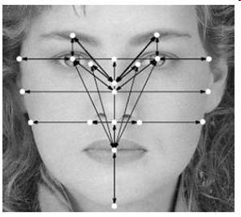
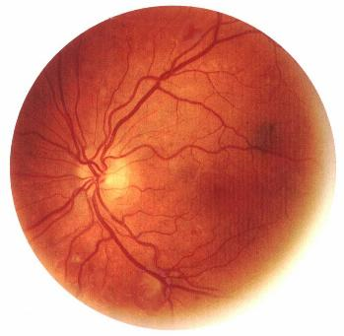


User Authentication
Methods
Something the user knows (e.g., password)
Something the user has
Something the user is (e.g., biometric)
Multifactor authentication

Slide 32
Passwords
Vulnerability | Defense
Guessing | Prevent dictionary attacks
Shoulder surfing | Be wary
Keyboard logger | Avoid malware
Sharing/Writing down | Don’t
Storing/Packet sniffing | Encrypt

Slide 33
Password Securificationismiology
Store passwords in file – File could be compromised
Store encrypted passwords – Mapping of typical (dictionary) to encrypted passwords could be precomputed
Store “salted” encrypted passwords – Password is concatenated with random n-bit string before being stored. Random string is also stored
One-time password
Book – Password list; each used only once
Chain – Pick secret, s, and number of passwords, n. P_{i-1} = f(P_{i}) and P_{n} = f(s) where f is a one-way hash function. The user only needs to know s, n, and i to compute password

Slide 34
Authorization
We know who you are…now what can you do?
Need to protect resources
Who can access it?
What can that person do with it (e.g., read, write, etc.)?
Domain – Set of (object, right) pairs
Right – Permission to perform operation
Processes run in one domain at a time but can switch
How do we use these capabilities?
Principle of least privilege – Limit privileges to “just enough”
Domain 1
Domain 2
Domain 3
File A[RW]
File B[R]
File A[RW]
File C[RWX]
File D[RW]
File C[RWX]
DVD[RW]
Printer[W]

Slide 35
UNIX
User assigned UID and GID at login in shell
Groups represent roles (e.g., admin, guest)
Process domain determined by UID/GID
UID/GID identifies set of accessible objects and permission on each object
Switching domains
SetUID/GID bit - Executing file with bit set changes protection domain
Executing a system call switches to kernel model which changes protection domain

Slide 36
Access Matrix
Need to track which objects are in which domain(s) and permission to switch between domains
Matrix is large and sparse (i.e., most domains have no access to most objects) so matrix is rarely used in actual implementations (expensive)
We explore alternative implementations
File 1
File 2
Printer
Domain 1
Domain 2
Domain 3
Domain 1
R | RW |  |  | Y
 | R | W
 | R |  |  |  | Y
Domain 2
Domain 3

Slide 37
Access Control Lists (ACL)
Idea: Implement matrix column as a list of (domain, rights) pairs associated with object
File 1: {(Domain1:R)}
File 2: {(Domain1:RW), (Domain2:R), (Domain3:R)}
Printer: {(Domain2:W)}
Domain as user
Password: {(Bob:R)}

Slide 38
ACLs and Groups
Domain can be user/group pairs
password: {(Bob, sysadmin:RW)}
blog: {(Bob, blogger:RW)}
When may Bob access password file?
Options
Only when he’s logged in group sysadmin?
Complex
Anytime because he’s in group sysadmin?
Can lead to mistakes
Use wildcard to distinguish
password: {(Bob, sysadmin:RW), (Jane, *:RW)}
Jane from any group; Bob only from sysadmin

Slide 39
Capabilities
Idea: Implement matrix row as a list of (resource, rights) pairs associated with domain
Domain 1: {(File 1:R), (File 2:RW)}
Domain 2: {(File 2:R), (Printer:W)}
Domain 3: {(File 2:R)}
Domain as user
Bob: {(Password:R)}
Can combine with groups

Slide 40
Lock-Key
Each object has an ACL implemented as list of (lock) ids and rights
Each domain has capabilities implemented as list of (key) ids
For each equal key and lock id, the user has the associated rights
Compromise between ACL and capability list

Slide 41
Comparison
ACLs - Object -> {(domain, right)…}
Good for users because user associates permissions for domains at creation time
Revocation easy for object (just search list)
Finding access rights for domain is expensive search
Capability Lists - Domain -> {(object, right)…}
Revoking access to an object is difficult because we have to find the reference in all domains
Hard to tell when no more references to object and, therefore, no access
Can use both

