Slide 1
Virtual Machines

Slide 2
Virtualization: The Next Logical Step
We’ve virtualized many resources
CPU: CPU scheduling - Process executes as if the only one
Memory: Logical address space – Process views all of memory (even beyond total physical memory) as its own
Disk: Files and directories – Process treats file system as its own

Slide 3
Virtualization: The Next Logical Step
Let’s virtualize entire host
Run virtual machine on physical machine
Operating system of guest can be completely unaware that it is running on virtualized hardware
OS
OS
Virtualization
OS
OS
OS
OS
Virtualization Kernel
Hardware
Hardware
Hardware

Slide 4
Why Virtualize?
Suspend/ snapshot VM
Different groups want different services (different VMs)
All services on a single machine
One service goes rogue and cripples machine
Service virtualization (one machine hosting different services)
Single web server differentiates virtual hosting using IP address or name
Problem
One group wants new scripting extension
One group wants PHP 4, another PHP 5
We need isolation and individualization

Slide 5
Why Virtualize?
Physical machine per-service
Isolation? Yes
Difficult to match server capability (now and in the future) to hardware. In recent survey, only 6% of data center server capability used
Little flexibility if estimated capabilities wrong
Wasted space, energy, maintenance, $$$
Test software on every variation (e.g., pre/post SP3) of every OS
Support legacy systems for history, accountability, curmudgeon
Developer needs access to supported OSs

Slide 6
Virtualized Machine
Run one or more hosts on a physical machine
Hosts virtualized - Believe that they are running on dedicated hardware
Isolation - Failure of one machine does not cause others to fail (vs. shared hosting)
Loading - Add virtual machines to physical server until resources (CPU, memory, disk, etc.) are fully utilized
Migration - Place VMs on set of physical servers and migrate VMs to handle load balancing, failure, hardware replacement, etc.

Slide 7
Hypervisor: Virtualization Core
Hypervisor – Manages resources and host guest operating systems
Type 1 Hypervisor – Runs on “bare” metal as OS
Type 2 Hypervisor – Run on host OS
P1 P2
XP
P1 P2
Linux
P1 P2
XP
P1 P2
Linux
P1 P2
Linux
P1 P2
XP
Type 2 Hypervisor
Type 1 Hypervisor
Host Operating System
Hardware
Hardware
Type 1
Type 2

Slide 8
Type 1 Hypervisor
Type 1 Hypervisor runs in kernel mode
VM runs as process in user mode
VM OS believes itself to be in kernel mode (now virtual kernel mode)
Problem: What happens when the OS executes kernel-mode only (“sensitive”) instructions?
Hardware should trap-and-emulate
Old Intel: Ignore such instructions
Other architectures and recently Intel/AMD VT/SVT provide necessary support
ESX(VMWare), Xen(open source), Hyper-V(MS)

Slide 9
Type 2 Hypervisor
Hypervisor runs as an ordinary user program in a host OS
OS installed on virtual disk, which is simply a file in the host OS
Most code executed natively; sensitive instructions are emulated (“binary translation”)
Some hypervisors use a dynamic recompiler that modifies problematic code; the guest OS may be patched to avoid future recompilation
VMWare Server/Workstation, Virtual Box, Microsoft Virtual PC/Server

Slide 10
Paravirtualization
Problem: Trapping and emulation expensive
Idea: Modify VM by replacing sensitive instructions in OS with calls to hypervisor
More efficient use of resources and smaller virtualization layer

Slide 11
Hardware-Assisted Virtualization
Intel’s VT-x and AMD’s AMD-V allow guest OS to run in a mode with the highest privileges
Sensitive calls are automatically trapped to hypervisor (no binary translation or paravirtualization)
So no modifications to guest VM like paravirtualization
Cons:
Very slow, high overhead
Explicit CPU support

Slide 12
Hypervisor
Hypervisor sounds valuable but…
Xen hypervisor is free
New servers boot ESX (a hypervisor) from ROM
Management software costs $ (LOTS!)
Control management of configuration, starting and monitoring of guests…
Free End User Options
VMWare: Free player with appliances
Virtual Box: Free on major OSs

Slide 13
Memory Virtualization
Consider OS that maps virtual pages 2, 5, 7 to physical pages 92, 75, and 83, respectively
Other OSs may also see those pages as free
Use shadow page table to map virtual pages used by VM to virtual pages assigned to the hypervisor, which maps to physical pages
VMWare Memory Virtualization

Slide 14
I/O Virtualization
On install, OS scans to determine
Hardware it manages
Specific drivers to install
What should the hypervisor tell it?
It doesn’t own the actual hardware
We may want to change the I/O hardware
Can present virtualized I/O hardware
Direct memory access writes to absolute address
Address OS gives is now virtual address
Hypervisor must intercept and translate

Slide 15
The VM
VM is just a set of files containing image of disk, settings, etc.
Clone
A copy of the VM
Enables you to experiment with copies
Snapshot
Captures the execution state
Can rollback to previous states

Slide 16
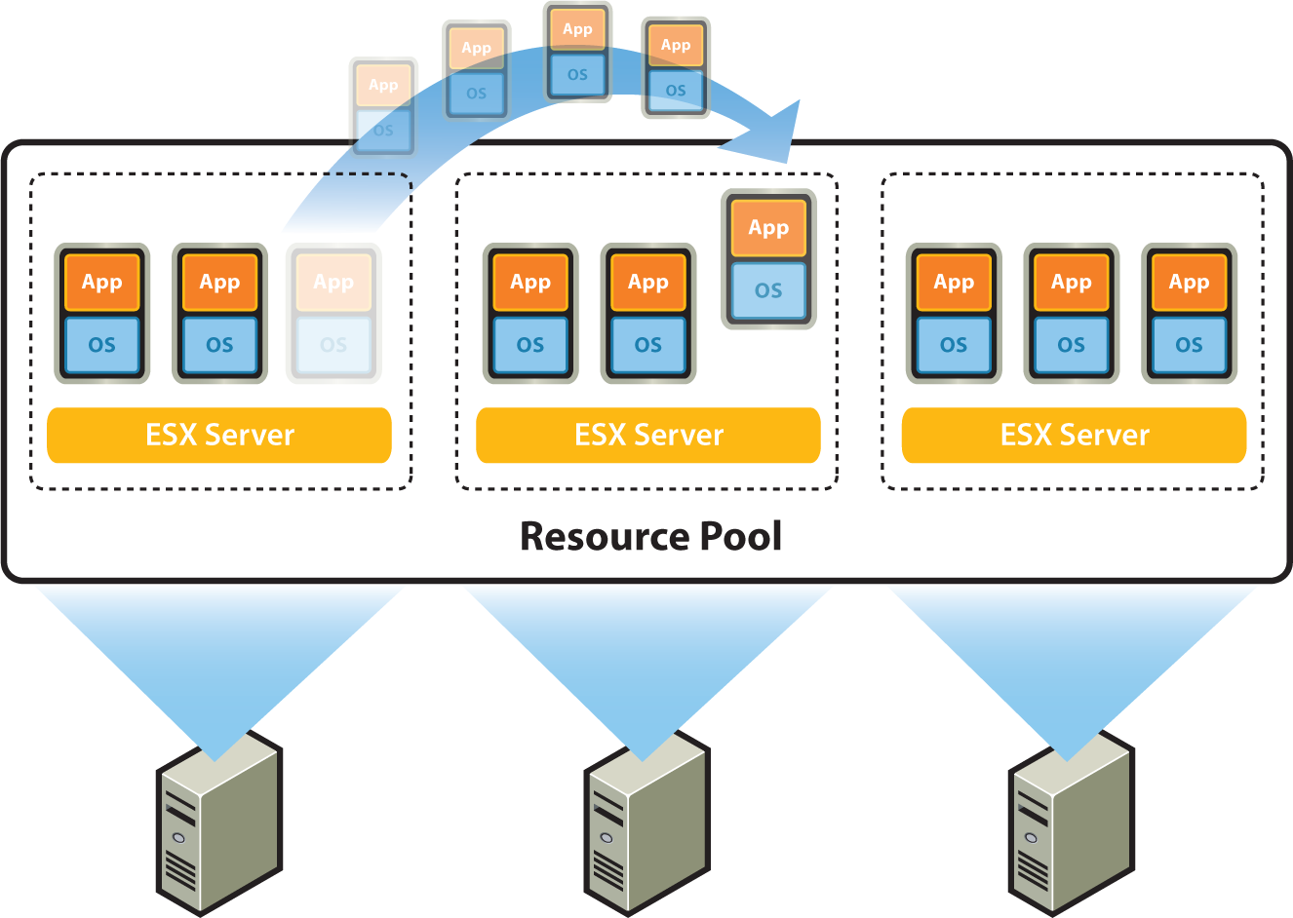
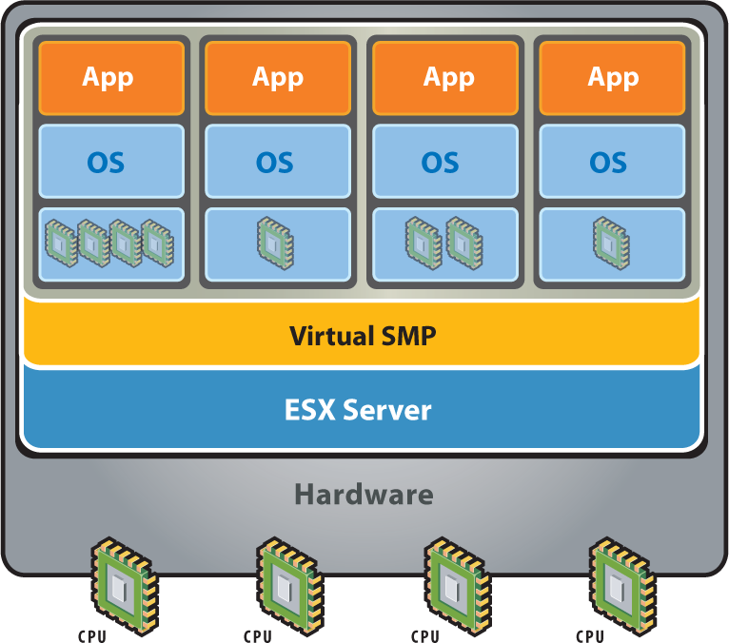
Virtual Server Farms
Clean separation between host and hardware
Map N VMs on M physical servers
Customization – Give VM as many virtualized CPUs, bytes of RAM and disk, etc. as needed
Pooling – Unused resources available to all (i.e., guest OS “sees” 1TB drive but only 150GBs actually used)
Load balancing - Move VMs based on resources
Natural scaling - Add physical servers as needed

Slide 17
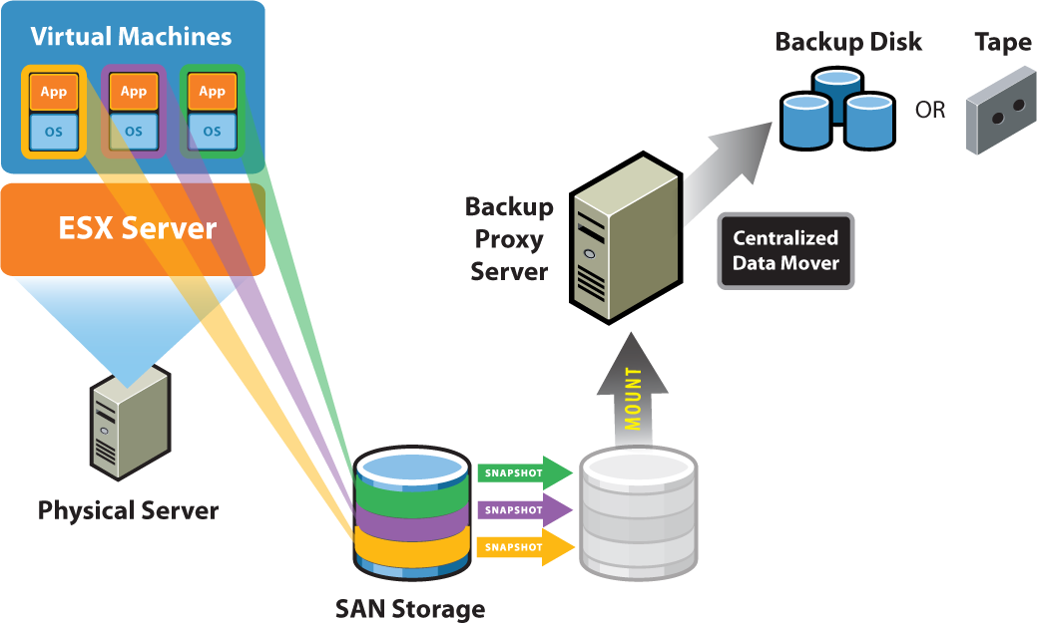
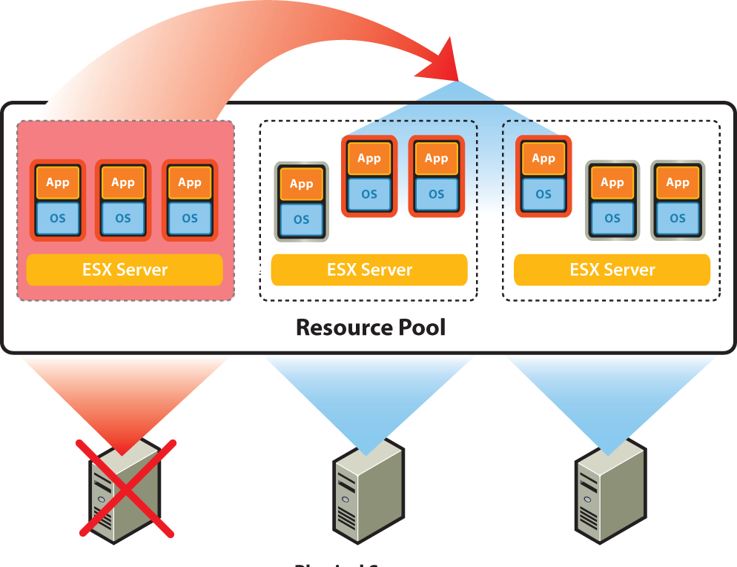
Virtual Server Farms
Maintenance - Move VMs to service hardware
Upgrade path – Add new servers and decommission old servers transparently (handles heterogeneous hardware)
Software testing - Create VM customized to match customers install
Backup – Take snapshot and move to backup proxy server where consistent backup performed
Physical-to-Virtual – Applications exists that will virtualize existing physical machines

Slide 18
Disaster Recovery
Traditional
Maintain replicated hardware, OS, and applications on separate machines (local for hardware failure and remote for disaster)
Must double (or more) hardware and maintain synchronization of OS (patches) and application
Virtualization
Virtualized machine, including hardware configuration, OS, and applications, contained in a few files
Rebuild is simply installing copies of VMs
Hardware does not have to perfectly match

Slide 19
Cloud Computing
Expertise and expense of building and maintaining server farm is high
Solution: Outsource
Amazon Elastic Compute Cloud (EC2)
Build and upload Amazon Machine Image (AMI)
Operate as many image instances as you wish
Pay by the hour/byte transfer/etc.
Question: Where is your Gmail?
Answer: Who cares? (or maybe you do)

Slide 20
VMs and Personal Computing
Virtual machines on personal computers
Isolation
Restoration (Image is just a file)
Standard image
Tuned application environments (ThinApps)
Remote virtual machines AS personal computers
Resource rich environments

