Slide 1
Introduction to Operating Systems

Slide 2

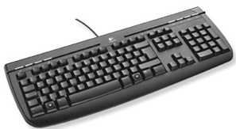
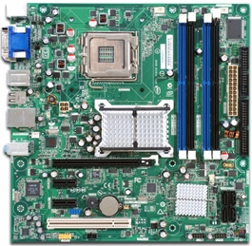
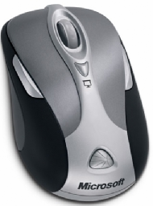
Your Mission
Write a program to coordinate the activities of a set of hardware
Issues?
Many different H/W components: Graphics, USB, PCI, audio, LAN, processor, disk, cache, etc.
Varying system configurations
Hardware instructions
Low level
Different instructions/paradigms
Timing/Coordination
Devices can operate independently and concurrently
Specialized functionality (e.g., 3D)
Feature creep
Notes:
MIPS: Microprocessor without Interlocked Pipeline Stages

Slide 3
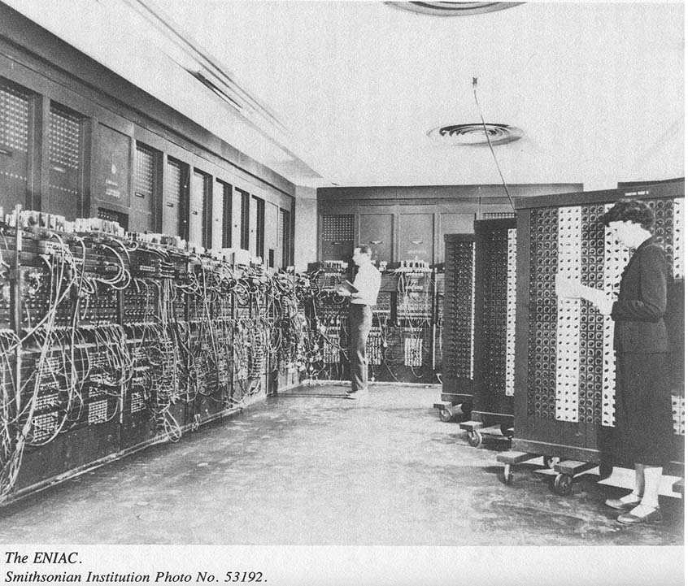
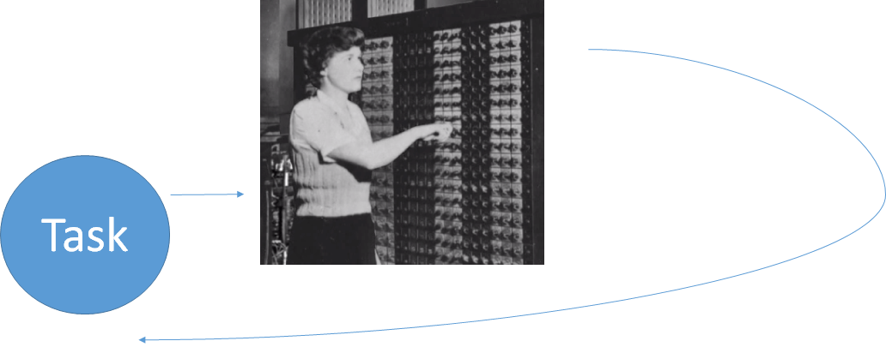
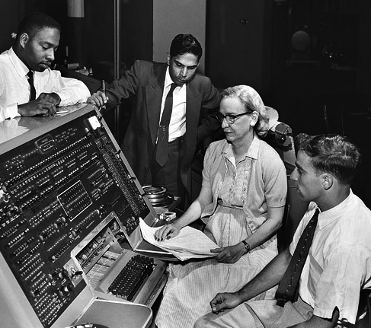
DIY Processor Sharing
Program directly
Manually load each program (“task”) serially
Person is “operating system”
Notes:
Grace Hopper
A pioneer in the field, she was one of the first programmers of theHarvard Mark I computer in 1944,^{[2]} and invented the first compiler for a computer programming language

Slide 4
DIY Processor Sharing
Problems
Entering program takes time; people are slow!
Somebody must be around to load the next program in the case of success or failure
How can we fix this?

Slide 5
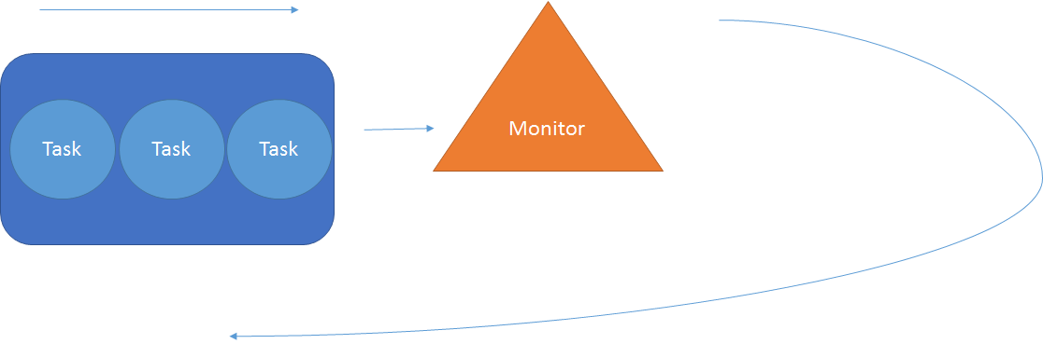
Batch Processing
Place tasks in a queue
Monitor repeatedly fetches next task and begins execution
Control is returned to monitor upon task completion (or failure)
Notes:
Mainframe computers 1950s
Billing

Slide 6
Batch Processing
Problems
No execution time limit
Protection of monitor and other tasks
Multicore
and ...

Slide 7
Slow Sequential I/O
run
Task 1
Disk I/O
User I/O
wait
x
run
Task 2
wait

Slide 8
Multiprogramming
Repeatedly
Run task at head of queue
Upon I/O
Surrender processor (“swapping”)
Requeue task when I/O completes

Slide 9
Multiprogramming in Action
run
Task 1
Disk I/O
User I/O
wait
x
run
Task 2
Network I/O
User I/O
wait
x
run
Task 3
Disk I/O
User I/O
wait
x
Processor isn’t the only better utilized resource
Memory utilized by multiple tasks (enables fast contest switch)
Disk can be accessed while a task is executing

Slide 10

Multiprogramming Frustration
User I/O
run
Task 1
wait
Console I/O
l
s
run
Task 2
Disk I/O
Disk I/O
wait
run
Task 3
Disk I/O
Disk I/O
wait
Suggestions?
Notes:
Frustaction = Frustration Distraction leading to little action
Here the processor is surrendered only voluntarily or in the event of some I/O

Slide 11
Time-Sharing
Each task is given time slice (or quantum)
Task surrenders processor at expiration or blocking request
User perception of dedicated computer
Each task gets approximately 1/Nth of processor
Overhead
Minimize response time
Maximize processor utilization
Notes:
Non-interactive, computationally-intensive tasks are externally interrupted to allow other tasks their slice.

Slide 12
Any issues?
Let’s look at a few…
Notes:
Context switching? Each process believes it “owns” registers, memory, etc.

Slide 13
Task Issues
Context switching Each task has execution state…
Memory mapping Sharing means caring who’s where in there (memory)
Protection Control who can do what and when
Notification Errors (div by 0), events (mouse click), quantum over, etc.

Slide 14
Consider the Processor
Registers
Program Counter (PC)
Instruction Register (IR)
Data Registers
Address Registers
Stack Pointer
Accumulator
Execution (Von Neumann) Repeated:
Fetch
Decode
Execute
Write results
What about switching tasks?
Memory
Data1
Data2
Data3
Inst1
Inst2
Inst3
Inst4
…
CPU
Registers
PC
Notes:
Program Counter – Address of next instruction to be fetched.
Instruction Register – Most recently fetched instruction
Data Registers – General purpose data holders
Address Registers -

Slide 15
Processor
Pipelining (Parallelize Von Neumann steps)
Superscalar
Multiple instructions simultaneously executing on a single processor
Processor guarantees serial correctness
Correctness can limit number of simultaneous instructions
“Multi” Processor
Multi/Hyperthreaded
Superscalar simultaneous instruction execution from multiple threads (less limited by correctness)
Fast context switches between threads
Multi/Many core
Notes:
Pipelining (Fetching in parallel with decoding in parallel with executing in parallel with storing

Slide 16
Context Switching
Each task changes registers
Tasks need their own state
Solutions?
Switching task requires
Saving the state (e.g., registers) for one task and
Restoring the state of the next task
What if we only switch registers?
Processes all share the same memory
Processes can change state of other processes, even the OS
Ex: Original Mac, DOS, etc.
Notes:
Program Counter – Address of next instruction to be fetched.
Instruction Register – Most recently fetched instruction
Data Registers – General purpose data holders
Address Registers -

Slide 17
Sharing Memory
Each task needs own memory
Allocate pieces of physical address space to each task
What if tasks are aware of this sharing?
Addresses do not start at 0 (i.e., complex)
Can look at and change other task’s memory
Solutions?
Notes:
When we switch, we store registers to memory. Perhaps we could switch memory to disk?

Slide 18
Better Memory Sharing
Address translation
Tasks use virtual address space (# from 0)
Virtual addresses from CPU translated to physical addresses by hardware (typically)
Advantages
Executable addresses independent of allocation
Each task has own virtual address space so protected from one another
More later…
Address: 0x5
Address: 0x7341
CPU
MMU
Physical Memory

Slide 19
Virtual Machine
Task
OS
Hardware
Task doesn’t want to know (or care) that it’s sharing the processor, memory, etc.
OS virtual machine isolates tasks from
Limited low-level functionality
Different hardware interfaces/behaviors
Missing hardware functionality (Do it in software)
Other tasks (and their faults – isolated crash)
Interfaces: Virtual machine + physical h/w
Virtual machine
interface
Physical hardware
interface
Big Question: What should be in each layer?
Context switching/Address translation hides that
I don’t have the processor/memory to myself
Others are using registers/memory
User “sees” dedicated (not shared) hardware
Kernel – Always running; provides virtual machine abstraction

Slide 20
Virtualization Approaches
Multiplexing
Make a set of virtual copies of the same resource
Time-Division Multiplexing (TDM)
Ex: Many virtual CPUs by rotating control of physical CPU
Space-Division Multiplexing (SDM)
Ex: Many virtual address spaces by carving out ranges of physical address space
Transforming
Make a new kind of resource from existing ones
Ex: Reliable virtual disk from many physical disks

Slide 21
To protect and serve…
Can Task A impact Task B by…
Altering memory mapping?
Refusing to surrender the processor?
Can a user task compromise the OS?
Solution
Only OS can execute some dangerous instructions
Hardware can take processor away from user task

Slide 22
Dual Mode
Need protection from malicious or inadvertent violations
Some instructions are dangerous (e.g., MMU translation map)
Idea: Limit privileged instruction execution to kernel code
Hardware operates in (at least) two modes: user vs. kernel
Privileged instructions only execute in kernel (or supervisor) mode
When do we switch to kernel mode?
Interrupt from I/O device
Want to take the CPU back from a process
System call
Intel chips
5 privilege levels called “rings”
Kernel (level 0) and user (level 3)
Interrupt/fault/system call
kernel
user
set user mode
Notes:
There are really two level 0 rings to allow for VM kernels (0P) and guest OSs (0D) running at the highest level

Slide 23
Interrupts
How do we
know I/O is ready in multiprogramming?
limit quantum in time-sharing?
learn about execution problems (e.g., overflow, div. by 0, illegal operation, etc.)
learn about hardware failures?
Interrupt - Notification of some hardware or software event
Trap – Software-generated interrupt, either by error (div. by 0) or requested (system call)

Slide 24
Interrupts Observed
Before
After
% cat /proc/interrupts
CPU0
0: 509458 XT-PIC timer
1: 14812 XT-PIC keyboard
2: 0 XT-PIC cascade
3: 146163 XT-PIC serial
5: 1 XT-PIC sound
8: 2 XT-PIC rtc
9: 176 XT-PIC aha152x
10: 0 XT-PIC eth0
12: 57584 XT-PIC mouse
13: 1 XT-PIC fpu
14: 139903 XT-PIC ide0
15: 27636 XT-PIC ide1
NMI: 0
> cat /proc/interrupts
CPU0
0: 510570 XT-PIC timer
1: 14854 XT-PIC keyboard
2: 0 XT-PIC cascade
3: 146163 XT-PIC serial
5: 1 XT-PIC sound
8: 2 XT-PIC rtc
9: 176 XT-PIC aha152x
10: 0 XT-PIC eth0
12: 57785 XT-PIC mouse
13: 1 XT-PIC fpu
14: 139911 XT-PIC ide0
15: 27636 XT-PIC ide1
NMI: 0

Slide 25
Handling Interrupts
Execution immediately transfer to handler
Generic – General purpose routine
Interrupt vector – Lookup table for interrupt-specific routine
After handler completes, interrupted task resumes where it left off
Processor must save (at least)
Address of the interrupted instruction
Registers
Interrupts masked during handling to prevent a lost interrupt

Slide 26
Interrupt Handling Example
See sigAction.c
Cntl-C sends interrupt
Interrupt is handled by specified routine
strace ./a.out – To watch interrupt

Slide 27
Who Cares How It Works?
Understand…
the kinds of services an OS will provide your programs
application behaviors at odds with OS
Don’t…
have to code these things yourself
end up doing some things the wrong way
have to know every little detail about hardware

Slide 28
We Need an Operating System
Usability and portability
Resource abstraction/interface
Efficiency
Resource management
Control
Permissions
Isolation
Virtualization
Notes:
Usability and portability – OS provides a higher-level, non-hardware specific interface + abstraction of resources (process with code + stack +…) that make hardware easier to use and our code easier to move
Efficiency – We’ve already looked at efficiency wrt using the processor; there are many other issues (e.g., memory, etc.)
Control – Can U look @ my memory?
Isolation – I don’t want to know your processes are there (e.g., my vs. your memory). This is not just a security issue. It’s convenience.

Slide 29
System Call
Request for service from the OS
Service uses privileged instructions
Implemented as trap where handler
Sets kernel mode
Save state
Verifies parameters, etc.
Executes request
Sets user mode and resumes execution

Slide 30
Library vs. System Calls?
Portability
System calls are OS-specific. Libraries calls follow an OS-independent standard
Usability
System calls can often be more detailed and difficult to use

Slide 31
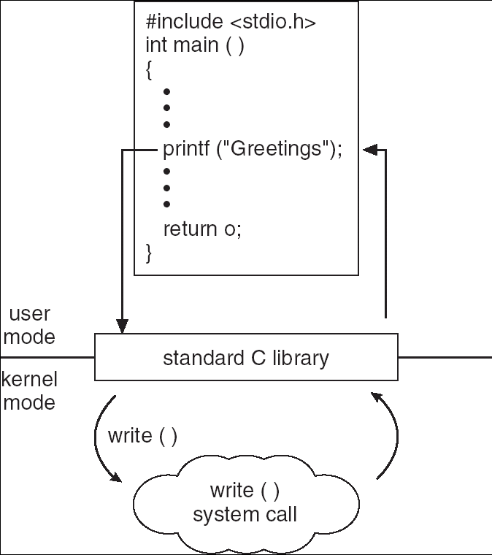
Standard C Library Example
C program invoking printf() library call, which calls write() system call

Slide 32
Steps in Making a System Call
count = read(fd, buffer, nbytes) Standard C Library Call
Steps
1-3: Push parameters onto stack*
4: Call library routine
5: Put ID of system call (read) in register EAX = __NR_read
6: Trap to OS/switch to kernel mode INT 0x80 – x86 interrupt instruction
7: Determine the handler based on ID from Step 5
8: Execute handler
9: Return control back to library call
10: Library call returns
11: Pop parameters off stack
*See book for parameter passing options
Systems calls are not cheap!
User Space
Return to caller
libc_read()
Library
read
Trap to the kernel
5
Put ID for read in register
10
4
11
6
Increment stack pointer
main()
User
program
calling
read
Call standard library read
3
Push fd
2
Push &buffer
1
Push nbytes
Kernel Space
9
Dispatch
Sys call handlers
7
8
system_call()
Kernel system call dispatcher
sys_read()
Kernel system
call for read
Notes:
Page 44-45 old Tannenbaum book.

Slide 33
// From Linux Kernel
asmlinkage int sys_read(unsigned int fd, char * buf, int count) {
int error;
struct file *file;
struct inode *inode;
error = -EBADF;
file = fget(fd);
if (!file)
goto bad_file;
inode = file->f_inode;
if (!inode)
goto out;
error = -EBADF;
if (!(file->f_mode & 1))
goto out;
error = -EINVAL;
if (!file->f_op || !file->f_op->read)
goto out;
error = 0;
if (count <= 0)
goto out;
error = locks_verify_area(FLOCK_VERIFY_READ,inode,file,file->f_pos,count);
if (error)
goto out;
error = verify_area(VERIFY_WRITE,buf,count);
if (error)
goto out;
error = file->f_op->read(inode,file,buf,count);
out:
fput(file, inode);
bad_file:
return error;
}

Slide 34
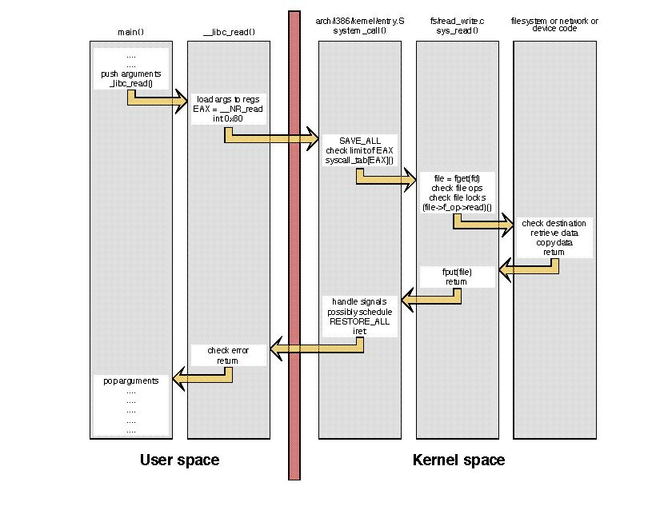
Notes:
From http://www.linux.it/~rubini/docs/ksys/ksys.html

Slide 35
Library vs. System Call
Library Call
System Call
Portability | Yes | Different in each OS
Executes | Library routine | Kernel service
Cost | Cheap as function call | 10 to 1000 times more expensive than function call
Address space | User | Kernel
Time counted | User | Kernel
Calling overhead | Normal function call | Context switch to kernel and back (2)
UNIX manual | Section 3 | Section 2
Number (approx.) | 300 in libc | 100 in UNIX
Examples | system, fprintf, malloc | chdir, fork, write
Notes:
Many UNIX system calls are part of the C language. UNIX implementations typically have library function that simply makes system call.

Slide 36
System Call Trace
See syscalls.c – Reads file into fixed-length buffer
time ./syscalls data 500
Real time, user CPU time, and kernel CPU time
strace –T ./syscalls data 500
System calls and time
You may not know you’re calling them (e.g., printf)
Compare above with
time ./syscalls data 5
strace –T ./syscalls data 5

Slide 37
Operating System Design and Implementation
Kernel
Many definitions
“It’s the part that…”
Runs all of the time
Operates in supervisor mode
No hard rule for design and implementation of OS, but some approaches have proven successful
Internal structure of different operating systems can vary widely
Start by defining goals and specifications
Affected by choice of hardware, type of system
User goals – Convenient to use, easy to learn, reliable, safe, fast
System goals – Easy to design, implement, and maintain, as well as flexible, reliable, error-free, efficient

Slide 38
Aside: Policy vs. Mechanism
Important distinction in system design
Policy – A plan specifying what to do
Mechanism - A way of doing something
Example
Policy – Only authorized users may enter the building
Mechanisms – Security guards, key card, dogs, etc.
Keep them separate
Simpler to specify and reason about policy independent of implementation considerations
Easier to test various mechanisms for enforcing a particular policy

Slide 39
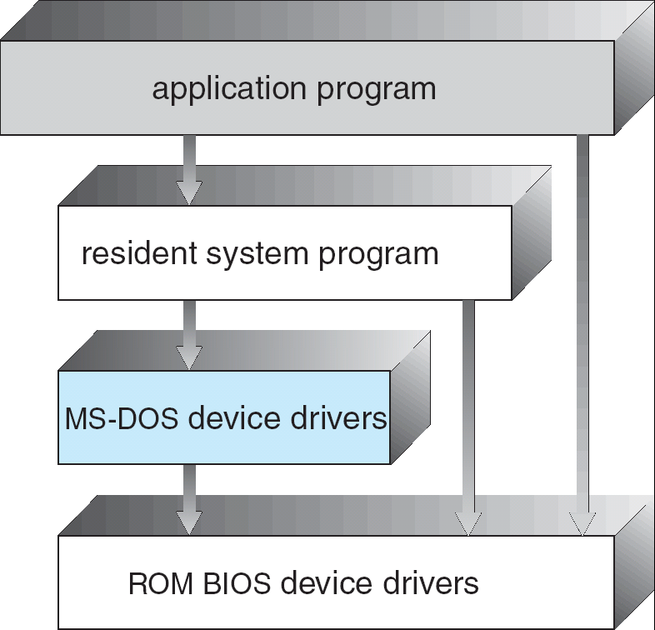
Simple Structure: MS-DOS
How do I structure my OS?
OS = Library of standard services for talking to devices, basic I/O, etc.
One program running
No protection for OS
Notes:
HIGH level routine access to low level I/O routines or “drivers’ e.g., the display

Slide 40
Driver Aside
Ignore details of specific devices
Device driver - Make all devices "look the same" to the rest of the OS
Example device driver interface
Provide better, more efficient ways to use the device
Caching
Buffering
Scheduling and sharing
Mutual exclusion
Driver problem is one of the primary causes of OS crash
// Source code from linux/fs.h
struct file_operations {
loff_t (*llseek) (struct file*, loff_t, int);
ssize_t (*read) (struct file*, char*, size_t, loff_t*);
ssize_t (*write) (struct file*, const char *, size_t, loff_t*);
unsigned int (*poll) (struct file *, struct poll_table_struct*);
int (*mmap) (struct file*, struct vm_area_struct*);
int (*open) (struct inode*, struct file*);
int (*flush) (struct file*);
int (*lock) (struct file*, int, struct file_lock*);
};

Slide 41
Monolithic Kernels
Earliest and most common OS architecture
Every component of the OS is contained in the kernel
Examples: OS/360, VMS and UNIX
Advantage
Efficient (direct communication between components)
Disadvantages
Susceptible to malicious code - all code execute with unrestricted access to the system
Difficult to isolate source of bugs and other errors
Hard to modify and maintain
Memory
Protection
Application
Application
Application
File System
I/O Managers
Graphics
Subsystem
Monolithic
Kernel
Device
Drivers
Network
Drivers
Graphics
Drivers
File System
Hardware

Slide 42
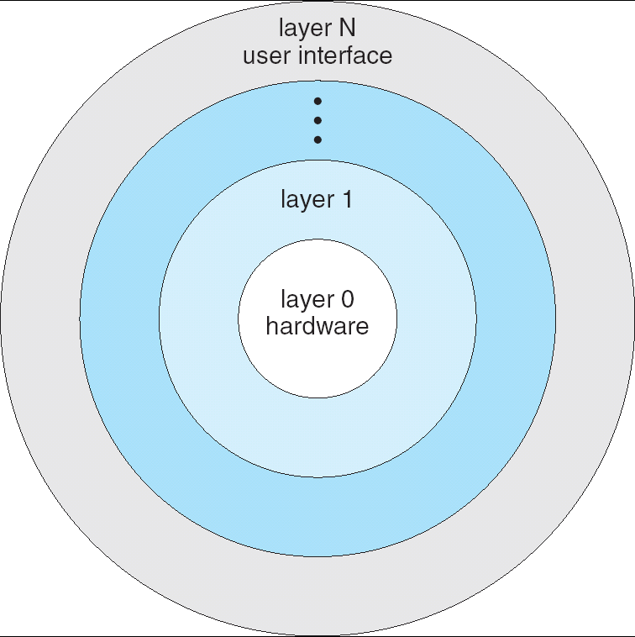
Layered Approach
Divides the OS into a number of layers (levels)
Each built on top of lower layers
Bottom layer is the hardware; top the UI
With modularity:
Layers are selected such that each uses functions (operations) and services of only lower-level layers
Example: Device driver for backing store (disk space used by virtual memory) must be lower than memory managers because memory management ‘uses’ the ability of the device driver
Application
Application
user
kernel
System Services
File System
Memory Management
Backing Store
Process Scheduling
hardware

Slide 43
Layered Approach: Problems
Which is the lower level?
Backing store vs. scheduler
Backing store needs the scheduler – Backing store may need to wait for I/O, and the CPU can be rescheduled at that time.
Scheduler needs backing store – Scheduler may need backing store to hold state.
Efficiency?
I/O layer, memory layer, scheduler layer, hardware
I/O operations triggers may call three layers
Each layer passes parameters, modifies data etc.
Lots of layers, adds overhead
How many layers?
More - Less efficient
Fewer - Less flexible
Application
Application
user
kernel
System Services
File System
Memory Management
Backing Store
Process Scheduling
hardware

Slide 44
Microkernel System Structure
Approach: Separate kernel programs into system and user level programs (or libraries)
Moves as much from the kernel into “user” space
Minimal kernel only essential components
Processes, memory and communication management
Communication between user modules uses message passing
Advantages
Easier to extend a microkernel
Easier to port the operating system to new architectures
More reliable (less code is running in kernel mode)
Fewer points of failure
More secure
Disadvantage
Slow: Performance overhead of user space to kernel space communication
Windows NT tried pure micro; too slow
System processes
User processes
thread
system
file
system
user
mode
network
support
CPU
scheduling
paging
kernel mode
micro- kernel
communication protection low-level VM processor control

Slide 45
Modules
Most modern operating systems implement dynamically loadable kernel modules
Uses object-oriented approach
Each core component is separate
Each talks to the others over known interfaces
Each is loadable as needed within the kernel
Overall, similar to layers but more flexible
Module can call any other module

Slide 46
Credit for Materials
Silberschatz, Galvin, Gagne (Book)
OS Books: Tanenbaum, etc.
Maria Hybinette, UGA
David Sturgill, NCSU
John Kubiatowicz, Berkeley
Jeff Donahoo, Baylor

