Slide 1
Processes

Slide 2
Multiprogramming
Want
multiple tasks “simultaneously” executing and
to handle asynchronous events
Must share limited resources (e.g., CPU, memory)
Don’t want to program for (or worry about) sharing
Why?
Solution
Each program has own VM

Slide 3
What is a Process?
“A program in execution”
VM abstraction
Execution (state)
Address space
Etc. (file system state…)
EX: compilation process, word processing process, scheduler (sched, swapper) process or daemon processes: ftpd, httpd

Slide 4
Time Sharing CPU
Run
Run
Process A
Run
Run
Process B
Run
Run
Run
Process C
Time
Within a process, execution is sequential but…
We can rapidly switch between processes creating multiprogramming but…
One processor (CPU) so pseudoparallelism
Why switch? I/O, voluntary yield, timer expiration, etc.

Slide 5
Process States
As a process executes, it changes state
New: The process is being created
Running: Instructions are being executed
Ready: The process is waiting to be assigned to a processor (CPU)
Terminated: The process has finished execution
Waiting: The process is waiting for some event to occur
New
Terminated
Ready
Running
Waiting

Slide 6
State Transitions
A process may change state as a result of
Program action (system call)
OS action (scheduling decision)
External action (interrupts)
New
Admitted
Interrupt (time) and scheduler picks another process
Terminated
Exit
Ready
Running
I/O or event completion
Scheduler pick
I/O or event wait
Waiting

Slide 7
Execution State
We are sharing so need to keep track of what each process is doing and using
Memory information
Pointer to memory segments needed to run a process, i.e., pointers to the address space, text, data, stack segments.
Process management information
Process state, ID
Content of registers
Program counter, stack pointer, process state, priority, process ID, CPU time used
File management & I/O information
Working directory, file descriptors open, I/O devices allocated
Accounting
CPU utilization
Memory Limits
Page Tables
Process Number
Program Counter
Registers
Process State
List of opened files
I/O Devices allocated
Accounting
Process Control Block (PCB)

Slide 8
Linux Process Control Block (PCB)
In Linux a process’ information is kept in a structure called struct task_struct declared in sched.h
Linux state
struct task_struct
pid_t pid; /* process identifier */
long state; /* state for the process */
unsigned int time_slice; /* scheduling information */
struct mm_struct *mm /* address space of this process */
volatile long state; /* -1 unrunnable, 0 runnable, >0 stopped */
#define TASK_RUNNING 0
#define TASK_INTERRUPTIBLE 1
#define TASK_UNINTERRUPTIBLE 2
#define TASK_ZOMBIE 4
#define TASK_STOPPED 8
#define TASK_EXCLUSIVE 32

Slide 9
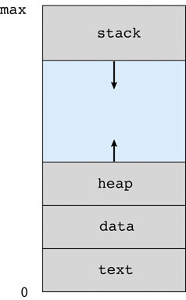
Secret Process Autopsy
Text (Program code)
Data (Global variables)
Heap (Dynamically allocated memory)
Stack
Function parameters
Return addresses
Local variables
User Address Space

Slide 10
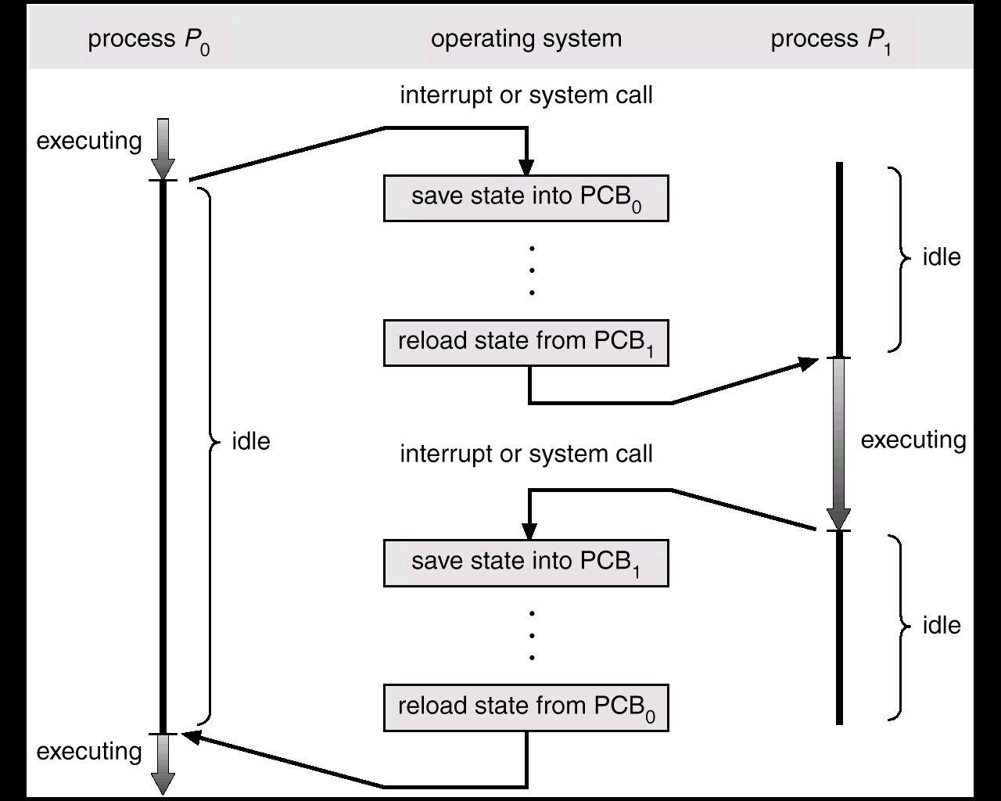
CPU Context Switches
save PC, SP, etc.
into PCB₀
restore PC, SP, etc.
from PCB₁
overhead
save PC, SP, etc.
into PCB₁
restore PC, SP, etc.
from PCB₀
overhead

Slide 11
Scheduler: Who Goes Next?
Objective: Maximize resource utilization
Running
Ready
Process A
Waiting
Process B
Process C
Scheduler
Time
Scheduler must execute to make decisions (overhead)
Details coming soon…

Slide 12
Process Creation
Process Cycle
Parents create children
Results in a tree of processes
Address space models
Child duplicate of parent
Child has a program loaded into it
Execution models
Parent and children execute concurrently
Parent waits until children terminate

Slide 13
Process Life Cycle: UNIX
PID 0 is usually the scheduler process (often called swapper)
System process (part of the kernel)
Grandmother of all processes
init - Mother of all user processes, init is started at boot time (at end of the boot strap procedure) and is responsible for starting other processes
It is a user process (not a system process that runs within the kernel like swapper) with PID 1 (but runs with root privileges)
init uses file inittab and directory /etc/rc?.d
Brings the user to a certain specified state (e.g., multiuser mode)
getty - Login process that manages login sessions

Slide 14
Processes Tree on a UNIX System
mother of all user processes
OS Kernel
Process 0
(sched - ATT, swapper - BSD)
Process 1
(init)
Process 2 (BSD)
pagedaemon
daemon (e.g., httpd)
getty
getty
login
login
bash
ksh

Slide 15
Other Systems
Page handler
Process spawner
Scheduler
Buffering/Flushing I/O
HP-UX 10.20
UID PID PPID C STIME TTY TIME COMMAND
root 0 0 0 Apr 20 ? 0:17 swapper
root 1 0 0 Apr 20 ? 0:00 init
root 2 0 0 Apr 20 ? 1:02 vhand
Linux RedHat 6.0:
UID PID PPID C STIME TTY TIME CMD
root 1 0 0 09:59 ? 00:00:07 init
root 2 1 0 09:59 ? 00:00:00 [kflushd]
root 3 1 0 09:59 ? 00:00:00 [kpiod]
root 4 1 0 09:59 ? 00:00:00 [kswapd]
root 5 1 0 10:00 ? 00:00:00 [mdrecoveryd]
Solaris:
UID PID PPID C STIME TTY TIME CMD
root 0 0 0 Apr 19 ? 0:00 sched
root 1 0 0 Apr 19 ? 0:22 /etc/init -
root 2 0 0 Apr 19 ? 0:00 pageout
* sched - dummy process which provides swapping services
* pageout - dummy process which provides virtual memory (paging) services

Slide 16
Process Creation Execution & Address Space in UNIX
fork() creates an exact copy of itself (the parent) and the new process is called the child process
exec() places the image of a new program over the newly copied program of the parent

Slide 17
Example: fork.c
gcc fork.c (-std=c99)
i is copied between parent and child
The switching between parent and child depends on many factors
Machine load, system process scheduling, …
I/O buffering effects the output shown
Output interleaving is non-deterministic
Cannot determine output by looking at code

Slide 18
Process Creation: Windows
Processes created via 10 params CreateProcess()
Child process requires loading a specific program into the address space.
BOOL WINAPI CreateProcess(
LPCTSTR lpApplicationName,
LPTSTR lpCommandLine,
LPSECURITY_ATTRIBUTES lpProcessAttributes,
LPSECURITY_ATTRIBUTES lpThreadAttributes,
BOOL bInheritHandles,
DWORD dwCreationFlags,
LPVOID lpEnvironment,
LPCTSTR lpCurrentDirectory,
LPSTARTUPINFO lpStartupInfo,
LPPROCESS_INFORMATION lpProcessInformation);

Slide 19
Process Termination
Process executes last statement and asks the operating system to delete it by using the exit()
Output data from child to parent (via wait)
Process’ resources are deallocated by operating system
Parent may terminate execution of children processes (abort)
Child has exceeded allocated resources
Task assigned to child is no longer required
Parent is exiting
Some operating systems do not allow a child to continue if its parent terminates
Cascading termination (initiated by system to kill of children of parents that exited).
If a parent terminates, its children are adopted by init() so they still have a parent to collect their status and statistics

Slide 20
Cooperating Processes
Independent process cannot affect or be affected by the execution of another process.
Cooperating process can affect or be affected by the execution of another process
Advantages of process cooperation
Information sharing
Computation speed-up
Modularity
Convenience
Requirement: Inter-process communication (IPC) mechanism
Notes:
?

Slide 21
Communication Models
Shared memory model
Share memory region for communication
Read and write data to shared region
Requires synchronization (e.g., locks)
Faster
Setup time
Message Passing model
Communication via exchanging messages
Notes:
?

Slide 22
Communication Models
Process A
Process A
M
1
1
Process B
Shared memory
M
Process B
2
…
…
2
Kernel
Kernel
M
Message Passing
Shared Memory

Slide 23
Shared Memory
Producer/Consumer with shared memory
Examples
shmemWrite.c – Creates shmem, reads 2 chars from console and sends
ipcs –m – Command to list shared memory segments
shmemRead.c – Reads shmem and prints
ipcrm –m <shmid> - Command to remove segment
Advantage
Simple (already using memory)
Fast
Communication in user space (no system calls)
Run shmemRead with strace
Disadvantage
Coordination
Must coordinate writes
Busy wait to detect updates

Slide 24
Message Passing
No shared state
Messages are sent and received primitives
Blocking and nonblocking send/receive
Ordinary pipes (pipe.c)
Unidirectional (read and write ends)
write()s of less than PIPE_BUF must be atomic
Only exists while communicating processes exist
Between parent and child process

Slide 25
Message Passing
Named pipe
Bidirectional
Persists outside of process (mkfifo in UNIX)
Looks like a file (ls to see; rm to remove)
Allows multiple readers/writers
Example
fifoRead.c – Reader blocks until data arrives on named pipe
fifoWrite.c – Write reads from console and writes to named pipe
Windows has CreateNamedPipe()

Slide 26
Communication Asynchronous or Synchronous
Timing of corresponding communication operations
Synchronous Communication
Sender does not return until the matching receive has been posted at the destination process
Asynchronous Communication
No coordination between sender and receiver, a message can be sent or received at any time without waiting for the receiver program to receive.
Allows more concurrency
No synchronization between the sender and the receiver
Example: Sender gets control back before the message has been copied or sent

Slide 27
Communication Blocking or Nonblocking
Pertains to the behavior of the operation itself (e.g. send and receives)
Blocking operations: The completion of the call is dependent on certain events
Non-blocking operations: The call returns without waiting for any event to complete (such as copying a message from user memory to system memory)
Synchronous communication is often implemented using blocking operators and asynchronous communication using non-blocking operators

Slide 28
Other Message Passing
Read the chapter
Mailboxes
Remote Procedure Calls (RPC)
Socket communication

